Slide 1
Lecture 12: Abstract Classes and Interfaces

Slide 2
Abstract Classes
Class that:
Cannot be instantiated on its own (cannot exist independently)
Is a blueprint for other classes
Contains abstract methods that are declared but not implemented
These must be implemented by the subclass
Can have implemented functions as well
Used to:
Enforce a structure in subclasses
Show common features that require specific implementation
Restrict base class instantiation
Switch to code – BasicAbstractClass

Slide 3
Interfaces
Not a class!
Cannot be instantiated on its own (cannot exist independently)
Is a blueprint for other classes
Is a collection of abstract methods and constants
No implemented functions!
Can only contain method signatures
Used to:
Enforce a contract across multiple unrelated classes
Support multiple inheritance
Switch to code – BasicInterface

Slide 4
Abstract Class vs Interface
Feature | Abstract Class | Interface
Instantiation | Cannot be instantiated | Cannot be instantiated
Methods | Can have abstract and concrete (implemented) methods | Only abstract methods (except default/static methods)
Method Modifiers | Methods can be public, default, protected, or private visibility. | Methods are public and abstract by default (except default/static methods)
Variables | Can have instance variables | Only static and final variables (constants)
Multiple Inheritance | A class can extend only one abstract class. | A class can implement multiple interfaces.
Usage | Used for shared behavior between related classes | Used for defining a contract that multiple classes can implement
Constructor | Can have a constructor (which is called when subclass is instantiated) | Cannot have a constructor
Blueprint | Provide default behavior and structures for similar classes. | Enforce a strict structure across different implementations.

Slide 5
Abstract Modifier
Abstract classes and abstract methods are denoted using the abstract modifier.
You cannot implement an abstract method in the same abstract class where it is declared.
It can be implemented in the subclass that extends it
Abstract methods are only allowed in abstract classes
In nonabstract subclasses, all abstract methods must be implemented even if they aren’t used in the subclass (could be a sign of bad design)

Slide 6
Abstract Constructors
Abstract classes cannot be instantiated using the new operator.
They can still be defined, but they can only be invoked via the constructors of its subclasses.
Abstract classes can contain no abstract methods, but even so you cannot create instances of them using new.
These serve as a base class for various subclasses.

Slide 7
Abstract Subclass of Concrete Parent
A subclass can be abstract even if it derives from a concrete parent class.
For example, the Object class is concrete, yet all abstract classes are inherently subclasses of it.
A subclass can override a method from its superclass and define it as abstract.
This is rare, but useful when the superclass’ implementation of the method becomes invalid in the subclass.

Slide 8
Abstract Class as Type
An abstract class cannot be instantiated using new, but it can be used as a data type!
For example, Shape[] shapes = new Shape[10]; works, but
Shape shapes = new Shape(); doesn’t.
Switch to code – InDepthAbstractClass

Slide 9
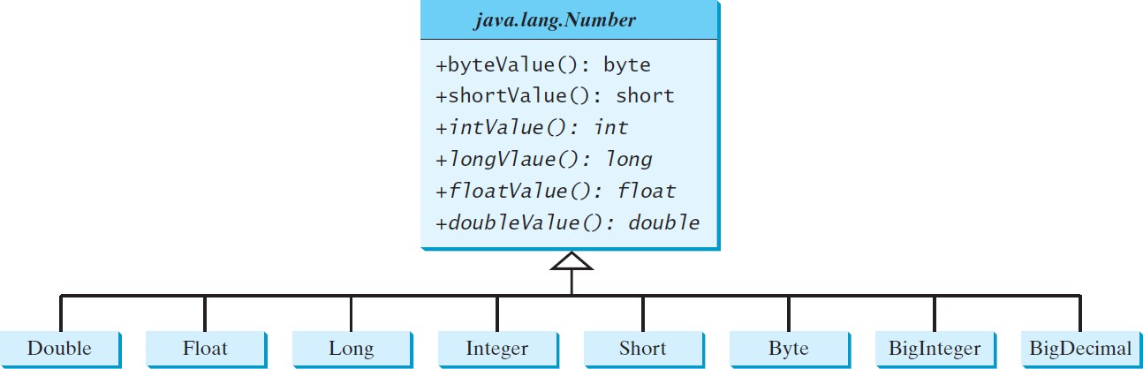
Common Abstract Classes
java.lang.Number is an abstract superclass for the numeric wrapper classes

Slide 10
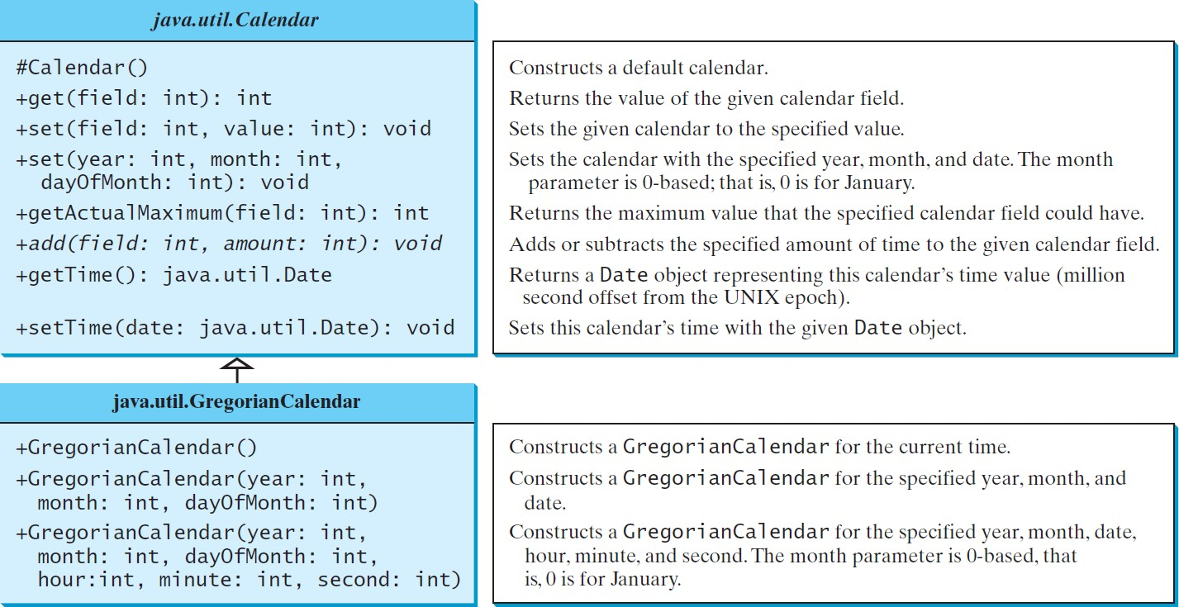
Common Abstract Classes

Slide 11
Abstract Calendar Class and its GregorianCalendar Subclass
An instance of java.util.Date represents a specific instant in time with millisecond precision.
java.util.Calendar is an abstract base class for extracting detailed information such as year, month, date, hour, minute, and second from a Date object.
Subclasses of Calendar implement specific calendar systems like Gregorian, Lunar, or Jewish calendars.
The add(field, value) is an abstract method in the Calendar class because its implementation is dependent on which concrete calendar system will be used.
add(Calendar.DAY_OF_MONTH, 7)

Slide 12
GregorianCalendar Class
Use new GregorianCalendar() to construct a default calendar with the current time.
Use new GregorianCalendar(year, month, date) to specify each of these properties.
Note the month is 0-based (0 = January, 11 = December).
The get(int field) method defined in Calendar is useful to extract specific elements of information from a Calendar object

Slide 13
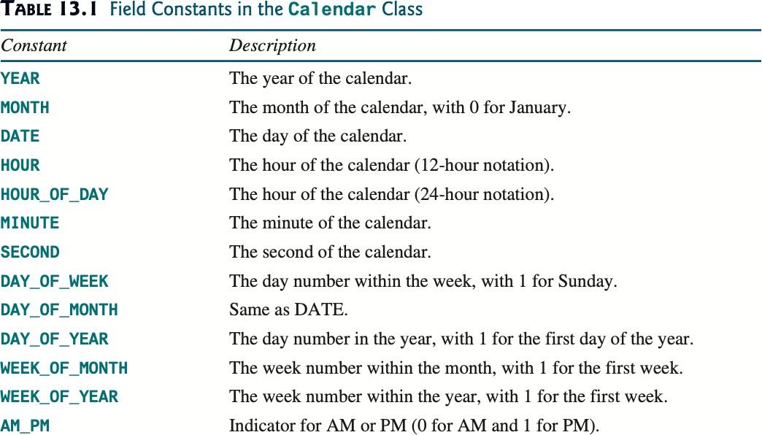
Calendar Constants
Note: All of these correspond to an integer value defined inside the Calendar class. Using the function like this: calendar.get(Calendar.YEAR)
is equivalent to saying calendar.get(1); Calendar.YEAR is a constant defined with the value of 1.

Slide 14
Interfaces
Class-like construct that contains only constants and abstract methods

Slide 15
Interfaces
In many ways, an interface is similar to an abstract class, but the intent of an interface is to specify common behavior for objects that may be otherwise entirely unrelated.
For example, you can specify that the objects are comparable, edible, and/or cloneable using appropriate interfaces.
The keyword for an interface is implements.
Naming Conventions:
Ordinary Class names & Abstract Classes are nouns
Interface names may be adjectives or nouns

Slide 16
Conceptual Difference between Abstract Classes and Interfaces
Abstract Classes are primarily used for Categorization (Inheritance)
This must mean it falls under one primary category.
A Bird is an Animal, so it must not be a Shape, a Genre, a Flavor, etc.
Serves as a blueprint for objects that share common characteristics
Interfaces are primarily used for Capabilities (Behavioral Contracts)
This means it can have any number of capabilities
A Bird can Fly, it can Walk, it can Squawk, it is Weighable
In order to carry out these capabilities, it must implement the functions defined by the corresponding interfaces
bird.fly(), bird.walk(), bird.squawk(), bird.heavierThan(Object other)
Switch to code - InterfaceVSAbstractClass

Slide 17
Defining an Interface
Interfaces are not classes! Use interface.
All data fields are public final static, and all methods are public abstract in an interface.
For this reason, these modifiers can be omitted when defining an interface.
Interfaces can have static members
These are invoked the same way as classes:
InterfaceName.method(args)
InterfaceName.VARIABLE

Slide 18
Omitting Modifiers in Interfaces
All data fields are public final static, and all methods are public abstract in an interface.
This means the following are equivalent:
=
public interface T1 {
public static final int K = 1;
public abstract void p();
}
public interface T1 {
int K = 1;
void p();
}

Slide 19
Default Methods
Relatively new feature (Java 8 in March 2014)
A default method provides a default implementation for the method in the interface and uses the keyword default.
A class that implements the interface may simply use the default implementation for the method or override the method with a new implementation.
Switch to code - InDepthInterface

Slide 20
Interface’s default method vs. Abstract Class’ implemented method
Default methods in an interface:
Cannot store or access instance information
Can create multiple inheritance of behavior (but beware of conflicts)
Implemented methods in abstract classes:
Can be used to store state (fields) and use them in methods
Will be the sole function inherited under that signature

Slide 21
Multiple Inheritance
A scenario where a class inherits some method implementation from multiple sources
Since Java does not support multiple inheritance for classes, interfaces with default methods allow a class to inherit behavior from multiple sources.
A class can implement multiple interfaces, but if two interfaces have conflicting default methods, the implementing class must override the method.
Switch to code – MultipleInheritance

Slide 22
Example: The Comparable Interface
The java.lang.Comparable interface defines the compareTo method for comparing objects
The compareTo method returns:
A negative integer if this object is less than other object
Zero if this object is equal to other object
A positive integer if this object is greater than other object

Slide 23
Implementing from an Interface
Many classes (e.g. the numeric wrapper classes) in the Java library implement Comparable to define a natural order for Objects.
The compareTo method is implemented in these classes.
Each wrapper class also overrides the core methods defined in the Object class: toString, equals, and hashCode
Note: The Comparable interfaces uses Generics. This is a whole lecture. For now, think of it as the data type to be used in place of an Object.
Switch to code - ComparableExample

Slide 24
The Comparable Interface
public class BigInteger extends Number implements Comparable<BigInteger> {
// class body omitted
@Override
public int compareTo(BigInteger o) {
// Implementation omitted
}
}
public class String extends Object implements Comparable<String> {
// class body omitted
@Override
public int compareTo(String o) {
// Implementation omitted
}
}

Slide 25
Examples
sout(new BigInteger(“3”).compareTo( new BigInteger(“5”));
sout(“ABC”.compareTo(“ABE”));
LocalDate date1 = LocalDate.of(2013, 1, 1);
LocalDate date2 = LocalDate.of(2012, 1, 1);
sout(date1.compareTo(date2));
Switch to code - MoreComparables

Slide 26
Marker Interfaces
An interface with an empty body is known as a marker interface.
Used to indicate a class possesses certain characteristics or behaviors
This allows Java’s runtime, libraries, or frameworks to process objects of that class in some special way
Common Marker Interfaces:
Serializable (from java.io): Allows its objects to be converted into a byte stream (essential for easy storing, transmitting, and processing)
Cloneable (from java.lang): Marks a class as cloneable, allowing it to be copied with Object.clone() (otherwise throws a CloneNotSupportedException)
Requires overriding clone()
Switch to code – MarkerInterfaces

Slide 27
Shallow vs Deep Copy
Shallow Copy: Creates a new object but does not create new copies of referenced objects. Instead it copies references to the same memory locations, meaning both the original and clone objects share the same referenced objects.
Deep Copy: Creates a completely new object and creates new copies of any referenced objects, ensuring the cloned object is fully independent of the original.

