Slide 1
Lecture 12: Abstract Classes and Interfaces
1

Slide 2
Abstract Classes
2

Slide 3
Motivations
You have learned how to write simple programs to create and display GUI components.
Can you write the code to respond to user actions, such as clicking a button to perform an action?
In order to write such code, you have to know about interfaces.
An interface is for defining common behavior for classes (including unrelated classes).
Before discussing interfaces, we introduce a closely related subject: abstract classes.
3

Slide 4
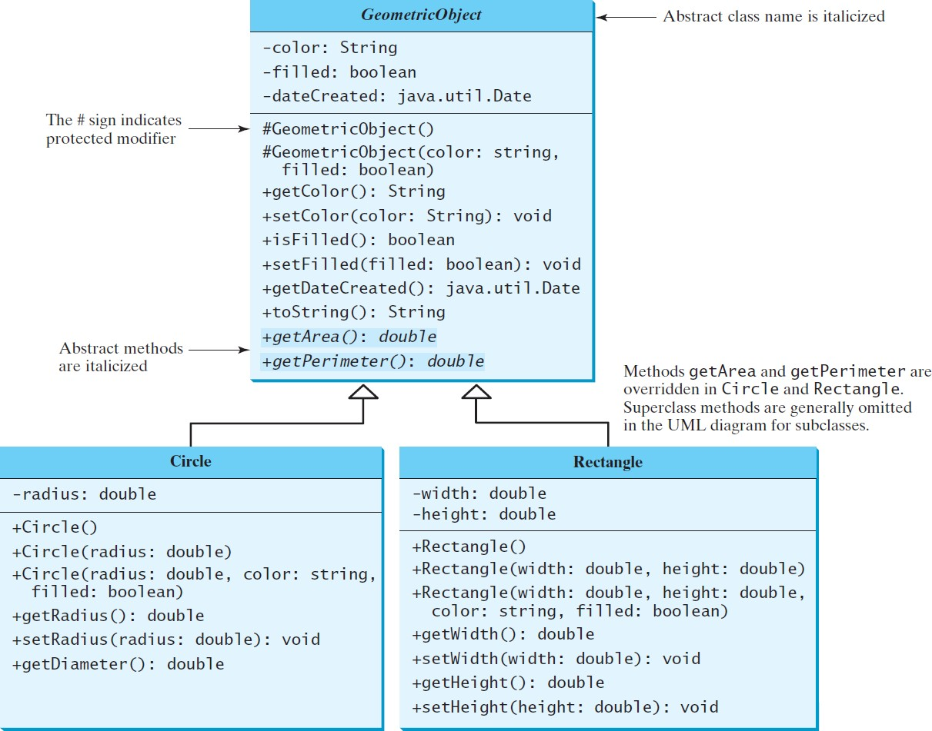
Abstract Classes and Abstract Methods
GeometricObject
Circle
Rectangle
TestGeometricObject
4

Slide 5
Methods and data fields visibility
Modifiers on Members in a Class | Accessed from the Same Class | Accessed from the Same Package | Accessed from a Subclass in a Different Package | Accessed from a Different Package
Public | ✓ | ✓ | ✓ | ✓
Protected | ✓ | ✓ | ✓
Default (no modifiers) | ✓ | ✓
Private | ✓
5

Slide 6
abstract modifier
Abstract classes and abstract methods are denoted
using the abstract modifier
Constructors in an abstract class are protected because they are only used by subclasses
public class GeometricObject{
abstract
private String color = "white";
private boolean filled;
private java.util.Date dateCreated;
…
protected GeometricObject(String color, boolean filled) { dateCreated = new java.util.Date();
this.color = color; this.filled = filled; } @override
…
/** Abstract method getArea */
public abstract double getArea();
/** Abstract method getPerimeter */
public abstract double getPerimeter();
}
Lecture 12
6

Slide 7
abstract method are only allowed in abstract class
An abstract method cannot be contained in a
nonabstract class.
If a subclass of an abstract superclass does not implement all the abstract methods, the subclass must be defined abstract.
In other words, in a nonabstract subclass extended from an abstract class, all the abstract methods must be implemented, even if they are not used in the subclass.

Slide 8
object cannot be created from abstract class
An abstract class cannot be instantiated using the new operator
you can still define its constructors, which are invoked in the constructors of its subclasses.
For instance, the constructors of GeometricObject are invoked in the Circle class and the Rectangle class.

Slide 9
public abstract class GeometricObject{ private String color = "white"; private boolean filled;
private java.util.Date dateCreated;
…
protected GeometricObject(String color, boolean filled) { dateCreated = new java.util.Date();
this.color = color; this.filled = filled; } @override
…
/** Abstract method getArea */
public abstract double getArea();
/** Abstract method getPerimeter */
public abstract double getPerimeter();
}
public class Circle
extends GeometricObject
{
private double radius; public Circle() {.. }
}

Slide 10
abstract class without abstract method
A class that contains abstract methods must be abstract.
It is also possible to define an abstract class that contains no abstract methods.
In this case, you cannot create instances of the class using the new operator.
This class is used as a base class for defining a new subclass.

Slide 11
Superclass of abstract class may be concrete
A subclass can be abstract even if its superclass is concrete.
For example, the Object class is concrete, but its subclasses (e.g., GeometricObject) may be abstract.

Slide 12
Concrete method overridden to be abstract
A subclass can override a method from its superclass to define it abstract.
This is rare, but useful when the implementation of the method in the superclass becomes invalid in the subclass.
In this case, the subclass must be defined abstract.

Slide 13
public abstract class GeometricObject{ private String color = "white"; private boolean filled;
private java.util.Date dateCreated;
…
protected GeometricObject(String color, boolean filled) { dateCreated = new java.util.Date();
this.color = color; this.filled = filled; }
@override
…
/** Abstract method getArea */ public abstract double getArea();
/** Abstract method getPerimeter */ public abstract double getPerimeter(); }
public class Circle extends GeometricObject { private double radius;
public Circle() {.. }
}

Slide 14
public class TestGeometricObject {
public static void main(String[] args){
GeometricObject geoObject1 = new Circle(5); GeometricObject geoObject2 = new Rectangle(5,3); System.out.println("The two objects have the same area? " +
equalArea(geoObject1, geoObject2)); displayGeometricObject(geoObject1); displayGeometricObject(geoObject2); }
public static boolean equalArea(GeometricObject object1, GeometricObject object2){ return object1.getArea() == object2.getArea(); }
public static void displayGeometricObject(GeometricObject object) { System.out.println();
System.out.println();
System.out.println("The area is " + object.getArea()); System.out.println("The perimeter is " + object.getPerimeter()); }
}

Slide 15
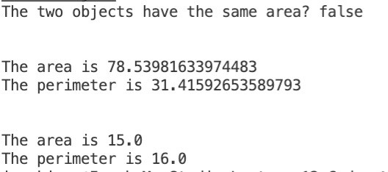

Slide 16
abstract class as type
Remember, an abstract class cannot be instantiated using the new operator.
But an abstract class can be used as a data type.
GeometricObject[] geo = new GeometricObject[10];

Slide 17
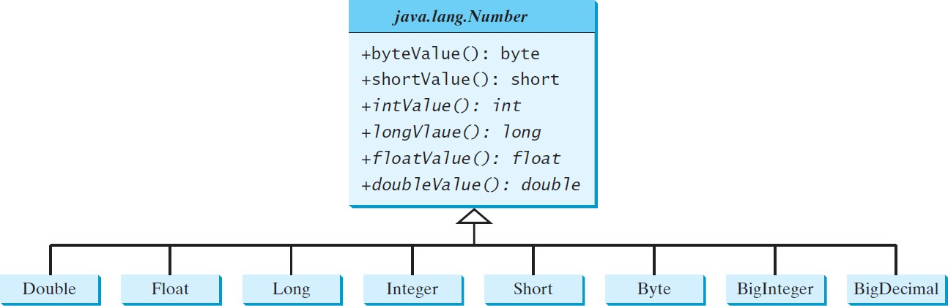
Case Study: the Abstract Number Class
Number is an abstract superclass for the numeric wrapper classes
byteVaue() and shortValue() call intValue() and cast result to byte and short, respectively
LargestNumbers

Slide 18
Case Study: the Abstract Number Class
import java.util.ArrayList; import java.math.*;
public class LargestNumber {
public static void main(String[] args) {
ArrayList<Number> list = new ArrayList<>(); list.add(45); // Add an integer list.add(3445.53); // Add a double
// Add a BigInteger
list.add(new BigInteger("3432323234344343101"));
// Add a BigDecimal
Create an array list and add number to list
Invoke getLargestNumber()
list.add(new BigDecimal("2.0909090989091343433344343"));
System.out.println("The largest number is " + getLargestNumber(list)); }
public static Number getLargestNumber(ArrayList<Number> list) { if (list == null || list.size() == 0)
return null;
Number number = list.get(0); for (int i = 1; i < list.size(); i++)
if (number.doubleValue() < list.get(i).doubleValue()) number = list.get(i);
doubleValue()
return number;}
}

Slide 19
Case Study: the Abstract Number Class
import java.util.ArrayList; import java.math.*;
public class LargestNumber {
public static void main(String[] args) {
ArrayList<Number> list = new ArrayList<>(); list.add(45); // Add an integer list.add(3445.53); // Add a double
// Add a BigInteger
list.add(new BigInteger("3432323234344343101"));
// Add a BigDecimal
Create an array list and add number to list
Invoke getLargestNumber()
list.add(new BigDecimal("2.0909090989091343433344343"));
System.out.println("The largest number is " + getLargestNumber(list)); }
public static Number getLargestNumber(ArrayList<Number> list) { if (list == null || list.size() == 0)
return null;
Number number = list.get(0); f
or (int i = 1; i < list.size(); i++) double
if (number.doubleValue() < list.get(i).doubleValue()) number = list.get(i);
Value()
return number;}
}

Slide 20
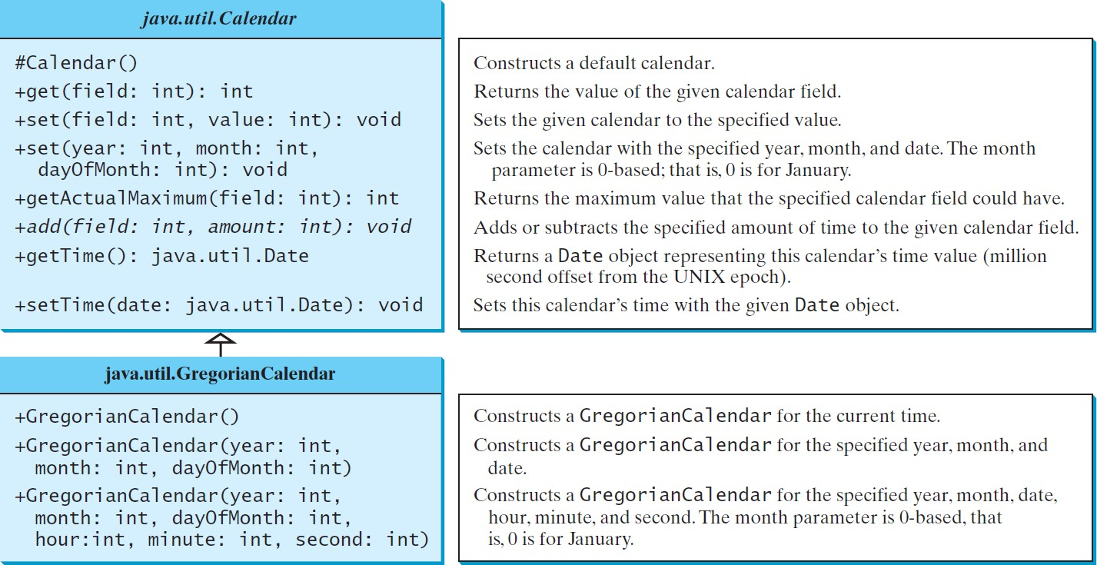
The Abstract Calendar Class and Its GregorianCalendar subclass

Slide 21
The Abstract Calendar Class and Its GregorianCalendar subclass
An instance of java.util.Date represents a specific instant in time with millisecond precision.
java.util.Calendar is an abstract base class for extracting detailed information such as year, month, date, hour, minute and second from a Date object.
Subclasses of Calendar can implement specific calendar systems such as Gregorian calendar, Lunar Calendar and Jewish calendar.
Currently, java.util.GregorianCalendar for the
Gregorian calendar is supported in the Java API.

Slide 22
The GregorianCalendar Class
Use new GregorianCalendar() to construct a default
GregorianCalendar with the current time.
Then use new GregorianCalendar(year, month, date) to construct a GregorianCalendar with the specified year, month, and date.
The month parameter is 0-based, i.e., 0 is for January.

Slide 23
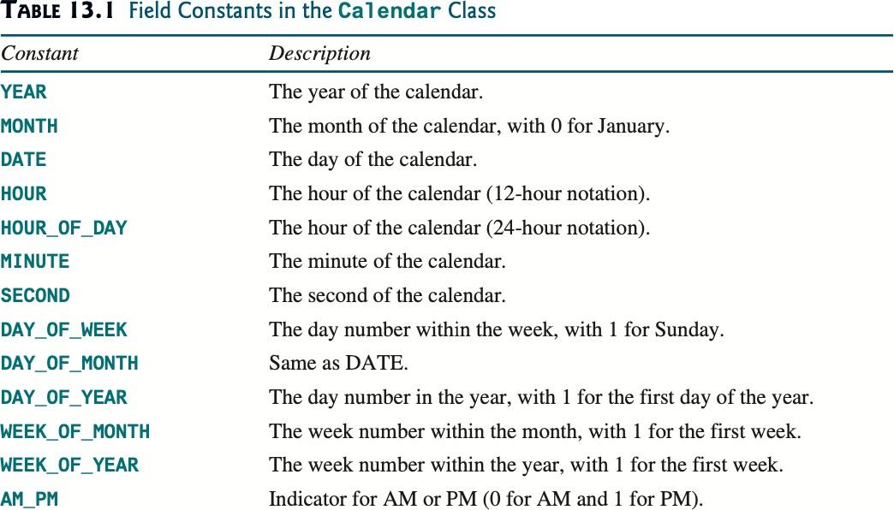
Calendar is an abstract base class
The get(int field) method defined in the Calendar class is useful to extract the date and time information from a Calendar object.
The fields are defined as constants.
Lecture 12

Slide 24
The abstract add method
The add method is abstract in the Calendar class because its implantation is dependent on a concrete calendar system.
add(field, value) adds the specific amount to a given field
Example:
Add 7 days to the current time of the calendar
add(Calendar.DAY_OF_MONTH, 7)

Slide 25
Getting Date/Time Information from Calendar
public class TestCalendar {
public static void main(String[] args) {
// Construct a Gregorian calendar for the current date and time
Calendar calendar = new GregorianCalendar();
System.out.println("Current time is " + new Date()); System.out.println("YEAR: " + calendar.get(Calendar.YEAR)); System.out.println("MONTH: " + calendar.get(Calendar.MONTH)); System.out.println("DATE: " + calendar.get(Calendar.DATE)); System.out.println("HOUR: " + calendar.get(Calendar.HOUR));
System.out.println("HOUR_OF_DAY: " + calendar.get(Calendar.HOUR_OF_DAY));
System.out.println("MINUTE: " + calendar.get(Calendar.MINUTE)); System.out.println("SECOND: " + calendar.get(Calendar.SECOND)); System.out.println("DAY_OF_WEEK: " + calendar.get(Calendar.DAY_OF_WEEK)); System.out.println("DAY_OF_MONTH: " + calendar.get(Calendar.DAY_OF_MONTH)); System.out.println("DAY_OF_YEAR: " + calendar.get(Calendar.DAY_OF_YEAR)); System.out.println("WEEK_OF_MONTH: " +
calendar.get(Calendar.WEEK_OF_MONTH));
System.out.println("WEEK_OF_YEAR: " + calendar.get(Calendar.WEEK_OF_YEAR)); System.out.println("AM_PM: " + calendar.get(Calendar.AM_PM));

Slide 26
Getting Date/Time Information from Calendar
public class TestCalendar {
public static void main(String[] args) {
// Construct a Gregorian calendar for the current date and time
…
// Construct a calendar for December 25, 1997
Calendar calendar1 = new GregorianCalendar(1997, 11, 25);
String[] dayNameOfWeek = {"Sunday", "Monday", "Tuesday", "Wednesday", "Thursday", "Friday", "Saturday"};
System.out.println("December 25, 1997 is a " + dayNameOfWeek[calendar1.get(Calendar.DAY_OF_WEEK)-1]);
}
}

Slide 27
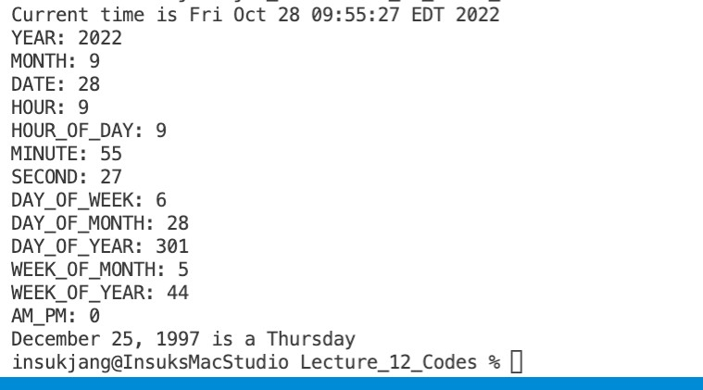
Getting Date/Time Information from Calendar

Slide 28
Interfaces

Slide 29
Interfaces
What is an interface?
Why is an interface useful?
How do you define an interface?
How do you use an interface?

Slide 30
What is an interface?
Why is an interface useful?
An interface is a class-like construct that contains
only constants and abstract methods.
In many ways, an interface is similar to an abstract class, but the intent of an interface is to specify common behavior for objects.
For example, you can specify that the objects are comparable, edible, and/or cloneable using appropriate interfaces.

Slide 31
Define an Interface
To distinguish an interface from a class, Java uses the keyword interface
public interface InterfaceName { constant declarations; abstract method signatures;
}
Example:
public interface Edible {
/** Describe how to eat */
public abstract String howToEat();
}

Slide 32
Interface is a Special Class
An interface is treated like a special class in Java.
Each interface is compiled into a separate bytecode file, just like a regular class.
Like an abstract class, you cannot create an instance from an interface using the new operator
Naming convection
Class names are nouns
Interface names may be adjectives or nouns
But in most cases, you can use an interface more or less the same way you use an abstract class.
For example, you can use an interface as a data type for a variable, as the result of casting, and so on.

Slide 33
Example
Use the Edible interface to specify whether an object is edible.
The class for the object implementing an interface uses the keyword implements
For example
abstract class Fruit Edible {
implements
// Data fields, constructors, and methods
}
class Chicken extends Animal
{
implements
Edible
// Data fields, constructors, and methods
}

Slide 34
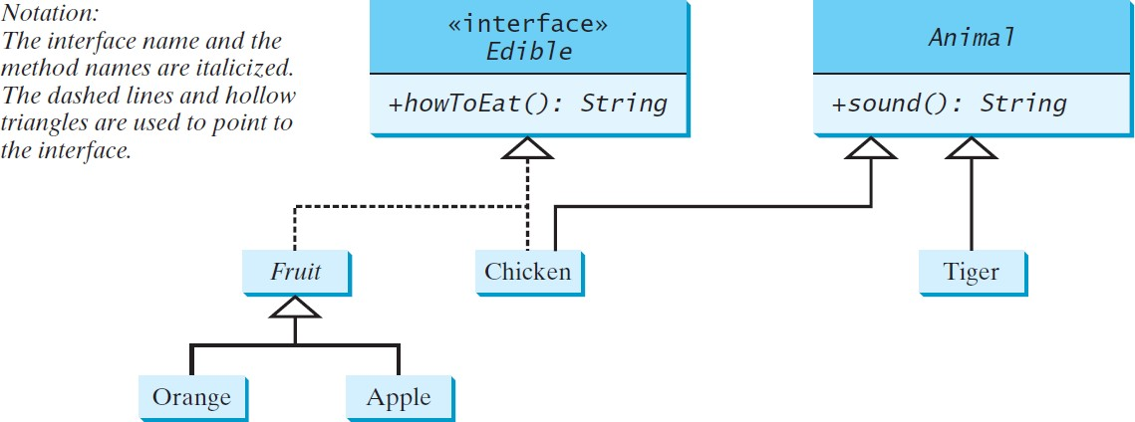
Example
Use the Edible interface to specify whether an object
is edible
Edible
TestEdible

Slide 35
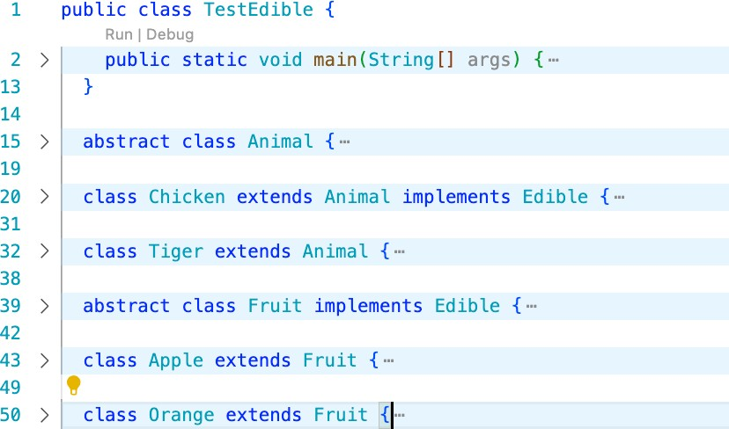
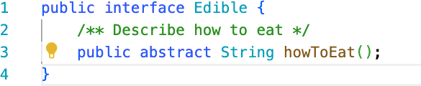
Lecture 12
35

Slide 36
public class TestEdible {
public static void main(String[] args) {
Object[] objects = {new Tiger(), new Chicken(), new Apple()}; for (int i = 0; i < objects.length; i++) {
if (objects[i] instanceof Edible) System.out.println(((Edible)objects[i]).howToEat());
if (objects[i] instanceof Animal) { System.out.println(((Animal)objects[i]).sound());
}
}
}
}
Lecture 12
36

Slide 37
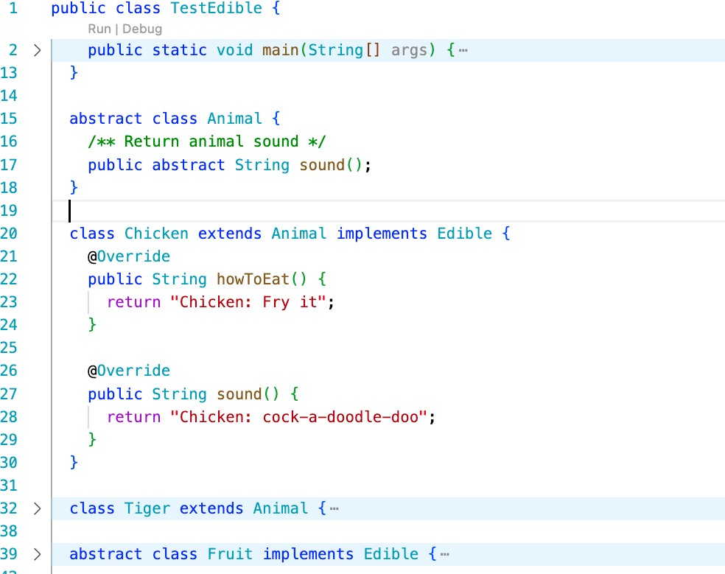
Lecture 12
37

Slide 38
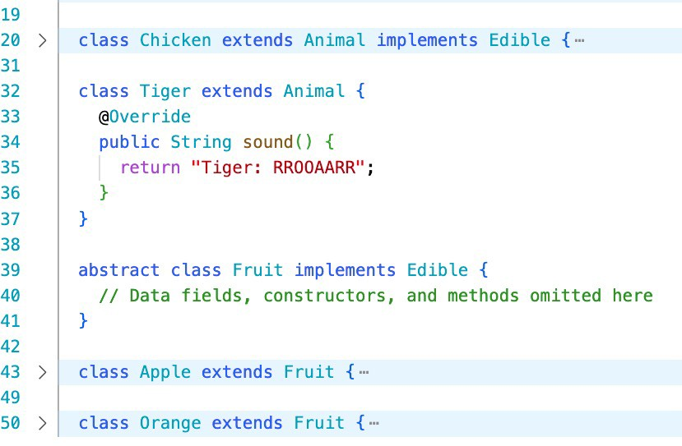

Slide 39
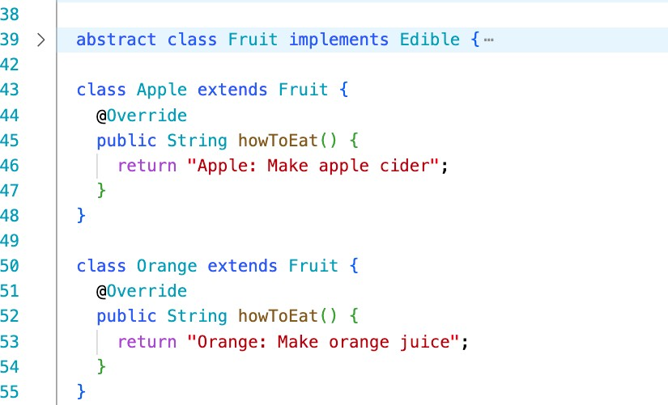
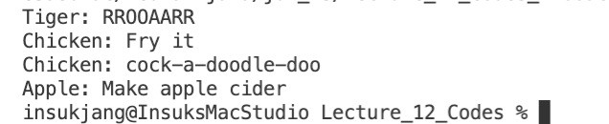

Slide 40
Omitting Modifiers in Interfaces
All data fields are public final static and all methods are public abstract in an interface.
For this reason, these modifiers can be omitted
public interface T1 {
public static final int K = 1;
public abstract void p();
}
public interface T1 { int K = 1;
Equivalent
void p();
}

Slide 41
Interface static members
Interface can have static members
Like class static members, the best practice is to make invocations of static methods and access of static data fields obvious.
Use InterfaceName.methodName(arguments) InterfaceName.variable

Slide 42
Interface default methods
A default method provides a default implementation for the method in the interface.
Use the keyword default
Example
public interface A {
public void doSomething(){
default
System.out.println(“Do Something”);
}
…
}
A class that implements the interface may simply use the default implementation for the method or override the method with a new implementation.

Slide 43
Example: The Comparable Interface
The java.lang.Comparable interface defines the comparedTo method for comparing objects package java.lang;
public interface Comparable<E> { public int compareTo(E o);
}
The compareTo method returns
A negative integer if this object is less than o
Zero if this object is equal to o
A positive integer if this object is greater than o

Slide 44
The toString, equals, and hashCode Methods
Many classes (e.g., the numeric wrapper classes) in the Java library implement Comparable to define a natural order for objects
the compareTo method is implemented in these classes.
Each wrapper class overrides the toString, equals, and
hashCode methods defined in the Object class.

Slide 45
The Comparable interface
public class Integer extends Number
implements Comparable<Integer> {
// class body omitted
@Override
public int compareTo(Integer o) {
// Implementation omitted
}
}
public class BigInteger extends Number
{
// class body omitted
@Override
public int compareTo(BigInteger o) {
// Implementation omitted
}
}
implements Comparable<BigInteger>
public class String extends Object
{
// class body omitted
@Override
public int compareTo(String o) {
// Implementation omitted
}
}
public class Date extends Object
{
// class body omitted
@Override
public int compareTo(Date o) {
// Implementation omitted
}
}
implements Comparable<String>
implements Comparable<Date>

Slide 46
Example
System.out.println(new Integer(3).compareTo(new Integer(5))); System.out.println("ABC".compareTo("ABE"));
java.util.Date date1 = new java.util.Date(2013, 1, 1); java.util.Date date2 = new java.util.Date(2012, 1, 1); System.out.println(date1.compareTo(date2));

Slide 47
Generic sort Method
Let n be an Integer object, s be a String object, and d be a
Date object. All the following expressions are true.
n instanceof Integer n instanceof Object
n instanceof Comparable
s instanceof String s instanceof Object
s instanceof Comparable
d instanceof java.util.Date d instanceof Object
d instanceof Comparable
The java.util.Arrays.sort(array) method requires that the elements in an array are instances of Comparable<E>.
SortComparableObjects

Slide 48
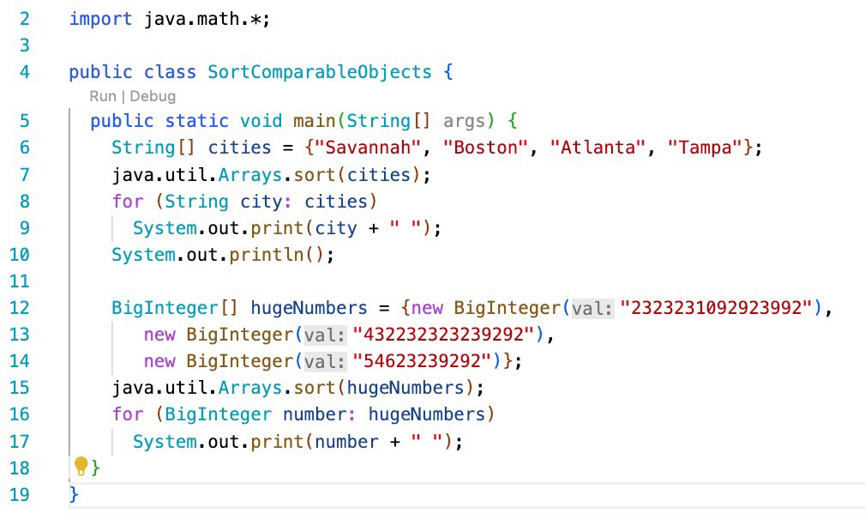

Slide 49
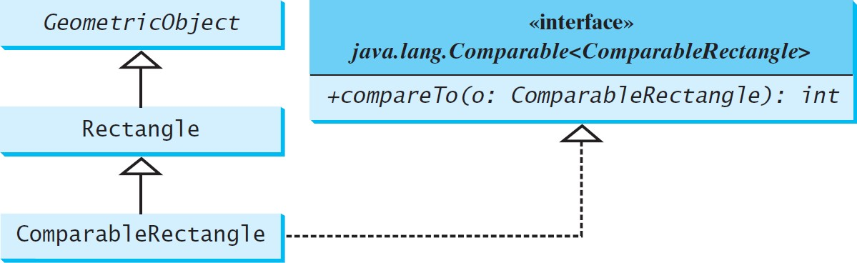
Defining Classes to Implement Comparable
ComparableRectangle
SortRectangles

Slide 50
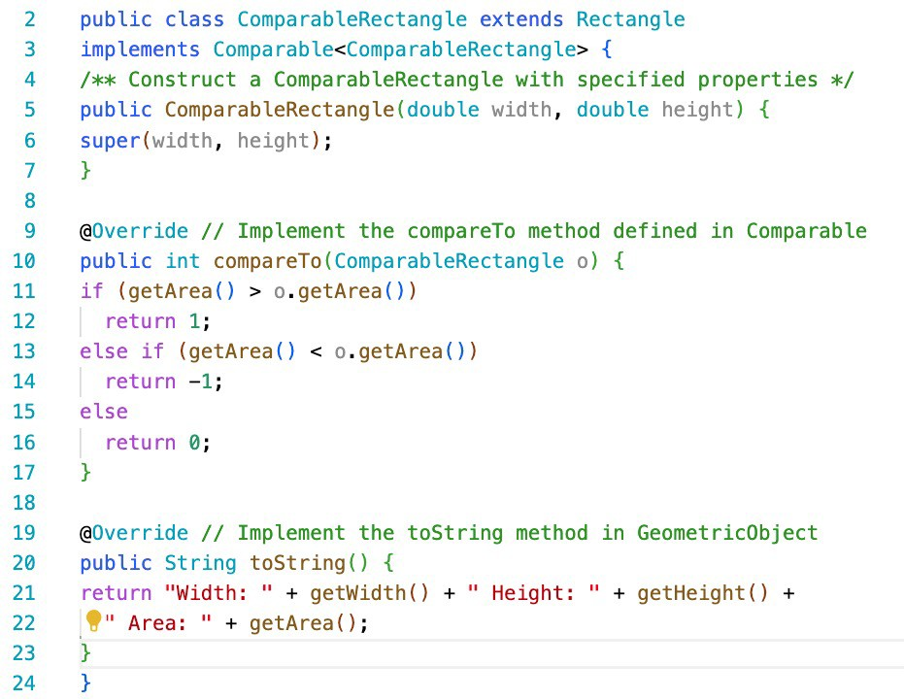
Lecture 12
50

Slide 51
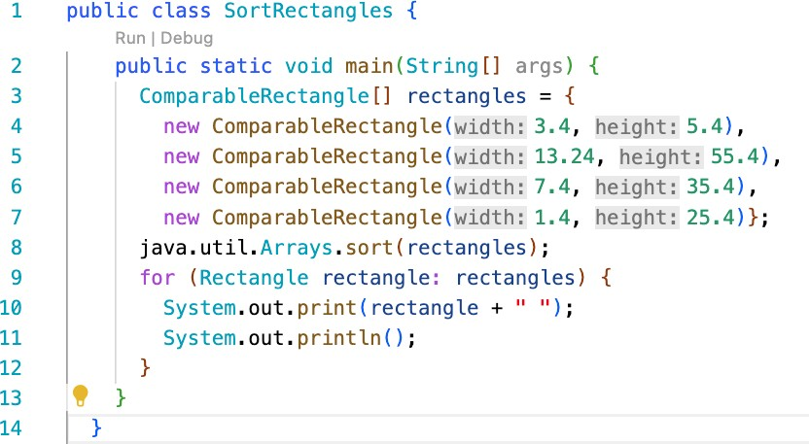
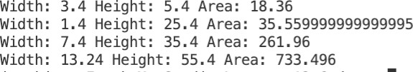

Slide 52
Interface example
The java.lang.Cloneable interface specifies that an object can be cloned (i.e., it can be copied)
package java.lang;
public interface {
}
Cloneable
The interface is empty
An interface with an empty body is called a marker interface
A class that implements the Cloneable interface is
marked cloneable
its objects can be cloned using the clone() method defined in the Object class

Slide 53
The Cloaneable interface
Many classes (e.g., Date and Calendar) in the Java library implement Cloneable.
The instances of these classes can be cloned.
Calendar calendar = new GregorianCalendar(2003, 2, 1); Calendar calendarCopy = (Calendar)calendar.clone(); System.out.println("calendar == calendarCopy is " +
(calendar == calendarCopy)); System.out.println("calendar.equals(calendarCopy) is " +
calendar.equals(calendarCopy));
displays
calendar == calendarCopy is false
calendar.equals(calendarCopy)is true

Slide 54
The Cloaneable interface
Array are cloneable
You can clone an array using the clone method
ArrayList implements Cloneable
int [] list1 = {1, 2};
int [] list2 = list1.clone();

Slide 55
Defining classes to implement Cloaneable
A class that implements the Cloanbale interface must override the clone method defined in the Object class
protected native Object clone() throws CloneNotSupportedException;
The keyword native indicates this method is not written in Java
It is implemented in the JVM for the native platform
The class must override the clone method and change the visibility modifier to public, so it can be used in any package
The class must implement Cloneable
Otherwise, CloneNotSupportedException is thrown

Slide 56
Implementing Cloneable Interface
The following code defines a class named House that implements Cloneable and Comparable.
House

Slide 57
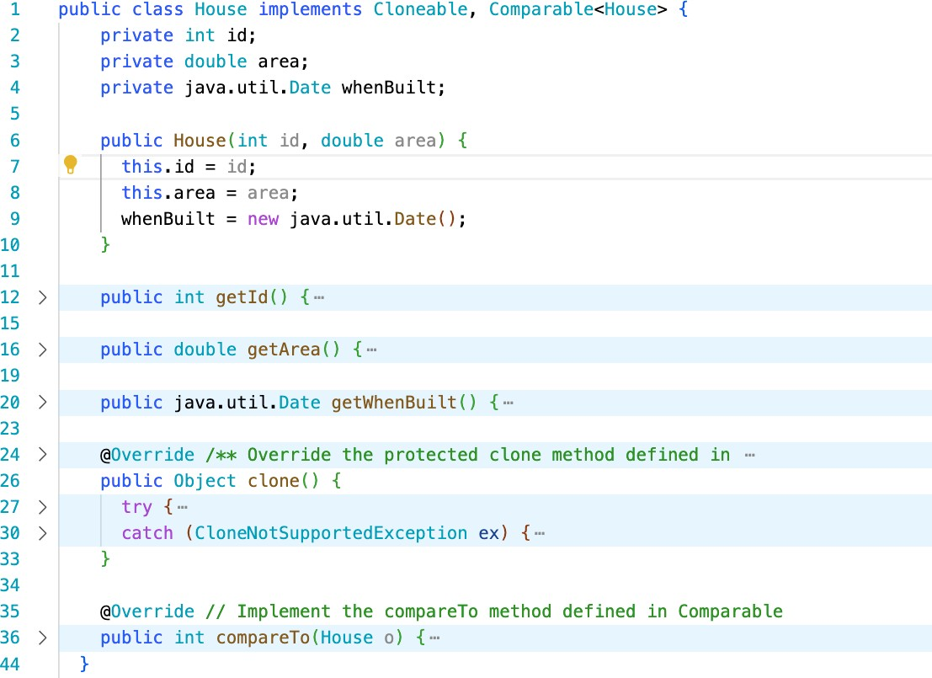

Slide 58
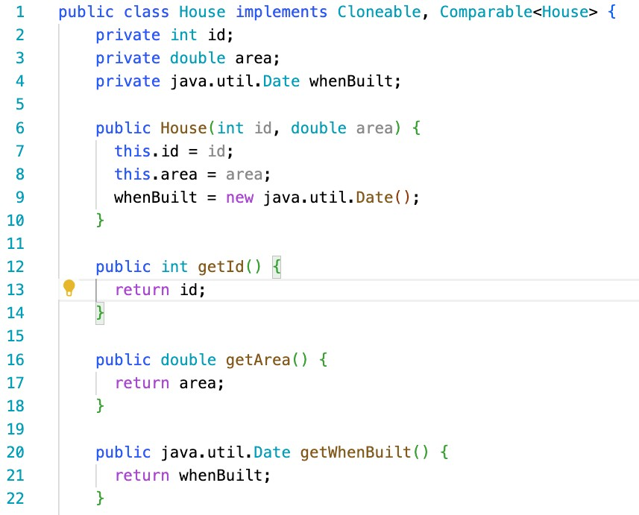

Slide 59
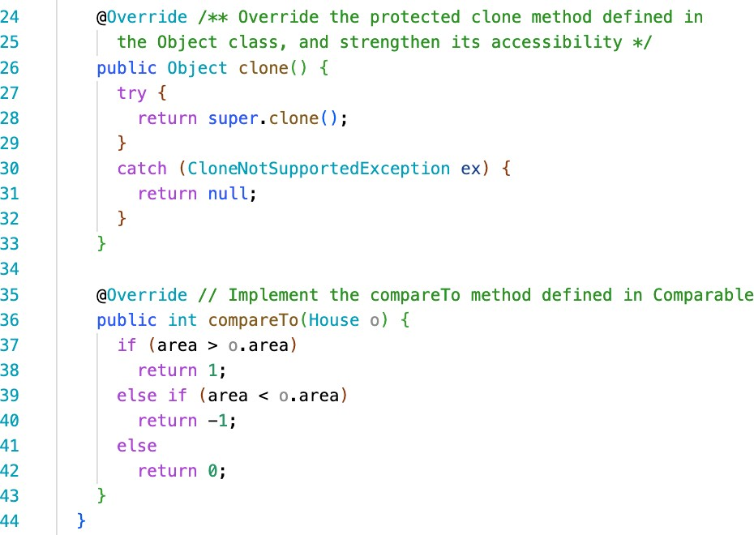

Slide 60
Defining classes to implement Cloaneable
To perform a shallow copy, the clone method in a class that implements the Cloneable interface can simply invoke the super.clone method
public class JangoFettClone extends JangoFettTemplate private String name;
private java.util.Date whenCreated;
implements Cloneable
{
public JangoFettClone(String name) {
this.name = name; whenCreated = new java.util.Date();
}
@Override public Object clone() {
For data fields that are object, the object’s references are copied
try {
return // Shallow copy
super.clone();
}
catch (CloneNotSupportedException ex) {
return null; }
}
}

Slide 61
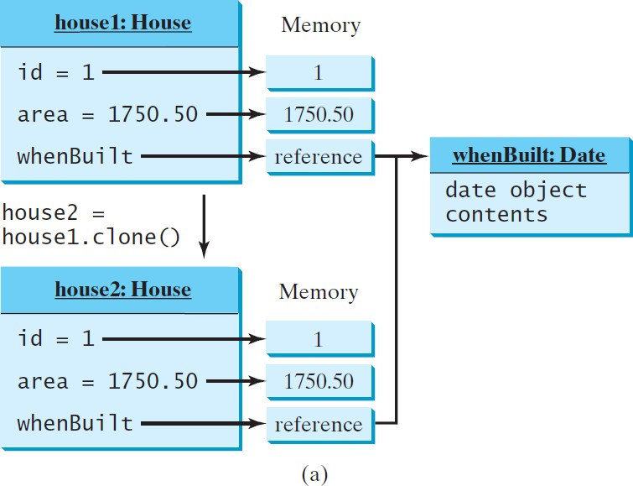
Shallow vs. Deep Copy
House house1 = new House(1, 1750.50); House house2 = (House)house1.clone();
Shallow Copy

Slide 62
Defining classes to implement Cloaneable
To perform a deep copy, the clone method in a class that implements the Cloneable interface must copy the contents of
data fields that are objects
public class JangoFettClone extends JangoFettTemplate private String name;
private java.util.Date whenCreated;
...
@Override
public Object clone() { try {
implements Cloneable
{
JangoFettClone ret = (JangoFettClone)super.clone(); // Shallow copy
// String is immutable, so deep copy is not required
ret.whenCreated = (java.util.Date)(whenCreated.clone());
return ret;
}
catch (CloneNotSupportedException ex) { return null;
}
}
}
62

Slide 63
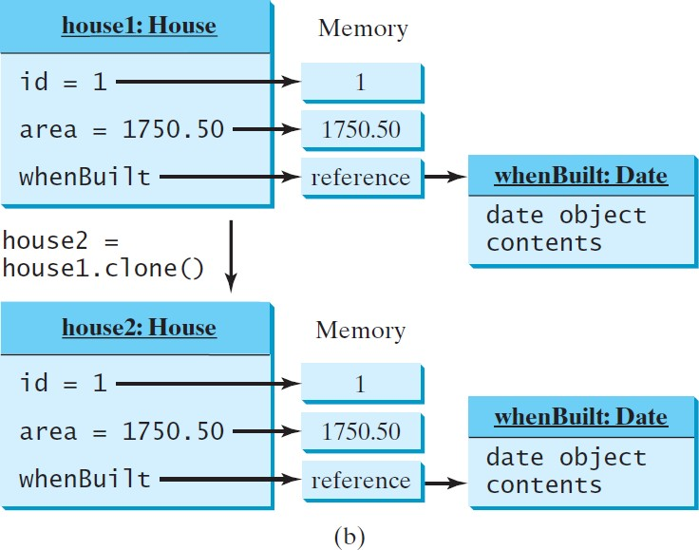
Shallow vs. Deep Copy
House house1 = new House(1, 1750.50); House house2 = (House)house1.clone();
Deep Copy

Slide 64
Several Questions from the clone method and Cloneable interface
why is the clone method in the Object class defined protected, not public?
why is the clone method not defined in the
Cloneable interface?
why doesn’t the Object class implement the
Cloneable interface?
what would happen if the House class did not implement Cloneable ?

Slide 65
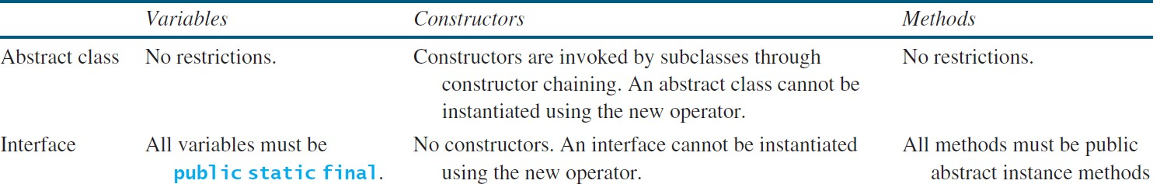
Interfaces vs. Abstract Classes
In an interface, the data must be constants; an abstract class can have all types of data.
Each method in an interface has only a signature without implementation; an abstract class can have concrete methods.

Slide 66
Interfaces vs. Abstract Classes
An interface can inherit other interfaces using the extends keyword. Such an interface is called a subinterface.
public interface NewInterface
extends
Interface1, ..., InterfaceN {
// constants and abstract methods
}
A class implementing NewInterface must implement the abstract methods defined in NewInterface, Interface1,…, InterfaceN.
An interface can extend other interfaces, but not classes.

Slide 67
Interfaces vs. Abstract Classes
All classes share a single root, the Object class, but there is no single root for interfaces
Like a class, an interface also defines a type
A variable of an interface type can reference any instance of the class that implements the interface
If interface2 extends interface1, then interface1 is like a superclass for interface2
You can use an interface as a data type and cast a variable of an interface type to its subclass, and vice versa

Slide 68
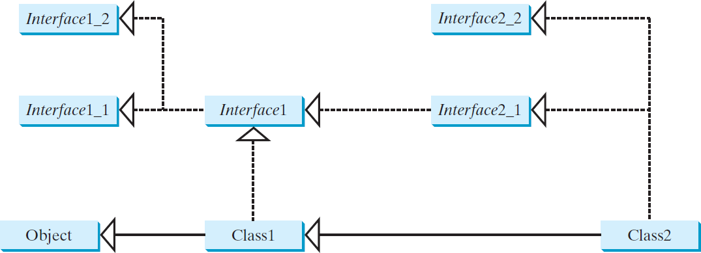
Interfaces vs. Abstract Classes
A class can implement multiple interfaces, but it can only extend one superclass
Suppose that c is an instance of Class2
c is also an instance of Object, Class1, Interface1, Interface1_1, Interface1_2, Interface2_1, and Interface2_2
.

Slide 69
Caution: conflict interfaces
On rare occasions, a class may implement two interfaces with conflict information (e.g., two same constants with different values or two methods with same signature but different return type).
This type of errors will be detected by the compiler.

Slide 70
Class design guidelines

Slide 71
Coherence
A class should describe a single entity, and all the class operations should logically fit together to support a coherent purpose
A single entity with many responsibilities can be broken into several classes to separate responsibilities

Slide 72
Consistency
Follow standard Java programming style and naming conventions
Choose informative names for classes, data fields, and methods
o Make names consistent
Place the data declaration before the constructor, and place constructors before methods
Provide a no-arg constructor (or document why the class does not support one)

Slide 73
Encapsulation
A class should use the private modifier to hide its data from direct access by clients
Provide getter methods and setter methods to provide users with access to the private data, but only to private data you want the user to see or to modify
A class should also hide methods not intended for client use
Make methods protected if they are intended for extenders of the class

Slide 74
Clarity and Completeness
A class should have a clear contract that is easy to explain and easy to understand
Design a class that imposes no restrictions on how or when the user can use it
Design the properties in a way that lets the user set them in any order and with any combination of values
Design methods that function independently of their order of occurrence

Slide 75
Clarity and Completeness
Methods should be defined intuitively without causing confusion
You should not declare a data field that can be derived from other data fields
A class should provide a variety of ways for customization through properties and methods that, together, are minimal and complete

Slide 76
Instance vs. Static
A variable or method dependent on a specific instance of the class must be an instance variable or method
A variable shared by all the instances of a class should be declared static
A method not dependent on a specific instance should be defined as a static method
Always reference static variables and methods from a class name to improve readability and avoid errors
Do not initialize a static data field from a constructor parameter
o Use a setter method to change the static data field

Slide 77
Inheritance vs. Aggregation
Use inheritance to model is-a relationships
Use aggregation (and composition) to model has-a
relationships

Slide 78
Whether to use an interface or a class?
Abstract classes and interfaces can both be used to model common behavior for objects.
Interfaces cannot contain data files, only constant
In general, a strong is-a relationship that clearly describes a parent- child relationship should be modeled using classes.
An is-kind-of relationship, indicates that an object possesses a certain property and can be modeled using interfaces
An interface can define a common supertype for unrelated classes.
A subclass can extend only one superclass, but can implement any number of interfaces
You can also use interfaces to circumvent single inheritance restriction if multiple inheritance is desired.
You have to design one as a superclass, and others as interface.

