Slide 1

CS 501 – Introduction to JAVA Programing
Lecture 9 – Objects and Classes Lecture 10 – Thinking in Objects

Slide 2


8.0. Motivations
Suppose you want to develop a graphical user interface as shown below. How do you program it?

Slide 3
8.1. Defining Classes for Objects
Object-oriented programming (OOP) involves programming using objects.
An object represents an entity in the real world that can be distinctly identified.

Slide 4
8.1. Defining Classes for Objects
For example, a student, a desk, a circle, a button, and even a loan can all be viewed as objects.
An object has a unique identity, state, and behaviors.
The state of an object consists of a set of data fields (also known as properties) with their current values.
The behavior of an object is defined by a set of methods.

Slide 5
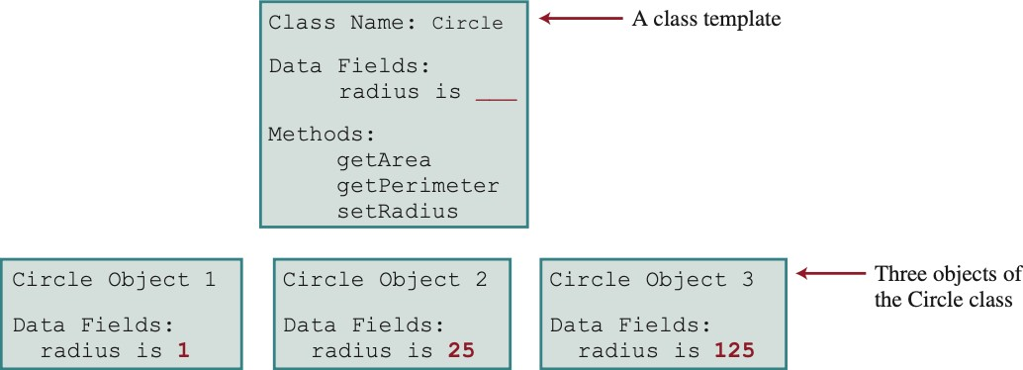
8.1. Defining Classes for Objects
An object has both a state and behavior.
The state defines the object, and the behavior defines what the object does.

Slide 6
8.1. Defining Classes for Objects
Classes are constructs that define objects of the same type.
A Java class uses
variables to define data fields and
methods to define behaviors.
Additionally, a class provides a special type of methods, known as
constructors, which are invoked to construct objects from the class.

Slide 7
8.1. Defining Classes for Objects
class Circle {
/** The radius of this circle */ double radius = 1.0;
Data field
/** Construct a circle object */ Circle() {
}
Constructors
/** Construct a circle object */ Circle(double newRadius) {
radius = newRadius;
}
/** Return the area of this circle */ double getArea() {
return radius * radius * 3.14159;
}
Method
}

Slide 8
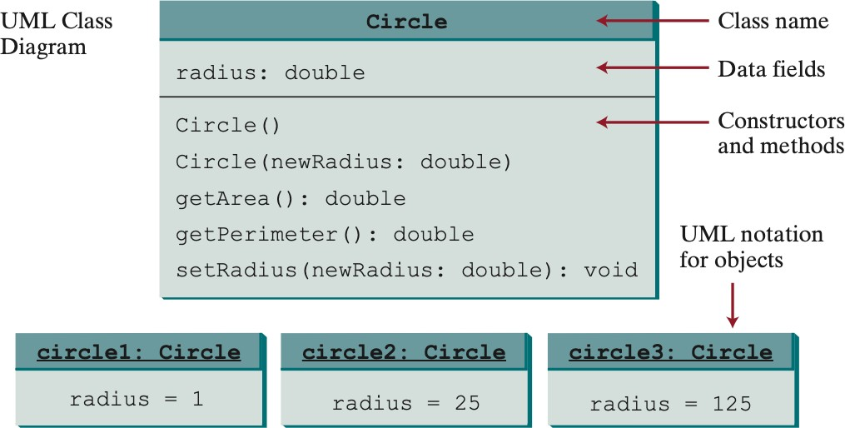
8.1. Defining Classes for Objects
UML: Unified Modeling Language

Slide 9
8.1. Defining Classes for Objects
Objective: Demonstrate creating objects, accessing data, and using methods.
The program contains two classes:
TestCircle – the main class to test the second class, Circle.
Two classes into one file – one will be a public class.
TestCircle is public and its file name as TestCircle.java.
The program constructs three radii, 1, 25, and 125, and display the radius and area of each circle.
Then the second radius changes to 100 and display the radius and area of new circle.

Slide 10
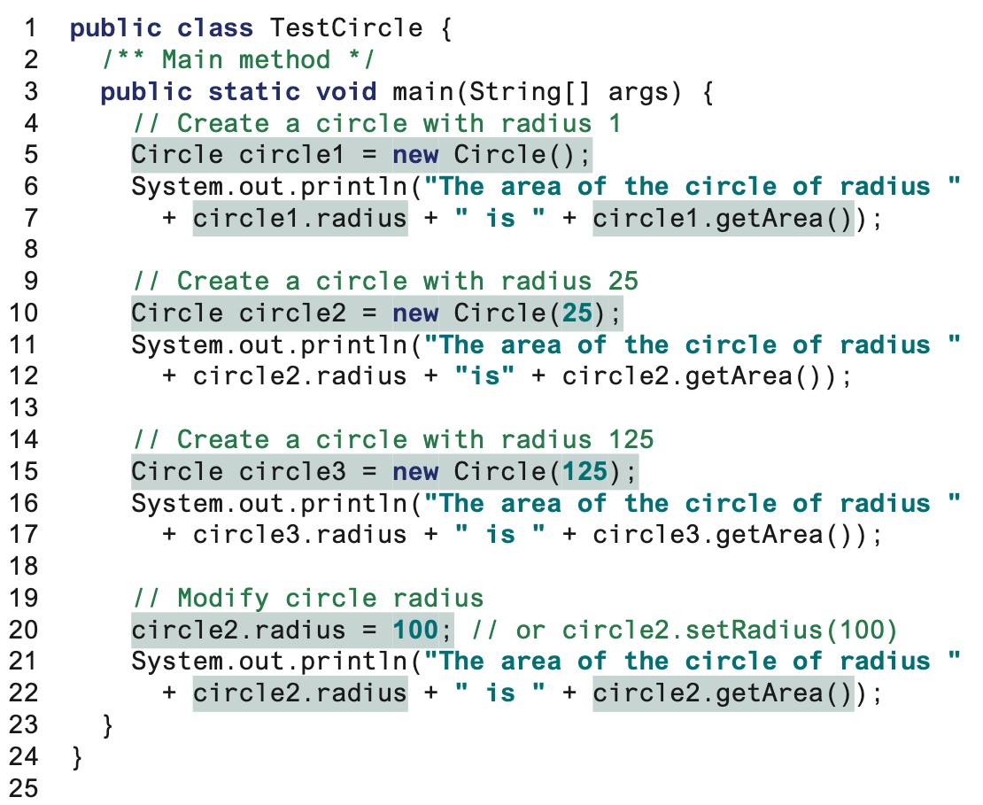
8.1. Defining Classes for Objects

Slide 11
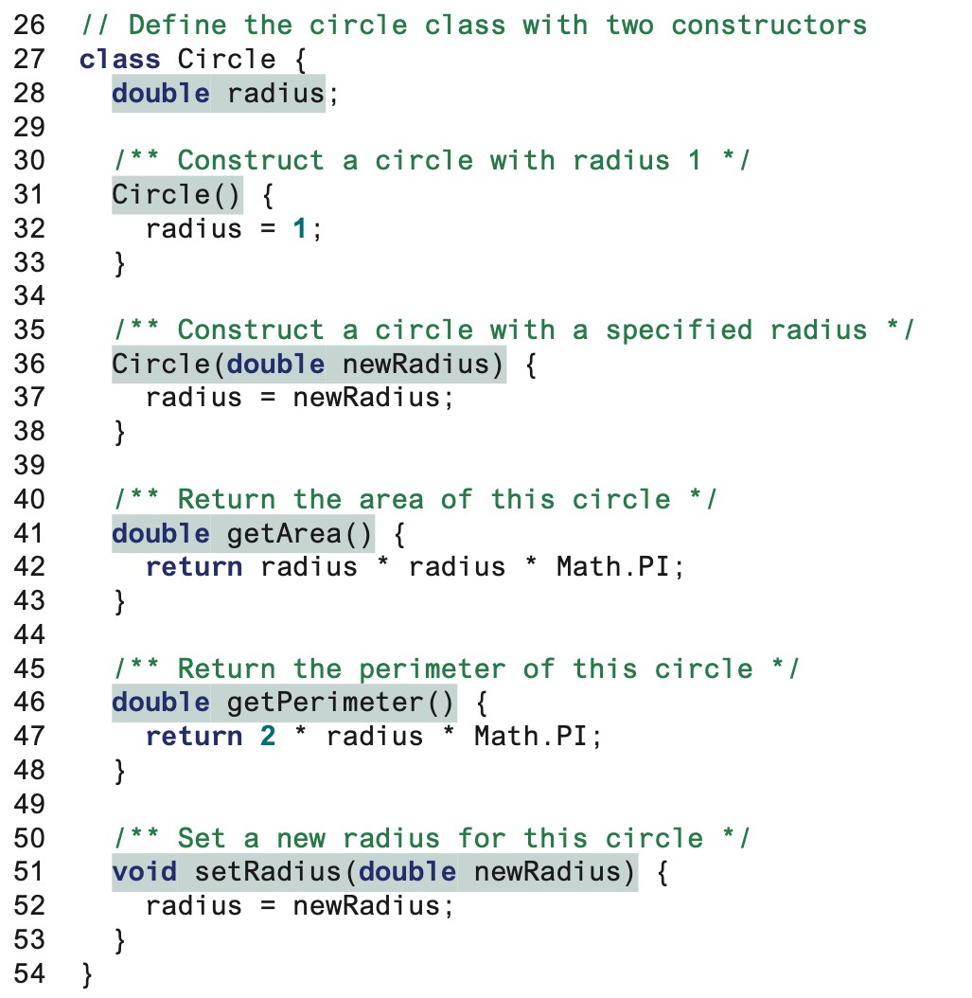
8.1. Defining Classes for Objects
class Circle
No argument constructor
Second constructor
getArea
getPerimeter
setRadius
CS501 - L9 - Obje
cts and Classes
11

Slide 12
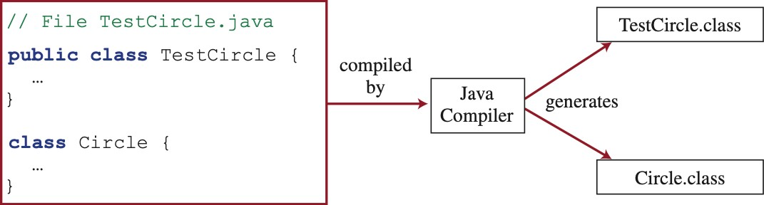
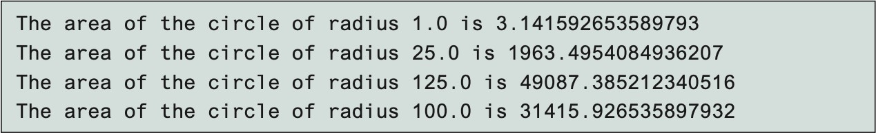
8.1. Defining Classes for Objects
Alternatively, two classes can be combined and precede into one.

Slide 13
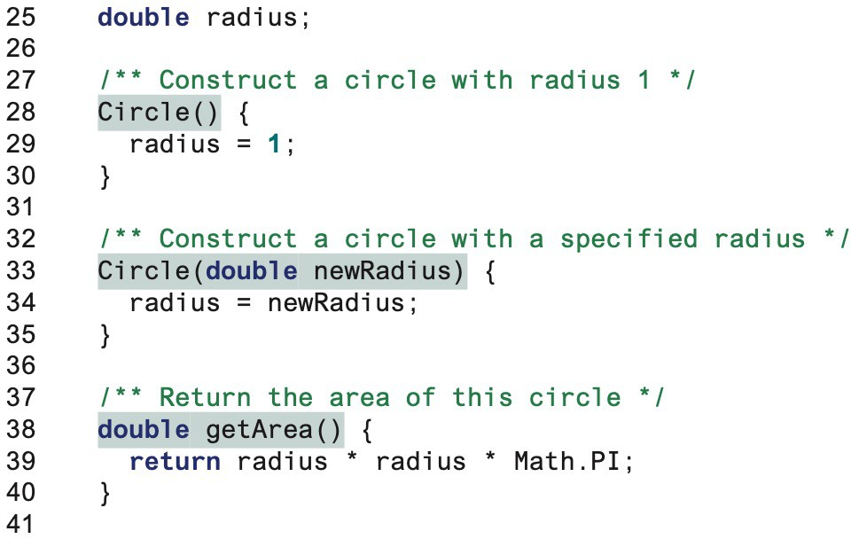
8.1. Defining Classes for Objects
Data field instead.

Slide 14
8.2. Constructing Objects Using Constructors
Circle() {
}
Circle(double newRadius) { radius = newRadius;
}
Constructors are a special kind of methods that are invoked to construct objects.
Name: Must have the same name as the class itself.
Return Type: Do not have a return type (not even void)
Overload: invoked using the new operator when an object is created.
Role: Initialize objects.

Slide 15
8.2. Constructing Objects Using Constructors
Public void Circle(){} new ClassName();
No-argument (no-arg) Constructor: A class normally provides a constructor without arguments.
Default Constructor: A public no-arg constructor with an empty body is implicitly defined in the class. This case is only if no constructors are explicitly defined in the class.

Slide 16
8.3. Accessing Objects via Reference Variables
The newly created objects are allocated in the memory and can be accessed via reference variables.
Such variables are declared as following syntax:
ClassName objectRefVar; ClassName objectRefVar = new ClassName();
Assign object reference
Example:
Create an object
Circle myCircle;
Circle myCircle = new Circle();

Slide 17
8.3. Accessing Objects via Reference Variables
□Use a dot operator (.) to access the object’s data and to invoke the methods.
□The dot operator is known as the object member access operator.
□Referencing the object’s data:
objectRefVar.data
Example: myCircle.radius
References radius in myCircle as an instance variable since it is dependent on a specific instance.
□Invoking the object’s method:
objectRefVar.methodName(arguments)
Example: myCircle.getArea()
The method getArea()is an instance variable and the object on which an instance method is invoked is called a calling object.

Slide 18
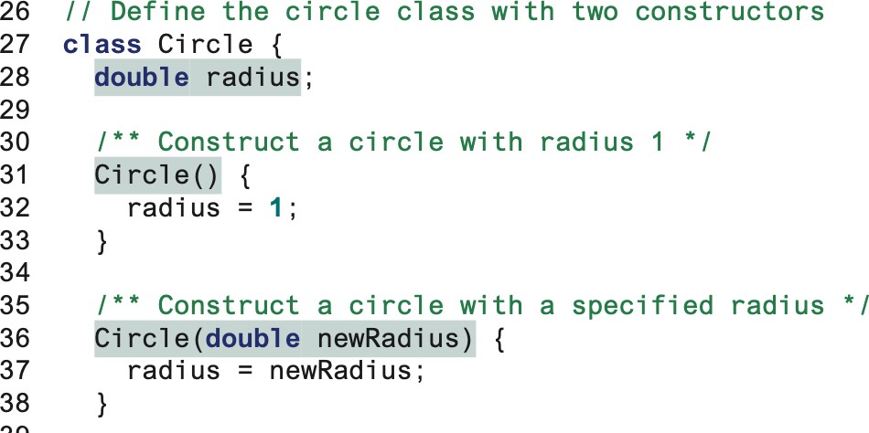
8.3. Accessing Objects via Reference Variables
Circle myCircle = new Circle(5.0);
Circle yourCircle = new Circle(); yourCircle.radius = 100;

Slide 19
8.3. Accessing Objects via Reference Variables
Remember computing exponents by invoking a pow method in the Math class:
Math.pow(3, 2.5)
Is this possible to do Circle.getArea()?
Is the method static? Can be used anywhere? Or only can be invoked from an object in class?
objectRefVar.methodName(arguments)

Slide 20
8.3. Accessing Objects via Reference Variables
The data fields can be of reference types.
If a data field of a reference type does not reference any object, the data field holds a special literal value, null.
null is not a Java keyword but it is a reserved word in Java.
0 for a numeric type
false for a Boolean type
\u000 for a chart type.
However, Java assigns no default value to a local variable inside a method.

Slide 21
8.3. Accessing Objects via Reference Variables
class Student {
String name; // name has the default value null int age; // age has the default value 0
boolean isScienceMajor; // isScienceMajor has default value
false
char gender; // gender has default value '\u0000'
}
class TestStudent {
public static void main(String[] args) { Student student = new Student();
System.out.println("name? " + student.name); System.out.println("age? " + student.age); System.out.println("isScienceMajor? " +
student.isScienceMajor); student.gender);
} }
System.out.println("gender? " +
CS501 - L9 - Objects and Classes
21

Slide 22
8.3. Accessing Objects via Reference Variables
class TestLocalVariables {
public static void main(String[] args) { int x; // x has no default value
String y; // y has no default value
System.out.println("x is " + x); System.out.println("y is " + y);
} }
Compile error: variable not initialized
Note: assign an object reference to the variable before invoking the method through the reference variable

Slide 23
8.3. Accessing Objects via Reference Variables
Created using new Circle()
Primitive type
int i = 1
i
1
Object type
Circle c c
reference
c: Circle
radius = 1

Slide 24
8.3. Accessing Objects via Reference Variables
Object type assignment c1 = c2
Primitive type assignment i = j
Before:
After:
Before:
After:
c1
c1
i
1
i
2
c2
c2
j
2
j
2
c1: Circle
c2: Circle
c1: Circle
c2: Circle
radius = 5
radius = 9
radius = 5
radius = 9
The useless object is called garbage. It occupies memory space.
We can assign null to a reference variable for the object.

Slide 25
8.4. Using Classes from the Java Library
The Date Class
Java provides a system-independent encapsulation of date and time in the
java.util.Date class.
We can use the Date class to create an instance for the current date and time and use its
toString method to return the date and time as a string.
java.util.Date
The + sign indicates public modifer
+Date()
+Date(elapseTime: long)
Constructs a Date object for the current time.
Constructs a Date object for a given time in milliseconds elapsed since January 1, 1970, GMT.
Returns a string representing the date and time. Returns the number of milliseconds since January 1,
1970, GMT.
Sets a new elapse time in the object.
+toString(): String
+getTime(): long
+setTime(elapseTime: long): void

Slide 26
8.4. Using Classes from the Java Library
For example, the following code
java.util.Date date = new java.util.Date(); System.out.println("The elapsed time since Jan 1, 1970 is " +
date.getTime() + " milliseconds"); System.out.println(date.toString());
displays
The elapsed time since Jan 1, 1970 is 1324903419651 milliseconds Mon Dec 26 07:43:39 EST 2011

Slide 27
8.4. Using Classes from the Java Library
The Random Class
Math.random() to obtain a random double value between 0.0 and 1.0 (excluding 1.0).
A more useful random number generator is provided in the java.util.Random class.
java.util.Random
+Random()
+Random(seed: long)
+nextInt(): int
+nextInt(n: int): int
+nextLong(): long
+nextDouble(): double
+nextFloat(): float
+nextBoolean(): boolean
Constructs a Random object with the current time as its seed. Constructs a Random object with a specified seed.
Returns a random int value.
Returns a random int value between 0 and n (exclusive). Returns a random long value.
Returns a random double value between 0.0 and 1.0 (exclusive). Returns a random float value between 0.0F and 1.0F (exclusive). Returns a random boolean value.

Slide 28
8.4. Using Classes from the Java Library
Random generator1 = new Random(3) ; System.out.print("From generator1: ") ; for (int i = 0; i < 10; i++)
System.out.print(generator1.nextInt(1000) + " ") ; Random generator2 = new Random(3) ; System.out.print("\nFrom generator2: ") ;
for (int i = 0; i < 10; i++) System.out.print(generator2.nextInt(1000) + " ");
From random1: 734 660 210 581 128 202 549 564 459 961
From random2: 734 660 210 581 128 202 549 564 459 961

Slide 29
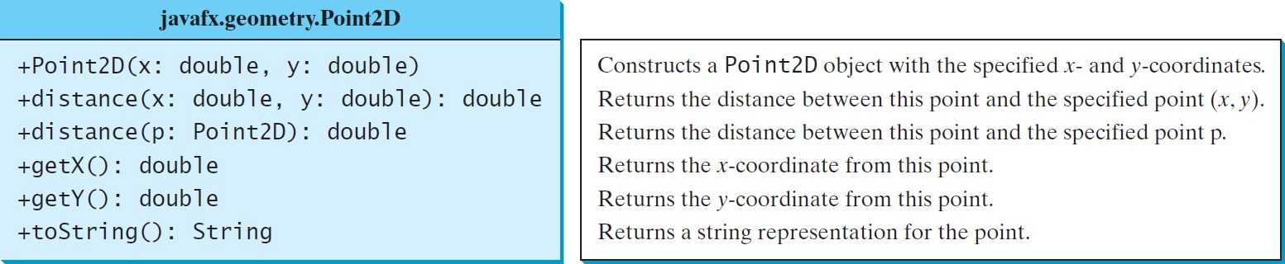
8.4. Using Classes from the Java Library
The Point2D Class
Java API has a convenient Point2D class in the javafx.geometry package for representing a point in a two-dimensional plane.

Slide 30
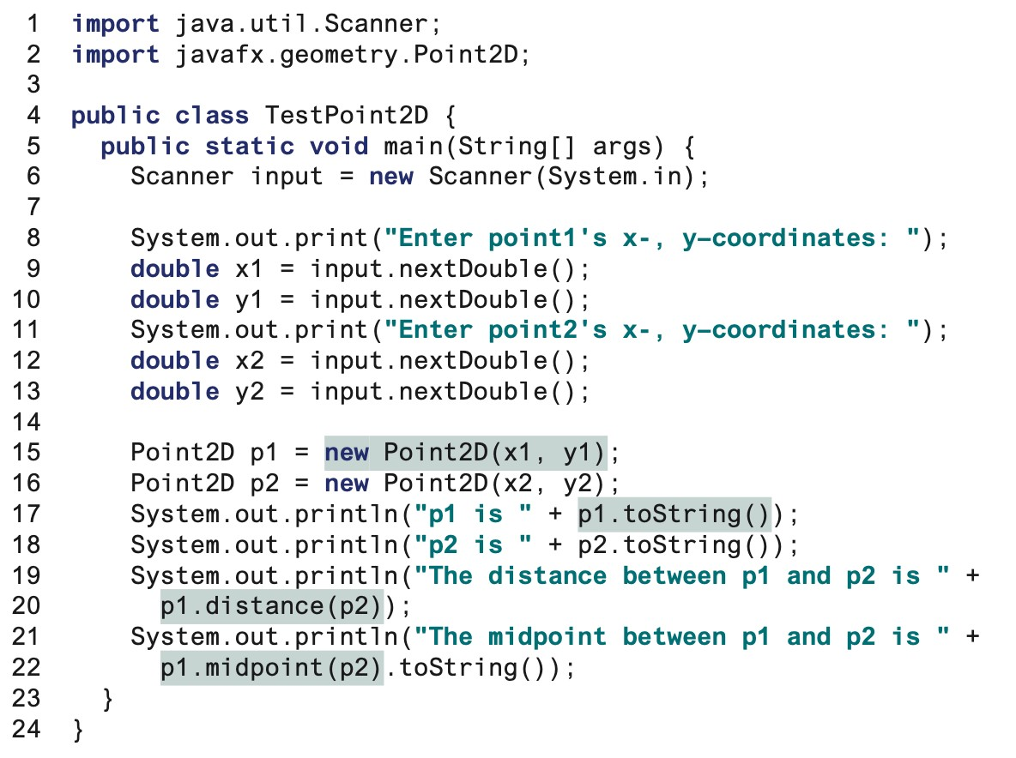
8.4. Using Classes from the Java Library

Slide 31
8.4. Static Variables, Constants, and Methods
Instance variables belong to a specific instance.
Instance methods are invoked by an instance of the class.
Static variables are shared by all the instances of the class.
Static methods are not tied to a specific object.
Static constants are final variables shared by all the instances of the class.
To declare static variables, constants, and methods, use the static modifier.

Slide 32
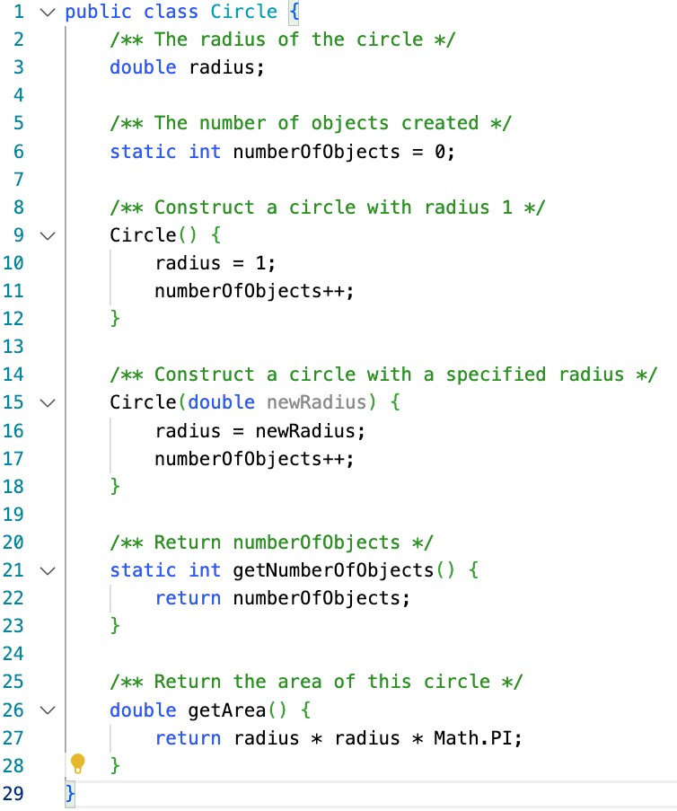
8.4. Static Variables, Constants, and Methods
getNumberofObject() and numberOfObjects a static method and static data, respectively.
They can be accessed from a reference variable or from their class name.
getArea() and radius are instance method
and instance data, respectively.
They can be accessed via reference variable.
C
S501 - L9 - Objects and Classes

Slide 33
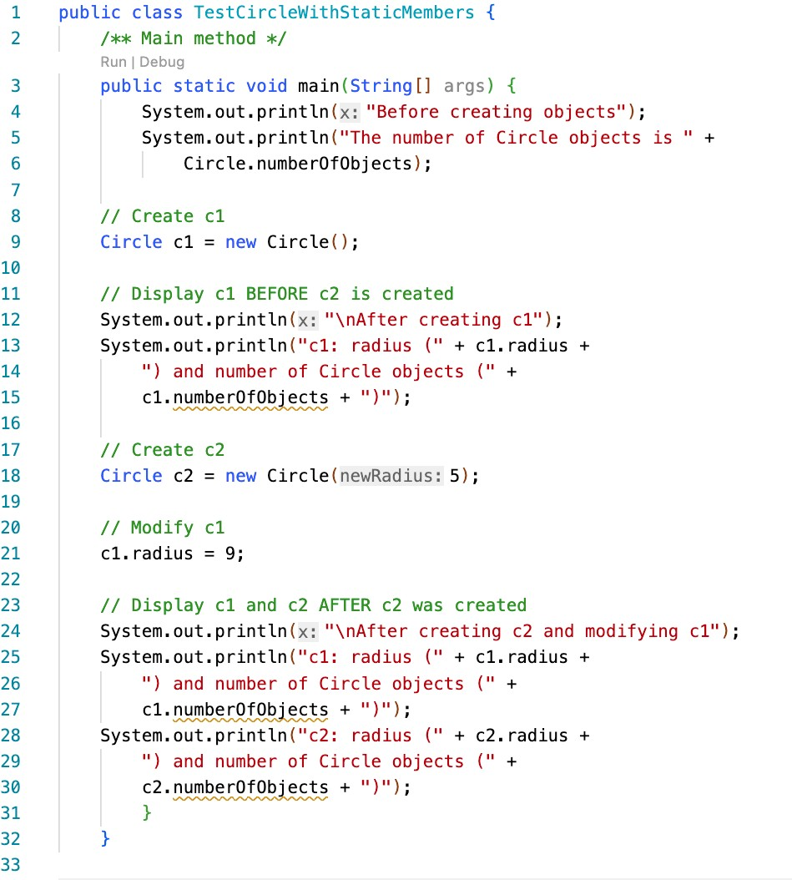
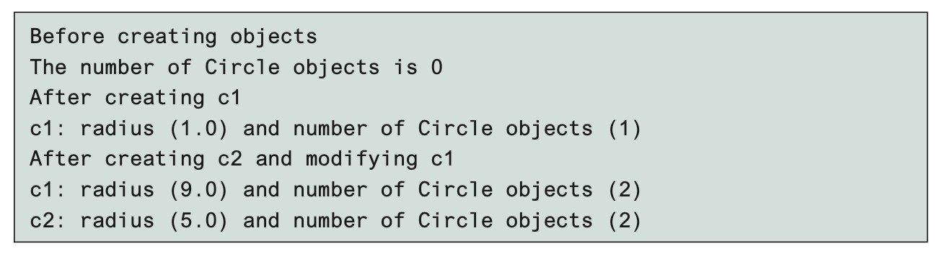
8.4. Static Variables, Constants, and Methods

Slide 34
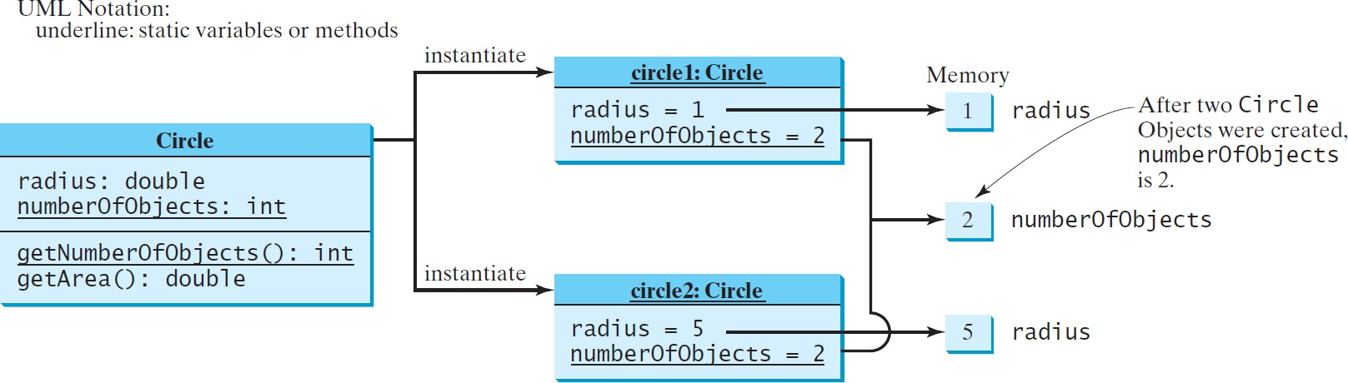
8.4. Static Variables, Constants, and Methods

Slide 35
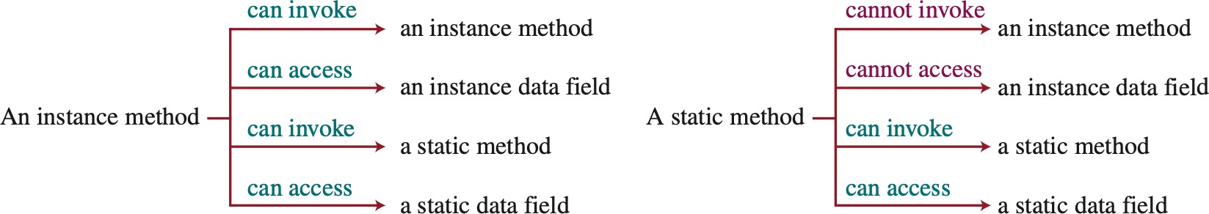
8.4. Static Variables, Constants, and Methods

Slide 36
8.4. Static Variables, Constants, and Methods
By default, the class, variable, or method can be accessed by any class in the same package.
0 public
The class, data, or method is visible to any class in any package.
0 private
The data or methods can be accessed only by the declaring class.
0 The get and set methods are used to read and modify private properties.

Slide 37
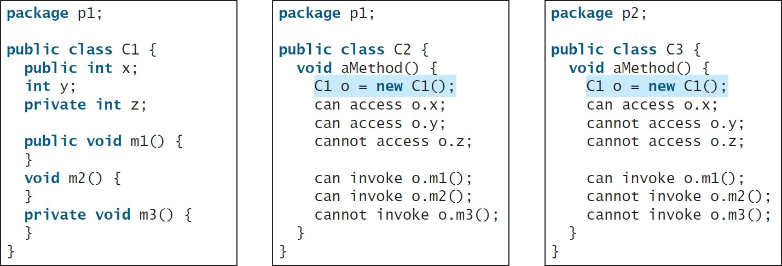
8.4. Static Variables, Constants, and Methods
The private modifier restricts access to within a class, the default modifier restricts access to within a package, and the public modifier enables unrestricted access.

Slide 38
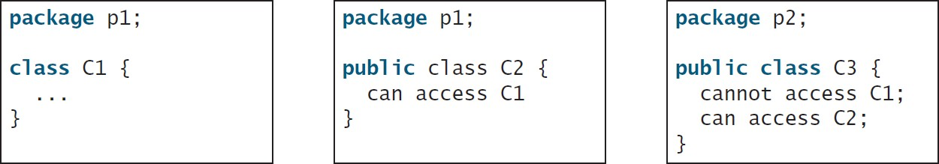
8.4. Static Variables, Constants, and Methods
The default modifier on a class restricts access to within a package, and the public modifier enables unrestricted access.

Slide 39
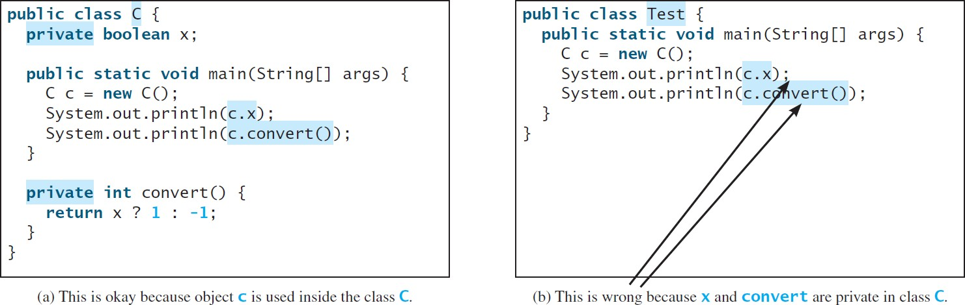
8.4. Static Variables, Constants, and Methods
An object cannot access its private members, as shown in (b). It is OK, however, if the object is declared in its own class, as shown in (a).

Slide 40
8.5. Data Field Encapsulation
To protect data.
To make code easy to maintain.
Consider doing
c1.radisu = 5;
Circle.numberOfObjects = 10;
Data may be tampered with. What if 10 is an arbitrary value? Not the exact count?
The class becomes difficult to maintain and vulnerable to bugs.
How would you modify the Circle class if other programs have already used the class?
Can you just change the Circle class?
Data Field Encapsulation: To prevent direct modification of data fields, the data fields should be declared using the private modifier.

Slide 41
8.5. Data Field Encapsulation
public class | Circle | {
/** The | radius | of | the | circle | */
private double radius = 1;
/** The number of objects created */ private static int numberOfObjects = 0;
/** Construct a circle with radius 1 */
Circle() {
radius = 1; numberOfObjects++;
}
/** Construct a circle with a specified radius */ Circle(double newRadius) {
radius = newRadius; numberOfObjects++;
}

Slide 42
8.5. Data Field Encapsulation
/** Return radius */ public double getRadius(){
return radius;
}
/** Set a new radius */
public void setRadius(double newRadius)
{
radius = (newRadius >= 0) ? newRadius : 0 ;
}
/** Return numberOfObjects */
public static int getNumberOfObjects()
{
return numberOfObjects;
}
/** Return the area of this circle */ public double getArea() {
return radius * radius * Math.PI;
}
}

Slide 43
8.5. Data Field Encapsulation
public class TestCircleWithPrivateDataFields {
/** Main method */
public static void main(String[] args) {
// Create a circl with radius 5.0 Circle myCircle = new Circle(5.0) ;
System.out.println("The area of the circle of radius"
+ + " is " + myCircle.getArea());
myCircle.getRadius()
//Increase myCircle's radius by 10% myCircle.setRadius(myCircle.getRadius() * 1.1); System.out.println("The area of the circle of radius"
+ + " is " + myCircle.getArea());
myCircle.getRadius()
System.out.println("The number of objects created is "
+ Circle.getNumberOfObjects());
}
}

Slide 44
8.5. Data Field Encapsulation
Circle
-radius: double -numberOfObjects: int
+Circle() +Circle(radius: double) +getRadius(): double +setRadius(radius: double): void +getNumberOfObjects(): int +getArea(): double
The - sign indicates private modifier
The radius of this circle (default: 1.0). The number of circle objects created.
Constructs a default circle object.
Constructs a circle object with the specified radius. Returns the radius of this circle.
Sets a new radius for this circle.
Returns the number of circle objects created. Returns the area of this circle.

Slide 45
8.5. Passing Objects to Methods
□Passing by value for primitive type value (the value is passed to the parameter)
□Passing by value for reference type value (the value is the reference to the object)

Slide 46
8.5. Passing Objects to Methods
public class TestPassObject {
/** Main method */
public static void main(String[] args) {
// Create a Circle object with radius 1 Circle myCircle = new Circle(1);
// Print areas for radius 1, 2, 3, 4, and 5. int n = 5;
printAreas(myCircle, n);
// See myCircle.radius and times
System.out.println("\n" + "Radius is " + myCircle.getRadius()); System.out.println("n is " + n);
}
/** Print a table of areas for radius */
public static void {
printAreas(Circle c, int times)
System.out.println("Radius \t\tArea"); while (times >= 1) {
System.out.println(c.getRadius() + "\t\t" + c.getArea());
c.setRadius(c.getRadius() + 1); times— —;
}
}
CS501 - L9 - Objects and Classes
46
}

Slide 47
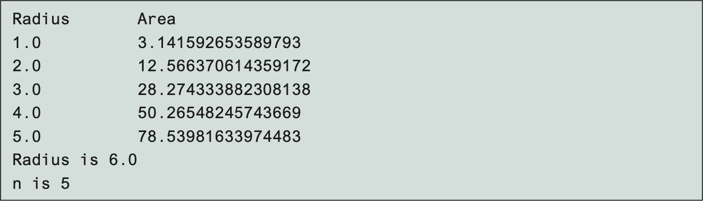
8.5. Passing Objects to Methods
public class Test {
public static void main(String[] args) { Circle myCircle = new Circle(5.0);
printCircle(myCircle);
}
public static void
printCircle(Circle c)
{
System.out.println("The area of the circle of radius"
+ + " is " + c.getArea());
c.getRadius()
}
}

Slide 48
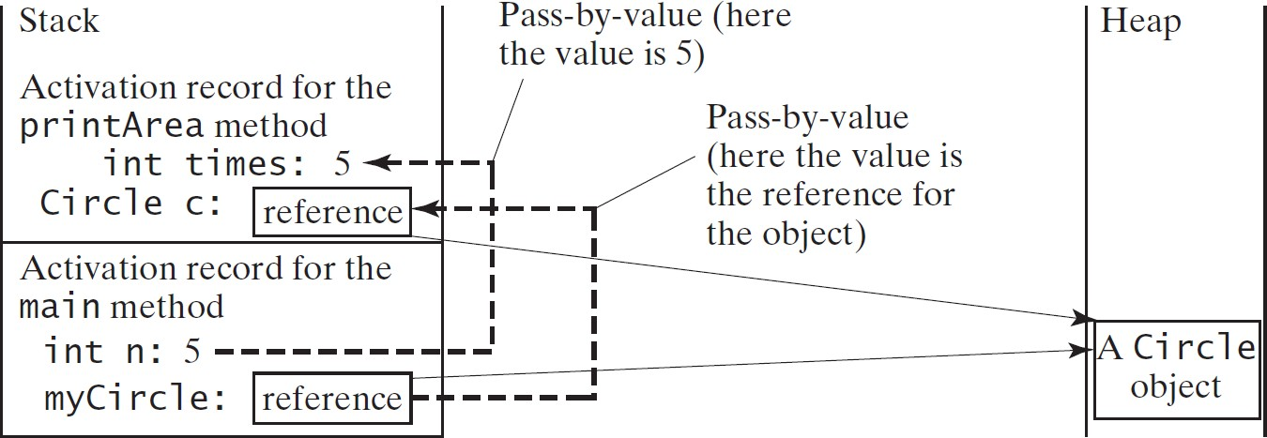
8.5. Data Field Encapsulation

Slide 49
8.6. Array of Objects
Circle[] circleArray = new Circle[10]
for (int i = 0; i < circleArray.length; i++) { circleArray[i] = new Circle();
}
An array of objects is actually an array of reference variables.
So invoking circleArray[1].getArea() involves two levels of referencing.
circleArray references to the entire array and circleArray[1] references to a Circle object.

Slide 50
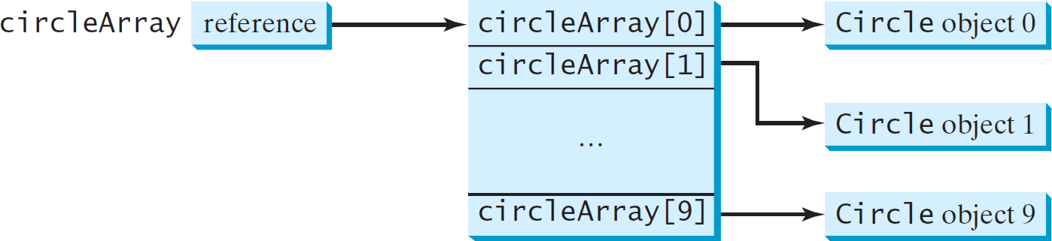
8.6. Array of Objects

Slide 51
8.6. Array of Objects
public class TotalArea {
public static void mina(String[] args){ Circle[] circleArray;
circleArray =
createCircleArray();
printCircleArray(circleArray);
}
public static Circle[]
createCircleArray()
{
Circle[] circleArray = new Circle[5];
for (int i=0; i<circleArray.length; i++) { circleArray[i] = new Circle(Math.random()*100);
}
return circleArray;
}
//** printCircleArray
//** sum
}

Slide 52
8.6. Array of Objects
public static void printCircleArray(Circle[] circleArray){ System.out.printf("%–30s%–15s\n", "Radius", "Area"); for (int i=0; i<circleArray.length; i++) {
System.out.printf("%–30f%–15f\n", circleArray[i].getRadius(), circleArray[i].getArea());
}
System.out.printf("%–30f%–15f\n", "The total area of circles is", sum(circleArray));
}
public static double sum(Circle[] circleArray){ double sum = 0;
for (int i=0; i<circleArray.length; i++) { sum += circleArray[i].getArea();
}
return
sum;
}

Slide 53
8.7. Immutable Objects and Classes
If the contents of an object cannot be changed once the object is created, the object is called an immutable object and its class is called an immutable class.
A class with all private data fields and without mutators is not necessarily immutable.
public class Student
{
private int id;
private BirthDate birthDate;
public Student(int ssn, int year, int month, int day) { id = ssn;
birthDate = new BirthDate(year, month, day);
}
public int getId() { return id;
}
public BirthDate getBirthDate() { return birthDate;
}
}
CS501 - L9 - Objects and Classes
53

Slide 54
8.7. Immutable Objects and Classes
public class BirthDate {
private int year;
private int month;
private int day;
public BirthDate(int newYear,int newMonth, int newDay) { year = newYear;
month = newMonth;
day = newDay;
}
public void setYear(int newYear) {
year = newYear;
}
}
public class Test {
public static void main(String[] args) {
Student student = new Student(111223333, 1970, 5, 3);
BirthDate date = student.getBirthDate();
date.setYear(2010); // Now the student birth year is changed!
}
}
54
CS501 - L9 - Objects and Classes

Slide 55
8.7. Immutable Objects and Classes
For a class to be immutable, it must meet the following requirements:
All data fields must be private.
There can’t be any mutator methods for data fields.
No accessor methods can return a reference to a data field that is mutable.

Slide 56
8.8. The Scope of Variables
The scope of instance and static variables is the entire class.
They can be declared anywhere inside a class.
The scope of a local variable starts from its declaration and continues to the end of the block that contains the variable.
A local variable must be initialized explicitly before it can be used.

Slide 57
8.9. The this Reference
The this keyword is the name of a reference that refers to an object itself. One common use of the this keyword is reference a class’s hidden data fields.
Another common use of the this keyword to enable a constructor to invoke another constructor of the same class.

Slide 58
8.9. The this Reference
public class F {
private int i = 5;
private static double k = 0;
void setI(int i) {
this.i = i;
}
static void setK(double k) {
F.k = k;
}
}
Suppose that f1 and f2 are two objects of F. F f1 = new F(); F f2 = new F();
Invoking f1.setI(10) is to execute
this.i = 10, where this refers f1
Invoking f2.setI(45) is to execute
this.i = 45, where this refers f2

Slide 59
8.9. The this Reference
public class Circle { private double radius;
public Circle(double radius) { this.radius = radius;
}
public Circle() { this(1.0);
}
Must be explicitly used to reference the data field radius of the object being constructed
Used to invoke another constructor
public double getArea() {
return this.radius * this.radius * Math.PI;
}
}

