Slide 1

CS 501 – Introduction to JAVA Programing
Lecture 9 – Objects and Classes Lecture 10 – Thinking in Objects

Slide 2
9.1. Class Abstraction and Encapsulation
Class abstraction: to separate class implementation from the use of the class. The creator of the class provides a description of the class and let the user know how the class can be used.
The user of the class does not need to know how the class is implemented. The detail of implementation is encapsulated and hidden from the user.
Class implementation is like a black box hidden from the clients
Class
Class Contract (Signatures of public methods and public constants)
Clients use the class through the contract of the class

Slide 3
9.2. Object-Oriented Thinking
Topics discussed so far lay a solid foundation for object-oriented programming.
Classes provide more flexibility and modularity for building reusable software.
Object-Oriented thinking allows us to gain the insight on the differences between the procedural programming and object-oriented programming and see the benefits of developing reusable code using objects and classes.

Slide 4
9.2. Object-Oriented Thinking
The get methods for these data fields are provided in the class, but omitted in the UML diagram for brevity.
The name of the person. The age of the person.
The weight of the person in pounds. The height of the person in inches.
Creates a BMI object with the specified name, age, weight, and height.
Creates a BMI object with the specified name, weight, height, and a default age 20.
Returns the BMI
Returns the BMI status (e.g., normal, overweight, etc.)
BMI
-name: String
-age: int
-weight: double
-height: double
+BMI(name: String, age: int, weight: double, height: double)
+BMI(name: String, weight: double, height: double)
+getBMI(): double
+getStatus(): String

Slide 5
9.2. Object-Oriented Thinking
public class UseBMIClass {
public static void main(String[] args) {
BMI bmi1 = new BMI("Kim Yang", 18, 145, 70);
System.out.println("The BMI for " + bmi1.getName() + " is "
+ + " " +
bmi1.getBMI()
bmi1.getStatus());
BMI bmi2 = new BMI("Susan King", 215, 70);
System.out.println("The BMI for " + bmi2.getName() + " is "
+ + " " + bmi2.getStatus());}
bmi2.getBMI()
}

Slide 6
9.2. Object-Oriented Thinking
public class BMI { private String name; private int age;
private double weight; // in pounds private double height; // in inches
public static final double KILOGRAMS_PER_POUND = 0.45359237; public static final double METERS_PER_INCH = 0.0254;
public BMI(String name, int age, double weight, double height) { this.name = name; this.age = age;
this.weight = weight; this.height = height;
}
public BMI(String name, double weight, double height) { this(name, 20, weight, height);}

Slide 7
9.2. Object-Oriented Thinking
public double getBMI(){
double bmi = weight * KILOGRAMS_PER_POUND /
((height * METERS_PER_INCH) * (height * METERS_PER_INCH));
return Math.round(bmi * 100) / 100.0; }
public String getStatus()
{ double bmi = getBMI();
if (bmi < 18.5)
return "Underweight"; else if (bmi < 25) return "Normal"; else if (bmi < 30) return "Overweight"; else
return "Obese";}
public String getName() { return name; }
public int getAge() { return age; }
public double getWeight() { return weight; }
public double getHeight() { return height;}
}

Slide 8

9.3. Class Relationships
Association: is a general binary relationship that describes an activity between two classes. (usually a binary relationship)
Composition (Aggregation): is a relationship is usually represented as a data field in the aggregating class.
public class Name {
...
}
public class Student { private Name name; private Address address;
...
}
public class Address {
...
}
Aggregated class
Aggregating class
Aggregated class

Slide 9
9.3. Class Relationships
Aggregation models has-a relationships and represents an ownership relationship between two objects.
The owner object is called an aggregating object and its class an aggregating class.
The subject object is called an aggregated object and its class an aggregated class.
Composition is when the aggregated object is dependent of aggregating object.
Sometimes, aggregation may exist between objects of the same class.
Composition
Aggre gation
1
1
1..3
1
Name
Student
Address

Slide 10
9.3. Class Relationships
public class Person {
// The type for the data is the class itself private Person supervisor;
...
}
1
Person
Supervisor
1

Slide 11
9.3. Class Relationships
Course
-courseName: String -students: String[] -numberOfStudents: int
+Course(courseName: String) +getCourseName(): String +addStudent(student: String): void +dropStudent(student: String): void +getStudents(): String[] +getNumberOfStudents(): int
The name of the course.
An array to store the students for the course. The number of student s (default : 0).
Creates a course with the specifi ed name. Returns the course name.
Ad ds a new student to the course. Drops a student from the course.
Returns the student s in the course.
Returns the number of students in the course.

Slide 12
9.3. Class Relationships
public class Course { private String courseName;
private String[] students = new String[100]; private int numberOfStudents;
public Course(String courseName) { this.courseName = courseName;}
public void addStudent(String student) { students[numberOfStudents] = student;
numberOfStudents++;}
public String[] getStudents() { return students;}
public int getNumberOfStudents() { return numberOfStudents;} public String getCourseName() { return courseName; }
public void dropStudent(String student) {
// Complete the Course
}
}

Slide 13
9.3. Class Relationships
public class TestCourse {
public static void main(String[] args) {
Course course1 = new Course("Data Structures"); Course course2 = new Course("Database Systems");
course1.addStudent("Peter Jones"); course1.addStudent("Kim Smith"); course1.addStudent("Anne Kennedy");
course2.addStudent("Peter Jones"); course2.addStudent("Steve Smith"); System.out.println("Number of students in course1: ” +
course1.getNumberOfStudents()); String[] students = course1.getStudents();
for (int i = 0; i < course1.getNumberOfStudents(); i++) { System.out.print(students[i] + ", ");
}
System.out.println();
System.out.print("Number of students in course2: " + course2.getNumberOfStudents());
}
}

Slide 14
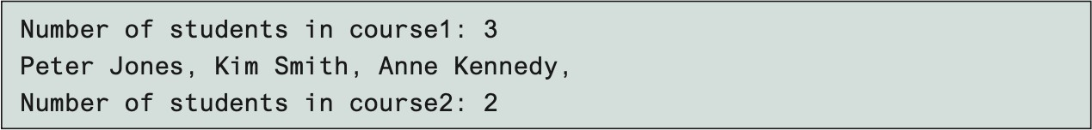
9.3. Class Relationships

Slide 15
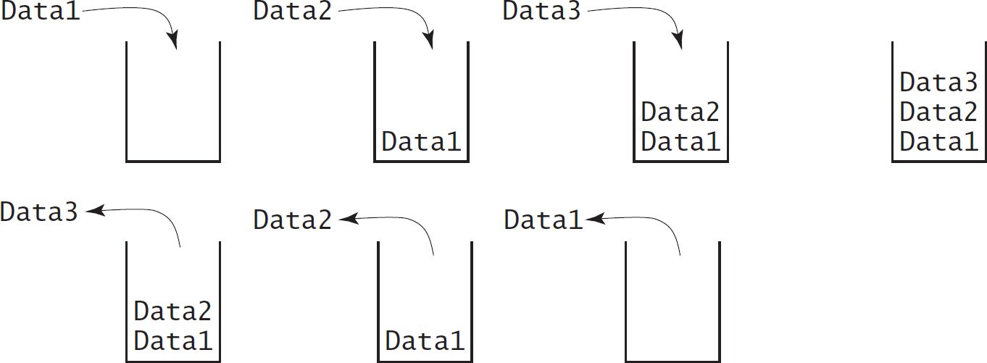
9.4. Case Study: Designing a Class for Stacks

Slide 16
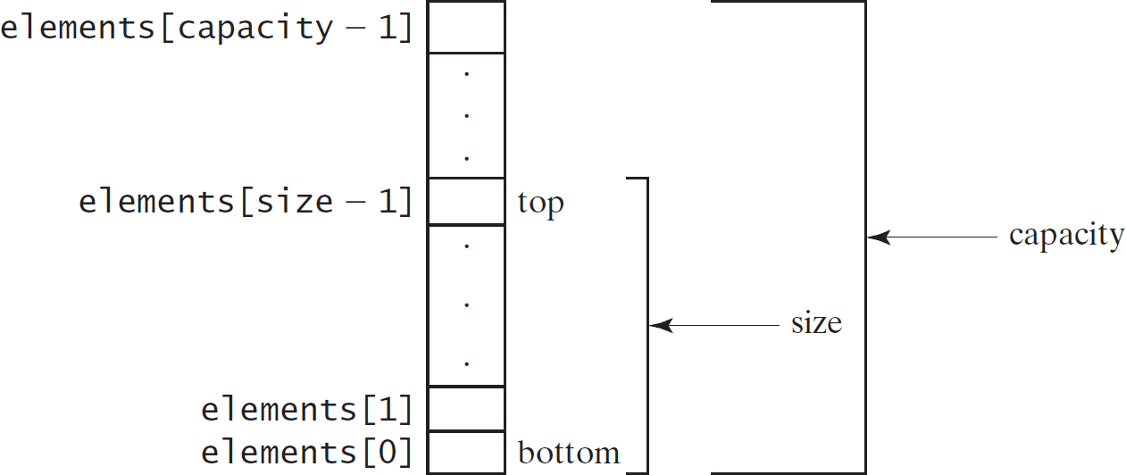
9.4. Case Study: Designing a Class for Stacks

Slide 17
9.4. Case Study: Designing a Class for Stacks
StackOfIntegers
-elements: int[]
-size: int
An array to store integers in the stack. The number of integers in the stack.
Constructs an empty stack with a default capacity of 16. Constructs an empty stack with a specified capacity.
Returns true if the stack is empty.
Returns the integer at the top of the stack without removing it from the stack.
Stores an integer into the top of the stack.
Removes the integer at the top of the stack and returns it. Returns the number of elements in the stack.
+StackOfIntegers()
+StackOfIntegers(capacity: int)
+empty(): boolean
+peek(): int
+push(value: int): int
+pop(): int
+getSize(): int

Slide 18
9.4. Case Study: Designing a Class for Stacks
public class StackOfIntegers { private int[] elements; private int size;
public static final int DEFAULT_CAPACITY = 16; public StackOfIntegers() { this(DEFAULT_CAPACITY); }
public StackOfIntegers(int capacity) { elements = new int[capacity];}
public void push(int value) {
if (size >= elements.length) {
int[] temp = new int[elements.length * 2]; System.arraycopy(elements, 0, temp, 0, elements.length); elements = temp;
}
elements[size++] = value;
}
public int pop() { return elements[--size]; }
public int peek() {return elements[size-1]; } public boolean empty() { return size == 0; } public int getSize() { return size; }
}

Slide 19
9.4. Case Study: Designing a Class for Stacks
public class TestStackOfInteger {
public static void main(String[] args) { StackOfIntegers stack = new StackOfIntegers(); for (int i = 0; i < 10; i++)
stack.push(i); while (!stack.empty())
System.out.print(stack.pop()+ " ");
}
}

Slide 20
9.5. Processing Primitive Data Type Values as Objects
□Boolean
□Character
□Short
□Byte
 Integer
 Long
 Float
 Double
NOTE: (1) The wrapper classes do not have no-arg constructors. (2) The instances of all wrapper classes are immutable, i.e., their internal values cannot be changed once the objects are created.

Slide 21
9.5. Processing Primitive Data Type Values as Objects
The Integer and Double Classes
java.lang.Integer
-value: int +MAX_VALUE: int +MIN_VALUE: int
+Integer(value: int) +Integer(s: String) +byteValue(): byte +shortValue(): short +intValue(): int +longVlaue(): long +floatValue(): float +doubleValue():double +compareTo(o: Integer): int +toString(): String +valueOf(s: String): Integer +valueOf(s: String, radix: int): Integer +parseInt(s: String): int +parseInt(s: String, radix: int): int
java.lang.Double
-value: double +MAX_VALUE: double +MIN_VALUE: double
+Double(value: double) +Double(s: String) +byteValue(): byte +shortValue(): short +intValue(): int +longVlaue(): long +floatValue(): float +doubleValue():double +compareTo(o: Double): int +toString(): String +valueOf(s: String): Double +valueOf(s: String, radix: int): Double +parseDouble(s: String): double +parseDouble(s: String, radix: int): double

Slide 22
9.5. Processing Primitive Data Type Values as Objects
Numeric Wrapper Class Constructors
The constructors for Integer and Double are: public Integer(int value) public Integer(String s) public Double(double value)
public Double(String s)

Slide 23
9.5. Processing Primitive Data Type Values as Objects
Numeric Wrapper Class Constants
Each numerical wrapper class has the constants MAX_VALUE and MIN_VALUE. MAX_VALUE represents the maximum value of the corresponding primitive data type.
For Byte, Short, Integer, and Long, MIN_VALUE represents the minimum byte, short, int, and long values.
For Float and Double, MIN_VALUE represents the minimum positive float and double values.
The following statements display
the maximum integer (2,147,483,647)
the minimum positive float (1.4E-45)
the maximum double floating-point number (1.79769313486231570e+308d).

Slide 24
9.5. Processing Primitive Data Type Values as Objects
Conversion Methods
Each numeric wrapper class implements the abstract methods doubleValue, floatValue, intValue, longValue, and shortValue, which are defined in the Number class.
These methods “convert” objects into primitive type values.

Slide 25
9.5. Processing Primitive Data Type Values as Objects
The Static valueOf Methods
The numeric wrapper classes have a useful class method, valueOf(String s).
This method creates a new object initialized to the value represented by the specified string. For example:
Double doubleObject = Double.valueOf("12.4"); Integer integerObject = Integer.valueOf("12");

Slide 26
9.5. Processing Primitive Data Type Values as Objects
The Methods for Parsing Strings into Numbers
The parseInt method: to parse a numeric string into an int value in the Integer class.
The parseDouble method: to parse a numeric string into a double value in the Double class.
Each numeric wrapper class has two overloaded parsing methods to parse a numeric string into an appropriate numeric value based on 10 or any specified radix (e.g., 2, 8, 16).

Slide 27
9.6. Automatic Conversion Between Primitive Types and Wrapper Class Types
Integer[] intArray = {new Integer(2), new Integer(4), new Integer(3)};
Equivalent
Integer[] intArray = {2, 4, 3};
(a)
New JDK 1.5 boxing
(b)
Integer[] intArray = {1, 2, 3}; System.out.println(intArray[0] + intArray[1] + intArray[2]);
Unboxing

Slide 28
9.7. BigInteger and BigDecimal
For very large integers or high precision floating-point values in computation, use the BigInteger and BigDecimal classes in the java.math package.
Both are immutable.
Both extend the Number class and implement the Comparable interface.

Slide 29
9.7. BigInteger and BigDecimal
BigInteger | a | = | new BigInteger("9223372036854775807");
BigInteger | b | = | new BigInteger("2");
BigInteger | c | = | a.multiply(b); System.out.println(c);

Slide 30
The String Class
□Constructing a String:
String message = "Welcome to Java“;
String message = new String("Welcome to Java“);
String s = new String();
□Obtaining String length and Retrieving Individual Characters in a string
□String Concatenation (concat)
□Substrings (substring(index), substring(start, end))
□Comparisons (equals, compareTo)
□String Conversions
□Finding a Character or a Substring in a String
□Conversions between Strings and Arrays
□Converting Characters and Numeric Values to Strings

Slide 31
9.7. The String Class
Constructing Strings
String newString = new String(stringLiteral); String message = new String("Welcome to Java");
Since strings are used frequently, Java provides a shorthand initializer for creating a string:
String message = "Welcome to Java";

Slide 32
9.7. The String Class
Strings Are Immutable
A String object is immutable; its contents cannot be changed. Does the following code change the contents of the string?
String s = "Java"; s = "HTML";

Slide 33
9.7. The String Class
After executing String s = "Java";
After executing s = "HTML";
s
: String
s
: String
This string object is now unreferenced
String object for "Java"
String object for "Java"
Contents cannot be changed
: String
String object for "HTML"

Slide 34
9.7. The String Class
Interned Strings
Since strings are immutable and are frequently used, to improve efficiency and save memory, the JVM uses a unique instance for string literals with the same character sequence.
Such an instance is called interned.
For example, the following statements:

Slide 35
9.7. The String Class
s1 s3
String s1 = "Welcome to Java";
: String
String s2 = new String("Welcome to Java");
Interned string object for "Welcome to Java"
String s3 = "Welcome to Java";
System.out.println("s1 | == | s2 | is | " | + | (s1 | == | s2));
System.out.println("s1 | == | s3 | is | " | + | (s1 | == | s3));
s2
: String
A string object for "Welcome to Java"
display
s1 == s is false s1 == s3 is true
A new object is created if you use the new operator.
If you use the string initializer, no new object is created if the interned object is already created.

Slide 36
9.7. The String Class
Replacing and Splitting Strings
java.lang.String
+replace(oldChar: char, newChar: char): String
+replaceFirst(oldString: String, newString: String): String
+replaceAll(oldString: String, newString: String): String
+split(delimiter: String): String[]
Returns a new string that replaces all matching character in this string with the new character.
Returns a new string that replaces the first matching substring in this string with the new substring.
Returns a new string that replace all matching substrings in this string with the new substring.
Returns an array of strings consisting of the substrings split by the delimiter.

Slide 37
9.7. The String Class
"Welcome".replace('e', 'A') returns a new string, WAlcomA. "Welcome".replaceFirst("e", "AB") returns a new string, WABlcome. "Welcome".replace("e", "AB") returns a new string, WABlcomAB. "Welcome".replace("el", "AB") returns a new string, WABcome.

Slide 38
9.7. The String Class
Splitting a String
String[] tokens = "Java#HTML#Perl".split("#", 0); for (int i = 0; i < tokens.length; i++)
System.out.print(tokens[i] + " ");

Slide 39
9.7. The String Class
Matching, Replacing and Splitting by Patterns
We can match, replace, or split a string by specifying a pattern.
This is an extremely useful and powerful feature, commonly known as regular expression.
"Java".matches("Java");
"Java".equals("Java");
"Java is fun".matches("Java.*"); "Java is cool".matches("Java.*");

Slide 40
9.7. The String Class
Matching, Replacing and Splitting by Patterns
The replaceAll, replaceFirst, and split methods can be used with a regular expression.
For example, the following statement returns a new string that replaces $, +, or # in "a+b$#c" by the string NNN.
String s = "a+b$#c".replaceAll("[$+#]", "NNN"); System.out.println(s);
Here the regular expression [$+#] specifies a pattern that matches $, +, or #. So, the output is aNNNbNNNNNNc.

Slide 41
9.7. The String Class
Matching, Replacing and Splitting by Patterns
The following statement splits the string into an array of strings delimited by some punctuation marks.
String[] tokens = "Java,C?C#,C++".split("[.,:;?]");
for (int i = 0; i < tokens.length; i++) System.out.println(tokens[i]);

Slide 42
9.7. The String Class
Convert Character and Numbers to Strings
The String class provides several static valueOf methods for converting a character, an array of characters, and numeric values to strings.
These methods have the same name valueOf with different argument types char, char[], double, long, int, and float.
For example, to convert a double value to a string, use
String.valueOf(5.44).
The return value is string consists of characters ‘5’, ‘.’, ‘4’, and ‘4’.

Slide 43
9.7. The String Class
StringBuilder and StringBuffer
The StringBuilder/StringBuffer class is an alternative to the String class.
In general, a StringBuilder/StringBuffer can be used wherever a string is used.
StringBuilder/StringBuffer is more flexible than String.
We can add, insert, or append new contents into a string buffer, whereas the value of a String object is fixed once the string is created.

Slide 44
9.7. The String Class
Constructs an empty string builder with capacity 16. Constructs a string builder with the specified capacity. Constructs a string builder with the specified string.
StringBuilder Constructors
java.lang.StringBuilder
+StringBuilder()
+StringBuilder(capacity: int)
+StringBuilder(s: String)

Slide 45
9.7. The String Class
Modifying Strings in the Builder
java.lang.StringBuilder
+append(data: char[]): StringBuilder
+append(data: char[], offset: int, len: int): StringBuilder
+append(v: aPrimitiveType): StringBuilder
+append(s: String): StringBuilder
+delete(startIndex: int, endIndex: int): StringBuilder
+deleteCharAt(index: int): StringBuilder
+insert(index: int, data: char[], offset: int, len: int): StringBuilder
+insert(offset: int, data: char[]): StringBuilder
+insert(offset: int, b: aPrimitiveType): StringBuilder
+insert(offset: int, s: String): StringBuilder
+replace(startIndex: int, endIndex: int, s: String): StringBuilder
+reverse(): StringBuilder
+setCharAt(index: int, ch: char): void
Appends a char array into this string builder. Appends a subarray in data into this string builder.
Appends a primitive type value as a string to this builder.
Appends a string to this string builder.
Deletes characters from startIndex to endIndex.
Deletes a character at the specified index.
Inserts a subarray of the data in the array to the builder at the specified index.
Inserts data into this builder at the position offset.
Inserts a value converted to a string into this builder.
Inserts a string into this builder at the position offset.
Replaces the characters in this builder from startIndex to endIndex with the specified string.
Reverses the characters in the builder.
Sets a new character at the specified index in this builder.

Slide 46
9.7. The String Class
StringBuilder stringBuilder = new StringBuilder(); stringBuilder.append("Welcome"); stringBuilder.append(' '); stringBuilder.append("to"); stringBuilder.append(' '); stringBuilder.append("Java");

Slide 47
9.7. The String Class
stringBuilder.delete(8, 11) changes the builder to Welcome Java. stringBuilder.deleteCharAt(8) changes the builder to Welcome o Java. stringBuilder.reverse() changes the builder to avaJ ot emocleW. stringBuilder.replace(11, 15, "HTML") changes the builder to Welcome to HTML. stringBuilder.setCharAt(0, 'w') sets the builder to welcome to Java.

Slide 48
9.7. The String Class
The toString, capacity, length, setLength, and charAt Methods
java.lang.StringBuilder
+toString(): String
+capacity(): int
+charAt(index: int): char
+length(): int
+setLength(newLength: int): void
+substring(startIndex: int): String
+substring(startIndex: int, endIndex: int): String
+trimToSize(): void
Returns a string object from the string builder. Returns the capacity of this string builder.
Returns the character at the specified index. Returns the number of characters in this builder. Sets a new length in this builder.
Returns a substring starting at startIndex.
Returns a substring from startIndex to endIndex-1.
Reduces the storage size used for the string builder.

