Slide 1

CS 501- Introduction to JAVA Programming
Lecture 11 - Exception Handling and Text I/O

Slide 2

Motivations
When a program runs into a runtime error, the program terminates abnormally.
How can you handle the runtime error so that the program can continue to run or terminate gracefully?

Slide 3
Exception-Handling Overview
import java.util.*;
public class Quotient {
public static void main(String[] arg) { Scanner input = new Scanner(System.in);
System.out.print("Enter two integers: "); int number1 = input.nextInt();
int number2 = input.nextInt();
System.out.println(number1 + " / " + number2 + " is " + (number1 / number2));
}
}

Slide 4
Exception-Handling Overview
Fix it using an if statement
import java.util.*;
public class QuotientWithIf {
public static void main(String[] arg) {
…
// if statement
}
}

Slide 5
Exception-Handling Overview
public static void main(String[] arg) {
…
// if statement
if (number2 !=0){
System.out.println(number1 + " / " + number2 + " is " + (number1 / number2));
}
else
System.out.println("Divisor cannot be zero");
}

Slide 6
Exception-Handling Overview
With a method
import java.util.*;
public class QuotientWithMethod {
public static int quotient(int number1, int number2)
{
…
return number1/number2;
}
public static void main(String[] arg) {
…
int result = quotient(number1, number2); System.out.println(number1 + " / " + number2 +
" is " + result);
}
}

Slide 7
Exception-Handling Overview
public static int quotient(int number1, int number2) {
if (number2 == 0)
{
System.out.println("Divisor cannot be zero");
System.exit(1);
}
return number1/number2;
}

Slide 8
Exception Types
ClassNotFoundException
ArithmeticException
IOException
Exception
NullPointerException
RuntimeException
IndexOutOfBoundsException
Many more classes
Object
Throwable
IllegalArgumentException
Many more classes
LinkageError
Error
VirtualMachineError
Many more classes

Slide 9
System Errors
ClassNotFoundException
ArithmeticException
IOException
Exception
NullPointerException
RuntimeException
IndexOutOfBoundsException
Many more classes
Object
Throwable
IllegalArgumentException
Many more classes
LinkageError
Error
VirtualMachineError
Many more classes

Slide 10
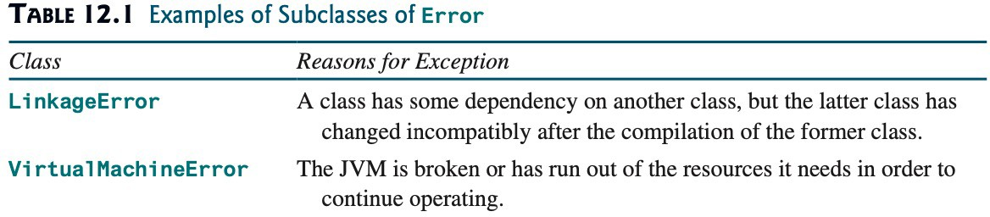
System Errors

Slide 11
Exceptions
ClassNotFoundException
ArithmeticException
IOException
Exception
NullPointerException
RuntimeException
IndexOutOfBoundsException
Many more classes
Object
Throwable
IllegalArgumentException
Many more classes
LinkageError
Error
VirtualMachineError
Many more classes
11
11

Slide 12
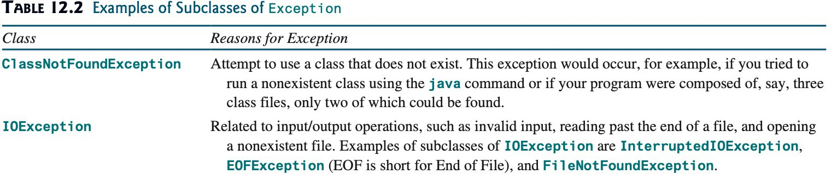
Exceptions

Slide 13
Runtime Exceptions
ClassNotFoundException
ArithmeticException
IOException
Exception
NullPointerException
RuntimeException
IndexOutOfBoundsException
Many more classes
Object
Throwable
IllegalArgumentException
Many more classes
LinkageError
Error
VirtualMachineError
Many more classes

Slide 14
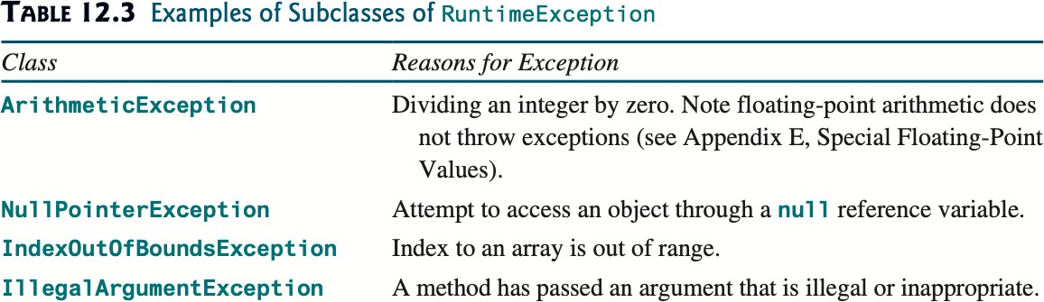
Runtime Exceptions

Slide 15
Checked Exceptions vs. Unchecked Exceptions
RuntimeException, Error and their subclasses are known as unchecked exceptions.
All other exceptions are known as checked exceptions.
□ The compiler forces the programmer to check and deal with the exceptions.

Slide 16
Unchecked Exceptions
Unchecked exceptions can occur anywhere in the program.
In most cases, unchecked exceptions reflect programming logic errors that are not recoverable.
a NullPointerException is thrown an object is accessed through a referenced variable before it is assigned to.
an IndexOutOfBoundsException is thrown if an element in array outside the bounds of the array is accessed.
To avoid cumbersome overuse of try-catch blocks, Java does not mandate you to write code to catch unchecked exceptions.

Slide 17
Unchecked Exceptions
ClassNotFoundException
ArithmeticException
IOException
Exception
NullPointerException
RuntimeException
IndexOutOfBoundsException
Many more classes
Object
Throwable
IllegalArgumentException
Many more classes
LinkageError
Error
VirtualMachineError
Many more classes

Slide 18


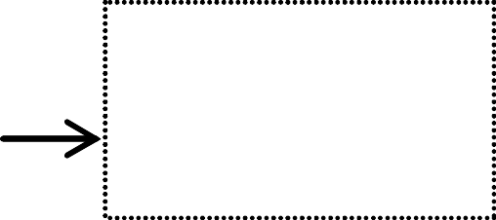



Declaring, Throwing, and Catching Exceptions
A handler for an exception is found by propagating the exception backward through a chain of method calls, starting from the current method.
method1() {
declare exception
method2() throws Exception {
try {
invoke method2;
}
catch (Exception ex) { Process exception;
}
if (an error occurs) {
catch exception
throw new Exception();
throw exception
}
}
}

Slide 19
Declaring Exceptions
declaring exceptions: Every method must state the types of checked exceptions it might throw.
public void myMethod()
throws IOException
public void myMethod()
throws IOException, OtherException

Slide 20
Throwing Exceptions
throwing an exception: When the program detects an error, the program can create an instance of an appropriate exception type and throw it.
throw new TheException();
TheException ex = new TheException(); throw ex;

Slide 21


Throwing Exceptions Example
/** Set a new radius */
public void setRadius(double newRadius) throws IllegalArgumentException {
if (newRadius >= 0) radius = newRadius; else
throw new IllegalArgumentException(
"Radius cannot be negative");
}

Slide 22
Catching Exceptions
try {
statements; // Statements that may throw exceptions
}
catch (Exception1 exVar1) { handler for exception1;
}
catch (Exception2 exVar2) { handler for exception2;
}
...
catch (ExceptionN exVar3) { handler for exceptionN;
}

Slide 23
Catching Exceptions
main method {
...
try {
...
invoke method1; statement1;
}
catch (Exception1 ex1) { Process ex1;
}
statement2;
}
method1 {
...
try {
...
invoke method2; statement3;
}
catch (Exception2 ex2) { Process ex2;
}
statement4;
}
method2 {
...
try {
...
invoke method3; statement5;
}
catch (Exception3 ex3) { Process ex3;
}
statement6;
}
An exception is thrown in method3
Call Stack
method3
method2 method1 main method
method2
method1 main method
method1
main method
main method

Slide 24
Catch or Declare Checked Exceptions
Suppose p2 is defined as follows:
void p2() throws IOException {
if (a file does not exist) {
throw new IOException("File does not exist");
}
...
}

Slide 25
Catch or Declare Checked Exceptions
Java forces to deal with checked exceptions.
If a method declares a checked exception (i.e., an exception other than Error or RuntimeException), you must invoke it in a try- catch block or declare to throw the exception in the calling method.
void p1() {
try {
p2();
}
catch (IOException ex) {
...
}
}
void p1() throws IOException {
p2();
}
(a)
25
(b)

Slide 26
Exception Advantages
Using the exception handling, enables a method to throw an exception to its caller.
Without this capability, a method must handle the exception or terminate the program.

Slide 27
Exception Advantages
import java.util.Scanner;
public class QuotientWithException {
//quotient method using throw
public static int quotient(int number1, int number2) {
…
public static void main(String[] arg) {
...
//try block
//catch block
System.out.println("Execution continues ...");
}
}

Slide 28
Exception Advantages
public static int quotient(int number1, int number2) { if (number2 == 0){
throw new ArithmeticException("Divisor cannot be zero");
}
return number1/number2;
}
public static void main(String[] arg) {
//try block
try {
int result = quotient(number1, number2); System.out.println(number1 + " / " + number2 + " is " + result);
}
//catch block
catch (ArithmeticException ex){
System.out.println("Exception: an integer " + "cannot be divided by zero ");
}

Slide 29
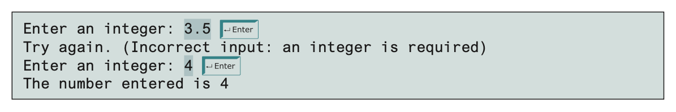
Handling InputMismatchException
By handling InputMismatchException, your program will continuously read an input until it is correct.
import java.util.*;
public class InputMismatchExceptionDemo { public static void main(String[] args) {
Scanner input = new Scanner(System.in); boolean continueInput = true;
do {
//try block
//Display the result
//catch block
} while (continueInput);
}
}
29

Slide 30
Handling InputMismatchException
//try block
try {
System.out.print("Enter an integer: "); int number = input.nextInt();
//Display the result
System.out.println("The number entered is " + number); continueInput = false;
}
//catch block
catch (InputMismatchException ex){
System.out.println("Try again. (" +
"Incorrect input: an integer is required)"); input.nextLine();
}
}
30

Slide 31
Example: Declaring, Throwing, and Catching Exceptions
Objective: Modify the Circle class that demonstrates declaring, throwing, and catching exceptions. The new setRadius method throws an exception if radius is negative.
public class TestCircleWithException { public static void main(String[] args) {
try
{
CircleWithException c1 = new CircleWithException(5); CircleWithException c2 = new CircleWithException(5); CircleWithException c3 = new CircleWithException(0); }
catch (IllegalArgumentException ex)
{
System.out.println(ex); } System.out.println("Number of objects created: " +
CircleWithException.getNumberOfObjects());
}
}
31

Slide 32
public class CircleWithException { private double radius;
private static int numberOfObjects = 0;
//Construct a circle with radius 1 public CircleWithException() {
this(1.0); }
//construct a circle with a specified radius public CircleWithException(double newRadius) {
setRadius(newRadius); numberOfObjects++; }
//Return radius
public double getRadius(){ return radius; }
//set new radius
…
}

Slide 33
public void setRadius(double newRadius)
throws IllegalArgumentException
{
if (newRadius >= 0) radius = newRadius;
else
throw new IllegalArgumentException( "Radius cannot be negative");}
//Return numberOfObjects
public static int getNumberOfObjects() { return numberOfObjects;
}
//Return the area of this circle public double findArea() {
return Math.pow(radius,2) * Math.PI; }
}

Slide 34
Rethrowing Exceptions
Java allows an exception handler to rethrow the exception if the handler cannot process the exception (or simply wants to let its caller be notified of the exception)
try {
// statements
}
catch(TheException ex) {
// handling statements before rethrowing throw ex;
}

Slide 35
The finally Clause
The finally clause is always executed regardless of whether an exception occurred or not.
try {
//statements;
}
catch(TheException ex) {
//handling ex;
}
finally {
//finalStatements;
}

Slide 36
The finally Clause
try {
statements;
}
catch(TheException ex) { handling ex;
}
finally { finalStatements;
}
Next statement;

Slide 37
Trace a Program Execution
Suppose no exceptions in the statements
try {
statements;
}
catch(TheException ex) { handling ex;
}
finally { finalStatements;
}
Next statement;

Slide 38
Trace a Program Execution
The final block is always executed
try {
statements;
}
catch(TheException ex) { handling ex;
}
finally {
finalStatements;
}
Next statement;

Slide 39
Trace a Program Execution
Next statement in the method is executed
try {
statements;
}
catch(TheException ex) { handling ex;
}
finally { finalStatements;
}
Next statement;

Slide 40
Trace a Program Execution
try {
statement1;
statement2; statement3;
}
catch(Exception1 ex) { handling ex;
}
finally { finalStatements;
}
Next statement;
Suppose an exception of type Exception1 is thrown in statement2

Slide 41
Trace a Program Execution
try {
statement1;
statement2; statement3;
}
catch(Exception1 ex) { handling ex;
}
finally { finalStatements;
}
Next statement;
The exception is handled.

Slide 42
Trace a Program Execution
try {
statement1;
statement2; statement3;
}
catch(Exception1 ex) { handling ex;
}
The final block is always executed.
finally {
finalStatements;
}
Next statement;

Slide 43
Trace a Program Execution
try {
statement1;
statement2; statement3;
}
catch(Exception1 ex) { handling ex;
}
finally { finalStatements;
}
The next statement in the method is now executed.
Next statement;

Slide 44
Trace a Program Execution
try {
statement1;
statement2 throws an exception of type Exception2.
statement2;
statement3;
}
catch(Exception1 ex) { handling ex;
}
catch(Exception2 ex) { handling ex;
throw ex;
}
finally { finalStatements;
}
Next statement;

Slide 45
Trace a Program Execution
try {
statement1; statement2;
statement3;
}
catch(Exception1 ex) { handling ex;
}
catch(Exception2 ex) {
Handling exception
handling ex; throw ex;
}
finally { finalStatements;
}
Next statement;

Slide 46
Trace a Program Execution
try {
statement1; statement2;
statement3;
}
catch(Exception1 ex) { handling ex;
}
catch(Exception2 ex) { handling ex;
throw ex;
}
finally {
Execute the final block
finalStatements;
}
Next statement;

Slide 47
Trace a Program Execution
try {
statement1; statement2;
statement3;
}
catch(Exception1 ex) { handling ex;
}
catch(Exception2 ex) { handling ex;
Rethrow the exception and control is transferred to the caller
throw ex;
}
finally { finalStatements;
}
Next statement;

Slide 48
Cautions When Using Exceptions
Exception handling separates error-handling code from normal programming tasks.
Be aware, however, that exception handling usually requires more time and resources because it requires instantiating a new exception object, rolling back the call stack, and propagating the errors to the calling methods.

Slide 49
When to Throw Exceptions
An exception occurs in a method.
If you want the exception to be processed by its caller, you should create an exception object and throw it.
If you can handle the exception in the method where it occurs, there is no need to throw it.

Slide 50
When to Use Exceptions
Use the try-catch block to deal with unexpected error conditions.
Do not use it to deal with simple, expected situations.
try {
System.out.println(refVar.toString());
}
catch (NullPointerException ex) { System.out.println("refVar is null");
}
if (refVar != null) System.out.println(refVar.toString());
else
System.out.println("refVar is null");

Slide 51
Defining Custom Exception Classes
Use the exception classes in the API whenever possible.
Define custom exception classes if the predefined classes are not sufficient.
Define custom exception classes by extending Exception or a subclass of Exception.

Slide 52
Custom Exception Class Example
Suppose you wish to pass the radius to the handler, you have to create a custom exception class.
public class TestCircleWithCustomException { public static void main(String[] args) {
try {
new CircleWithCustomException(5); new CircleWithCustomException(-5); new CircleWithCustomException(0); }
catch (InvalidRadiusException ex){
System.out.println(ex); } System.out.println("Number of objects created: " +
CircleWithCustomException.getNumberOfObjects());
}
}

Slide 53
class CircleWithCustomException { private double radius;
private static int numberOfObjects = 0;
public CircleWithCustomException()
throws
InvalidRadiusException
{
this(1.0); }
public CircleWithCustomException(double newRadius)
throws InvalidRadiusException
{
setRadius(newRadius); numberOfObjects++; }
public double getRadius() { return radius; }

Slide 54
public void setRadius(double newRadius)
throws InvalidRadiusException
{
if (newRadius >= 0) radius = newRadius;
else
throw new InvalidRadiusException(newRadius);
}
public static int getNumberOfObjects(){ return numberOfObjects; }
public double findArea() {
return radius * radius * Math.PI; }
}

Slide 55
public class InvalidRadiusException extends Exception { private double radius;
//Construct an exception
public InvalidRadiusException(double radius){
super("Invalid radius " + radius); this.radius = radius;
}
//return the radius
public double getRadius(){
reference variable that is used to
refer parent class objects
return radius;
}
}

Slide 56
Assertions
An assertion is a Java statement that enables you to assert an assumption about your program.
An assertion contains a Boolean expression that should be true during program execution.
Assertions can be used to assure program correctness and avoid logic errors.

Slide 57
Declaring Assertions
An assertion is declared using the new Java keyword
assert
assert assertion; or
assert assertion : detailMessage;
assertion is a Boolean expression
detailMessage is a primitive-type or an Object value.

Slide 58
Executing Assertions
When an assertion statement is executed, Java evaluates the assertion.
If it is false, an AssertionError will be thrown.
The AssertionError class has a no-arg constructor and seven overloaded single-argument constructors of type int, long, float, double, boolean, char, and Object.
For the first assert statement with no detail message, the no- arg constructor of AssertionError is used.
For the second assert statement with a detail message, an appropriate AssertionError constructor is used to match the data type of the message.
Since AssertionError is a subclass of Error, when an assertion becomes false, the program displays a message on the console and exits.

Slide 59
Executing Assertions Example
public class AssertionDemo {
public static void main(String[] args) { int i; int sum = 0;
for (i = 0; i < 10; i++) { sum += i;
}
assert i == 10;
assert sum > 10 && sum < 5 * 10 : "sum is " + sum;
}
}

Slide 60
Executing Assertions Example
A best practice is to place assertions in a switch statement without a default case.
switch (month) {
case 1: ... ; break;
case 2: ... ; break;
...
case 12: ... ; break;
default: assert false : "Invalid month: " + month
}

Slide 61
Running Programs with Assertions
By default, the assertions are disabled at runtime.
To enable it, use the switch –enableassertions, or –ea
for short, as follows:
java –ea AssertionDemo
Assertions can be selectively enabled or disabled at class level or package level.
The disable switch is –disableassertions or –da for short.
For example, the following command enables assertions in package package1 and disables assertions in class Class1.
java –ea:package1 –da:Class1 AssertionDemo

Slide 62
Using Exception Handling or Assertions
Assertion should not be used to replace exception handling.
Exception handling deals with unusual circumstances
during program execution.
Assertions are to assure the correctness of the program.
Exception handling addresses robustness.
Assertion addresses correctness.
Like exception handling, assertions are not used for normal tests, but for internal consistency and validity checks.
Assertions are checked at runtime and can be turned
on or off at startup time.

Slide 63
Using Exception Handling or Assertions
Do not use assertions for argument checking in public methods.
Valid arguments that may be passed to a public method are considered to be part of the method’s contract.
The contract must always be obeyed whether assertions are enabled or disabled.
For example, the following code in the Circle class should be rewritten using exception handling.
public void setRadius(double newRadius) { assert newRadius >= 0;
radius = newRadius;
}

Slide 64
Using Exception Handling or Assertions
Use assertions to reaffirm assumptions.
This gives you more confidence to assure correctness of the program.
A common use of assertions is to replace assumptions with assertions in the code.
A best practice is to use assertions liberally.
Assertions are checked at runtime and can be turned on or off at startup time, unlike exception handling.

Slide 65
The File Class
The File class is intended to provide an abstraction that deals with most of the machine-dependent complexities of files and path names in a machine- independent fashion.
The filename is a string.
The File class is a wrapper class for the file name and its directory path.

Slide 66
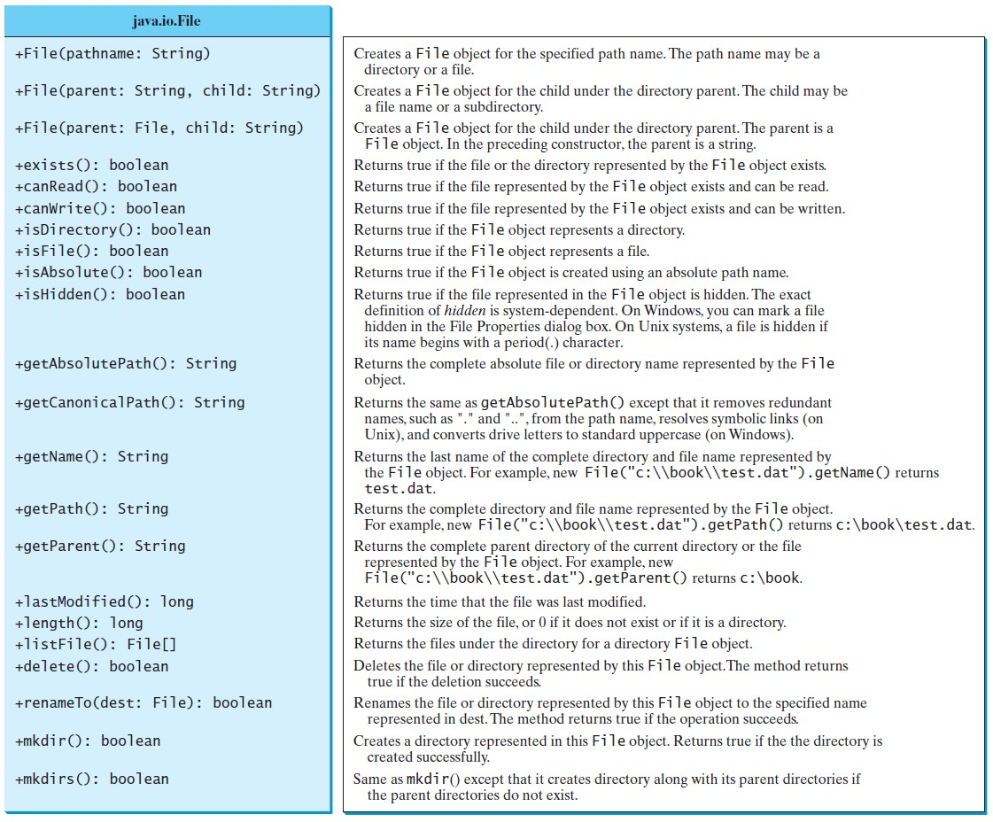
Obtaining file properties and manipulating file

Slide 67
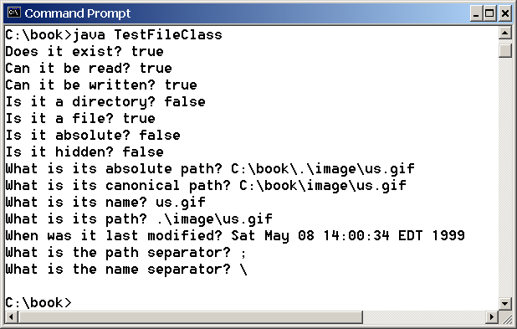
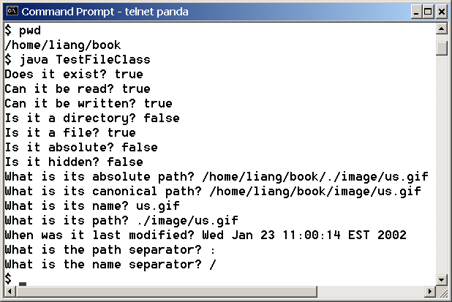
Problem: Explore File Properties
Objective: Write a program that demonstrates how to create files in a platform-independent way and use the methods in the File class to obtain their properties.

Slide 68
Problem: Explore File Properties
public class TestFileClass {
public static void main(String[] args){
java.io.File file = new java.io.File("image/us.gif");
System.out.println("Does it exist? " + file.exists()); System.out.println("The file has " + file.length() + " bytes"); System.out.println("Can it be read? " + file.canRead()); System.out.println("Can it be written? " + file.canWrite()); System.out.println("Is it a directory? " + file.isDirectory()); System.out.println("Is it a file? " + file.isFile()); System.out.println("Is it absolute? " + file.isAbsolute()); System.out.println("Is it hidden? " + file.isHidden()); System.out.println("Absolute path is " + file.getAbsolutePath()); System.out.println("Last modified on " +
new java.util.Date(file.lastModified()));
}
}
68

Slide 69
Text I/O
A File object encapsulates the properties of a file or a path, but does not contain the methods for reading/writing data from/to a file.
In order to perform I/O, you need to create objects using appropriate Java I/O classes.
The objects contain the methods for reading/writing data from/to a file.
File
Scanner
PrintWriter

Slide 70
Writing Data Using PrintWriter
java.io.PrintWriter
+PrintWriter(filename: String)
+print(s: String): void
+print(c: char): void
+print(cArray: char[]): void
+print(i: int): void
+print(l: long): void
+print(f: float): void
+print(d: double): void
+print(b: boolean): void Also contains the overloaded
println methods.
Also contains the overloaded printf methods.
Creates a PrintWriter for the specified file. Writes a string.
Writes a character.
Writes an array of character. Writes an int value.
Writes a long value. Writes a float value.
Writes a double value. Writes a boolean value.
A println method acts like a print method; additionally it prints a line separator. The line separator string is defined by the system. It is \r\n on Windows and \n on Unix.
The printf method was introduced in §4.6, “Formatting
Console Output and Strings.”

Slide 71
Writing Data Using PrintWriter
public class WriteData {
public static void main(String[] arg) throws java.io.IOException {
java.io.File file = new java.io.File("scores.txt");
if (file.exists()) {
System.out.println("File already exists"); System.exit(1); }
//create a file
java.io.PrintWriter output = new java.io.PrintWriter(file);
// Write formatted output to the file
output.print("John T Smith ");
output.println(90);
output.print("Eric K Jones "); output.println(85);
//close the file
output.close();
}
}
71

Slide 72
Reading Data Using Scanner
j ava.util.Scanner
+Scanner(source: File)
+Scanner(source: St ring)
+close()
+hasNext (): boolean
+next(): String
+nextByte(): byte
+nextShort (): short
+nextInt(): int
+nextLong(): long
+nextFloat (): float
+nextDouble(): doubl e
+useDel imit er(pattern: St ring): Scanner
Creates a Scanner object to read data from t he speci fied file. Creates a Scanner object to read data from t he speci fied string. Clos es th is scanner.
Returns true if thi s scanner has another t oken in its input.
Returns next token as a stri ng. Returns next token as a b yt e.
Returns next token as a short. Returns next token as an int. Returns next token as a long. Returns next token as a float.
Returns next token as a d oubl e.
Sets t hi s scanner’s delimiting pat tern.

Slide 73
Reading Data Using Scanner
import java.util.Scanner;; public class ReadData {
public static void main(String[] args) throws Exception {
java.io.File file = new java.io.File("scores.txt");
//Crate a scanner for the file
Scanner input = new Scanner(file);
//read data from file
while ( ) {
input.hasNext()
String firstName = input.next();
String mi = input.next();
String lastName = input.next(); int score = input.nextInt();
System.out.println(firstName +" " + mi + " " + lastName + " " + score);
}
//close the file
input.close();
}
}

Slide 74
Problem: Replacing Text
Write a class named ReplaceText that replaces a string in a text file with a new string.
The filename and strings are passed as command-line arguments as follows:
java ReplaceText sourceFile targetFile oldString newString
For example, invoking
java ReplaceText FormatString.java t.txt StringBuilder StringBuffer
replaces all the occurrences of StringBuilder by StringBuffer
in FormatString.java and saves the new file in t.txt.

Slide 75
import java.io.*; import java.util.*;
public class ReplaceText {
public static void main(String[] args) throws Exception {
// Check command line parameter usage if (args.length != 4) {
System.out.println("Usage: java ReplaceText sourceFile targetFile oldStr newStr"); System.exit(1);
}
// Check if source file exists
File sourceFile = new File(args[0]); if (!sourceFile.exists()) {
System.out.println("Source file " + args[0] + " does not exist"); System.exit(2);
}
// Check if target file exists
File targetFile = new File(args[1]); if (targetFile.exists()) {
System.out.println("Target file " + args[1] + " already exists");
System.exit(3);
75

Slide 76
try (
// Create input and output files
Scanner input = new Scanner(sourceFile);
PrintWriter output = new PrintWriter(targetFile);
) {
while (input.hasNext()) { String s1 = input.nextLine();
String s2 = s1.replaceAll(args[2], args[3]); output.println(s2);
}
}
}
}

Slide 77
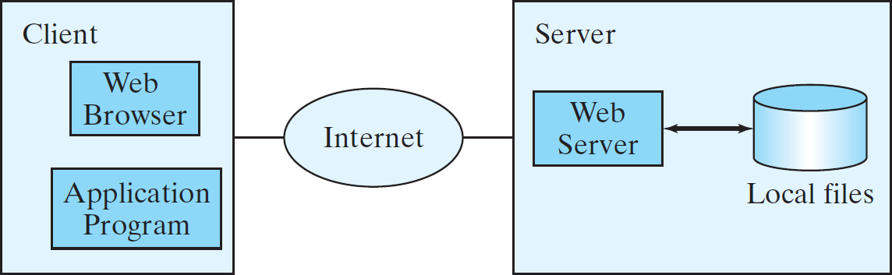
Reading Data from the Web
Just like you can read data from a file on your computer, you can read data from a file on the Web.

Slide 78
Reading Data from the Web
URL url = new URL("www.google.com/index.html");
After a URL object is created, you can use the openStream() method defined in the URL class to open an input stream and use this stream to create a Scanner object as follows:
Scanner input = new Scanner(url.openStream());

Slide 79
import java.util.Scanner; public class ReadFileFromURL {
public static void main(String[] args){
System.out.print("Enter a URL: ");
String URLString = new Scanner(System.in).next();
try {
java.net.URL url = new java.net.URL(URLString);
int count = 0;
Scanner input = new Scanner(url.openStream());
while (input.hasNext()) {
String line = input.nextLine(); count += line.length(); }
System.out.println("The file size is " + count + " characters"); }
catch (java.net.MalformedURLException ex) {
System.out.println("Invalid URL"); }
catch (java.io.IOException ex) {
System.out.println("I/O Errors: no such file");
}
}
}
79

Slide 80
Midterm
Friday 3:00 – 5:00 PM
Closed Notes/Books
Topics: From Lecture Lecture 2 to Lecture 11.
Online via LockDown Browser
Question Types?
Multiple Choice
Multiple Select
T/F
Fill in the blank
80

