Slide 1
Lecture 17 Sets and Maps

Slide 2
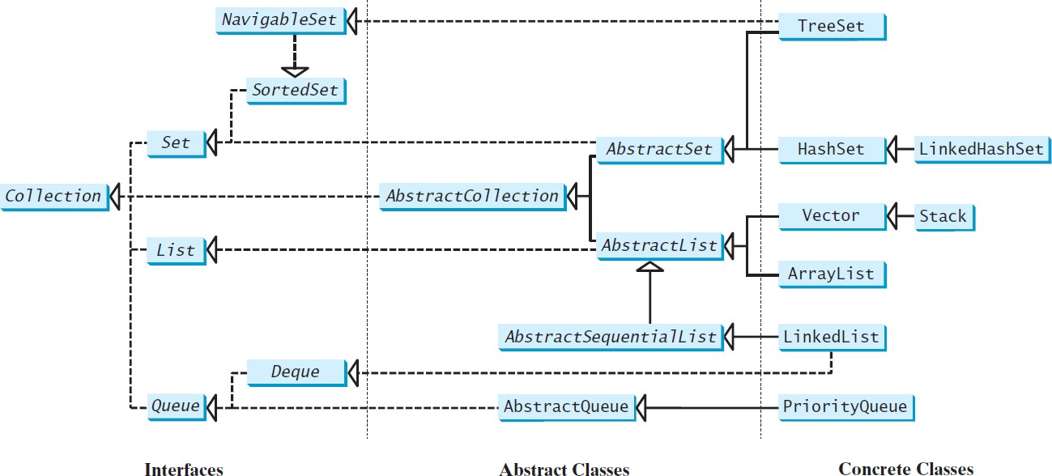
Review of Java Collection Framework hierarchy
Set and List are subinterfaces of Collection.

Slide 3
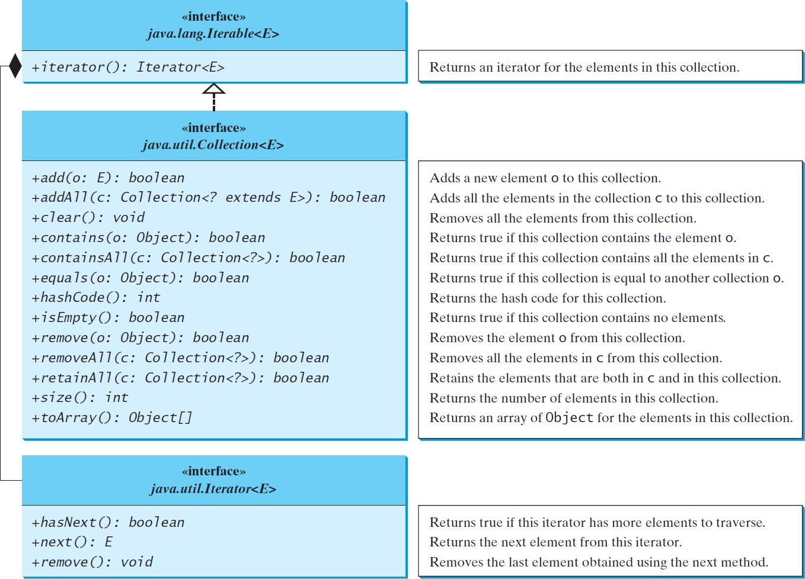
The Collection interface is the root interface
for manipulating a collection of objects.

Slide 4
The Set Interface
The Set interface extends the Collection interface.
It does not introduce new methods or constants, but it stipulates that an instance of Set contains no duplicate elements.
The concrete classes that implement Set must ensure that no duplicate elements can be added to the set.
That is no two elements e1 and e2 can be in the set such that e1.equals(e2) is true.

Slide 5
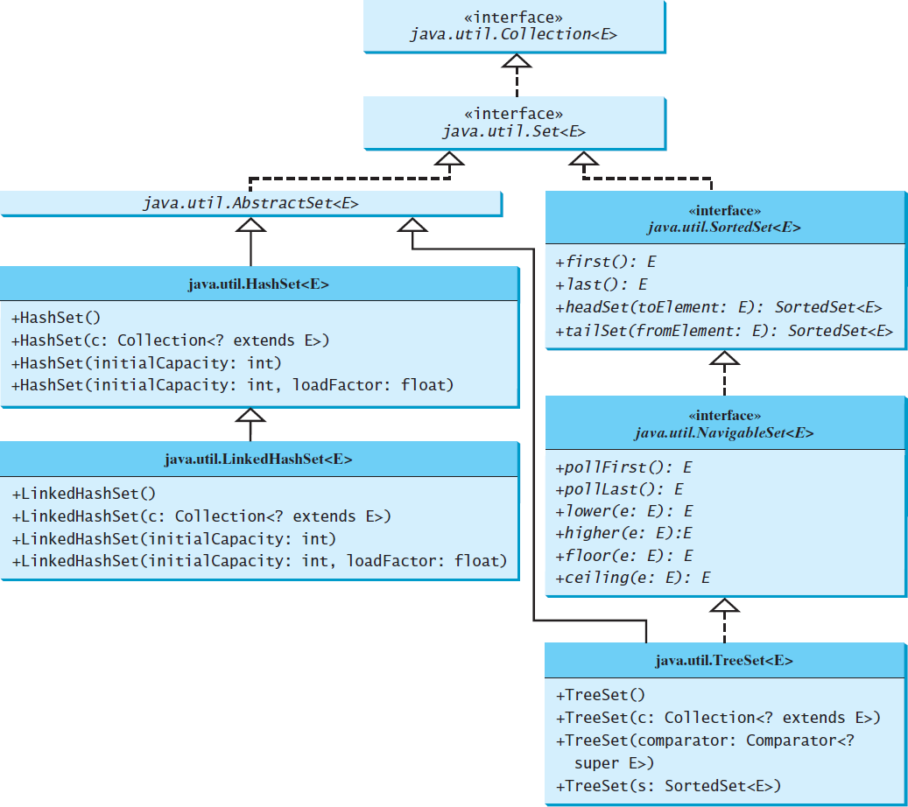
The Set Interface Hierarchy

Slide 6
The AbstractSet Class
The AbstractSet class is a convenience class that extends AbstractCollection and implements Set.
The AbstractSet class provides concrete implementations for the equals method and the hashCode method.
The hash code of a set is the sum of the hash code of all the elements in the set.
Since the size method and iterator method are not implemented in the AbstractSet class, AbstractSet is an abstract class.

Slide 7
The HashSet Class
The HashSet class is a concrete class that implements Set.
It can be used to store duplicate-free elements.
For efficiency, objects added to a hash set need to implement the hashCode method in a manner that properly disperses the hash code.

Slide 8
Example: TestHashSet
This example creates a hash set filled with strings, and uses an iterator to traverse the elements in the list.
Add Paris, New York, San Francisco, Beijing, New York to set.
public class TestHashSet {
public static void main(String[] args) {
// Create a hash set
Set<String> set = new HashSet<>();
// Add strings to the set
set.add("London");

Slide 9
public class TestHashSet {
public static void main(String[] args) {
// Create a hash set
Set<String> set = new HashSet<>();
// Add strings to the set set.add("London");… System.out.println(set);
// Display the elements in the hash set for (String s: set) { System.out.print(s.toUpperCase() + " ");
}
// Process the elements using a forEach method
System.out.println();
set.forEach(e -> System.out.print(e.toLowerCase() + " "));
}

Slide 10
Example: TestLinkedHashSet
This example creates a hash set filled with strings, and uses an iterator to traverse the elements in the list.
You can simplify the for loop without using an iterator, as follows:
for (Object element: set) System.out.print(element.toString() + " ");

Slide 11
The SortedSet Interface and the TreeSet Class
SortedSet is a subinterface of Set, which guarantees that the elements in the set are sorted.
TreeSet is a concrete class that implements the SortedSet interface.
You can use an iterator to traverse the elements in the sorted order.
The elements can be sorted in two ways.

Slide 12
The SortedSet Interface and the TreeSet Class
One way is to use the Comparable interface.
Or to to specify a comparator for the elements in the set if the class for the elements does not implement the Comparable interface.
Do not use the compareTo method in the class that implements the Comparable interface.
This approach is referred to as order by comparator.

Slide 13
Example: TestTreeSet
This example creates a hash set filled with strings, and then creates a tree set for the same strings.
The strings are sorted in the tree set using the compareTo method in the Comparable interface.
The example also creates a tree set of geometric objects.
The geometric objects are sorted using the compare method in the Comparator interface.

Slide 14
TestTreeSet.java
public class TestTreeSet {
public static void main(String[] args) {
// Create a hash set
Set<String> set = new HashSet<>();
// Add strings to the set
set.add("London");
set.add("Paris");
set.add("New York"); set.add("San Francisco"); set.add("Beijing");
set.add("New York");
TreeSet<String> treeSet = new TreeSet<>(set); System.out.println("Sorted tree set: " + treeSet);

Slide 15
// Use the methods in SortedSet interface System.out.println("first(): " + treeSet.first()); System.out.println("last(): " + treeSet.last()); System.out.println("headSet(\"New York\"): " + treeSet.headSet("New York")); System.out.println("tailSet(\"New York\"): " + treeSet.tailSet("New York"));
// Use the methods in NavigableSet interface System.out.println("lower(\"P\"): " + treeSet.lower("P")); System.out.println("higher(\"P\"): " + treeSet.higher("P")); System.out.println("floor(\"P\"): " + treeSet.floor("P")); System.out.println("ceiling(\"P\"): " + treeSet.ceiling("P")); System.out.println("pollFirst(): " + treeSet.pollFirst()); System.out.println("pollLast(): " + treeSet.pollLast()); System.out.println("New tree set: " + treeSet);
}
}

Slide 16
Example: TestTreeSetWithComparator
Write a program that demonstrates how to sort elements in a tree set using the Comparator interface.
The example creates a tree set of geometric objects.
The geometric objects are sorted using the compare method in the Comparator interface.

Slide 17
Example: TestTreeWithComparator
public class TestTreeSetWithComparator {
public static void main(String[] args) {
// Create a tree set for geometric objects using a comparator
Set<GeometricObject> set =
new TreeSet<>(new GeometricObjectComparator()); set.add(new Rectangle(4, 5));
set.add(new Circle(40)); set.add(new Circle(40));
set.add(new Rectangle(4, 1));
// Display geometric objects in the tree set System.out.println("A sorted set of geometric objects"); for (GeometricObject element: set) System.out.println("area = " + element.getArea());
}
}

Slide 18
Case Study: Counting Keywords
This example presents an application that counts the number of the keywords in a Java source code file.
You are going to complete the while loop.

Slide 19
Counting Keywords.java
public class CountKeywords {
public static void main(String[] args) throws Exception { Scanner input = new Scanner(System.in); System.out.print("Enter a Java source file: ");
String filename = input.nextLine();
File file = new File(filename);
if (file.exists()) {
System.out.println("The number of keywords in " + filename
+ " is " + countKeywords(file));
}
else {
System.out.println("File " + filename + " does not exist");
}
}

Slide 20
public static int countKeywords(File file) throws Exception {
// Array of all Java keywords + true, false and null
String[] keywordString = {"abstract", "assert", "boolean", "break", "byte", "case", "catch", "char", "class", "const",
"continue", "default", "do", "double", "else", "enum",
"extends", "for", "final", "finally", "float", "goto",
"if", "implements", "import", "instanceof", "int",
"interface", "long", "native", "new", "package", "private",
"protected", "public", "return", "short", "static", "strictfp", "super", "switch", "synchronized", "this", "throw", "throws", "transient", "try", "void", "volatile",
"while", "true", "false", "null"};
Set<String> keywordSet =
new HashSet<>(Arrays.asList(keywordString));

Slide 21
Set<String> keywordSet =
new HashSet<>(Arrays.asList(keywordString));
int count = 0;
Scanner input = new Scanner(file);
while (input.hasNext()) {
String word = input.next();
if (keywordSet.contains(word))
count++;
}
return count;
}
}

Slide 22
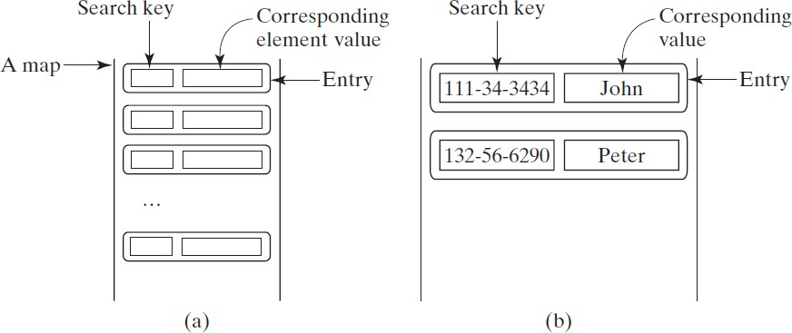
The Map Interface
The Map interface maps keys to the elements.
The keys are like indexes.
In List, the indexes are integer.
In Map, the keys can be any objects.

Slide 23
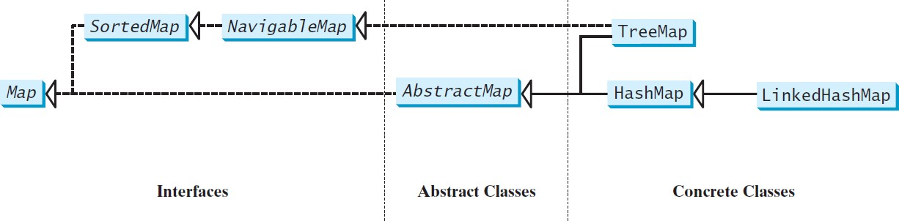
Map Interface and Class Hierarchy
An instance of Map represents a group of objects, each of which is associated with a key.
You can get the object from a map using a key, and you have to use a key to put the object into the map.

Slide 24
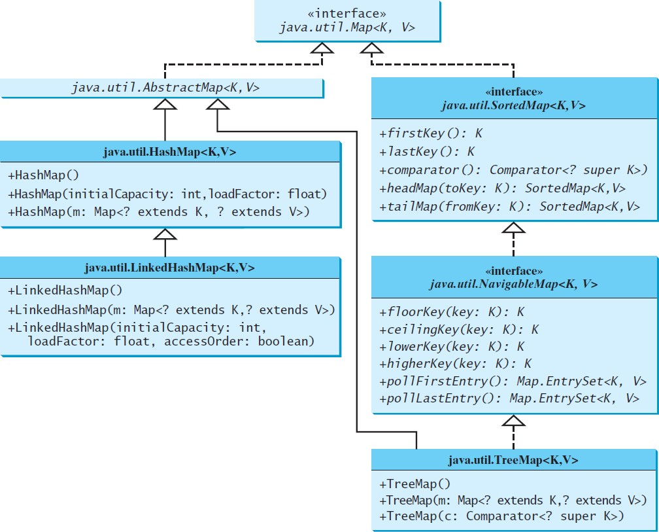
Concrete Map Classes

Slide 25
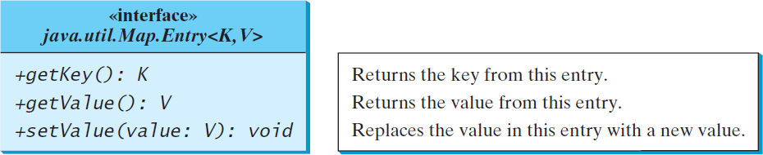
Entry

Slide 26
HashMap
The HashMap class is efficient for locating a value, inserting a mapping, and deleting a mapping.

Slide 27
LinkedHashMap
LinkedHashMap was introduced in JDK 1.4.
It extends HashMap with a linked list implementation that supports an ordering of the entries in the map.
The entries can be retrieved in the order in which they were inserted into a map (known as the insertion order)
or the order in which they were last accessed, from least recently accessed to most recent (access order).
The entries in a HashMap are not ordered
To construct a LinkedHashMap with the access order, use
LinkedHashMap(initialCapacity, loadFactor, true).

Slide 28
TreeMap
The HashMap, LinkedHashMap, and TreeMap classes are three concrete implementations of the Map interface.
The HashMap class is efficient for locating a value,
inserting a mapping, and deleting a mapping.
The TreeMap class, implementing SortedMap, is efficient for traversing the keys in a sorted order.

Slide 29
Example: TestMap
This example creates a hash map that maps borrowers to mortgages.
The program first creates a hash map with the borrower’s name as its key and mortgage as its value.
The program then creates a tree map from the hash map, and displays the mappings in ascending order of the keys.

Slide 30
TestMap.java
public class TestMap {
public static void main(String[] args) {
// Create a HashMap
Map<String, Integer> hashMap = new HashMap<>(); hashMap.put("Smith", 30);
hashMap.put("Anderson", 31);
hashMap.put("Lewis", 29);
hashMap.put("Cook", 29);
System.out.println("Display entries in HashMap"); System.out.println(hashMap + "\n");
// Create a TreeMap from the preceding HashMap
Map<String, Integer> treeMap = new TreeMap<>(hashMap); System.out.println("Display entries in ascending order of key"); System.out.println(treeMap);

Slide 31
TestMap.java
// Create a LinkedHashMap
Map<String, Integer> linkedHashMap = new LinkedHashMap<>(16, 0.75f, true); linkedHashMap.put("Smith", 30);
linkedHashMap.put("Anderson", 31);
linkedHashMap.put("Lewis", 29);
linkedHashMap.put("Cook", 29);
// Display the age for Lewis System.out.println("\nThe age for " + "Lewis is " + linkedHashMap.get("Lewis"));
// Display the linkedHashmap
System.out.println("Display entries in LinkedHashMap"); System.out.println(linkedHashMap);

Slide 32
TestMap.java
// Display each entry with name and age System.out.print("\nNames and ages are "); treeMap.forEach(
(name, age) -> System.out.print(name + ": " + age + " "));
}
}

Slide 33
Case Study: CountOccurrenceOfWords
This program counts the occurrences of words in a text and displays the words and their occurrences in ascending order of the words.
The program uses a hash map to store a pair consisting of a word and its count.
For each word, check whether it is already a key in the map.
If not, add the key and value 1 to the map.
Otherwise, increase the value for the word (key) by 1 in the map.
To sort the map, convert it to a tree map.

Slide 34
Lecture 18: Developing Efficient Algorithms

Slide 35
Executing Time
Suppose two algorithms perform the same task such as search (linear search vs. binary search). Which one is better?
One possible approach to answer this question is to implement these algorithms in Java and run the programs to get execution time.

Slide 36
Executing Time
But there are two problems for this approach:
First, there are many tasks running concurrently on a computer.
The execution time of a particular program is dependent on the system load.
Second, the execution time is dependent on specific input.
Consider linear search and binary search for example. If an element to be searched happens to be the first in the list, linear search will find the element quicker than binary search.

Slide 37
Growth Rate
It is very difficult to compare algorithms by measuring their execution time.
To overcome these problems, a theoretical approach
was developed to analyze algorithms independent of computers and specific input.
This approach approximates the effect of a change on the size of the input.
In this way, you can see how fast an algorithm’s
execution time increases as the input size increases, so you can compare two algorithms by examining their growth rates.

Slide 38
Big O Notation
Consider linear search.
The linear search algorithm compares the key with the
elements in the array sequentially until the key is found or the array is exhausted.
If the key is not in the array, it requires n comparisons for an array of
size n.
If the key is in the array, it requires n/2 comparisons on average. The algorithm’s execution time is proportional to the size of the array.
If you double the size of the array, you will expect the number of comparisons to double.
Computer scientists use the Big O notation to abbreviate for
“order of magnitude.”
Using this notation, the complexity of the linear search algorithm is O(n), pronounced as “order of n.”

Slide 39
Best, Worst, and Average Cases
For the same input size, an algorithm’s execution time may vary, depending on the input.
An input that results in the shortest execution time is
called the best-case input and an input that results in the longest execution time is called the worst-case input.
Best-case and worst-case are not representative, but worst-case analysis is very useful.
You can show that the algorithm will never be slower than the
worst-case.

Slide 40
Best, Worst, and Average Cases
An average-case analysis attempts to determine the average amount of time among all possible input of the same size.
Average-case analysis is ideal, but difficult to perform, because it is hard to determine the relative probabilities and distributions of various input instances for many problems.
Worst-case analysis is easier to obtain and is thus common. So, the analysis is generally conducted for the worst-case.

Slide 41
Ignoring Multiplicative Constants
Using the Big O notation, both cases require O(n) time. The multiplicative constant (1/2) can be omitted.
Algorithm analysis is focused on growth rate.
The multiplicative constants have no impact on growth rates. The growth rate for n/2 or 100n is the same as n, i.e., O(n) = O(n/2) = O(100n).
f(n)
n/2
100n
n
n
100
100
50
10000
200
200
100
20000
2
2
2
f(200) / f(100)

Slide 42
Ignoring Non-Dominating Terms
Consider the algorithm for finding the maximum number in an array of n elements.
If n is 2, it takes one comparison to find the maximum number.
If n is 3, it takes two comparisons to find the maximum number.
In general, it takes n-1 times of comparisons to find maximum number in a list of n elements.

Slide 43
Ignoring Non-Dominating Terms
Algorithm analysis is for large input size.
If the input size is small, there is no significance to estimate an algorithm’s efficiency.
As n grows larger, the n part in the expression n-1
dominates the complexity.
The Big O notation allows you to ignore the non- dominating part (e.g., -1 in the expression n-1) and highlight the important part (e.g., n in the expression n- 1).
So, the complexity of this algorithm is O(n).

Slide 44
Useful Mathematic Summations
1 + 2 + 3 + .... + (n − 1) + n = ^{n(n + 1)}
2
a⁰ + a¹ + a² + a³ + .... + a + a =
_{a}n+1 ₋ ₁
( n−1)
n
a − 1 ₂n+1 ₋ ₁
( n−1)
n
2⁰ + 2¹ + 2² + 2³ + .... + 2 + 2 =
2 − 1

Slide 45
Examples: Determining Big-O
Repetition
Sequence
Selection
Logarithm

Slide 46
Repetition: Simple Loops
for (i = 1; i <= n; i++) { k = k + 5;
executed
n times
}
constant time
Time Complexity
T(n) = (a constant c) * n = cn = O(n)
Ignore multiplicative constants (e.g., “c”).

Slide 47
Repetition: Nested Loops
for (i = 1; i <= n; i++) { for (j = 1; j <= n; j++) {
k = k + i + j;
}
}
constant time
executed
n times
inner loop executed n times
Time Complexity
T(n) = (a constant c) * n * n = cn² = O(n²)
Ignore multiplicative constants (e.g., “c”).

Slide 48
Repetition: Nested Loops
for (i = 1; i <= n; i++) { for (j = 1; j <= i; j++) {
k = k + i + j;
}
}
executed
n times
inner loop executed
i times
constant time
Time Complexity
T(n) = c + 2c + 3c + 4c + … + nc = cn(n+1)/2 = (c/2)n² + (c/2)n = O(n²)
Ignore non-dominating terms
Ignore multiplicative constants

Slide 49
Repetition: Nested Loops
for (i = 1; i <= n; i++) { for (j = 1; j <= 20; j++) {
k = k + i + j;
}
}
constant time
executed
n times
inner loop executed 20 times
Time Complexity
T(n) = 20 * c * n = O(n)
Ignore multiplicative constants (e.g., 20*c)

Slide 50
Sequence
for k } | (j = 1; j = k + 4; |  | <= 10; j++) {
for | (i = 1; i |  | <= n; i++) {
for |  | (j = 1; | j | <= | 20; | j++) | {
k |  | = k + i | + | j;
executed
10 times
executed
n times
inner loop executed 20 times
}
}
Time Complexity
T(n) = c *10 + 20 * c * n = O(n)

Slide 51
Selection
O(n)
if (list.contains(e)) { System.out.println(e);
}
else
for (Object t: list) { System.out.println(t);
}
Let n be list.size(). Executed n times.
Time Complexity
T(n) = test time + worst-case (if, else)
= O(n) + O(n)
= O(n)

Slide 52
Constant Time
The Big O notation estimates the execution time of an algorithm in relation to the input size.
If the time is not related to the input size, the algorithm is said to take constant time with the notation O(1).
For example, a method that retrieves an element at a
given index in an array takes constant time, because it does not grow as the size of the array increases.

Slide 53
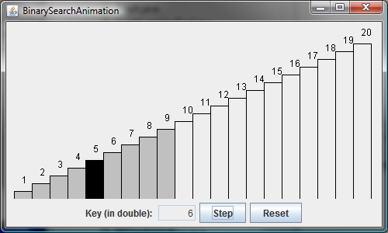
Binary Search Animation
https://liveexample.pearsoncmg.com/dsanimation/BinaryS earcheBook.html

Slide 54
Logarithm: Analyzing Binary Search
𝑛 = 2!
BinarySearch.java, searches a key in a sorted array.
Each iteration in the algorithm contains a fixed number of operations, denoted by c.
Let T(n) denote the time complexity for a binary search on a list of
n elements.

Slide 55
Logarithm: Analyzing Binary Search
𝑛 = 2!
Without loss of generality, assume n is a power of 2 and 𝑘 = log" 𝑛. Since binary search eliminates half of the input after two comparisons,
𝑛 ₂"
𝑛 ₂#
𝑇 𝑛 = 𝑇 ^{𝑛} + 𝐶 = 𝑇
+ 2𝐶 = 𝑇
+ 3𝐶 = ⋯
𝑛
2
𝑛
𝑛
= 𝑇
₂!
+ 𝑘𝐶 = 𝑇
₂$%&! '
+ 𝐶log
"
= 𝑛
= 𝑇 1 + 𝐶 log" 𝑛
𝑇 𝑛
= 𝑂 log" 𝑛

Slide 56
Logarithmic Time
Ignoring constants and smaller terms, the complexity of the binary search algorithm is 𝑂 log! 𝑛 .
An algorithm with the 𝑂 log! 𝑛 time complexity is called a
logarithmic algorithm.
The base of the log is 2, but the base does not affect a logarithmic growth rate, so it can be omitted.
The logarithmic algorithm grows slowly as the problem size increases.
If you square the input size, you only double the time for the algorithm.

Slide 57
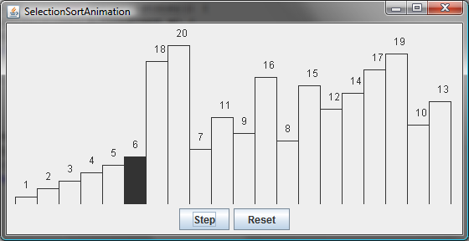
Selection Sort Animation
https://liveexample.pearsoncmg.com/dsanimation/Selectio nSortNew.html

Slide 58
Analyzing Selection Sort
SelectionSort.java finds the smallest number in the list and places it first. It then finds the smallest number remaining and places it second, and so on until the list contains only a single number.
The number of comparisons is n-1 for the first iteration, n-2 for the second iteration, and so on.
Let T(n) denote the complexity for selection sort and c denote the total number of other operations such as assignments and additional comparisons in each iteration.
𝑇 𝑛 = 𝑛 − 1 + 𝑐 + 𝑛 − 2 + 𝑐 + ⋯ + 1 + 𝑐
𝑛 𝑛 − 1
_{𝑛}"
𝑛
=
+ 𝑐 𝑛 − 1 = ₂ − ₂ + 𝑐𝑛 − 𝑐
2
Ignoring constants and smaller terms, the complexity of the selection sort algorithm is O(n²).

Slide 59
Analyzing Selection Sort.java
public class SelectionSort {
/** The method for sorting the numbers */ public static void selectionSort(double[] list) { for (int i = 0; i < list.length - 1; i++) {
// Find the minimum in the list[i..list.length-1]
double currentMin = list[i];
int currentMinIndex = i;
n iterations
𝑇 𝑛 = 𝑛
for (int j = i + 1; j < list.length; j++) {
if (currentMin > list[j]) { currentMin = list[j]; currentMinIndex = j;
}
}
n-1 iterations
𝑇 𝑛 = (𝑛 − 1)
// Swap list[i] with list[currentMinIndex] if necessary;
if (currentMinIndex != i) { list[currentMinIndex] = list[i]; list[i] = currentMin;
Constant
𝑇 𝑛 = 𝑐₍

Slide 60
Quadratic Time
An algorithm with the O(n²) time complexity is called a
quadratic algorithm.
The quadratic algorithm grows quickly as the problem size increases.
If you double the input size, the time for the algorithm is quadrupled.
Algorithms with a nested loop are often quadratic.

Slide 61
Analyzing Tower of Hanoi
TowerOfHanoi.java moves n disks from tower A to tower B with the assistance of tower C recursively as follows:
Move the first n – 1 disks from A to C with the assistance of tower B.
Move disk n from A to B.
Move n - 1 disks from C to B with the assistance of tower A.

Slide 62
Analyzing Tower of Hanoi
Let T(n) denote the complexity of the algorithm that moves disks and c denote the constant time to move one disk, i.e., T(1) is c. So,
𝑇 𝑛 = 𝑇 𝑛 − 1 + 𝑐 + 𝑇 𝑛 − 1 = 2𝑇 𝑛 − 1 + 𝑐
Number of subproblems
= 2 2𝑇 𝑛 − 2 + 𝑐 + 𝑐
= 2 2 2𝑇 𝑛 − 3 + 𝑐 + 𝑐 + 𝑐
Split
= 2^{')*}𝑇 1 + 𝑐2^{')"} + 𝑐2^{')"} + ⋯ 𝑐2 + 𝑐
𝑐2'
= 𝑂 2'

Slide 63
Common Recurrence Relations
Recurrence Relation
Result
Example
T (n) = T (n / 2) + O(1)
T (n) = T (n − 1) + O(1)
T (n) = 2T (n / 2) + O(1)
T (n) = 2T (n / 2) + O(n )
T (n) = 2T (n / 2) + O(nlogn )
T (n) = T (n − 1) + O(n )
T (n) = 2T (n − 1) + O(1)
T (n) = T (n − 1) + T (n − 2) + O(1)
T (n) = O(log n)
T (n) = O(n)
T (n) = O(n)
T (n) = O(nlogn)
T (n) = O (n log² n)
T (n) = O(n² )
T (n) = O(2^{n} )
T (n) = O(2^{n} )
Binary search, Euclid’s GCD
Linear search
Merge sort (Chapter 24)
Selection sort, insertion sort
Towers of Hanoi
Recursive Fibonacci algorithm

Slide 64
Comparing Common Growth Functions
O(1) < O(log n) < O(n) < O(n log n) < O(n² ) < O(n³ ) < O(2^{n} )
Constant time Logarithmic time Linear time
Log-linear time Quadratic time
Cubic time Exponential time
O(1)
O(log n)
O(n)
O(n log n)
O(n² )
O(n³ )
O(2^{n} )

Slide 65
Comparing Common Growth Functions
O(1) < O(log n) < O(n) < O(n log n) < O(n² ) < O(n³ ) < O(2^{n} )
O(2^{n})
O(n²)
O(nlogn)
O(n)
O(logn)
O(1)

Slide 66
Case Study: Fibonacci Numbers
/** The method for finding the Fibonacci number */ public static long fib(long index) {
if (index == 0) // Base case return 0;
else if (index == 1) // Base case return 1;
else // Reduction and recursive calls return fib(index - 1) + fib(index - 2);
}
Finonacci series: 0 1 1 2 3 5 8 13 21 34 55 89…
indices: 0 1 2 3 4 5 6 7 8 9 10 11
fib(0) = 0;
fib(1) = 1;
fib(index) = fib(index -1) + fib(index -2); index >=2

Slide 67
Case Study: Fibonacci Numbers
/** The method for finding the Fibonacci number */ public static long fib(long index) {
if (index == 0) // Base case return 0;
else if (index == 1) // Base case return 1;
else // Reduction and recursive calls return fib(index - 1) + fib(index - 2);
}
𝑇 𝑛
= 𝑇 𝑛 − 1 + 𝑇 𝑛 − 2 + 𝑐
≤ 2𝑇 𝑛 − 1 + 𝑐
= 𝑂 2'
𝑇 𝑛 − 1 ≥ 𝑇 𝑛 − 2

Slide 68
Case Study: ImprovedFibonacci.java
public static long fib(long n) {
long f0 = 0; // For fib(0) long f1 = 1; // For fib(1) long f2 = 1; // For fib(2)
if (n == 0)
return f0; else if (n == 1) return f1;
else if (n == 2)
return f2;
for (int i = 3; i <= n; i++) { f0 = f1;
f1 = f2;
f2 = f0 + f1;
}

Slide 69
Dynamic Programming
The algorithm for computing Fibonacci numbers presented here uses an approach known as dynamic programming.
Dynamic programming is to solve subproblems, then combine the solutions of subproblems to obtain an overall solution.
This naturally leads to a recursive solution.

Slide 70
Dynamic Programming
However, it would be inefficient to use recursion, because the subproblems overlap.
The key idea behind dynamic programming is to solve each subprogram only once and storing the results for subproblems for later use to avoid redundant computing of the subproblems.

Slide 71
Case Study: GCD Algorithms Version 1
public static int gcd(int m, int n) { int gcd = 1;
for (int k = 2; k <= m && k <= n; k++) { if (m % k == 0 && n % k == 0)
gcd = k;
}
return gcd;
}

Slide 72
Case Study: GCD Algorithms Version 2
for (int k = n; k >= 1; k--) {
if (m % k == 0 && n % k == 0) { gcd = k;
break;
}
}

Slide 73
Case Study: GCD Algorithms Version 3
public class GCD {
/** Find gcd for integers m and n */ public static int gcd(int m, int n) { int gcd = 1;
if (m % n == 0) return n;
for (int k = n / 2; k >= 1; k--) {
if (m % k == 0 && n % k == 0) { gcd = k;
break;
}
}

Slide 74
Euclid’s algorithm
Let gcd(m, n) denote the gcd for integers m and n:
If m % n is 0, gcd (m, n) is n.
Otherwise, gcd(m, n) is gcd(n, m % n).
m = n*k + r
if p is divisible by both m and n, it must be divisible by r: m / p = n*k/p + r/p

Slide 75
Euclid’s Algorithm Implementation
public class GCDEuclid {
/** Find gcd for intergers m and n */ public static int gcd(int m, int n) { if (m % n == 0)
return n;
else
𝑛
return gcd(n, m % n);
𝑇 𝑛
+ 𝑐
^{= 𝑇} ₂!/"
}
= O log"n

Slide 76
Finding Prime Numbers
Compare three versions:
Brute-force
Check possible divisors up to Math.sqrt(n)
Check possible prime divisors up to Math.sqrt(n)

Slide 77
PrimeNumbers.java
// Repeatedly find prime numbers
while (number <= n) {
// Assume the number is prime
n iterations
boolean isPrime = true; // Is the current number prime?
𝑛 iterations
// ClosestPair if number is prime
for (int divisor = 2; divisor <= (int)(Math.sqrt(number)); divisor++) {
if (number % divisor == 0) { // If true, number is not prime
isPrime = false; // Set isPrime to false
≤ 𝑛 iterations
break; // Exit the for loop
}
}

Slide 78
PrimeNumbers.java
// Print the prime number and increase the count
if (isPrime) {
count++; // Increase the count
≤ 𝑛 iterations
if (count % NUMBER_PER_LINE == 0) {
// Print the number and advance to the new line
System.out.printf("%7d\n", number);
}
else
System.out.printf("%7d", number);
}
// Check if the next number is prime
number++;
}

Slide 79
EfficientPrimeNumbers.java
// Repeatedly find prime numbers
while (number <= n) {
// Assume the number is prime
n iterations
boolean isPrime = true; // Is the current number prime?
if (squareRoot * squareRoot < number) squareRoot++;
// ClosestPair if number is prime
for (int k = 0; k < list.size()
&& list.get(k) <= squareRoot; k++) {
if (number % list.get(k) == 0) { // If true, not prime
isPrime = false; // Set isPrime to false
Repeats
'
$%&,
break; // Exit the for loop
'
}
$%& ' many iterations
}

Slide 80
EfficientPrimeNumbers.java
// Print the prime number and increase the count
if (isPrime) {
count++; // Increase the count list.add(number); // Add a new prime to the list if (count % NUMBER_PER_LINE == 0) {
// Print the number and advance to the new line
System.out.println(number);
}
else
System.out.print(number + " ");
}
// Check if the next number is prime
number++;
}

Slide 81
Divide-and-Conquer
The divide-and-conquer approach divides the problem into subproblems, solves the subproblems, then combines the solutions of subproblems to obtain the solution for the entire problem.
Unlike the dynamic programming approach, the subproblems in the divide-and-conquer approach don’t overlap.
A subproblem is like the original problem with a smaller size, so you can apply recursion to solve the problem.
In fact, all the recursive problems follow the divide-and- conquer approach.

Slide 82
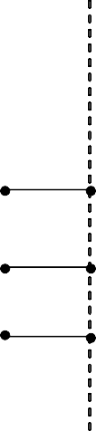

Case Study: Closest Pair of Points
S₁
S₂
stripL
stripR
stripL
stripR
stripL
stripR
d₁
d₂
p
d
p
mid
q[r]
d
d
d
d
T (n) = 2T (n / 2) + O(n) = O(n log n)
http://www.cs.armstrong.edu/liang/animation/web/ ClosestPair.html

Slide 83
Case Study: Closest Pair of Points
S₁
S₂
stripL
stripR
stripL
stripR
stripL
stripR
d₁
d₂
p
d
p
mid
q[r]
d
d
d
d
T (n) = 2T (n / 2) + O(n) = O(n log n)

Slide 84
Practical Considerations
The big O notation provides a good theoretical estimate of algorithm efficiency.
However, two algorithms of the same time complexity are not necessarily equally efficient.

