Slide 1

CS 501 – Introduction to JAVA Programing
Lecture 9 – Objects and Classes Lecture 10 – Thinking in Objects

Slide 2
What is object-oriented thinking?
Instead of writing code as a sequence of functions, Object Oriented Programming (OOP) structures code around objects which represent entities
Like a Car, Person, or BankAccount
Objects contain:
Data (attributes): Represents the characteristics of the object
A Car’s speed or brand
Behavior (methods): Defines what an object can do
A Car can drive() or brake()
Objects interact with each other, creating a dynamic, modular system.
A Person bob can call his Car honda’s drive() or brake() function.

Slide 3
Key Principles
Encapsulation – Restrict outside access to internal workings of a class
Prevent unintended modifications, control what can be accessed
private int socialSecurityNum;
Abstraction – Allow functionality without needing to understand details
Hides unnecessary details and mess, huge for scaling complex systems
isPrime(2147483647) → true
Inheritance – Allow a subclass to inherit functionality from a parent
Promotes code reuse, organization, natural hierarchy
Animal.eat() → Person extends Animal → Person.eat()
Polymorphism – Allow different objects to fall under the same category
printName(Animal a), Cat extends Animal, Dog extends Animal
printName(dog) → “Bill”; printName(cat) → “Larry”

Slide 4
Objects in Java
public class Car {
private String brand;
public Car(String brand) {
this.brand = brand;
}
public void drive() {
System.out.println(brand + " is driving!");
}
}
public class Main {
public static void main(String[] args) {
Car myCar = new Car("Toyota");
myCar.drive();
}
}

Slide 5
9.1. Class Abstraction and Encapsulation
Separate implementation from class usage.
The user of the class does not need to know how the class is implemented.
The detail of implementation is encapsulated and hidden from the user.
Classes can be considered black boxes
Class
Users pick the method to use based on its description, not its implementation
Method Names + Docstring descriptions
Switch to Code - BankAccount

Slide 6
Class Inheritance and Polymorphism
Create class hierarchy and categorization structures
Classes that fall under a larger category can share common traits rather than need to reimplement them every time. Similarly, functions can list a superclass as a parameter and automatically handle subclasses.
Switch to Code – Vehicle/Car/Truck

Slide 7
Java Class Relationships
Understanding how classes interact in Java

Slide 8
Key Relationships
Association
One class references another (HAS A)
Aggregation
Weak association, one class has another, but the contained object can otherwise exist on its own
Composition
Strong association, one class owns another, and the contained object cannot exist independently
Inheritance
One class derives from another (IS A)
Dependency
One class depends on another temporarily (USES A)
Realization
One class is realized from the blueprint of another

Slide 9
Association (HAS A)
A general relationship where one class references another
Types:
One-to-one: Person – Passport
One-to-many: Department – Employees
Many-to-many: Students – Courses
class Employee {
String name;
}
class Department {
Employee[] employees; // Department has Employees
}s

Slide 10
Aggregation (Weak Association)
One class has another class, but the contained object can exist independently.
class Engine {
void start() {
System.out.println("Engine started");
}
}
class Car {
Engine engine;
Car(Engine engine) {
this.engine = engine;
}
}

Slide 11
Composition (Strong Association)
One class owns another class, and the contained object cannot exist independently.
class Brain {
void function() {
System.out.println("Brain is functioning");
}
}
class Human {
private final Brain brain = new Brain();
void live() {
brain.function();
}
}

Slide 12
Inheritance (IS A)
One class derives from another using extends. Promotes code reuse and polymorphism.
class Animal {
void makeSound() {
System.out.println("Some sound...");
}
}
class Dog extends Animal {
void bark() {
System.out.println("Bark!");
super.makeSound();
}
}

Slide 13
Dependency (USES A)
One class depends on another temporarily (e.g., method parameters).
class Printer {
void print(Document doc) {
System.out.println("Printing: " + doc.getText());
}
}
class Document {
String getText() {
return "Hello, world!";
}
}

Slide 14
Realization (Interface Implementation)
A class implements an interface to enforce a blueprint
interface Flyable {
void fly();
}
class Bird implements Flyable {
public void fly() {
System.out.println("Bird is flying");
}
}

Slide 15
9.3. Class Relationships – UML Diagrams
Course
-courseName: String -students: String[] -numberOfStudents: int
+Course(courseName: String) +getCourseName(): String +addStudent(student: String): void +dropStudent(student: String): void +getStudents(): String[] +getNumberOfStudents(): int
Class Name
Attributes
Methods
Relationships to other classes

Slide 16
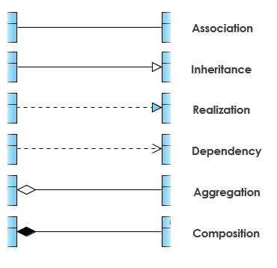
9.3. Class Relationships – UML Notations
To denote relationships between classes, use:
Solid line for Associations
Solid line ending with an open arrow for Inheritances
Dashed line ending with a closed arrow for Interfaces
Dashed line ending with an open arrow for Dependencies
Solid line ending with a hollow diamond for Aggregations
Solid line ending with a filled-in diamond for Compositions
https://www.visual-paradigm.com/guide/uml-unified-modeling-language/uml-class-diagram-tutorial/

Slide 17
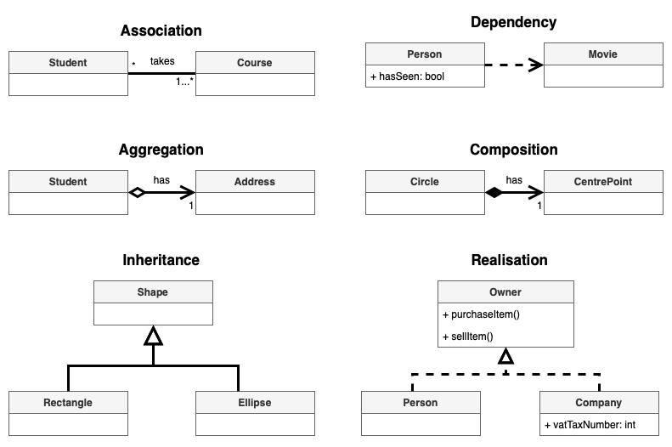
9.3. Class Relationships – UML Notations Examples
https://www.drawio.com/blog/uml-class-diagrams

Slide 18
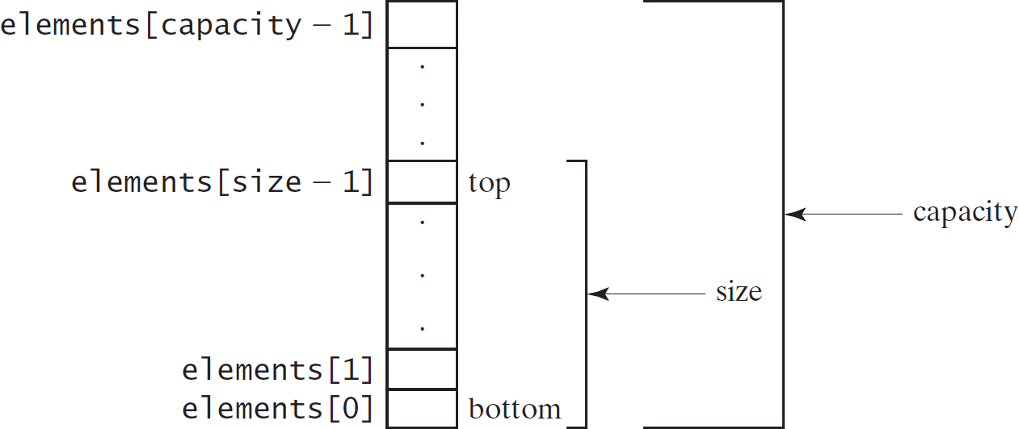
9.4. Case Study: Designing a Class for Stacks

Slide 19
9.4. Case Study: Designing a Class for Stacks
StackOfIntegers
-elements: int[]
-size: int
An array to store integers in the stack. The number of integers in the stack.
Constructs an empty stack with a default capacity of 16. Constructs an empty stack with a specified capacity.
Returns true if the stack is empty.
Returns the integer at the top of the stack without removing it from the stack.
Stores an integer into the top of the stack.
Removes the integer at the top of the stack and returns it. Returns the number of elements in the stack.
+StackOfIntegers()
+StackOfIntegers(capacity: int)
+empty(): boolean
+peek(): int
+push(value: int): int
+pop(): int
+getSize(): int
Switch to code - Stack

Slide 20
9.4. Case Study: Designing a Class for Stacks
public class TestStackOfInteger {
public static void main(String[] args) { StackOfIntegers stack = new StackOfIntegers(); for (int i = 0; i < 10; i++)
stack.push(i); while (!stack.empty())
System.out.print(stack.pop()+ " ");
}
}

Slide 21
9.5. Processing Primitive Data Type Values as Objects
□Boolean
□Character
□Short
□Byte
 Integer
 Long
 Float
 Double
NOTE: (1) The wrapper classes do not have no-arg constructors. (2) The instances of all wrapper classes are immutable, i.e., their internal values cannot be changed once the objects are created.

Slide 22
9.5. Processing Primitive Data Type Values as Objects
The Integer and Double Classes
java.lang.Integer
-value: int +MAX_VALUE: int +MIN_VALUE: int
+Integer(value: int) +Integer(s: String) +byteValue(): byte +shortValue(): short +intValue(): int +longVlaue(): long +floatValue(): float +doubleValue():double +compareTo(o: Integer): int +toString(): String +valueOf(s: String): Integer +valueOf(s: String, radix: int): Integer +parseInt(s: String): int +parseInt(s: String, radix: int): int
java.lang.Double
-value: double +MAX_VALUE: double +MIN_VALUE: double
+Double(value: double) +Double(s: String) +byteValue(): byte +shortValue(): short +intValue(): int +longVlaue(): long +floatValue(): float +doubleValue():double +compareTo(o: Double): int +toString(): String +valueOf(s: String): Double +valueOf(s: String, radix: int): Double +parseDouble(s: String): double +parseDouble(s: String, radix: int): double

Slide 23
9.5. Processing Primitive Data Type Values as Objects
Numeric Wrapper Class Constructors
The constructors for Integer and Double are: public Integer(int value) public Integer(String s) public Double(double value)
public Double(String s)

Slide 24
9.5. Processing Primitive Data Type Values as Objects
Numeric Wrapper Class Constants
Each numerical wrapper class has the constants MAX_VALUE and MIN_VALUE. MAX_VALUE represents the maximum value of the corresponding primitive data type.
For Byte, Short, Integer, and Long, MIN_VALUE represents the minimum byte, short, int, and long values.
For Float and Double, MIN_VALUE represents the minimum positive float and double values.
The following statements display
the maximum integer (2,147,483,647)
the minimum positive float (1.4E-45)
the maximum double floating-point number (1.79769313486231570e+308d).

Slide 25
9.5. Processing Primitive Data Type Values as Objects
Conversion Methods
Each numeric wrapper class implements the abstract methods doubleValue, floatValue, intValue, longValue, and shortValue, which are defined in the Number class.
These methods “convert” objects into primitive type values.

Slide 26
9.5. Processing Primitive Data Type Values as Objects
The Static valueOf Methods
The numeric wrapper classes have a useful class method, valueOf(String s).
This method creates a new object initialized to the value represented by the specified string. For example:
Double doubleObject = Double.valueOf("12.4"); Integer integerObject = Integer.valueOf("12");

Slide 27
9.5. Processing Primitive Data Type Values as Objects
The Methods for Parsing Strings into Numbers
The parseInt method: to parse a numeric string into an int value in the Integer class.
The parseDouble method: to parse a numeric string into a double value in the Double class.
Each numeric wrapper class has two overloaded parsing methods to parse a numeric string into an appropriate numeric value based on 10 or any specified radix (e.g., 2, 8, 16).

Slide 28
9.6. Automatic Conversion Between Primitive Types and Wrapper Class Types
Integer[] intArray = {new Integer(2), new Integer(4), new Integer(3)};
Equivalent
Integer[] intArray = {2, 4, 3};
(a)
New JDK 1.5 boxing
(b)
Integer[] intArray = {1, 2, 3}; System.out.println(intArray[0] + intArray[1] + intArray[2]);
Unboxing

Slide 29
9.7. BigInteger and BigDecimal
For very large integers or high precision floating-point values in computation, use the BigInteger and BigDecimal classes in the java.math package.
Both are immutable.
Both extend the Number class and implement the Comparable interface.

Slide 30
9.7. BigInteger and BigDecimal
BigInteger | a | = | new BigInteger("9223372036854775807");
BigInteger | b | = | new BigInteger("2");
BigInteger | c | = | a.multiply(b); System.out.println(c);

Slide 31
The String Class
□Constructing a String:
String message = "Welcome to Java“;
String message = new String("Welcome to Java“);
String s = new String();
□Obtaining String length and Retrieving Individual Characters in a string
□String Concatenation (concat)
□Substrings (substring(index), substring(start, end))
□Comparisons (equals, compareTo)
□String Conversions
□Finding a Character or a Substring in a String
□Conversions between Strings and Arrays
□Converting Characters and Numeric Values to Strings

Slide 32
9.7. The String Class
Constructing Strings
String newString = new String(stringLiteral); String message = new String("Welcome to Java");
Since strings are used frequently, Java provides a shorthand initializer for creating a string:
String message = "Welcome to Java";

Slide 33
9.7. The String Class
Strings Are Immutable
A String object is immutable; its contents cannot be changed. Does the following code change the contents of the string?
String s = "Java";
s = "HTML";
No. Replaces it with a new string.

Slide 34
9.7. The String Class
After executing String s = "Java";
After executing s = "HTML";
s
: String
s
: String
This string object is now unreferenced
String object for "Java"
String object for "Java"
Contents cannot be changed
: String
String object for "HTML"
Note the hanging object with no way to access it! Java cleans this up automatically, but this would your problem in C++.

Slide 35
9.7. Interned Strings
Since strings are immutable and are frequently used, to improve efficiency and save memory, the JVM can pool references to strings with the same character sequence together.
When you create a string using string literals, Java automatically interns it:
When you create a string using new, its stored separately:
String s1 = "hello";
String s2 = "hello";
System.out.println(s1 == s2); // true (same reference)
String s3 = new String(“hello”);
System.out.println(s1 == s3);
// false (different reference)

Slide 36
9.7. The String Class
s1 s3
String s1 = "Welcome to Java";
: String
String s2 = new String("Welcome to Java");
Interned string object for "Welcome to Java"
String s3 = "Welcome to Java";
System.out.println("s1 | == | s2 | is | " | + | (s1 | == | s2));
System.out.println("s1 | == | s3 | is | " | + | (s1 | == | s3));
s2
: String
A string object for "Welcome to Java"
display
s1 == s is false s1 == s3 is true
A new object is created if you use the new operator.
If you use the string initializer, no new object is created if the interned object is already created.

Slide 37
9.7. The String Class
Replacing and Splitting Strings
java.lang.String
+replace(oldChar: char, newChar: char): String
+replaceFirst(oldString: String, newString: String): String
+replaceAll(oldString: String, newString: String): String
+split(delimiter: String): String[]
Returns a new string that replaces all matching character in this string with the new character.
Returns a new string that replaces the first matching substring in this string with the new substring.
Returns a new string that replace all matching substrings in this string with the new substring.
Returns an array of strings consisting of the substrings split by the delimiter.

Slide 38
9.7. The String Class
"Welcome".replace('e', 'A') returns a new string, WAlcomA. "Welcome".replaceFirst("e", "AB") returns a new string, WABlcome. "Welcome".replace("e", "AB") returns a new string, WABlcomAB. "Welcome".replace("el", "AB") returns a new string, WABcome.

Slide 39
Splitting a String
String[] tokens = "Java#HTML#Perl".split("#", 0);
for (int i = 0; i < tokens.length; i++)
System.out.println(tokens[i]);
// Outputs: Java
HTML
Perl
First param: character sequence to split on
Second param: the limit of how many times to split. If limit <= 0, then infinite

Slide 40
Matching, Replacing and Splitting by Patterns
We can match, replace, or split a string by specifying a pattern.
This is an extremely useful and powerful feature, commonly known as regular expression.
"Java".matches("Java");
"Java".equals("Java");
"Java is fun".matches("Java.*"); "Java is cool".matches("Java.*");

Slide 41
Regular Expressions
Literal Characters
Metacharacters
Character Classes
Predefined Character Classes
Grouping and Alternation
Anchors
Lookaheads & Lookbehinds (advanced)
Escape Sequences
Flags

Slide 42
Literals and Metas
Symbol | Description | Example
. | Matches any single character (except newline) | "c.t" matches "cat", "cut", "cot"
^ | Matches start of a string | "^Hello" matches "Hello world", but not "Say Hello"
$ | Matches end of a string | "world$" matches "Hello world" but not "world peace"
* | Matches 0 or more occurrences | "ab*" matches "a", "ab", "abb", "abbbbb"
+ | Matches 1 or more occurrences | "ab+" matches "ab", "abb", "abbbbb" but not "a"
? | Matches 0 or 1 occurrence (optional) | "colou?r" matches "color" and "colour"
{n} | Matches exactly n occurrences | "a{3}" matches "aaa" but not "aa"
{n,} | Matches at least n occurrences | "a{2,}" matches "aa", "aaa", "aaaa", etc.
{n,m} | Matches between n and m occurrences | "a{2,4}" matches "aa", "aaa", "aaaa"
Literal Characters
a-z, A-Z, 0-9: Matches exact letters or digits
Metacharacters:

Slide 43
Character Classes
Used to match specific sets of characters
Symbol | Description | Example
[abc] | Matches any one of a, b, or c | "gr[ae]y" matches "gray" or "grey"
[^abc] | Matches any character except a, b, or c | "[^0-9]" matches any non-digit
[a-z] | Matches any lowercase letter | "a-z" matches "apple" but not "APPLE"
[A-Z] | Matches any uppercase letter | "A-Z" matches "HELLO" but not "hello"
[0-9] | Matches any digit | "Age: [0-9]+" matches "Age: 25"
[a-zA-Z0-9] | Matches alphanumeric characters | "abc123"

Slide 44
Predefined Character Classes
Shorthand notations for common patterns
Symbol | Description | Equivalent To
\\d | Matches any digit (0-9) | [0-9]
\\D | Matches any non-digit | [^0-9]
\\w | Matches word characters (letters, digits, underscore _) | [a-zA-Z0-9_]
\\W | Matches non-word characters | [^a-zA-Z0-9_]
\\s | Matches whitespace (spaces, tabs, newlines) | [ \\t\\n\\r\\f\\v]
\\S | Matches non-whitespace characters | [^ \\t\\n\\r\\f\\v]

Slide 45
Grouping, Alternation, Anchors
Group expressions, define alternatives, define positions in the text
Symbol | Description | Example
() | Groups expressions | "(ab)+" matches "ab", "abab", "ababab"
| | Alternation (OR) | “(a|b)” matches “a”, “b”, but not “ab”
Symbol | Description | Example
^ | Start of string | "^Hello" matches "Hello world", but not "Say Hello"
$ | End of string | "world$" matches "Hello world", but not "world peace"
\\b | Word boundary | \\bcat\\b matches " cat " but not "category"
\\B | Not a word boundary | \\Bcat\\B matches "category" but not " cat "

Slide 46
Lookaheads & Lookbehinds (quite advanced)
Make sure one pattern follows or preempts another
Symbol | Description | Example
(?=...) | Positive Lookahead (Ensures pattern follows) | "foo(?=bar)" matches "foo" in "foobar", but not "foobaz"
(?!...) | Negative Lookahead (Ensures does NOT follow) | "foo(?!bar)" matches "foo" in "foobaz", but not "foobar"
(?<=...) | Positive Lookbehind (Ensures pattern precedes) | "(?<=\$)\\d+" matches numbers after $, like "$100"
(?<!...) | Negative Lookbehind (Ensures does NOT precede) | "(?<!\\$)\\d+" matches numbers not after $, avoiding "$100"

Slide 47
Escape Sequences
Since metacharacters have special meanings, escape them with \\ when needed.
Symbol | Matches | Symbol
\\. | A literal . character | \\.
\\* | A literal * character | \\*
\\? | A literal ? character | \\?
\\( | A literal ( character | \\(
\\) | A literal ) character | \\)
\\\\ | A literal \\ character | \\\\

Slide 48
Flags (Modifiers)
Flags modify how the regex behaves
Flag | Description | Example
(?i) | Case-insensitive match | "(?i)hello" matches "Hello", "hELLo"
(?m) | Multiline mode (^ and $ match per line) | In code
(?s) | Dot-all mode (. matches newlines)
(?x) | Ignore whitespace (for readability)

Slide 49
9.7. The String Class
Matching, Replacing and Splitting by Patterns
The replaceAll, replaceFirst, and split methods can be used with a regular expression.
For example, the following statement returns a new string that replaces $, +, or # in "a+b$#c" by the string NNN.
String s = "a+b$#c".replaceAll("[$+#]", "NNN"); System.out.println(s);
Here the regular expression [$+#] specifies a pattern that matches $, +, or #. So, the output is aNNNbNNNNNNc.

Slide 50
9.7. The String Class
Matching, Replacing and Splitting by Patterns
The following statement splits the string into an array of strings delimited by some punctuation marks.
String[] tokens = "Java,C?C#,C++".split("[.,:;?]");
for (int i = 0; i < tokens.length; i++) System.out.println(tokens[i]);

Slide 51
9.7. The String Class
Convert Character and Numbers to Strings
The String class provides several static valueOf methods for converting a character, an array of characters, and numeric values to strings.
These methods have the same name valueOf with different argument types char, char[], double, long, int, and float.
For example, to convert a double value to a string, use
String.valueOf(5.44).
The return value is string consists of characters ‘5’, ‘.’, ‘4’, and ‘4’.

Slide 52
9.7. The String Class
StringBuilder and StringBuffer
The StringBuilder/StringBuffer class is an alternative to the String class.
In general, a StringBuilder/StringBuffer can be used wherever a string is used.
StringBuilder/StringBuffer is more flexible than String.
We can add, insert, or append new contents into a string buffer, whereas the value of a String object is fixed once the string is created.

Slide 53
9.7. The String Class
Constructs an empty string builder with capacity 16. Constructs a string builder with the specified capacity. Constructs a string builder with the specified string.
StringBuilder Constructors
java.lang.StringBuilder
+StringBuilder()
+StringBuilder(capacity: int)
+StringBuilder(s: String)

Slide 54
9.7. The String Class
Modifying Strings in the Builder
java.lang.StringBuilder
+append(data: char[]): StringBuilder
+append(data: char[], offset: int, len: int): StringBuilder
+append(v: aPrimitiveType): StringBuilder
+append(s: String): StringBuilder
+delete(startIndex: int, endIndex: int): StringBuilder
+deleteCharAt(index: int): StringBuilder
+insert(index: int, data: char[], offset: int, len: int): StringBuilder
+insert(offset: int, data: char[]): StringBuilder
+insert(offset: int, b: aPrimitiveType): StringBuilder
+insert(offset: int, s: String): StringBuilder
+replace(startIndex: int, endIndex: int, s: String): StringBuilder
+reverse(): StringBuilder
+setCharAt(index: int, ch: char): void
Appends a char array into this string builder. Appends a subarray in data into this string builder.
Appends a primitive type value as a string to this builder.
Appends a string to this string builder.
Deletes characters from startIndex to endIndex.
Deletes a character at the specified index.
Inserts a subarray of the data in the array to the builder at the specified index.
Inserts data into this builder at the position offset.
Inserts a value converted to a string into this builder.
Inserts a string into this builder at the position offset.
Replaces the characters in this builder from startIndex to endIndex with the specified string.
Reverses the characters in the builder.
Sets a new character at the specified index in this builder.

Slide 55
9.7. The String Class
StringBuilder stringBuilder = new StringBuilder(); stringBuilder.append("Welcome"); stringBuilder.append(' '); stringBuilder.append("to"); stringBuilder.append(' '); stringBuilder.append("Java");

Slide 56
9.7. The String Class
stringBuilder.delete(8, 11) changes the builder to Welcome Java. stringBuilder.deleteCharAt(8) changes the builder to Welcome o Java. stringBuilder.reverse() changes the builder to avaJ ot emocleW. stringBuilder.replace(11, 15, "HTML") changes the builder to Welcome to HTML. stringBuilder.setCharAt(0, 'w') sets the builder to welcome to Java.

Slide 57
9.7. The String Class
The toString, capacity, length, setLength, and charAt Methods
java.lang.StringBuilder
+toString(): String
+capacity(): int
+charAt(index: int): char
+length(): int
+setLength(newLength: int): void
+substring(startIndex: int): String
+substring(startIndex: int, endIndex: int): String
+trimToSize(): void
Returns a string object from the string builder. Returns the capacity of this string builder.
Returns the character at the specified index. Returns the number of characters in this builder. Sets a new length in this builder.
Returns a substring starting at startIndex.
Returns a substring from startIndex to endIndex-1.
Reduces the storage size used for the string builder.

