Slide 1
Recursion
Lecture 14 – also a pretty wild one

Slide 2
Overview
Introduction to Recursion
Core Recursive Patterns
Recursive Data Structures
Algorithmic Applications
Advanced Topics
Optimizations & Limitations
Practical Applications

Slide 3
Recursion
“To understand recursion, you must first understand recursion.”
A method that calls itself
Solves a problem by breaking it down into smaller instances of the same problem.
Components of Recursion:
Base Case: End condition to stop the recursive function calls
Recursive Case: A piece of the problem that can itself be represented as the problem.
Progress toward the base case (so we don’t recurse infinitely)

Slide 4
Recursion in Java
Java methods can call themselves
Each call creates a new stack frame
Local variables are distinct for each call
public static int factorial(int n) {
// Base case
if (n <= 1) {
return 1;
}
// Recursive case
return n * factorial(n - 1);
}
Draw this out
Switch to code - Factorial

Slide 5
Call Stack in Java
Each method call adds a frame to the stack
Each frame contains:
Method parameters
Local variables
Return address
Stack grows upward, resolves downward
main
factorial(5)
main
factorial(4) factorial(5)
main
factorial(3)
factorial(4) factorial(5)
main
factorial(2) factorial(3)
factorial(4) factorial(5)
main
factorial(1)
factorial(2) factorial(3)
factorial(4) factorial(5)
main

Slide 6
Stack Overflow in Java
Java’s default stack size: ~1MB
Exceeding this limit throws StackOverflowError
Not a checked exception (extends Error)
Cannot be caught and handled reliably
public static void infiniteRecursion() {
infiniteRecursion(); // No base case!
}

Slide 7
Linear Recursion
One recursive call per method invocation
Stack depth is proportional to input size
Time complexity: O(n)
Space complexity: O(n) (due to call stack)
public static String reverse(String str) {
// Base case
if (str.length() <= 1) {
return str;
}
// Recursive case
return reverse(str.substring(1)) + str.charAt(0);
}
Draw this out with "Hey!"
Switch to code – ReverseString

Slide 8
What is Time and Space Complexity?
Time Complexity: Measure of how execution time increases as an input of size n grows
Space Complexity: Measure of how memory usage increases as an input of size n grows
Both are expressed using “Big O” notation, or some variation of O(n)
Also referred to as “worst case” time complexity as it defines the upper bound
You may see theta (θ) to describe a tightly bounded algorithm, and
Omega (Ω) to describe the lower bound, or “best case”

Slide 9
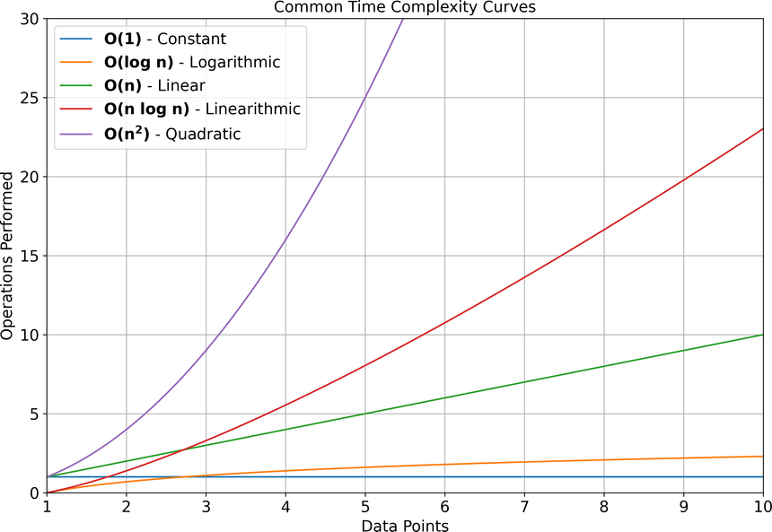
Big O Notation
Describes the upper bound of an algorithm’s growth rate
Simplifies complexity analysis by focusing on dominant terms
Common notations
O(1): Constant time/space (doesn’t grow with n)
O(log n): Logarithmic (grows logarithmically with n)
O(n): Linear
O(n log n): Linearithmic
O(n²): Quadratic
O(n³): Cubic
O(2^{n}): Exponential

Slide 10
Time Complexity
Measures how execution time grows with input size
Execution time depends on:
Number of operations
Types of operations
Processing power (ignored in theoretical analysis)
Analyzed by counting the number of basic operations
Though you’ll note, we don’t include constants in our conclusion
i.e. O(n/2) is still linear and so is still O(n).
O(10¹²n) is still linear, still O(n)
Switch to code - TimeComplexityExamples

Slide 11
Space Complexity
Measures how memory usage grows with input size
Memory usage includes:
Data space (variables, objects)
Stack space (function calls)
Heap space (dynamic allocations aka creating objects)
Java-specific considerations:
Object overhead
References
Garbage collection
Switch to code - SpaceComplexityExamples

Slide 12
Optimizing for Time and Space
If you’ve ever used LeetCode (a site to practice interview coding questions), time and space are the sole indicators for performance.
Time-Space Tradeoff: Often improving one worsens the other
Memoization: Trade space for time by caching results
Data Structure Selection: Choose based on operation frequency
Avoiding Unnecessary Object Creation: Reuse when possible
Measuring Performance: normal analysis, VisualVM, JProfiler

Slide 13
Binary Recursion
Here's why we talked about time complexity!
Two recursive calls per invocation
Time Complexity: O(2^{n})* *technically O(φ^{n}) where phi is golden ratio
Space Complexity: O(n)
public static int fibonacci(int n) {
// Base cases
if (n <= 1) {
return n;
}
// Recursive case (two calls)
return fibonacci(n - 1) + fibonacci(n - 2);
}
Draw all of these out
Switch to code for all of these

Slide 14
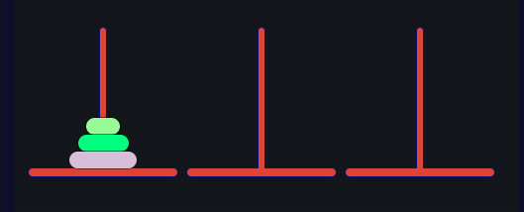
Multiple Recursion
Multiple recursive calls per invocation
Exponential time complexity O(2^{n})
Space Complexity: O(n)
Towers of Hanoi: Three pegs (source, auxiliary, and target) and a number of disks of different sizes. The goal is to move all disks from the source peg to the target peg, following these rules:
Only one disk can be moved at a time
A larger disk cannot be placed on top of a smaller disk
All disks start on the source peg in decreasing size order (largest at bottom)
https://www.mathsisfun.com/games/towerofhanoi.html

Slide 15
Towers of Hanoi Code
public static void hanoi( int n, char source, char auxiliary, char target) {
if (n == 1) {
sout("Move disk 1 from " + source + " to " + target);
return;
}
// Solve the one-step simpler case
hanoi(n - 1, source, target, auxiliary);
// Move the bottom peg to the target
sout("Move disk " + n + " from " + source + " to " + target);
// Solve the one-step simpler case, but starting on middle
hanoi(n - 1, auxiliary, source, target);
}

Slide 16
Tail Recursion
Recursive call is the last operation
No further computation after recursive call
public static int factorialTail(int n, int accumulator) {
// Base case
if (n <= 1) {
return accumulator;
}
// Tail recursive call
return factorialTail(n - 1, n * accumulator);
}
// Wrapper method
public static int factorial(int n) {
return factorialTail(n, 1);
}

Slide 17
Mutual Recursion
Methods call each other recursively, creating a cycle of dependencies
Useful for problems with alternating states
public static boolean isEven(int n) {
if (n == 0) {
return true;
}
return isOdd(n - 1);
}
public static boolean isOdd(int n) {
if (n == 0) {
return false;
}
return isEven(n - 1);
}

Slide 18
Recursive Binary Tree
Trees are one of the most common data structures that we use recursion for
Traversals:
Preorder: Note the node upon first sight
Inorder: Note the node as you move to the right
Postorder: Note the node upon last sight
Searching:
If unsorted, check if the root is the node you're looking for
Else, check if its in the left subtree.
If it's not, check if its in the right subtree.

Slide 19
Recursive Binary Search
We did this iteratively back in L6 Arrays
In theory, any iterative algorithm can be converted to a recursive one.
private static int binarySearch(int[] arr, int target, int low, int high){ if (low > high) { return -1; } int mid = low + (high - low) / 2; if (arr[mid] == target) { return mid; } if (arr[mid] > target) { return binarySearch(arr, target, low, mid - 1); } return binarySearch(arr, target, mid + 1, high); }

Slide 20
Memoization
Caching values to remove repetitive recursive cases
Once we find fibonacci(5), we don’t need to recurse through its subcalls again.
We store previously solved values in a Map, which is an object holding a set of key-value pairs
Need to define it as HashMap as Map is an interface
map.get(key) produces a value at that key
map.put(key, value) puts a value at that key

Slide 21
Combinatorics/Permutations
When we want to completely exhaust a search space, we can use recursion to gather all possible combinations within our set
All permutations of ABC:
ABC
ACB
BAC
BCA
CBA
CAB
All combinations from the set {1, 2, 3}:
1
2
3
1 2
1 3
2 3
1 2 3
Switch to code combinatorics, permutations

