Slide 1

CS 501 – Introduction to JAVA Programing
Mathematical Functions, Characters, and Strings
Loops

Slide 2

4.1. Motivations
Suppose that you need to print a string (e.g., "Welcome to Java!") a hundred times. It would be tedious to have to write the following statement a hundred times:
System.out.println("Welcome to Java!");
So, how do you solve this problem?

Slide 3
4.1. Motivations
System.out.println("Welcome | to | Java!");
System.out.println("Welcome | to | Java!");
System.out.println("Welcome | to | Java!");
System.out.println("Welcome | to | Java!");
System.out.println("Welcome | to | Java!");
System.out.println("Welcome | to | Java!");
…
…
… System.out.println("Welcome | to | Java!");
System.out.println("Welcome | to | Java!");
System.out.println("Welcome | to | Java!");
100
times

Slide 4
4.2. while Loop
int count = 0;
while (count < 100) { System.out.println("Welcome to Java"); count++;
}

Slide 5
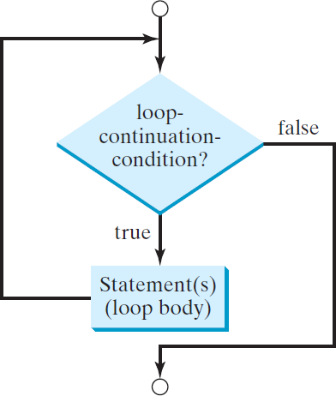
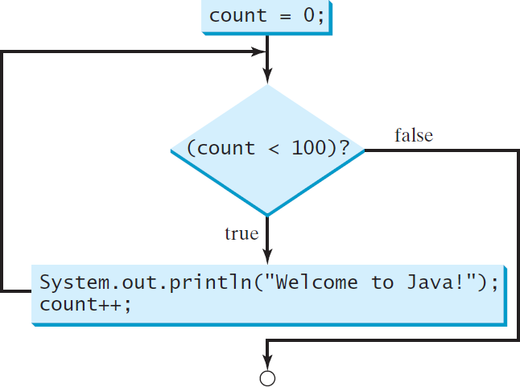
4.2.1. while Loop
while (loop-continuation-condition) {
// loop-body; Statement(s);
}
int count = 0;
while (count < 100) { System.out.println("Welcome to Java!"); count++;
}

Slide 6
4.2.1. while Loop
Initialize count
int count = 0;
while (count < 2) { System.out.println("Welcome count++;
to Java!");
}

Slide 7
4.2.1. while Loop
(count < 2) is true
int count = 0;
while (count < 2) {
System.out.println("Welcome to Java!"); count++;
}

Slide 8
4.2.1. while Loop
int count = 0;
< 2) {
Print Welcome to Java
while (count
System.out.println("Welcome to Java!");
count++;
}

Slide 9
4.2.1. while Loop
Increase count by 1 count is 1 now
int count = 0;
< 2) {
while (count
System.out.println("Welcome to Java!");
count++;
}

Slide 10
4.2.1. while Loop
(count < 2) is still true since count is 1
int count = 0;
while (count < 2) {
System.out.println("Welcome to Java!"); count++;
}

Slide 11
4.2.1. while Loop
int count = 0;
< 2) {
Print Welcome to Java
while (count
System.out.println("Welcome to Java!");
count++;
}

Slide 12
4.2.1. while Loop
Increase count by 1 count is 2 now
int count = 0;
< 2) {
while (count
System.out.println("Welcome to Java!");
count++;
}

Slide 13
4.2.1. while Loop
(count < 2) is false since count is 2 now
int count = 0;
while (count < 2) {
System.out.println("Welcome to Java!"); count++;
}

Slide 14
4.2.1. while Loop
The loop exits. Execute the next statement after the loop.
int count = 0;
< 2) {
while (count
System.out.println("Welcome to Java!"); count++;
}

Slide 15
4.2.1. Problem: Repeat Addition Until Correct
Using a loop, write the program to let the user enter a new answer until it is correct. Let the problem be generated randomly from 0 to 10.

Slide 16
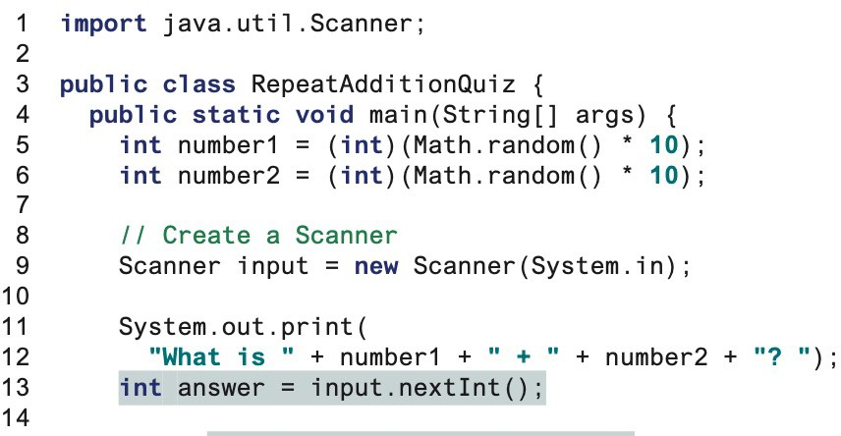
4.2.1. Problem: Repeat Addition Until Correct
Assign two random numbers Why *10?
Show a question

Slide 17
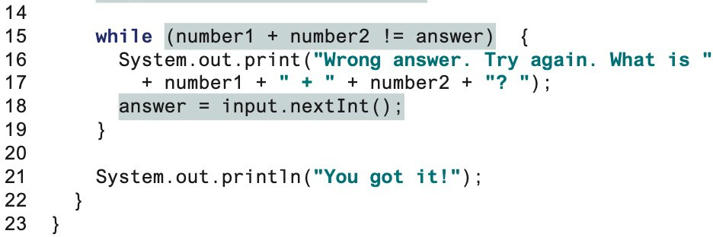
4.2.1. Problem: Repeat Addition Until Correct
Using a while loop, we can iterate until we the the correct answer.
The condition is while the answer is incorrect.
Why is it outside of the loop?
CS501 - L4 - Loop
17

Slide 18
4.2.2. Problem: Guessing Numbers
Write a program that randomly generates an integer between 0 and 100, inclusive.
The program prompts the user to enter a number continuously until the number matches the randomly generated number.
For each user input, the program tells the user whether the input is too low or too high, so the user can choose the next input intelligently.

Slide 19
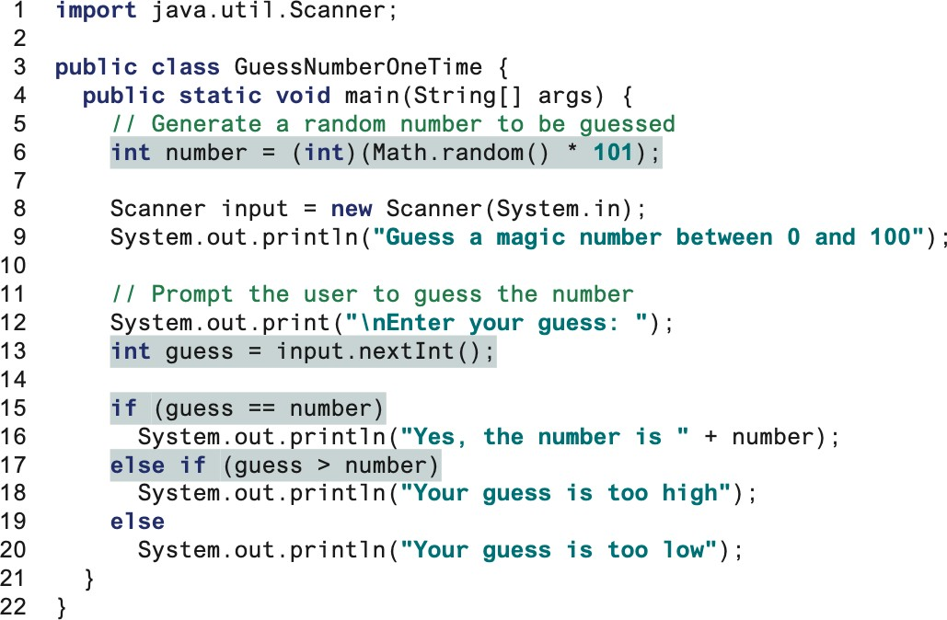
4.2.2. Problem: Guessing Numbers
Assign a number. Why 101, not 100?
Input the guess number.
If-else statement begins.

Slide 20
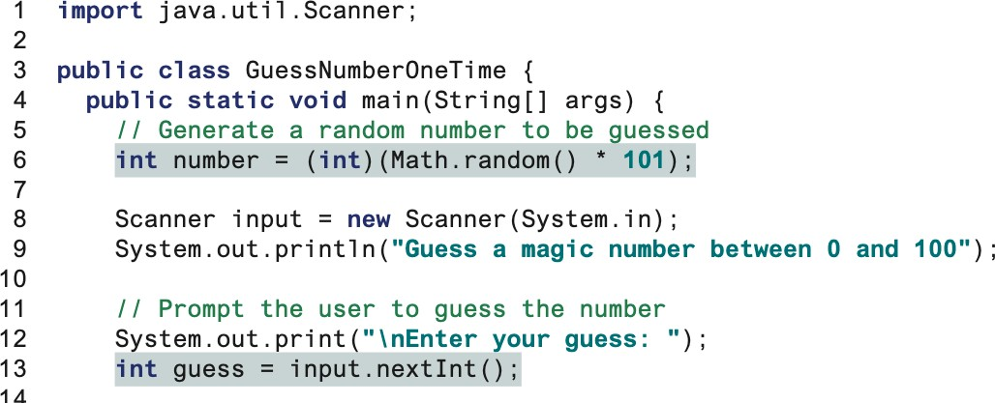
4.2.2. Problem: Guessing Numbers
How can we improve it to meet the condition of problem?

Slide 21
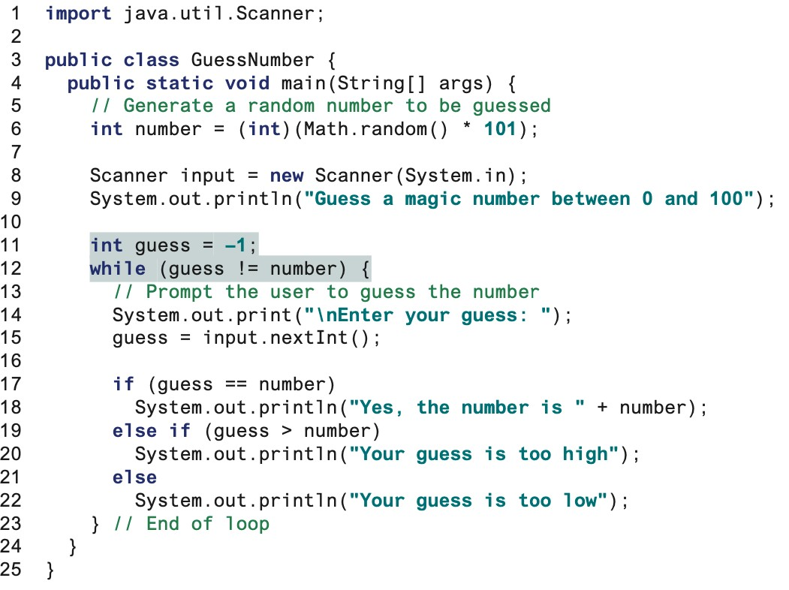
4.2.2. Problem: Guessing Numbers
We have a while loop. L11 necessary? Why? What are other ways w/o using L11.

Slide 22
4.2.3. Problem: An Advanced Math Learning Tool
The Math subtraction learning tool program generates just one question for each run.
You can use a loop to generate five questions and report the number of the correct answers and the time took answering five questions.
Answers cannot be negative.

Slide 23

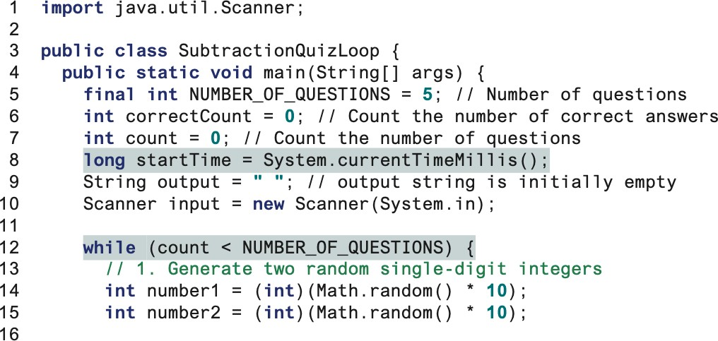
4.2.3. Problem: An Advanced Math Learning Tool
Define the constant variable: number of questions.
Initialize the correct and questions
Record the starting time
While starts…

Slide 24
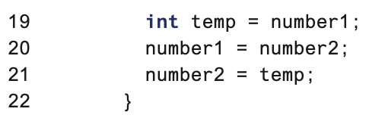
4.2.3. Problem: An Advanced Math Learning Tool
If number2 > number 1, answer is negative.

Slide 25
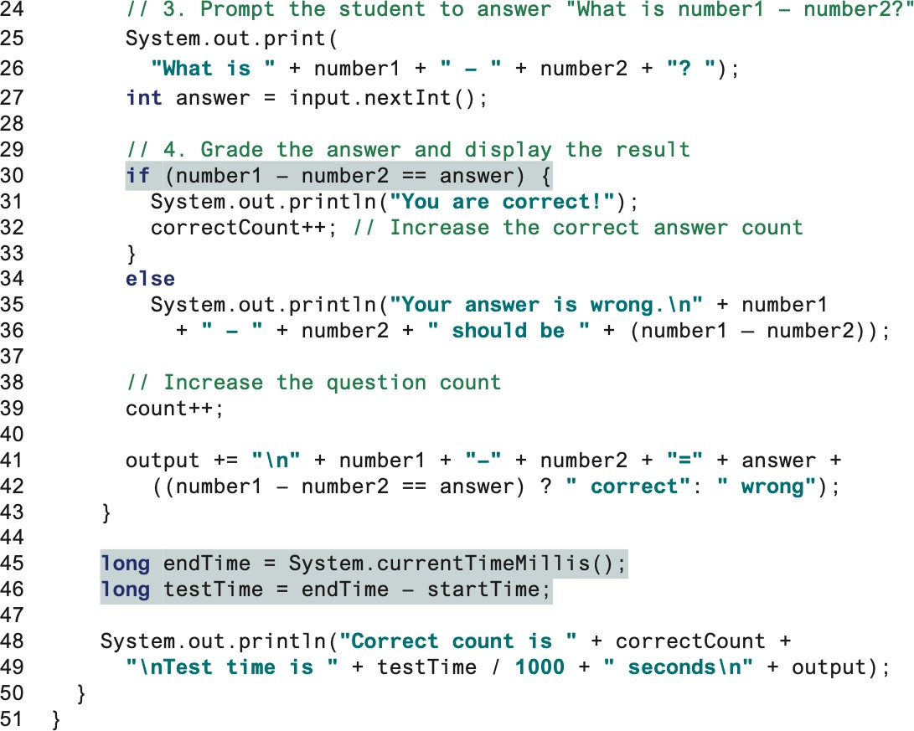
4.2.3. Problem: An Advanced Math Learning Tool
Increase count by 1. The loop will terminate if count>5
CS501 - L4 - Loop

Slide 26
4.2.4. Ending a Loop with a Sentinel Value
Often the number of times a loop is executed is not predetermined.
You may use an input value to signify the end of the loop. Such a value is known as a sentinel value.
Write a program that reads and calculates the sum of an unspecified number of integers. The input 0 signifies the end of the input.

Slide 27
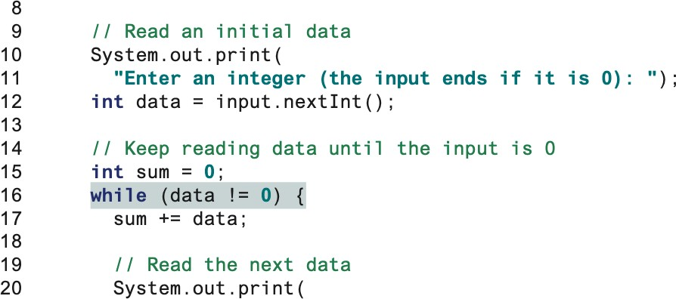
4.2.4. Ending a Loop with a Sentinel Value
The loop will not terminate if data is not 0.

Slide 28

4.2.4. Ending a Loop with a Sentinel Value
Don’t use floating-point values for equality checking in a loop control.
Since floating-point values are approximations for some values, using them could result in imprecise counter values and inaccurate results.
Consider the following code for computing 1 + 0.9 + 0.8 + ... + 0.1:
double while
sum
item = 1; double
!= 0) { //
sum = 0;
(item
No guarantee item will be 0
+= item;
item -= 0.1;
}
System.out.println(sum);

Slide 29
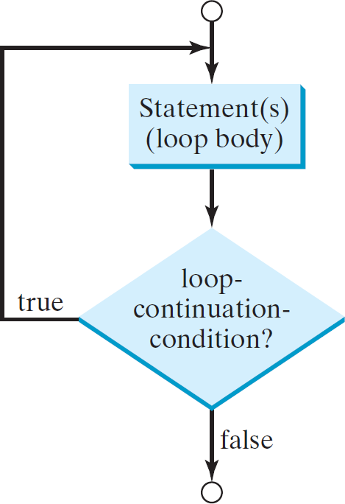
4.3. do-while Loop
do {
// Loop body; Statement(s);
} while (loop-continuation-condition);

Slide 30
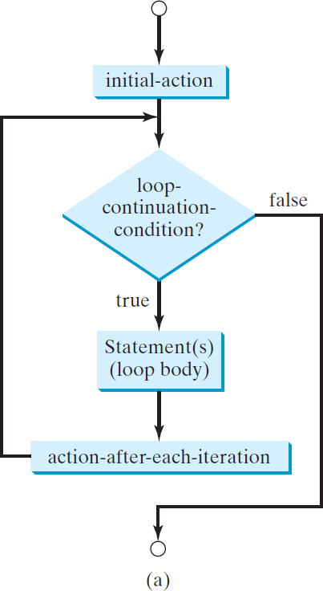
4.4. for Loops
for (initial-action; loop-continuation-condition; action-after-each-iteration) {
// loop body; Statement(s);
}

Slide 31
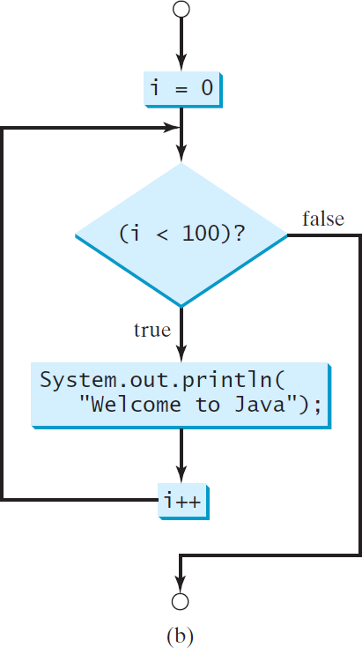
4.4. for Loops
int i;
for (i = 0; i < 100; i++) { System.out.println(
"Welcome to Java!");
}

Slide 32
4.4. for Loops
Declare i
int i;
for (i = 0; i < 2; i++) { System.out.println("Welcome to Java!");
}

Slide 33
4.4. for Loops
Execute initializer i is now 0
int i;
for (i = 0; i < 2; i++) {
System.out.println("Welcome to Java!");
}

Slide 34
4.4. for Loops
(i < 2) is true since i is 0
int i;
for (i = 0; i < 2; i++) {
System.out.println("Welcome to Java!");
}

Slide 35
4.4. for Loops
Print Welcome to Java
int i;
for (i = 0; i < 2; i++) {
System.out.println("Welcome to Java!");
}

Slide 36
4.4. for Loops
Execute adjustment statement i now is 1
int i;
for (i = 0; i < 2; i++) {
System.out.println("Welcome to Java!");
}

Slide 37
4.4. for Loops
(i < 2) is still true since i is 1
int i;
for (i = 0; i < 2; i++) {
System.out.println("Welcome to Java!");
}

Slide 38
4.4. for Loops
Print Welcome to Java
int i;
for (i = 0; i < 2; i++) {
System.out.println("Welcome to Java!");
}

Slide 39
4.4. for Loops
Execute adjustment statement i now is 2
int i;
for (i = 0; i < 2; i++) {
System.out.println("Welcome to Java!");
}

Slide 40
4.4. for Loops
(i < 2) is false since i is 2
int i;
for (i = 0; i < 2; i++) {
System.out.println("Welcome to Java!");
}

Slide 41
4.4. for Loops
Exit the loop. Execute the next statement after the loop
int | i;
for | (i | = | 0; | i | < | 2; | i++) | {
System.out.println("Welcome to Java!");
}

Slide 42
4.4. for Loops
The initial-action in a for loop can be a list of zero or more comma-separated expressions.
The action-after-each-iteration in a for loop can be a list of zero or more comma- separated statements.
Therefore, the following two for loops are correct. They are rarely used in practice, however.
for (int i = 1; i < 100; System.out.println(i++));
for (int i = 0, j = 0; (i + j < 10); i++, j++) {
// Do something
}

Slide 43
4.4. for Loops
If the loop-continuation-condition in a for loop is omitted, it is implicitly true.
Thus the statement given below in (a), which is an infinite loop, is correct.
Nevertheless, it is better to use the equivalent loop in (b) to avoid confusion:
for ( ; ; ) {
// Do something
}
Equivalent
while (true) {
// Do something
}
(a)
(b)

Slide 44
4.4. for Loops
Adding a semicolon at the end of the for clause before the loop body is a common mistake, as shown below:
Logic Error
for (int i=0; i<10; i++);
{
System.out.println("i is " + i);
}

Slide 45
4.4. for Loops
Similarly,
the following loop is also wrong:
int i=0;
Logic Error
while (i < 10);
{
System.out.println("i is " + i); i++;
}
In
the case of the
do loop,
to end the loop.
the following
semicolon
is needed
int i=0; do {
System.out.println("i is " + i);
i++;
} while (i<10);
Correct

Slide 46
4.5. Which Loop to Use?
The three forms of loop statements, while, do-while, and for, are expressively equivalent; that is, you can write a loop in any of these three forms. For example, a while loop in (a) in the following figure can always be converted into the following for loop in (b):
while (loop-continuation-condition) {
// Loop body
}
Equivalent
for ( ; loop-continuation-condition; )
// Loop body
}
(a) (b)
A for loop in (a) in the following figure can generally be converted into the following while loop in (b) except in certain special cases
for (initial-action;
loop-continuation-condition; action-after-each-iteration) {
// Loop body;
}
initial-action;
while (loop-continuation-condition) {
// Loop body;
action-after-each-iteration;
}
Equivalent
(a)
(b)

Slide 47
4.6. Nested Loops
Problem: Write a program that uses nested for loops to print a multiplication table vertically.

Slide 48
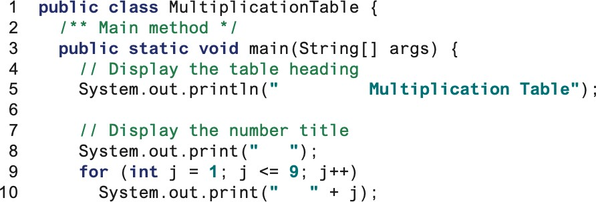
4.6. Nested Loops

Slide 49
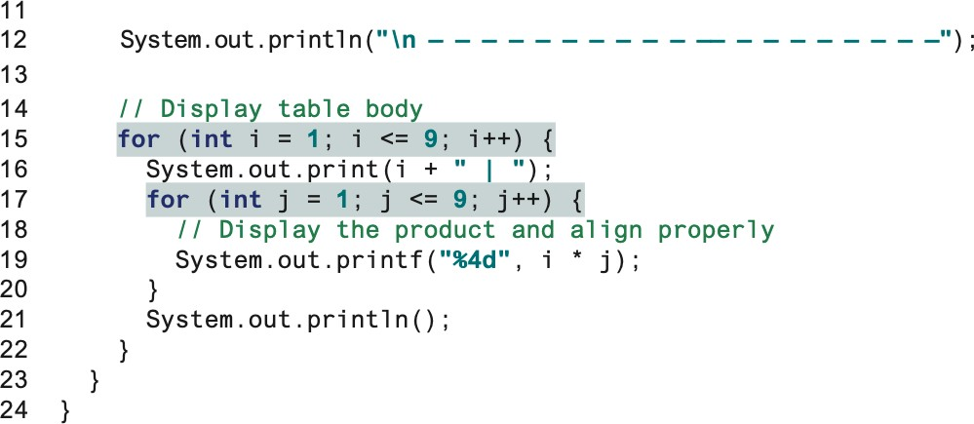
4.6. Nested Loops
Columns
Rows

Slide 50
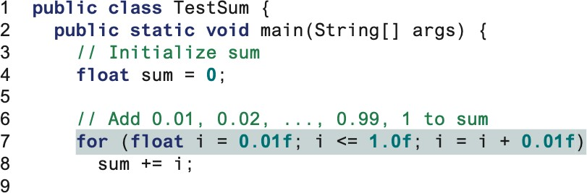
4.7. Minimizing Numerical Errors
Numeric errors involving floating-point numbers are inevitable.
Here is an example that sums a series that starts with 0.01 and ends with 1.0. The numbers in the series will increment by 0.01, as follows: 0.01 + 0.02 +
0.03 and so on.

Slide 51
4.8. Problem: Finding the Greatest Common Divisor
Problem: Write a program that prompts the user to enter two positive integers and finds their greatest common divisor.
Solution: Suppose you enter two integers 4 and 2, their greatest common divisor is 2. Suppose you enter two integers 16 and 24, their greatest common divisor is 8. So, how do you find the greatest common divisor?
Let the two input integers be n1 and n2. You know number 1 is a common divisor, but it may not be the greatest commons divisor. So you can check whether k (for k = 2, 3, 4, and so on) is a common divisor for n1 and n2, until k is greater than n1 or n2.

Slide 52
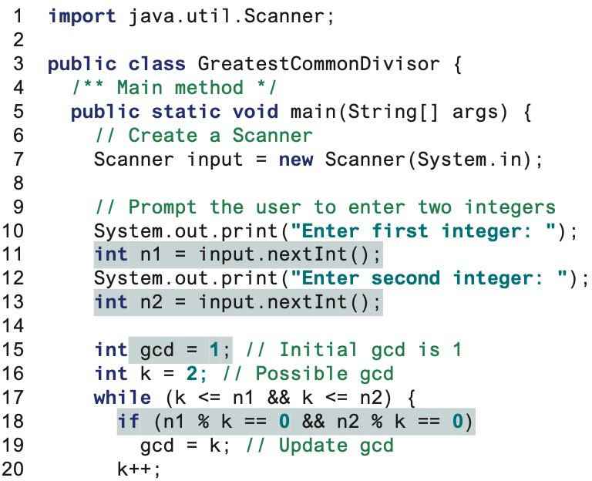
4.8. Problem: Finding the Greatest Common Divisor
Why?
What happens to k?

Slide 53
4.9. Problem: Predicting the Future Tuition
Problem: Suppose that the tuition for a university is $10,000 this year and tuition increases 7% every year. In how many years will the tuition be doubled?

Slide 54
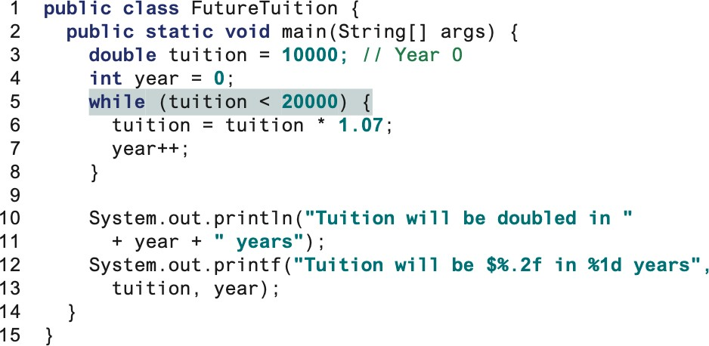
4.9. Problem: Predicting the Future Tuition
Why double?
Why <2000? Why not
=2000?

Slide 55
4.10. Using break and continue
You can also use break in a loop to immediately terminate the loop.
You can also use the continue keyword in a loop. When it is encountered, it ends the current iteration and program control goes to the end of the loop body.
In other words, continue breaks out of an iteration, while the
break keyword breaks out of a loop.

Slide 56
4.10. Using break and continue
public class TestBreak {
public static void main(String[] int sum = 0;
int number = 0;
args) {
while (number < 20) { number++;
sum += number;
When will it work?
if (sum >= 100)
break;
}
System.out.println("The number is " + number); System.out.println("The sum is " + sum);
}
}

Slide 57
4.10. Using break and continue
public class TestContinue {
public static void main(String[] int sum = 0;
int number = 0;
args) {
while (number < 20) { number++;
if (number == 10 || number == 11) continue;
sum += number;
}
What does it do?
System.out.println("The sum is " + sum);
}
}

Slide 58
4.11. Problem: Displaying Prime Numbers
Problem: Write a program that displays the first 50 prime numbers in five lines, each of which contains 10 numbers.
An integer greater than 1 is prime if its only positive divisor is 1 or itself. For example, 2, 3, 5, and 7 are prime numbers, but 4, 6, 8, and 9 are not.
Solution: The problem can be broken into the following tasks:
For number = 2, 3, 4, 5, 6, ..., test whether the number is prime.
Determine whether a given number is prime.
Count the prime numbers.
Print each prime number, and print 10 numbers per line.

Slide 59
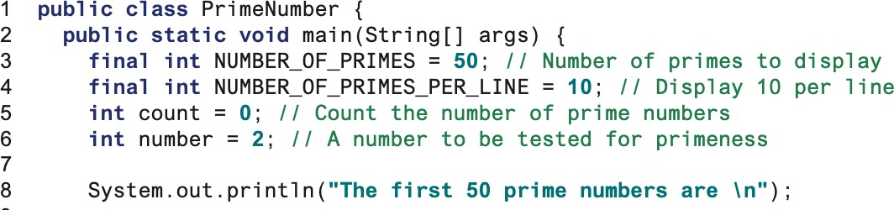
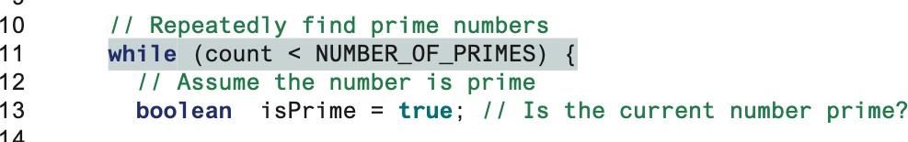
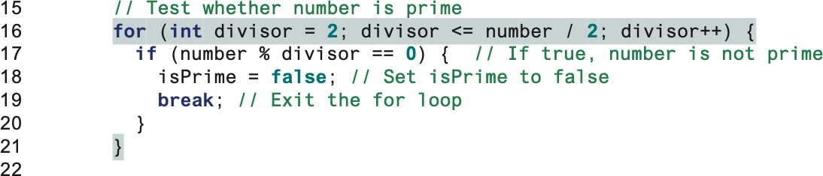
What are constants and variables?
4.11. Problem: Displaying Prime Numbers
Need a while loop to find the primes.
Need to test the primes.

Slide 60
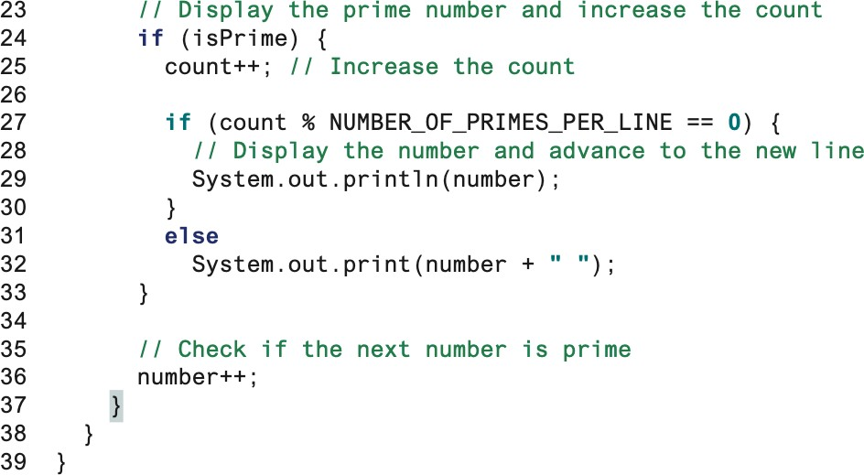
4.11. Problem: Displaying Prime Numbers
Why do we update count?
What is the role of this if test?
What is the updated number?

