Slide 1

CS 501 – Introduction to JAVA Programing
Lecture 5 – Methods
Lecture 6 – 1-D Array
Lecture 7 – M-D Array

Slide 2

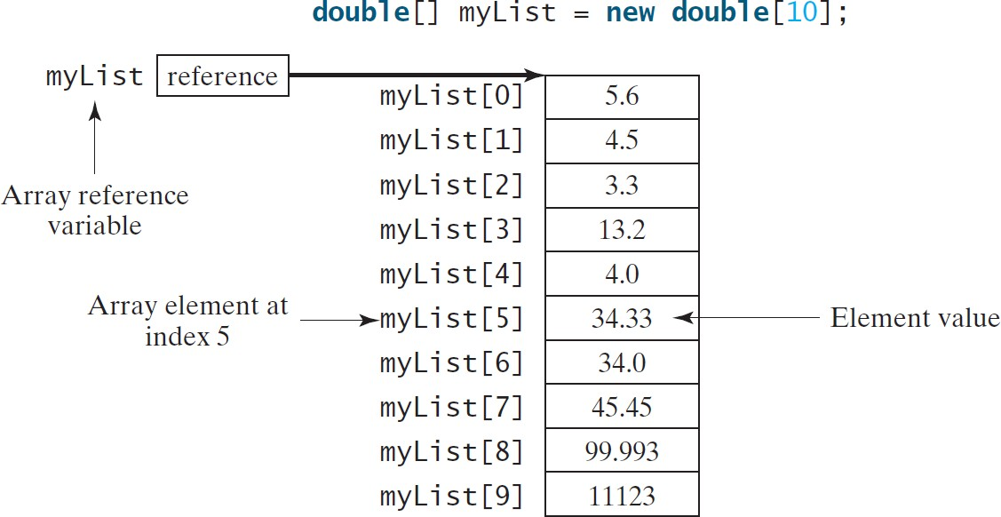
6.1. Introducing Arrays
Array is a data structure that represents a collection of the same types of data.

Slide 3
6.2. Array Basics
Declaration:
datatype[] arrayRefVar;
Example:
double[] myList;
// This style is allowed, but not preferred This is more C/C++ style.
datatype arrayRefVar[]; Example:
double myList[];

Slide 4
6.2. Array Basics
Creating Array:
arrayRefVar = new datatype[arraySize];
Example:
myList = new double[10];
myList[0] references the first element in the array. myList[9] references the last element in the array.

Slide 5
6.2. Array Basics
datatype[] arrayRefVar = new datatype[arraySize];
double[] myList = new double[10];

Slide 6
6.2. Array Basics
Once an array is created, its size is fixed. It cannot be changed. You can find its size using
arrayRefVar.length
For example,
double myList[] = new double[10]; myList.length returns 10

Slide 7
6.2. Array Basics
When an array is created, its elements are assigned the default value of 0 for the numeric primitive data types, '\u0000' for char types, and false for boolean types.

Slide 8
6.2. Array Basics
The array elements are accessed through the index. The array indices are 0-based, i.e., it starts from 0 to arrayRefVar.length-1. In the example in Figure 6.1, myList holds ten double values and the indices are from 0 to 9.
Each element in the array is represented using the following syntax, known as an indexed variable:
arrayRefVar[index];

Slide 9
6.2. Array Basics
After an array is created, an indexed variable can be used in the same way as a regular variable.
For example, the following code adds the value in myList[0] and myList[1] to
myList[2].
myList[2] = myList[0] + myList[1];

Slide 10
6.2. Array Basics
Declaring, creating, initializing in one step:
double[] myList = {1.9, 2.9, 3.4, 3.5};
This shorthand syntax must be in one statement.

Slide 11
6.2. Array Basics
double[] myList = {1.9, 2.9, 3.4, 3.5};
This shorthand notation is equivalent to the following statements:
double[] myList = new double[4]; myList[0] = 1.9;
myList[1] = 2.9;
myList[2] = 3.4;
myList[3] = 3.5;

Slide 12
6.2. Array Basics
Using the shorthand notation, you have to declare, create, and initialize the array all in one statement. Splitting it would cause a syntax error.
For example, the following is wrong:
double[] myList;
myList = {1.9, 2.9, 3.4, 3.5};

Slide 13
6.2. Array Basics
Declare array variable values, create an array, and assign its reference to values
public class Test {
public static void main(String[] args) {
After the array is created
int[] values = new int[5];
for (int i = 1; i < 5; i++) { values[i] = i + values[i-1];
}
values[0] = values[1] + values[4];
0
0
0
0
0
0
1
2
3
4
}
}

Slide 14
6.2. Array Basics
i becomes 1
public class Test {
public static void main(String[] args) { int[] values = new int[5];
After the array is created
for (int i = 1; i < 5; i++) {
0
0
0
0
0
0
values[i] = i + values[i-1];
}
values[0] = values[1] + values[4];
1
2
}
3
}
4

Slide 15
6.2. Array Basics
i (=1) is less than 5
public class Test {
public static void main(String[] args) { int[] values = new int[5];
After the array is created
for (int i = 1; i++) {
0
0
0
0
0
i < 5;
0
values[i] = i + values[i-1];
1
}
values[0] = values[1] + values[4];
2
3
}
4
}

Slide 16
6.2. Array Basics
After this line is executed, value[1] is 1
public class Test {
public static void main(String[] args) { int[] values = new int[5];
for (int i = 1; i < 5; i++) {
After the first iteration
0
0
values[i] = i + values[i-1];
1
1
}
values[0] = values[1] + values[4];
2
0
3
0
}
4
0
}

Slide 17
6.2. Array Basics
public class Test {
public static void main(String[] args) {
int[] values = new int[5]; for (int i = 1; i < 5; i++) {
After i++, i becomes 2
After the first iteration
0
0
values[i] = i + values[i-1];
1
1
}
values[0] = values[1] + values[4];
0
2
3
0
4
0
}
}

Slide 18
6.2. Array Basics
public class Test {
public static void main(String[] args) {
int[] values = new int[5];
i (= 2) is less than 5
After the first iteration
for (int i = 1; i < 5; i++) {
0
0
1
1
values[i] = i + values[i-1];
2
0
}
values[0] = values[1] + values[4];
3
0
4
0
}
}

Slide 19
6.2. Array Basics
After this line is executed, values[2] is 3 (2 + 1)
public class Test {
public static void main(String[] args) {
int[] values = new int[5]; for (int i = 1; i < 5; i++) {
After the second iteration
0
0
1
1
values[i] = i + values[i-1];
}
values[0] = values[1] + values[4];
2
3
3
0
4
0
}
}

Slide 20
6.2. Array Basics
After this, i becomes 3.
public class Test {
public static void main(String[] args) { int[] values = new int[5];
After the second iteration
0
0
1
3
0
0
for (int i = 1; i < 5; i++) {
1
values[i] = i + values[i-1];
2
}
values[0] = values[1] + values[4];
3
4
}
}

Slide 21
6.2. Array Basics
i (=3) is still less than 5.
public class Test {
public static void main(String[] args) { int[] values = new int[5];
After the second iteration
for (int i = 1; i < 5; i++) {
0
0
1
3
0
0
values[i] = i + values[i-1];
1
}
values[0] = values[1] + values[4];
2
3
}
4
}

Slide 22
6.2. Array Basics
After this line, values[3] becomes 6 (3 + 3)
public class Test {
public static void main(String[] args) { int[] values = new int[5];
for (int i = 1; i < 5; i++) {
After the third iteration
0
0
values[i] = i + values[i-1];
1
1
}
values[0] = values[1] + values[4];
2
3
3
6
}
4
0
}

Slide 23
6.2. Array Basics
After this, i becomes 4
public class Test {
public static void main(String[] args) { int[] values = new int[5];
After the third iteration
0
0
1
3
6
0
for (int i = 1; i < 5; i++) {
1
values[i] = i + values[i-1];
2
}
values[0] = values[1] + values[4];
3
4
}
}

Slide 24
6.2. Array Basics
public class Test {
i (=4) is still less than 5
public static void main(String[] args) { int[] values = new int[5];
for (int i = 1; i < 5; i++) {
After the third iteration
0
0
1
3
6
0
1
values[i] = i + values[i-1];
2
3
}
values[0] = values[1] + values[4];
4
}
}

Slide 25
6.2. Array Basics
After this, values[4] becomes 10 (4 + 6)
public class Test {
public static void main(String[] args) { int[] values = new int[5];
for (int i = 1; i < 5; i++) {
After the fourth iteration
0
0
1
1
values[i] = i + values[i-1];
2
3
}
values[0] = values[1] + values[4];
6
3
4
10
}
}

Slide 26
6.2. Array Basics
public class Test {
After i++, i becomes 5
public static void main(String[] args) { int[] values = new int[5];
After the fourth iteration
for (int i = 1; i < 5; i++) {
0
0
values[i] = i + values[i-1];
1
1
}
values[0] = values[1] + values[4];
2
3
3
6
}
4
10
}

Slide 27
6.2. Array Basics
i ( =5) < 5 is false. Exit the loop
public class Test {
public static void main(String[] args) { int[] values = new int[5];
After the fourth iteration
0
0
1
3
6
10
for (int i = 1; i < 5; i++) {
1
values[i] = i + values[i-1];
}
values[0] = values[1] + values[4];
2
3
}
4
}

Slide 28
6.2. Array Basics
After this line, values[0] is 11 (1 + 10)
public class Test {
public static void main(String[] args) { int[] values = new int[5];
for (int i = 1; i < 5; i++) {
values[i] = i + values[i-1];
}
0
11
1
1
2
3
3
6
values[0] = values[1] + values[4];
4
10
}
}

Slide 29
6.2. Array Basics
Processing Arrays
Initializing arrays with input values
Initializing arrays with random values
Printing arrays
Summing all elements
Finding the largest element
Finding the smallest index of the largest element
Random shuffling
Shifting elements

Slide 30
6.2. Array Basics
Initializing arrays with input values
java.util.Scanner input = new java.util.Scanner(System.in); System.out.print("Enter " + myList.length + " values: "); for (int i = 0; i < myList.length; i++)
myList[i] = input.nextDouble();
Initializing arrays with random values
for (int i = 0; i < myList.length; i++) { myList[i] = Math.random() * 100;
}

Slide 31
6.2. Array Basics
Printing arrays
for (int i = 0; i < myList.length; i++) { System.out.print(myList[i] + " ");
}
Summing all elements
double total = 0;
for (int i = 0; i < myList.length; i++) { total += myList[i];
}

Slide 32
6.2. Array Basics
Finding the largest element
double max = myList[0];
for (int i = 1; i < myList.length; i++) { if (myList[i] > max)
max = myList[i];
}
Finding the smallest index of the largest element
int indexOfMax = 0; double max = myList[0];
for (int i = 1; i < myList.length; i++) { if (myList[i] > max) {
max = myList[i];
indexOfMax = i;
}
}
Lecture 6 - 1-D Array
32

Slide 33
6.2. Array Basics
7. Random shuffling
for (int i = 0; i < myList.length - 1; i++) {
// Generate an index j randomly int j = (int)(Math.random()
* myList.length);
myList
i
[0] .
[1] .
[i]
.
.
// Swap myList[i] with myList[j] double temp = myList[i]; myList[i] = myList[j];
myList[j] = temp;
swap
A random index [j]
}

Slide 34
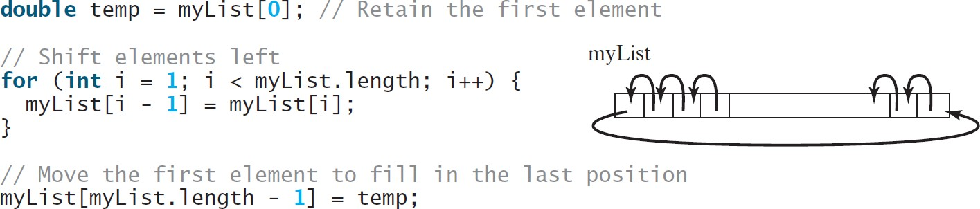
6.2. Array Basics
8. Shifting elements

Slide 35
6.2. Array Basics
We can traverse the complete array sequentially without using an index variable. For example, the following code displays all elements in the array myList:
for (double value: myList) System.out.println(value);
In general, the syntax is
for (elementType value: arrayRefVar) {
// Process the value
}
We need to use an index variable if we want to traverse the array in a different order or change the elements in the array.

Slide 36
6.2. Case Study 1
Read one hundred numbers, compute their average, and find out how many numbers are above the average.

Slide 37
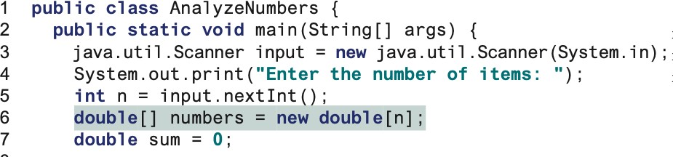
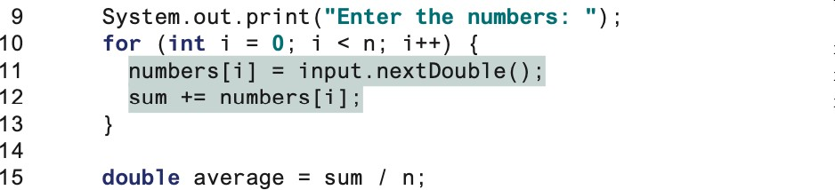
6.2. Case Study 1

Slide 38
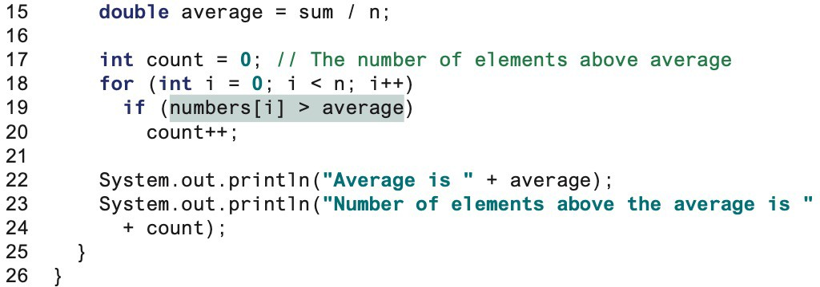
6.2. Case Study 1

Slide 39
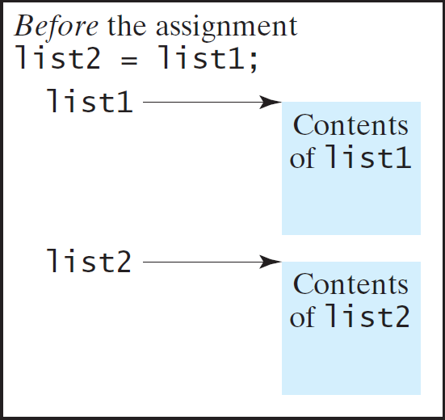
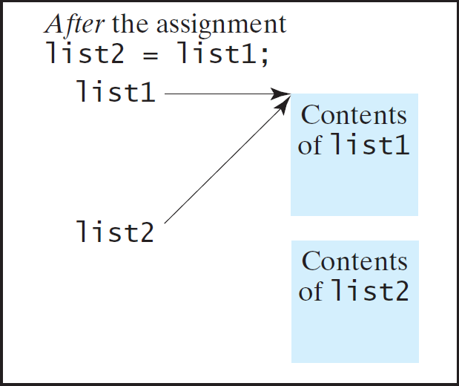
6.3. Copying Arrays
To duplicate an array or a part of an array, we ca use the assignment statement (=), as follows:
list2 = list1;

Slide 40
6.3. Copying Arrays
1. Use a loop:
int[] | sourceArray | = | {2, | 3, | 1, | 5, | 10};
int[] | targetArray | = | new
int[sourceArray.length];
for (int i = 0; i < sourceArrays.length; i++) targetArray[i] = sourceArray[i];

Slide 41
6.3. Copying Arrays
2. Use the static arraycopy method in the System class
arraycopy(sourceArray, src_pos, targetArray, tar_pos, length);
Example:
System.arraycopy(sourceArray, 0, targetArray, 0, sourceArray.length);

Slide 42
6.4. Passing Arrays to Methods
public static void printArray(int[] array) { for (int i = 0; i < array.length; i++) {
System.out.print(array[i] + " ");
}
}
Invoke the method
the reference of the array is passed to the method
int[] list = {3, 1, 2, 6, 4, 2};
printArray(list);
Invoke the method
printArray(new int[]{3, 1, 2, 6, 4, 2});
Anonymous array

Slide 43
6.4. Passing Arrays to Methods
Java uses pass by value to pass arguments to a method.
The differences between passing a value of variables of primitive data types and passing arrays:
For a parameter of a primitive type value:
The actual value is passed.
Changing the value of the local parameter inside the method does not affect the value of the variable outside the method.
For a parameter of an array type:
The value of the parameter contains a reference to an array.
The reference is passed to the method.
□Any changes to the array that occur inside the method body will affect the original array that was passed as the argument.

Slide 44
6.4. Passing Arrays to Methods
public static void main(String[] args) { int x = 1; // x represents an int value
int[] y = new int[10];
x =1
m(x, y); // Invoke m with arguments x an_{y}d₌ ₅₅y₅₅ System.out.println("x is " + x); System.out.println("y[0] is " + y[0]);
}
public static void m(int number, int[] numbers) { number = 1001; // Assign a new value to number numbers[0] = 5555; // Assign a new value to numbers[0]
}

Slide 45
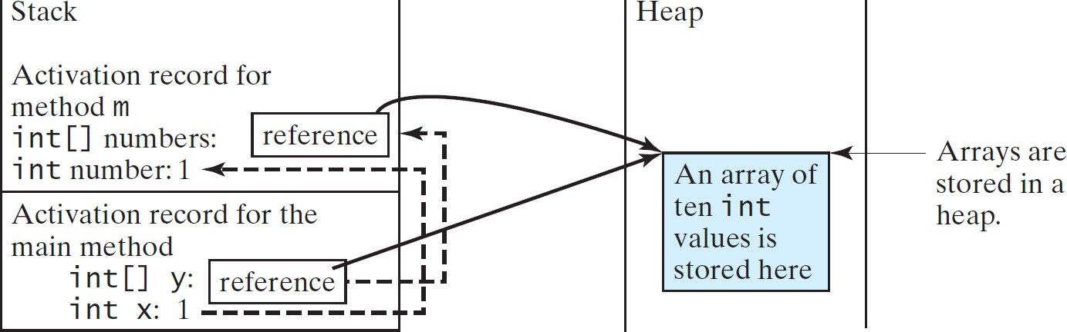
6.4. Passing Arrays to Methods
When invoking m(x, y), the values of x and y are passed to number and numbers.
Since y contains the reference value to the array, numbers now contains the same reference value to the same array.

Slide 46
6.4. Passing Arrays to Methods
Heap
The arrays are stored in a heap.
 | 5555
0
0
Space required for the main method
int[] y: reference
int x: 1
The array in an area of memory, called heap, which is used for dynamic memory allocation where blocks of memory are allocated and freed in an arbitrary order.

Slide 47
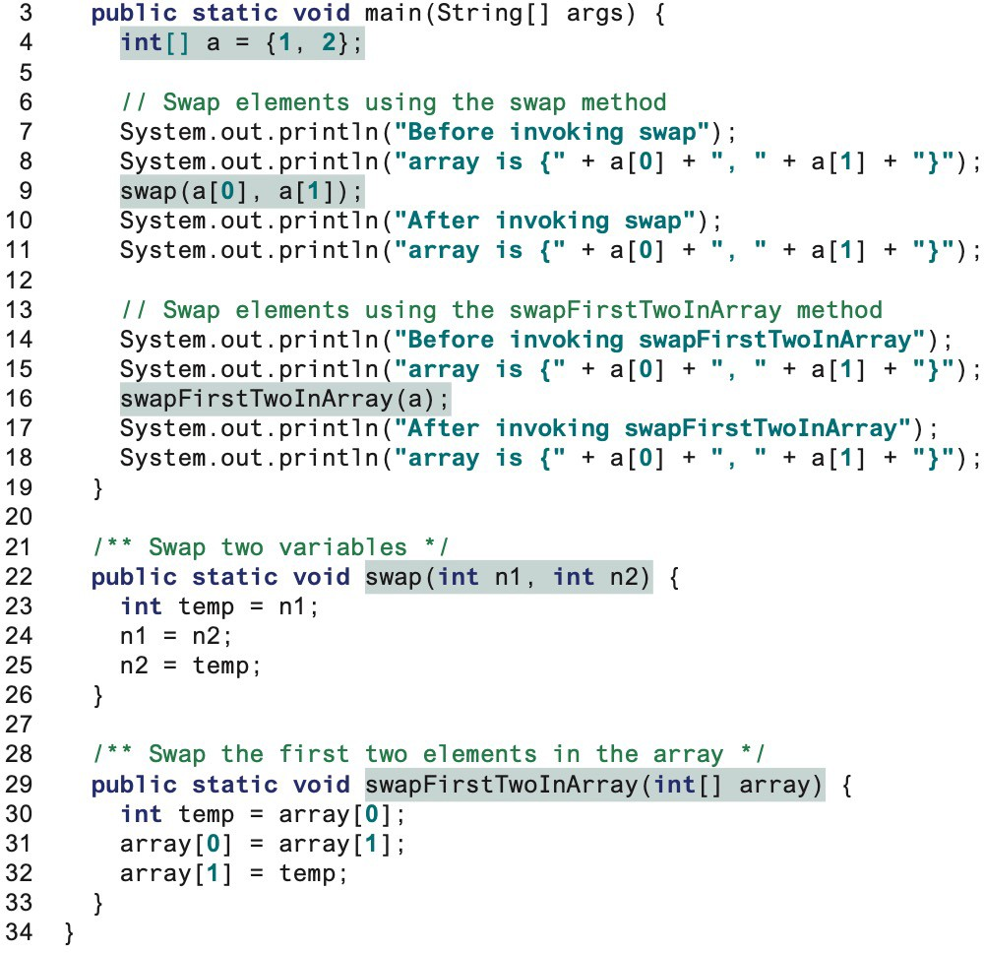
6.4. Passing Arrays to Methods
{1,2}
{2,1}

Slide 48
6.4. Returning an Array from a Method
public static int[] reverse(int[] list) { int[] result = new int[list.length];
for (int i = 0, j = result.length - 1; i < list.length; i++, j--) {
result[j] = list[i];
}
list
return result;
}
result
int[] list1 = {1, 2, 3, 4, 5, 6};
int[] list2 = reverse(list1);

Slide 49
6.4. Returning an Array from a Method int[] list1 = {1, 2, 3, 4, 5, 6}; int[] list2 = reverse(list1);
public static int[] reverse(int[] list) {
int[] result = new int[list.length];
for (int i = 0, j = result.length - 1; i < list.length; i++, j--) {
result[j] = list[i];
}
list
return result;
1 | 2 | 3 | 4 | 5 | 6
}
result
0 | 0 | 0 | 0 | 0 | 0

Slide 50
6.4. Returning an Array from a Method int[] list1 = {1, 2, 3, 4, 5, 6}; int[] list2 = reverse(list1);
public static int[] reverse(int[] list) { int[] result = new int[list.length];
i = 0 and j = 5
for (int i = 0, j = result.length - 1; i < list.length; i++, j--) {
result[j] = list[i];
}
return result;
list
1 | 2 | 3 | 4 | 5 | 6
result
0 | 0 | 0 | 0 | 0 | 0
}

Slide 51
6.4. Returning an Array from a Method
public static int[] reverse(int[] list) { int[] result = new int[list.length];^{i = 0 and j = 5}
Assign list[0] to result[5]
for (int i = 0, j = result.length - 1; i < list.length; i++, j--) {
result[j] = list[i];
}
list
1 | 2 | 3 | 4 | 5 | 6
return result;
}
result
0 | 0 | 0 | 0 | 0 | 1

Slide 52
6.4. Returning an Array from a Method
public static int[] reverse(int[] list) {
int[] result = new int[list.length]^{i};^{= 1 and j = 4}
Assign list[1] to result[4]
for (int i = 0, j = result.length - 1; i < list.length; i++, j--) {
result[j] = list[i];
}
list
1 | 2 | 3 | 4 | 5 | 6
return result;
}
result
0 0 0 0
2
1

Slide 53
6.4. Returning an Array from a Method
public static int[] reverse(int[] list) {
int[] result = new int[list.length]^{i};^{= 2 and j = 3}
Assign list[2] to result[3]
for (int i = 0, j = result.length - 1; i < list.length; i++, j--) {
result[j] = list[i];
}
list
1 | 2 | 3 | 4 | 5 | 6
return result;
}
result
0 0 0
3
2
1

Slide 54
6.4. Returning an Array from a Method
public static int[] reverse(int[] list) {
int[] result = new int[list.length]^{i};^{= 3 and j = 2}
Assign list[3] to result[2]
for (int i = 0, j = result.length - 1; i < list.length; i++, j--) {
result[j] = list[i];
}
list
1 | 2 | 3 | 4 | 5 | 6
return result;
}
result
0 0
4
3
2
1

Slide 55
6.4. Returning an Array from a Method
public static int[] reverse(int[] list) {
int[] result = new int[list.length]^{i};^{= 4 and j = 1}
Assign list[4] to result[1]
for (int i = 0, j = result.length - 1; i < list.length; i++, j--) {
result[j] = list[i];
}
list
1 | 2 | 3 | 4 | 5 | 6
return result;
}
result
0
5
4
3
2
1

Slide 56
6.4. Returning an Array from a Method
public static int[] reverse(int[] list) { int[] result = new int[list.length];
for (int i = 0, j = result.length - 1; i < list.length; i++, j--) {
result[j] = list[i];
}
list
1 | 2 | 3 | 4 | 5 | 6
return result;
}
result
6 | 5 | 4 | 3 | 2 | 1

Slide 57
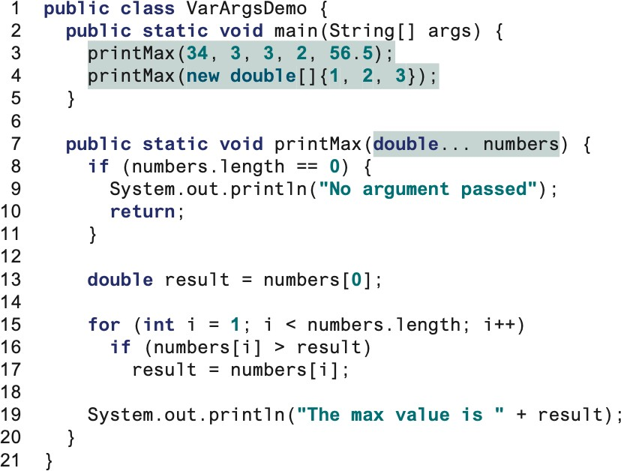
6.5. Variable-Length Arguments
We can pass a variable number of arguments of the same type to a method.
typeName … parameterName
Invokes with a variable-length argument list passed to the array numbers
Invokes with an array

Slide 58
6.5. Searching Array
Searching is the process of looking for a specific element in an array; for example, discovering whether a certain score is included in a list of scores.
Searching is a common task in computer programming.
There are many algorithms and data structures devoted to searching.
linear search
binary search.

Slide 59
6.5. Searching Array
The linear search approach compares the key element, key, sequentially with each element in the array list.
The method continues to do so until the key matches an element in the list or the list is exhausted without a match being found.
If a match is made, the linear search returns the index of the element in the array that matches the key.
If no match is found, the search returns -1.

Slide 60
6.5. Searching Array – Linear Search
/** The method for finding a key in the list */ public static int linearSearch(int[] list, int key) {
for (int i = 0; i < list.length; i++)
if (key == list[i]) return i;
return -1;
}
int[] list = {1, 4, 4, 2, 5, -3, 6, 2};
int | i | = | linearSearch(list, | 4);
int | j | = | linearSearch(list, | -4);
int | k | = | linearSearch(list, | -3);

Slide 61
6.5. Searching Array – Binary Search
For binary search to work, the elements in the array must already be ordered.
Without loss of generality, assume that the array is in ascending order.
e.g., 2 4 7 10 11 45 50 59 60 66 69 70 79
The binary search first compares the key with the element in the middle of the array.
Consider the following three cases:
If the key is less than the middle element, we need to search the key in the first half of the array.
If the key is equal to the middle element, the search ends with a match.
If the key is greater than the middle element, we only need to search the key in the second half of the array.

Slide 62
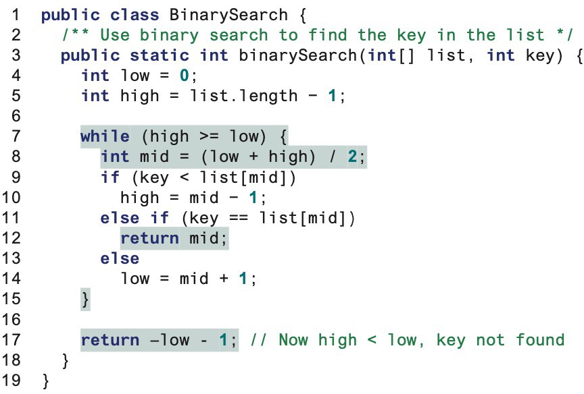
6.5. Searching Array – Binary Search
Find the mid-point index
Case 1
Case 2
Case 3
No cases

Slide 63
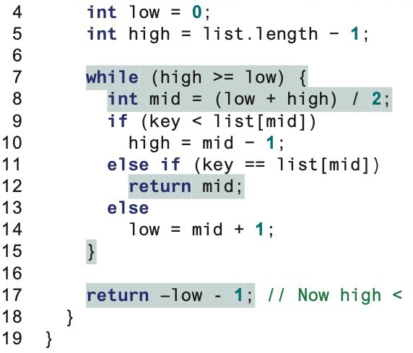
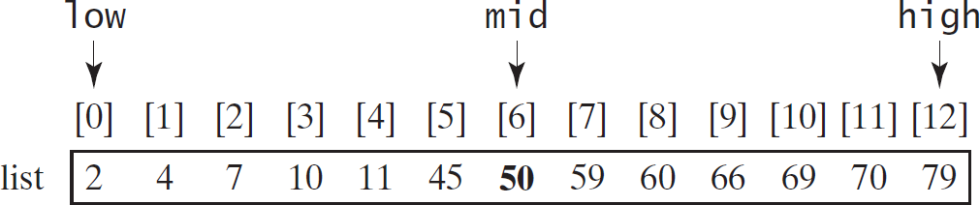
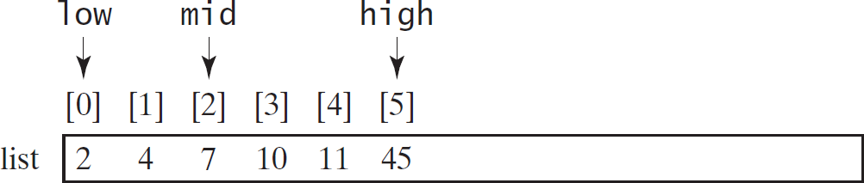
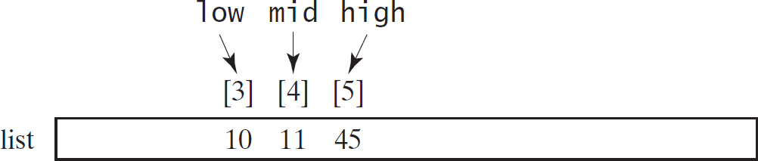
6.5. Searching Array – Binary Search
int[] list = {2, 4, 7, 10, 11, 45, 50, 59, 60, 66, 69, 70, 79};
i_{M}n_{i}t_{d=6}j_{,11<}=_{5,} B_{H}i_{ig}n_{h=}a₅rySearch.binarySearch(list, 11); // Returns 4
mid=4,11=11
Mid=2, 11>7, low=1

Slide 64
6.5. Searching Array – Binary Search
int[] list = {2, 4, 7, 10, 11, 45, 50, 59, 60, 66, 69, 70, 79};
int j = BinarySearch.binarySearch(list, 12);
Terminates when low>high
Then, return -6

Slide 65
6.5. Sorting Array
Sorting, like searching, is also a common task in computer programming. Many different algorithms have been developed for sorting.
For now, we will discuss selection sort.
General Idea:
Finds the smallest number in the list and places it first.
It then finds the smallest number remaining and places it second, and so on until the list contains only a single number.

Slide 66



6.5. Sorting Array – Selection Sort

Slide 67

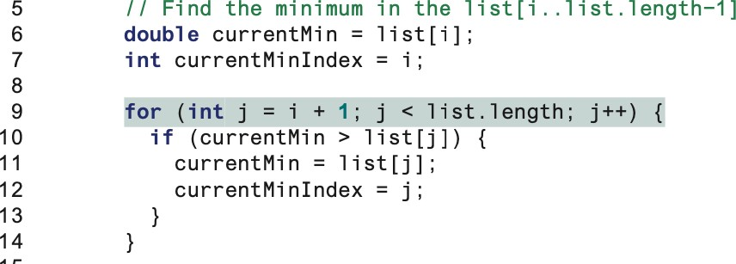
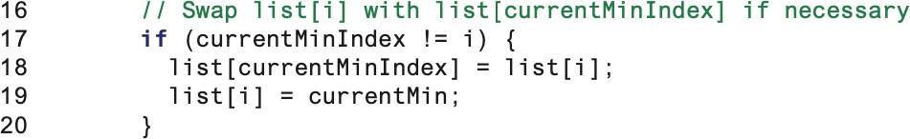
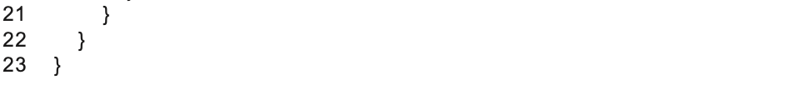
6.5. Sorting Array

Slide 68
6.6. The Arrays Class
Java provides several overloaded sort methods for sorting an array of int, double, char, short, long, and float in the java.util.Arrays class.

Slide 69
6.6. The Arrays Class
double[] numbers = {6.0, 4.4, 1.9, 2.9, 3.4, 3.5}; java.util.Arrays.sort(numbers); // Sort the whole array java.util.Arrays.parallelSort(numbers); // Sort the whole array
char[] chars = {'a', 'A', '4', 'F', 'D', 'P’};
java.util.Arrays.sort(chars, 1, 3); // Sort part of the array java.util.Arrays.parallelSort(chars, 1, 3);
int[] list = {2, 4, 7, 10, 11, 45, 50, 59, 60, 66, 69, 70, 79};
System.out.println("1. Index is " + java.util.Arrays.binarySearch(list, 11));
char[] chars = {'a', 'c', 'g', 'x', 'y', 'z’}; System.out.println("3. Index is " + java.util.Arrays.binarySearch(chars, 'a'));

Slide 70
6.6. The Arrays Class
int[] | list1 | = | {2, | 4, | 7, | 10};
int[] | list2 | = | {2, | 4, | 7, | 10};
int[] | list3 | = | {4, | 2, | 7, | 10};
System.out.println(java.util.Arrays.equals(list1, list2)); System.out.println(java.util.Arrays.equals(list2, list3));

Slide 71
6.7. Case Study: Calculator
Objective: Write a program that will perform binary operations on integers. The program receives three parameters: an operator and two integers.
java Calculator 2 + 3
java Calculator 2 - 3
java Calculator 2 / 3
java Calculator 2 . 3

Slide 72
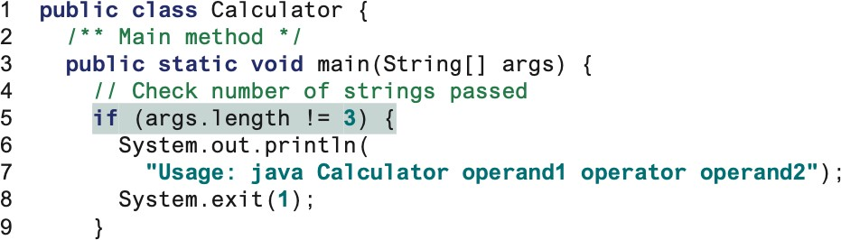
6.7. Case Study: Calculator

Slide 73
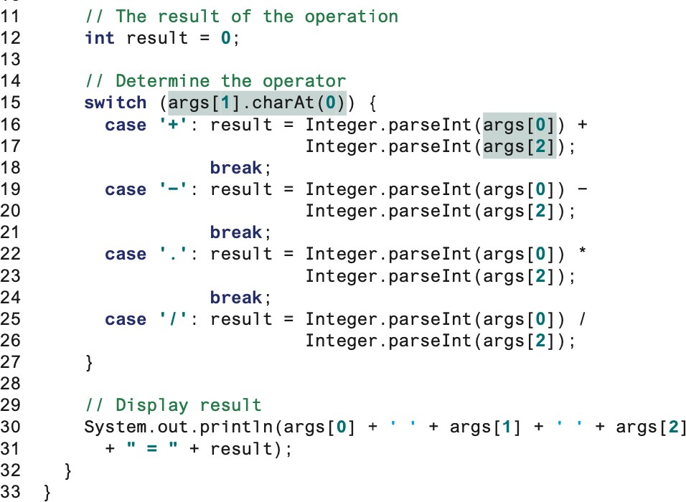
6.7. Case Study: Calculator

