Slide 1
Queues and Priority Queues
Lecture 16

Slide 2
Overview
Intro to Queues
Queue Operations
Implementation in Java
Priority Queues + Implementation
Heap Data Structure
Applications and Examples

Slide 3
What's a Queue?
Linear data structure that follows the First-In, First-Out (FIFO) principle.
The first element added to the queue will be the first one to be removed.
This is in contrast to a stack for example, which is Last-In, First-Out (LIFO)
Very common real world examples:
Standing in line
Print jobs sent to a printer
Drive throughs
Computer processes waiting for execution

Slide 4
Queue Terminology
Head/Front: Element next to be removed
Tail/Rear: Most recently added element
Enqueue: Adding an element to the rear of a queue
offer()/add()
offer() is preferred as it doesn't throw on a capped out queue
Dequeue: Removing an element from the front of a queue
poll()/remove()
poll() is preferred for same reason
Switch to Code – BasicQueue

Slide 5
Queue Interface
public interface Queue<E> extends Collection<E> {
// Basic operations
boolean add(E e); // Adds an element, throws exception if no space
boolean offer(E e); // Adds an element, returns false if no space
E remove(); // Removes and returns head, throws exception if empty
E poll(); // Removes and returns head, returns null if empty
E element(); // Retrieves but doesn't remove head, throws exception if empty
E peek(); // Retrieves but doesn't remove head, returns null if empty
}
Switch to code – QueueFromScratch

Slide 6
Common Applications of Queues
Process Scheduling
Operating systems use queues to manage processes waiting for CPU time
First-come, first-served scheduling uses basic queues
Buffering and Synchronization
Data buffers between producers and consumers
Message queues in distributed systems
Event handling in GUI applications
Breadth-First Search (BFS)
Graph traversal algorithm using queues to explore nodes level by level
Resource Allocation
Managing shared resources like printers, disk storage, CPU
Web Servers
Request handling: incoming HTTP requests are queued and processed

Slide 7
Print Queue
PrintJob
Take in a document and an assigned user
PrinterQueue
While there are jobs in the job queue, execute the printing process
Switch to Code - PrinterQueue

Slide 8
Round Robin (RR) Scheduler
Each process in the queue gets a small, fixed time slice to execute in a circular. If a process doesn't finish, its placed back into the end of the queue for its next turn.
Process Class:
ID, total execution time required, remaining time
RRScheduler:
LinkedList as queue (addLast can be made O(1) by adding a tail pointer)
Fixed time quantum (execution time slice)
Processes that don’t finish and placed back into queue

Slide 9
Priority Queue
Each element has an associated priority value
Elements with higher priority are served before elements with lower priority
Lower numbers typically mean high priority, high numbers mean low priority
Implement Priority Queue using a Min Heap
Min Heap: Binary tree where for any node, its value is less than those of its children
BasicPriorityQueue

Slide 10
What is a Heap?
A heap is a tree-based data structure that satisfies the heap property:
In a max heap, for any given node, the value is greater than or equal to the values of its children
In a min heap, for any given node, the value is less than or equal to the values of its children
Properties
Complete binary tree (All levels filled except leaf level, which is filled from left to right)
Heap property must be maintained for all nodes
Efficient for finding the max or min element (depending on type of heap)
Typically implemented using arrays rather than linked nodes

Slide 11
Array Representation of Heap
For a zero-based array:
Parent of a node at index i: (i-1)/2
Left child of node at index i: 2*i + 1
Right child of node at index i: 2*i + 2
Key Heap Operations
Insert: Adds a new element while maintaining the heap property O(log n)
Extract Min/Max: Remove and return the root element O(log n)
Not constant O(1) because rebalancing is required
Peek: View the root element without removing it O(1)
Heapify: Convert an arbitrary array into a valid heap O(n)

Slide 12
Heapifying an Arbitrary Array
Two Helper Methods:
Sift Down: Swap a node that is too large with its smallest child (moving it down) until it is at least as small as the nodes below it
Sift Up: Swap a node that is too small with its parent until it is no smaller than the node above it
Start at the end of the array (bottom of heap), iterating back and sifting down
Why O(n)? https://stackoverflow.com/questions/9755721/how-can-building-a-heap-be-on-time-complexity

Slide 13
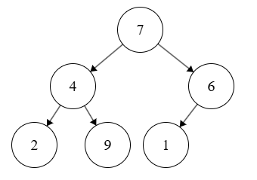
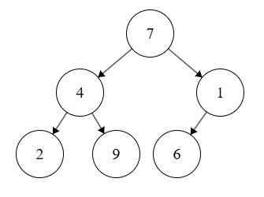
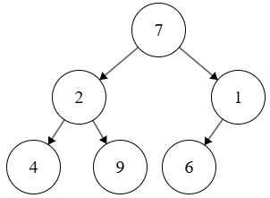
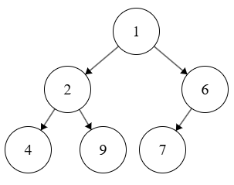
Heapify Example
Starting with:
1 is last, parent is 6.
sift 6 down, done
Now onto 4 and 9, already min.
2 and 4, sift 4 down, done.
Next in line is 1, parent is 7.
sift 7 down once, then once more with 6. min heap!

Slide 14
Heaps in Priority Queues
When a new element is added into a priority queue, it gets added to the leftmost leaf-level node, or a new level if full.
Then, to maintain the heap, it may bubble up to its correct position
When the root (highest prio) element is removed, the last element in the heap is swapped in to replace it
Then, to maintain the heap, the newly-made root sifts down to its correct position
PriorityQueueFromScratch

Slide 15
Time Complexity Comparison
Operation | Array-based Queue | LinkedList Queue | Priority Queue (Heap)
Enqueue/Insert | O(1) amortized | O(1) | O(log n)
Dequeue/DeleteMin | O(1) | O(1) | O(log n)
Peek | O(1) | O(1) | O(1)
Search | O(n) | O(n) | O(n)
isEmpty | O(1) | O(1) | O(1)
Size | O(1) | O(1) or O(n)* | O(1)

Slide 16
Priority Scheduler
PrioProcess (Just a normal Process, name was taken)
Priority, Arrival Time, Burst Time (required time), Remaining Time
PriorityScheduler
Ready Queue that stores waiting processes
Total processes counter, completed processes counter
Fills up ready queue with processes that have arrived
Grabs the highest prio process when CPU idles, executes it for a unit of time
Checks for new, higher prio process. If not, continue processing old one for another unit of time.
Repeat until done with all processes.
PriorityScheduler

