Slide 1
Trees
Lecture 17

Slide 2
Overview
Binary Search Trees
AVL Trees
Red-Black Trees

Slide 3
Binary Search Trees (BST)
Defining property of BSTs is: left subtree < root < right subtree
In other words, left child's value must be less than the root's value and the root's value must be less than the right child's value
Doesn't allow duplicate values
To include duplicates, could use counters or force directional insertion rules
Insertion costs O(log n), O(n) if unbalanced
How can we ensure this doesn’t happen?
BinarySearchTree

Slide 4
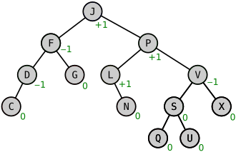
AVL Trees (Adelson-Velsky & Landis)
Self-balancing binary search tree!
Balanced by HEIGHT, not weight
The heights of the two subtrees of any node differ by at most one.
If at any time they differ by more than one, rebalancing is done.
Notice the right subtree looks much heavier, but the heights meet the requirements
Lookup, insertion, and deletion all take O(log n)
How do we keep this balanced?
Balancing Factor (BF): The height difference between left subtree and right subtree
https://en.wikipedia.org/wiki/AVL_tree

Slide 5
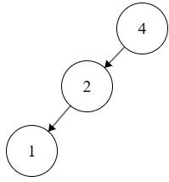
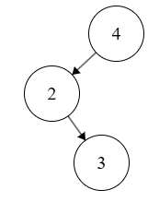
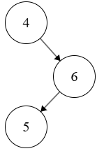
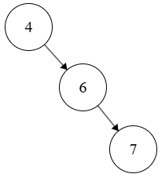
Rebalancing
If some node X hits a BF of -2 or +2, then if we let Z be the root of the taller subtree, we have four tree structure variants to handle
Left Left: Z is the left child of X and BF(Z) <= 0
Left Right: Z is the left child of X and BF(Z) > 0
Right Left: Z is the right child of X and BF(Z) < 0
Right Right: Z is the right child of X and BF(Z) >= 0

Slide 6
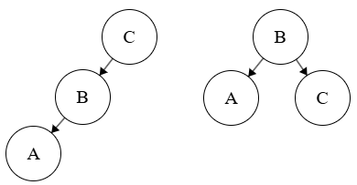
To Fix Left Left
Problem: BF(C) = -2, BF(B) = -1
Solution: Simple rotate right.
Pull B to be the root,
C to be B's right child, and
B's old right child to be C's left child.

Slide 7
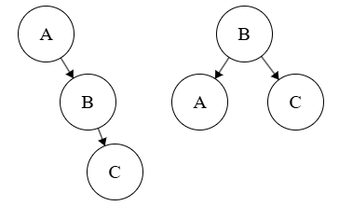
To Fix Right Right
Problem: BF(C) = +2, BF(B) = +1
Solution: Simple rotate left.
Pull B to be the root,
A to be B's left child, and
B's old left child to be A's right child.

Slide 8
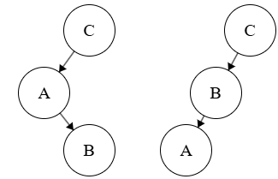
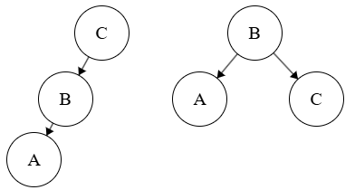
To Fix Left Right
Problem: BF(C) = -2, BF(A) = +1
Solution:
First, rotate the left subtree left.
Pull B to be the root,
A to be B's left child, and
B's old left child to be A's right child.
Next, simple rotate right.
Pull B to be the root,
C to be B's right child, and
B's old right child to be C's left child.

Slide 9
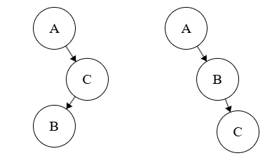
To Fix Right Left
Problem: BF(A) = +2, BF(C) = -1
Solution:
First, rotate the right subtree right.
Pull B to be the root,
C to be B's right child, and
B's old right child to be C's left child.
Next, simple rotate left.
Pull B to be the root,
A to be B's left child, and
B's old left child to be A's right child.

Slide 10
Deleting A Node
If a node has 0 children, easy peasy set the node to null.
If a node has 1 child, replace the node with its child.
If a node has 2 children, replace it with its inorder successor (smallest node in the right subtree), and then try to delete the right child.
AVLTree

Slide 11
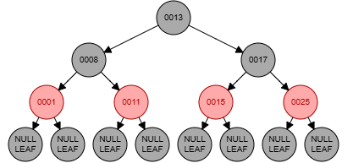
Red-Black Trees
Properties:
Each node is red or black
Root is always black.
No two red nodes can be adjacent
ie. a red node can have neither a red parent nor a red child.
Every path from a node to its descendant null leaves must have the same number of black nodes (called black height)
All null leaves are considered black.
https://www.cs.usfca.edu/~galles/visualization/RedBlack.html

Slide 12
Insertion
Insert like a BST
New nodes are always red to minimize potential violations
If the parent is black, no rules are broken
Fix Violations
Double-Red Violation: If the parent is red, we have a red adjacency. Fix based on uncle's color.
Root Violation: If from recoloring, the root becomes red, we set it black.
Black-Height Violation: Deletion of a black node disrupts the equal black-node count on paths.
Fixing these violations is a bit out of scope, but we can trace through
RedBlackTree

