Slide 1
Lecture 15 Sets and Maps

Slide 2
Overview
Collections
Sets in Java (HashSet, TreeSet)
Maps in Java (HashMap, TreeMap)
Use Cases and Applications

Slide 3
Collections
What are they?
Data structures to store and manipulate groups of objects
Provide efficient ways to manage data
Why use them?
To represent an underlying structure to the problem
Store important data to aid the creation of fast algorithms and codebases
java.util.Collections framework
Root of most of our data structures
Groups of data like: Lists, Sets, Queues, Deques
More complex structures: Maps, lots of Trees

Slide 4
Iterator Interface
Iterator interface is a fundamental part of the Collections Framework
Provides a standard way to traverse the elements of a collection
Whether iterating through an ArrayList, HashSet, or LinkedList, you use the same Iterator methods
Sequential access to process the elements of a collection
Safe way to remove elements from a collection while traversing

Slide 5
Iterator Core Methods
hasNext(): boolean
Checks if there are more elements available in the collection that haven't been visited yet.
Must always call hasNext() before next() to avoid errors
next(): E
Returns the next element in the collection. Each time you call next(), the iterator advances its position.
Can throw a NoSuchElementException if used without hasNext()
remove(): void (Optional function)
Removes the last element that was returned by the next() method
Not always supported, so may throw UnsupportedOperationException
Can only call once per next() call

Slide 6
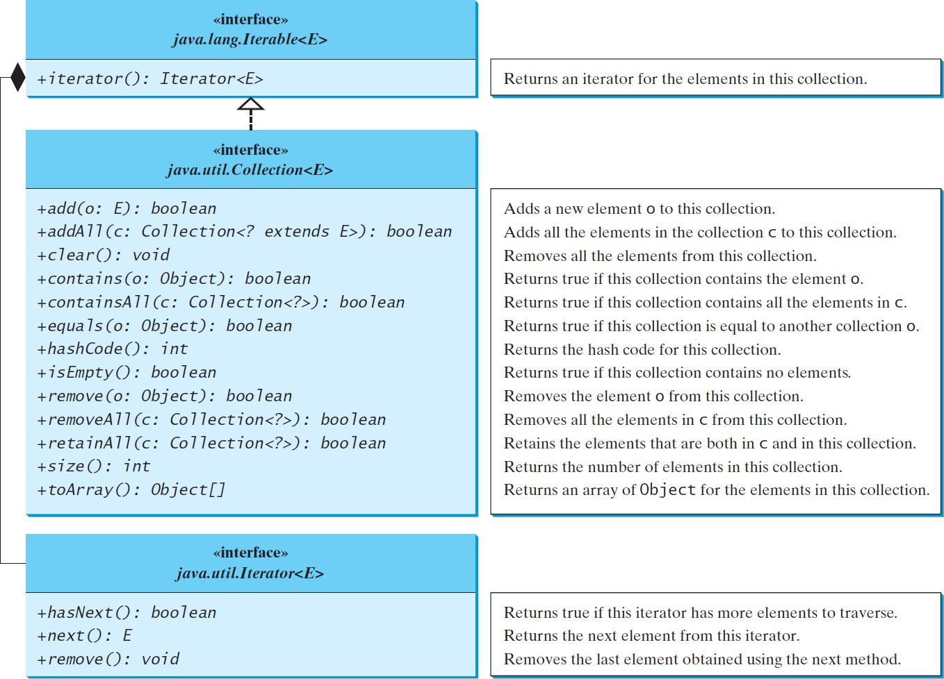
Concrete classes that implement the Collection interface are responsible for providing their own specific implementation of the Iterator interface
See internal iterators of ArrayList, HashMap

Slide 7
Sets
Interface from java.util.Set;
Collection of unique elements
Each element must be unique
Cannot add duplicates. If you try, it won't be added
Unordered (moreso order not guaranteed)
Most implementations do not guarantee the elements maintain order
Order in which elements are added may not be order in which elements are stored or retrieved
Cannot be indexed

Slide 8
Common Set Implementations
HashSet
Most common one by far
Stores elements in a hash table (will discuss)
TreeSet
Stores elements in a sorted order
Uses a tree structure (elements must be Comparable)

Slide 9
HashSet (secretly a HashMap)
Uses a hash table for storage
This is a collection of key-value pairs
You provide a key, and a hash function generates its hash code
This hash code is transformed into an index within the bounds of the hash table's array
The key-value pair is then stored at the calculated index
For HashSets, we don’t care about the value, just the key
When a key hashes to the same index, we can assume it is the same key and so a duplicate
More details: https://en.wikipedia.org/wiki/Hash_table

Slide 10
Hashing
For HashSet to work correctly, equals() and hashCode() methods must be properly implemented
If two objects are equivalent according to equals(), their hashCode() methods must return the same values
Hash functions can be anything
Once determined, the index must be within bounds, so mod the length of the table
Must be deterministic (same value must yield same result on repetition)
Common hash function: SHA-256 used for encryption

Slide 11
Collisions
Two or more distinct elements can happen to produce the same hash code, resulting in a collision.
For example, say we've got a hash table with 4 slots, and we're storing a set of numbers. Our hash function is just f(x) = x % 4.
I store the number 3, then I store the number 7.
They both hash to the same index of 3, meaning they would both be fighting for the same storage location.
Buckets
If multiple distinct keys map to the same index, we use a LinkedList (among other possible approaches) that we'd need to search through to find our corresponding key.

Slide 12
LinkedList
Data structure where elements are not necessarily stored in contiguous memory locations
Instead, each Node contains:
Data: The actual information being stored
Pointer (Reference): The link to the next node in the sequence.
You may also hear about:
Doubly Linked Lists:
Data, Pointer to NEXT node, Pointer to PREV node
Circularly Linked Lists:
Final node points also back to head node.

Slide 13
Usage in Hash Maps
Efficient Insertion/Deletion:
To remove the current node, move the previous node's pointer to the next node
To insert the current node, move the previous node's pointer to the current node, and the current node's pointer to the previous node's old location
No contiguous memory required:
Nodes can be stored anywhere, just need to store the head's location in memory to start the chain
Can dynamically handle theoretically infinite collisions
Many collisions is a sign of insufficient storage space or a bad hash function

Slide 14
Linked List Operation Complexity
All data structures have the Big 4 Operations
Insertion
O(n): Must traverse through nodes to update their pointers accordingly
Removal
O(n): Must traverse through nodes to update their pointers accordingly
Traversal
O(n)
Searching/Contains
O(n)

Slide 15
HashSet Operation Complexity
Insertion
O(1): Key (in this case the element) gets hashed, key gets stored in location
Can fall to O(n) if all elements index to same linked list
Mechanisms in place to prevent this unless blocked by user
Removal
O(1): Hashed key brings you directly to removal location
Can fall to O(n) for same reason
Traversal
O(n), iterate through all elements
Searching
O(1): Knowing the key brings you directly to the storage location

Slide 16
TreeSet (not so secretly a Tree)
Underlying data structure is a Red Black tree
A bit too involved for this class, we may discuss in future
Link to learn more: https://www.eecs.umich.edu/courses/eecs380/ALG/red_black.html
Maintains the set in sorted order
Very nice if order is important to solve your problem

Slide 17
TreeSet Operation Complexity
Insertion
O(log n): Must traverse through the height of the tree to place properly
Removal
O(log n): Must traverse through the height of the tree to locate and remove, and potentially need to rebalance the tree as well
Traversal
O(n): Visit every node
Searching
O(log n): Must traverse through the height of the tree for correct node
Why is removal not more expensive? It is, just not significantly enough to reclassify
Rebalancing costs O(log n), O(log n) + O(log n) = O(2 log n) = O(log n)

Slide 18
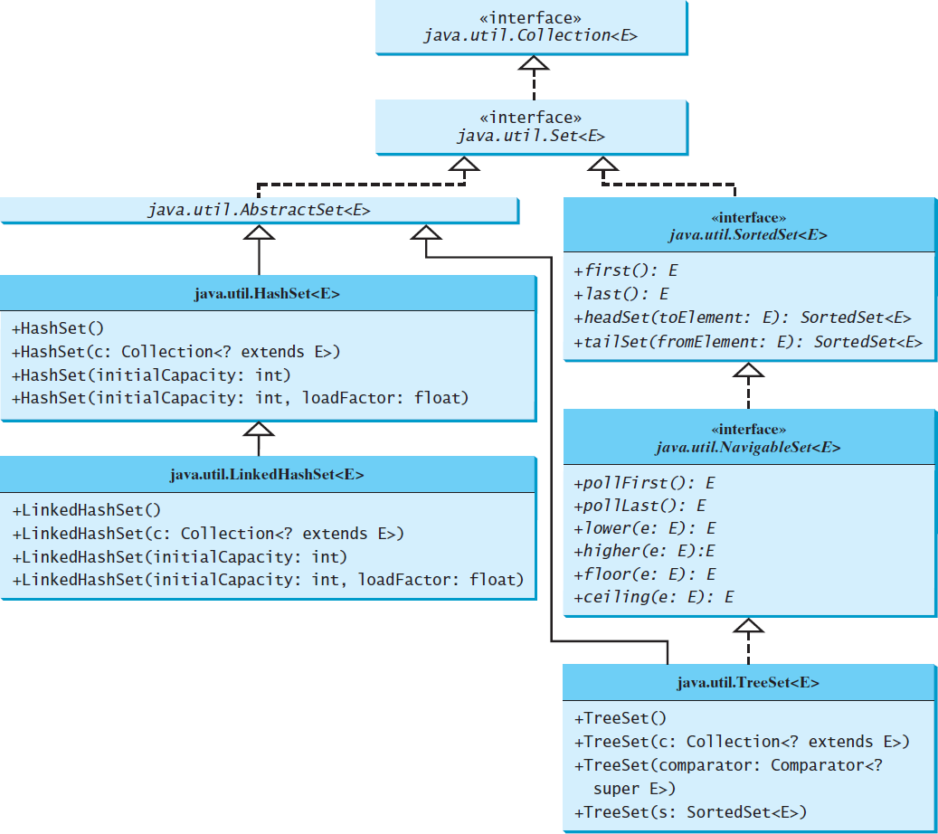
Set Hierarchy

Slide 19
Problems
RemoveDuplicates
UniqueString
Intersection
MissingNumber
LongestUniqueSubstring

Slide 20
Maps
Interface from java.util.Map;
Collection of key-value pairs
Each key is unique, and maps to exactly one value
Not part of the Collection interface, but part of the Java Collections Framework
Useful for storing associations, bucketing frequencies, as dictionaries
Order not guaranteed, key set may not be traversed as entered

Slide 21
Common Map Implementations
HashMap
Most commonly used, this is largely what we talked about before, but with values included now
No ordering guarantee
Allows one null key and multiple null values
LinkedHashMap
Maintains insertion order
Slightly slower than HashMap due to ordering overhead
TreeMap
Stores keys in sorted order
O(log n) time complexity
No null keys allowed (null values are fine)

Slide 22
Common Map Operations
Method | Description
put(K key, V value) | Adds/updates a key-value pair.
get(K key) | Retrieves value by key (or null).
remove(K key) | Removes a key-value pair.
containsKey(K key) | Checks if key exists.
keySet() | Returns all keys as a Set.
values() | Returns all values as a Collection.
entrySet() | Returns all entries (Set<Map.Entry>).

Slide 23
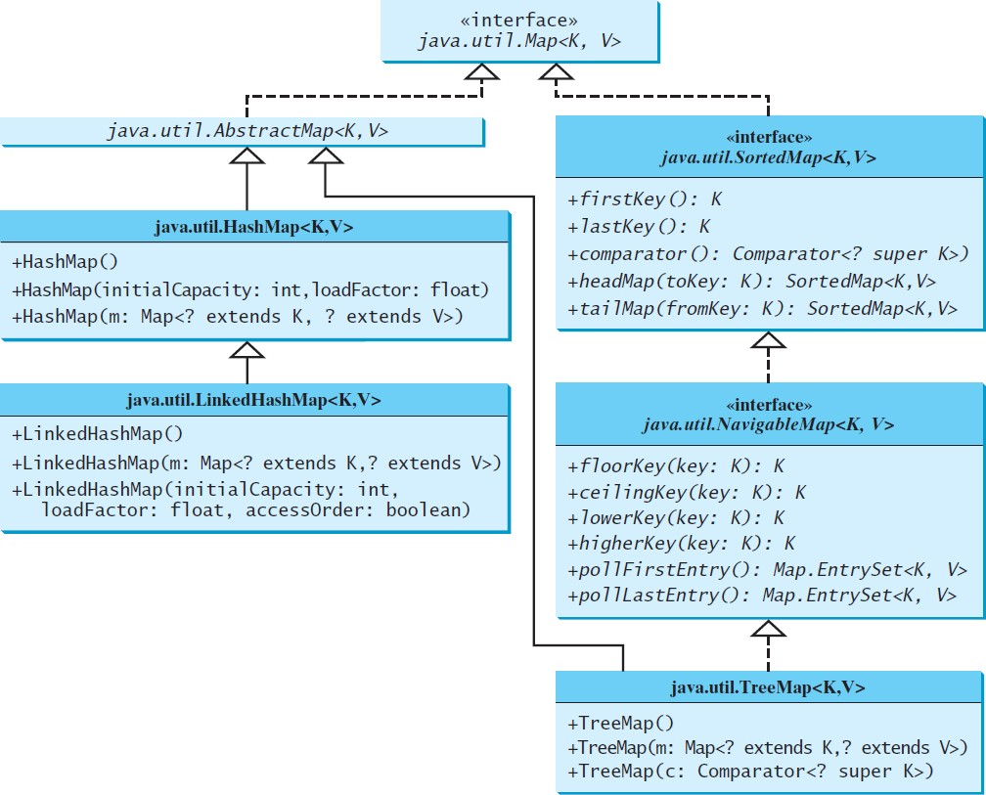
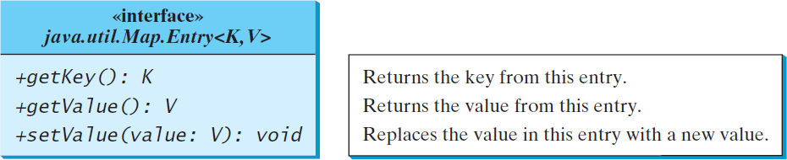
Map Hierarchy
An Entry is the key-value pair you'll get when you call entrySet if you want to iterate through a map. Each implementation may have their own version of this.

Slide 24
Problems
TwoSum
FindUniqueChars
FindSymmetricPairs
FindMajorityElement
EmployeeHierarchy

