Slide 1
Lecture 17 Sets and Maps

Slide 2
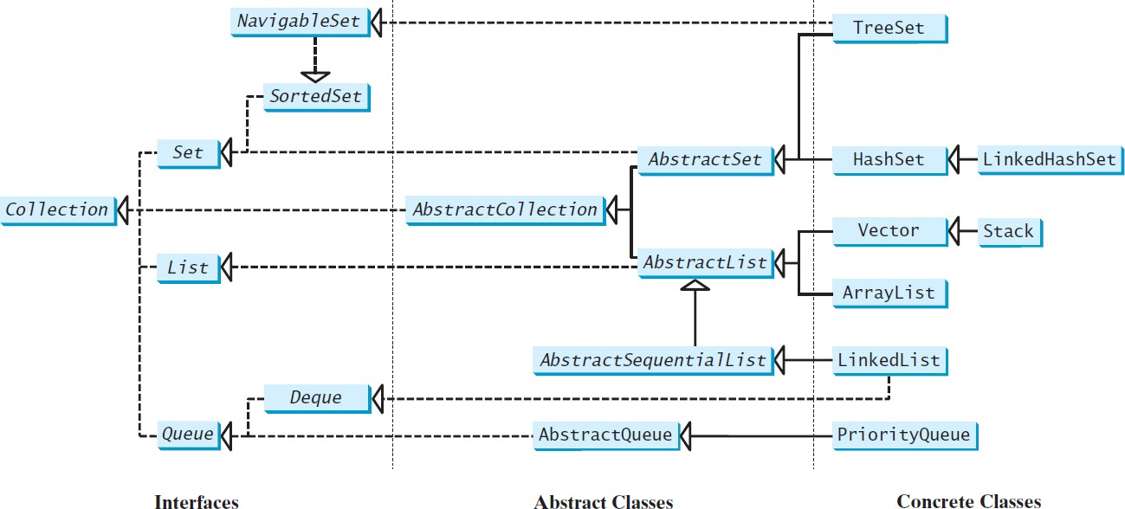
Review of Java Collection Framework hierarchy
Set and List are subinterfaces of Collection.

Slide 3
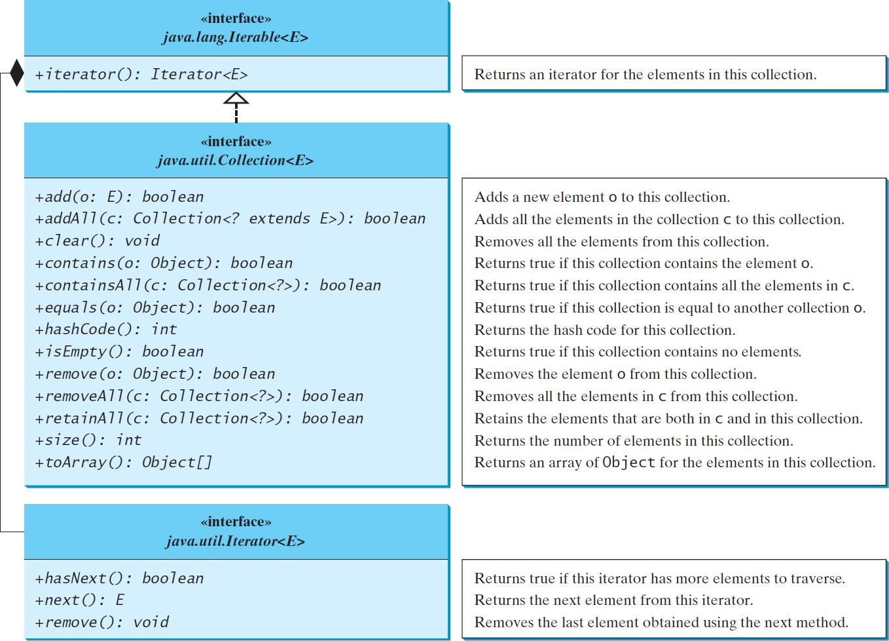
The Collection interface is the root interface
for manipulating a collection of objects.

Slide 4
The Set Interface
The Set interface extends the Collection interface.
It does not introduce new methods or constants, but it stipulates that an instance of Set contains no duplicate elements.
The concrete classes that implement Set must ensure that no duplicate elements can be added to the set.
That is no two elements e1 and e2 can be in the set such that e1.equals(e2) is true.

Slide 5
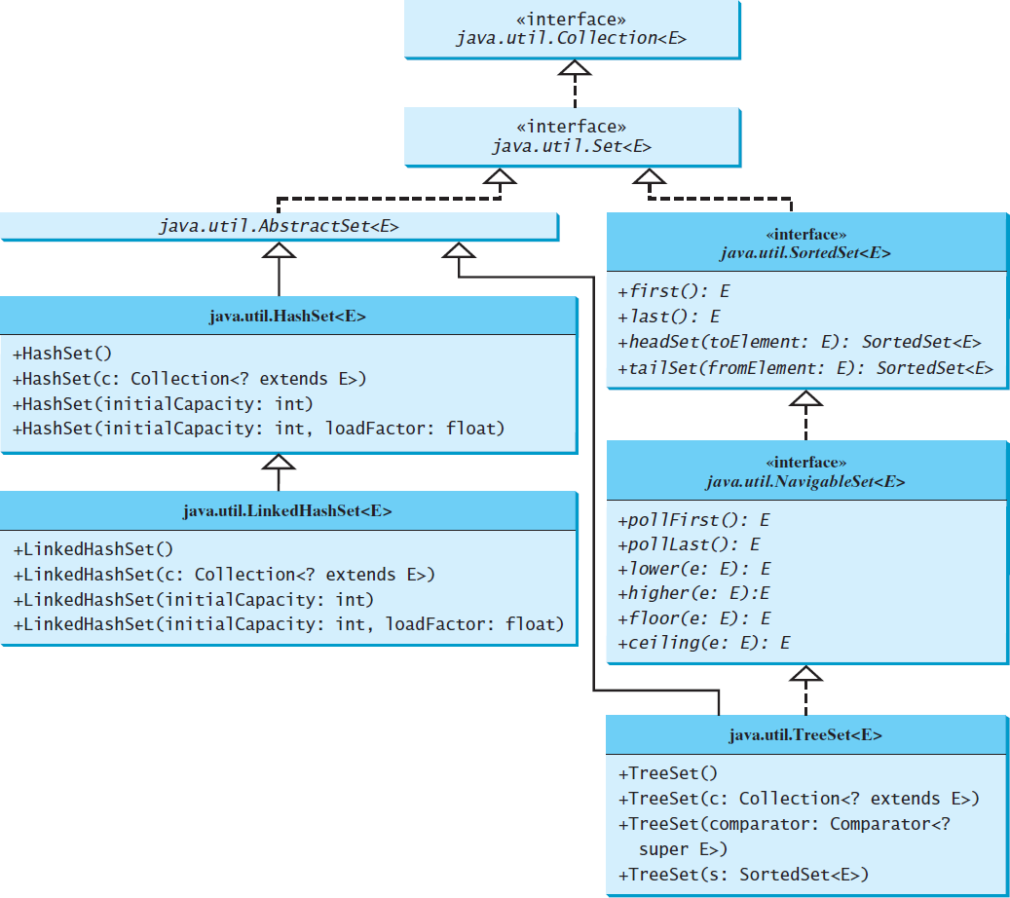
The Set Interface Hierarchy

Slide 6
The AbstractSet Class
The AbstractSet class is a convenience class that extends AbstractCollection and implements Set.
The AbstractSet class provides concrete implementations for the equals method and the hashCode method.
The hash code of a set is the sum of the hash code of all the elements in the set.
Since the size method and iterator method are not implemented in the AbstractSet class, AbstractSet is an abstract class.

Slide 7
The HashSet Class
The HashSet class is a concrete class that implements Set.
It can be used to store duplicate-free elements.
For efficiency, objects added to a hash set need to implement the hashCode method in a manner that properly disperses the hash code.

Slide 8
Example: TestHashSet
This example creates a hash set filled with strings, and uses an iterator to traverse the elements in the list.
Add Paris, New York, San Francisco, Beijing, New York to set.
public class TestHashSet {
public static void main(String[] args) {
// Create a hash set
Set<String> set = new HashSet<>();
// Add strings to the set
set.add("London");

Slide 9
public class TestHashSet {
public static void main(String[] args) {
// Create a hash set
Set<String> set = new HashSet<>();
// Add strings to the set set.add("London");… System.out.println(set);
// Display the elements in the hash set for (String s: set) { System.out.print(s.toUpperCase() + " ");
}
// Process the elements using a forEach method
System.out.println();
set.forEach(e -> System.out.print(e.toLowerCase() + " "));
}

Slide 10
Example: TestLinkedHashSet
This example creates a hash set filled with strings, and uses an iterator to traverse the elements in the list.
You can simplify the for loop without using an iterator, as follows:
for (Object element: set) System.out.print(element.toString() + " ");

Slide 11
The SortedSet Interface and the TreeSet Class
SortedSet is a subinterface of Set, which guarantees that the elements in the set are sorted.
TreeSet is a concrete class that implements the SortedSet interface.
You can use an iterator to traverse the elements in the sorted order.
The elements can be sorted in two ways.

Slide 12
The SortedSet Interface and the TreeSet Class
One way is to use the Comparable interface.
Or to to specify a comparator for the elements in the set if the class for the elements does not implement the Comparable interface.
Do not use the compareTo method in the class that implements the Comparable interface.
This approach is referred to as order by comparator.

Slide 13
Example: TestTreeSet
This example creates a hash set filled with strings, and then creates a tree set for the same strings.
The strings are sorted in the tree set using the compareTo method in the Comparable interface.
The example also creates a tree set of geometric objects.
The geometric objects are sorted using the compare method in the Comparator interface.

Slide 14
TestTreeSet.java
public class TestTreeSet {
public static void main(String[] args) {
// Create a hash set
Set<String> set = new HashSet<>();
// Add strings to the set
set.add("London");
set.add("Paris");
set.add("New York"); set.add("San Francisco"); set.add("Beijing");
set.add("New York");
TreeSet<String> treeSet = new TreeSet<>(set); System.out.println("Sorted tree set: " + treeSet);

Slide 15
// Use the methods in SortedSet interface System.out.println("first(): " + treeSet.first()); System.out.println("last(): " + treeSet.last()); System.out.println("headSet(\"New York\"): " + treeSet.headSet("New York")); System.out.println("tailSet(\"New York\"): " + treeSet.tailSet("New York"));
// Use the methods in NavigableSet interface System.out.println("lower(\"P\"): " + treeSet.lower("P")); System.out.println("higher(\"P\"): " + treeSet.higher("P")); System.out.println("floor(\"P\"): " + treeSet.floor("P")); System.out.println("ceiling(\"P\"): " + treeSet.ceiling("P")); System.out.println("pollFirst(): " + treeSet.pollFirst()); System.out.println("pollLast(): " + treeSet.pollLast()); System.out.println("New tree set: " + treeSet);
}
}

Slide 16
Example: TestTreeSetWithComparator
Write a program that demonstrates how to sort elements in a tree set using the Comparator interface.
The example creates a tree set of geometric objects.
The geometric objects are sorted using the compare method in the Comparator interface.

Slide 17
Example: TestTreeWithComparator
public class TestTreeSetWithComparator {
public static void main(String[] args) {
// Create a tree set for geometric objects using a comparator
Set<GeometricObject> set =
new TreeSet<>(new GeometricObjectComparator()); set.add(new Rectangle(4, 5));
set.add(new Circle(40)); set.add(new Circle(40));
set.add(new Rectangle(4, 1));
// Display geometric objects in the tree set System.out.println("A sorted set of geometric objects"); for (GeometricObject element: set) System.out.println("area = " + element.getArea());
}
}

Slide 18
Case Study: Counting Keywords
This example presents an application that counts the number of the keywords in a Java source code file.
You are going to complete the while loop.

Slide 19
Counting Keywords.java
public class CountKeywords {
public static void main(String[] args) throws Exception { Scanner input = new Scanner(System.in); System.out.print("Enter a Java source file: ");
String filename = input.nextLine();
File file = new File(filename);
if (file.exists()) {
System.out.println("The number of keywords in " + filename
+ " is " + countKeywords(file));
}
else {
System.out.println("File " + filename + " does not exist");
}
}

Slide 20
public static int countKeywords(File file) throws Exception {
// Array of all Java keywords + true, false and null
String[] keywordString = {"abstract", "assert", "boolean", "break", "byte", "case", "catch", "char", "class", "const",
"continue", "default", "do", "double", "else", "enum",
"extends", "for", "final", "finally", "float", "goto",
"if", "implements", "import", "instanceof", "int",
"interface", "long", "native", "new", "package", "private",
"protected", "public", "return", "short", "static", "strictfp", "super", "switch", "synchronized", "this", "throw", "throws", "transient", "try", "void", "volatile",
"while", "true", "false", "null"};
Set<String> keywordSet =
new HashSet<>(Arrays.asList(keywordString));

Slide 21
Set<String> keywordSet =
new HashSet<>(Arrays.asList(keywordString));
int count = 0;
Scanner input = new Scanner(file);
while (input.hasNext()) {
String word = input.next();
if (keywordSet.contains(word))
count++;
}
return count;
}
}

Slide 22
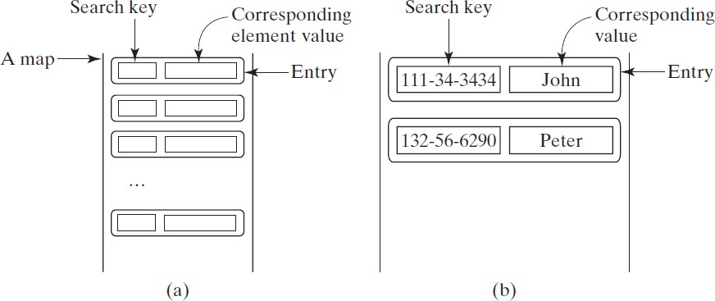
The Map Interface
The Map interface maps keys to the elements.
The keys are like indexes.
In List, the indexes are integer.
In Map, the keys can be any objects.

Slide 23
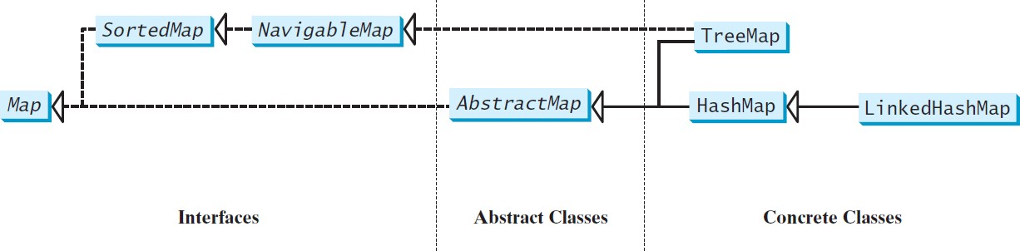
Map Interface and Class Hierarchy
An instance of Map represents a group of objects, each of which is associated with a key.
You can get the object from a map using a key, and you have to use a key to put the object into the map.

Slide 24
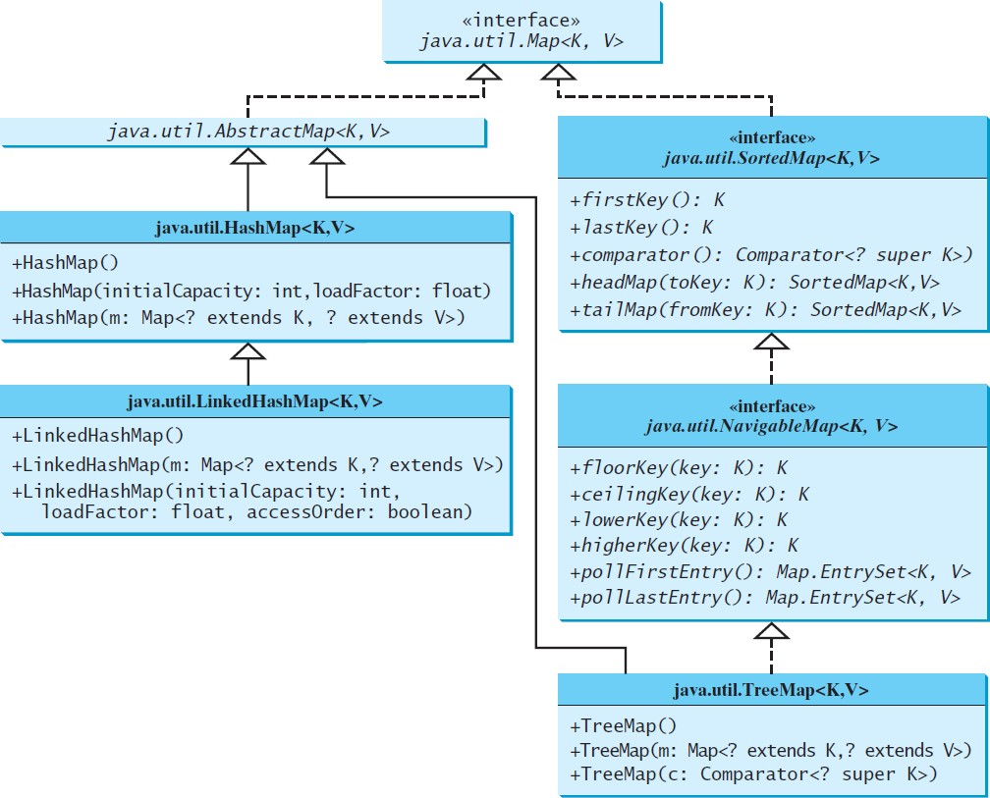
Concrete Map Classes

Slide 25
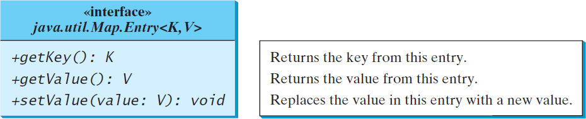
Entry

Slide 26
HashMap
The HashMap class is efficient for locating a value, inserting a mapping, and deleting a mapping.

Slide 27
LinkedHashMap
LinkedHashMap was introduced in JDK 1.4.
It extends HashMap with a linked list implementation that supports an ordering of the entries in the map.
The entries can be retrieved in the order in which they were inserted into a map (known as the insertion order)
or the order in which they were last accessed, from least recently accessed to most recent (access order).
The entries in a HashMap are not ordered
To construct a LinkedHashMap with the access order, use
LinkedHashMap(initialCapacity, loadFactor, true).

Slide 28
TreeMap
The HashMap, LinkedHashMap, and TreeMap classes are three concrete implementations of the Map interface.
The HashMap class is efficient for locating a value,
inserting a mapping, and deleting a mapping.
The TreeMap class, implementing SortedMap, is efficient for traversing the keys in a sorted order.

Slide 29
Example: TestMap
This example creates a hash map that maps borrowers to mortgages.
The program first creates a hash map with the borrower’s name as its key and mortgage as its value.
The program then creates a tree map from the hash map, and displays the mappings in ascending order of the keys.

Slide 30
TestMap.java
public class TestMap {
public static void main(String[] args) {
// Create a HashMap
Map<String, Integer> hashMap = new HashMap<>(); hashMap.put("Smith", 30);
hashMap.put("Anderson", 31);
hashMap.put("Lewis", 29);
hashMap.put("Cook", 29);
System.out.println("Display entries in HashMap"); System.out.println(hashMap + "\n");
// Create a TreeMap from the preceding HashMap
Map<String, Integer> treeMap = new TreeMap<>(hashMap); System.out.println("Display entries in ascending order of key"); System.out.println(treeMap);

Slide 31
TestMap.java
// Create a LinkedHashMap
Map<String, Integer> linkedHashMap = new LinkedHashMap<>(16, 0.75f, true); linkedHashMap.put("Smith", 30);
linkedHashMap.put("Anderson", 31);
linkedHashMap.put("Lewis", 29);
linkedHashMap.put("Cook", 29);
// Display the age for Lewis System.out.println("\nThe age for " + "Lewis is " + linkedHashMap.get("Lewis"));
// Display the linkedHashmap
System.out.println("Display entries in LinkedHashMap"); System.out.println(linkedHashMap);

Slide 32
TestMap.java
// Display each entry with name and age System.out.print("\nNames and ages are "); treeMap.forEach(
(name, age) -> System.out.print(name + ": " + age + " "));
}
}

Slide 33
Case Study: CountOccurrenceOfWords
This program counts the occurrences of words in a text and displays the words and their occurrences in ascending order of the words.
The program uses a hash map to store a pair consisting of a word and its count.
For each word, check whether it is already a key in the map.
If not, add the key and value 1 to the map.
Otherwise, increase the value for the word (key) by 1 in the map.
To sort the map, convert it to a tree map.

