Slide 1
HaloCAS
Next-Generation Safety for Heavy Machinery
Powered by ADK 2.0 Graph Workflows

Slide 2

The Problem: Blind Spots in the Danger Zone
In mining and manufacturing, humans and colossal machines operate side-by-side.
• The Risk: Heavy machinery creates deadly blind spots.
• The Flaw: Standard cameras require constant monitoring.
• The Result: 'Alarm fatigue' from sensors that beep at everything.

Slide 3
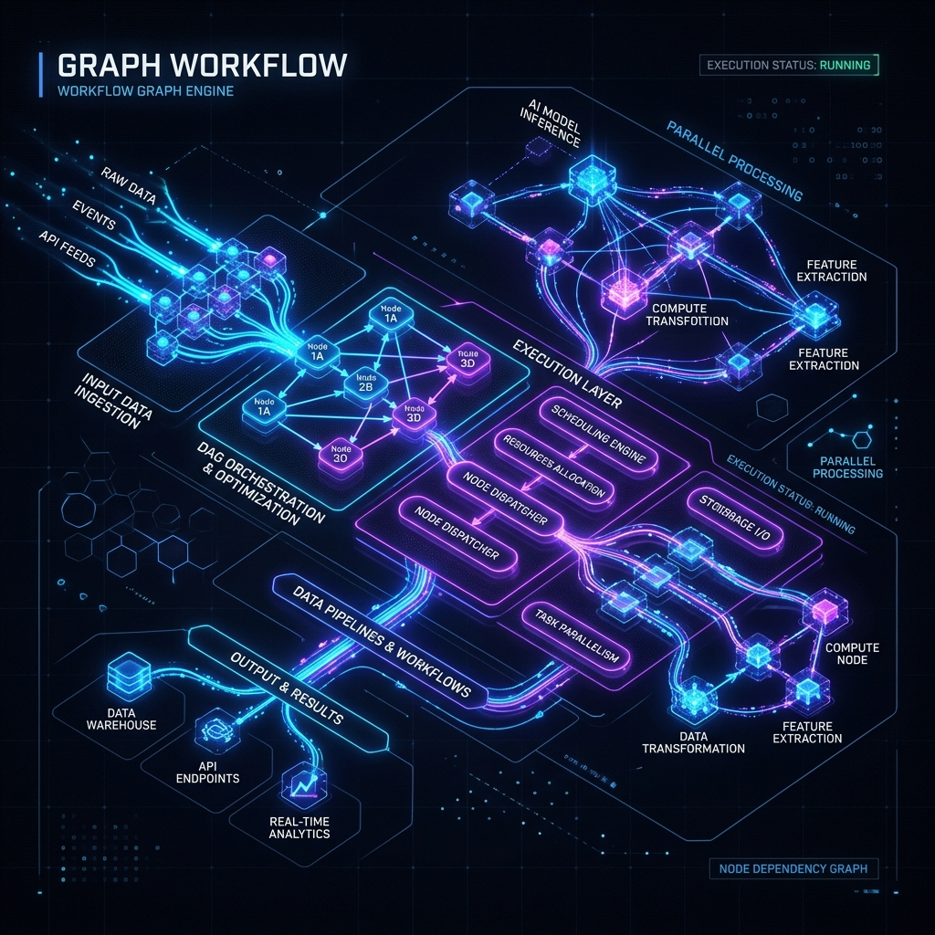
The Solution: ADK 2.0 Graph Intelligence
HaloCAS doesn't just beep—it thinks.
1. State Check: Is the machine moving?
2. Proximity: Has a worker breached 10m?
3. Trajectory: Is the machine moving towards the worker?
4. Auth Scan: Is it an authorized mechanic?

Slide 4
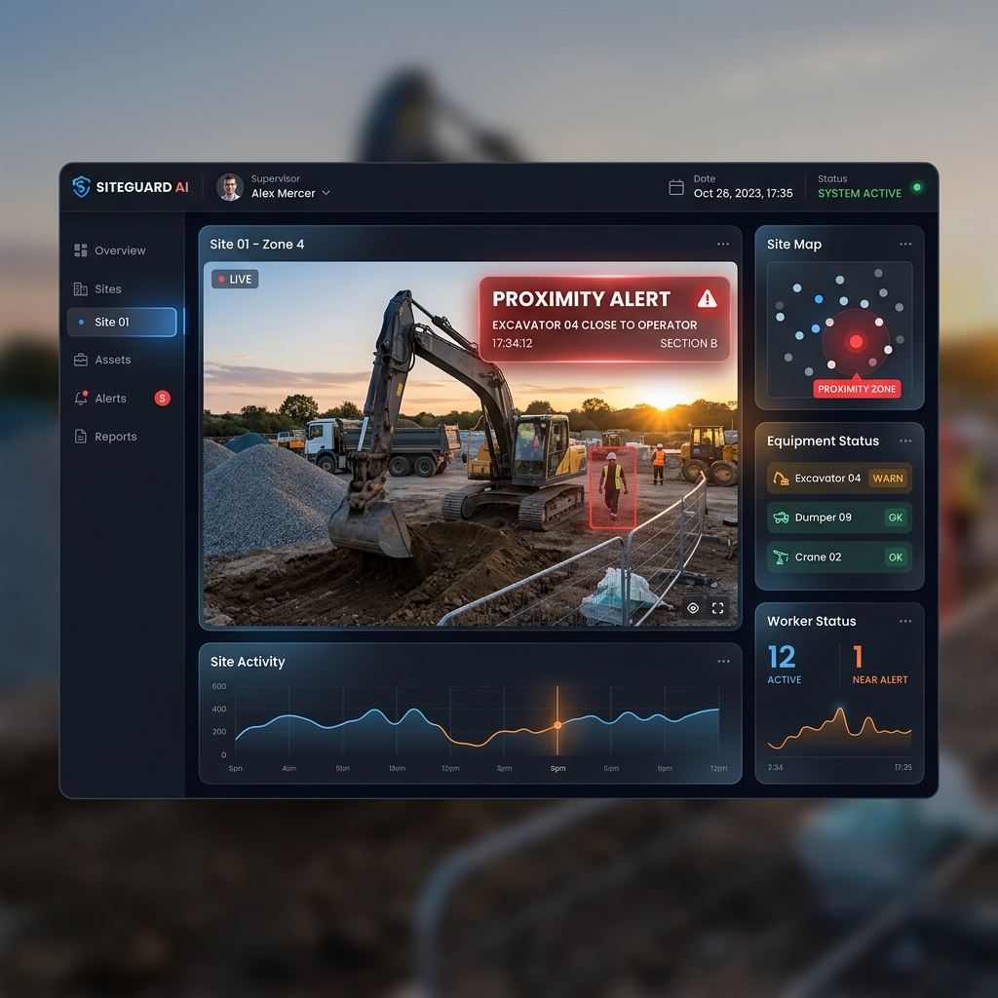
Actionable User Experience
HaloCAS operates completely invisibly to operators on the ground.
When an incident occurs, Safety Officers receive:
• Instant automated email alerts.
• Clear context of who and when.
• Attached MP4 video clips for undeniable evidence.

Slide 5
See the Code
Check out the open-source code and technical architecture on GitHub: https://github.com/Augmencord/HaloCAS

