Slide 1
Task1
Place Modem in a location with good air circulation and away from any other device that may cause interfere with signals.

Slide 2
Task1
Place Modem in a location with good air circulation and away from any other device that may cause interfere with signals.

Slide 3
Task2
Plug the Phone cable with one end in the phone and other into the DSL port on the back of the modem.

Slide 4
Task2
Plug the Phone cable with one end in the phone and other into the DSL port on the back of the modem.

Slide 5
Task3
Plug the power source cable lid with one end in the modem and another end in the Power socket.

Slide 6
Task3
Plug the power source cable lid with one end in the modem and another end in the Power socket.

Slide 7
Task4
Power it on by plugging it and pressing the power button. Wait a minute or two for modem to boot up completely.

Slide 8
Task4
Power it on by plugging it and pressing the power button. Wait a minute or two for modem to boot up completely.

Slide 9
Task5
Connect Computer to the modem by using an Ethernet cable, connect computer to the internet or WAN port on back of router.

Slide 10
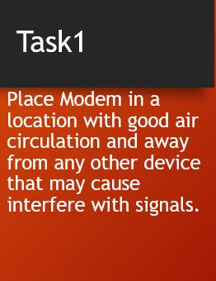
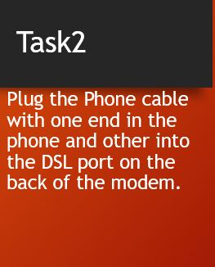


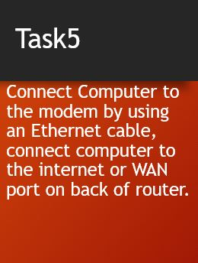

Slide 11
Task5
Connect Computer to the modem by using an Ethernet cable, connect computer to the internet or WAN port on back of router.

Slide 12
