Slide 1
Scope of work

Slide 2
Connect two arbitrary roads with a connection road given the absolute positions of the roads

Slide 3
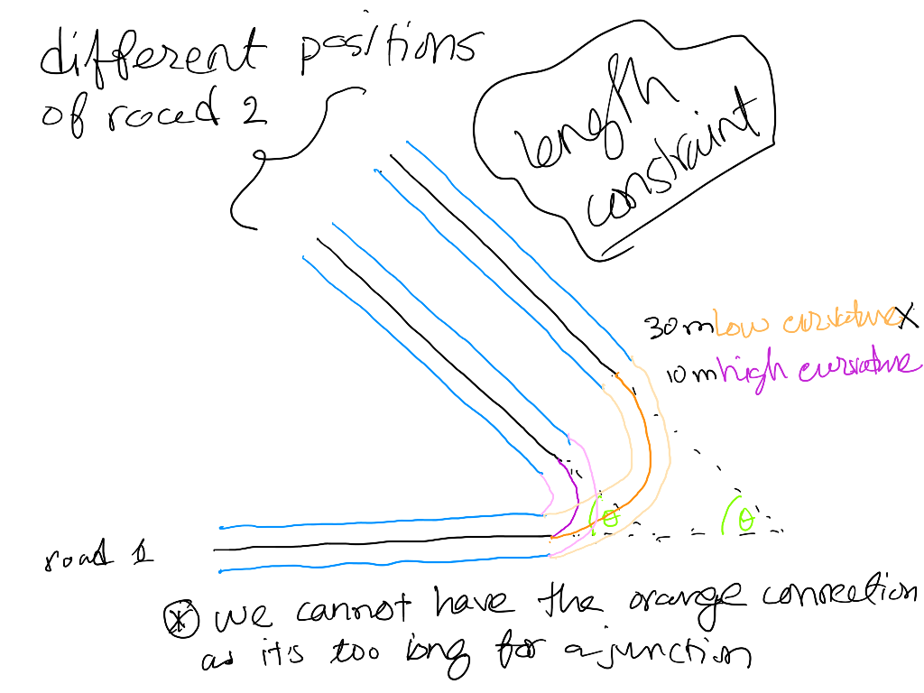
2. Find feasible curvatures for a given curve angle

Slide 4
3. Create roads with given lane configuration
We can define standard lane configurations ( like two right, one left ) with standard lane geometric variations.
Input lanes, output lanes.

Slide 5
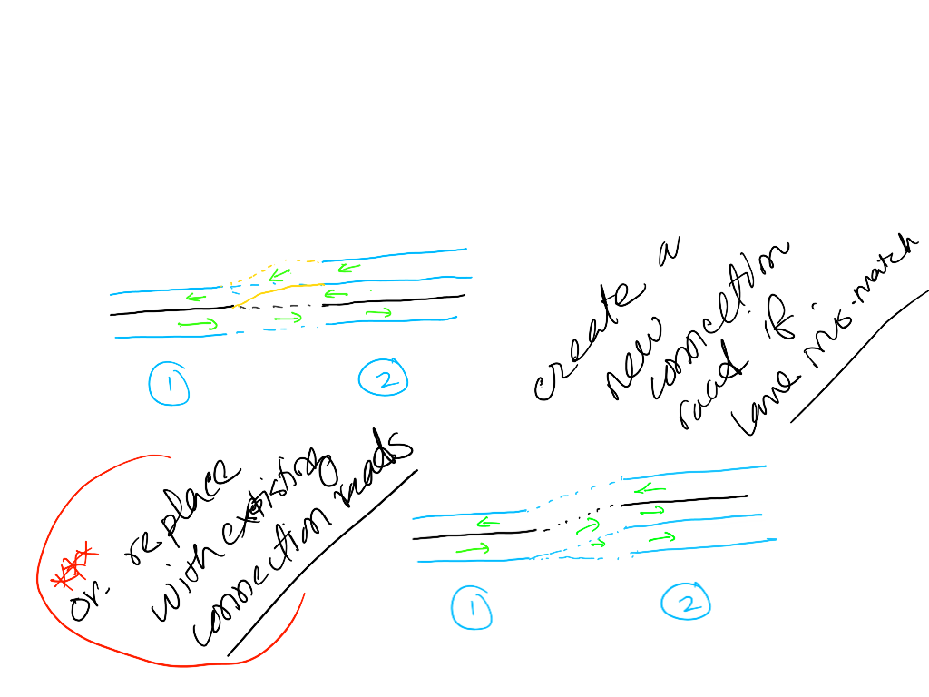
3.1 Connect roads with different number of lanes

Slide 6
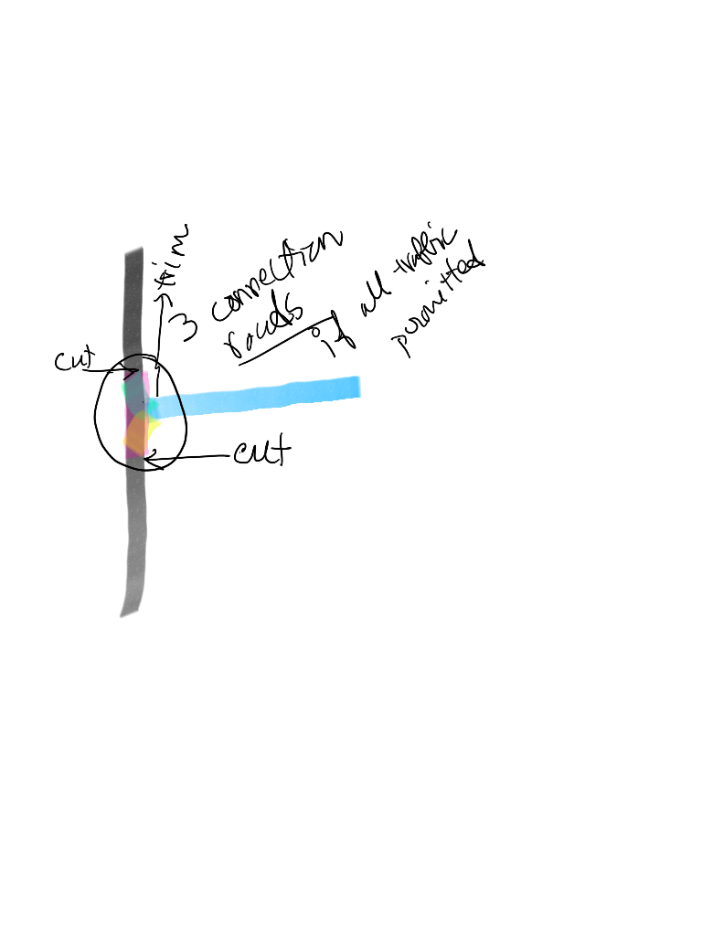
4. Merge any road into a given point of another road
Given point can be in inertial coordinate or in reference line coordinate

Slide 7
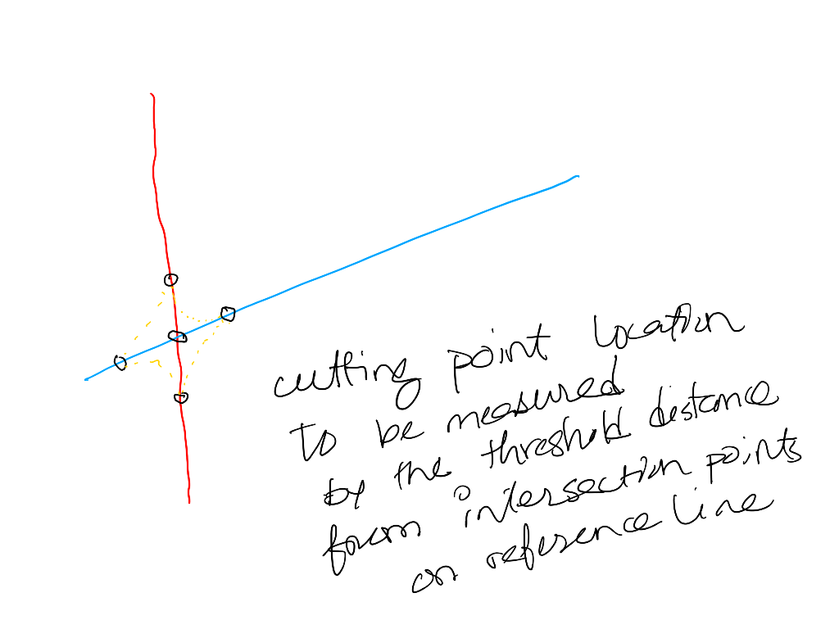
5. Detecting and Solving road overlaps

Slide 8
5. Detecting and Solving road overlaps
Complicated by lane configurations of the roads and overlap areas

Slide 9
6. Add elevation

Slide 10
7. Convert opendrive xml to opendrive objects in pyodrx

Slide 11
8. Identify unique junctions and atomic roads and save them in a database
Atomic roads are those unique roads from which all other roads can be generated. They may have several road components, several lane sections. They need to be used as atomic units.

Slide 12
9. UE plugin to create roads from open drive xml files.
All third-party dependencies must be included in the package
All the objects must be saved in serializable formats or as c++ classes which can be used to instantiate them, so that users do not need to create new objects or update references. Must have object and class version mappings.

Slide 13
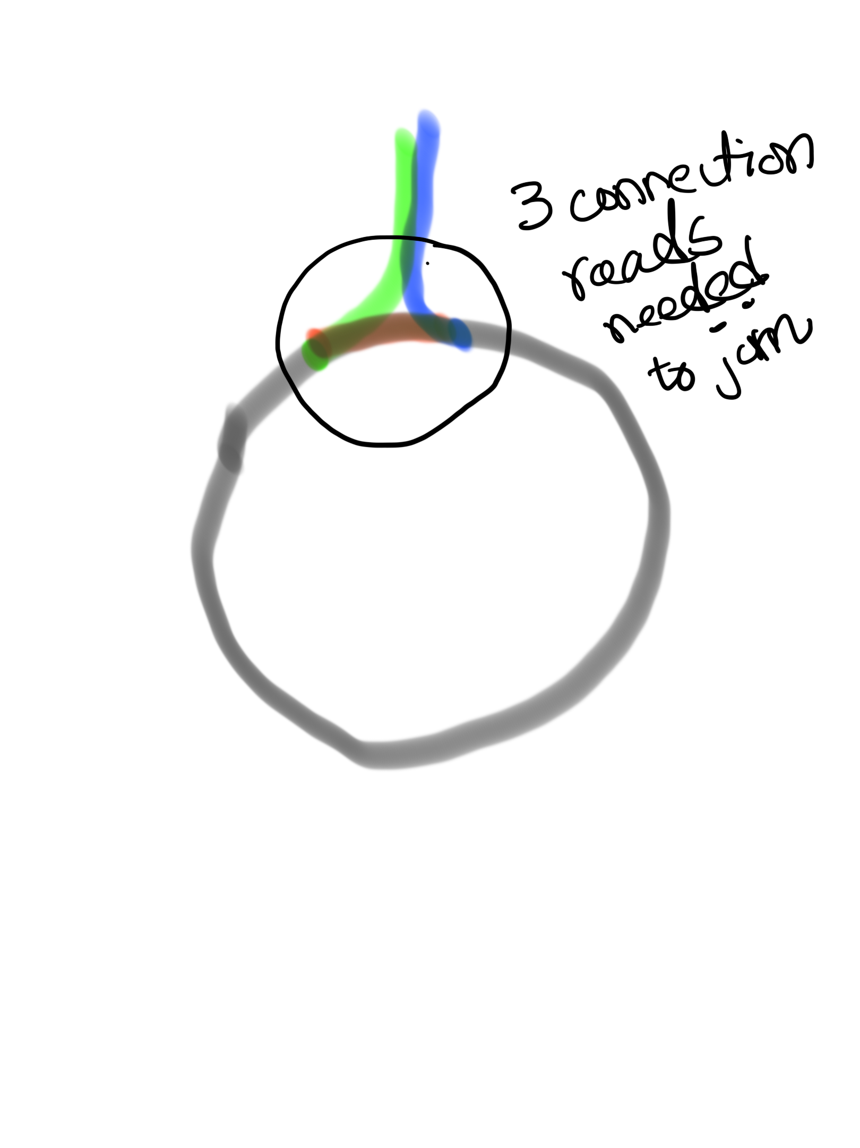
10. Arbitrary roundabout given an area and a set of obstacles
Merge angle: 90 degrees or any?

Slide 14
11. Connection roads with obstacle constraints.

Slide 15
12 Important curve design features
Super elevation
Speed constraints (max speed to be enforced after curve is designed).
Lane width variations
Sight distance

Slide 16
13. Modeling poor roads
Poorly designed in terms of safety

Slide 17
14. Ramp

Slide 18
15. Creating roads from drawings

Slide 19
16. Constraint based road generator

Slide 20
17. Evolving roads

Slide 21
18 Interstate roads

Slide 22
19 Variable width lanes
In case of curves, variable width lanes are desired for comfortable driving (STREETGEN)

Slide 23
20 Junction connection road curvature constraints
Max curvature to prevent lane overlaps given an angle
Min curvature to prevent lane length going over a threshold given an angle

Slide 24
21 Turn lanes that are not a part of the junction

Slide 25
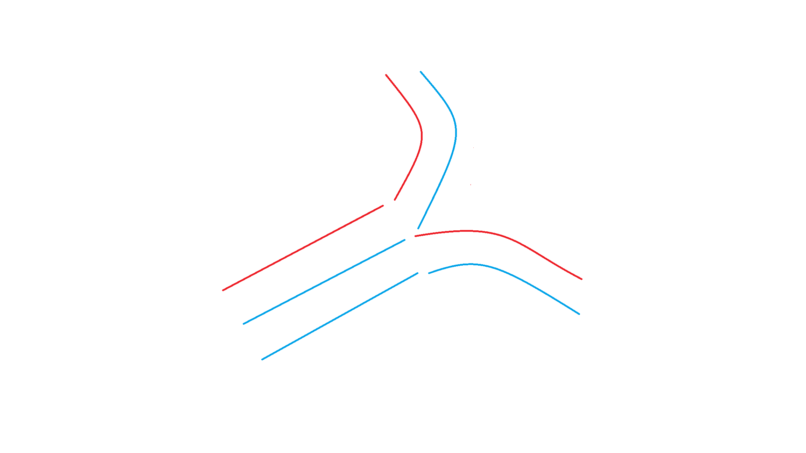
22 Connection roads with different reference lines
Shift is along t axis which is at right angle of reference line
t
s
1
2
y
x

Slide 26
22 Connection roads with different reference lines

Slide 27


Slide 28
23 Adjust lane widths after linking
Adjust according to the predecessor and successor lane widths. May need to create new lane section

Slide 29
24. Lane Linkage possibilities
Solid connections: the example configuration
Broken connections: alternative options
R
1
2
End
L
L
-1
-2
-3
-1
-2
-3
End
R

Slide 30
24. Lane Linkage possibilities
R
1
2
End
L
L
-1
-2
-3
-1
-2
-3
End
R

Slide 31
24. Lane Linkage possibilities
R
1
2
End
L
L
-1
-2
-3
-1
-2
-3
End
R

Slide 32
24. Lane Linkage possibilities
Solid connections: the example configuration
Broken connections: alternative options
R
1
2
End
L
L
-1
-2
-3
-1
-2
-3
End
R

Slide 33
Lane configuration
Traffic comes out of the right lanes at “END” and out of left lanes at “START” of the road
End
L
Start
-1
-2
-3
End
L
L
End
Start
-1
-2
-3
Start
-1
-2
-3

Slide 34
Lane configuration
End
End
L
L
Start
-1
-2
-3
Start
-1
-2
-3
Traffic comes out of the right lanes at “END” and out of left lanes at “START” of the road

Slide 35
25. Possible strategies for junction generation with different lane connections
Turns depend on signals
Signals depend on turns
Turn-first strategy vs signal first strategy vs deletion strategy
Don’t allow merges inside junctions, but allow extensions.
Extensions allowed, but merge not
Sequential generation of connections
Road first strategy: From each road, find possible paths.
Right turns always connected

Slide 36
25.1 Deletion strategy
Connect all lanes with each other with 1-lane connection roads. Based on signal rules or agent simulation, delete connection roads
Detect lane crossings for a given direction of traffic. Allow extensions, but not merges.

Slide 37
25.2 Turn first strategy
Harvest roads with different types of turns
Connect without crossings (all possible valid junctions given a set of roads with different types of turns)
Left turn and right turns are connected to adjacent roads only. Convert middle lanes as turn lanes and find more combinations.

Slide 38
25.3 Signal first strategy
Based on road positions, signals, and direction of traffic, select pairs of roads to be connected
Create required lanes on the roads
Create connection roads.

Slide 39
25.4 Basic rules
A straight lane cannot exist on the left of a left/left-straight turn lane (lane crossing). Same for right.
No merge in a connection road inside junctions
2 separate connection roads can cross because they can be controlled by signaling.

Slide 40
26. Geometric variations of existing junctions
Without changing the lane configurations, find variations by changing the reference line geometries.

Slide 41
Link Configurations Part 2
Link configurations for incoming lanes to outgoing lanes can be simplified if we order the outgoing lanes in such a way that leftmost outgoing lane is at the top and rightmost at the bottom. In addition, we can split, but cannot merge.

Slide 42
Lane configuration
Traffic comes out of the right lanes at “END” and out of left lanes at “START” of the road
End
L
Start
-1
-2
-3
End
L
L
End
Start
-1
-2
-3
Start
-1
-2
-3

Slide 43
24. Lane Linkage possibilities
Road 1
Solid connections: the example configuration
Broken connections: alternative options
R
1
2
Road 2
End
L
L
-1
-2
-3
Road 0
-1
-2
-3
End
R
Road 3

Slide 44
Link Configurations Part 2
Proof:
1:-1
1:-2
1:-3
0:-1
2:-1
0:-2
2:-2
2:-3
Link configurations for incoming lanes to outgoing lanes can be simplified if we order the outgoing lanes in such a way that leftmost outgoing lane is at the top and rightmost at the bottom. In addition, we can split, but cannot merge.

Slide 45
Evaluation

Slide 46
25. Median Island for intersections
4 Ways to do it:
Wide median lanes with islands as regular objects
Tackle lane width variations, way point calculations require object placement adjustments.
Extra non-driving lanes near median as islands
Need to identify which lanes are connected to an intersection.
Easy waypoint calculation
Don’t need to have variation in width
Single-way roads positioned arbitrarily.
Arbitrary separation between left and right lanes.
Will be hard to connect to a given intersection.
Forks (left lanes on a leg, right lanes on another).
Might be the best idea.

