Slide 1

Review 1 NUCLEOLINK: A Collaborative Platform for Molecular Visualization and AI-Driven Molecule Generation Using SMILES Notation Project Category: PRODUCT
Guide Name: Student Name & Registration Number:
Dr. Nivedhitha M. (103219) Augnik Banerjee(RA2211028010006)
Aniket singh(RA2211028010014)

Slide 2
Introduction
The rapid advancements in computational chemistry and artificial intelligence (AI) have significantly transformed molecular research and drug discovery. Traditional molecular modeling and analysis methods often require extensive computational resources and are limited by manual processing inefficiencies. To address these challenges, this project introduces a web-based molecular research platform that integrates molecular visualization, AI-driven molecule generation, and real-time collaboration, providing a seamless and interactive environment for researchers and developers.
One of the key features of the platform is molecular visualization, allowing users to render and analyze molecular structures in 2D and 3D. The platform also supports custom molecule generation using SMILES (Simplified Molecular Input Line Entry System) notation, enabling researchers to create and study novel molecular structures efficiently. Additionally, machine learning models are integrated to predict molecular properties such as toxicity, solubility, and binding affinity, aiding in early-stage drug discovery.

Slide 3
Objectives
Accelerate AI-driven drug discovery by enabling custom molecule generation, property prediction, and optimization.
Empower researchers with intuitive tools for 2D/3D molecular visualization, SMILES-based editing, and real-time collaboration.
Leverage public datasets and ML models to enhance accuracy, reproducibility, and transparency in early-stage drug development.

Slide 4
Literature Review
Year & Journal | Authors | Methodology | Benefits & Challenges
1988, J. Chem. Inf. Comput. Sci. | Weininger, D. | Introduced SMILES notation to encode molecular structures as ASCII strings. | Benefits: Simplifies chemical structure representation; widely adopted in cheminformatics. Challenges: Cannot represent 3D structure; may be ambiguous without canonicalization.
2019, Nature Machine Intelligence | Zhou, Z., Kearnes, S., Li, L., et al. | Used reinforcement learning for molecular optimization in drug discovery. | Benefits: Generates novel compounds with desirable properties. Challenges: Requires reward shaping; computationally intensive.
2022, Briefings in Bioinformatics | Li, Q., Wei, Y. | Review of biomolecular visualization tools for analysis and communication. | Benefits: Enhances understanding of complex biomolecular interactions. Challenges: Visualization depends on accurate structure data; performance varies by tool.

Slide 5
Literature Review
Year & Journal | Authors | Methodology | Benefits & Challenges
2012, J. Cheminformatics | Hanwell, M. D., et al. | Developed Avogadro, a 3D molecule editor and visualization tool. | Benefits: Open-source; supports plugin architecture and 3D rendering. Challenges: Limited advanced cheminformatics features natively.
2018, J. Cheminformatics | Gui, Y., et al. | Reviewed molecular visualization systems and their interoperability. | Benefits: Promotes standardization and integration across platforms. Challenges: Limited compatibility across data formats.
2021, J. Cheminformatics | Sicho, M., et al. | Introduced GenUI, a GUI-based drug design platform. | Benefits: User-friendly interface; integrates multiple generation models. Challenges: Heavy UI framework may limit scalability.

Slide 6
Literature Review
Year & Journal | Authors | Methodology | Benefits & Challenges
2023, Nature Communications | Lu, Z., et al. | Proposed 3D molecular generation with dynamics using neural networks. | Benefits: Captures structural flexibility; useful for docking simulations. Challenges: Requires high-quality 3D training data.
2024, Artificial Intelligence in the Life Sciences | Nahal, S., et al. | Active learning framework involving human-in-the-loop feedback. | Benefits: Improves model performance with fewer labels. Challenges: Needs expert involvement; time-consuming labeling.
2023, Patterns | Heberle, H., et al. | Developed XSMILES for molecular visualization with explainable AI. | Benefits: Enhances interpretability of model predictions. Challenges: Visualization quality depends on explainability model robustness.

Slide 7
Research Gap
Most existing platforms focus either on molecule generation or visualization — lacking a unified, interactive solution.
Limited integration of real-time collaboration tools and human-in-the-loop learning in current drug discovery systems.
Few studies provide an end-to-end framework that combines SMILES editing, 2D/3D visualization, property prediction, and explainable AI.
Lack of scalable, web-based platforms that enable seamless transition from molecular design to evaluation using public datasets.

Slide 8
Research objectives
Develop a unified web-based platform for molecular generation, visualization, and property prediction.
Integrate SMILES-based editing with interactive 2D/3D structure visualization for enhanced usability.
Implement machine learning models (e.g., GNNs, XGBoost) for accurate molecular property prediction.
Enable real-time collaboration and messaging features to support teamwork among researchers.
Ensure scalability, transparency, and reproducibility in the drug discovery workflow using open datasets and explainable AI.

Slide 9
Proposed Methodology
Molecule Input & Editing
Accept SMILES notation from users and convert it into 2D/3D molecular structures using RDKit.js.
Molecular Visualization
Render molecules in interactive 2D/3D views using web-based visualization libraries integrated with PubChem data.
Property Prediction
Use ML models (GNNs, XGBoost, etc.) trained on datasets like Tox21 to predict properties (e.g., toxicity, solubility).
Molecule Generation
Integrate pre-trained deep learning models (e.g., from NVIDIA AI) for novel molecule generation and optimization.
Explainability & Interpretation
Visualize model outputs with tools like XSMILES to highlight molecular substructures influencing predictions.
Real-Time Collaboration
Implement Ably-powered group messaging for live collaboration, feedback, and experiment sharing.
Platform Deployment
Host the application using Next.js and AWS (EC2, S3, Cognito) for secure, scalable access.

Slide 10
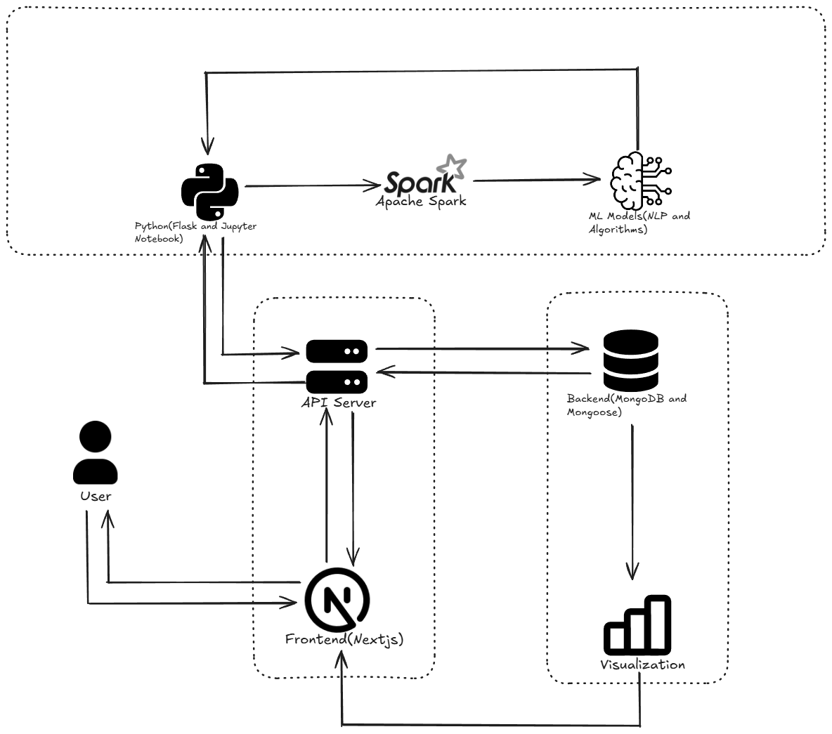
Architecture Diagram

Slide 11
Justification For Project SDG
SDG 4: Quality Education
Promoting Education and Research: Your project serves as a platform for learning and advancing knowledge in molecular science, AI, and drug discovery. It provides an opportunity for students, researchers, and professionals to gain new skills in cutting-edge technologies such as machine learning, molecular biology, and data science.
Access to Information: By democratizing access to advanced molecular discovery tools, your platform can provide educational content, tutorials, and training materials, enabling students and researchers globally to learn about molecular design, AI applications in healthcare, and sustainable innovations.

Slide 12
References
Zhou, Z., Kearnes, S., Li, L., et al. (2019). Optimization of molecules via deep reinforcement learning. Scientific Reports, 9, 10752. https://doi.org/10.1038/s41598-019-47148-x
Li, H., & Wei, X. (2022). A concise review of biomolecule visualization. Current Issues in Molecular Biology, 24, 1318-1334. https://doi.org/10.3390/cimb46020084
Hanwell, M. D., Curtis, D. E., Lonie, D. C., et al. (2012). Avogadro: An advanced semantic chemical editor, visualization, and analysis platform. Journal of Cheminformatics, 4(17). https://doi.org/10.1186/1758-2946-4-17
Gui, S., Khan, D., Wang, Q., et al. (2018). Frontiers in biomolecular mesh generation and molecular visualization systems. Visual Computing for Industry, Biomedicine, and Art, 1(7). https://doi.org/10.1186/s42492-018-0007-0
Sicho, M., Liu, X., Svozil, D., et al. (2021). GenUI: Interactive and extensible open-source software platform for de novo molecular generation and cheminformatics. Journal of Cheminformatics, 13, 73. https://doi.org/10.1186/s13321-021-00550-y

Slide 13
References
Lu, S., Yao, L., Chen, X., Zheng, H., He, D., & Ke, G. (2023). 3D molecular generation via virtual dynamics. arXiv Preprint. https://doi.org/10.48550/arXiv.2302.05847
Nahal, Y., Menke, J., Martinelli, J., et al. (2024). Human-in-the-loop active learning for goal-oriented molecule generation. Journal of Cheminformatics, 16, 138. https://doi.org/10.1186/s13321-024-00924-y
Heberle, H., Zhao, L., Schmidt, S., et al. (2023). XSMILES: Interactive visualization for molecules, SMILES and XAI attribution scores. Journal of Cheminformatics, 15(2). https://doi.org/10.1186/s13321-022-00673-y
Wang, Q., Wei, X., Hu, X., Wang, Z., & Dong, Y. (2023). Molecular generation strategy and optimization based on ACC reinforcement learning in the de novo drug design. Bioinformatics, 39(11).
Eriksen, K., Nielsen, B. E., & Pittelkow, M. (2020). Visualizing 3D molecular structures using an augmented reality app. Journal of Chemical Education, 97(5), 1487-1490. https://doi.org/10.1021/acs.jchemed.9b01033

