Slide 1
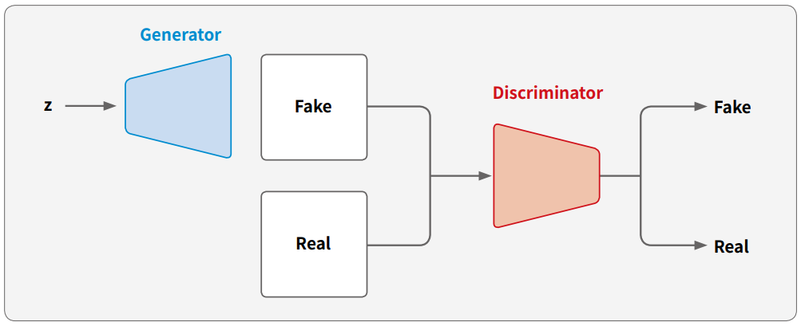
GAN
Generative Adversarial Network

Slide 2
