Slide 1
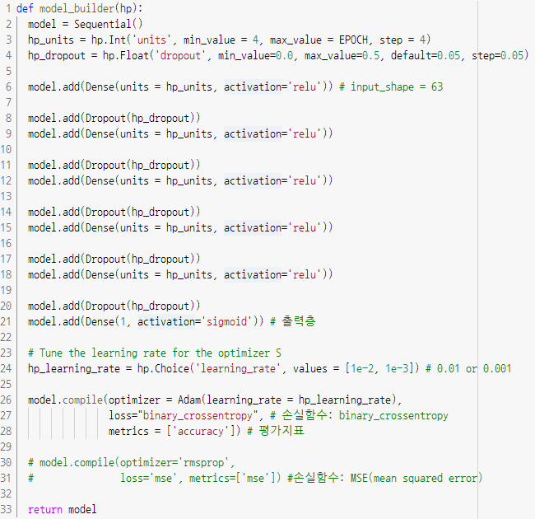
Keras를 이용한 ML Model

Slide 2
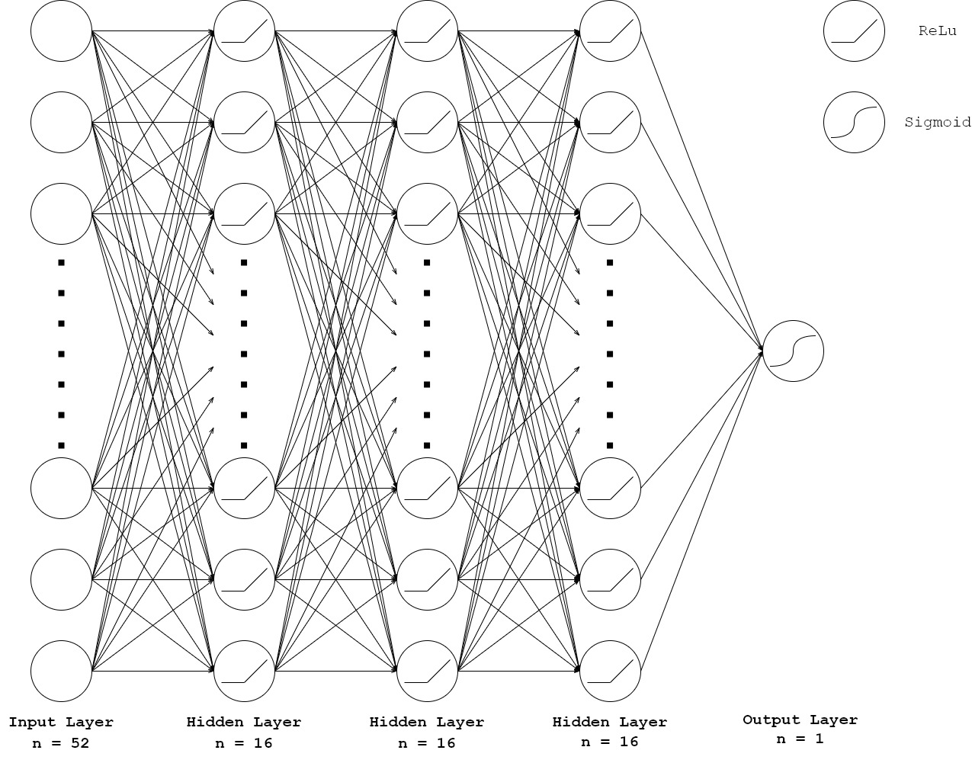
Keras를 이용한 ML Model

Slide 3
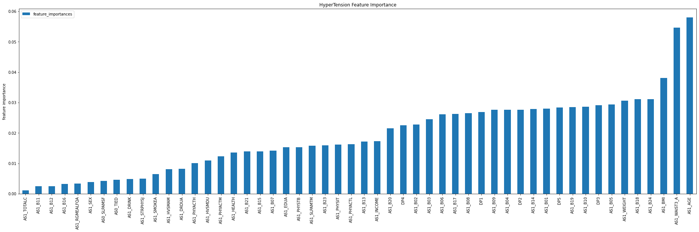
Keras를 이용한 ML Model

Slide 4
Keras를 이용한 ML Model
 | AS1_HEALTH | AS1_AGE | AS1_HVSMAM | AS1_HVSMDU | AS1_TOTALC | AS1_SLPAMTM | AS1_RGMEALFQA | AS1_BMI | AS1_WEIGHT | AS1_WAIST3_A | DP1 | DP2 | DP3 | DP4 | DP5
count | 9704.000000 | 9704.000000 | 9704.000000 | 9704.000000 | 9704.000000 | 9704.000000 | 9704.000000 | 9704.000000 | 9704.000000 | 9704.000000 | 9704.000000 | 9704.000000 | 9704.000000 | 9704.000000 | 9704.000000
mean | 0.499367 | 0.498965 | 0.225248 | 0.224145 | 0.009334 | 0.499846 | 0.500044 | 0.499991 | 0.499976 | 0.500013 | 0.496125 | 0.499544 | 0.498914 | 0.479692 | 0.499955
std | 0.276165 | 0.291046 | 0.383002 | 0.382764 | 0.095943 | 0.281277 | 0.171468 | 0.288722 | 0.288645 | 0.288720 | 0.294831 | 0.289453 | 0.290548 | 0.316889 | 0.288688
min | 0.000000 | 0.000000 | 0.000000 | 0.000000 | 0.000000 | 0.000000 | 0.000000 | 0.000000 | 0.000000 | 0.000000 | 0.000000 | 0.000000 | 0.000000 | 0.000000 | 0.000000
25% | 0.189690 | 0.238238 | 0.000000 | 0.000000 | 0.000000 | 0.290791 | 0.563063 | 0.250000 | 0.248749 | 0.251752 | 0.265265 | 0.259760 | 0.251251 | 0.225726 | 0.263263
50% | 0.518519 | 0.487988 | 0.000000 | 0.000000 | 0.000000 | 0.566066 | 0.563063 | 0.499499 | 0.511011 | 0.500501 | 0.499499 | 0.501001 | 0.499499 | 0.502002 | 0.500000
75% | 0.840841 | 0.747247 | 0.748248 | 0.750751 | 0.000000 | 0.815315 | 0.563063 | 0.749750 | 0.750250 | 0.750250 | 0.749750 | 0.749750 | 0.750250 | 0.749750 | 0.755756
max | 1.000000 | 1.000000 | 1.000000 | 1.000000 | 1.000000 | 1.000000 | 1.000000 | 1.000000 | 1.000000 | 1.000000 | 1.000000 | 1.000000 | 1.000000 | 1.000000 | 1.000000

