Slide 1

Thesis Presentation
Effects of virtual environment platforms on emotional responses
Kwanguk Kim
M. Zachary Rosenthal David J. Zielinski Rachael Brady
SUNGMIN YOO

Slide 2
A TABLE OF CONTENTS
0. ABSTRACT
1. INTRODUCTION
2. METHOD
3. RESULTS
4. DISCUSSION

Slide 3
0. ABSTRACT

Slide 4
ABSTRACT
The Goal of the current study
To Investigate the effects of different VE technologies on emotional arousal and task performance
Participants | VE Technologies | Stress | Dependent Variables
53 | Desktop PC | Low stress | Arousal
 |  |  | Valence
 | Head mounted display (HMD)
 | Head mounted display (HMD) |  | Skin conductance
 |  | High stress | Task performance
 | Fully immersive platforms (CAVE) |  | Presence
 |  |  | Simulator sickness
Highest amount of presence : Fully immersive system (CAVE)
Highest amount of Simulator Sickness : Head mounted Display (HMD)

Slide 5
1. INTRODUCTION

Slide 6




INTRODUCTION
VE
Education & Skill Training
Game
HCI
Psychiatry & Psychology
However, many questions remain about how to optimize the use of VEs

Slide 7
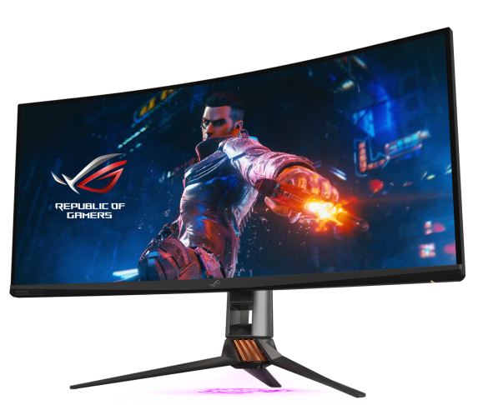
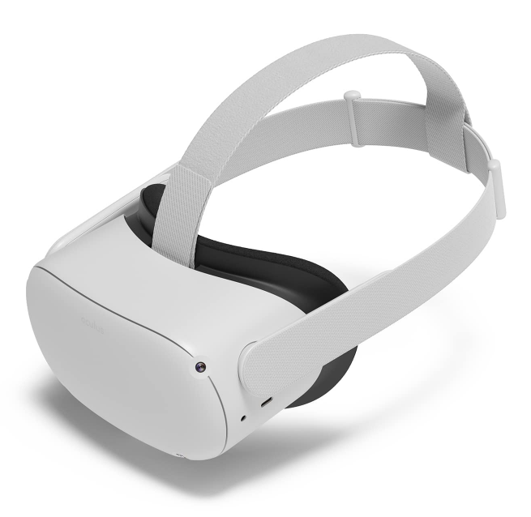
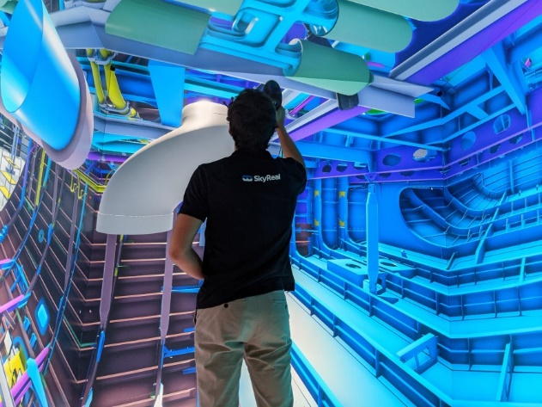
INTRODUCTION
selection of VE platform
And more..
Desktop PC
Head Mounted Display (HMD)
Fully immersive platforms (Six wall CAVE)
may influence the primary dependent variables of the research
To provide empirical evidence capable of helping researchers and clinicians select an appropriate VE platform

Slide 8
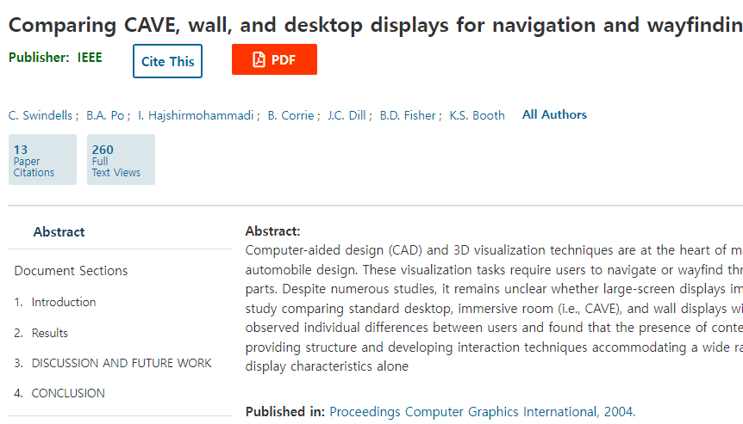
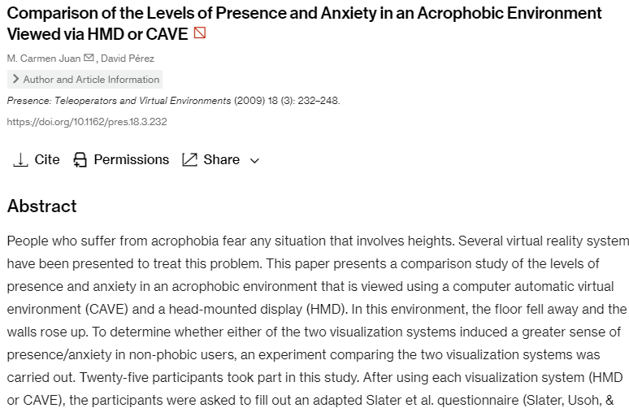
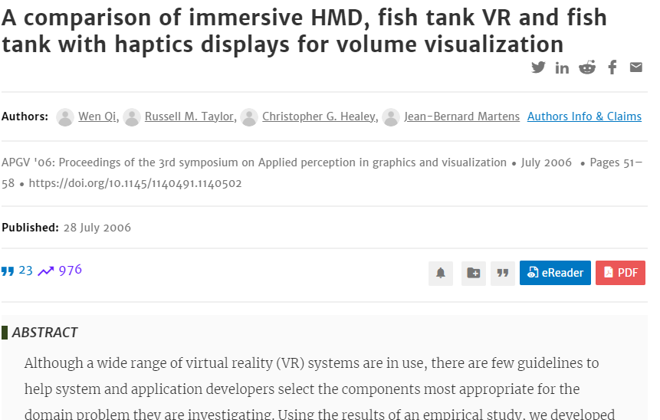
INTRODUCTION
Previous studies ..
(1)
(3)
(2)
VE platforms have been designed to address this issue in tasks involving spatial navigation or visualization
(1) Swindells et al.
(2) W. Qi et al. (3) Juan and Perez

Slide 9
INTRODUCTION
In the present study,
compared these three common VE systems on presence and simulator sickness in response to a low- and high-stress behavioral task.

Slide 10
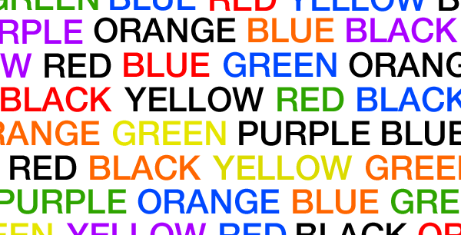
INTRODUCTION
Using a modified 3D Stroop Task
examined emotional reactivity and behavioral performance

Slide 11
INTRODUCTION
The experiment was ..
Hypothesis
Arousal & Presence | Performance on 3D Stroop task | Simulator Sickness | negative Emotion
CAVE | CAVE | HMD | HMD
with high-stress VEs
greater emotional arousal & lower valence than low-stress VEs

Slide 12
2. METHOD

Slide 13
PARTICIPANTS
Age |  | Participants
M = 21.6 | SD = 3.9 | 53 |  | Female = 52.8%
Asian/Pacific | Caucasian | Black/African | Hispanic/Latino |  | Other
24 | 19 | 6 | 3 |  | 1
No participants reported currently being prescribed any psychiatric medications

Slide 14
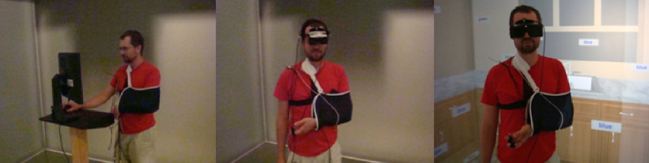
VIRTUAL ENVIRONMENTS
Desktop PC
Head Mounted Display (HMD)
Fully immersive platforms (Six wall CAVE)
Pic. 1 - Scenes of the experiment (Desktop system (left); HMD system (middle); DiVE System (right))

Slide 15
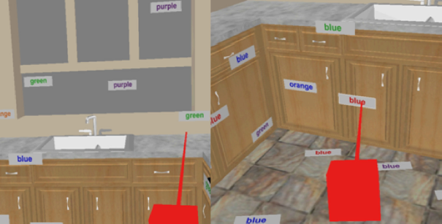
VIRTUAL ENVIRONMENTS
VE TASK
Pic. 2 - Scenes of the task (Modified 3D Stroop Task) (Low-stressful task (left); High-stressful task (right))
Low-stressful Task | High-stressful Task
- The color of the word and the meaning were congruent - No aversive stimulation | - The color of the word and the meaning were incongruent - With aversive stimulation (multimodal) (randomly onsets and offsets during 25% of task time)
Aversive stimulation : Loud noises, unexpected flashes, and tactile vibration to the ankles

Slide 16
DEPENDENT MEASURES
SELF-REPORT
BAI | SAM | PQ | SSQ
Individual’s anxiety | Emotional arousal and valence | Presence | simulator sickness
21 items | Likert Scale and visual depictions of a manikin | 33 items | 16 items
Four-point scale | Nine-point scale | Seven-point scale | Four-point scale
Cronbach α = .88 | Cronbach α = .81 | Cronbach α = .90 | Cronbach α = .91
- Beck Ansurance Inventory (BAI)
- Self Assessment Manikin (SAM)
- Presence Questionnaire (PQ)
- Simulator Sickness Questionnaire (SSQ)

Slide 17
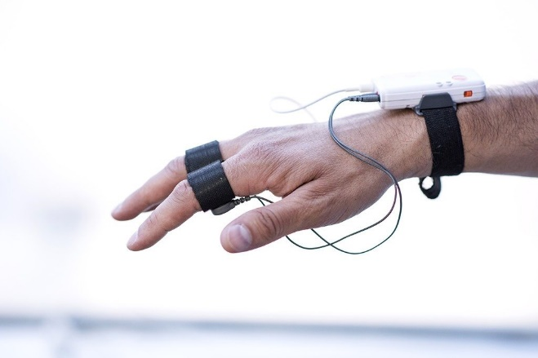

DEPENDENT MEASURES
SKIN CONDUCTANCE
Collected Galvanic Skin Response (GSR) measure set
Skin Conductance Response (SCR)
Applied a Digital lowpass filter with cut-off frequency of 1 Hz

Slide 18
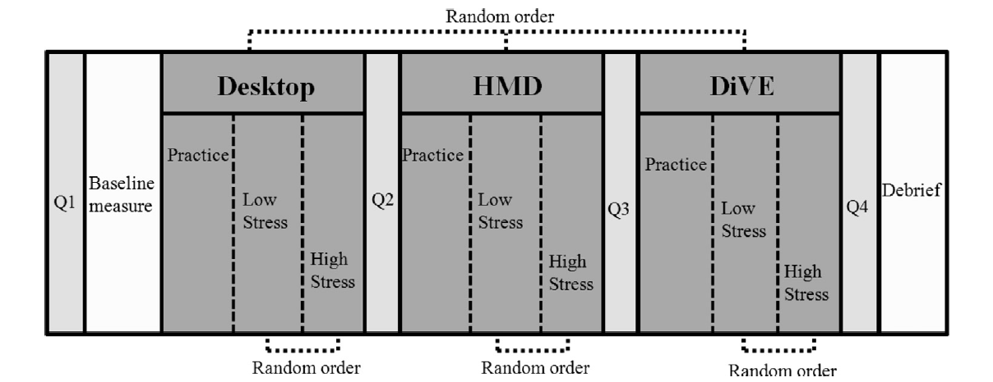
PROCEDURE
Q1 | Baseline | Q2, Q3, Q4
Informed consent form Personal history form BAI | Skin conductance Arousal Valence | Arousal Valence Presence Questionnaire (PQ) Simulator Sickness Questionnaire (SSQ)
All participants to avoid systematic order effects

Slide 19
3. RESULTS

Slide 20
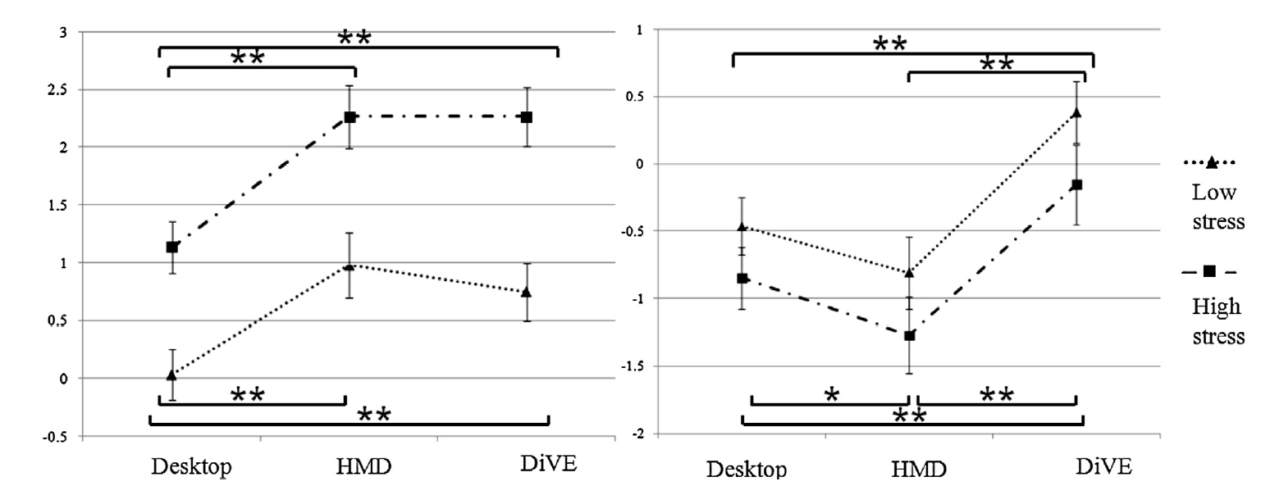
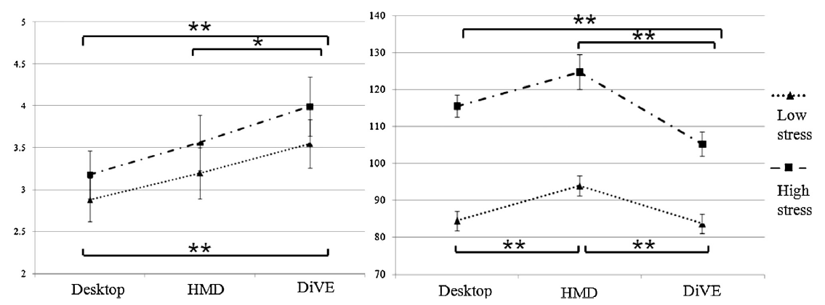
EMOTIONAL REACTIVITY & TASK PERFORMANCE
Results of arousal (left) and valence (right) for two stress conditions in three VE systems
Skin conductance (left) and task performance (right) for two stress conditions in three VE systems

Slide 21
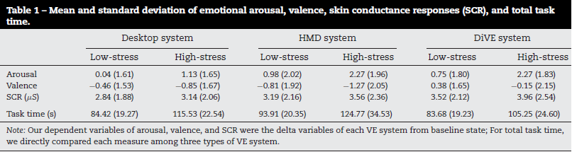
EMOTIONAL REACTIVITY & TASK PERFORMANCE

Slide 22
PRESENCE AND SIMULATOR SICKNESS
Results of presence (left) and simulator sickness (right) for three VE systems

Slide 23
4. DISCUSSION

Slide 24
DISCUSSION
elicit positive emotion or mitigate negative emotion | increase negative emotion
Use Fully immersive platforms | Use HMD
Require decisions about the use of VE platform carefully weigh the pros and cons of using HMDs based on the purposes of the study.
it will be important to extend the current results using additional VE platforms.

Slide 25
THANKS

