Slide 1

Predicting Asthma Diagnosis as a Screening Test
August J.F. Perez
October 2023 Cohort
Springboard Data Science capstone 2 Project
Mentor: Rahul Sagrolikar
July 2024
Github hosted Jupyter Notebook Link

Slide 2
Relevant Links
Github repository for this project
https://github.com/August-JF-Perez/Capstone_2_Springboard_August_Perez/tree/main
Direct link to the Jupyter Notebook containing the project
https://github.com/August-JF-Perez/Capstone_2_Springboard_August_Perez/blob/main/CapstoneTwo_Everything_AugustPerez.ipynb
Direct link to project report
https://github.com/August-JF-Perez/Capstone_2_Springboard_August_Perez/blob/main/Capstone2_Report_August_P.ipynb

Slide 3
The Problem
"An ounce of prevention is worth a pound of cure." - Benjamin Franklin
About 7.7% of the U.S. population has asthma (source: CDC Website)
A screening test for asthma would assist physicians in allocating their time and efforts more effectively. In addition, unnecessary use of resources could be prevented or reduced
By reducing the time and effort needed in identifying patients who might benefit from an asthma diagnosis, or waiting for patients to approach their doctor themselves, more time can be spent focusing on other tasks that require a physician's attentions

Slide 4


Interested Groups
Hospitals
Private Medical Practices
Insurance Companies
Patients
Medical staff in general

Slide 5
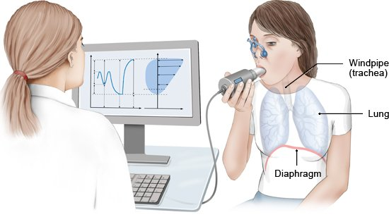
What factors might affect asthma diagnosis?
Diagnosis
Allergies
Environmental Factors
Genetics
Respiratory infections
History of symptoms
allergies, eczema, and other lung diseases
Medical history review (including family)
Spirometry
Chest X-ray
Blood test
Skin test
Source: Cleveland Clinic

Slide 6
Data Source: Asthma Disease Dataset (Link)
Extensive health information for 2,392 patients
Includes demographic details, lifestyle factors, environmental and allergy factors, medical history, clinical measurements, symptoms, and a diagnosis indicator
Feature Count: 29
Final Feature Count: 31
After relevant feature filtering and feature engineering

Slide 7
Feature Engineering
Created Feature
lifequality
exposure_count
lungfunction
allergy_count
symptom_count
Method
Mean
Mean
Division
Sum
Sum
Features Used
physical activity
diet quality
sleep quality
pollution exposure
pollen exposure
dust exposure
smoking
lung function fev1
lung function fvc
pet allergy
history of allergies
eczema
hay fever
gastroesophageal reflux
wheezing
shortness of breath
chest tightness
coughing
nighttime symptoms
exercise induced

Slide 8
Data Exploration Highlights
Feature Distributions
Comparison of Distributions between Diagnosis states
Correlations between features

Slide 9
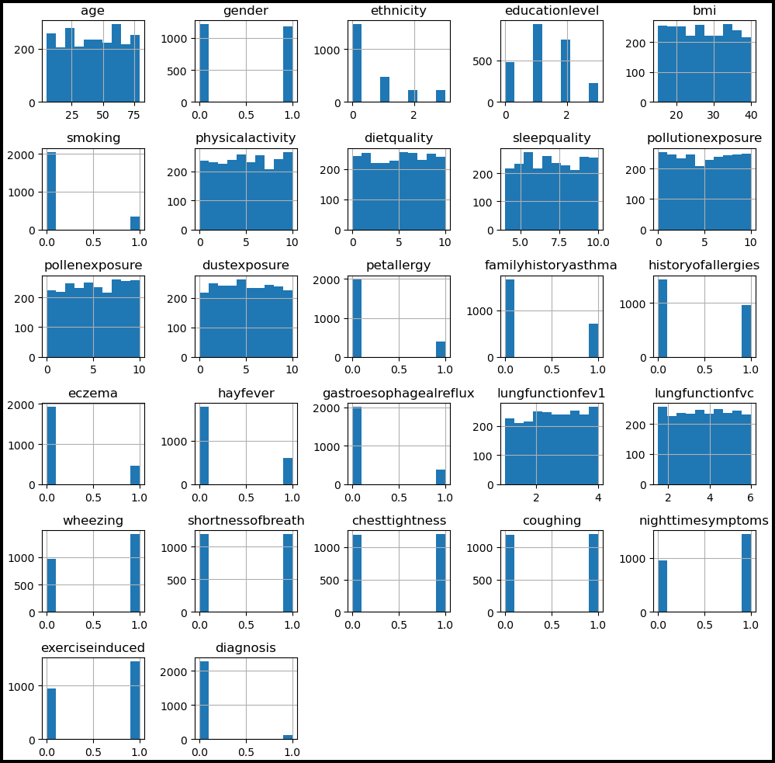
Feature Distributions
Fairly flat distributions for numeric variables.
bmi, lungfunctionfev1, lungfunctionfvc
Discrete
age, ethnicity, educationlevel, physicalactivity, dietquality, sleepquality, pollutionexposure, pollenexposure, dustexposure
The ratios within the categorical variables seem to reflect ratios expected in the real population.
Binary
gender, smoking, petallergy, familyhistoryasthma, historyofallergies, eczema, hayfever, gastroesophagealreflux, wheezing, shortnessofbreath, chesttightness, coughing, nighttimesymptoms, exerciseinduced, diagnosis (the target variable)
Ordinal
age, educationlevel, physicalactivity, dietquality, sleepquality, pollutionexposure, pollenexposure, dustexposure
Nominal
ethnicity

Slide 10
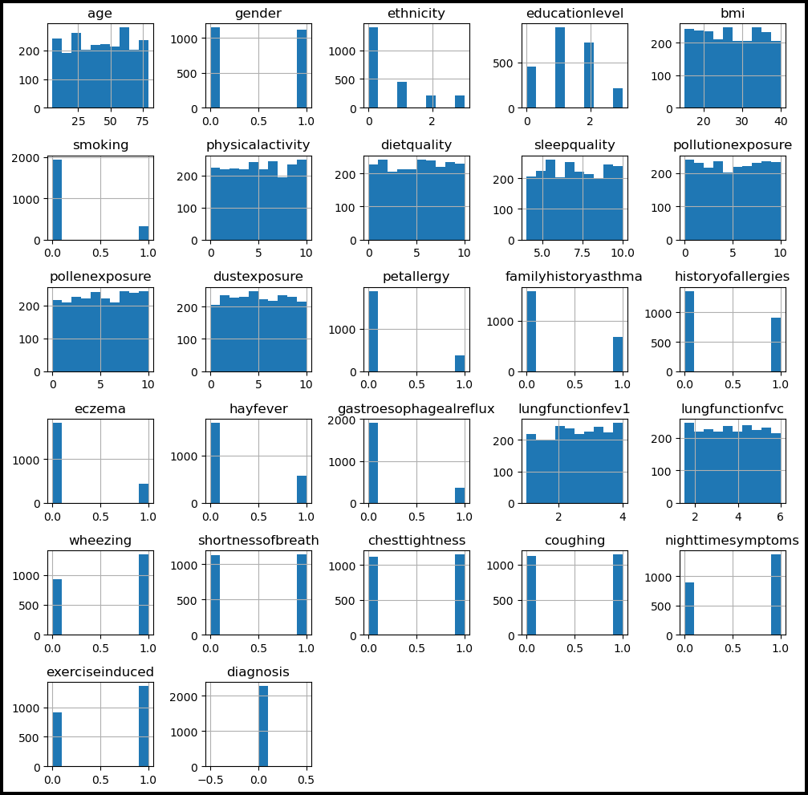
Feature Distributions (Diagnosis = 0)
Near to the same distributions as the unfiltered data

Slide 11
Feature Distributions (Diagnosis = 1)
Numerical variables seemingly have more varied distributions.
Likely due to about 5% of the total data has Diagnosis = 1.
pollutionexposure almost a bimodal distribution but not a strong enough case to be confidently classified as such.
Categorical variables have extremely similar ratios to the unfiltered and Diagnosis=0 distributions

Slide 12
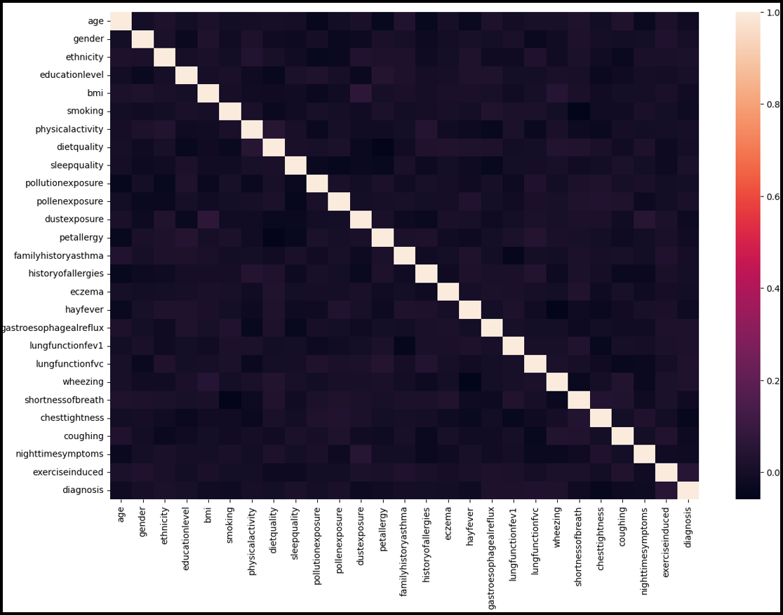
Correlations between features
Correlation between two features
Highest: 0.064841
BMI & DustExposure
Lowest: -0.059298
Wheezing & Hayfever
Correlation between diagnosis & a feature
Highest: 0.053956
ExerciseInduced
Lowest: -0.039278
Chesttightness
These correlation coefficients indicate there is barely any relationship between features or a relationship between a single feature and Diagnosis. With a correlation of 1 or -1 being a perfect linear relationship.

Slide 13
Modeling
Type: Supervised learning
Tools: SciKit learn
Binary classification: 1 for diagnosed with asthma and 0 for not diagnosed with asthma
Highly imbalanced data: 5.18% data tagged with diagnosis = 1
Addressed with resampling (oversampling of diagnosis = 1)
6 Classification models were trained, tested, & scored. The best 2 models then underwent hyperparameter tuning & scoring.

Slide 14
Models Created
Decision Tree
Random Forest
K Nearest Neighbors
Logistic Regression
Marked for hyperparameter tuning
Gradient Boosting (with decision trees)
Adaptive Boosting (AdaBoost) (with logistic regression)
Best model overall
A DummyClassifier model was created to simulate random guessing as a baseline to compare models to. (Recall = 37.9%)

Slide 15
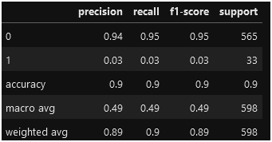
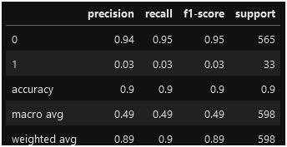
Models 1 & 2 Metrics
Model 1: Decision Tree
Model 2: Random Forest
Accuracy: 91%
Recall: 3%
High scores for diagnosis=0, low scores for diagnosis=1
Worse recall than dummy classifier
Accuracy: 94%
Recall: 0%
Worse recall than dummy classifier
Performed well for diagnosis=0, extremely poorly for predicting diagnosis=1

Slide 16
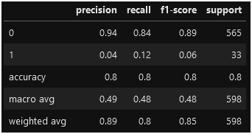
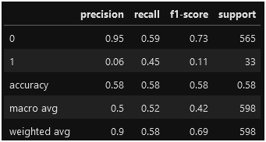
Models 3 & 4 Metrics
Model 3: K Nearest Neighbors
Model 4: Logistic Regression
Accuracy: 80%
Recall: 12%
Worse recall than dummy classifier
KNN did well predicting diagnosis=0, slightly better than previous models but still poorly in predicting diagnosis=1
Accuracy: 58%
Recall: 45%
Improved recall over dummy classifier
Low accuracy but much higher recall vs other models.
Theorized cause is grouping of data points makes it difficult to make a decision plane

Slide 17
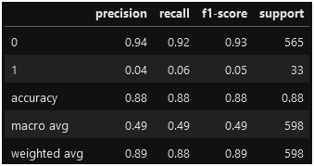
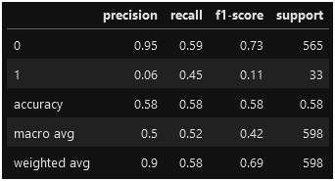
Models 5 & 6 Metrics
Model 5: Gradient Boosting (decision trees)
Model 6: Adaptive Boosting (logistic regression)
Accuracy: 88%
Recall: 6%
Worse recall than dummy classifier
Accuracy lower than all models except Logistic Regression (at 58%). Recall is only better than the tree & forest models.
Accuracy: 58%
Recall: 45%
Almost exact same results as Logistic Regression by itself. Changing weights does not seem to have an effect using default values

Slide 18
Hyperparameter Tuning
Tuned models: Logistic Regression, & AdaBoost(LogisticRegression)
Performed by applying a Grid Search
Logistic Regression did not see an improvement in recall (45% → 43%)
AdaBoost saw about a 1% improvement in recall (45% → 46%)
The AdaBoost model was shown to be the best to be applied to this problem and dataset

Slide 19
Tuning Results (Grid Search Cross Validation)
Logistic Regression
Adaptive Boosting (logistic regression)
mean_test_accuracy: 57.40%
mean_test_recall: 42.83%
mean_test_accuracy: 57.74%
mean_test_recall: 46.07%
Parameters:
class_weight : balanced
max_iter : 500
random_state : 9
solver : liblinear
Parameters:
estimator : LogisticRegression
class_weight = 'balanced'
max_iter = 500
solver = 'liblinear'
learning_rate : 0.1
Best Model

Slide 20
Possible Limitations
Low count of Diagnosis=1 samples (only about 5% of the original dataset)
Weak correlation between features and target
The samples recorded in the dataset may not truly reflect the population
Faulty sample collection or incorrect data handling of the dataset prior to being made available may have occurred
Suspected as class ratios for common asthma symptoms do not appear to change significantly from Diagnosis=0 to Diagnosis=1

Slide 21
Future Improvements
Effective feature engineering by learning more about each variable collected in the dataset and gaining a deeper understanding of how they could relate to each other.
Perform feature selection and apply it to the models.
Gaining a better understanding of how to perform effective feature selection is the hurdle for this improvement.
Gain more data from other studies.
This would make the data used for modeling more reflective of the population.
This might elucidate the potential inaccuracies within the original dataset.

Slide 22
Conclusions
Out of 6 models & 2 hyperparameter tuned models, the tuned AdaBoost model using Logistic Regression provided the best recall
A final count of 32 features (including 5 engineered features & the target feature)
The overall recall (sensitivity) for correctly predicting a true diagnosis of asthma was fairly low (at 46%)
While diagnostic screening tests can have very low sensitivities (when favoring specificity), any test that aims to minimize false negatives requires a high sensitivity (usually > 80%)
For real world application, I would recommend against using the model in its current state as a screening test for asthma. Further improvements to the model or data are required

