Slide 1

Characterizing Vehicle Crash Locations Through Machine Learning
August J.F. Perez
October 2023 Cohort
Springboard Data Science capstone 3 Project
Mentor: Rahul Sagrolikar
OCt 2024

Slide 2
Relevant Links
Github repository for this project
https://github.com/August-JF-Perez/AugustP_Capstone3
Direct link to the Jupyter Notebook containing the project
https://github.com/August-JF-Perez/AugustP_Capstone3/blob/main/Capstone_3_Everything.ipynb
Direct link to project report
https://github.com/August-JF-Perez/AugustP_Capstone3/blob/main/Capstone_3_Project%20Report_August_Perez.pdf

Slide 3
The Problem
Agencies that respond to vehicle accidents would benefit from pre-planning where to allocate resources and personnel before an accident occurs to decrease response time. Determining general locations with higher accident risk to station personnel will be of great use.

Slide 4
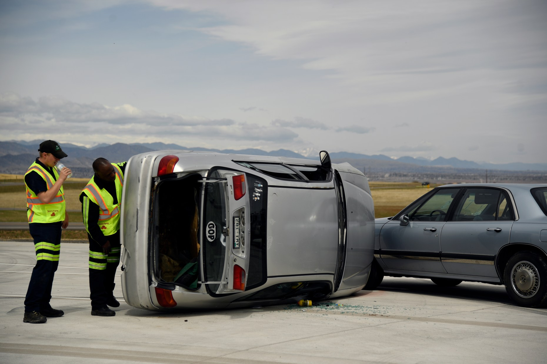
Interested Groups
First Responder agencies
Insurance Companies
Anyone operating or riding in a vehicle on roads serviced by first responders

Slide 5
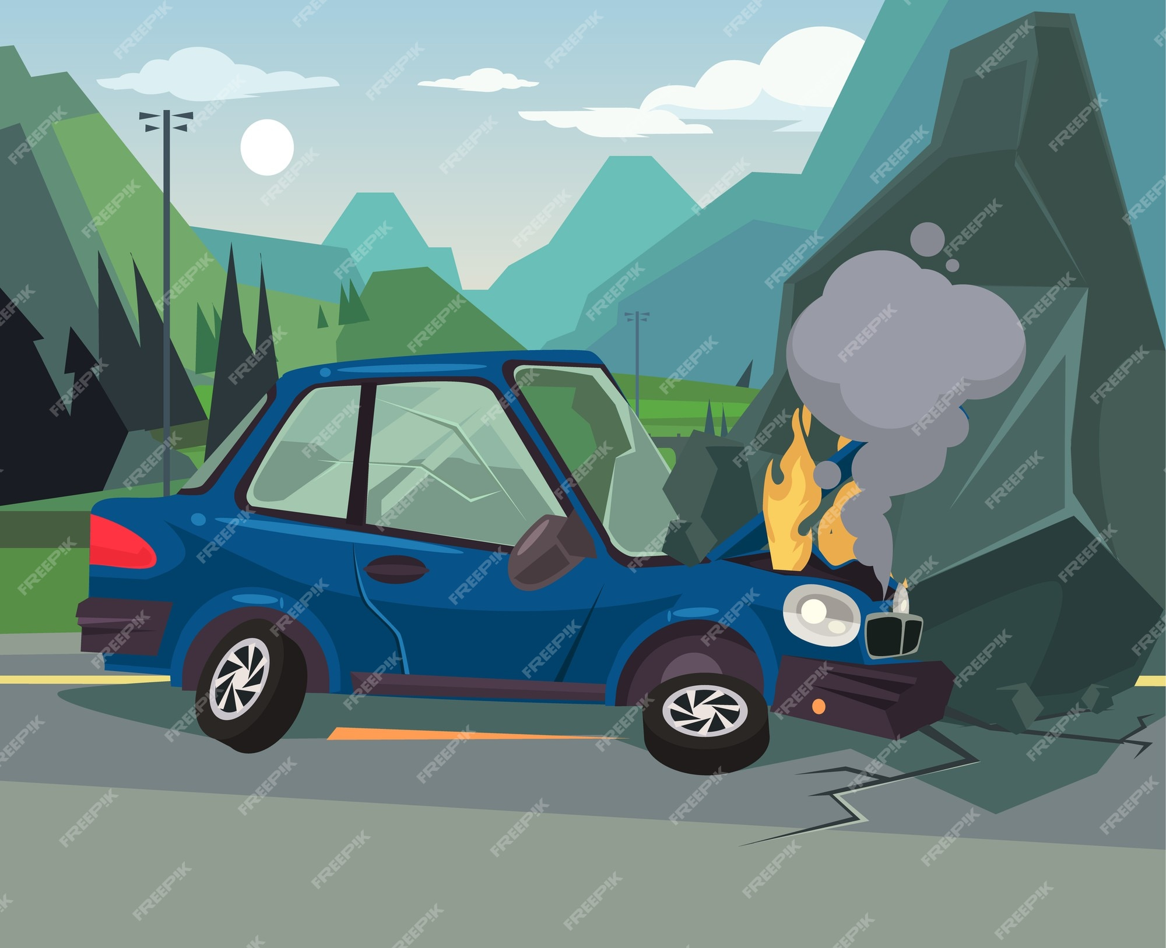
What factors might affect crash probability that agencies can account for?
Road characteristics
ex. lane count
Environmental Factors
ex. rain or shine
Driving Conditions
ex. lack of light

Slide 6
Data Source: Accidents in France from 2005 to 2016 (Link)
4 datasets used, collecting different details of the crash that occured
caracteristics
(typo is present in the kaggle source)
holidays
places
users
The datasets were cleaned and merged together after relevant feature selection and engineering
Feature Count: 18
All categorical type features
Final Feature Count: 127
After one-hot encoding

Slide 7
Feature Engineering
Feature engineering consisted of converting continuous variables to categorical
Such as encoding 1 if any amount of pedestrians were involved in the accident and 0 if no pedestrians were recorded for the accident
Time based features were created based on the date of the accident
To determine if the crash occurred on a holiday, weekend, and what day of the week the crash occurred.
The hour of the day for the crash was also extracted
A 'crash' feature was created to denote whether a crash occurred or not.
Every observation was labeled 1 (Yes-crash) to start as the data was only about car accidents
crash=0 data was addressed by artificially creating feature combos not already present in the data

Slide 8
Data Exploration Highlights
Summary Statistics
Feature Distributions
Note: Correlations between features were examined but it was found to be as expected for strong relationships between each of the features. Such as an autoroute always has at least 2 lanes.

Slide 9
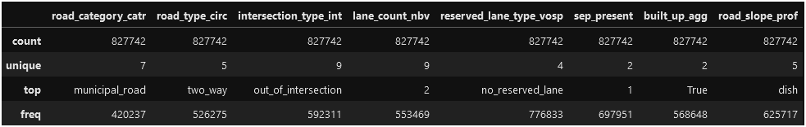
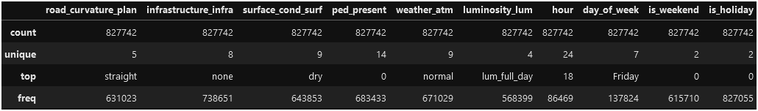
Summary Statistics

Slide 10
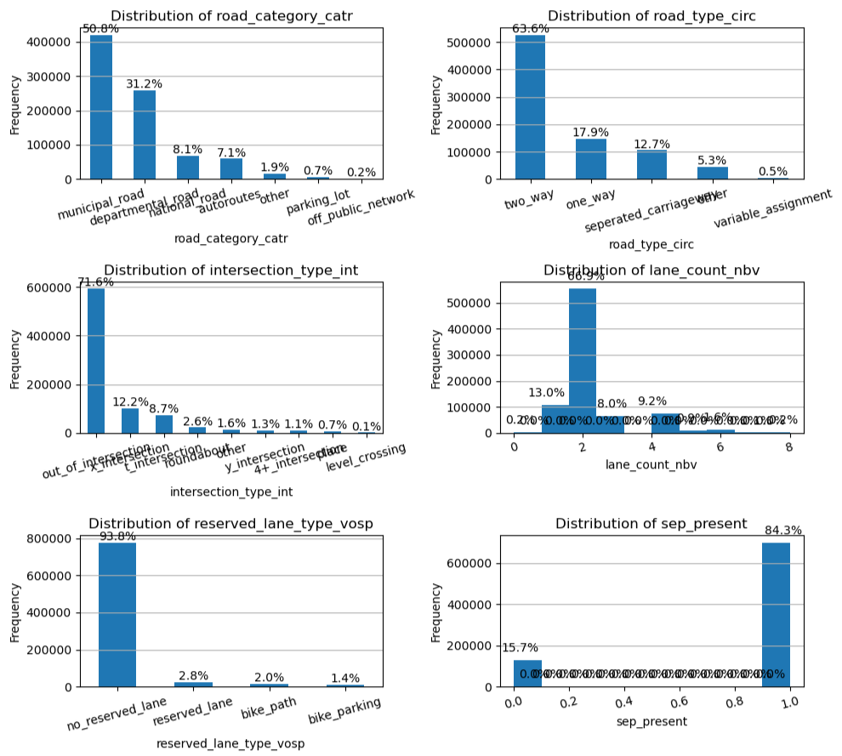
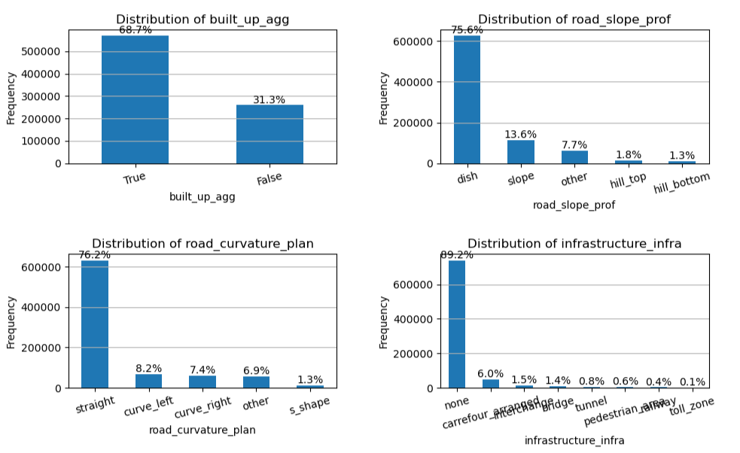
Feature Distributions
- Road Descriptor Features -

Slide 11
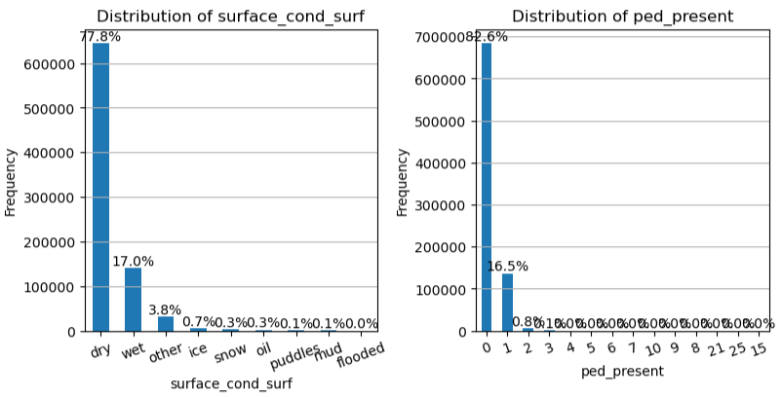
Feature Distributions
- Driving Conditions Features -
Dry roads are most common with wet road surfaces being a distant second ('other' being even more distant third)
Makes sense as dry conditions are extremely common compared to any other
Pedestrians are not commonly present in a crash

Slide 12
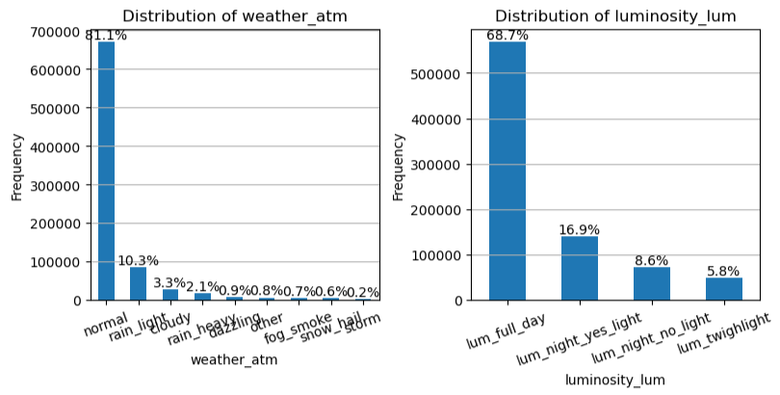
Feature Distributions
- Weather Descriptor Features -
Majority is 'normal' weather
implying reasonable sunshine for visibility, sparse cloud cover, and no percipitation
light rain is distant second weather condition for crashes
full daylight is present for majority of crashes

Slide 13
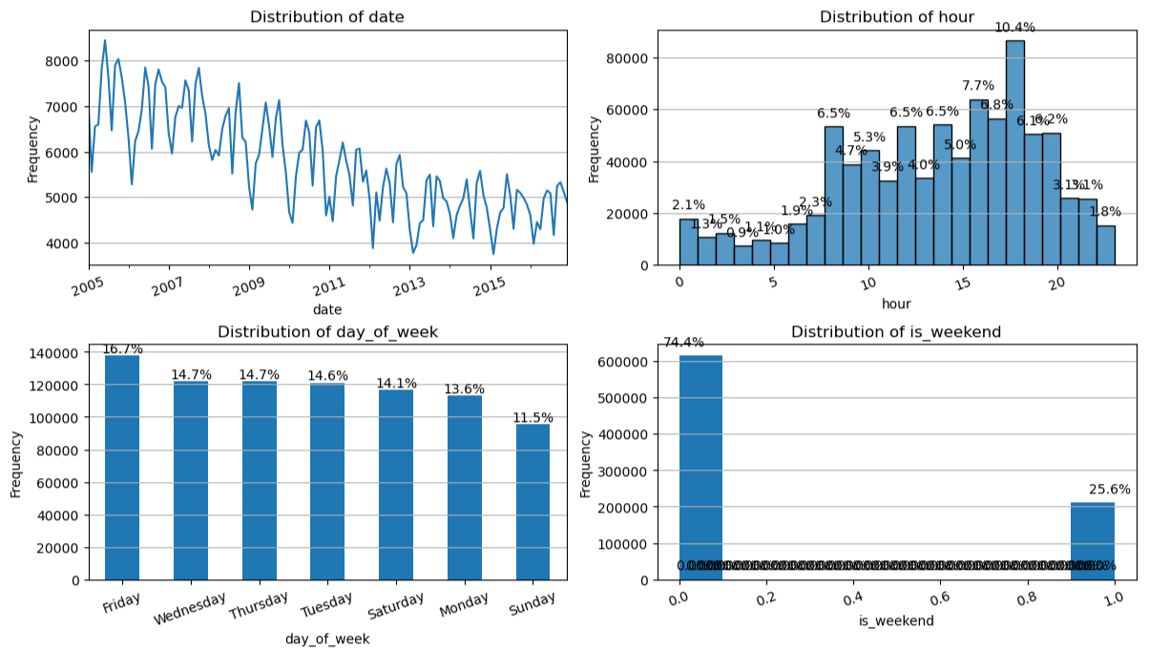
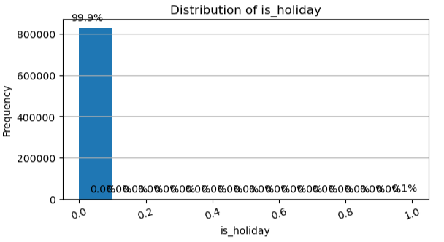
Feature Distributions
- Time Descriptor Features -
(Time-series check) Crashes seem to be declining in a linear fashion over the years
Time frame for elevated crashes is 8am - 7pm with peak at 6pm (avg sunset time after 7pm, https://sunrise-sunset.org/france)
Friday has the most crashes & Sunday has least amount of crashes
Not usually a weekend for crashes
Makes sense as friday is most common crash day. And that weekdays are more common than weekends
Super majority of crashes on non-holidays
Makes sense as holidays are not common (especially with only looking at 11 days out of the 365 day year)

Slide 14
Modeling
Type: Supervised learning
Tools: SciKit learn, Keras
Binary classification: 1 for crash and 0 for not a crash
Classes 1 & 0 were balanced 1:1
Equal count of unique feature combinations and equal count of samples for each class
3 Classification models were trained, tested, & scored.
The top 20 features for predicting crash=1 were extracted from each model

Slide 15
Models Created
Logistic Regression
Random Forest
Sequential Neural Network
Marked for hyperparameter tuning

Slide 16
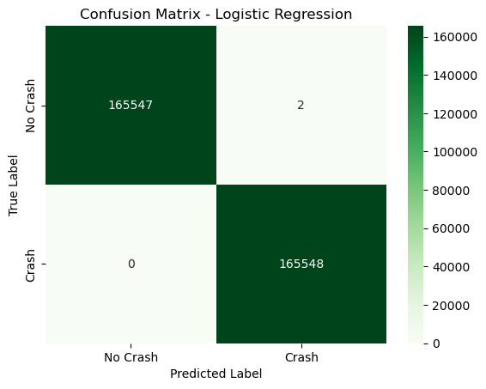
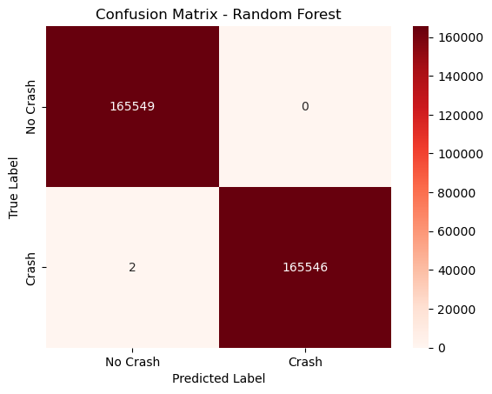
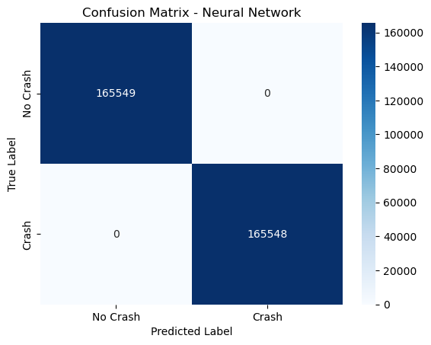
Metrics & Confusion Matrices:
Every model achieved 100% (1.0) for all scores.
Understandably due to no overlap in feature combinations for crash = 0 or 1
This is acceptable and desired as the goal is to increase understanding of where & when these crashes occur

Slide 17
Hyperparameter Tuning
The neural network model then underwent hyperparameter tuning to determine optimal parameters
This was performed more as an instructional exercise as the original model had near perfect metrics already.
Hyperparameters tuned specifically include: number of layers and learning rate
Other hyperparameters were checked and tuned automatically through the keras function Hyperband, with direction to optimize accuracy
There was no appreciable improvement in scores for the model

Slide 18
Chosen Model
Logistic Regression Classifier
default values as of scikit Learn version 1.5.2
random_state=9 for reproducibility
Chosen due mainly to lower resource usage and time for code execution when compared to random forest and the neural network models
Another very important factor is the feature coefficients are much more informative of how each feature affects the chance of a crash occurring versus the black box nature of a neural network whose top most important features change each time the model is trained.

Slide 19
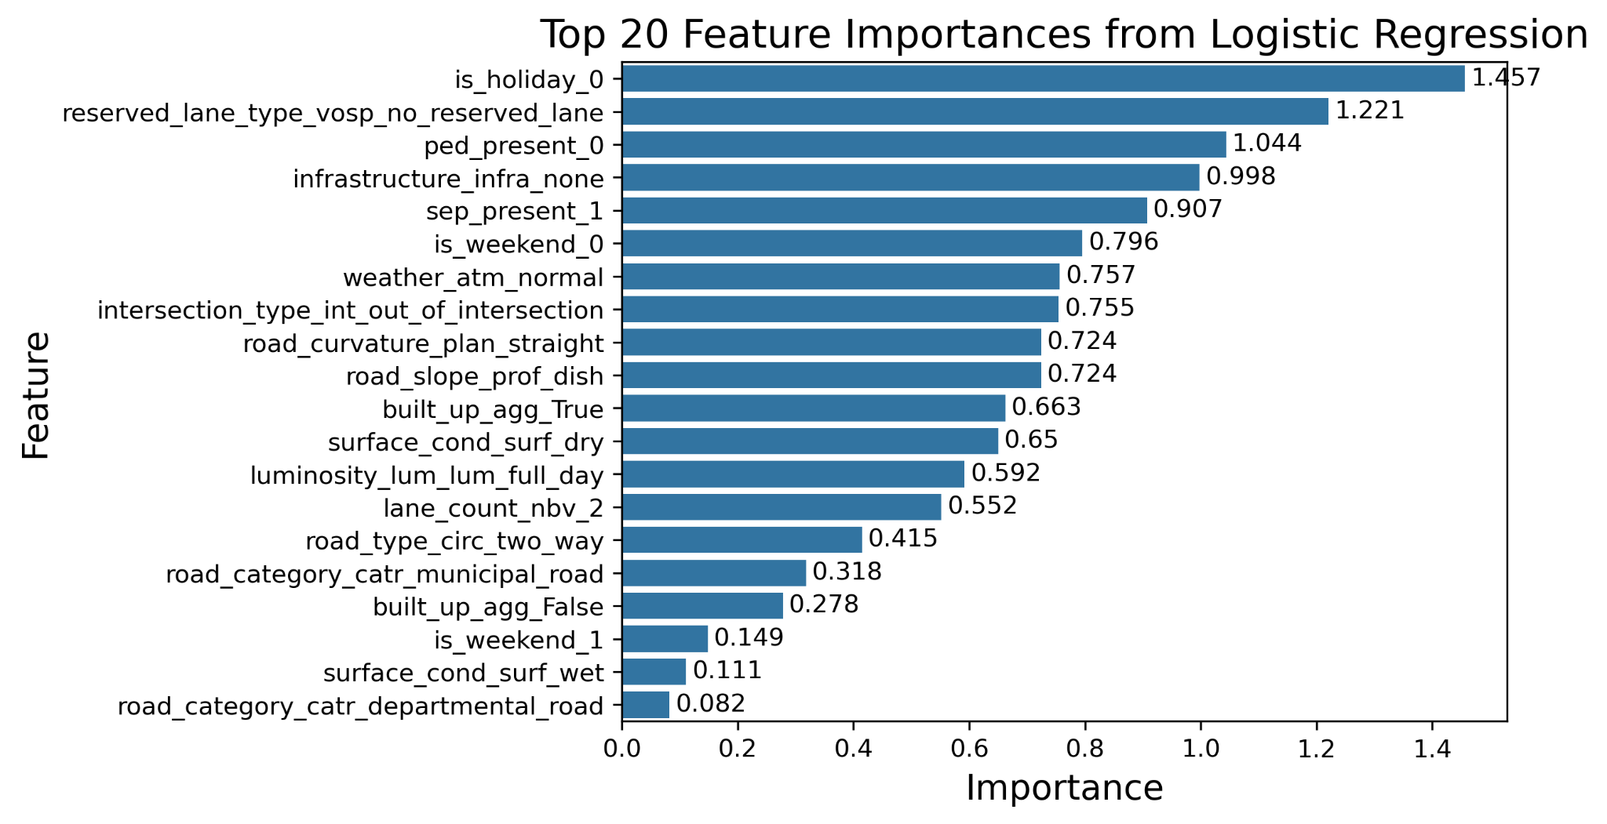
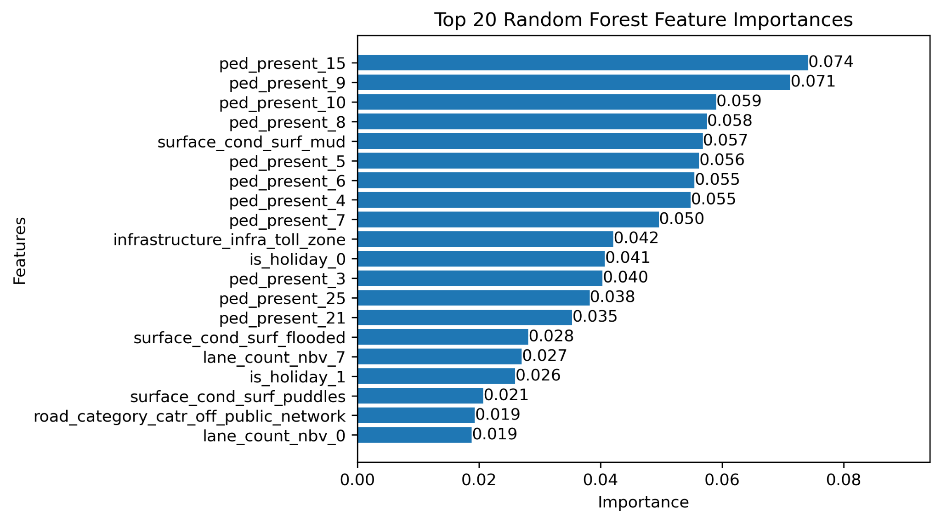
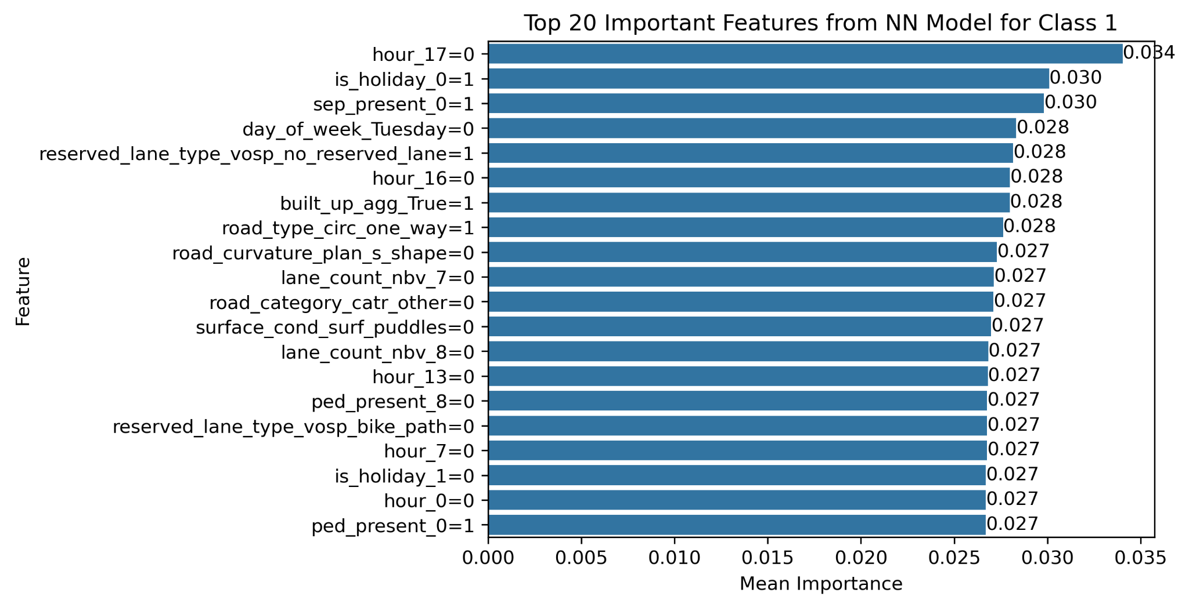
Top 20 Feature Importances per Model
Feature Importance Notes:
Top features for both the neural network and random forest models change every time the model is trained and predictions made.
The logistic regression model top features seem consistent across new trainings

Slide 20
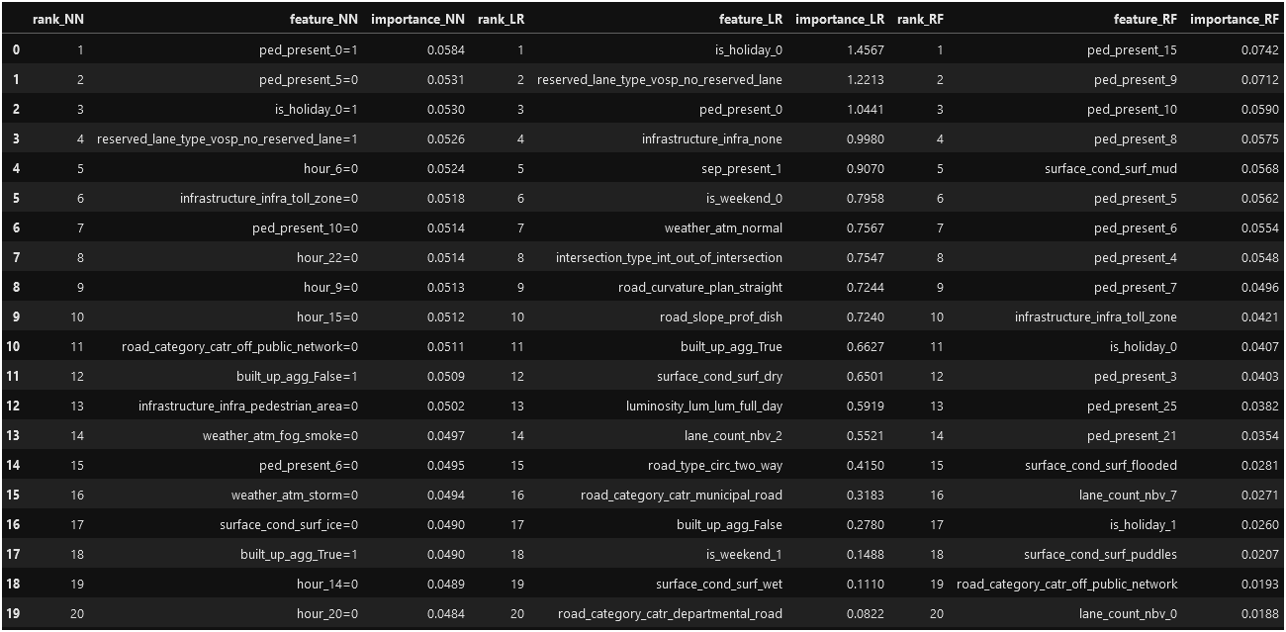
Top 20 Feature Importances per Model (Table)

Slide 21
Possible Limiting factors & Improvements:
Non-crash data not present
Potential for collection by automatic detectors that count passing cars.
Matching data to the crashes dataset would also need to be collected
Except for weather and date/time; features should generally remain static and can be hard coded such that they are included when a car is counted.
Using non-crash data would improve model quality in that an actual probability could be determined for a crash rather than simply treating a combination of features as Yes-crash or No-crash

Slide 22
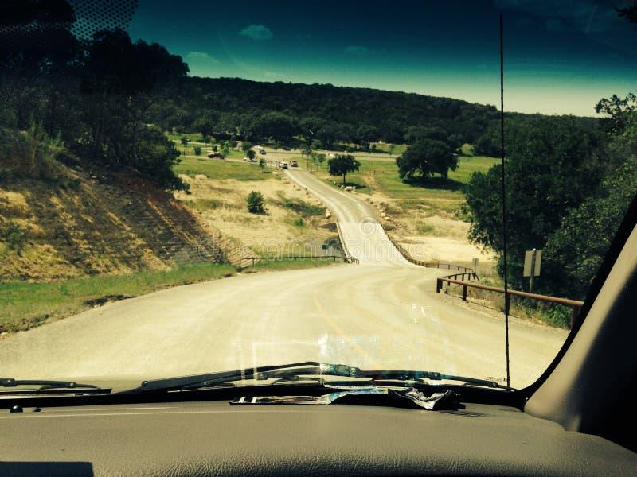
Most Likely Crash Location Characteristics:
From Top Logistic Regression Non-Conflicting Top 20 Features
non-holiday
no reserved lane (ex. an emergency lane)
no pedestrians
no infrastructure in immediate area
a separator is present
weekday (Mon-Fri)
normal weather
away from an intersection
straight road
dish slope (ex. bottom of two hills)
in built-up areas (i.e. town or city)
dry roads (matches for normal weather)
full daylight
2 lanes
two way road
municipal (local) road
Note: this is taking the top features that do not conflict, this does not necessarily confirm this specific combination has a 100% accident rate.

Slide 23
Conclusions
The goal of this project was to characterize (describe) the locations where vehicle crashes were most likely to occur.
This was performed through building a binary classification model (Yes crash or No crash) and examining the importance of the characteristics for predicting the occurrence of a crash.
A hypothesis set at the beginning of this project was that crashes would be more likely to occur for bad driving conditions (i.e. weather, more cars crossing paths, etc.).
This was proven false by the top features indicating non-inclement conditions
This does not mean that adverse conditions do not carry risk, just that agencies may want to monitor these areas more than others in order to increase efficiency in which they respond to an emergency.

