Slide 1
Finite Automata
（有限自动机 或 有穷自动机）
Motivation
An Example
Slides Courtesy of Stanford CS154 and etc

Slide 2
Informal Explanation
Finite automata are finite collections of states (状态) with transition rules (转移规则) that take you from one state to another.
Original application was sequential switching circuits, where the “state” was the settings of internal bits.
Today, several kinds of software can be modeled by FA.

Slide 3
Representing FA
（有限自动机的图示法）
Simplest representation is often a graph.
  Nodes(节点）= states.
  Arcs (边) indicate state transitions.
  Labels (标签) on arcs tell what causes the transition.

Slide 4
Example: Recognizing Strings Ending in “ing”
Not i or g
Not i
Not i or n
i
nothing
Saw i
Saw in
Saw ing
i
n
g
Start
i

Slide 5
Automata to Code
In C/C++, make a piece of code for each state. This code:
  Reads the next input.
  Decides on the next state.
  Jumps to the beginning of the code for that state.

Slide 6
Example: Automata to Code
2: /* i seen */
c = getNextInput();
if (c == ’n’) goto 3;
else if (c == ’i’) goto 2;
else goto 1;
3: /* ”in” seen */
. . .

Slide 7
Automata to Code – Thoughts
How would you do this in Python, which formally has no goto?
You don’t really write code like this. Rather, a code generator takes a “regular expression”（正则表达式） describing the pattern(s) you are looking for.
  Example: .*ing works in grep （检索形如*ing的字符串）.
自动机与代码之间的关系是什么？
  为什么不用程序做计算模型？

Slide 8
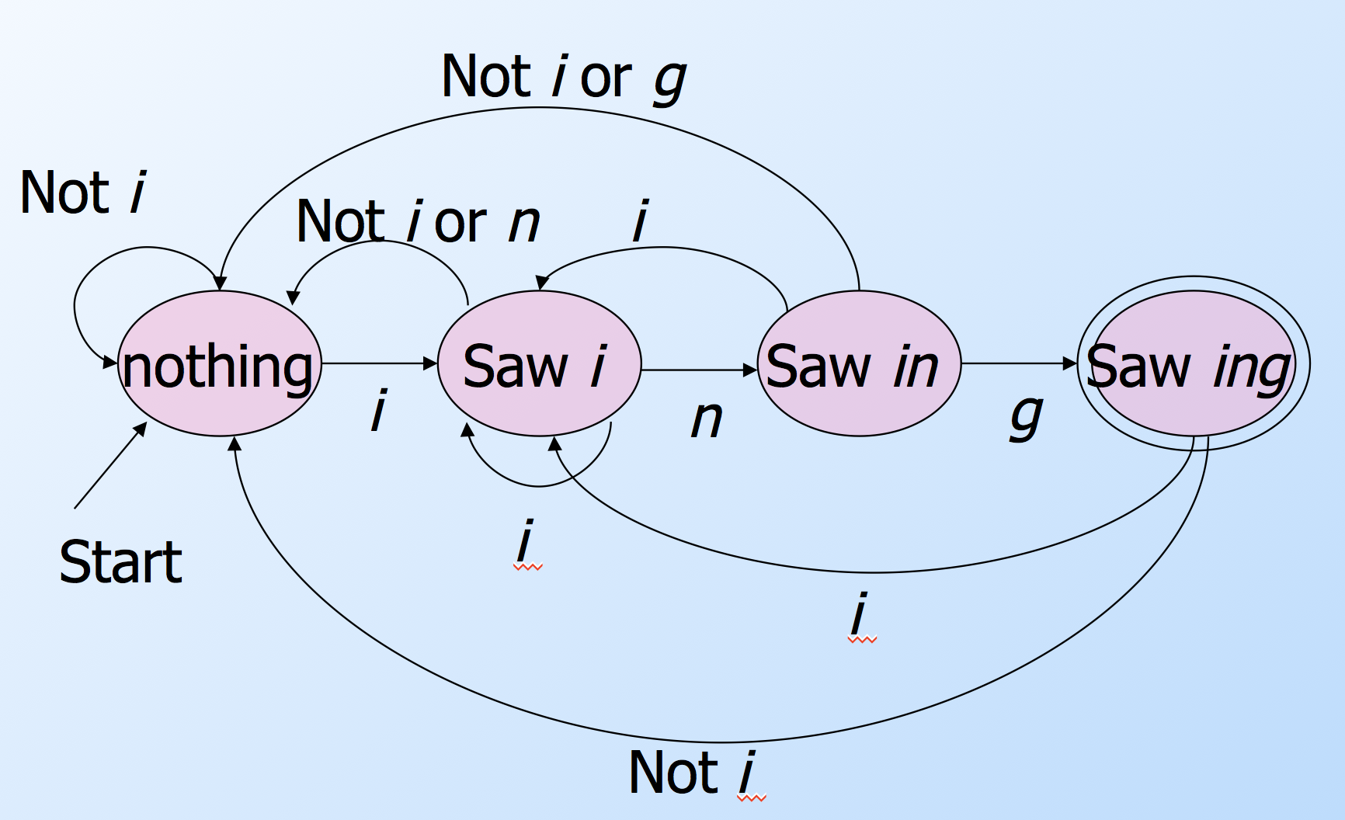
Example in Java: without using goto
Scanner scan = new Scanner(System.in);
String s = scan.next();
int q = 0;
for (char c : s.toCharArray()) {
switch (q) {
case 0: q = (c=='i')? 1 : 0; break;
case 1: q = (c=='n')? 2 : ((c=='i')? 1 : 0); break;
case 2: q = (c=='g')? 3 : ((c=='i')? 1 : 0); break;
case 3: q = (c=='i')? 1 : 0;
}
}
if (q==3)
System.out.println("accept.");
else
System.out.println("reject.");
Start state
Loop through string s
Transitions
Final state
0
1
2
3

Slide 9
Formal Introduction to Finite Automata
Languages
Deterministic Finite Automata
（DFA, 确定性有限自动机）
Representations of Automata

Slide 10
"Finite Automata and Their Decision Problems"
By Scott Dana and Rabin Michael (1959).
Doctoral advisor of Both: Alonzo Church
  两位都是图灵的师弟
Turing Award (1976)
Automata theory is closely related to formal language theory.
  In this context, automata are used as finite representations of formal languages that may be infinite.

Slide 11
Alphabets (字母表)
An alphabet is any finite set of symbols.
  A symbol is some unit of information representation
Examples:
  ASCII, Unicode, {0,1} (binary alphabet ), {a,b,c}.

Slide 12
Strings(字符串)
The set of strings over an alphabet Σ is the set of lists, each element of which is a member of Σ.
  Strings shown with no commas, e.g., abc.
Σ* denotes this set of strings.
ε stands for the empty string
  (string of length 0，空串).

Slide 13
Example: Strings
{0,1}* = {ε, 0, 1, 00, 01, 10, 11, 000, 001, . . . }
Subtlety: 0 as a string, 0 as a symbol look the same.
  Context（上下文） determines the type.

Slide 14
Languages （语言）
A language is a subset of Σ* for some alphabet Σ. （定义在某个字母表上的一组字符串）
Example: The set of strings of 0’s and 1’s with no two consecutive 1’s.
  L = {ε, 0, 1, 00, 01, 10, 000, 001, 010, 100, 101, 0000, 0001, 0010, 0100, 0101, 1000, 1001, 1010, . . . }
Hmm… 1 of length 0, 2 of length 1, 3, of length 2, 5 of length
3, 8 of length 4. I wonder how many of length 5?

Slide 15
Deterministic Finite Automata
（确定性有限自动机）
A formalism for defining languages, consisting of:
  A finite set of states (Q, typically ，状态集).
  An input alphabet (Σ, typically，输入字母表).
  A transition function (δ, typically, 转移函数).
  A start state (q₀, in Q, typically，起始状态).
  A set of final states (F ⊆ Q, typically，终止状态).
    “Final” and “accepting（接受）” are synonyms. （终止与接受是同义词）

Slide 16
The Transition Function
（转移函数，面向一个字符定义）
Takes two arguments:
  a state and an input symbol.
δ(q, a) = the state that the DFA goes to when it is in state q and input a is received.
  当前处于状态q
  当前输入字符a
  下一个状态等于δ(q, a)

Slide 17
Graph Representation of DFA’s
（DFA的图表示）
Nodes = states.
Arcs represent transition function.
  Arc from state p to state q labeled by all those input symbols that have transitions from p to q.
Arrow labeled “Start” to the start state.
Final states indicated by double circles.

Slide 18
Example: Graph of a DFA
Accepts all strings without two consecutive 1’s.
（接受不含两个连续1的所有0/1串，如”0”, “01”,”1”,”101”）
0
0,1
1
1
A
B
C
Start
0
Previous
string OK,
does not
end in 1.
Previous
String OK,
ends in a
single 1.
Consecutive
1’s have
been seen.

Slide 19
Alternative Representation: Transition Table （转移表）
Final states
starred
Columns =
input symbols
0
1
*
A A B
B A C
C C C
Arrow for
start state
*
Rows = states

Slide 20
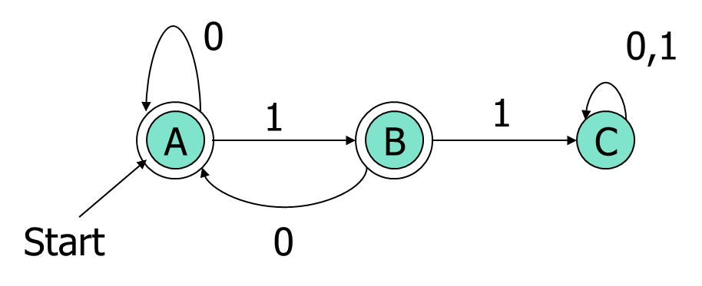
Python piece for coding the DFA
{
  ‘Q’: {‘A’, ‘B’, ‘C’},
  ‘SIGMA’: {‘0’, ’1’},
  ‘DELTA’:
  {
  (‘A’, ‘0’): ‘A’,
  (‘A’, ‘1’): ‘B’
  (‘B’, ‘0’): ‘A’,
  (‘B’, ‘1’): ‘C’
  (‘C’, ‘0’): ‘C’,
  (‘C’, ‘1’): ‘C’
  }
  ‘q0’: ‘A’
  ‘F’: {‘A’, ‘B’}
}

Slide 21
More Examples: (1)
An Even Number of 1’s
0
0
1
even
odd
Start
1
注意：
这个自动机是有限的，而包含偶数个1的字符串的个数是无限的

Slide 22
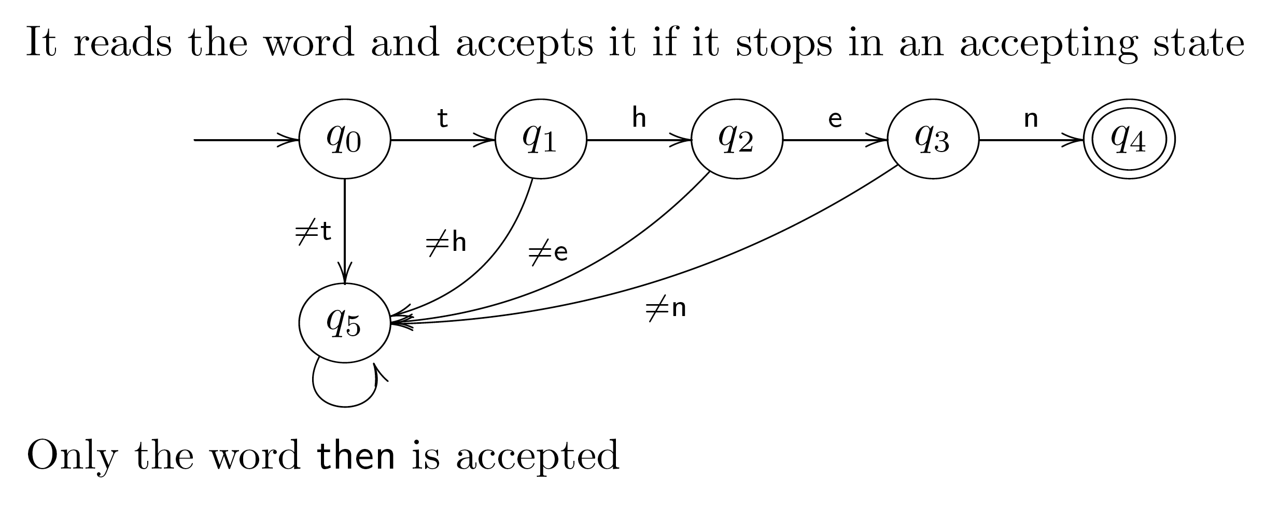
More Examples: (2)
Password/Keyword Example
any character
any character
This is sometimes called a dead state.
BTW, there is a potential security risk on the password application if this finite automaton reports failure too quickly.

Slide 23
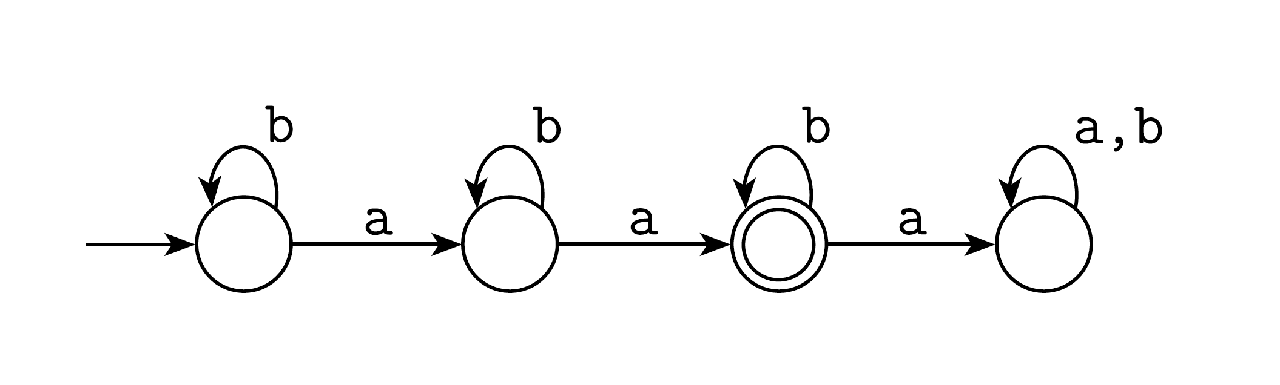
More Examples: (3)
Exactly Two a’s

Slide 24
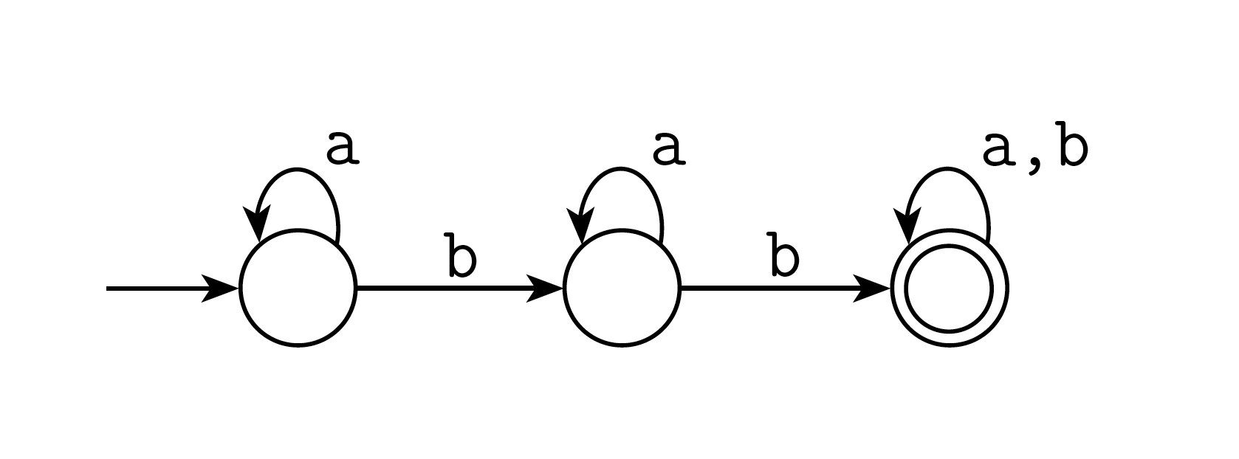
More Examples: (4)
At Least Two b’s

Slide 25
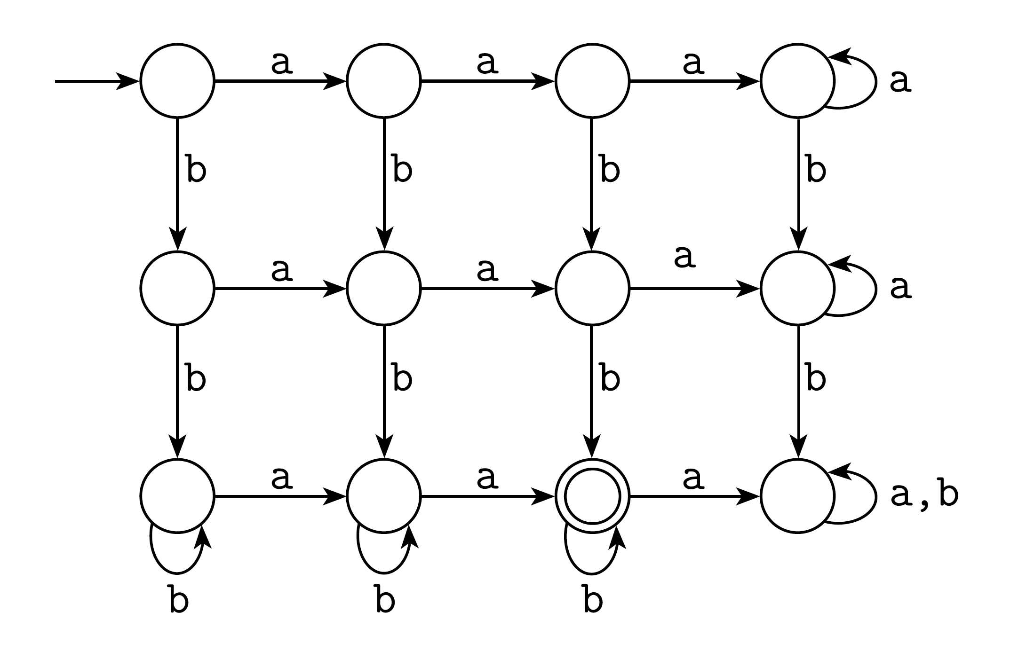
More Examples: (5)
Exactly two a’s and at least two b’s

Slide 26
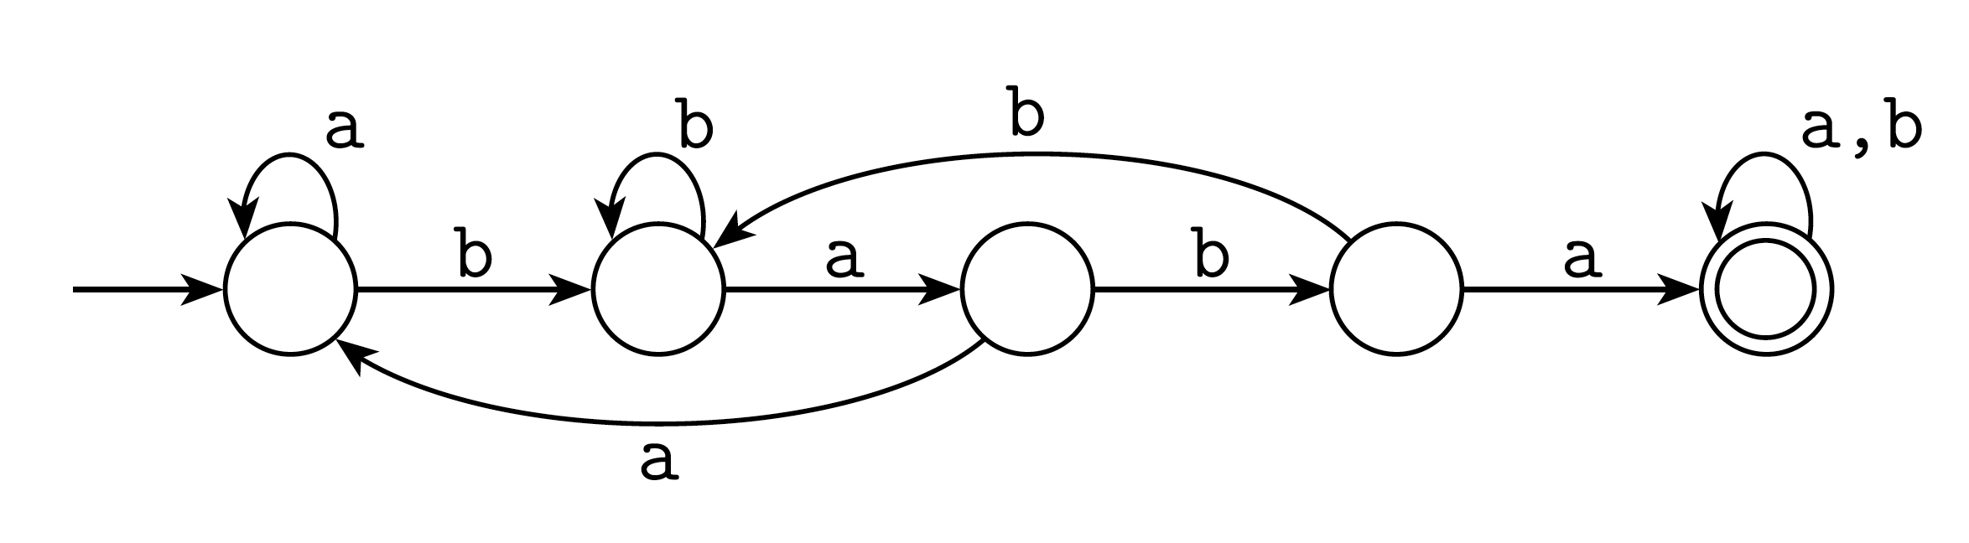
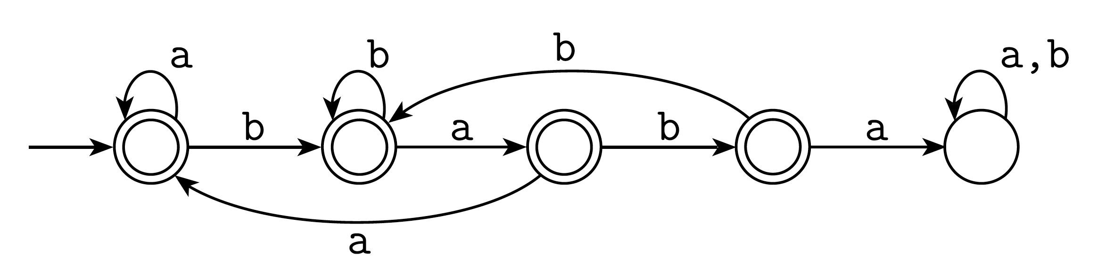
More Examples: (6)
Containing Substrings or Not
Contains “baba”:
Does not contain “baba”:

Slide 27
General Comments
Some things are easy with finite automata:
  Substrings (…abcabc…)
  Subsequences (…a…b…c…b…a…)
  Modular counting (odd number of 1’s)
Some things are impossible with finite automata (we will prove this later):
  An equal number of a’s and b’s
  More 0’s than 1’s
But when they can be used, they are fast.

Slide 28
Extended Transition Function
（扩展转移函数，面向一个字符串定义：转移函数迭代使用的最终效果）
We describe the effect of a string of input symbols on a DFA by extending δ to a state and a string.
  自动机从左至右逐个读输入串中的字符，并且相应地依次发生转移，直到整个输入串都读完。
Induction on length of string.
Basis: δ(q, ε) = q （空串ε代表没有读入任何字符）
Induction: δ(q,wa) = δ(δ(q,w),a)
  w is a string; a is an input symbol.

Slide 29
Extended δ: Intuition
Convention:
  … w, x, y, x are strings.
  a, b, c,… are single symbols.
Extended δ is computed for state q and inputs a₁a₂…a_{n} by following a path in the transition graph, starting at q and selecting the arcs with labels a₁, a₂,…,a_{n} in turn.

Slide 30
Example: Extended Delta
0
1
A A B
B A C
C C C
δ(B,011) = δ(δ(B,01),1) = δ(δ(δ(B,0),1),1) =
δ(δ(A,1),1) = δ(B,1) = C

Slide 31
Delta-hat
（带帽子的delta)
In book, the extended δ has a “hat” to distinguish it from δ itself.
Not needed, because both agree when the string is a single symbol.
δ(q, a) = δ(δ(q, ε), a) = δ(q, a)
˄
˄
Extended deltas

Slide 32
Language of a DFA
Automata of all kinds define languages.
If A is an automaton, L(A) is its language.
For a DFA A, L(A) is the set of strings labeling paths from the start state to a final state.
Formally: L(A) = the set of strings w such that δ(q₀, w) is in F.

Slide 33
Example: String in a Language
String 101 is in the language of the DFA below.
Start at A.
0
0,1
1
1
A
B
C
Start
0

Slide 34
Example: String in a Language
String 101 is in the language of the DFA below.
Follow arc labeled 1.
0
0,1
1
1
A
B
C
Start
0

Slide 35
Example: String in a Language
String 101 is in the language of the DFA below.
Then arc labeled 0 from current state B.
0
0,1
1
1
A
B
C
Start
0

Slide 36
Example: String in a Language
String 101 is in the language of the DFA below.
Finally arc labeled 1 from current state A. Result
is an accepting state, so 101 is in the language.
0
0,1
1
1
A
B
C
Start
0

Slide 37
Example – Concluded
The language of our example DFA is:
{w | w is in {0,1}* and w does not have
two consecutive 1’s}
Such that…
These conditions
about w are true.
Read a set former as
“The set of strings w…

Slide 38
Proofs of Set Equivalence
（集合等价，例如包含同一组字符串）
Often, we need to prove that two descriptions of sets are in fact the same set.
  两种不同描述实际上描述的是同一集合
Here,
  one set is “the language of this DFA,”
  and the other is “the set of strings of 0’s and 1’s with no consecutive 1’s.”

Slide 39
Proofs – (2)
In general, to prove S=T, we need to prove two parts: S ⊆ T and T ⊆ S. That is:
  If w is in S, then w is in T.
  If w is in T, then w is in S.
As an example, let S = the language of our running DFA, and T = “no consecutive 1’s.”
  S基于自动机描述，T基于自然语言描述

Slide 40
Part 1: S ⊆ T
(如果w作为一个输入串被自动机接受，那么w必定不包含两个连续的1)
0
0,1
1
1
To prove: if w is accepted by
then w has no consecutive 1’s.
Proof is an induction on length of w.
Important trick: Expand the inductive hypothesis to be more detailed than you need.
  证明技巧是展开归纳假设，直到有足够多的细节可用
A
B
C
Start
0

Slide 41
The Inductive Hypothesis
（简称IH，归纳假设）
IH (1): If δ(A, w) = A, then w has no consecutive 1’s and does not end in 1.
IH (2): If δ(A, w) = B, then w has no consecutive 1’s and ends in a single 1.
Basis: |w| = 0; i.e., w = ε （空串情形）.
  IH (1) holds since δ(A, ε) = A and ε has no 1’s at all.
  IH (2) holds vacuously, since δ(A, ε) = A is not B.
Important concept:
If the “if” part of “if..then” is false,
the statement is true.
“length of”

Slide 42
Inductive Step
(归纳步）
0
0,1
A
1
B
1
C
Start
0
Assume IH (1) and (2) are true for strings shorter than w, where |w| is at least 1.
Because w is not empty, we can write w = xa, where a is the last symbol of w, and x is the string that precedes.
IH （归纳假设） is true for x.

Slide 43
Inductive Step – (2)
0
0,1
A
1
B
1
C
Start
0
Need to prove IH (1) and IH (2) for w = xa.
IH (1) for w is: If δ(A, w) = A, then w has no consecutive 1’s and does not end in 1.
Since δ(A, w) = A, δ(A, x) must be A or B, and a must be 0 (参见右上角的自动机).
By the IH, x has no 11’s.
Thus, w has no 11’s and does not end in 1.

Slide 44
Inductive Step – (3)
0
0,1
A
1
B
1
C
Start
0
Now, prove IH (2) for w = xa: If δ(A, w) = B, then w has no 11’s and ends in a single 1.
Since δ(A, w) = B, δ(A, x) must be A, and a must be 1 (参见右上角的自动机).
By the IH, x has no 11’s and does not end in 1.
Thus, w has no 11’s and ends in 1.

Slide 45
Part 2: T ⊆ S
X
Now, we must prove: if w has no 11’s, then w is accepted by
Contrapositive : If w is not accepted by
then w has 11.
0
0,1
Y
A
1
B
1
C
Start
0
0
0,1
A
1
B
1
C
Key idea: contrapositive
of “if X then Y” is the
equivalent statement
“if not Y then not X.”
Start
0

Slide 46
Using the Contrapositive
0
0,1
A
1
B
1
C
Start
0
Every w gets the DFA to exactly one state.
  Simple inductive proof based on:
    Every state has exactly one transition on 1, one transition on 0.
The only way w is not accepted is if it gets to C.

Slide 47
Using the Contrapositive – (2)
0
0,1
A
1
B
1
C
Start
0
The only way to get to C [formally: δ(A,w) = C] is if w = x1y, x gets to B, and y is the tail of w that follows what gets to C for the first time.
If δ(A,x) = B then surely x = z1 for some z.
Thus, w = z11y and has 11.

Slide 48
Regular Languages
（正则语言，通过自动机定义版）
A language L is regular if it is the language accepted by some DFA.
  Note: the DFA must accept only the strings in L, no others.
Some languages are not regular.
  Intuitively, regular languages “cannot count” to arbitrarily high integers.

Slide 49
Example: A Nonregular Language
L₁ = {0^{n}1^{n} | n ≥ 1}
Note: a^{i} is conventional for i a’s.
  Thus, 0⁴ = 0000, e.g.
Read: “The set of strings consisting of n 0’s followed by n 1’s, such that n is at least 1.
Thus, L₁ = {01, 0011, 000111,…}

Slide 50
Another Example
L₂ = {w | w in {(, )}* and w is balanced }
  Note: alphabet consists of the parenthesis symbols ’(’ and ’)’.
  Balanced parens are those that can appear in an arithmetic expression.
    E.g.: (), ()(), (()), (()()),…

Slide 51
But Many Languages are Regular
Regular Languages can be described in many ways, e.g., regular expressions.
They appear in many contexts and have many useful properties.
Example: the strings that represent floating point numbers in your favorite language is a regular language.

Slide 52
Example: A Regular Language
L₃ = { w | w in {0,1}* and w, viewed as a binary integer is divisible by 23}
The DFA:
  23 states, named 0, 1,…,22.
  Correspond to the 23 remainders （余数）of an integer divided by 23.
  Start and only final state is 0.

Slide 53
Transitions of the DFA for L₃
If string w represents integer i, then assume δ(0, w) = i%23.
Then w0 represents integer 2i, so we want δ(i%23, 0) = (2i)%23.
Similarly: w1 represents 2i+1, so we want δ(i%23, 1) = (2i+1)%23.
Example: δ(15,0) = 30%23 = 7; δ(11,1) = 23%23 = 0.
Key idea: design a DFA
by figuring out what
each state needs to
remember about the past.

Slide 54
Another Example
L₄ = { w | w in {0,1}* and w, viewed as the reverse of a binary integer is divisible by 23}
Example: 01110100 is in L₄, because its reverse, 00101110 is 46 in binary.
Hard to construct the DFA.
But theorem says the reverse of a regular language is also regular.
  利用正则语言的性质，前提是证明出性质

