Slide 1
Nondeterministic Finite Automata
非确定性有限自动机
Nondeterminism(非确定性)
Subset Construction(子集构造算法)

Slide 2
Nondeterminism – (1)
(非确定性)
A nondeterministic finite automaton has the ability to be in several states at once.
  类似美猴王拔9根毫毛，说一声“变”：同时存在10个美猴王 8-）
Transitions from a state on an input symbol can be to any set of states.
  可以同时转移到一组状态，而非仅仅转移到一个状态

Slide 3
Nondeterminism – (2)
Start in one start state.
  从一个起始状态启动NFA的运行
Accept if any sequence of choices leads to a final state.
  如果存在任何一个状态转移序列能够抵达某个终止状态，那么输入串就是被对应NFA接受的
Intuitively: the NFA always “guesses right.”
  上述“NFA接受输入串的定义”直观上相当于NFA总是“猜对了”

Slide 4
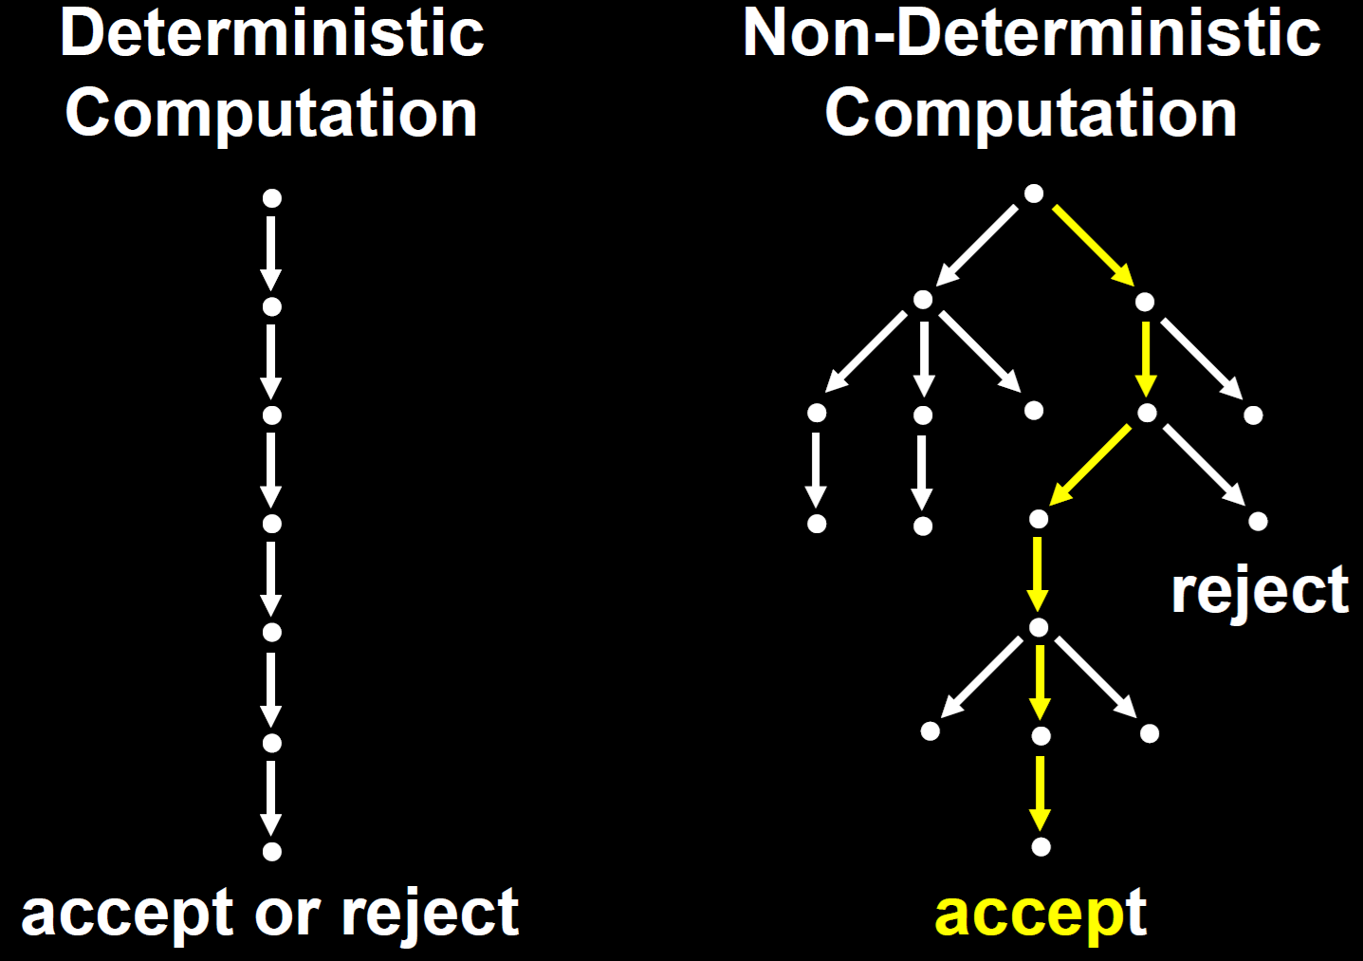
DFA vs NFA
（串行计算 对 并行计算？）
顶点为起始状态
有向边表示状态转移
接受或拒绝状态对应没有出边的节点

Slide 5
Example: Moves on a Chessboard （棋盘）
States = squares.
  状态表示棋盘的格子
Inputs = r (move to an adjacent red square) and b (move to an adjacent black square).
  输入是棋子移动序列，r表示移动到一个相邻的红色格子， b表示移动到一个相邻的黑色格子。
Start state, final state are in opposite corners.
  起始状态对应左上角格子，终止状态（接受）对应右下角格子

Slide 6
Example: Chessboard
1
2
3
r b
2,4 5
4,6 1,3,5
2,6 5
2,8 1,5,7
2,4,6,8 1,3,7,9
2,8 3,5,9
4,8 5
4,6 5,7,9
6,8 5
4
5
6
7
8
9
r
b
b
1
2
1
5
4
3
1
*
5
3
7
7
9
Accept, since final state reached

Slide 7
Formal NFA
A finite set of states, typically Q.
An input alphabet, typically Σ.
A transition function, typically δ.
A start state in Q, typically q₀.
A set of final states F ⊆ Q.
  “Final” and “accepting（接受）” are synonyms. （终止与接受是同义词）
  非终止状态相当于“拒绝”

Slide 8
Transition Function of an NFA
δ(q, a) is a set of states.
  δ(q, a) is a single state in an DFA
Extend to strings as follows:
Basis: δ(q, ε) = {q}
  注意：花括号表示集合
Induction: δ(q, wa) = the union over all states p in δ(q, w) of δ(p, a)

Slide 9
Language of an NFA
A string w is accepted by an NFA if δ(q₀, w) contains at least one final state.
  注意： δ(q₀, w) 这里是扩展的转移函数
The language of the NFA is the set of strings it accepts.

Slide 10
Example: Language of an NFA
1
2
3
4
5
6
7
8
9
For our chessboard NFA we saw that rbb is accepted.
If the input consists of only b’s, the set of accessible states alternates between {5} and {1,3,7,9}, so only even-length, nonempty strings of b’s are accepted.
What about strings with at least one r?

Slide 11
Equivalence of DFA’s, NFA’s – (1)
（思考：串行计算与并行计算在能完成的计算任务上没区别？）
A DFA can be turned into an NFA that accepts the same language.
  一个DFA可以转变成一个接受同一语言的一个NFA
If δ_{D}(q, a) = p, let the NFA have δ_{N}(q, a) = {p}.
Then the NFA is always in a set containing exactly one state – the state the DFA is in after reading the same input.

Slide 12
Equivalence – (2)
Surprisingly, for any NFA there is a DFA that accepts the same language.
Proof is the subset construction.
The number of states of the DFA can be exponential in the number of states of the NFA.
Thus, NFA’s accept exactly the regular languages.

Slide 13
Subset Construction – (1)
Given an NFA with states Q, inputs Σ, transition function δ_{N}, start state q₀, and final states F, construct equivalent DFA with:
  States 2^{Q} (Set of subsets of Q，即Q的幂集).
  Inputs Σ.
  Start state {q₀}.
  Final states = all those with a member of F.

Slide 14
Critical Point
The DFA states have names that are sets of NFA states.
But as a DFA state, an expression like {p,q} must be read as a single symbol, not as a set.
  一个NFA的一组状态当作一个DFA的一个状态
Analogy（类比）: a class of objects whose values are sets of objects of another class.

Slide 15
Subset Construction – (2)
The transition function δ_{D} is defined by:
δ_{D}({q₁,…,q_{k}}, a) is the union over all i = 1,…,k of δ_{N}(q_{i}, a).
Example: We’ll construct the DFA equivalent of our “chessboard” NFA.

Slide 16
Example: Subset Construction
r b
2,4 5
4,6 1,3,5
2,6 5
2,8 1,5,7
2,4,6,8 1,3,7,9
2,8 3,5,9
4,8 5
4,6 5,7,9
6,8 5
r b
{1}
{2,4} {5}
{2,4}
{5}
*
Alert: What we’re doing here is
the lazy form of DFA construction,
where we only construct a state
if we are forced to.

Slide 17
Example: Subset Construction
r b
2,4 5
4,6 1,3,5
2,6 5
2,8 1,5,7
2,4,6,8 1,3,7,9
2,8 3,5,9
4,8 5
4,6 5,7,9
6,8 5
r b
{1}
{2,4} {5}
{2,4}
{2,4,6,8} {1,3,5,7}
{5}
{2,4,6,8}
{1,3,5,7}
*

Slide 18
Example: Subset Construction
r b
2,4 5
4,6 1,3,5
2,6 5
2,8 1,5,7
2,4,6,8 1,3,7,9
2,8 3,5,9
4,8 5
4,6 5,7,9
6,8 5
r b
{1}
{2,4} {5}
{2,4}
{2,4,6,8} {1,3,5,7}
{5}
{2,4,6,8} {1,3,7,9}
{2,4,6,8}
{1,3,5,7}
* {1,3,7,9}
*

Slide 19
Example: Subset Construction
r b
2,4 5
4,6 1,3,5
2,6 5
2,8 1,5,7
2,4,6,8 1,3,7,9
2,8 3,5,9
4,8 5
4,6 5,7,9
6,8 5
r b
{1}
{2,4} {5}
{2,4}
{2,4,6,8} {1,3,5,7}
{5}
{2,4,6,8} {1,3,7,9}
{2,4,6,8}
{2,4,6,8} {1,3,5,7,9}
{1,3,5,7}
* {1,3,7,9}
* {1,3,5,7,9}
*

Slide 20
Example: Subset Construction
r b
2,4 5
4,6 1,3,5
2,6 5
2,8 1,5,7
2,4,6,8 1,3,7,9
2,8 3,5,9
4,8 5
4,6 5,7,9
6,8 5
r b
{1}
{2,4} {5}
{2,4}
{2,4,6,8} {1,3,5,7}
{5}
{2,4,6,8} {1,3,7,9}
{2,4,6,8}
{2,4,6,8} {1,3,5,7,9}
{1,3,5,7}
{2,4,6,8} {1,3,5,7,9}
* {1,3,7,9}
* {1,3,5,7,9}
*

Slide 21
Example: Subset Construction
r b
2,4 5
4,6 1,3,5
2,6 5
2,8 1,5,7
2,4,6,8 1,3,7,9
2,8 3,5,9
4,8 5
4,6 5,7,9
6,8 5
r b
{1}
{2,4} {5}
{2,4}
{2,4,6,8} {1,3,5,7}
{5}
{2,4,6,8} {1,3,7,9}
{2,4,6,8}
{2,4,6,8} {1,3,5,7,9}
{1,3,5,7}
{2,4,6,8} {1,3,5,7,9}
* {1,3,7,9}
{2,4,6,8} {5}
* {1,3,5,7,9}
*

Slide 22
Example: Subset Construction
r b
2,4 5
4,6 1,3,5
2,6 5
2,8 1,5,7
2,4,6,8 1,3,7,9
2,8 3,5,9
4,8 5
4,6 5,7,9
6,8 5
r b
{1}
{2,4} {5}
{2,4}
{2,4,6,8} {1,3,5,7}
{5}
{2,4,6,8} {1,3,7,9}
{2,4,6,8}
{2,4,6,8} {1,3,5,7,9}
{1,3,5,7}
{2,4,6,8} {1,3,5,7,9}
* {1,3,7,9}
{2,4,6,8} {5}
* {1,3,5,7,9}
{2,4,6,8} {1,3,5,7,9}
*

Slide 23
Proof of Equivalence: Subset Construction
The proof is almost a pun(一语双关).
  同一语义，两种转移函数
Show by induction on |w| that
δ_{N}(q₀, w) = δ_{D}({q₀}, w)
Basis:
  w = ε: δ_{N}(q₀, ε) = δ_{D}({q₀}, ε) = {q₀}.

Slide 24
Induction
Assume IH （归纳假设） for strings shorter than w.
Let w = xa; IH holds for x
  since x is shorter than w.
Let δ_{N}(q₀, x) = δ_{D}({q₀}, x) = S.
Let T = the union over all states p in S of δ_{N}(p, a).
Then δ_{N}(q₀, w) = δ_{D}({q₀}, w) = T.
  For NFA: the extension of δ_{N}.
  For DFA: definition of δ_{D} plus extension of δ_{D}.
    That is, δ_{D}(S, a) = T; then extend δ_{D} to w = xa.

Slide 25
NFA’s With ε-Transitions
We can allow state-to-state transitions on ε input.
These transitions are done spontaneously（不由自主地）, without looking at the input string.
A convenience at times, but still only regular languages are accepted.
  ε 的引入方便自动机设计，但仍然只能接受正则语言

Slide 26
Example: ε-NFA
0 1 ε
A {E} {B} ∅
B ∅ {C} {D}
C ∅ {D} ∅
D ∅ ∅ ∅
E {F} ∅ {B, C}
F {D} ∅ ∅
ε
1
1
1
B
C
D
A
ε
*
ε
0
0
E
F
0

Slide 27
Closure of States
（状态的闭包）
CL(q) = set of states you can reach from state q following only arcs labeled ε.
Example: CL(A) = {A};
CL(E) = {B, C, D, E}.
Closure of a set of states = union of the closure of each state.
ε
1
1
1
B
C
D
A
ε
ε
0
0
E
F
0

Slide 28
Extended Delta
（小红帽表示）
˄
Basis: (q, ε) = CL(q).
Induction: (q, xa) is computed as follows:
  Start with (q, x) = S.
  Take the union of CL(δ(p, a)) for all p in S.
Intuition: (q, w) is the set of states you can reach from q following a path labeled w.
δ
˄
δ
˄
δ
˄
δ
And notice that δ(q, a) is not
that set of states, for symbol a.

Slide 29
Example: Extended Delta
ε
1
1
1
B
C
D
A
ε
ε
0
0
E
F
˄
0
δ
(A, ε) = CL(A) = {A}.
(A, 0) = CL({E}) = {B, C, D, E}.
(A, 01) = CL({C, D}) = {C, D}.
Language of an ε-NFA is the set of strings w such that (q₀, w) contains a final state.
˄
δ
˄
δ
˄
δ

Slide 30
Equivalence of NFA, ε-NFA – (1)
Every NFA is an ε-NFA.
  It just has no transitions on ε.
Converse requires us to take an ε-NFA and construct an NFA that accepts the same language.
We do so by combining ε–transitions with the next transition on a real input.
Warning: This treatment is a
bit different from that in the text （参考书）.

Slide 31
Picture of ε-Transition Removal
a
a
a
Transitions
on ε
Transitions
on ε

Slide 32
Picture of ε-Transition Removal
To here, and performs
the subset construction
Text （参考书） goes
from here
a
a
a
Transitions
on ε
Transitions
on ε

Slide 33
Picture of ε-Transition Removal
To here, with no
subset construction
a
We’ll go
from here
a
a
Transitions
on ε
Transitions
on ε

Slide 34
Equivalence – (2)
Start with an ε-NFA with states Q, inputs Σ, start state q₀, final states F, and transition function δ_{E}.
Construct an “ordinary” NFA with states Q, inputs Σ, start state q₀, final states F’, and transition function δ_{N}.

Slide 35
Equivalence – (3)
Compute δ_{N}(q, a) as follows:
  Let S = CL(q).
  δ_{N}(q, a) is the union over all p in S of δ_{E}(p, a).
F’ = the set of states q such that CL(q) contains a state of F.
Intuition: δ_{N} incorporates ε–transitions before using a but not after.

Slide 36
Equivalence – (4)
Prove by induction on |w| that
CL(δ_{N}(q₀, w)) = _{E}(q₀, w).
Thus, the ε-NFA accepts w if and only if the “ordinary” NFA does.
  “ordinary” NFA: 普通NFA，即不带ε的NFA
˄
δ

Slide 37
Example: ε-NFA-to-NFA
Interesting
closures: CL(B)
= {B,D}; CL(E)
= {B,C,D,E}
0 1 ε
A {E} {B} ∅
B ∅ {C} {D}
C ∅ {D} ∅
D ∅ ∅ ∅
E {F} ∅ {B, C}
F {D} ∅ ∅
0 1
A {E} {B}
B ∅ {C}
C ∅ {D}
D ∅ ∅
E {F} {C, D}
F {D} ∅
*
*
*
*
Since closure of
E includes B and
C; which have
transitions on 1
to C and D.
ε-NFA
Since closures of
B and E include
final state D.

Slide 38
Summary
DFA’s, NFA’s, and ε–NFA’s all accept exactly the same set of languages: the regular languages.
  自动机接受语言之范围层面
The NFA types are easier to design and may have exponentially fewer states than a DFA.
  自动机设计层面
But only a DFA can be implemented!
  自动机实现层面

