Slide 1



并行程序设计
任课教师：
黄聃（Huang，Dan）

Slide 2
用OpenMP进行共享内存编程

Slide 3
Roadmap
Writing programs that use OpenMP.
Using OpenMP to parallelize many serial for loops
with only small changes to the source code.
Task parallelism.
Explicit thread synchronization.
Standard problems in shared-memory programming.

Slide 4
OpenMP
An API for shared-memory parallel programming.
MP = multiprocessing
Designed for systems in which each thread or process can potentially have access to all available memory.
System is viewed as a collection of cores or CPU’s, all of which have access to main memory.

Slide 5
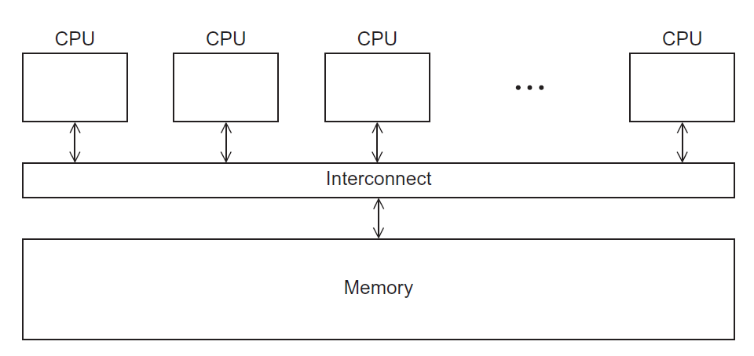

A shared memory system

Slide 6
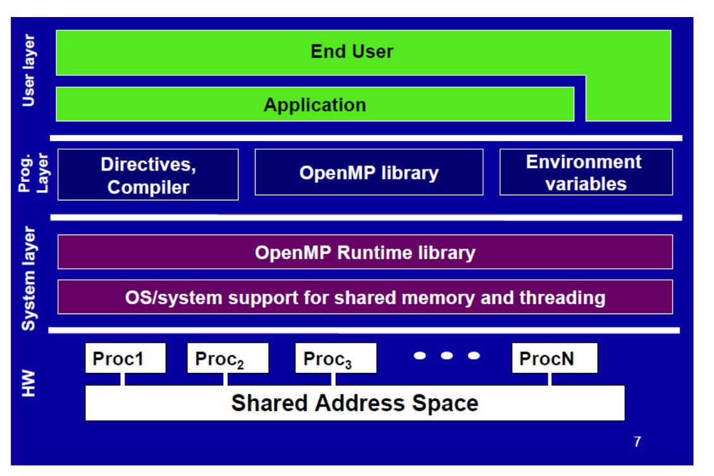

Design Architecture

Slide 7
Pragmas（编译程序指令）
Special preprocessor instructions（预处理指令，例如宏定义、条件编译等）.
Typically added to a system to allow behaviors that
aren’t part of the basic C specification.
Compilers that don’t support the pragmas ignore
them.
#pragma

Slide 8
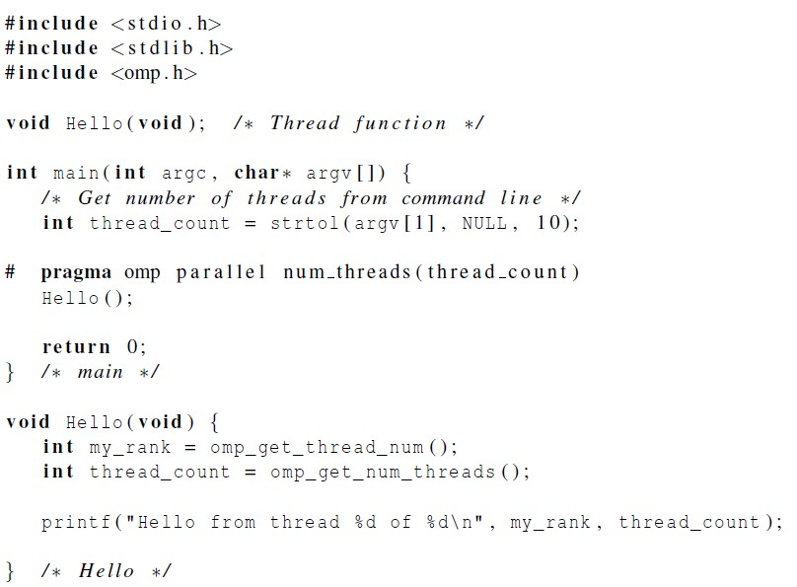

Slide 9
gcc −g −Wall −fopenmp −o omp_hello omp_hello . c
. omp_hello 4
compiling
running with 4 threads
Hello from thread 0 of 4
Hello from thread 1 of 4
Hello from thread 2 of 4
Hello from thread 3 of 4
possible
outcomes
Hello from thread 3 of 4
Hello from thread 1 of 4
Hello from thread 2 of 4
Hello from thread 0 of 4
Hello from thread 1 of 4
Hello from thread 2 of 4
Hello from thread 0 of 4
Hello from thread 3 of 4

Slide 10
OpenMp pragmas
# pragma omp parallel
Most basic parallel directive（指令）.
The number of threads that run the following structured block of code is determined by the run- time system.

Slide 11
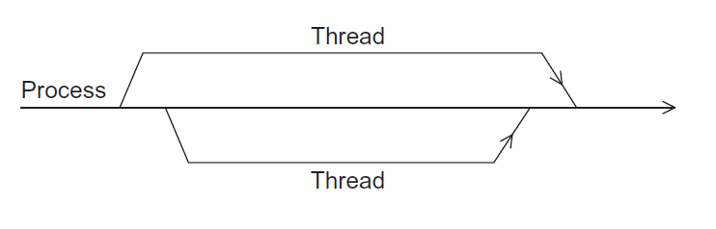
A process forking and joining two
threads

Slide 12
Clause（子句）
Text that modifies a directive.
The num_threads clause can be added to a parallel
directive.
It allows the programmer to specify the number of
threads that should execute the following block.
# pragma omp parallel num_threads ( thread_count )
10

Slide 13
parallel num_threads
There may be system-defined limitations on the
number of threads that a program can start.
The OpenMP standard doesn’t guarantee that this will actually start thread_count threads.
Most current systems can start hundreds or even
thousands of threads.
Unless we’re trying to start a lot of threads, we will almost always get the desired number of threads.

Slide 14

Some terminology
The collection of threads executing the parallel block is called a team
the original thread is called the master/server, and the additional threads are called slaves/clients.

Slide 15
In case the compiler doesn’t
support OpenMP
# include <omp.h>
#ifdef _OPENMP
# include <omp.h>
#endif
gcc -D name=definition_name …… (shell command)
#define definition_name (C code)
The contents of definition are tokenized and processed as if they appeared during translation phase three in a ‘#define’ directive. In particular, the definition is truncated by embedded newline characters.

Slide 16
In case the compiler doesn’t support
OpenMP
# ifdef _OPENMP
int my_rank = omp_get_thread_num ( );
int thread_count = omp_get_num_threads ( );
# else
int my_rank = 0;
int thread_count = 1;
# endif

Slide 17

The Trapezoidal Rule

Slide 18
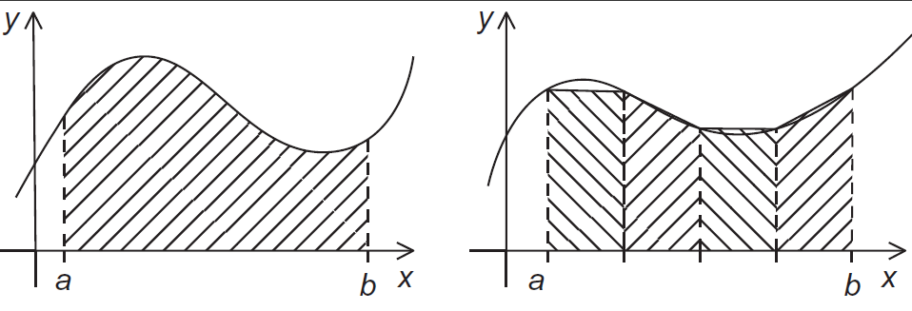
The trapezoidal rule

Slide 19
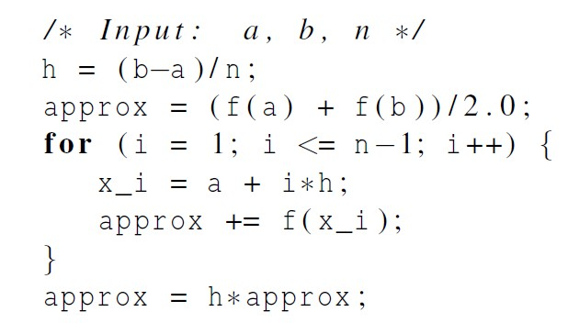
Serial algorithm

Slide 20
A First OpenMP Version
We identified two types of tasks:
computation of the areas of individual trapezoids
adding the areas of trapezoids.
There is no communication among the tasks in the first collection, but each task in the first collection (task 1a) communicates with task 1b.

Slide 21
A First OpenMP Version
3) We assumed that there would be many more
trapezoids than cores.
So we aggregated tasks by assigning a contiguous block of trapezoids to each thread (and a single thread to each core).

Slide 22
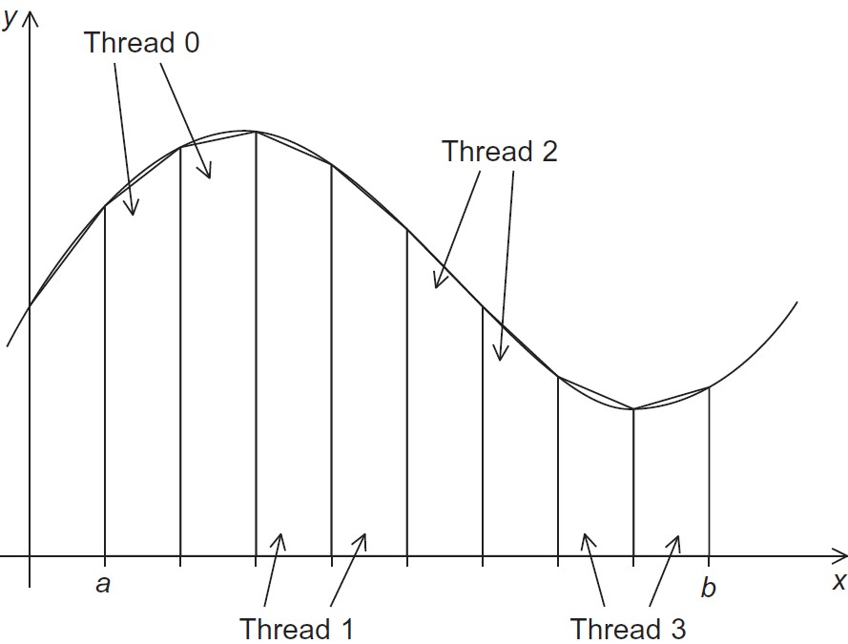
Assignment of trapezoids to threads
20

Slide 23
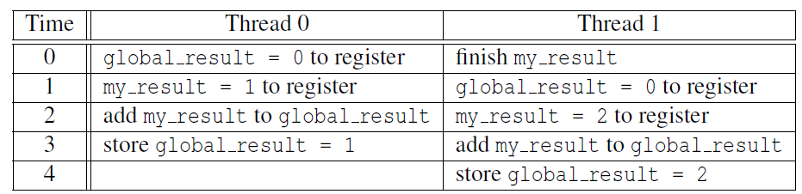

Race condition
Unpredictable results when two (or more) threads attempt to simultaneously execute:
global_result += my_result ;

Slide 24
Mutual exclusion
# pragma omp critical global_result += my_result ;
only one thread can execute
the following structured block at a time

Slide 25
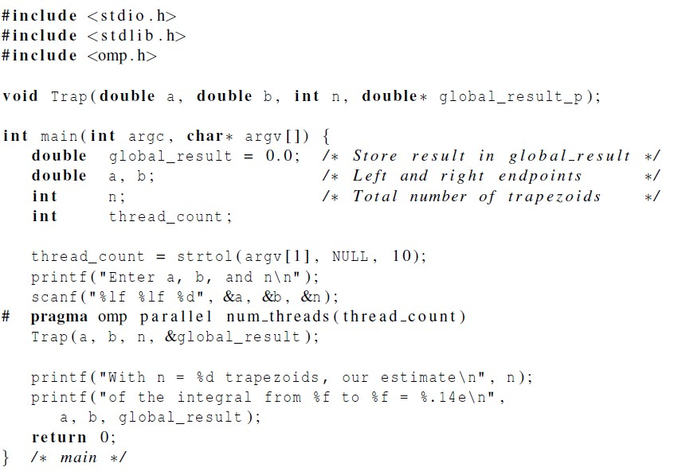

Slide 26
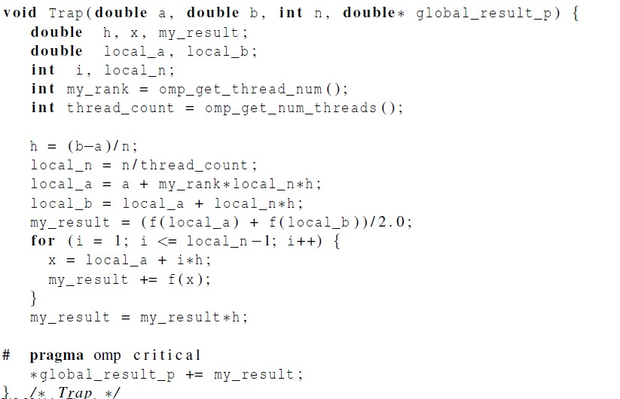

Slide 27

Scope of Variables

Slide 28
Scope
In serial programming, the scope of a variable consists of those parts of a program in which the variable can be used.
In OpenMP, the scope of a variable refers to the set of threads that can access the variable in a parallel block.

Slide 29

Scope in OpenMP
A variable that can be accessed by all the threads in
the team has shared scope.
A variable that can only be accessed by a single
thread has private scope.
The default scope for variables declared before a parallel block is shared.

Slide 30

The Reduction Clause

Slide 31
We need this more complex version to add each
thread’s local calculation to get global_result.
Although we’d prefer this.

Slide 32
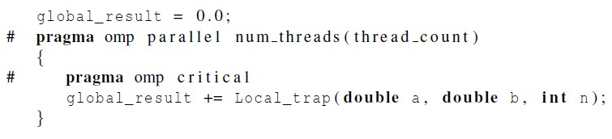
If we use this, there’s no critical section!
If we fix it like this…
… we force the threads to execute sequentially.
30

Slide 33
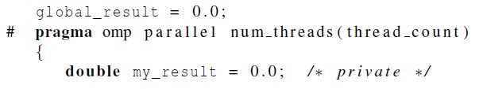
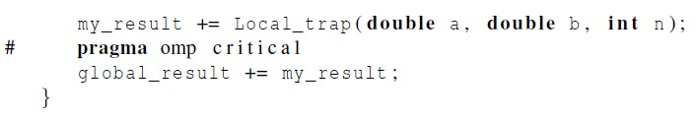
We can avoid this problem by declaring a private variable inside the parallel block and moving the critical section after the function call.

Slide 34
Reduction operators
A reduction operator is a binary operation (such as
addition or multiplication).
A reduction is a computation that repeatedly applies the same reduction operator to a sequence of operands in order to get a single result.
All of the intermediate results of the operation should be stored in the same variable: the reduction variable.

Slide 35
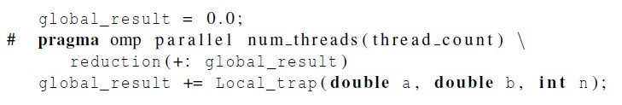
A reduction clause can be added to a parallel directive.
+, *, -, &, |, ˆ, &&, ||
Reduction secretly creates a temporary private variable (e.g. tmp_global_result) for each thread’s private global_result. Each thread adding into its own tmp_global_result doesn’t interfere with any other thread adding into its own tmp_global_result, and so threads don’t need to slow down to get out of the way of each other.
Reduction automatically creates a binary tree structure to add the N private tmp_global_result to the global_result variable, in log2N time instead N time.

Slide 36

The “Parallel For” Directive

Slide 37
Parallel for
Creates a team of threads to execute the following structured block.
However, the structured block following the parallel for directive must be a for loop.
Furthermore, with the parallel for directive the system parallelizes the for loop by dividing the iterations of the loop among the threads.

Slide 38
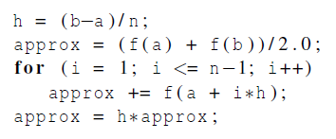
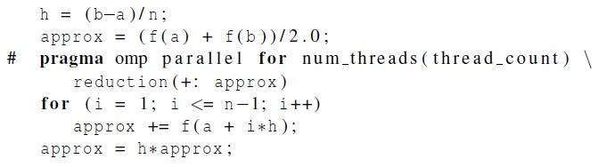

Slide 39
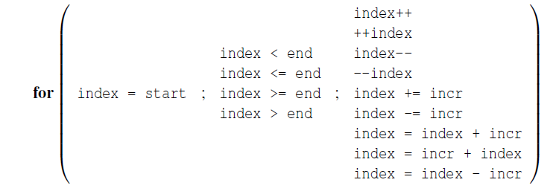
Legal forms for parallelizable for
statements

Slide 40
Caveats (注意事项）
The variable index must have integer or pointer
type (e.g., it can’t be a float).
The expressions start, end, and incr must have a compatible type. For example, if index is a pointer, then incr must have integer type.

Slide 41
Caveats
The expressions start, end, and incr must not change during execution of the loop.
During execution of the loop, the variable index can only be modified by the “increment expression” in the for statement.
40

Slide 42
Data dependencies
fibo[ 0 ] = fibo[ 1 ] = 1;
for (i = 2; i < n; i++)
fibo[ i ] = fibo[ i – 1 ] + fibo[ i – 2 ];
note 2 threads
fibo[ 0 ] = fibo[ 1 ] = 1;
# pragma omp parallel for num_threads(2)
for (i = 2; i < n; i++)
fibo[ i ] = fibo[ i – 1 ] + fibo[ i – 2 ];
but sometimes
we get this
1 1 2 3 5 8 13 21 34 55
this is correct
1 1 2 3 5 8 0 0 0 0

Slide 43
What happened?
OpenMP compilers don’t check for dependences among iterations in a loop that’s being parallelized with a parallel for directive.
A loop in which the results of one or more iterations depend on other iterations cannot be correctly parallelized by OpenMP.

Slide 44
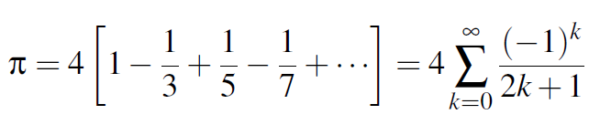
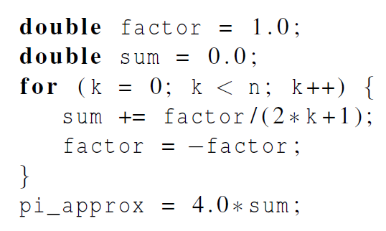
Estimating π

Slide 45
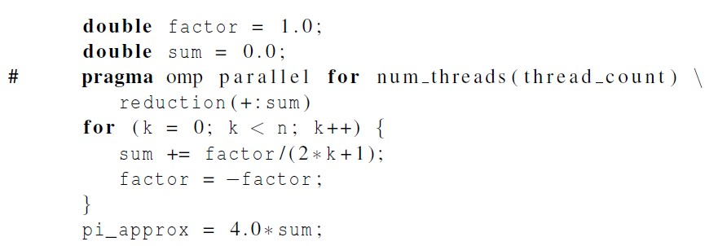
OpenMP solution #1
loop dependency

Slide 46
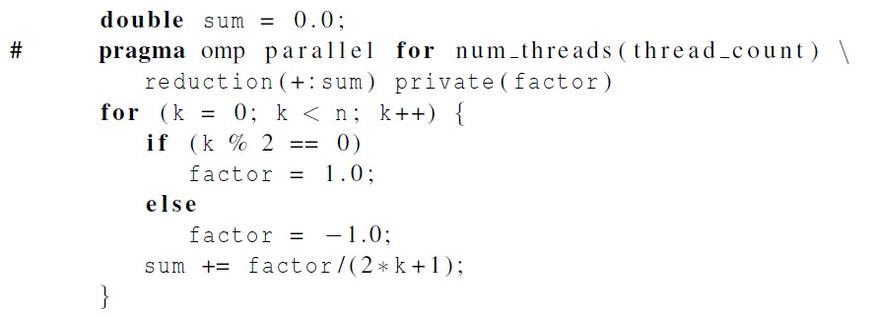
OpenMP solution #2
set factor as private scope.

Slide 47
Data sharing attributes
default(private), for example, all of the variables are set to private by default and can be used to avoid large list of variables to be privatized
default(none) : many programmers like to use this clause so they are forced to express each variable’s sharing attribute: shared/private/lastprivate/firstprivate explicitly
One can selectively change storage attributes Constructs using the following clauses*
• SHARED
• PRIVATE
• FIRSTPRIVATE
• THREADPRIVATE
The value of a private inside a parallel loop can be transmitted to a global value outside the loop with:
• LASTPRIVATE
• The default status can be modified with:
• DEFAULT (PRIVATE | SHARED | NONE)

Slide 48
Private clause
• private (var) creates a local copy of var for each thread
– The value is uninitialized
– Private copy is not storage-associated with the original
– The original is undefined at the end
• Each thread gets its own var which are however not initialized
• Regardless of initialization, var is undefined at the end of the parallel region
int var;
#pragma omp parallel for private (var)
for ( j=0; j<1000; j++ ) {
var = var + j;
}
printf (“%d\n”, var );

Slide 49
Firstprivate clause
Firstprivate is a special case of private.
– Initializes each private copy with the corresponding value from the master thread.
• Each thread gets its own var with an initial value of 13
int var = 13;
#pragma omp parallel for firstprivate (var)
for ( j=0; j<1000; j++ ) {
var = var + j;
}
printf (“%d\n”, var );
Note：In C/C++: a variable with the same name in an inner scope will prevent
a variable with that name in an outer scope to be accessed - this is called: shadowing

Slide 50
Lastprivate clause
• Lastprivate passes the value of a private from the last iteration to a global variable
• Each thread gets its own var with an initial value of 13
• var is defined as its value at the “last sequential” iteration (i.e. for j=999)
int var = 13;
#pragma omp parallel for firstprivate (var) lastprivate (var)
for ( j=0; j<1000; j++ ) {
var = var + j;
}
printf (“%d\n”, var );

Slide 51
default(none) clause
default(none) lets the programmer specify the scope of each variable in a block.
With this clause the compiler will require that we specify the scope of each variable we use in the block and that has been declared outside the block.

Slide 52
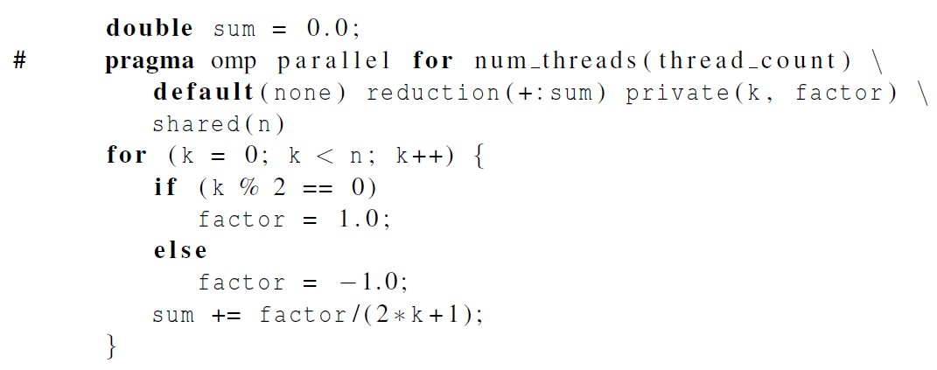
Default clause

Slide 53
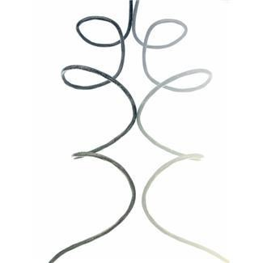
More About Loops in OpenMP:
Sorting

Slide 54
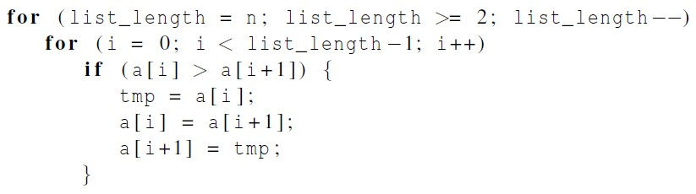

Bubble Sort

Slide 55
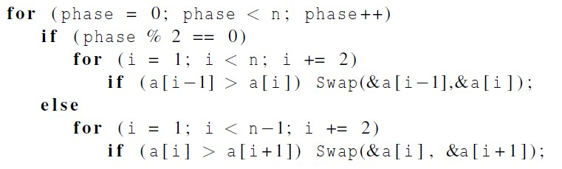
Serial Odd-Even Transposition Sort
50

Slide 56
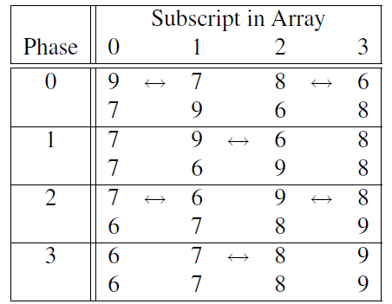
Serial Odd-Even Transposition Sort

Slide 57
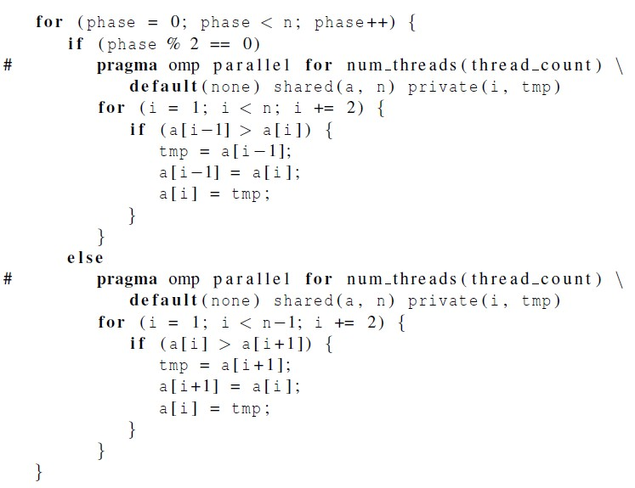
First OpenMP Odd-Even Sort

Slide 58
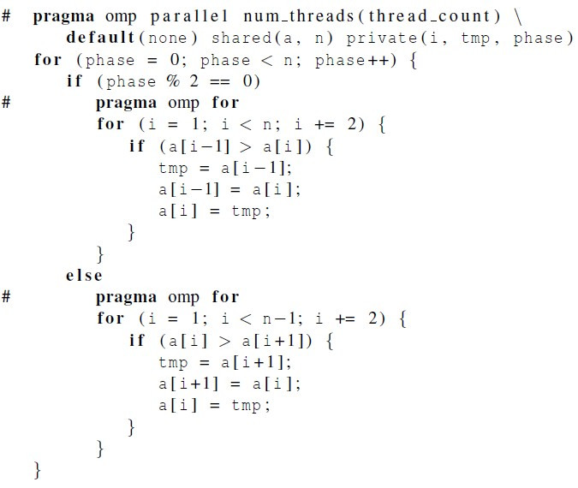
Second OpenMP Odd-Even Sort
Tells OpenMP to parallelize the for loop with existing team of threads

Slide 59
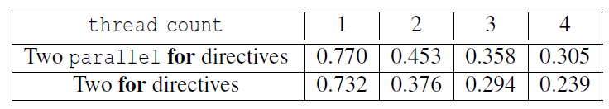

Odd-even sort with two parallel for directives and
two for directives.
(Times are in seconds.)

Slide 60
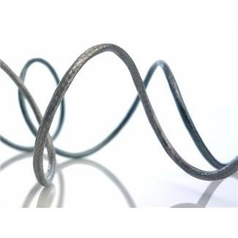
Scheduling Loops

Slide 61
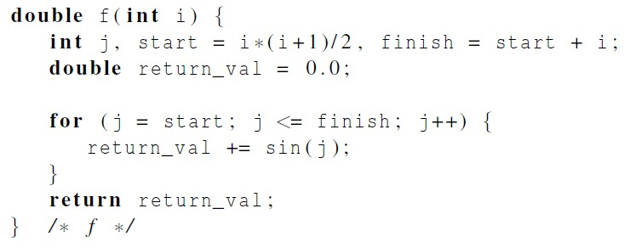
Our definition of function f.
The time required by the call to f
is proportional to the size of i

Slide 62
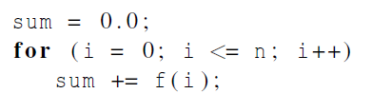
We want to parallelize this loop.
Thread | Iterations
0 | 0, t, 2t, …
1 | 1, t + 1, 2t + 1, …
t – 1 | t – 1, t + t – 1, 2t + t – 1, ……
Thread | Iterations
0 | 0, 1, 2, … n/t - 1
1 | n/t, n/t + 1, n/t + 1, …
t – 1 | (t – 1)n/t, (t – 1)n/t + 1, (t – 1)n/t + 2, ……
Assignment of work
using cyclic partitioning.
Default assignment of work using block partitioning.

Slide 63
Results
f(i) calls the sin function i times.
Assume the time to execute f(2i) requires approximately twice as much time as the time to execute f(i).
• n = 10,000
one thread
run-time = 3.67 seconds.

Slide 64
Results
• n = 10,000
two threads
default assignment
run-time = 2.76 seconds
speedup = 1.33
• n = 10,000
two threads
cyclic assignment
run-time = 1.84 seconds
speedup = 1.99
The default scheduling when no schedule clause is present is static with chunk size equal to #iterations / #threads

Slide 65
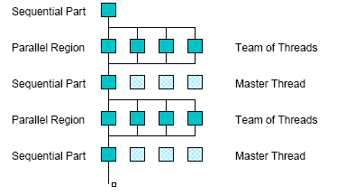
Impact of Scheduling Decision
Load balance
Same work in each iteration?
Processors working at same speed?
Scheduling overhead
Static decisions are cheap because they require no run-time coordination
Dynamic decisions have overhead that is impacted by complexity and frequency of decisions
Data locality
Particularly within cache lines for small chunk sizes
Also impacts data reuse on the same processor
Data layout at NUMA and multi-core CPU
Question: What is the motivation of designing a scheduler in a system?

Slide 66
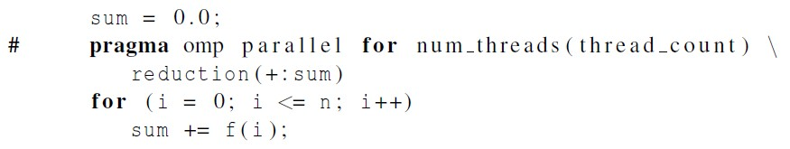
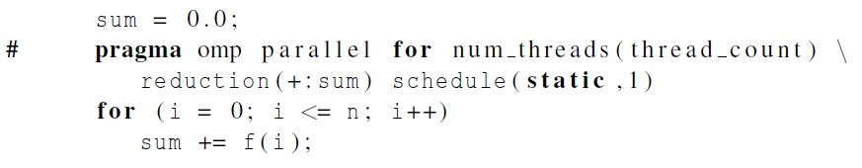
The Schedule Clause
Default schedule:
Cyclic schedule:
60

Slide 67
schedule ( type , chunksize )
Type can be:
static: the iterations can be assigned to the threads before the loop is executed.
dynamic or guided: the iterations are assigned
to the threads while the loop is executing.
auto: the compiler and/or the run-time system determine the schedule.
runtime: the schedule is determined at run- time environment variables.

Slide 68

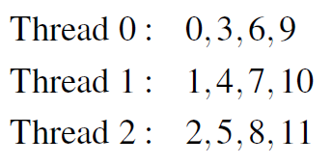
twelve iterations, 0, 1, . . . , 11, and three threads
The Static Schedule Type

Slide 69

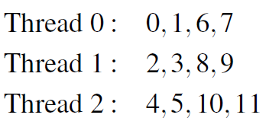
The Static Schedule Type
twelve iterations, 0, 1, . . . , 11, and three threads

Slide 70

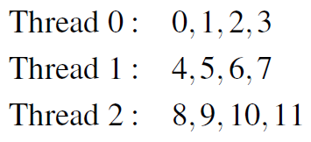
The Static Schedule Type
twelve iterations, 0, 1, . . . , 11, and three threads

Slide 71
The Dynamic Schedule Type
The iterations are also broken up into chunks
of chunksize consecutive iterations.
Each thread executes a chunk, and when a thread finishes a chunk, it requests another one from the run-time system (the task scheduler in OpenMP runtime).
This continues until all the iterations are
completed.

Slide 72
The Guided Schedule Type
Each thread also executes a chunk, and when a thread finishes a chunk, it requests another one.
However, in a guided schedule, as chunks are completed, the size of the new chunks decreases.

Slide 73
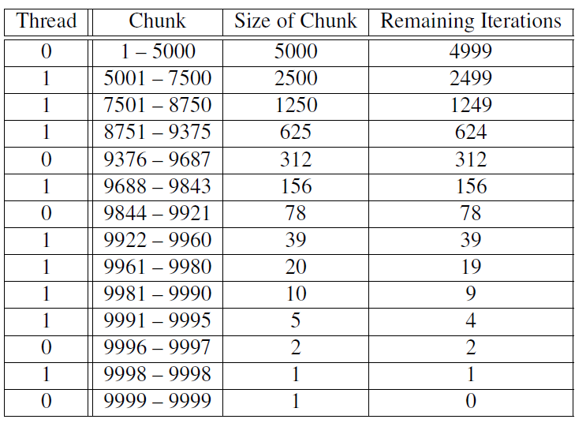
Assignment of trapezoidal rule iterations 1–9999 using a
guided schedule with two threads.

Slide 74
The Runtime Schedule Type
The system uses the environment variable OMP_SCHEDULE to determine at run-time how to schedule the loop.
The OMP_SCHEDULE environment variable can take on any of the values that can be used for a static, dynamic, or guided schedule.

Slide 75
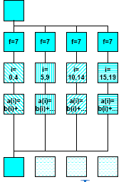
OpenMP parallel and for directives
Syntax:
#pragma omp for [ clause [ clause ] ... ] new-line
for-loop
clause can be one of the following:
shared (list)
private( list)
reduction( operator: list)
schedule( type [ , chunk ] )
nowait (C/C++: on #pragma omp for)
#pragma omp parallel private(f) {
f=7;
#pragma omp for
for (i=0; i<20; i++)
a[i] = b[i] + f * (i+1);
} /* omp end parallel */

Slide 76
OpenMP environment variables
OMP_NUM_THREADS
sets the number of threads to use during execution
when dynamic adjustment of the number of threads is enabled, the value of this environment variable is the maximum number of threads to use
For example,
setenv OMP_NUM_THREADS 16 [csh, tcsh]
export OMP_NUM_THREADS=16 [sh, ksh, bash]
OMP_SCHEDULE
applies only to do/for and parallel do/for directives that have the schedule type RUNTIME
sets schedule type and chunk size for all such loops
For example,
setenv OMP_SCHEDULE GUIDED,4 [csh, tcsh]
export OMP_SCHEDULE= GUIDED,4 [sh, ksh, bash]

Slide 77

Producers and
Consumers

Slide 78
Queues
Can be viewed as an abstraction of a line of customers waiting to pay for their groceries in a supermarket.
A natural data structure to use in many multithreaded applications.
For example, suppose we have several “producer”
threads and several “consumer” threads.
Producer threads might “produce” requests for data.
Consumer threads might “consume” the request by finding
or generating the requested data.
70

Slide 79
Message-Passing
Each thread could have a shared message queue
When one thread wants to “send a message” to another thread, it could enqueue the message in the destination thread’s queue.
A thread could receive a message by dequeuing the message at the head of its message queue.

Slide 80
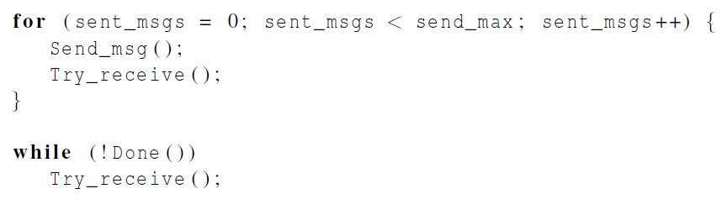
Message-Passing
// sending messages by a thread.

Slide 81
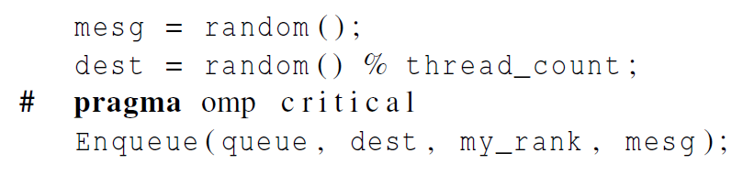
Sending Messages

Slide 82
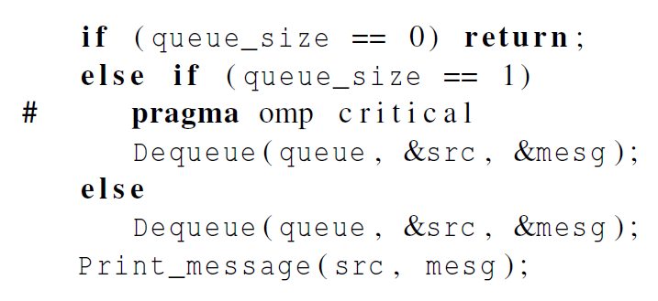
Receiving Messages
Head and tail operate on the same message.
Head and tail operate on the different messages.
Msg queue
tail: enqueue
head: dequeue

Slide 83
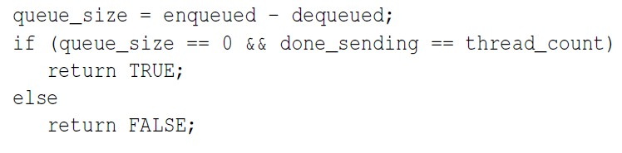

Termination Detection
each thread increments this
after completing its for loop

Slide 84
Startup (1)
When the program begins execution, a single thread, the master thread, will get command line arguments and allocate an array of message queues: one queue for each thread.
This array needs to be shared among the threads, since any thread can send to any other thread, and hence any thread can enqueue a message in any of the queues.

Slide 85

Startup (2)
Queue initialization with barrier:
One or more threads may finish allocating their queues before some other threads.
We need an explicit barrier so that when a thread encounters the barrier, it blocks until all the threads in the team have reached the barrier.
After all the threads have reached the barrier, all the threads in the team can proceed.

Slide 86
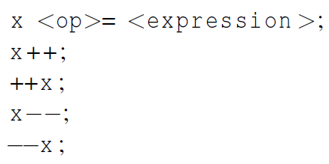
The Atomic Directive (1)
Unlike the critical directive, it can only protect critical sections that consist of a single C assignment statement.
Further, the statement must have one of the following forms:

Slide 87
The Atomic Directive (2)
Here <op> can be one of the binary operators
Many processors provide a special load-modify-
store instruction.
A critical section that only does a load-modify-store can be protected much more efficiently by using this special instruction.

Slide 88
Critical Sections with names
OpenMP provides the option of adding a name to a
critical directive:
When we do this, two blocks protected with critical directives with different names can be executed simultaneously.
However, the names are set during compilation, and we want a different critical section for each thread’s queue.
80

Slide 89

Locks
A lock consists of a data structure and functions that allow the programmer to explicitly enforce mutual exclusion in a critical section.

Slide 90
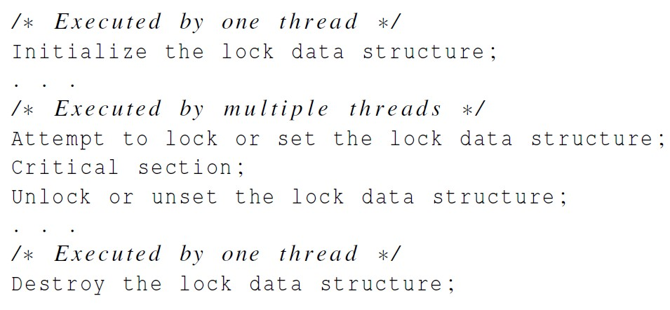
Locks

Slide 91
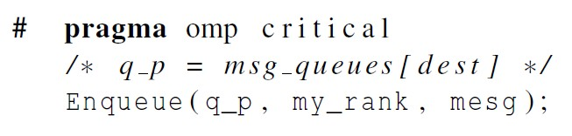
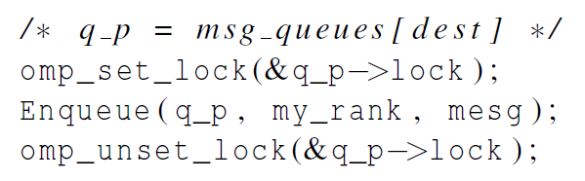
Using Locks in the Message- Passing Program
omp_lock_t lock;
omp_init_lock(&lock);

Slide 92
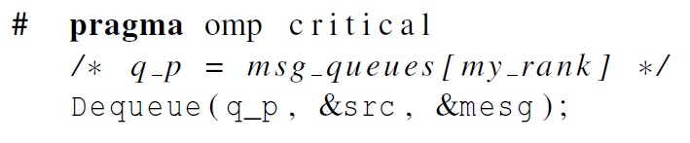
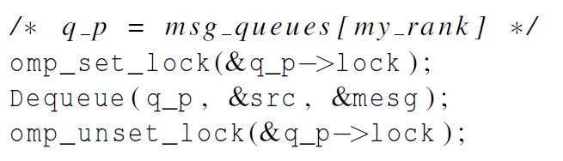
Using Locks in the Message- Passing Program

Slide 93
Some Caveats
if (…)
# pragma omp atomic
x +=f(y);
else
# pragma omp critical
x = g(x);
You shouldn’t mix the different types of mutual
exclusion for a single critical section.
E.g., critical may not exclude atomic.
There is no guarantee of fairness in mutual
exclusion constructs.
E.g., it is possible that a thread can be blocked forever due to always failure of competing for a lock.
It can be dangerous to “nest” mutual exclusion
constructs.
While(1){
# pragma omp critical
x = g(my_rank);
}
#pragma omp critical (one)
y = f(x)
…
Double f (double x){
# pragma omp critical (two)
z = g(x); // z is shared
}
#pragma omp critical
y = f(x)
…
Double f (double x){
# pragma omp critical
z = g(x); // z is shared
}
//outer critical can be assigned, the critical in f() is blocked

Slide 94



Matrix-vector multiplication

Slide 95


Matrix-vector multiplication
Valgrind is an instrumentation framework for building dynamic analysis tools, that can automatically detect many memory management and threading bugs.
Runtimes and efficiencies

Slide 96

Thread-Safety
strtok_r()
strtok_r()

Slide 97

OpenMP Execution Model
Fork and Join Model
Master thread forks new threads at the beginning of parallel regions.
Multiple threads share work in parallel.
Threads join at the end of the parallel regions.
- 97 -

Slide 98


Hopper/Edison Compute Nodes
Hopper: NERSC Cray XE6, 6,384 nodes, 153,126 cores.
4 NUMA domains per node, 6 cores per NUMA domain.
Edison: NERSC Cray XC30, 5,576 nodes, 133,824 cores.
2 NUMA domains per node, 12 cores per NUMA domain. 2 hardware threads per core.
Memory bandwidth is non-homogeneous among NUMA domains.
- 98 -

Slide 99
Thread Affinity Control in OpenMP 4.0
OMP_PLACES: a list of places that threads can be pinned on
CPU threads: Each place corresponds to a single hardware thread (e.g. vcpu in Intel hyperthreading) on the target machine.
CPU cores: Each place corresponds to a single core (having one or more hardware threads) on the target machine.
CPU sockets（CPU插槽）: Each place corresponds to a single socket (consisting of one or more cores) on the target machine.
A list with explicit place values: such as:
"{0,1,2,3},{4,5,6,7},{8,9,10,11},{12,13,14,15}”
“{0:4},{4:4},{8:4},{12:4}”
OMP_PROC_BIND
spread: Bind threads as evenly distributed (spread) as possible
close: Bind threads close to the master thread while still distributing threads for load balancing, wrap around once each place receives one thread
master: Bind threads the same place as the master thread

Slide 100

Nested OpenMP Thread Affinity Illustration
setenv OMP_PLACES threads setenv OMP_NUM_THREADS 4,4
setenv OMP_PROC_BIND spread,close
spread
close

Slide 101
Sample Nested OpenMP Code
#include <omp.h> #include <stdio.h>
void report_num_threads(int level)
{
#pragma omp single {
prinl("Level %d: number of threads in the team: %d\n", level, omp_get_num_threads());
}
}
int main()
{
omp_set_dynamic(0);
#pragma omp parallel num_threads(2) { report_num_threads(1);
#pragma omp parallel num_threads(2) { report_num_threads(2);
#pragma omp parallel num_threads(2) {
report_num_threads(3);
}
}
}
return(0);
}
% setenv OMP_NESTED TRUE
% a.out
Level 1: number of threads in the team: 2 Level 2: number of threads in the team: 2 Level 2: number of threads in the team: 2
Level 3: number of threads in the team: 2 Level 3: number of threads in the team: 2 Level 3: number of threads in the team: 2 Level 3: number of threads in the team: 2
Level 0: P0
Level 1: P0 P1
Level 2: P0 P2; P1 P3
Level 3: P0 P4; P2 P5; P1 P6; P3 P7

Slide 102
Concluding Remarks (1)
OpenMP is a standard for programming shared-
memory systems.
OpenMP uses both special functions and preprocessor directives called pragmas.
OpenMP programs start multiple threads rather
than multiple processes.
Many OpenMP directives can be modified by clauses.

Slide 103
Concluding Remarks (2)
A major problem in the development of shared memory programs is the possibility of race conditions.
OpenMP provides several mechanisms for insuring
mutual exclusion in critical sections.
Critical directives
Named critical directives
Atomic directives
Simple locks
90

Slide 104
Concluding Remarks (3)
By default most systems use a block-partitioning of
the iterations in a parallelized for loop.
OpenMP offers a variety of scheduling options.
In OpenMP the scope of a variable is the collection of threads to which the variable is accessible.

Slide 105
Concluding Remarks (4)
A reduction is a computation that repeatedly applies the same reduction operator to a sequence of operands in order to get a single result.

