Slide 1
GITHUB

Slide 2
INTRODUCTION
GitHub is a code hosting platform for version control and collaboration.
It lets you and others work together on projects from anywhere.

Slide 3
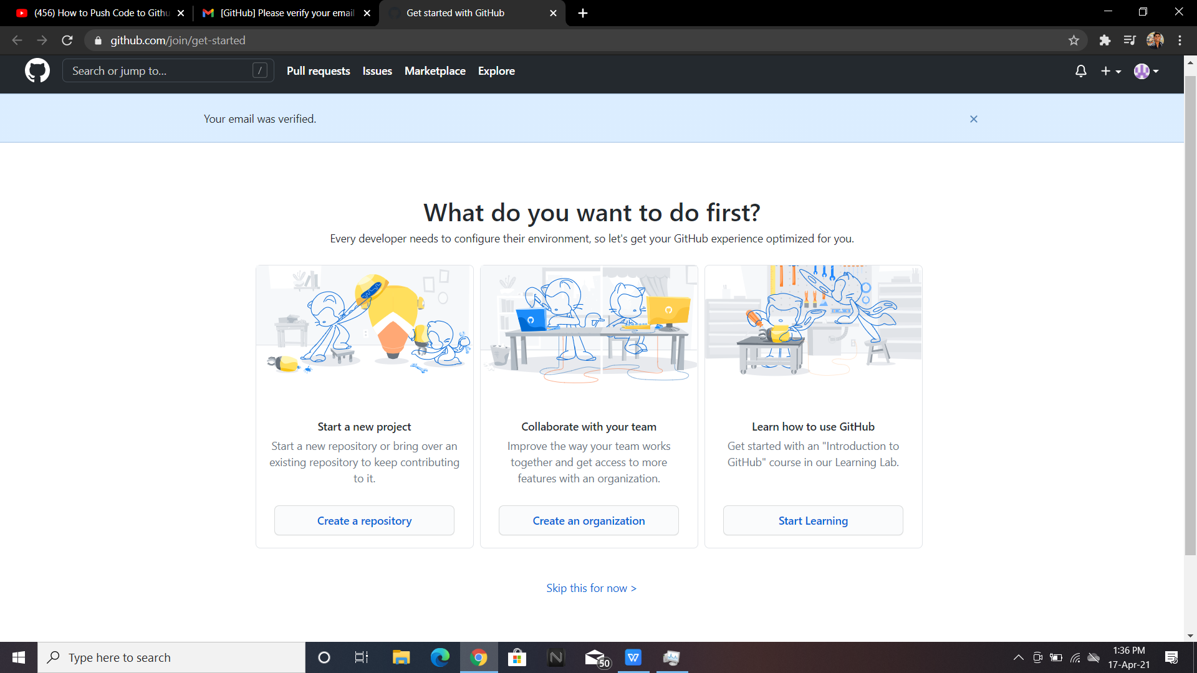
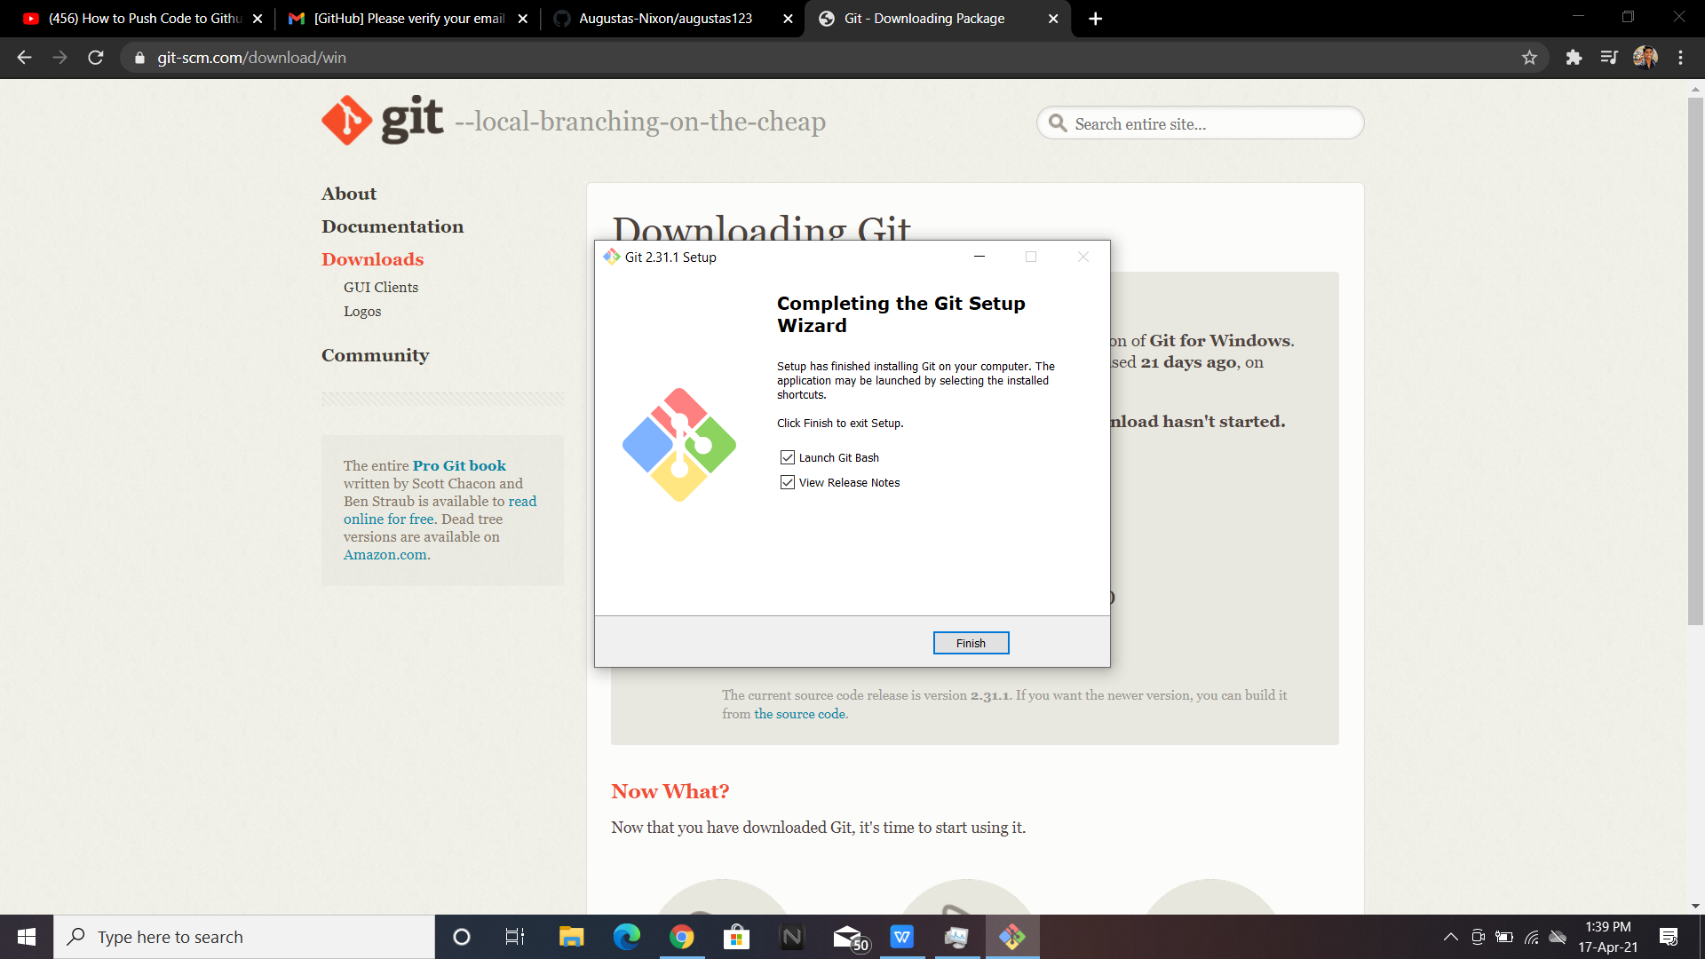
PUSH CODE TO GITHUB
STEP 1: Sign In to your github account,if such an account is not present create an account.
STEP 2:Install git into your system based on your OS

Slide 4
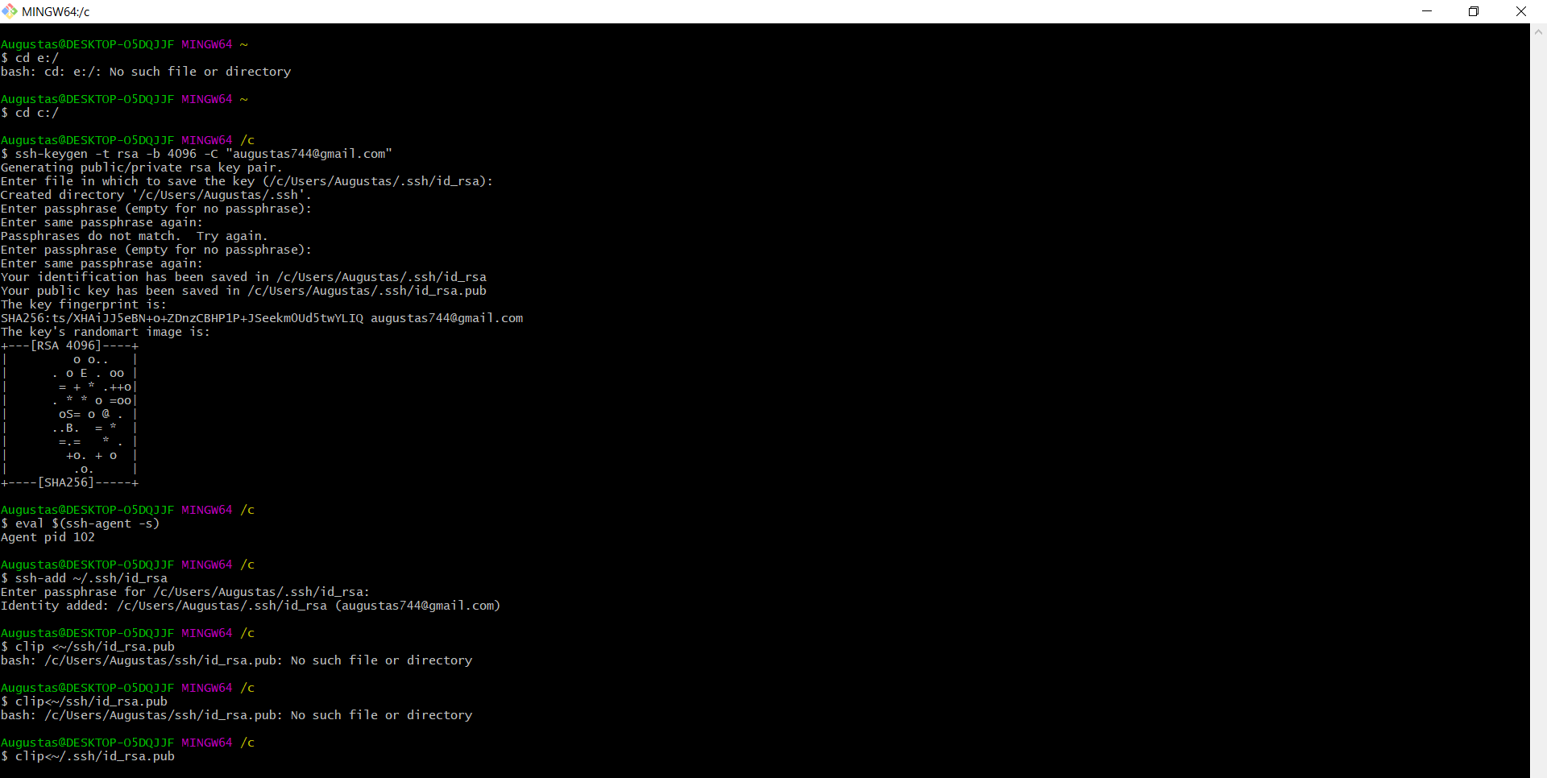
STEP 3:Open git bash in your pc and enter the commands to :
generating a key
name of file to save to
enter password
command to create private and public keys.

Slide 5
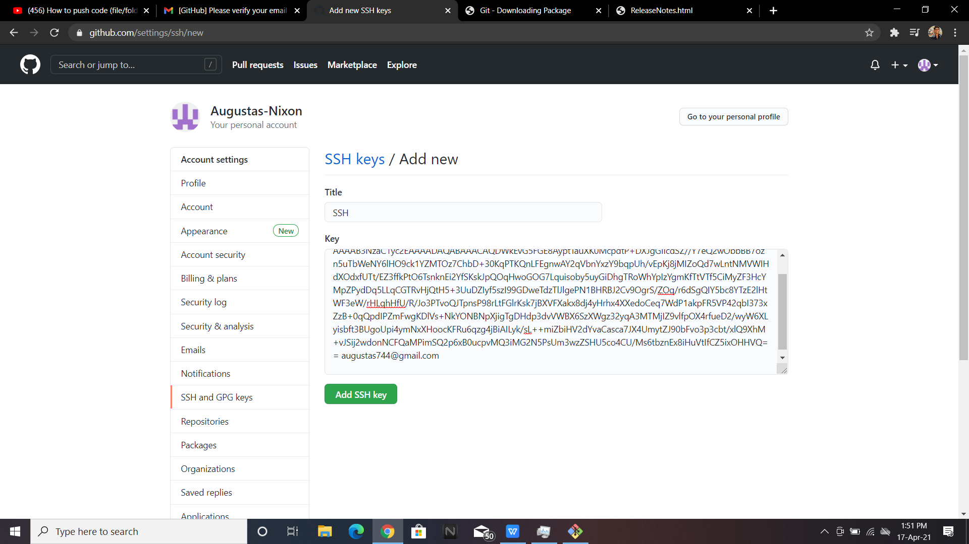
STEP 4:Add SSH key to your github profile.

Slide 6
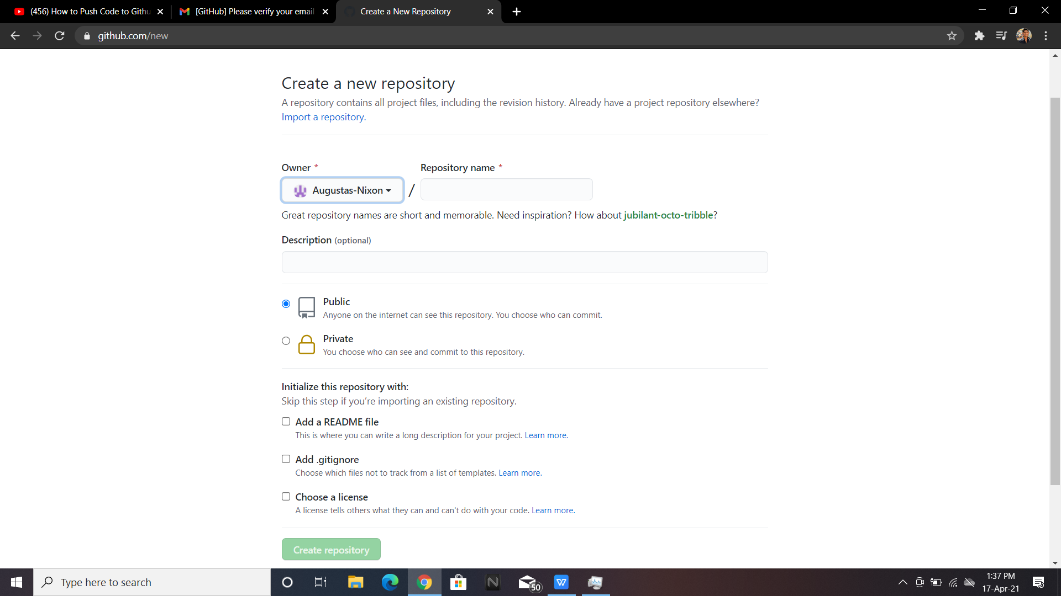
STEP 5:Create a repository and verify it using your email-id

Slide 7
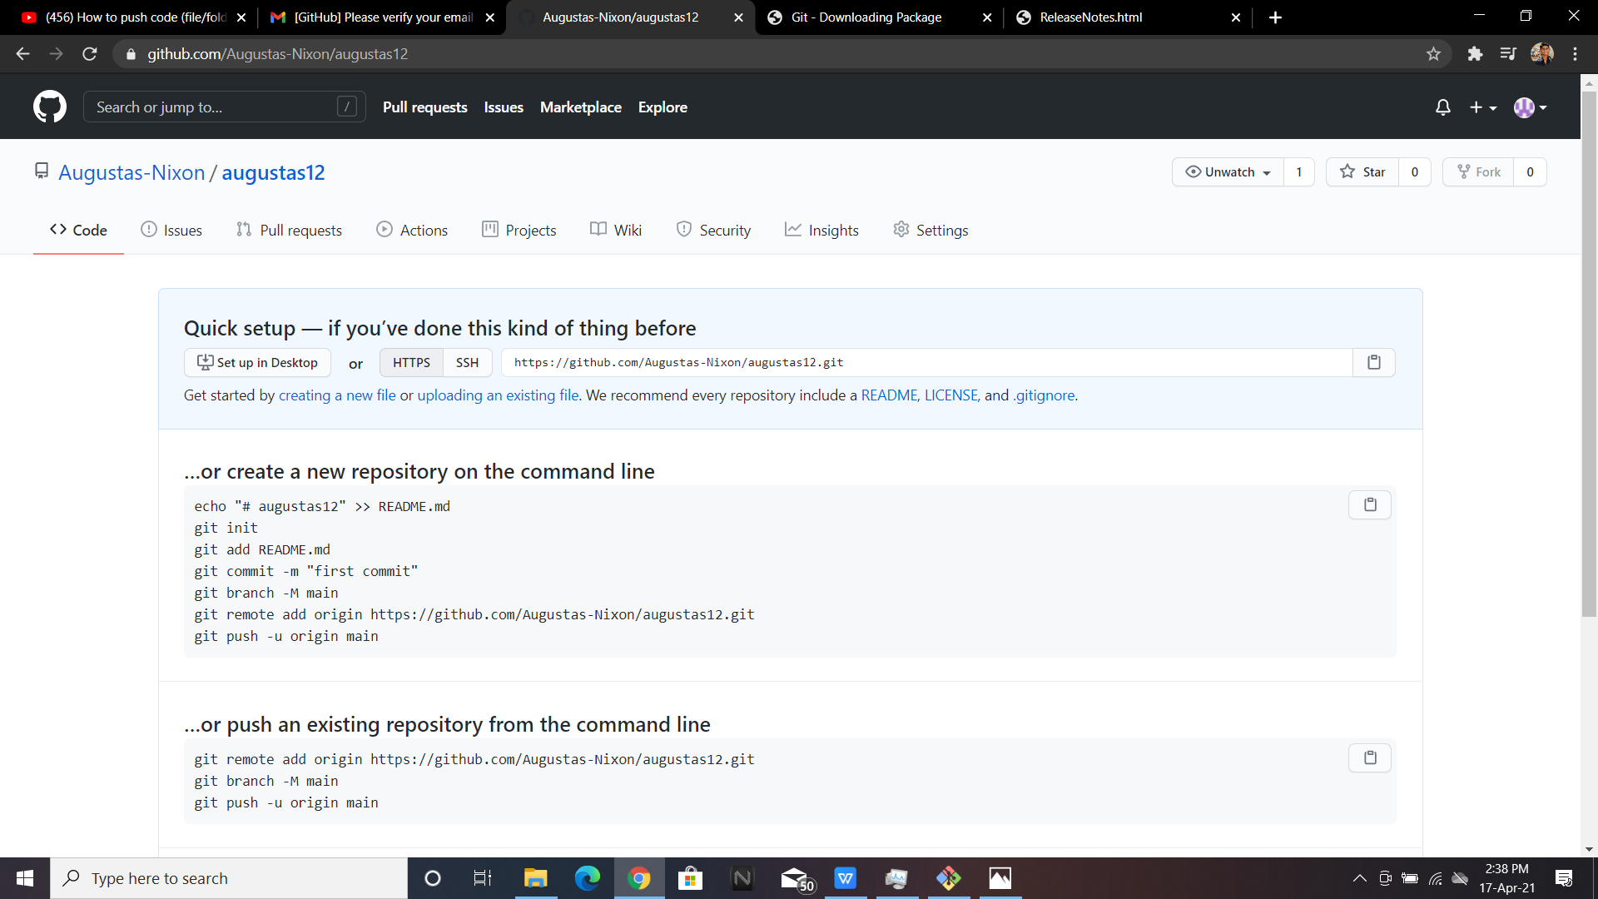
STEP 6:Open GIT bash in the folder where the code to be pushed is present.
STEP 7:Enter the commands to do the following:
initialise git bash.
add the files present in the directory(ignore warning)
command to perform the changes locally
to access the repository created,use the link in repository page and finish the command
finally perform the push comand to enter the code to your repository

Slide 8
THANK YOU

