Slide 1

Momentum and Branching: a Promising Global Optimisation Strategy for Sparse Problems

Slide 2
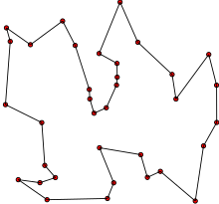
In real life
Maximising efficiency for amazon van dropping off parcels
Scheduling surgeries in a hospital
Balancing network routing in telecommunications
Important problems with large consequences
Taken from Wikipedia: https://en./wiki/Travelling_salesman_problemwikipedia.org

Slide 3
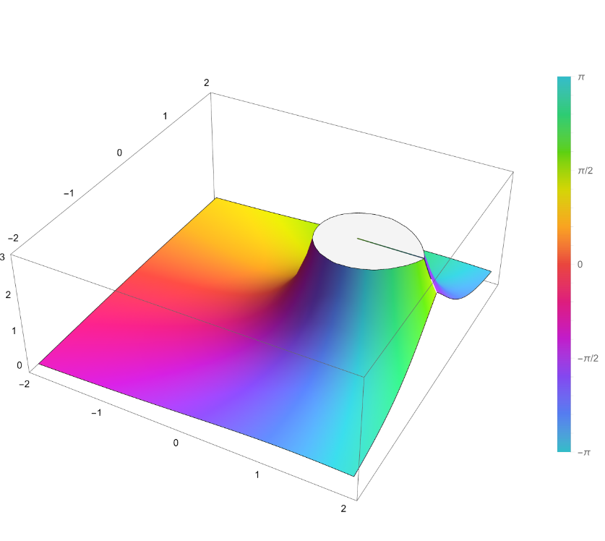
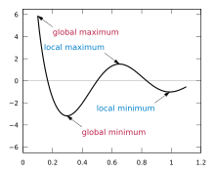
What are optimization problems and its challenges?
Generalized to a function over a set of constraints where algebraic methods can’t be used to find a maximum or minimum
Large search spaces along multiple dimensions
Too large to brute force
Taken from Wikipedia: https://en.wikipedia.org/wiki/Hypergeometric_function
Taken from Wikipedia: https://en.wikipedia.org/wiki/Maximum_and_minimum

Slide 4

Non-convex Discrete Multi-objective Black-box
Very little to no information

Slide 5
Stochastic approaches
Genetic algorithms
Covariance matrix adaptation evolution strategy
Particle swarm optimization
Work around an element of randomness to explore the landscape without bias

Slide 6
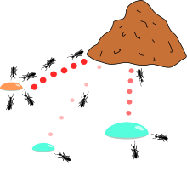
Stochastic approaches
Reinforcement Learning
Very generalizable
Not great performance compared to popular meta-heuristic approaches
Ant-colony-optimisation
White Box
Probability Matrix
Taken from Wikipedia: https://en.wikipedia.org/wiki/Ant_colony_optimization_algorithms

Slide 7
Deterministic approaches
Regression
Function interpolation
RBF interpolation
Try find optimal solution for all problems with assurance

Slide 8
Deterministic approaches
Branch and Cut
For constrained OP
Worst case Exponential
Branch and bound
White box OP
Worst case Exponential

Slide 9
Motivation
Lack of competitive general algorithms
Very relevant for AI

Slide 10
My aims and objectives
Non-convex Discrete Black-Box
Generalisable
Extendable
Multi-objective
Ideally:
Faster run time
Better solution quality

Slide 11
Information found in non-convex discrete black-box OPs
Dimensional
Inter dimensional

Slide 12
Branches
Exploitation – maintain dimensional context
Tree structure

Slide 13
Momentum
Exploration – Reduce redundant computation

Slide 14
Video Link
Recording
Dissertation Folder
2024-05-01 11-17-49.mkv

