Slide 1
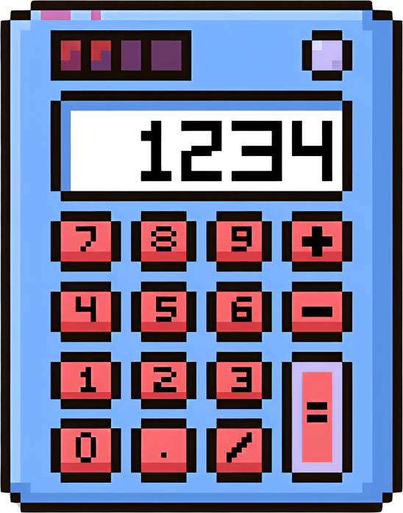

Welcome
⟨ / ⟩
SCIENTIFIC CALCULATOR
CSE 115 | Section 05 | Group 13
K.M Mohib Nawaz
Augustine Gomes
Usayed Bin Gias
Abrar Shahriyar
North South University
Notes:
1

Slide 2
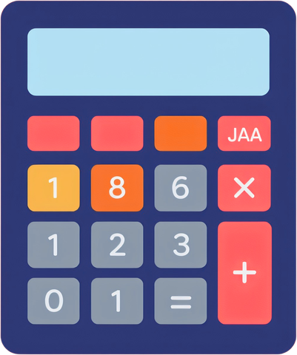
Introduction & Objectives
INTRODUCTION
OBJECTIVES
▸ Console-based, menu-driven application
▸ Covers elementary to advanced mathematical operations
▸ Developed collaboratively by 4 team members
▸ Each member owns a distinct functional segment
▸ Built on modular programming principles in C
▸ Emphasize modular programming with switch-case
▸ Perform high-precision calculations using math.h
▸ Handle invalid inputs & domain violations
▸ Cover: Arithmetic, Trig, Log, Power, Combinatorics & Matrix
▸ Systematic error checking across all modules
Notes:
2

Slide 3


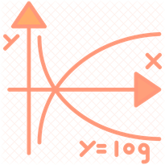

Team Members & Tools
01
K.M. Mohib Newaz
02
Usayed Bin Gias
Arithmetic Operations
Trigonometric Operations
Abrar Shahriar
04
Augustine Gomes
03
Logarithm, Factorial & Perm/Comb
Power & Root + Matrix Operations
TOOLS & ENVIRONMENT
Language: C
Compiler: GCC
Libraries: stdio.h math.h stdlib.h
Platform: Code::Blocks / Windows
Notes:
3

Slide 4
System Architecture
Option 0 → Exit
Program
Start
Main Menu
(Switch-Case)
Segment
Function Called
Sub-Menu
& Input
Compute
& Display
↑ Loop back to Main Menu (ENTER to continue) ↑
6 CALCULATOR SEGMENTS
1. Arithmetic
2. Trigonometry
3. Logarithm
4. Power & Root
5. Factorials & Comb.
6. Matrix Ops
Notes:
4

Slide 5
01
Arithmetic Operations
( + − × / % )
K.M. Mohib Newaz
Addition
a + b
Division
a / b
Two doubles; result to 4 decimal places
Checks b ≠ 0 before computing
Subtraction
a − b
Modulus
a % b
Two doubles; formatted with %.4lf
Integers only; checks ib ≠ 0 (%d format)
Multiplication
a × b
⚠ Error Handling
Double-precision floating-point multiplication
▸ Division by zero → error message, no crash
▸ Modulus by zero → checked before % operator
▸ Invalid menu choice → graceful return
Notes:
5

Slide 6
02
Trigonometric Operations
sin cos tan arc
Usayed Bin Gias
Degree ↔ Radian Conversion
User enters degrees → converted to radians via DEG_TO_RAD(x) before computation. Results converted back with RAD_TO_DEG where needed.
sin(θ)
Direct
cos(θ)
Direct
tan(θ)
Direct
Domain: All real angles
Domain: All real angles
Domain: θ ≠ 90°, 270°
Converts deg→rad, calls sin()
Converts deg→rad, calls cos()
Uses fmod() to detect undefined angles
arcsin
Inverse
arccos
Inverse
arctan
Inverse
Domain: Input ∈ [−1, 1]
Domain: Input ∈ [−1, 1]
Domain: All real numbers
Returns angle in degrees; domain checked
Returns angle in degrees; domain checked
No domain restriction; atan() used
Notes:
6

Slide 7
02
Trigonometric Operations
sin cos tan arc
Usayed Bin Gias
⚠ Error Handling
tan(90°) Undefined: The program uses fmod(angle, 180.0) == 90.0 to detect this and prints an error.
⚠ Error Handling
arcsin - arccos Domain Error: The program validates the input and rejects out-of

Slide 8
03
Logarithmic Operations
log ln logₙ
Abrar Shahriar
log₁₀(x)
ln(x)
logₙ(x)
Common Logarithm
Natural Logarithm
Custom Base
Base 10
Base e ≈ 2.71828
logₙ(x) = ln(x)/ln(n)
Uses log10() from math.h directly.
Output precise to 6 decimal places.
Uses log() from math.h.
Euler's number as the base.
Change-of-base formula applied.
User specifies the base.
ERROR HANDLING
⚠ Non-positive Input
⚠ Invalid Custom Base
val ≤ 0 → error printed before any computation
base > 0 and base ≠ 1 are both required
Notes:
7

Slide 9
04
Factorial, Permutation & Combination
n! P(n,r) C(n,r)
Abrar Shahriar
Factorial n!
Permutation P(n,r)
Combination C(n,r)
n! = 1 × 2 × ... × n
P(n,r) = n! / (n−r)!
C(n,r) = n! / (r! × (n−r)!)
Iterative loop (avoids stack overflow from recursion). Return type is double to accommodate large values. Convention: 0! = 1.
Counts ordered arrangements of r items from n. Calls factorial() twice. Order matters.
Counts unordered selections of r items from n. Calls factorial() three times. Order does NOT matter.
ERROR HANDLING
⚠ Negative n → factorial() returns −1
⚠ r < 0 or r > n → error displayed
⚠ n < 0 for Perm/Comb → rejected
Notes:
8

Slide 10
05
Power & Root Operations
xʸ √x ∛x ⁿ√x
Augustine Gomes
General Power
x ^ y
Square Root
√x
Function: pow(x, y)
Function: sqrt(x)
User enters base x and exponent y. Handles any real-valued exponentiation.
Checks x ≥ 0 before calling. Undefined for negative numbers.
Cube Root
∛x
Nth Root
x^(1/n)
Function: cbrt(x)
Function: pow(a, 1.0/b)
Defined for negative reals. No domain restriction needed.
Custom root. Ensures floating-point division via 1.0/b.
⚠ Errors:
sqrt(negative) rejected
nth-root of negative with even degree rejected
n=0 causes division by zero → blocked:
Notes:
9

Slide 11
06
Matrix Operations
A+B A×B
Augustine Gomes
Matrix Addition A + B
Matrix Multiplication A × B
Requires identical dimensions: m = p and n = q
Columns of A must equal Rows of B
C[i][j] = A[i][j] + B[i][j]
C[i][j] += A[i][k] * B[k][j]
▸ readMatrix() prompts element-by-element: A[1][1], A[1][2]...
▸ printMatrix() displays formatted grid with | delimiters
▸ 2D array type: double[10][10]
▸ Triple nested loop (classical algorithm)
▸ Innermost accumulates dot product per element
▸ Result C is m×n matrix
⚠ Errors:
validDim checks 1–10 range
Addition: rA ≠ rB or cA ≠ cB shown
Multiplication: cA ≠ rB → operation blocked
Notes:
10

Slide 12
Conclusion
Complete console-based scientific calculator in C
6 segments covering arithmetic to matrix algebra
✓
✓
Modular architecture using switch-case function control
Systematic error-handling across all operations
✓
✓
Double-precision results with appropriate format specifiers
Collaborative development with clear individual ownership
✓
✓
CSE 115 | Section 05 | Scientific Calculator | Group 13
Notes:
11

