Slide 1
Quantum Portfolio Optimisation
8-Qubit Sector-Selection QUBO on Bloqade Neutral-Atom Simulator
GOALCWRU
GOALCWRU
YQuantum 2026 · Capgemini × The Hartford
Dataset
Real Hartford workbook · 50 assets · 1,200 economic scenarios
Key Innovations
✓ K₈ edge-coloring: 28 → 7 parallel ZZ moments per layer
✓ 2D atom layout via MDS on sector correlations
✓ Insurer-aware penalties: Solvency II capital + liquidity
✓ Quantum matches classical optimum in all 4 model variants
✓ Gemini noise analysis: fidelity vs depth characterisation
✓ Fully reproducible pipeline from real Hartford workbook
Sectors
8 asset-class sectors · equal-weight aggregation · 8×8 covariance
Hardware
Bloqade neutral-atom simulator · 8 qubits · Gemini noise models
Algorithm
QUBO → Ising → QAOA (p=1,2,3) · COBYLA optimiser · 2,048 shots
GOALCWRU | YQuantum 2026 | Capgemini × The Hartford
1

Slide 2
Problem Statement
Insurer portfolio selection under regulatory capital & liquidity constraints
The Hartford seeks to allocate capital across 8 asset-class sectors to maximise risk-adjusted return while satisfying Solvency II capital charges and liquidity requirements. Select exactly B = 4 from 8 sectors — a binary optimisation that maps naturally to an 8-qubit QUBO.
Combinatorial Structure
Insurer Constraints
Quantum Formulation
•
50 Hartford assets → 8 sectors
•
Markowitz mean–variance objective
•
Binary xᵢ ∈ {0,1} → 8 qubits
•
Equal-weight aggregation: wᵢ = xᵢ/B
•
Capital-charge penalty (γ = 0.25)
•
QUBO encodes obj + constraints
•
Select 4 of 8: C(8,4) = 70 feasible
•
Illiquidity penalty (η = 0.25)
•
Ising Hamiltonian for Bloqade
•
Search space: 2⁸ = 256 bitstrings
•
1,200 scenario stress testing
•
QAOA with p = 1, 2, 3 layers
•
Ground truth via exact brute-force
•
VaR₉₅, CVaR₉₅, worst-case metrics
•
Neutral-atom 2D array execution
Sector → Qubit Mapping (project_config.py):
q₀ Cash
q₁ Gov Bonds
q₂ IG Credit
q₃ HY Credit
q₄ Eq US
q₅ Eq Intl
q₆ Real Est.
q₇ Infra.
Budget constraint: 1ᵀx = B = 4 → C(8,4) = 70 feasible portfolios from 256 total bitstrings → exact brute-force validation possible
GOALCWRU | YQuantum 2026 | Capgemini × The Hartford
2

Slide 3
Mathematical Formulation
QUBO model verified against portfolio_model.py lines 615–668
Objective Function (Markowitz + budget + insurer penalties)
min (q/B²) xᵀΣx − (1/B) μᵀx + λ(1ᵀx − B)² + (γ/B) c̃ᵀx + (η/B) ĩᵀx
x ∈ {0,1}⁸ q = risk aversion λ = budget penalty c̃ = normalised capital charge ĩ = normalised illiquidity
Upper-Triangular QUBO Matrix Q
Qᵢᵢ = (q/B²)Σᵢᵢ − μᵢ/B + λ(1 − 2B) + (γ/B)c̃ᵢ + (η/B)ĩᵢ
Qᵢⱼ = (2q/B²)Σᵢⱼ + 2λ (i < j)
← Budget penalty 2λ appears in every off-diagonal → near-complete K₈ graph!
Ising Mapping (for Bloqade QAOA)
xᵢ = (1 − sᵢ)/2 → H_C = Σᵢ hᵢZᵢ + Σᵢ<ⱼ JᵢⱼZᵢZⱼ
Jᵢⱼ = Qᵢⱼ/4 hᵢ = −Qᵢᵢ/2 − (1/4) Σⱼ≠ᵢ Qᵢⱼ
Hyperparameters (project_config.py ModelHyperparameters + ExecutionConfig):
B = 4
q = 0.5
λ = 8.0
γ = 0.25
η = 0.25
shots = 2048
Budget (sectors)
Risk aversion
Budget penalty
Capital penalty
Illiquidity penalty
Measurement samples
GOALCWRU | YQuantum 2026 | Capgemini × The Hartford
3

Slide 4
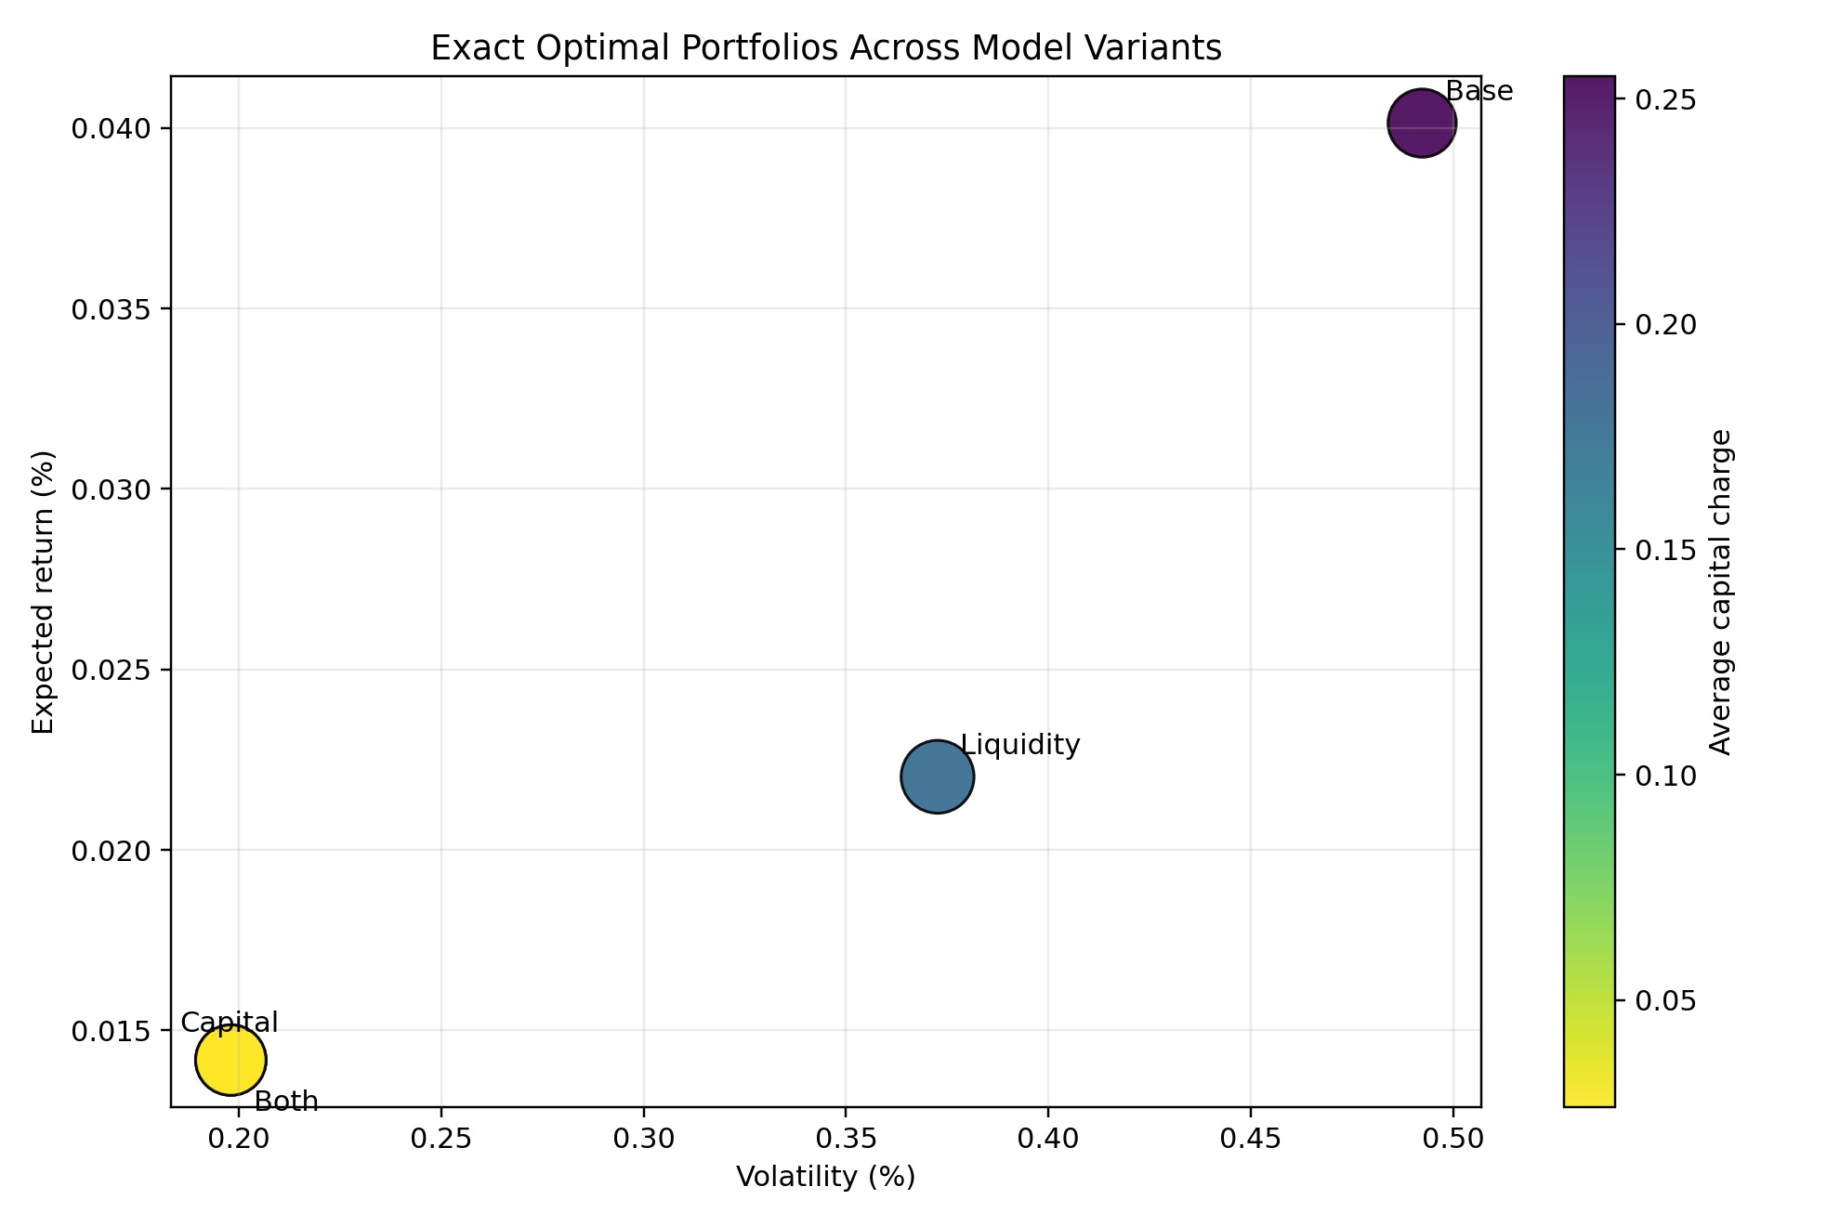
Portfolio Tradeoff Frontier
Four model variants — real Hartford workbook data
Base
00011110
HY Credit · Eq US · Eq Intl · Real Estate
Obj: −128.000
Ret: 0.040% Vol: 0.492% CapChg: 0.255
+ Capital
11110000
Cash · Gov Bonds · IG Credit · HY Credit
Obj: −127.985
Ret: 0.014% Vol: 0.198% CapChg: 0.026
+ Liquidity
11001100
Cash · Gov Bonds · Eq US · Eq Intl
Obj: −127.980
Ret: 0.022% Vol: 0.373% Liq: 4.21
Both
11110000
Cash · Gov Bonds · IG Credit · HY Credit
Obj: −127.915
Ret: 0.014% Vol: 0.198% CapChg: 0.026
Business insight: Capital model rotates entirely to fixed-income sectors (capital charge drops 0.255 → 0.026). When γ = η = 0.25, solvency constraint is the binding driver — highly relevant for Solvency II-regulated insurers like The Hartford.
GOALCWRU | YQuantum 2026 | Capgemini × The Hartford
4

Slide 5
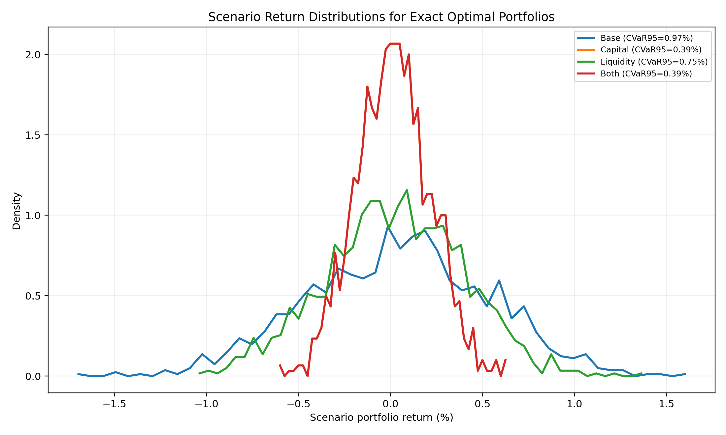
Scenario-Based Risk Analysis
1,200 economic scenarios from The Hartford workbook
Stress Metrics
(from comparison_table.csv)
Model
Worst
VaR₉₅
Vol
Base
−1.73%
0.786%
0.492%
Capital
−0.61%
0.310%
0.198%
Liquid.
−1.06%
0.611%
0.373%
Both
−0.61%
0.310%
0.198%
Capital model reduces worst-case loss by 65% (−1.73% → −0.61%) and VaR₉₅ by 60% — directly improves Solvency II SCR ratio.
C(8,4) = 70 feasible portfolios from 256 total
Portfolio scenario return:
r_t(x) = Σₛ (xₛ/B) · R_t^(sec)
Computed per results_metrics.py
using all 1,200 Hartford scenarios
GOALCWRU | YQuantum 2026 | Capgemini × The Hartford
5

Slide 6
QAOA Circuit Architecture
Quantum Approximate Optimisation Algorithm on Bloqade
QAOA Ansatz:
|ψ(γ,β)⟩ = ∏ₖ₌₁ᵖ exp(−iβₖ H_M) · exp(−iγₖ H_C) · |+⟩⊗⁸
H_C = Σᵢ hᵢZᵢ + Σᵢ<ⱼ JᵢⱼZᵢZⱼ (cost Hamiltonian) H_M = Σᵢ Xᵢ (transverse-field mixer)
1
Initialise |+⟩⊗⁸
Hadamard on all 8 qubits → uniform superposition over 256 bitstrings
2
Cost layer (×p)
Rz(2γhᵢ) for single-qubit fields; ZZ-phase via H · CZ · Rx(2γJᵢⱼ) · CZ · H decomposition — 28 edges from K₈ coupling graph
3
Mixer layer (×p)
Rx(2βₖ) on every qubit — explores solution space around current state
4
Classical optimiser
COBYLA minimises ⟨ψ|H_C|ψ⟩ over {γₖ, βₖ} · 12 random restarts · 5 coordinate-descent refinement rounds
5
Sample & decode
Draw 2,048 measurement shots · filter feasible (Σxᵢ = 4) · select bitstring with lowest QUBO energy
Depths: p = 1, 2, 3 | Seeds: {7, 11, 19} | Schedules: naive / auto-parallel / hand 7-color / pruned | Simulator: Bloqade + Gemini noise
GOALCWRU | YQuantum 2026 | Capgemini × The Hartford
6

Slide 7
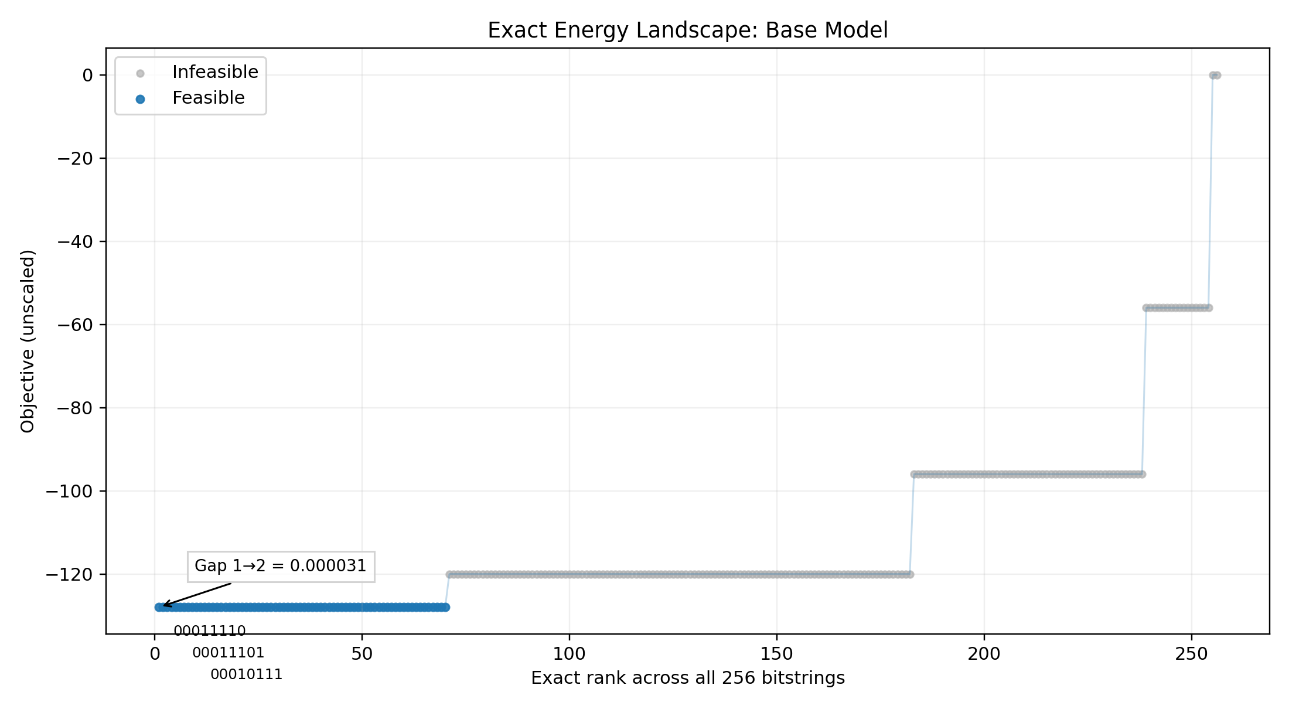
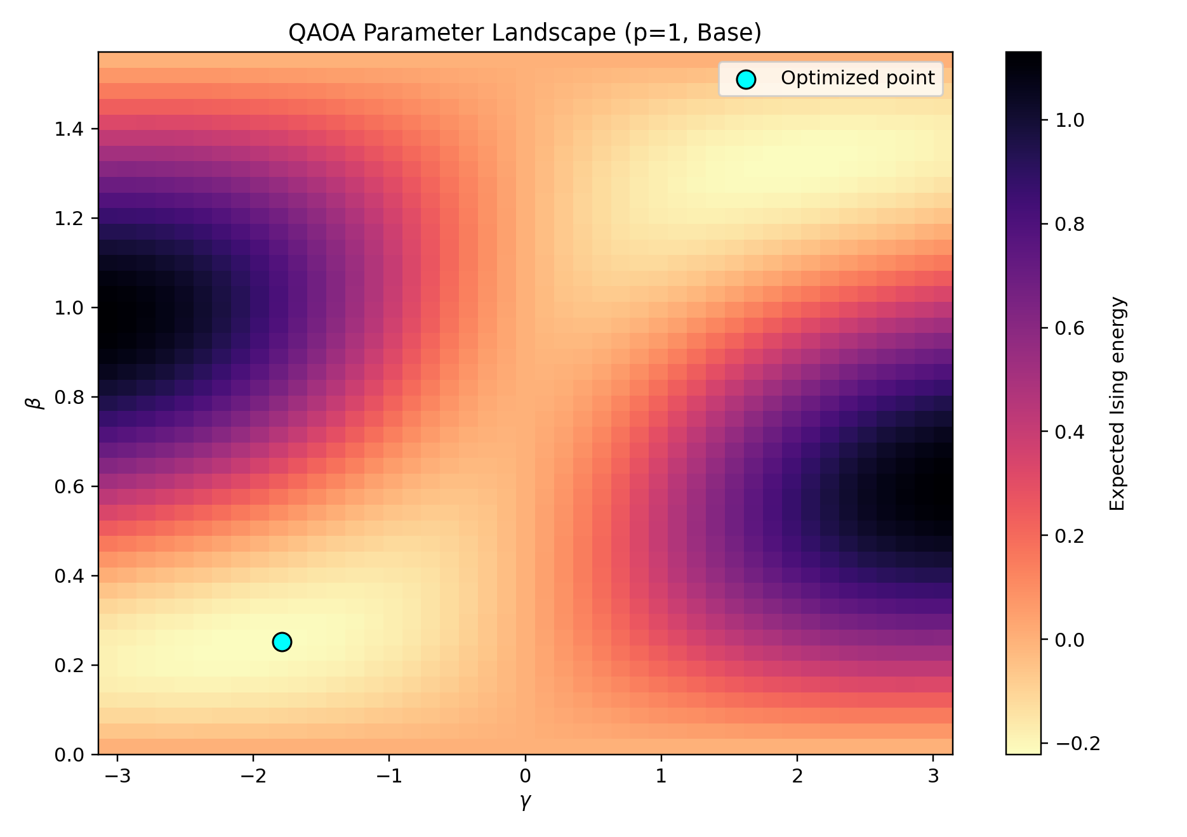
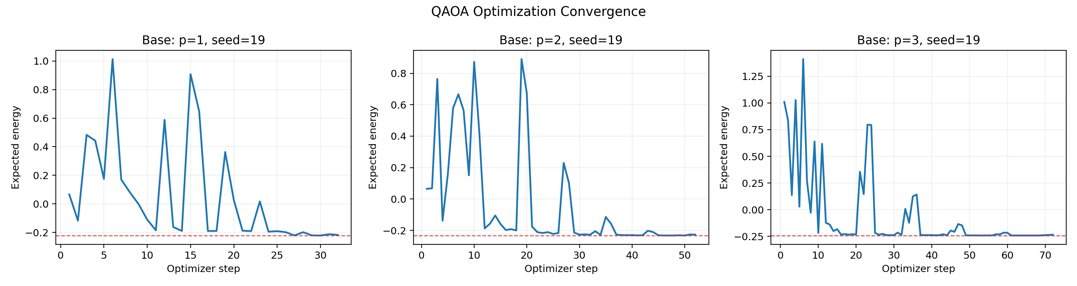
Energy Landscape & Parameter Search
Exact 256-state enumeration validates quantum approach
All 256 states — energy landscape
(γ, β) parameter landscape p=1
QAOA convergence p = 1, 2, 3
70 Feasible Portfolios
QAOA Finds the Optimum
C(8,4) = 70 feasible bitstrings out of 2⁸ = 256. Exact brute-force confirms ground truth for all models.
Best sampled feasible bitstring matches exact classical optimum for all 4 model variants (base, capital, liquidity, both).
P(optimal) at p=1 = 0.849%
Feasible Mass = 57.66%
From bloqade_validation.json: base_p1_probability_best. Compare to uniform baseline: 1/70 ≈ 1.43%.
Hand-schedule p=3 run. Over half the quantum distribution concentrates on valid budget-4 portfolios.
GOALCWRU | YQuantum 2026 | Capgemini × The Hartford
7

Slide 8
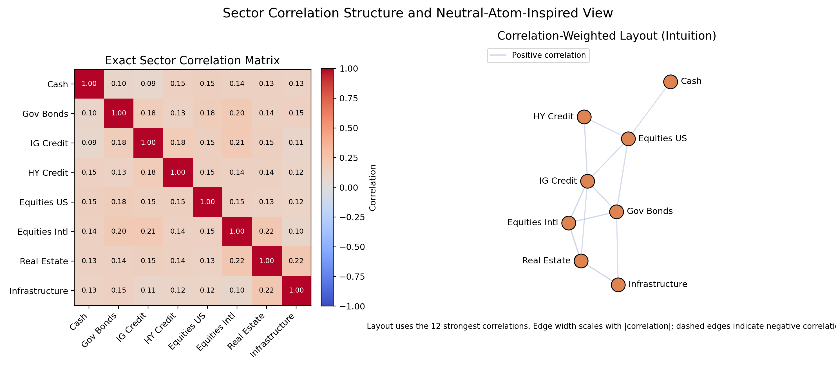
2D Neutral-Atom Layout
Atom positions from classical MDS on sector correlations
Sector Correlation Structure
How it’s built
1) Start with 8×8 sector covariance Σ
2) Distance: d(i,j) = 1 − |corr(i,j)|
3) Classical MDS → 2D (x,y) positions
4) Highly-correlated sectors placed closer
Hardware motivation:
• Rydberg blockade radius ~ 6–10 μm
• Closer atoms → stronger native ZZ coupling
• Layout aligns problem↔hardware structure
• Fewer SWAP gates for strongly-coupled pairs
Important note:
• The correlation heatmap is exact
• The 2D layout is approximate
• Not a literal physical atomic placement
• Matrix is the proof, layout is for intuition
This correlation-driven 2D embedding is a key hardware insight: it shows how the financial problem structure can directly inform the neutral-atom trap geometry for reduced gate overhead on real QuEra/Pasqal hardware.
GOALCWRU | YQuantum 2026 | Capgemini × The Hartford
8

Slide 9
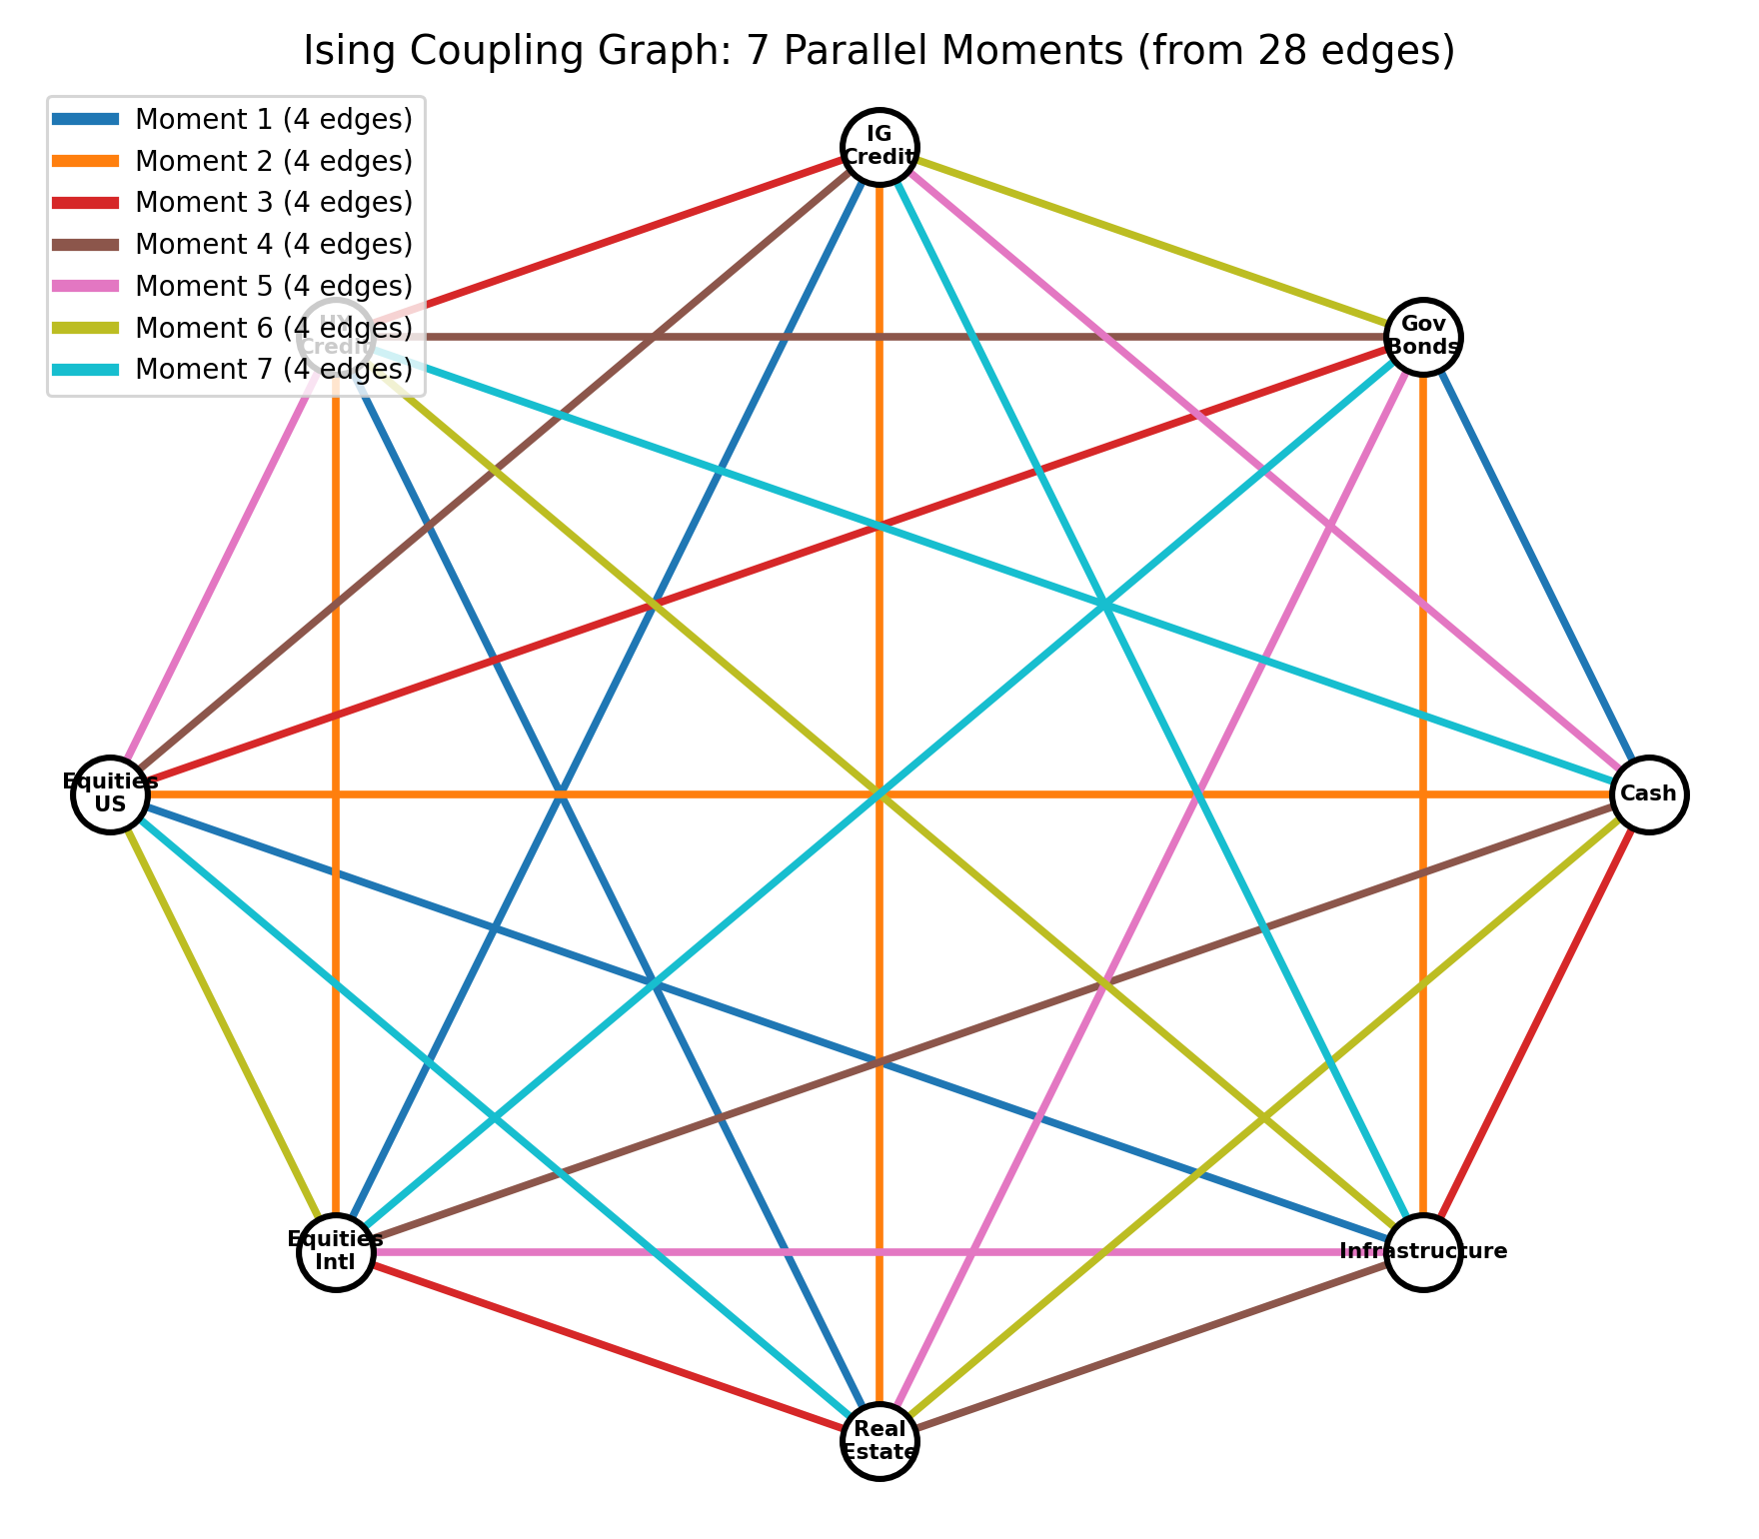
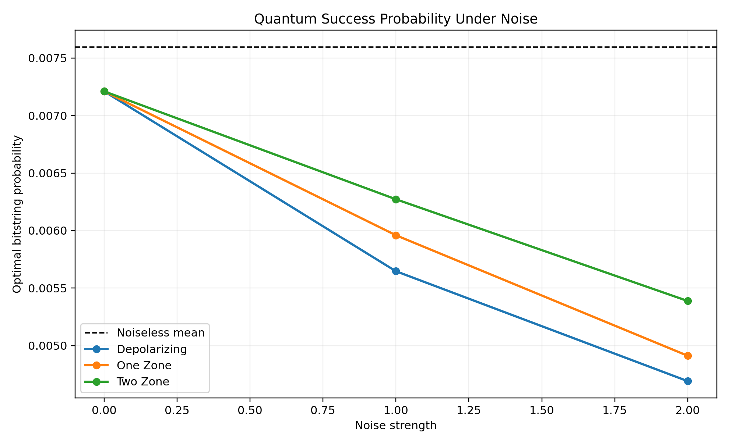
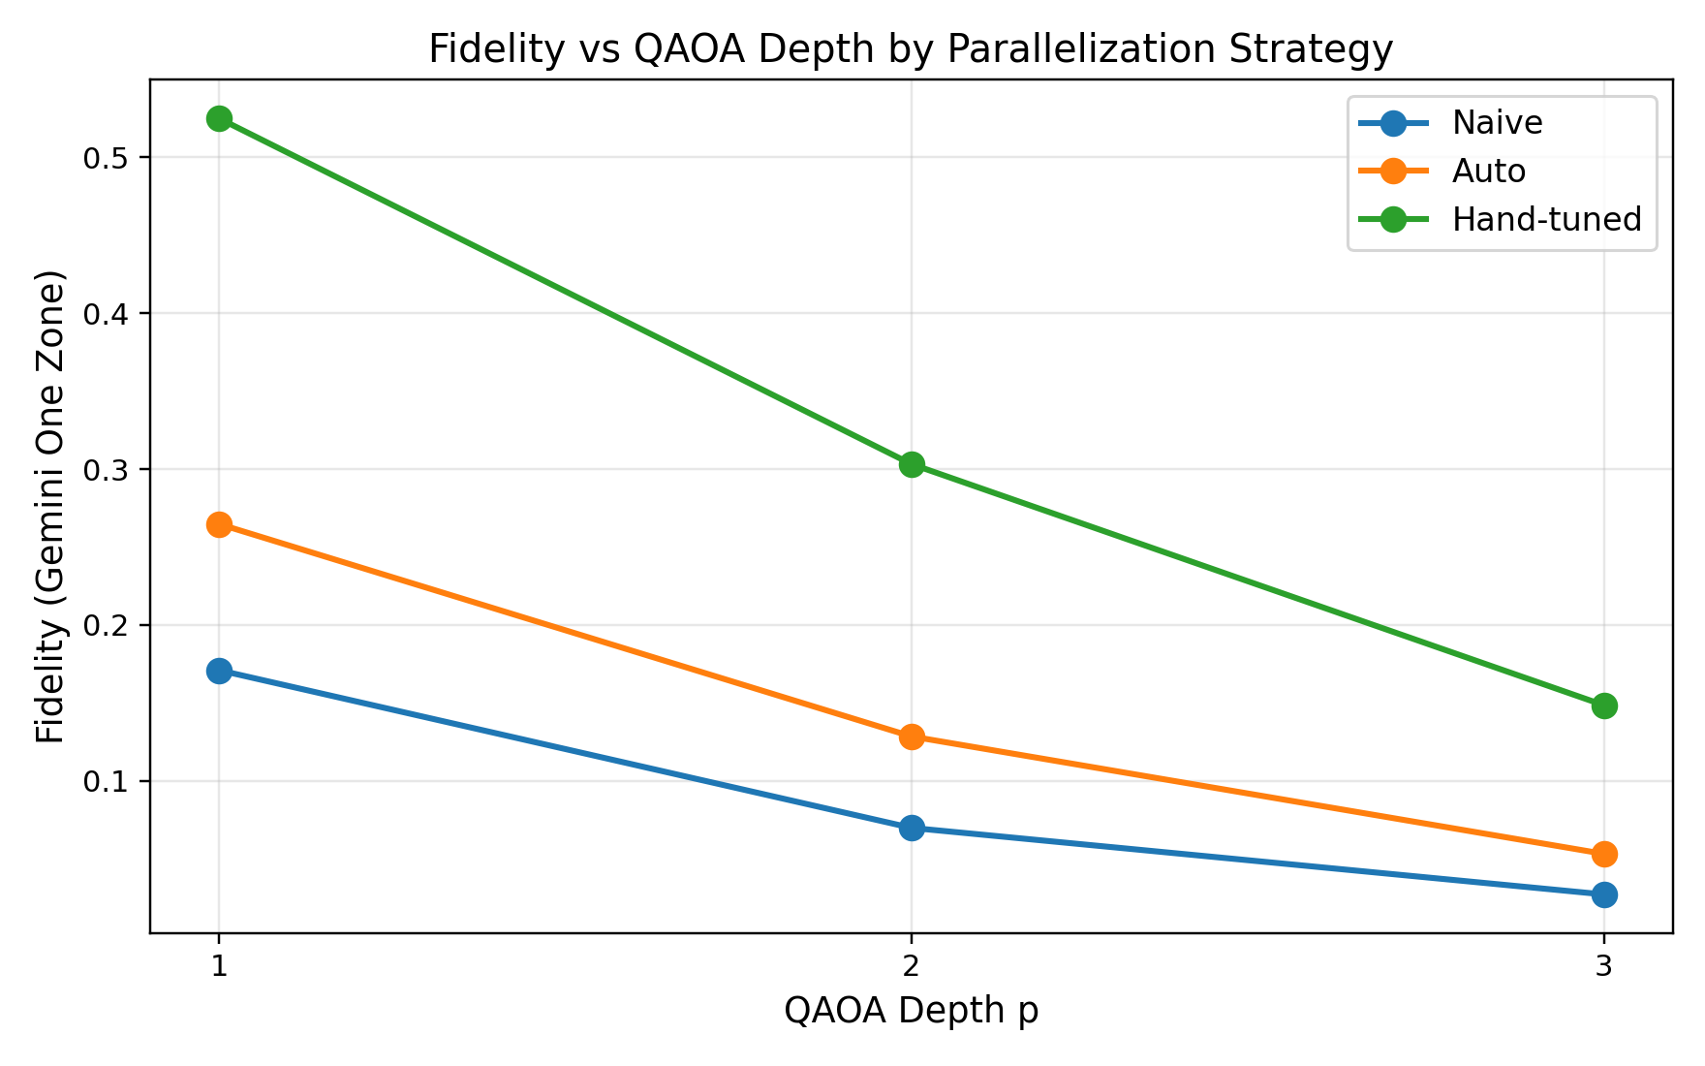
Hardware Insight — Edge Coloring & Noise
K₈ parallelism · Gemini noise model · circuit depth reduction
K₈ edge coloring (7 colours)
Success probability vs noise
Fidelity vs QAOA depth
Key insight: K₈ → 7-colour edge schedule → 4× depth reduction
Budget penalty 2λ adds constant coupling to every qubit pair → near-complete K₈. Optimal 7-colouring (Vizing's theorem) schedules all 28 ZZ gates in 7 parallel moments per cost layer (vs 28 sequential). Gate depth drops ~252 → 85 at p=3.
Noise impact (Gemini one-zone)
Circuit metrics (hand 7-color, p=3)
Feasible mass: 59.44% → 47.64% Optimal P(x*): 0.849% → 0.697%
Circuit depth: 85 gates One-zone fidelity: 0.1486
GOALCWRU | YQuantum 2026 | Capgemini × The Hartford
9

Slide 10
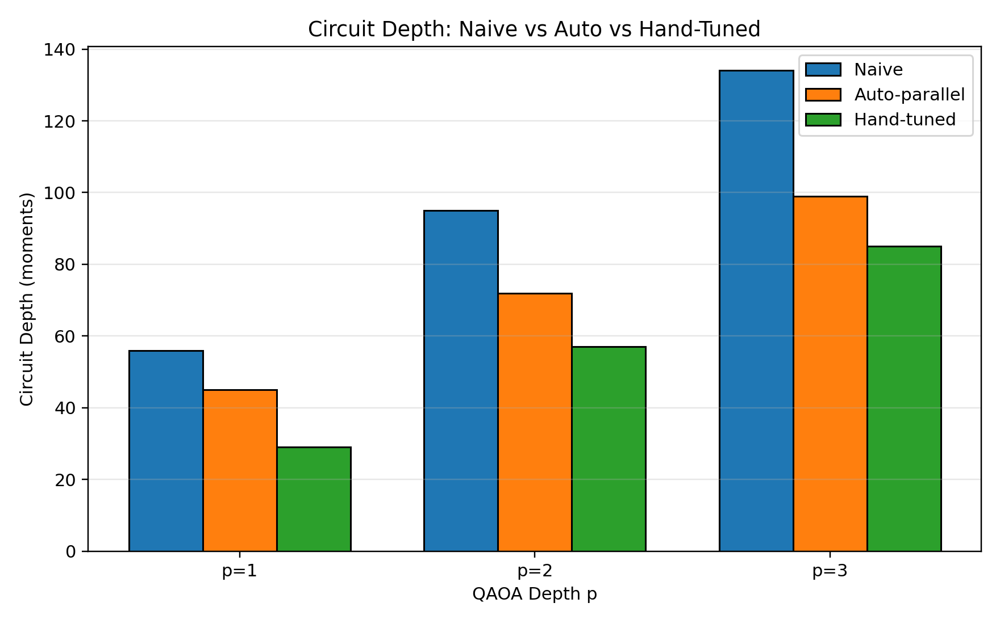
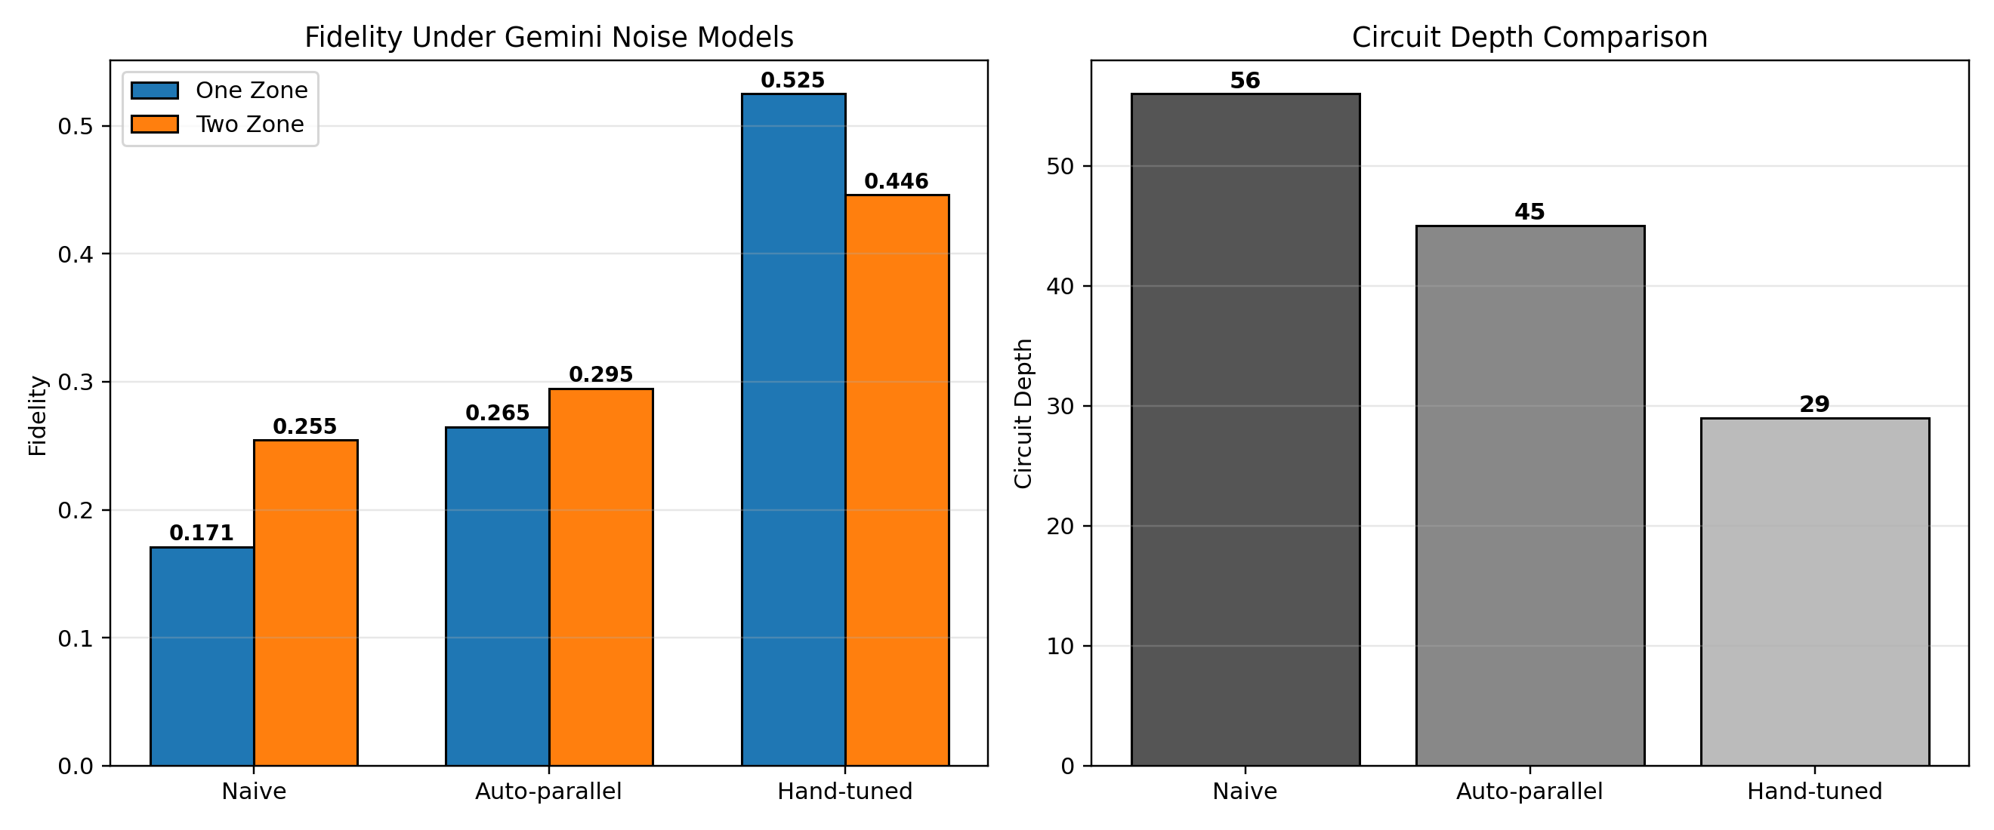
Scheduling & Depth–Quality Tradeoff
Naive vs auto-parallel vs hand 7-colour
Depth comparison by p
Fidelity under noise
Scheduling comparison (Base model, p=3, bloqade_validation.json):
Schedule
ZZ Moments/Layer
Optimal P(x*)
Feasible Mass
Depth (p=3)
Naive sequential
28
~0.85%
~57.7%
134
Auto-parallel
14
~0.85%
~57.7%
99
Hand 7-color ✓
7
0.824%
57.7%
85
GOALCWRU | YQuantum 2026 | Capgemini × The Hartford
10

Slide 11
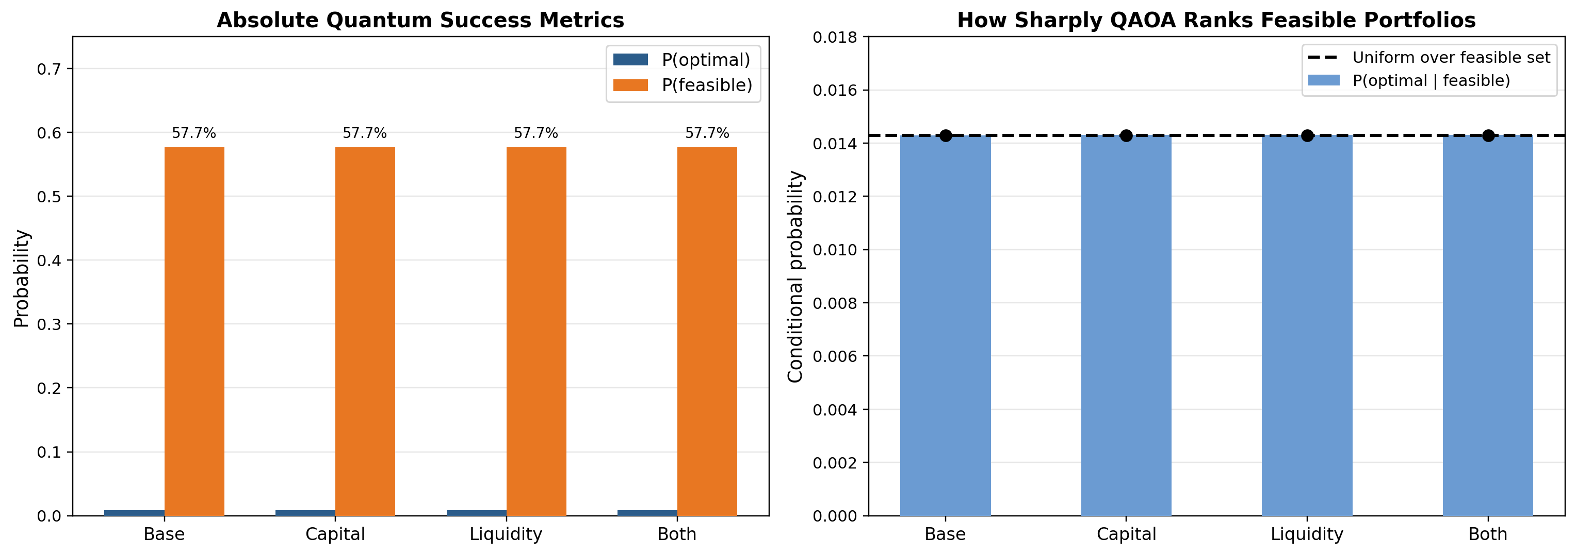
Quantum vs Classical — Results
bloqade_validation.json · comparison_table.csv · hand 7-color p=3
Validated Bloqade results (hand 7-color, p=3, 2,048 shots):
Model
Exact Opt.
Quantum Best
Match?
P(x*)
Feasible Mass
Depth
Base
00011110
00011110
Yes ✓
0.824%
57.66%
85
Capital
11110000
11110000
Yes ✓
0.825%
57.66%
85
Liquidity
11001100
11001100
Yes ✓
0.825%
57.66%
85
Both
11110000
11110000
Yes ✓
0.825%
57.66%
85
✓ Best sampled feasible matches classical optimum for all 4 models | Honest limitation: P(x*) ≈ 0.82% vs uniform 1/70 ≈ 1.43% — QAOA learns budget structure but does not sharply rank feasible portfolios at 8 qubits
GOALCWRU | YQuantum 2026 | Capgemini × The Hartford
11

Slide 12
Full Model Comparison & Business Takeaways
All metrics from comparison_table.csv — real Hartford data
Model
Bitstring
Sectors
Return
Vol
Cap Chg
Liq Score
Worst
Base
00011110
HY · EqUS · EqIntl · RE
0.040%
0.492%
0.255
3.30
−1.73%
Capital
11110000
Cash · Gov · IG · HY
0.014%
0.198%
0.026
3.73
−0.61%
Liquid.
11001100
Cash · Gov · EqUS · EqIntl
0.022%
0.373%
0.179
4.21
−1.06%
Both
11110000
Cash · Gov · IG · HY
0.014%
0.198%
0.026
3.73
−0.61%
Business Takeaways
Base Model
Capital Model
Maximises expected return (0.040%) but accepts 5× higher volatility and 10× higher capital charge. Suitable for growth-oriented allocation without regulatory constraints.
Solvency capital charge drops 0.255 → 0.026. Worst scenario improves −1.73% → −0.61%. Directly improves Solvency II SCR ratio — the most relevant outcome for The Hartford.
Liquidity Model
Both Model
Retains growth exposure (Eq US, Eq Intl) while improving average liquidity score 3.30 → 4.21. Best balance for balance-sheet flexibility under stress.
At γ = η = 0.25, capital penalty dominates — outcome identical to Capital model. Confirms that solvency is the binding insurer constraint at these penalty weights.
GOALCWRU | YQuantum 2026 | Capgemini × The Hartford
12

Slide 13
Conclusions & Path Forward
GOALCWRU | YQuantum 2026
What We Demonstrated
Path to Quantum Advantage
1
8-qubit QUBO encoding of real Hartford 50-asset workbook
→
Scale to 20–50 qubits: full asset-level QUBO beyond brute-force
2
Insurer-aware objective: capital (γ) + illiquidity (η) penalties
→
Continuous portfolio weights via VQE or amplitude encoding
3
QAOA p=1,2,3 on Bloqade — matches classical optimum (4/4 models)
→
Exploit Rydberg blockade for native cardinality constraint
4
K₈ edge-coloring: 28 → 7 parallel ZZ moments per cost layer
→
Hardware execution on Pasqal / QuEra neutral-atom QPU
5
2D neutral-atom layout from sector correlations (MDS embedding)
→
Multi-period rebalancing as parameterised quantum circuit
6
Gemini noise: feasible mass 59.4% → 47.6% under one-zone model
→
Hybrid quantum-classical loop for dynamic re-optimisation
7
Full stress analytics from 1,200 real Hartford scenarios
→
Live price data integration for production deployment
8
Fully reproducible pipeline — code, data, figures, and results
→
Benchmarking against quantum-inspired classical solvers
GOALCWRU — 8 qubits · 4 sectors · 1 quantum approach to insurer portfolio optimisation
GOALCWRU | YQuantum 2026 | Capgemini × The Hartford
13

