Slide 1
Central Limit Theorem

Slide 2
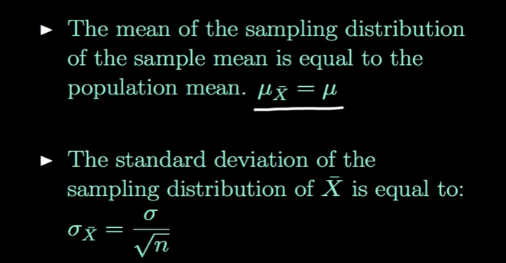
Central Limit Theorem
The Sample mean will be approximately normal distributed for large sample sizes, regardless of the distribution from which we are sampling
If the Population is normally distributed , then the mean of sample also normal distributed

Slide 3
Central Limit Theorem
 | Input | Sample | Mean
 | 3 | s1 | 3.5
 | 4 | s2 | 5
 | 6 | s3 | 2
 | 2 | s4 | 3
 | 4 | s5 | 4.5
 | 5 | s6 | 6.5
 | 8
 |  | Population mean | 4.083333
Mean | 4
 |  | S1 = 3+4

Slide 4
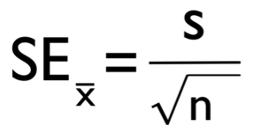
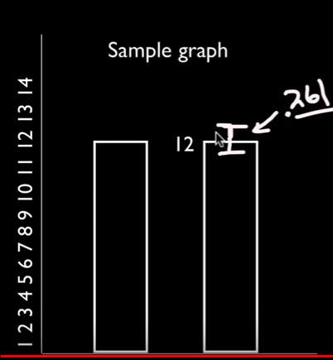
CLT : Standard Error
Standard error is the standard deviation of the sampling distribution of a statistic. It can be abbreviated as S.E.
The statistical inference involved in the construction of the confidence interval is mainly based on standard error.
S is std deviation, n sample size
 | Dataset 1 | Dataset 2
 | 9 | 10.9
 | 15 | 11.9
 |  | 12.2
 |  | 12.2
 |  | 12.9
 |  | 12.6
 |  | 12.3
 |  | 12.3
 |  | 12.5
 |  | 10.2
Mean | 12 | 11.4
Std dev | 4.242641 | 0.825967
Std error = std dev / sqrt(n) | 3 | 0.261194
It is the measure of precision

Slide 5
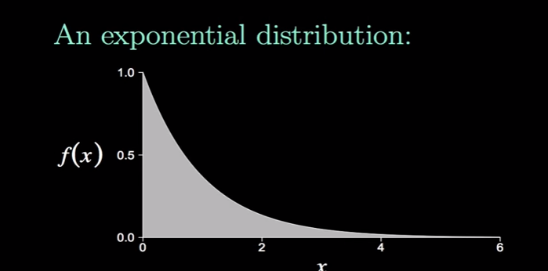
Central Limit Theorem – Graph based on samples

Slide 6
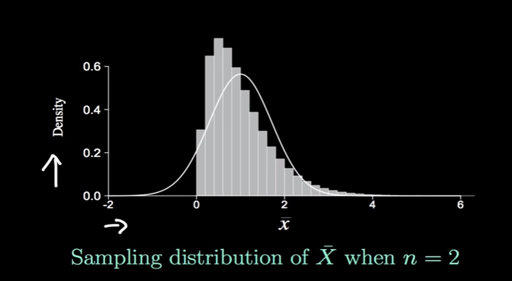
Central Limit Theorem – Graph based on samples

Slide 7
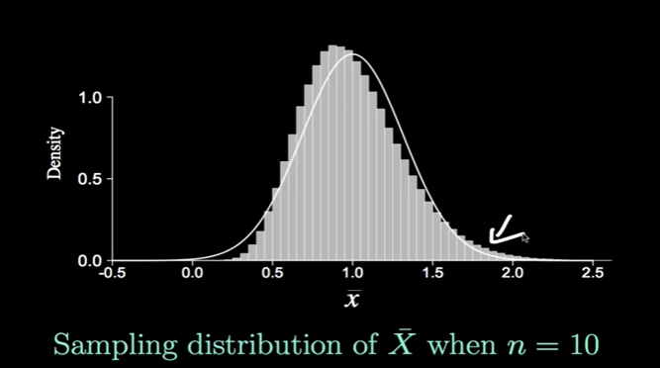
Central Limit Theorem – Graph based on samples

Slide 8
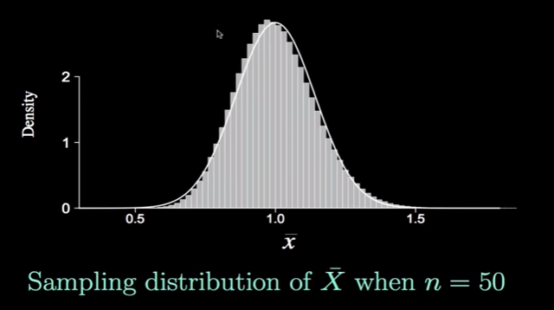
Central Limit Theorem – Graph based on samples
Sample mean to be appr. Normal distributed, sample size should be >= 30

Slide 9
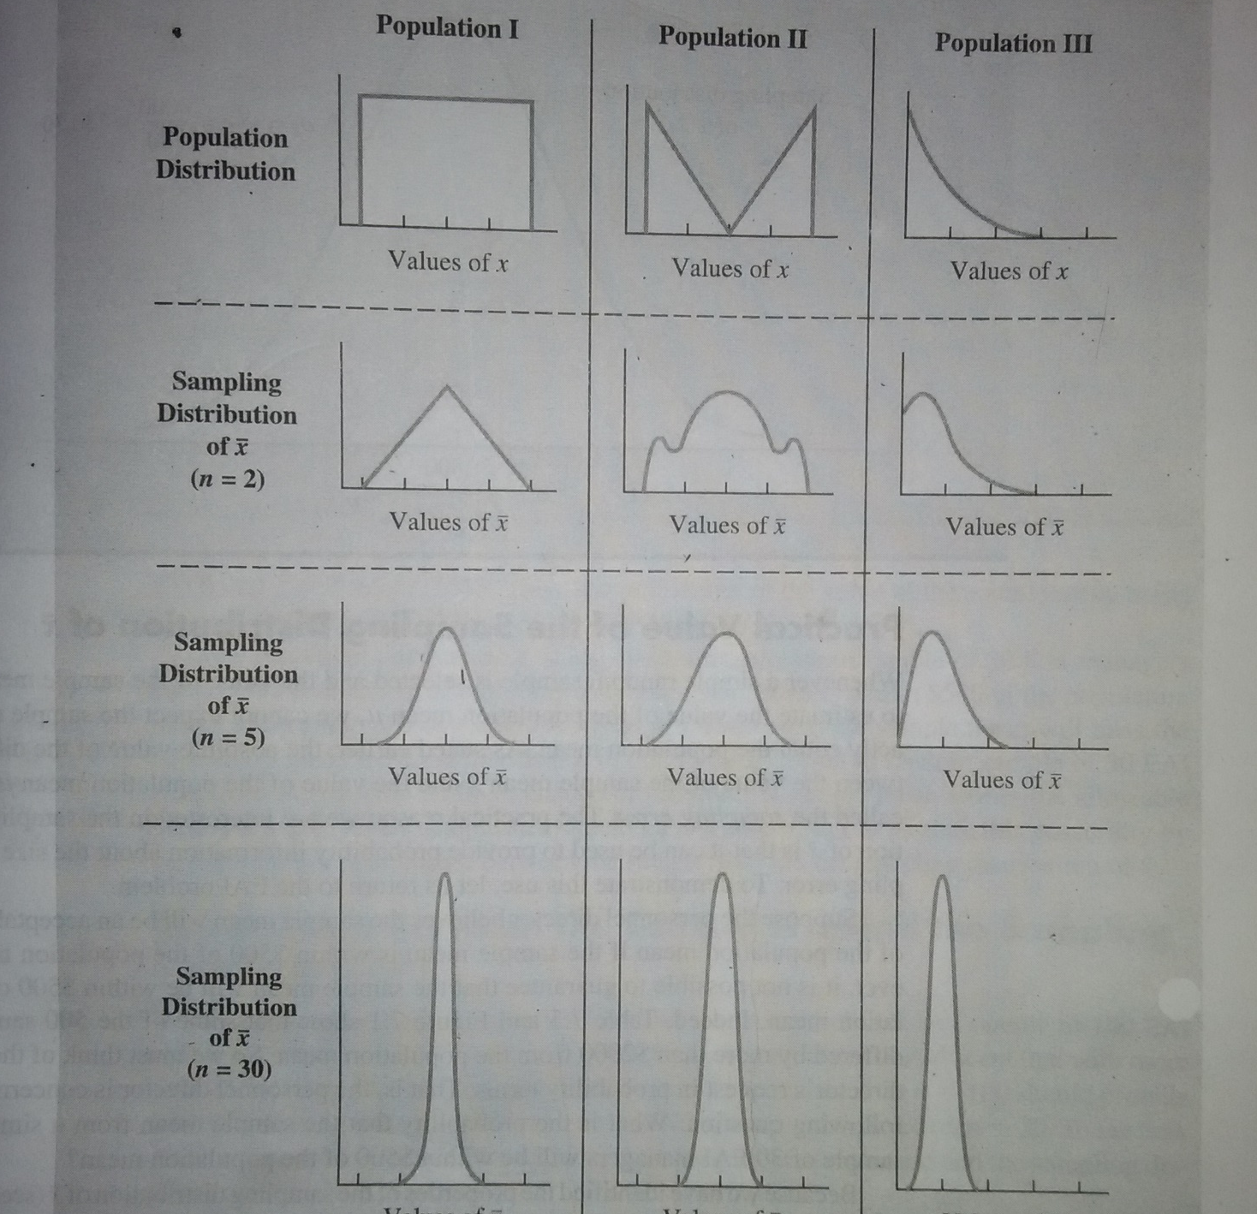
Central Limit Theorem
For Central Limit Theorem, Normal distributed data shape is not considered

Slide 10
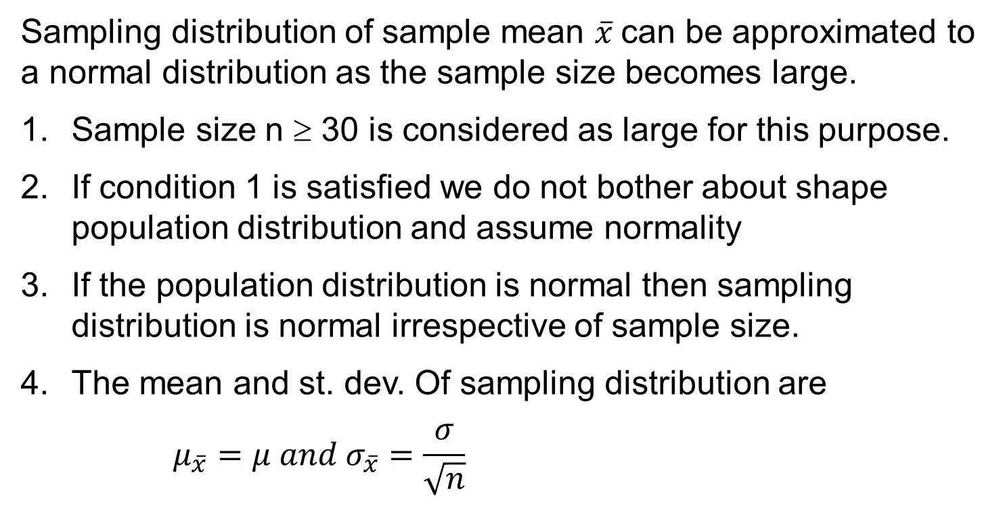
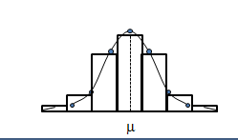
Sampling Distribution

Slide 11
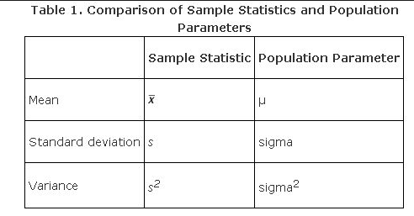
Point Estimation
Parameters are numbers that summarize data for an entire population.
This means the parameter tells us something about the whole population.
It is any numerical quantity that characterizes a given population
Statistics are numbers that summarize data from a sample, i.e. some subset of the entire population.

Slide 12
Point Estimation
Any Statistic can be a point estimate
A statistics is an estimator of some parameter in a population
eg.
The sample standard deviation (s) is a point estimate of the population standard deviation (σ).
The sample mean (̄x) is a point estimate of the population mean, μ
The sample variance (s2 is a point estimate of the population variance (σ2).

Slide 13
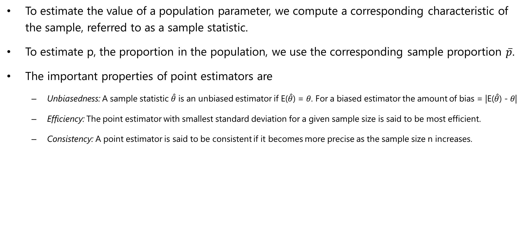
Point Estimation
To estimate the value of a population parameter, we compute a corresponding characteristic of the sample, referred to as a sample statistic.
To estimate p, the proportion in the population, we use the corresponding sample proportion $\overline{p}$.
The important properties of point estimators are
Unbiasedness: A sample statistic $\hat{θ}$ is an unbiased estimator if E($\hat{θ}$) = 𝜃. For a biased estimator the amount of bias = |E($\hat{θ}$) - 𝜃|
Efficiency: The point estimator with smallest standard deviation for a given sample size is said to be most efficient.
Consistency: A point estimator is said to be consistent if it becomes more precise as the sample size n increases.

Slide 14
Thank You

