Slide 1
Confidence Interval & Interval Estimation

Slide 2
Non-Probability Sampling
Central Limit Theorem
Interval Estimation
Confidence Interval

Slide 3
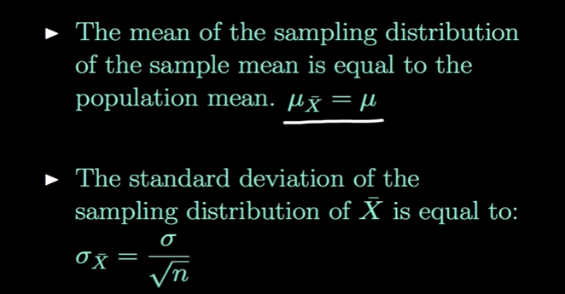
Central Limit Theorem
The Sample mean will be approximately normal distributed for large sample sizes, regardless of the distribution from which we are sampling
If the Population is normally distributed , then the mean of sample also normal distributed

Slide 4
Central Limit Theorem
 | Input | Sample | Mean
 | 3 | s1 | 3.5
 | 4 | s2 | 5
 | 6 | s3 | 2
 | 2 | s4 | 3
 | 4 | s5 | 4.5
 | 5 | s6 | 6.5
 | 8
 |  | Population mean | 4.083333
Mean | 4
 |  | S1 = 3+4

Slide 5
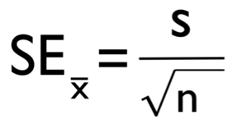
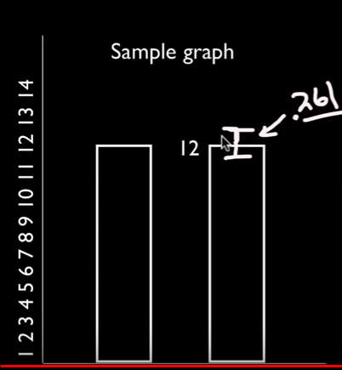
CLT : Standard Error
Standard error is the standard deviation of the sampling distribution of a statistic. It can be abbreviated as S.E.
The statistical inference involved in the construction of the confidence interval is mainly based on standard error.
S is std deviation, n sample size
 | Dataset 1 | Dataset 2
 | 9 | 10.9
 | 15 | 11.9
 |  | 12.2
 |  | 12.2
 |  | 12.9
 |  | 12.6
 |  | 12.3
 |  | 12.3
 |  | 12.5
 |  | 10.2
Mean | 12 | 11.4
Std dev | 4.242641 | 0.825967
Std error = std dev / sqrt(n) | 3 | 0.261194
It is the measure of precision

Slide 6
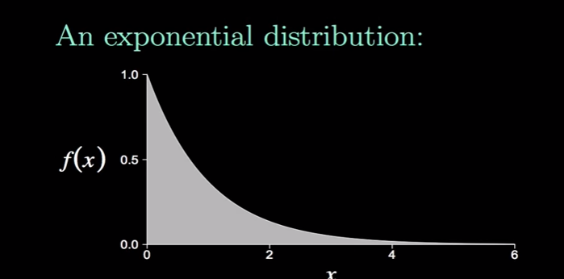
Central Limit Theorem – Graph based on samples

Slide 7
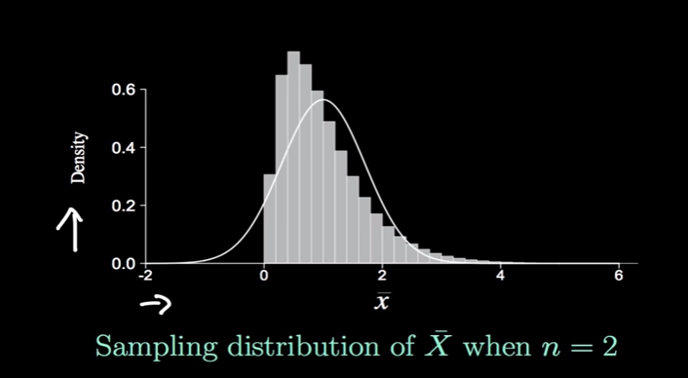
Central Limit Theorem – Graph based on samples

Slide 8
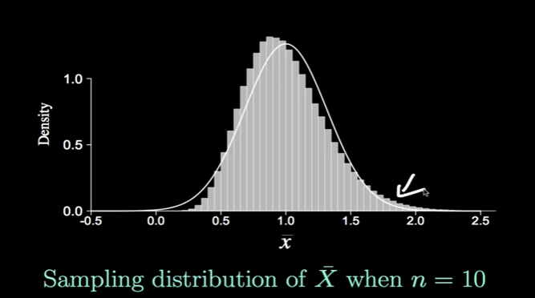
Central Limit Theorem – Graph based on samples

Slide 9
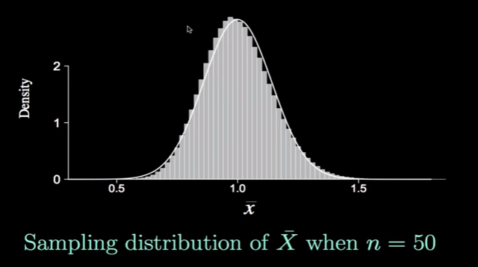
Central Limit Theorem – Graph based on samples
Sample mean to be appr. Normal distributed, sample size should be >= 30

Slide 10
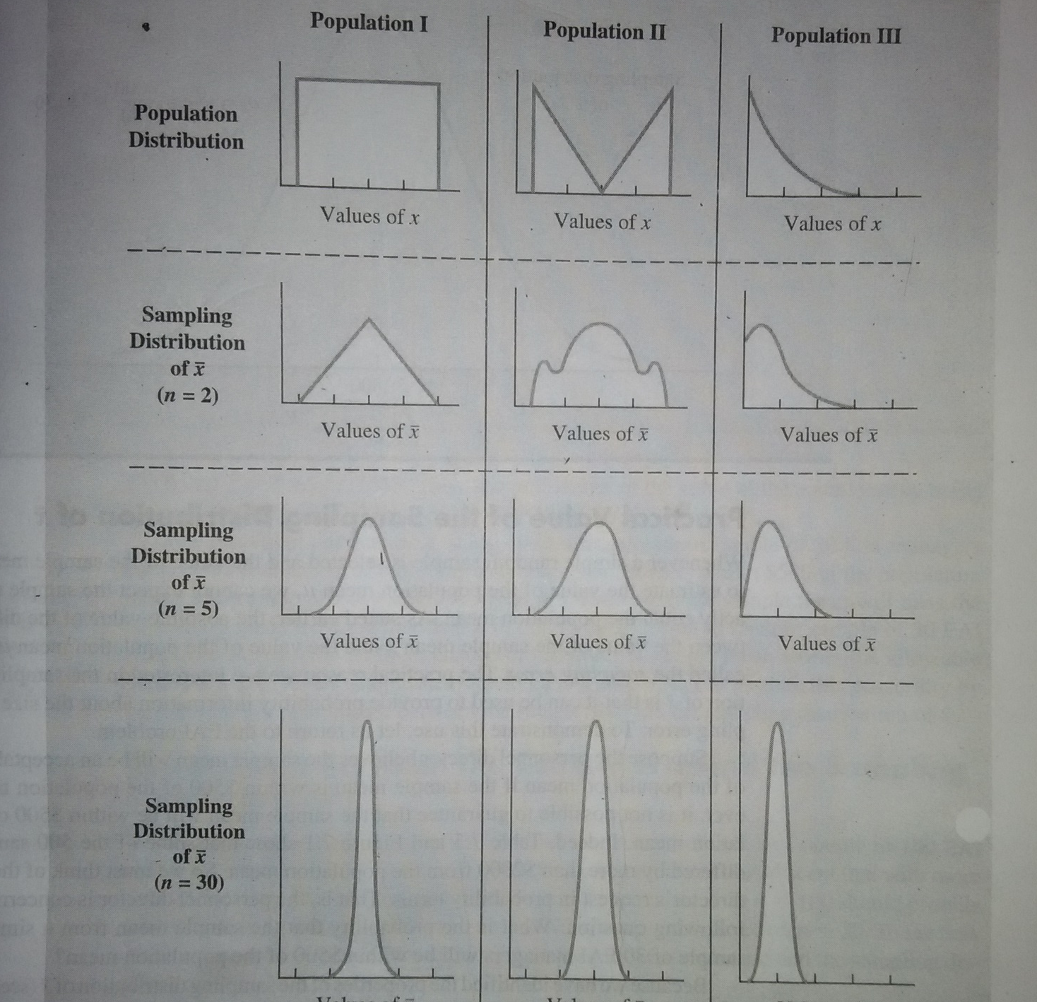
Central Limit Theorem
For Central Limit Theorem, Normal distributed data shape is not considered

Slide 11
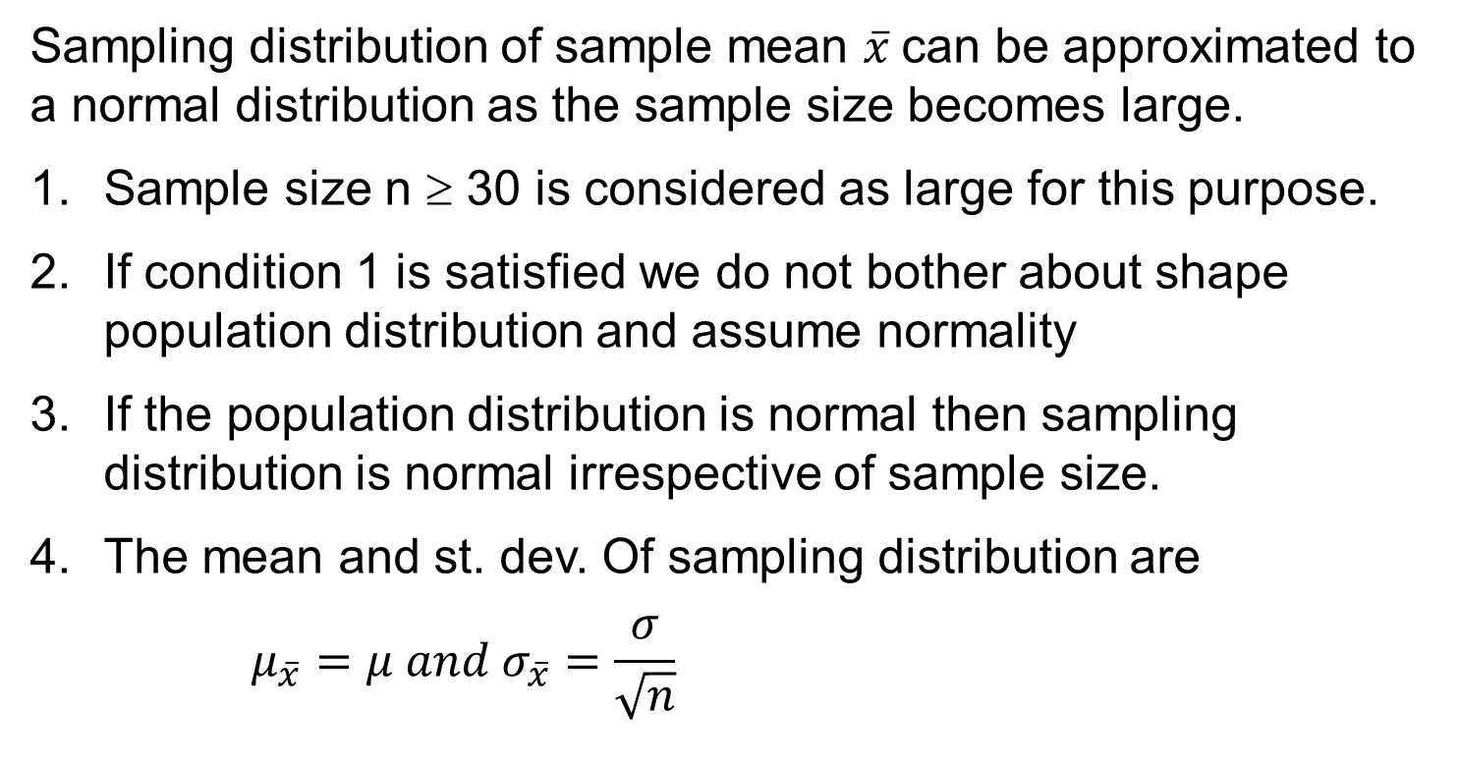
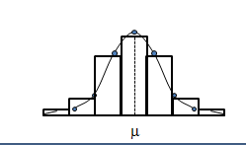
Sampling Distribution

Slide 12
Point Estimation
A point estimate of a population parameter is a single value of a statistic.
Example :
sample mean x is a point estimate of the population mean μ.
sample proportion p is a point estimate of the population proportion P.

Slide 13
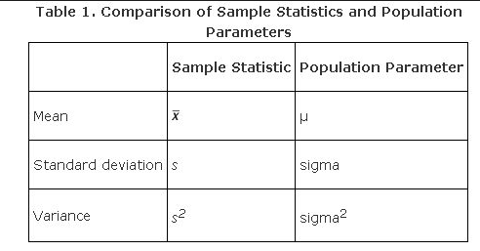
Point Estimation
Parameters are numbers that summarize data for an entire population.
This means the parameter tells us something about the whole population.
It is any numerical quantity that characterizes a given population
Statistics are numbers that summarize data from a sample, i.e. some subset of the entire population.

Slide 14
Interval Estimate
An interval estimate is defined by two numbers
Interval between which a population parameter is said to lie.
Example, a < x < b is an interval estimate of the population mean μ.
It indicates that the population mean is greater than a but less than b.

Slide 15
Confidence Interval
Statisticians use a confidence interval to express the precision and uncertainty associated with a particular sampling method .A confidence interval consists of three parts.
A confidence level.
A statistic.
A margin of error.

Slide 16
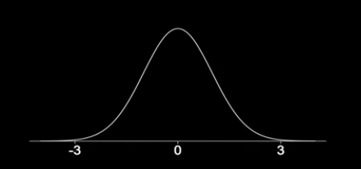
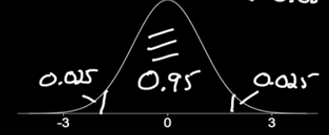
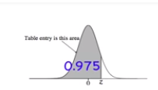
Calculate Confidence Coefficient for a given CI
What is the approximate z value for a 95% confidence Interval ?
(1- α) 100% = 95%
100%-100^{α} % = 95%
-100 α % =-5%
α = 5/100 = .05
α = 0.05
Area to the left of the required z value = 1- 0.025 =0.975 ;
Z α /2 (critical value) = 1.96

Slide 17

Calculate Confidence Coefficient for a given CI
Confidence level is expressed in % terms and confidence coefficient is expressed as a fraction. αis called level of significance.
To construct a 95% confidence interval
C. Coeff= (1- α) = 0.95; α = 0.05; α/2 = 0.25
CI = $\overline{x} ± Z_{\frac{α}{2}}\frac{σ}{\sqrt{n}}$
Zα/2 = is the z value providing an area of α/2 in the upper tail
Confidence Level | α | α/2 | Z_{α/2}
90% | 0.10 | 0.05 | 1.645
95% | 0.05 | 0.025 | 1.960
99% | 0.01 | 0.005 | 2.576

Slide 18
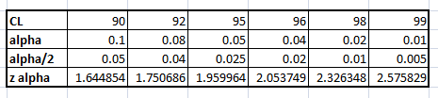
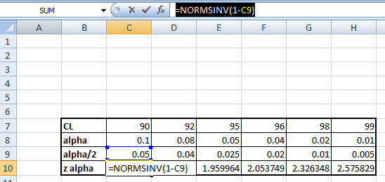
Z alpha/2 value using Excel

Slide 19
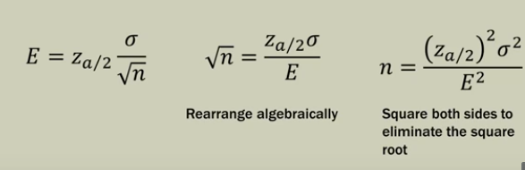


Margin of Error
In a confidence interval, range of values above and below the sample statistic is called the margin of error.
For example, suppose we wanted to know the percentage of adults that exercise daily. Well estimate will not differ from the true population value by more than, say, 5 percent (the margin of error) 90 percent of the time (the confidence interval)

Slide 20
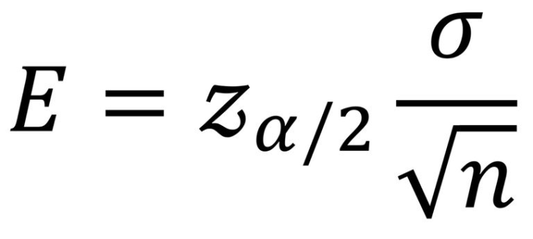
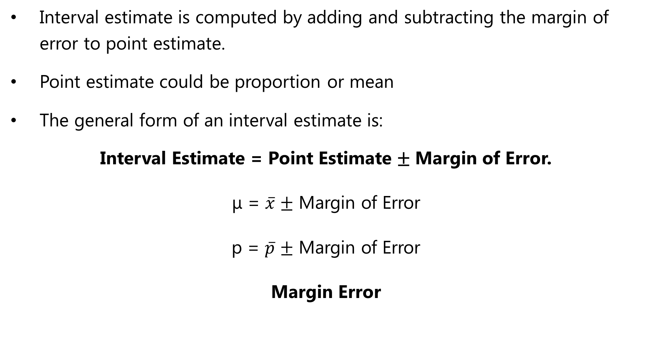
Interval Estimation
Interval estimate is computed by adding and subtracting the margin of error to point estimate.
Point estimate could be proportion or mean
The general form of an interval estimate is:
Interval Estimate = Point Estimate ± Margin of Error.
μ = $\overline{x}$ ± Margin of Error
p = $\overline{p}$ ± Margin of Error
Margin Error

Slide 21
Interval Estimation with Mean
Interval estimate of a population mean (σ known)
Where,
(1 - α) is the confidence coefficient
zα/2 is the z value providing an area of α/2
in the upper tail of the standard normal probability distribution.

Slide 22
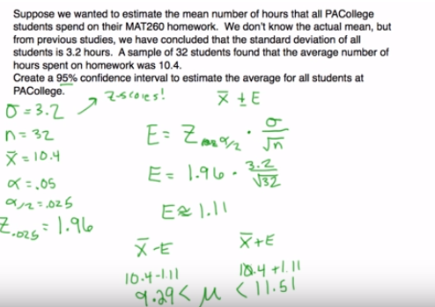
Confidence Interval Estimation with Mean - Example

Slide 23
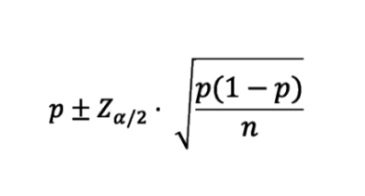
Confidence Interval for Population Proportion
The theory behind a confidence interval of proportion is the same as that for a mean
Each element in the population can be considered as success or failure
Means and proportions are equivalent, except that proportion data is limited to binary values (1s and 0s)

Slide 24
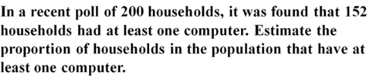

Estimating Population Proportion

Slide 25
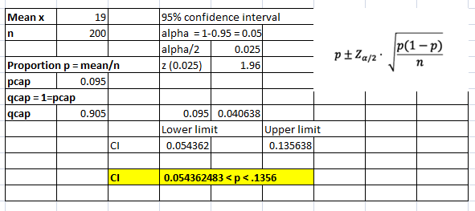
Confidence Interval for Population Proportion - example
A semi conductor manufacturer producers controllers used in automobile engine app. On random sample of 200 devices, found 19 are defective. Construct 95% confidence Interval around the true proportion defective.
Solution:

Slide 26
Confidence Interval
The standard deviation of a sampling distribution is called the standard error of the mean (basically they are measures of sampling variability or estimates of dispersion or spread).
A standard error generally has a level of confidence associated with it. You use the standard error of the mean to determine how close to the true population mean you can expect your sample mean to be and how much confidence you can place in that expectation.
To reduce the amount of sampling variability you can make your sample larger and more homogeneous.

Slide 27
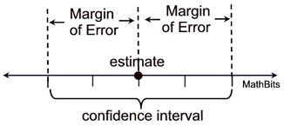
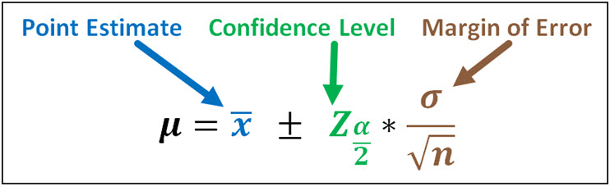
Confidence Level
Confidence levels are used when two sets of data are being compared.
A confidence level is the likelihood of obtaining a particular result by chance rather than due to a truly significant difference in the two sets of data.
A confidence interval addresses this issue because it provides a range of values which is likely to contain the population parameter of interest.
A 95% confidence interval means that there is a 95% chance that the confidence interval contains the population mean.

Slide 28
Calculate Confidence Interval using Margin of Error - Example
In a survey 200 males in USA work average 15.7 hrs/week. Marginal error is 2.2 hrs at a confidence level of 95%. Find the confidence interval ?
Solution :
x bar = 15.7 hrs/week Marginal error (M.E) = 2.2 hrs/week
Upper limit= 15.7+2.2 = 17.9
Lower limit = 15.7 -2.2 = 13.5
13.5
15.7
17.9
Confidence Interval 13.5 < µ < 17.9

Slide 29

Sample Size Determination
Choose a sample size large enough to provide a desired margin of error.
The quantity E = $z_{α/2}\frac{σ}{\sqrt{n}}$ is called margin of error
$$\sqrt{n}=z_{α/2}\frac{σ}{E}$$
Sample size, $n={{(z}_{α/2})}^{2}\frac{σ^{2}}{E^{2}}$
This sample size provides the desired margin of error at the chosen confidence level

Slide 30
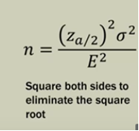
Sample Size Determination Example
How large a sample should be selected to provide a 95% confidence interval with the margin of error of 8? Assuming population, standard deviation is sigma = 36
Solution:
Confidence Level = 95%
Marginal Error = 8%
Population std. deviation = 36
= ((1.96)^2 * (36)^2) / (8^2)
= 77.8
n~ 78

Slide 31

Standard Error
Standard Error is a method of measurement or estimation of standard deviation of sampling distribution associated with an estimation method.
Total Inputs (N) = (10,20,30,40,50) Total Inputs (N) = 5
Mean (x_{m}) = 30
SD = 15.811
Standard Error = SD/ √(N) Standard Error = 15.811388300841896/√(5) Standard Error = 7.0711

Slide 32
Interval Estimation
Small Sample Cases: T- Distribution
When s is used to estimate σ, the margin of error and the interval estimate for the population mean are based on a probability distribution known as the t distribution.
When we have a sample of size < 30 and population standard deviation is unknown, in order to estimate population mean we use student “t” distribution with n-1 degrees of freedom.
Interval estimate of a population mean: σ Unknown

Slide 33
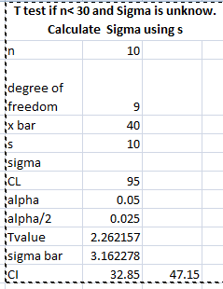
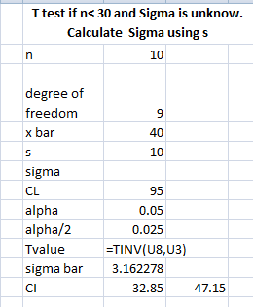
Interval Estimation using T test using excel

Slide 34
Thank You

