Slide 1
Hypothesis

Slide 2
Hypothesis
A hypothesis is an educated guess about something in the world around you.
It should be testable, either by experiment or observation.
Example :
A new medicine you think might work.
A way of teaching you think might be better.

Slide 3
Hypothetical Statement
If you are going to propose a hypothesis, it’s customary to write a statement.
Example :
If I (decrease the amount of water given to herbs) then (the herbs will increase in size).
If I (give patients counseling in addition to medication) then (their overall depression scale will decrease).
If I (give exams at noon instead of 7) then (student test scores will improve).

Slide 4
Hypothesis Testing
Hypothesis testing in statistics is a way for you to test the results of a survey or experiment
Hypothesis testing is a statistical method that is used in making statistical decisions using experimental data.
Hypothesis Testing is basically an assumption that we make about the population parameter.
A premise or claim that we want to test
Example : If I pour less water to the herbs, growth of the plant will increase in size. Size of herb should be measured and technically it should be proven

Slide 5
Types of Hypothesis : H0
Null hypothesis. the null hypothesis is always the accepted fact
Null hypothesis is denoted by; H0: μ1 = μ2, which shows that there is no difference between the two population means.
Example :
Shape of DNA is helix
Size of plant will increase based on watering
More time you spend in studying, more score student will get
Special training on student has great effect

Slide 6
Types of Hypothesis : Ha
Alternative hypothesis Contrary to the null hypothesis, the alternative hypothesis shows that observations are the result of a real effect.
Example :
Special training on student has no effect
Different Teaching method has no difference in students performance
Drug used for headache has no effect after medication

Slide 7
Hypothesis Testing
Hypothesis testing is a statistical method that is used in making statistical decisions using experimental data.
Hypothesis Testing is basically an assumption that we make about the population parameter.
A premise or claim that we want to test
Example :
A new medicine you think might work.
A way of teaching you think might be better.

Slide 8
Hypothesis Testing - Example
Test Type | Description | Ho / Ha
Testing Research Hypothesis | R&D dept has developed a new battery with higher Ah. The present performance is 80Ah. The new product has a higher performance. | Ho: μ ≤ 80
 |  | Ha: μ > 80
Validating a claim | A claim is made that average inflation rate is less than 6.76% | Ho: μ ≥ 6.76
 |  | Ha: μ < 6.76
Testing Decision making situations | Crime rate in North Chennai is different from that of South Chennai = 453/year | Ho: μ = 453
 |  | Ha: μ ≠ 453

Slide 9
Summary of H0 and Ha:
H_{o}: μ ≤ μ₀
H_{a}: μ > μ₀
H_{o}: μ ≥ μ₀
H_{a}: μ < μ₀
H_{o}: μ = μ₀
H_{a}: μ ≠ μ₀
The equality sign =, ≤, ≥ should always appear on Null Hypothesis side.
Always try to establish Alternate Hypothesis by rejecting Null Hypothesis.
The chance of erroneously rejecting Null Hypothesis when it is true is controlled by choice of confidence coefficient.

Slide 10
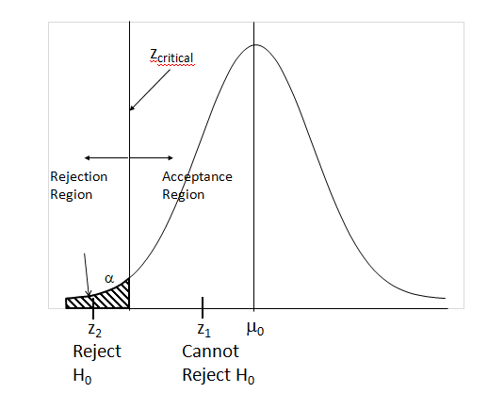
Hypothesis Testing – Identify Rejection area

Slide 11
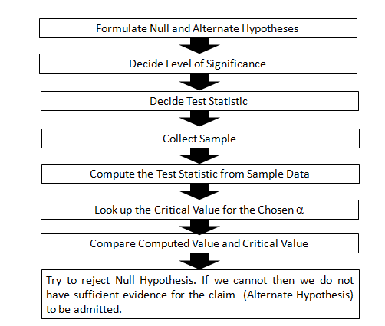
Hypothesis Testing Procedure

Slide 12
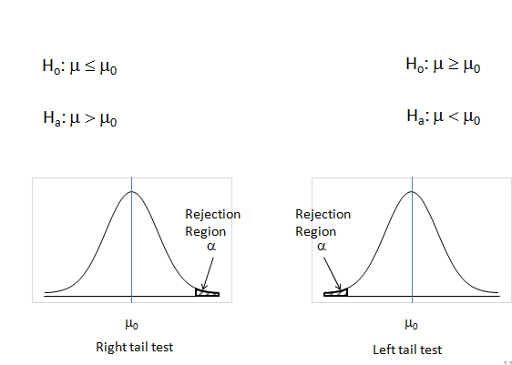
One Tail Test

Slide 13
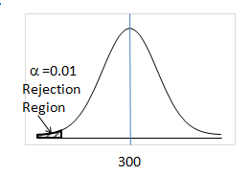
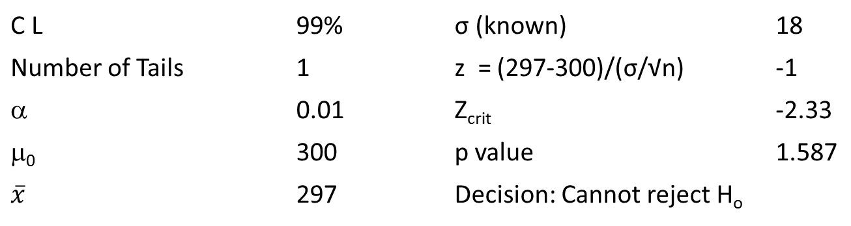
Left Tail Test
A consumer forum suspects that 300 gm pack of Narasu’s Coffee, is underweight. The forum wants to check this by collecting a sample and using a 0.05 level of significance.
H_{o}: μ ≥ 300(μ₀)
H_{a}: μ < 300(μ₀)
C L | 99% |  | σ (known) | 18
Number of Tails | 1 |  | z = (297-300)/(σ/√n) | -1
α | 0.01 |  | Z_{crit} | -2.33
μ₀ | 300 |  | p value | 1.587
 | 297 |  | Decision: Cannot reject H_{o}

Slide 14
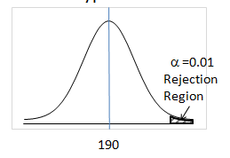
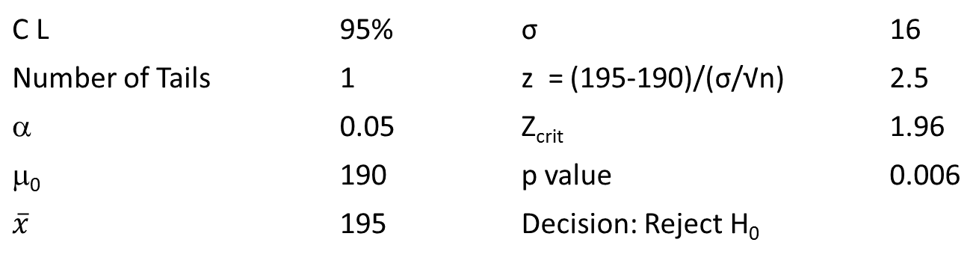
Right Tail Test
The Food Administration Authority received complaints that Maggi Noodle pack contains lead beyond permissible limits. The amount of lead should not exceed 190 gm. Conduct the Hypothesis test.
H_{o}: μ ≤ 190(μ₀)
H_{a}: μ > 190(μ₀)
C L | 95% |  | σ | 16
Number of Tails | 1 |  | z = (195-190)/(σ/√n) | 2.5
α | 0.05 |  | Z_{crit} | 1.96
μ₀ | 190 |  | p value | 0.006
 | 195 |  | Decision: Reject H₀

Slide 15
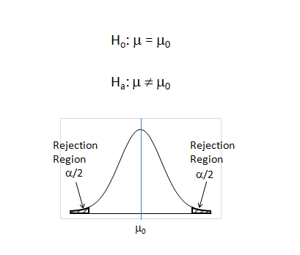
Two Tail Test

Slide 16
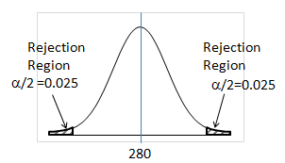
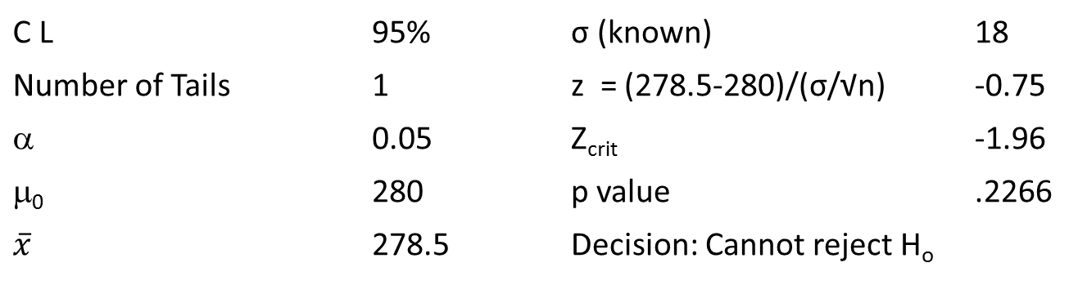
Two Tail Test - Example
The weight of a drug has to be critically controlled. If less, the drug may not be effective, if more it may have some side effects. The manufacturer of the drug wants ascertain that the weight of the capsule is 280 mg at 95% confidence.
H_{o}: μ = 280(μ₀)
H_{a}: μ ≠ 280(μ₀)
C L | 95% |  | σ (known) | 18
Number of Tails | 2 |  | z = (278.5-280)/(σ/√n) | -0.75
α | 0.05 |  | Z_{crit} | -1.96
μ₀ | 280 |  | p value | .2266
 | 278.5 |  | Decision: Cannot reject H_{o}

Slide 17
Bi Variant Hypothesis involving Two population

Slide 18
Types of Bi variant Test
Tests for mean and proportion
Independent Samples.
Large sample case (≥ 30)
Small sample case (< 30)
Matched Samples.
Large sample case (≥ 30)
Small sample case (< 30)
Variation:
σ Known or estimated.

Slide 19
Bivariate Tests – Tests for Mean Difference
Type | Sample Size | Test Statistic
Independent Sample | Large
Independent Sample | Small
Dependent Sample | Large
Dependent Sample | Small
Where D=X₁-X₂
Where D=X₁-X₂

Slide 20
Thank You Write us : annworks.in@gmail.com

