Slide 1
Chi Square

Slide 2
Bivariate Data
Bivariate data has two variables and studies relationship between them.
Examples:
Relationship between age and height
Relationship between profit and number of people employed.
The type of analysis used depends on the type of variables in the data set.
Dependent Var(y) | Independent Var(x) | Technique
Categorical | Categorical | Chi-Square
Continuous | Categorical | ANOVA
Continuous | Continuous | Regression

Slide 3
IMPORTANT TERMS
Parametric Tests
The tests in which the population constants like mean, standard deviation, standard error, correlation coefficient, proportion etc. are used and data tend to follow one assumed or established distributions such as normal, binomial, Poisson etc.
Non Parametric Tests
The tests in which no constant of population is used. Data do not follow any specific distribution and no assumptions is made in these tests. Eg. To classify good better and best we do not allot arbitrary numbers or marks to each category.
Hypothesis:
It is a definitive statement about population parameter.

Slide 4
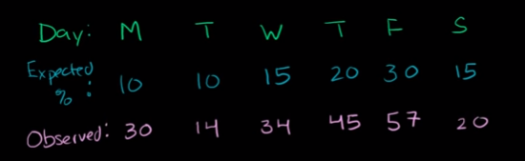
Chisquare Example
What is the distribution of the number of customers based on Days in a week ?

Slide 5
Hypothesis
H0 : Owners distribution is correct
Ha : Owners distribution is not correct

Slide 6
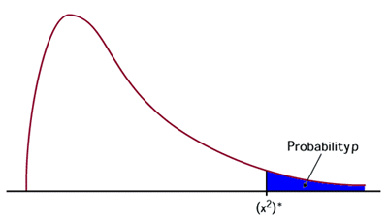
Chi Square (χ²) Test
The Chi Square test is a non-parametric Test
It tests relationship between two nominal variables
The statistic chi square is given by the equation and has a distribution as shown.
The conditions for using chi square
Data must be counts
The observations must be random and independent
None of the cells must have a count less than 5

Slide 7
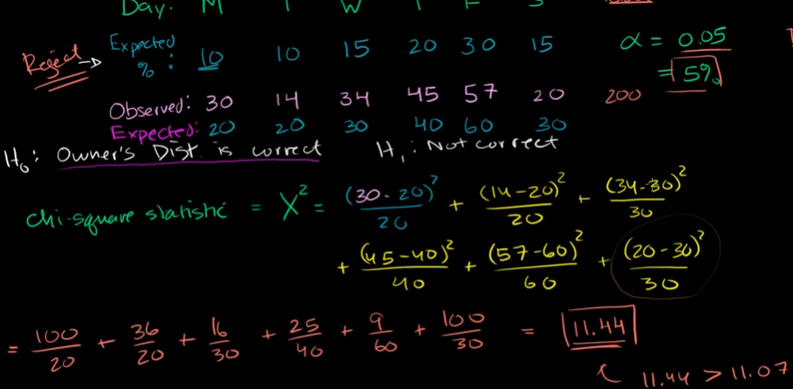
Hypothesis Inference
Inference :
Chi calculated > Chi critical;
Reject H0, Owners distribution is not correct

Slide 8
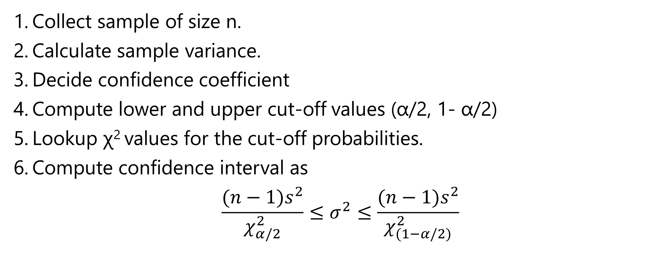
Steps in Interval Estimation of Population Variance
Collect sample of size n.
Calculate sample variance.
Decide confidence coefficient
Compute lower and upper cut-off values (α/2, 1- α/2)
Lookup χ² values for the cut-off probabilities.
Compute confidence interval as
$$\frac{(n−1)s^{2}}{χ_{α/2}^{2}}≤σ^{2}≤\frac{(n−1)s^{2}}{χ_{(1−α/2)}^{2}}$$

Slide 9
ChiSquare for One Varaince - example
A manufacturer of hard safety hats for construction workers is concerned about the mean and the variation of the forces its helmets transmits to wearers when subjected to an external force. The manufacturer has designed the helmets so that the mean force transmitted by the helmets to the workers is 800 pounds (or less) with a standard deviation to be less than 40 pounds. Tests were run on a random sample of n = 40 helmets, and the sample mean and sample standard deviation were found to be 825 pounds and 48.5 pounds, respectively.
Do the data provide sufficient evidence, at the α = 0.05 level, to conclude that the population standard deviation exceeds 40 pounds?

Slide 10
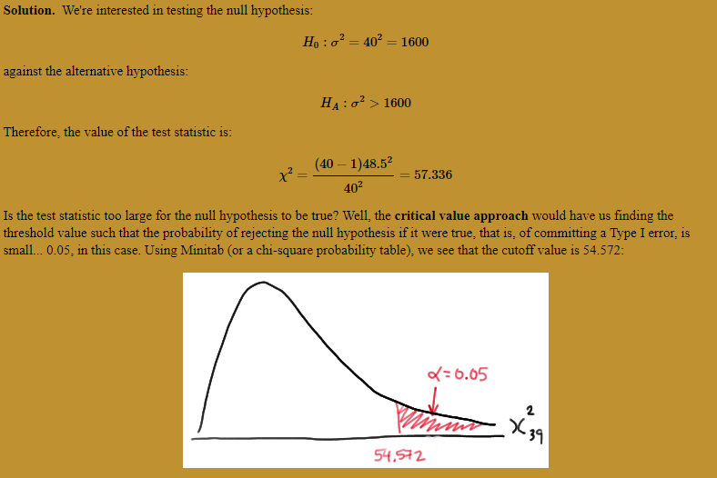
Chisquare One variance

Slide 11
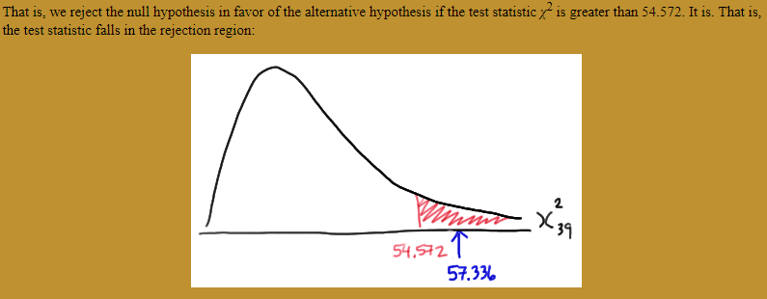
Chisquare One variance example - conclusion

Slide 12
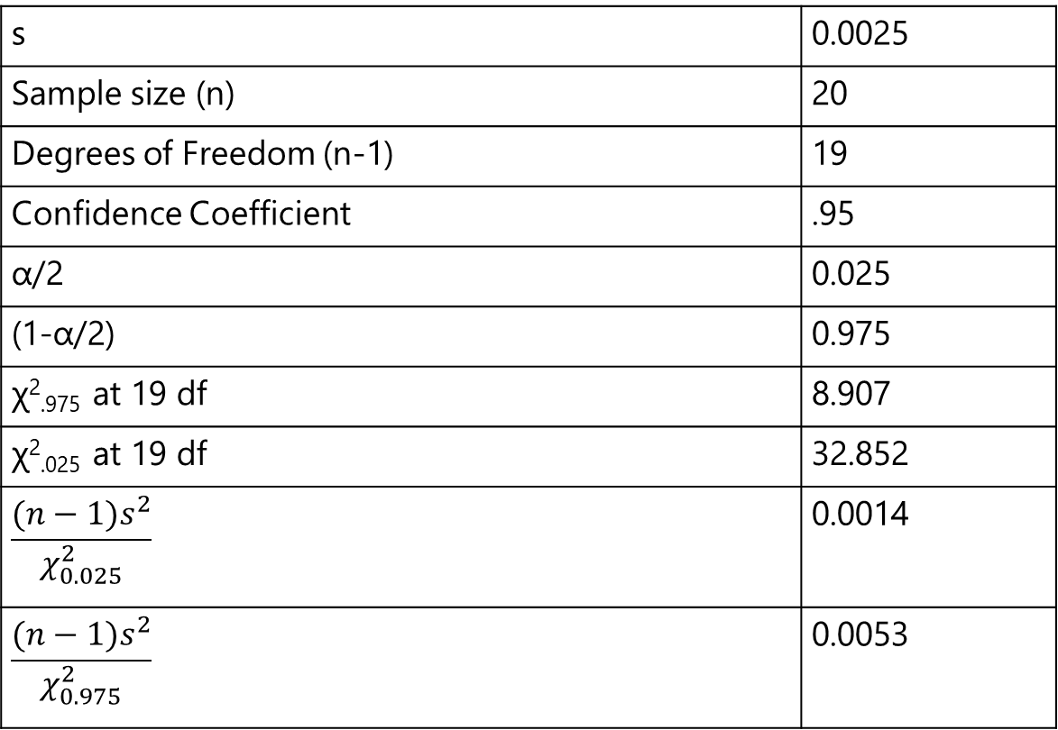
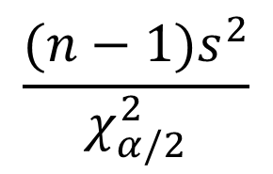
Estimation of Population Variance Example
Consider a sample of 20 machined parts. From the sample the variance in diameter was found to be 0.0025. What is the interval estimate for population variance?
s | 0.0025
Sample size (n) | 20
Degrees of Freedom (n-1) | 19
Confidence Coefficient | .95
α/2 | 0.025
(1-α/2) | 0.975
χ²_{.975} at 19 df | 8.907
χ²_{.025} at 19 df | 32.852
$$\frac{(n−1)s^{2}}{χ_{0.025}^{2}}$$ | 0.0014
$$\frac{(n−1)s^{2}}{χ_{0.975}^{2}}$$ | 0.0053
$$\frac{(n−1)s^{2}}{χ_{α/2}^{2}}$$

Slide 13
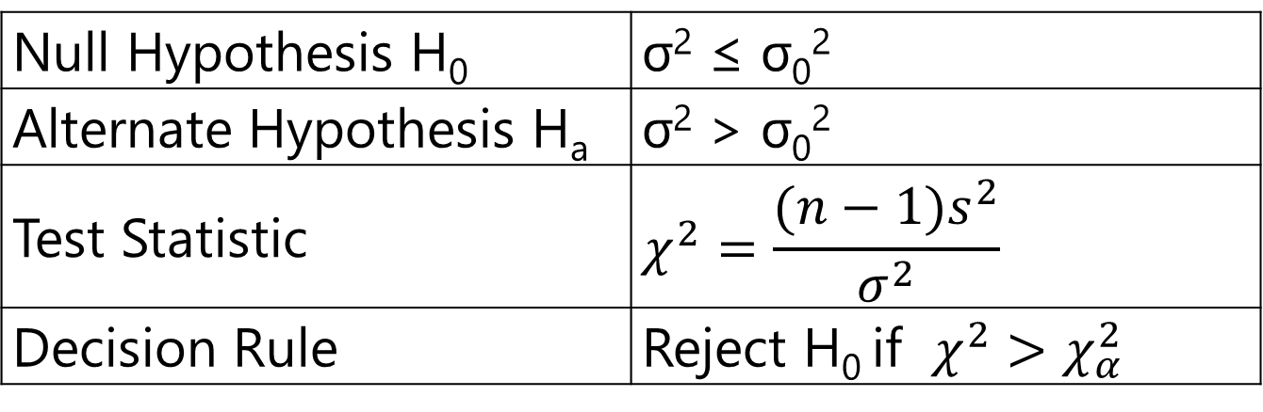
Hypothesis Testing of Population Variance – One Tail
Null Hypothesis H₀ | σ² ≤ σ₀²
Alternate Hypothesis H_{a} | σ²>σ₀²
Test Statistic | $$χ^{2}=\frac{(n−1)s^{2}}{σ^{2}}$$
Decision Rule | Reject H₀ if $χ^{2}>χ_{α}^{2}$

Slide 14
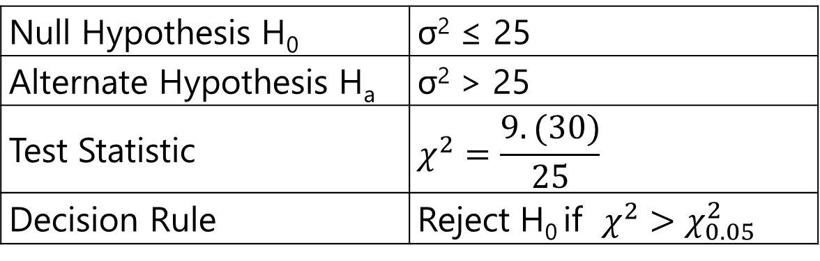
Hypothesis Testing Example - One Tail
MTC management felt that its fleets' on-time performance is poor with large variation in arrival times. The policy is that the variance in arrival time should not exceed 25 minutes. To ascertain the performance a sample of 10 arrivals is taken and a sample variance of 30 minutes was obtained. Conduct a test at 95% confidence.
Null Hypothesis H₀ | σ² ≤ 25
Alternate Hypothesis H_{a} | σ²> 25
Test Statistic | $$χ^{2}=\frac{9.(30)}{25}$$
Decision Rule | Reject H₀ if $χ^{2}>χ_{0.05}^{2}$

Slide 15
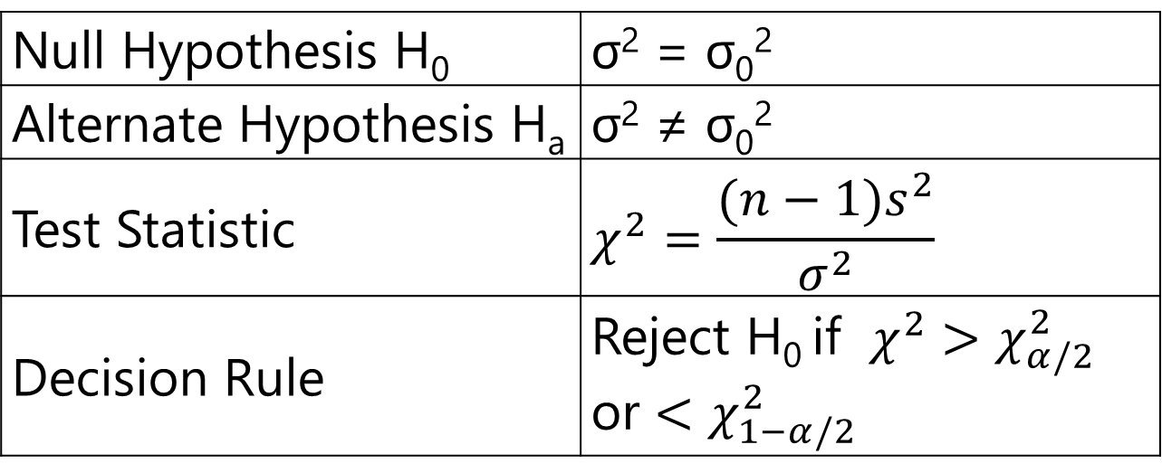
Hypothesis Testing of Population Variance – Two Tail
Null Hypothesis H₀ | σ² = σ₀²
Alternate Hypothesis H_{a} | σ² ≠ σ₀²
Test Statistic | $$χ^{2}=\frac{(n−1)s^{2}}{σ^{2}}$$
Decision Rule | Reject H₀ if $χ^{2}>χ_{α/2}^{2}$ or $<χ_{1−α/2}^{2}$

Slide 16
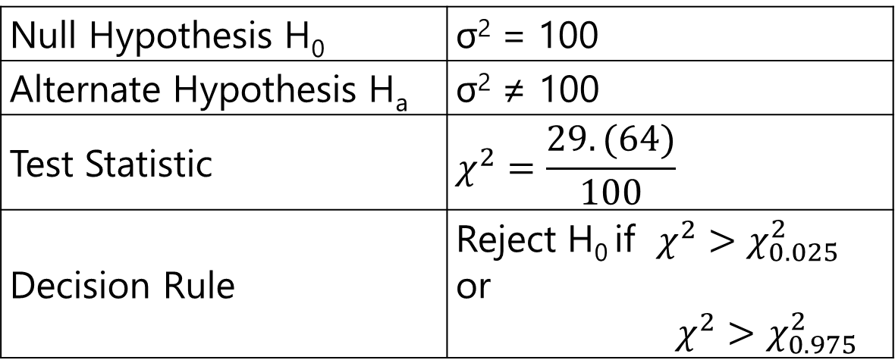
Hypothesis Testing Example - Two Tail
Academic councils regularly perform due diligence on question papers set by the faculty. The question papers are tested on a sample of students and if the variation is small the question paper is too easy or too difficult. If the variation is large, the question paper is likely to be vague. The expected variance is 100. The test was administered on 30 students and sample variance obtained was 64. Is there sufficient evidence for too small or too large variance at 95% confidence level?
Null Hypothesis H₀ | σ² = 100
Alternate Hypothesis H_{a} | σ² ≠ 100
Test Statistic | $$χ^{2}=\frac{29.(64)}{100}$$
Decision Rule | Reject H₀ if $χ^{2}>χ_{0.025}^{2}$ or $$χ^{2}>χ_{0.975}^{2}$$

Slide 17
CONDITIONS FOR APPLICATION OF χ² TEST
The following conditions should be satisfied before x2 test can be applied:
Data must be in the form of frequencies
The frequency data must have precise numerical value and must be organized into categories or groups
Observations recorded and used are collected on a random basis
All the items in the sample must be independent
No group should contain very few items, say less than 5. In case where the frequencies are less than 5, regrouping is done by combining the frequencies of adjoining groups so that the new frequencies become greater than 5. (Some statisticians prefer 10, but 5 is ok)
The overall number of items must also be reasonable, should at least be 30.

Slide 18
LIMITATIONS OF χ² TEST
The data must be from random sample
The expected frequencies any cell must be ≥ 5.
The accuracy falls if the total sample size < 30.
The test only detects presence or absence of association but not the strength of association
The test does not tell the cause and effect.
The sample observations are independent of each other.

Slide 19
Chi Square (χ²) Test - Analysis
 | OBSERVED
 | FINANCE | HR | MARKETING
ENGINEERING | 13 | 8 | 19 | 40
COMMERCE | 18 | 9 | 11 | 38
HUMANITIES | 6 | 9 | 7 | 22
 | 37 | 26 | 37 | 100
 | EXPECTED
 | FINANCE | HR | MARKETING
ENGINEERING | 14.8 | 10.4 | 14.8 | 40
COMMERCE | 14.06 | 9.88 | 14.06 | 38
HUMANITIES | 8.14 | 5.72 | 8.14 | 22
 | 37 | 26 | 37 | 100
CHISQ = 6.416208
CHISQ_{CRITICAL}= 9.487729

Slide 20
Thank You

