Slide 1
ANOVA

Slide 2
ANOVA Introduction
The term ANOVA stands for ANalysis Of VAriance. This technique is a part of the domain called experimental design.
It was invented by Sir Ronald Fisher, considered as “Father of Inferential Statistics”
It helps in establishing the Cause – Effect relation amongst the variables. It tests for equality of two or more populations.
Extensively used in analyzing the results in Regression Analysis.
Plays a key role in the branch of statistics called Experimental Design.

Slide 3
When Anova
Dependent Var(y) | Independent Var(x) | Technique
Categorical | Categorical | Chi-Square
Continuous | Categorical | ANOVA
Continuous | Continuous | Regression

Slide 4
ANOVA Introduction
Analysis of Variance is a statistical procedure that can be used to test if significant differences exists in the means of different populations.
Consider three populations with means µ₁, µ₂, µ₃ respectively. Using sample results we can set up the following NULL and ALTERNATE hypotheses.
Test:
If µ₁, µ₂, µ₃ are means three populations then
H₀ : µ₁ = µ₂ =µ₃
H_{a} : µ₁ ≠ µ₂ ≠ µ₃
ANOVA is used to determine whether the observed differences in the sample means are large enough to reject the NULL hypothesis.

Slide 5
ANOVA Assumptions
For each population, the response variable is normally distributed
The variance σ² of response variable is same for all the distributions.
The observations are independent of each other.

Slide 6
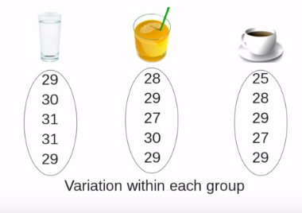
Anova Variance – Example 1
Numbers – reaction time of people after the drink

Slide 7
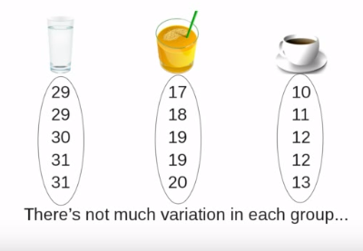
Anova Variance – Example 1

Slide 8
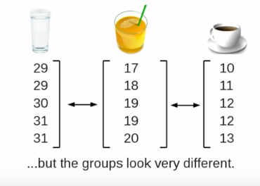
Anova Variance – Example 1

Slide 9
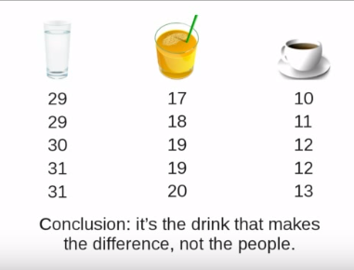
Anova Variance – Example 1
Variance within the group is less
Variance across the group is more.
Inference is : variation within the group is because of the people and not because of the drink

Slide 10
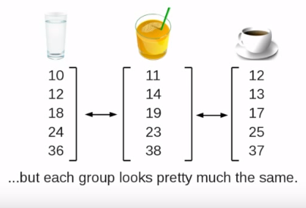
Anova Variance – Example 2

Slide 11
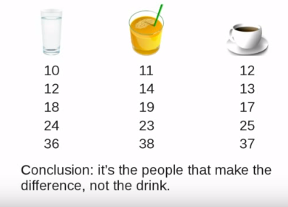
Anova Variance – Example 2
Variance within the group is more
Variance across the group is less.
Inference is : variation across the group is because of the drink and not because of the people

Slide 12
ANOVA Conceptual Overview
Sample means are close together when they come from one population when H₀ is true
X₁
µ
X₂
X₃
Sample means are not close together when they come from different populations when H₀ is not true
X₁
µ₁
µ₂
X₂
X₃
µ₃

Slide 13
ANOVA Conceptual Overview
Consider 3 populations with means µ₁, µ₂, µ₃ respectively and we have drawn one sample of size n from each.
If the means of the three populations are equal, we would expect sample means to be close together.
More the sample means differ more is the evidence that sample means differ.
In other words if variability amongst the sample means is small it supports NULL hypothesis, otherwise it supports H_{a}
If null hypothesis is true, then we can consider that each sample came from same normal distribution. In this case mean and variance would be
= (µ₁+µ₂+µ₃) and Var (σ²) = n(σ_{x̄}²)
This is called between treatments estimate.
(continued)

Slide 14
ANOVA Conceptual Overview
When H₀ is false, we have three sampling distributions. The means are not close together and the variance S_{x̄}² will be larger causing σ² to be larger.
In this case the pooled variance estimate is applied. Therefore
Var (σ²) = (s_{x̄}²+ s_{x̄}² +s_{x̄}² )/3
This is called within treatments estimate.
The ratio of between treatments estimate to within treatment estimate is called F ratio.
Larger the F ratio, more is evidence that the populations differ.

Slide 15
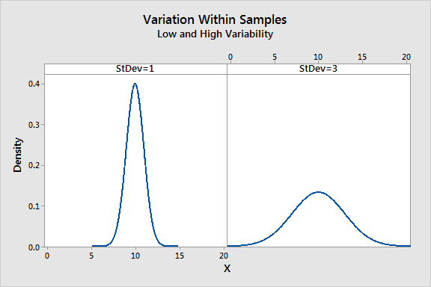
Anova F value
Total variance is calculated within the group and across the group.
It’s the ratio of 2 variance
Variance are measure of desperation, how far data is moved from the mean
Larger value represents greater dispersion
F = Between the groups / Within groups
Larger the ratio, more likely it is that group have different mean (reject H0)

Slide 16
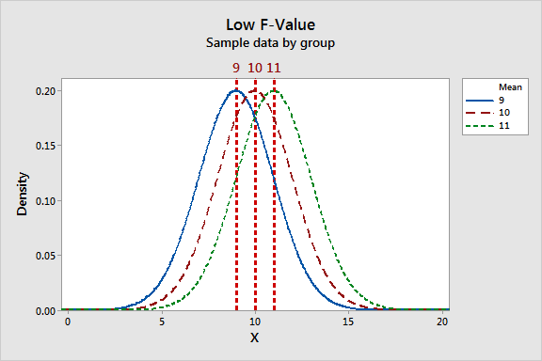
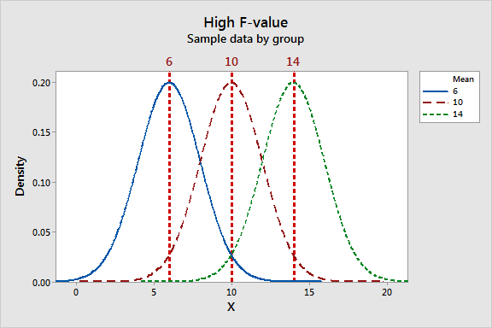
ANOVA F value : low or high
Lower the f value, group means are
Close together with low variability
Within each group
The high F-value graph shows a case where the variability of group means is large relative to the within group variability.

Slide 17
Calculate degree of freedom
F(b,w)
b- > df for variance between groups
W - > df for variance within the groups
b = number of groups -1
w = total number of observations - number of groups

Slide 18
Sum of Squares in ANOVA
In analysis of variance (ANOVA), the total sum of squares helps express the total variation that can be attributed to various factors. For example, you do an experiment to test the effectiveness of three laundry detergents.
The total sum of squares (SST) = treatment sum of squares (SSTR) + sum of squares of the residual error (SSE)
The treatment sum of squares is the variation attributed to, or in this case between, the laundry detergents. The sum of squares of the residual error is the variation attributed to the error.
Converting the sum of squares into mean squares by dividing by the degrees of freedom lets you compare these ratios and determine whether there is a significant difference due to detergent. The larger this ratio is, the more the treatments affect the outcome.

Slide 19
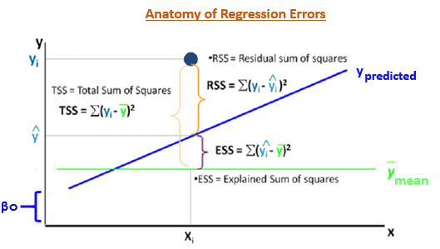

ANOVA Terminology
If there are n observations and k treatments
Total Sum of Squares (SST)
Total Degrees of Freedom $=n−1$
Sum of Squares due to Treatment (SSTR)
Treatment Degrees of Freedom $=k−1$
Mean Square due to Treatment (MSTR)
Sum of Squares due to Error (SSE) = $\sum_{i}{\sum_{j}{(x_{ij}−{\overline{x}}_{j})}}$
Error degrees of Freedom $=k−1$
Mean Square due to Error (MSE) $=\frac{\sum_{i}{\sum_{j}{(x_{ij}−{\overline{x}}_{j})}}}{k−1}$

Slide 20
ANOVA Table
Analysis of Variance
Source of Variation | Degrees of Freedom | Sum of Squares | Mean Square Error | F | P
Treatment | k - 1 | SSTR | MSTR = SSTR/(k-1) | MSTR/MSE
Error | n - k | SSE | MSE = SSE/(n-k)
Total | n - 1 | SST
Factorial ANOVA is used when the experimenter wants to study the interaction effects among the treatments

Slide 21
One Way ANOVA
Business Case:
An operations manager wants to buy a new machine. He has been using 3 models and would like to go for one which produced minimum % no. of defects. He collected the following data:
% Number of defects produced
Machine 1 | Machine 2 | Machine 3
15 | 10 | 17
14 | 14 | 12
20 | 9 | 14
15 | 10 | 15
16 | 11 | 12
Decision:
Is there a significant performance difference between machines?
If Yes, Which is the best performer?

Slide 22
ANOVA
Source | Sum of Squares | Degrees of Freedom | Mean Square | F | F Crit
Treatment | 68.8 | 2 | 34.4 | 7.53 | 3.89
Error | 54.8 | 12 | 4.566667
Total | 123.6 | 14

Slide 23
Two Way ANOVA
Business Case:
A super market has a chain of 5 stores. The General Manager is seriously concerned about quality of service at each stores. He conducted a survey on customer perceived quality on each day of the week.
Customer Rating on quality
Week Day | S1 | S2 | S3 | S4 | S5
MON | 79 | 81 | 74 | 77 | 66
TUE | 78 | 86 | 89 | 97 | 86
WED | 81 | 87 | 84 | 94 | 82
THU | 80 | 83 | 81 | 88 | 83
FRI | 70 | 74 | 77 | 89 | 68
Decision:
Is there a significant quality difference among the stores?
Is day of the week influencing the quality of service?

Slide 24
Two Way ANOVA
Source | Sum of Squares | Degrees Freedom | Mean Square | F | F Crit
Factor 1 (Store) | 461.76 | 4 | 115.44 | 6.53 | 3.01
Factor 2 (Day) | 617.36 | 4 | 154.34 | 8.74 | 3.01
Error | 282.64 | 16 | 17.665
Total | 1361.76 | 24

Slide 25
Thank You

