Slide 2
Antitrust Notice
The Casualty Actuarial Society is committed to adhering strictly to the letter and spirit of the antitrust laws. Seminars conducted under the auspices of the CAS are designed solely to provide a forum for the expression of various points of view on topics described in the programs or agendas for such meetings.
Under no circumstances shall CAS seminars be used as a means for competing companies or firms to reach any understanding – expressed or implied – that restricts competition or in any way impairs the ability of members to exercise independent business judgment regarding matters affecting competition.
It is the responsibility of all seminar participants to be aware of antitrust regulations, to prevent any written or verbal discussions that appear to violate these laws, and to adhere in every respect to the CAS antitrust compliance policy.

Slide 3
Pet Insurance
Image placeholder
Cute Risks, Complex Considerations
Notes:
Insert better image

Slide 4


Meet Your Presenters
Daniel Tevin
FCAS
Senior Actuarial Manager, Verisk
Sean Malloy
FCAS
Educator, Owner at FIR
Pricing Actuary at Nationwide Pet
Favorite Fictional Pet:
Favorite Fictional Pet:

Slide 5
Poll EV’s

Slide 6
Overview
Introduction
Your Property Is Sneezing:
Medical claims in a P&C line
Millennials Are Saving The Industry:
Explosive growth in an old product
Millennials Are Killing The Industry:
Changing behavior in pet owners
Image placeholder

Slide 7
U.S. Pet Insurance Market
A small, concentrated market growing fast
Market Share
5M
US pets insured
1982
First US policy written
80%
of insured pets are dogs
Inland Marine
Where the line historically sat
Notes:
Key message: this is a small market, highly concentrated, and much younger as a distinct product than most people assume.
Five million insured pets sounds large until you compare it to the roughly ninety million dogs and seventy-five million cats in US households. Penetration is low single digits, which is the gap that every growth projection in this market is built on.
1982 is the first US policy, written on Lassie. The product is forty-plus years old, but most of the premium has been written in the last decade.
Eighty percent dogs is a pricing fact, not a trivia fact. Dogs claim more often and more expensively than cats, so the mix drives the overall loss cost and any shift in mix moves the indication.
Historically filed as inland marine: pet had no line of its own, which is why market-wide data has been so hard to assemble and why the move to a distinct line matters.
On the chart, the top four carriers write about seventy percent of the market. Other is shown in gray so the concentration is easy to read. A market this concentrated means a few carriers' pricing decisions set the tone for everyone.
Check the market share figures and the insured pet count against a current source before presenting, since both move every year.

Slide 8


Coverage & Policy Structure
Health-style coverage, delivered through a P&C reimbursement policy
Coverage
Standard Policy
Accident
Base tier: lowest cost and utilization
Deductible, limit, coinsurance
Inflation leverages the insurer’s share
Accident + Illness
Most common policy: chronic and recurring claims
Pre-existing exclusions
The biggest single cost control
Waiting periods
First defense against anti-selection
Wellness / Preventative Care
Predictable, not fortuitous; often sold separately
Bilateral exclusions
A frequent source of complaints
Notes:
Key message: what pet insurance covers looks like health insurance, but how it pays looks like a P&C reimbursement policy. Both sides of this slide are pricing levers.
Coverage tiers, top to bottom: accident-only is the entry product, with the lowest cost and the lowest utilization. Accident plus illness is what most people actually buy, and it is where the chronic and recurring claims live. Each step up adds cost, adds utilization, and changes who selects into the product.
Wellness and preventative care is shown separately on purpose. Routine exams, vaccines and dental cleanings are scheduled, predictable purchases rather than fortuitous losses, so they behave more like a budgeting plan than insurance. The NAIC model act requires wellness to be sold and disclosed separately from insurance for that reason.
Policy terms, as loss-cost levers. Deductible, limit and coinsurance: with vet costs rising faster than general inflation, fixed-dollar deductibles and limits erode and the insurer's share of each claim grows every year.
Pre-existing condition exclusions are the single biggest cost control in the product. How a pre-existing condition is defined does more to the loss cost than most rating variables.
Waiting periods are the first line of defense against anti-selection, stopping someone from buying coverage on the way to the vet.
Bilateral exclusions, where a condition on one side is treated as pre-existing for the other, such as cruciate ligament tears, are actuarially sound but are one of the most frequent sources of consumer complaints.
Ask the room: which of these terms would you expect a regulator to challenge first?

Slide 9
Your Property is Sneezing
Medical claims in a P&C line
Pet insurance operates within a traditional P&C framework while managing risks that closely resemble human health insurance.
What happens when the thing you insure can get sick, and the bill is written by a doctor?
Image placeholder

Slide 10


Health Risk, P&C Rules
Pet insurance prices health-like risk under P&C rules
Health: The Risk
P&C: The Rules
Medical cost inflation
Age-driven risk progression
Chronic condition management
Provider utilization considerations
Behavioral and anti-selection dynamics
State-specific filing requirements
Traditional ratemaking
Loss ratio and reserving discipline
Indemnity reimbursement structure
Underwriting-driven pricing
Notes:
Key message: pet insurance is a health-shaped risk living inside a P&C chassis. Everything challenging about this line comes from that mismatch, and the rest of this section works through it.
Read the slide as pairs, left to right. Medical cost inflation runs into state-specific filing requirements: veterinary costs rise faster than general inflation, but the rate that recognizes that has to clear a filing process built for property and liability trends.
Age-driven risk progression runs into traditional ratemaking: loss cost climbs steeply with the age of the pet, so a rating plan built around a one-year policy term has to reflect a lifetime cost curve.
Chronic condition management runs into loss ratio and reserving discipline: diabetes, allergies and arthritis recur every renewal, which strains the assumption that policy years are independent.
Provider utilization runs into the indemnity reimbursement structure: there is no network and no negotiated fee schedule, so the insurer reimburses whatever the vet charges and has very little control over the cost of a claim.
Behavioral and anti-selection dynamics run into underwriting-driven pricing: who buys, who renews and who claims is driven by owner behavior as much as by the pet, and the underwriting tools available are limited.
Where this goes next: we will look at that mismatch through three lenses in turn, product design, pricing, and regulation, and we will come back to these same pairings each time.

Slide 11




Why Product Design Matters
Small design changes can materially affect profitability
Richer coverage drives higher utilization
Simpler products improve consumer understanding
Medical inflation pressures coverage limits and deductibles
P&C pricing must remain actuarially sound despite health-like claim dynamics
Notes:
Key message: product design is not just a marketing decision. In pet insurance, small changes to coverage terms can move loss ratios materially, so actuaries need a seat at the product design table.
Richer coverage drives higher utilization: this is the classic moral hazard and induced-demand effect. When wellness or preventive care is covered, owners visit the vet more often. That changes frequency, not just severity.
Simpler products improve consumer understanding: fewer options and clearer terms reduce complaints and disputed claims, and can improve retention. It also supports regulatory review. Rate and form filings under P&C oversight go more smoothly when the product is easy to explain.
Medical inflation pressures limits and deductibles: veterinary costs have been rising faster than general inflation. Fixed-dollar deductibles and limits erode in real terms, so the insurer's share of each claim grows every year. This is the deductible and increased-limits leveraging effect.
P&C pricing must stay actuarially sound: pet insurance is filed and regulated as P&C, but its claims look like health claims. They recur, grow with age, and are driven by chronic conditions. Standard P&C tools such as trending, loss development, and credibility still apply. But assumptions like independence between policy years or a short tail may not hold, and the rating framework must still meet the Statement of Principles Regarding P&C Insurance Ratemaking.
Tie-back for the audience: none of this needs new actuarial theory. It is the exam syllabus toolkit applied to a product where health-style dynamics sit inside a P&C framework.

Slide 12



Pricing a Hybrid Risk
Health-style claims, P&C-style rules: pricing must bridge both
Age curves shape lifetime loss cost, not just year‑one premium
Chronic conditions persist and recur at each renewal
Wellness care is predictable, not a fortuitous risk
Notes:
Key message: pet insurance is priced with P&C tools, but the claims behave like health claims. The pricing job is to bridge the two without breaking either framework.
Age curves shape lifetime loss cost: claim frequency and severity rise steeply with age, so the rate that is adequate at year one is badly inadequate at year eight. If you price only the first year, you build in a guaranteed shortfall and a book that gets worse as it matures. This is a classic ratemaking question about the exposure period and trend, applied to an aging exposure base.
Chronic conditions persist and recur: once a pet develops diabetes, allergies or arthritis, the claims repeat every year. That breaks the independence-between-policy-years assumption behind much standard P&C work. Pre-existing condition definitions, not the rate, are often what controls this cost, which is exactly why product design and pricing cannot be separated.
Wellness care is predictable, not fortuitous: routine exams, vaccines and dental cleanings are scheduled purchases, not random losses. Pricing them is closer to a financing arrangement with an expense load than to insurance. Many states require these to be sold as a separate plan for that reason.
Tie-back: the toolkit is familiar. Trend, development, credibility and classification all still apply. What changes is which assumptions hold. Ask the room which of these three dynamics they think is hardest to reflect in a filed rate.

Slide 13



Regulating a Hybrid Product
Health-style pricing meets P&C regulatory scrutiny
Age factors raise renewal rates, but regulators resist automatic trend
Pricing on utilization draws regulatory pushback
Health-style exclusions and waiting periods require P&C-style disclosure
Notes:
Key message: the pricing logic that makes actuarial sense for pet insurance is the same logic that draws the most regulatory scrutiny, because this product is filed and reviewed as P&C.
Age factors raise renewal rates: the loss cost genuinely rises with age, but a rating plan that increases a policyholder's premium every year purely for getting older looks like a renewal penalty to a regulator. Expect questions about whether the increase is supported by data rather than by an assumed trend
Pricing on utilization draws pushback: using a pet's own claim history is intuitive to an actuary and looks like experience rating. To a regulator it can look like penalizing people for using the coverage they bought. This is where the distinction between a prohibited utilization factor and an allowed claims-free discount matters, and it is a big part of why the same rating idea gets different answers in different states.
Exclusions and waiting periods need disclosure: pre-existing condition language, bilateral exclusions and waiting periods are the most common source of consumer complaints in this line. The NAIC Pet Insurance Model Act pushes those terms into plain-language disclosure at the point of sale. The actuarial point is that the exclusion is a pricing assumption, so if disclosure or regulation narrows it, the rate has to move with it.
Tie-back: the pricing question and the filing question are the same question here. Ask the room how they would support an age curve in a rate filing when the regulator sees it as an automatic increase.

Slide 14
Millennials Are Saving The Industry
Explosive growth in an old product
More than forty years since the first policy (Lassie, 1982)
What do you do when the book doubles before the losses do?
Image placeholder

Slide 15




Growth Without Innovation
Exposure is booming; product design is not
New carriers and subsidiaries enter on low rates, not new products
Copycat coverage leaves price as the main way to compete
Penetration stays low: cost, confusion, exclusions
Distribution is innovating; the products themselves are not
Notes:
Key message: the market has grown dramatically, but the product itself has barely changed. Growth has come from more people buying roughly the same policy, not from better policies.
New carriers enter on low rates: much of the recent entry is new subsidiaries and MGA-backed programs competing on price rather than on coverage. New entrants have no loss history of their own, so early rates lean on industry assumptions and are often optimistic.
Copycat coverage leaves price as the lever: most products look alike, with similar annual limits, deductibles, reimbursement percentages and exclusions. When coverage is undifferentiated, competition collapses to price, which pressures margins across the whole market.
Penetration stays low: only a small share of US pets are insured. The barriers are cost, confusion about what is covered, and the exclusions people discover at claim time. That is a product design problem as much as a marketing one.
Distribution is innovating, products are not: the real innovation is in how the product is sold, through employee benefits, adoption and vet-point sales, and embedded offers. That changes the mix of who buys, which changes the risk, even when the policy form is unchanged.
Tie-back: ask the room what a genuinely differentiated pet product would look like, and what it would take to price one with no relevant history.

Slide 16



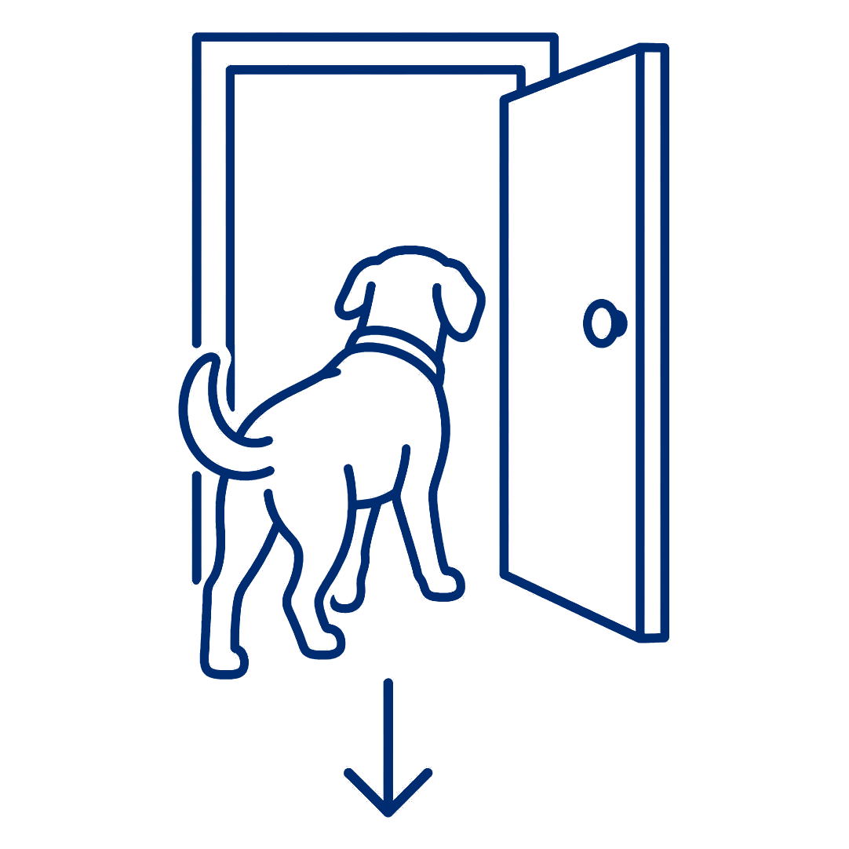
Pricing a Fast-Growing Book
Growth outran the data; pricing must catch up
Thin loss history made adverse selection common and costly
Growth strains adequacy: file rate increases early and often
New data makes sophisticated pricing possible and necessary
Big increases push healthy pets out, worsening the pool
Notes:
Key message: the book grew faster than the data. Every pricing decision here is made on experience that is thin, immature, or no longer representative of the current book.
Thin loss history and adverse selection: early in a program, the people most eager to buy are often the ones who already expect a claim. With little credible history, that selection is hard to see until it shows up in the loss ratio. Standard credibility methods apply, but the complement of credibility is doing most of the work.
Growth strains adequacy: a fast-growing book means a large share of exposure is new and priced on assumptions rather than experience. If rate need appears, the honest answer is to file early and often, because waiting lets inadequacy compound across a bigger book.
New data makes better pricing possible: breed, age, geography, and vet cost data are far richer than they were a decade ago. Multivariate methods that were impractical on a small book are now both feasible and necessary, and a carrier that does not use them will be selected against by one that does.
Big increases push healthy pets out: this is the anti-selective lapse problem. Large increases are most likely to be accepted by owners who expect to claim, so the pool deteriorates and the next indication is worse. It is why the size and pace of increases matter as much as the total.
Tie-back: growth hides pricing errors, and it hides them longer than most of us are comfortable with. Ask the room how they would set a rate level when most of the exposure has no mature history.

Slide 17



Regulation Catches Up
Rapid growth is earning pet insurance its own rules
Pet is only now becoming its own line with regulatory distinction
More states continue to adopt the NAIC Pet Insurance Model Act
Disclosure and consumer protection rules keep evolving
Notes:
Key message: regulation is catching up with the market. Pet insurance is moving from an afterthought inside other lines to a product with its own rules.
Pet is becoming its own line: historically pet was reported inside inland marine or other liability, which made market-wide data hard to assemble. As it gains its own statistical identity, regulators and actuaries both get better visibility, and carriers get more scrutiny.
States continue to adopt the model act: the NAIC Pet Insurance Model Act was adopted in 2022 and states have been enacting versions of it since. It standardizes definitions of pre-existing condition and waiting period, requires plain-language disclosure, separates wellness plans from insurance, and adds producer training requirements.
Disclosure rules keep evolving: the direction of travel is clear, more disclosure at point of sale and less room for exclusions that surprise the consumer at claim time. Each of those requirements is a constraint on the product, which makes it a constraint on the rate.
Tie-back: the practical message is that the regulatory framework is still being written, so assumptions about what is allowed should be revisited every filing season, not set once.

Slide 18
Millennials Are Killing The Industry
Dramatic inflation and behavior growth
Higher vet costs, more advanced treatment, increased utilization, and greater consumer demand are pushing claim costs up faster than the book is growing.
What happens when pets get human-grade medicine, and owners want to use all of it?
Image placeholder

Slide 19




Designing for Better Care
Rising care standards reshape what policies must cover
Insureds increasingly expect the “gold standard” of care
Having coverage itself drives utilization and inflation
Coverage must keep pace: telemedicine, rehab, alternative care
Fixed deductibles and limits erode as vet costs rise
Notes:
Key message: what owners now expect from veterinary care has changed, and the policy has to keep up with it. This is a coverage design problem created by outside forces.
The gold standard expectation: MRIs, oncology, specialty surgery and referral hospitals are now routine requests, not exotic ones. Owners increasingly ask for the best available treatment rather than the most economical one, and the presence of a policy makes that ask easier.
Coverage itself drives utilization: this is induced demand, the same effect seen in health insurance. An insured owner visits the vet sooner, accepts more diagnostics and approves more treatment. It raises frequency and severity at once, and it means a coverage change needs its own utilization load rather than a pro-rata cost estimate.
Coverage must keep pace: telemedicine, rehabilitation and physical therapy, and alternative treatments like acupuncture were edge cases a few years ago and are mainstream requests now. A form that is silent on them creates disputes; a form that covers them without pricing them creates losses.
Fixed deductibles and limits erode: when vet costs rise faster than general inflation, a fixed-dollar deductible covers a smaller share of each claim and a fixed annual limit caps less of it. The insurer's share grows every year with no change in the policy. This is the leveraged effect of inflation on deductibles and limits, and it argues for indexing or regular review.
Tie-back: ask the room which of these they think their current rating plan actually reflects, and which is being absorbed silently in the loss ratio.

Slide 20




Pricing a Rising Cost Curve
Severity and frequency are climbing at the same time
Costlier medicine plus higher utilization hits rates twice
Utilization signals owner behavior more than pet health
DOIs deny utilization rating but allow “claims free”
Fast-changing veterinary care dates ratemaking assumptions
Notes:
Key message: this is a one-two punch. Severity is rising because veterinary medicine is more advanced and more expensive, and frequency is rising because insured owners use more of it. Most pricing frameworks are built to absorb one of those at a time.
Costlier medicine plus higher utilization: trending severity alone understates the problem, because the frequency trend is moving in the same direction for behavioral reasons rather than for risk reasons. Rate need compounds faster than a single trend factor suggests.
Utilization signals owner behavior: this is the subtle point. A pet's claim history is partly a signal of underlying health, but it is much more a signal of the owner's willingness to take the pet to a vet. Two identical pets with different owners produce very different claim counts, and that owner effect is persistent and predictive, which is exactly why it is such a useful and such a contested rating variable.
DOIs deny utilization but allow claims free: regulators generally reject rating directly on utilization as penalizing people for using coverage, while permitting a claims-free discount that captures much of the same signal from the other direction. The economics are similar, the framing is what differs, and knowing that distinction is worth a lot in a filing.
Rapid change dates assumptions: when treatment patterns shift every few years, historical loss data describes a different product being delivered to a different standard of care. Development patterns and trend selections based on older years need to be questioned rather than rolled forward.
Tie-back: ask the room how they would separate the pet's risk from the owner's behavior in a rating plan that a regulator will accept.

Slide 21


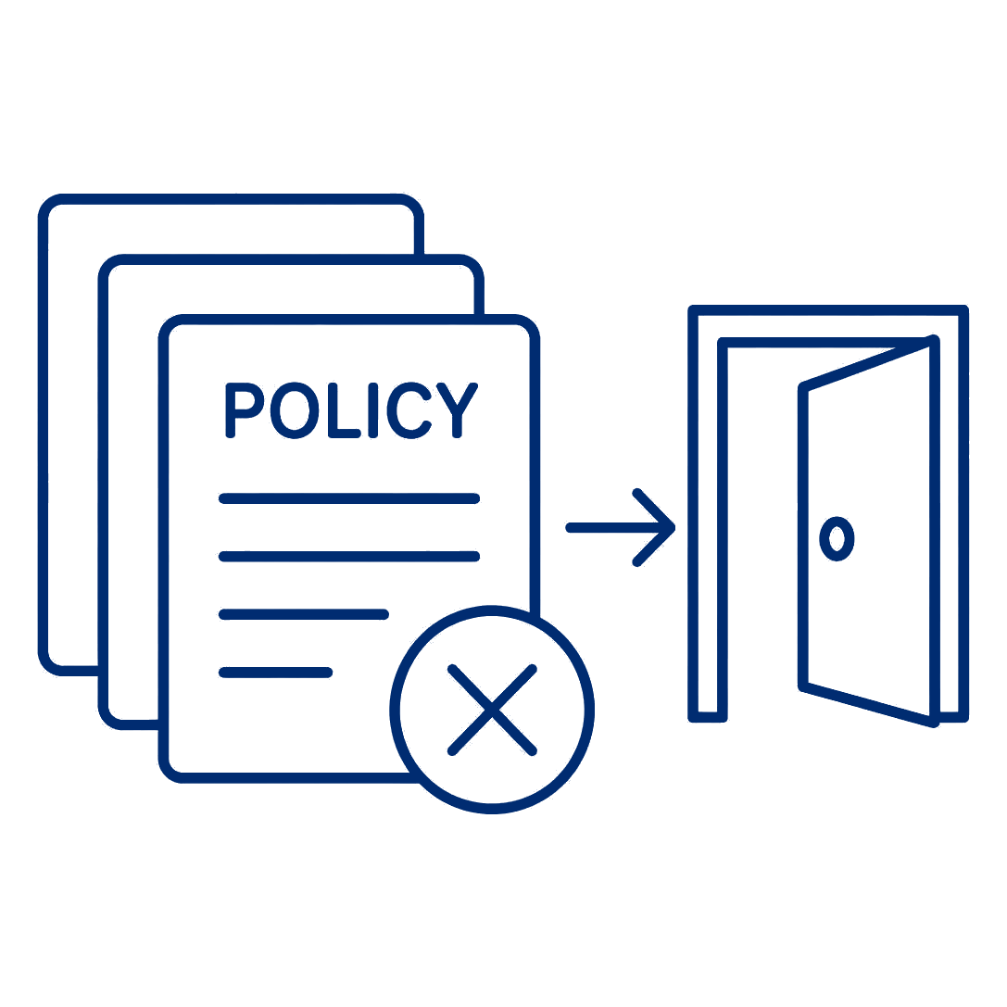
Rate Need Meets Rate Approval
Cost pressure collided with the rate approval process
Every carrier needed steep rate increases at once
Many states denied or capped the filings that were needed
The result was mass non-renewals and shrinking availability
Notes:
Key message: this is what happens when genuine rate need meets a rate approval process that was not expecting it. The actuarial answer and the regulatory answer diverged, and consumers felt the result.
Every carrier needed increases at once: because the cost pressure was industry-wide rather than company-specific, indications moved together and in large amounts. A filing that looks extreme on its own looks very different when every carrier in the market is filing something similar.
States denied or capped the filings: prior approval states in particular pushed back on the size of increases, and some approved only a portion of the indication. A partially approved increase does not remove the rate need, it defers it and makes the next filing larger.
The result was non-renewals: when a carrier cannot get an adequate rate, the remaining levers are underwriting restrictions, withdrawal from a state, or mass non-renewal. That converts a rate adequacy problem into an availability problem, which is a worse outcome for the consumer than the increase would have been.
Tie-back: this is the core tension in rate regulation, affordability now against availability later. Ask the room what they would have filed, and what they would have done if half of it came back approved.

Slide 22
Questions?
Thank you
We would love to hear your questions, pushback, and pet insurance stories.
Daniel Tevin, FCAS | Sean Malloy, FCAS
Image placeholder

Slide 23
Accessibility
& Presentation Standards

Slide 24
Color Accessibility Standards
CAS color combinations are designed to support readability and accessibility across presentations and branded materials.
Maintain strong contrast between typography and background colors.
  Utilize contrast checker when working outside of brand colors.
Avoid light text on light backgrounds or dark text on dark backgrounds.
Use CAS Blue or Deep Blue for primary body copy whenever possible.
Use white typography only on approved dark brand backgrounds.
Avoid relying on color alone to communicate meaning in charts or diagrams.

Slide 25
Typography Accessibility Standards
To support accessibility and readability standards, CAS materials should use clear typographic hierarchy and sufficient font sizing across presentations.
Recommended Sizes
Main Slide Titles: 30–36 pt
Section Headers/Subheads: 22-28 pt
Body Copy: Minimum 22 pt
Captions & Notes: Minimum 22 pt
Charts, Graphs & Data Labels: Minimum 16 pt, though this will still be difficult to view. Alt text is critical.
Font Usage
Use Montserrat for headlines and section headers.
Use Source Sans 3 for body copy, captions, charts, and supporting text.
Use bold strategically for emphasis and hierarchy.

Slide 26
Presentation Content & Structure Standards
Accessible presentations prioritize clarity, hierarchy, and readability to help audiences quickly interpret information in both in-person and virtual environments.
Organize slides around one primary takeaway.
Use concise bullet points instead of dense paragraphs.
Use clear visual hierarchy through headlines, spacing, alignment, and layout structure.
Maintain consistent layouts and formatting throughout the presentation.
Leave adequate white space around text, charts, and visual elements.

Slide 27
Technical Presentation Best Practices
Simplify complex charts and tables.
Highlight key insights rather than displaying raw data without context.
Avoid spreadsheet screenshots or crowded tables.
Label charts and graphs directly.
Use callouts or visuals to guide interpretation of technical visuals.
Ensure all videos are captioned (YouTube & Vimeo)
Ensure charts, labels, and legends remain legible when projected or viewed virtually.
CAS presentations often include technical and data-driven content. Prioritize clarity and interpretation over volume of information.

Slide 28
Accessibility Review Checklist
Typography meets minimum size standards
Color contrast is readable
Slides are not overcrowded
Visual hierarchy is clear and consistent
Charts and labels are legible
Alt text added to meaningful visuals
Decorative visuals marked appropriately
Reading order is logical
Videos include captions when applicable
Presentation tested in Presentation Mode
PDF export reviewed for readability

