Slide 1
FINTECH LOAN PREDICTION
By:
Aulia a. pratama

Slide 2
Problems
For most financial institutions, their main source of income is coming from their lending activities
When debtors late repaying their loans, causing financial activities to the lenders

Slide 3
Possible Problems Factors
High nominal on approved credit that also affected on installment nominal
High Instalment that affected customers cash flow based on their income
Customers got any other problems that lead them to late payment

Slide 4
Goals
Identify possible factors that affected customers late payment
Analyze important feature that affected late payment
Business Insight and Recommendations

Slide 5
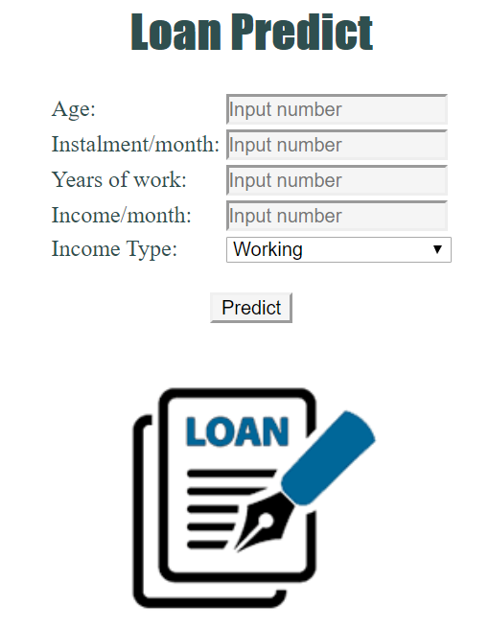
Home Page

Slide 6
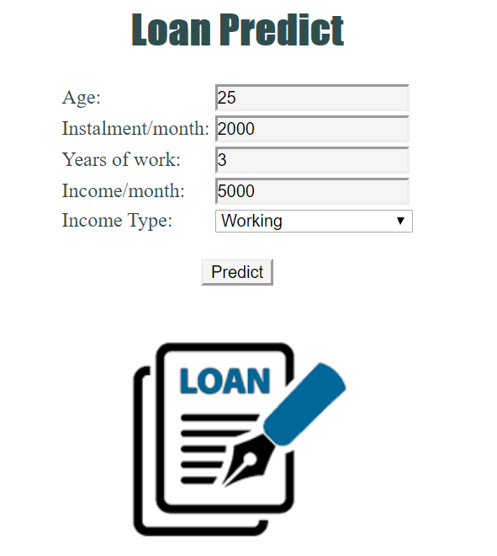
Input Prediction

Slide 7
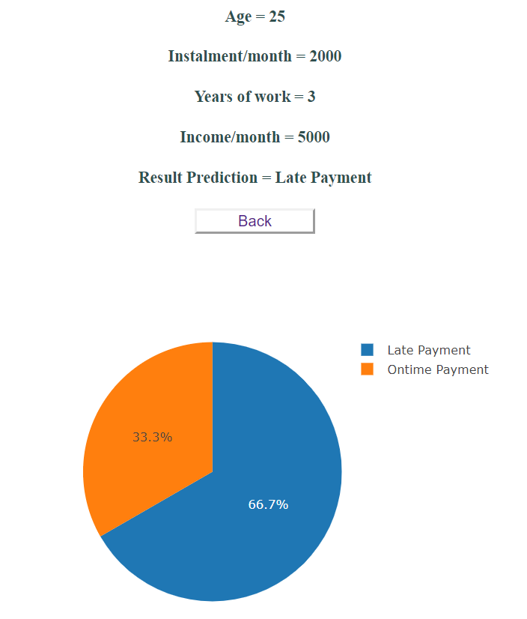
Result Page

Slide 8
THANK YOU

