Slide 1
Servlets
Spring MVC
Jersey
Netty

Slide 2
Servlets
Servlet 1.0 Июнь 1997 *
* Servlet 2.1 Ноябрь 1998

Slide 3
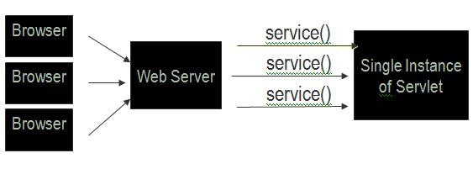
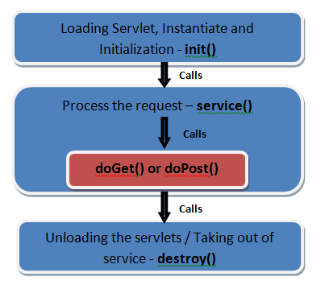

Slide 4
doGet, if the servlet supports HTTP GET requests
doPost, for HTTP POST requests
doPut, for HTTP PUT requests
doDelete, for HTTP DELETE requests
init and destroy, to manage resources that are held for the life of the servlet
getServletInfo, which the servlet uses to provide information about itself

Slide 5
Servlet Containers
Apache Tomcat
GlassFish
JBoss Application Server
Jetty

Slide 6
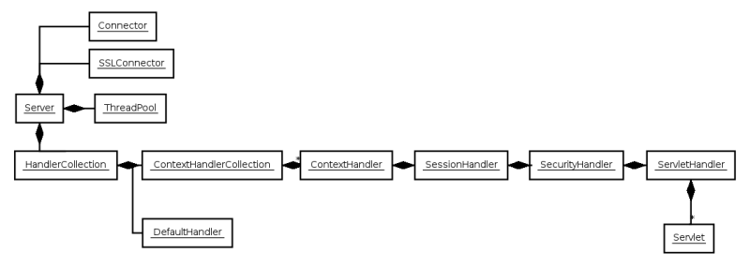
Jetty architecture

Slide 7
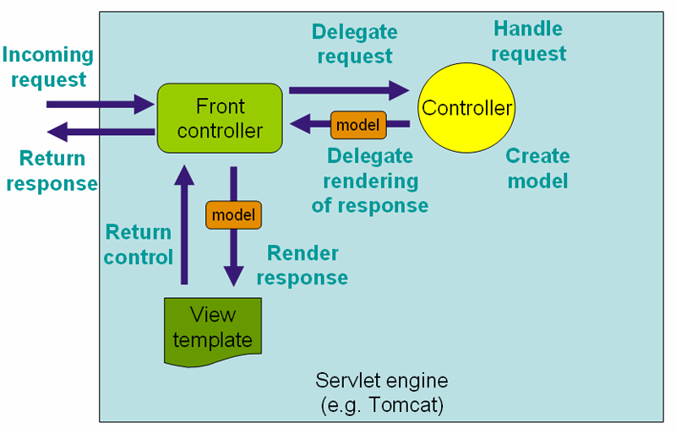
Spring MVC

Slide 8
Jersey
JSR 311: JAX-RS:
The Java API for RESTful Web Services

Slide 9
implementations
Apache CXF
Jersey
RESTeasy

Slide 10
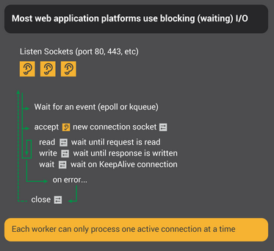

Slide 11
