Slide 1
PORTFOLIO CASE STUDY
AUGUST 2026
Prioritising Late-Delivery
Reviews Under Limited Capacity
Historical order evidence, risk ranking, and a capacity-based review queue
Notes:
This portfolio case study asks a practical decision question: when review capacity is limited, how can historical order data help focus attention on the orders most likely to be delivered late? I will first establish the historical scale of the problem, then identify the clearest operational association, test whether a simple model provides useful risk ranking, and finally translate that ranking into a manageable review queue. The objective is decision support, not automated decision-making or a claim that individual delivery outcomes can be predicted with certainty.
[Sources]
- upload/03_analyze_delivery_risk_and_workload(7).ipynb
[/Sources]

Slide 2
DECISION CONTEXT
The decision is how to use limited review capacity
Review teams cannot inspect every eligible order.
Four questions connect evidence to action
AQ1
How large and persistent is late delivery?
The business task is to focus limited attention on orders with the highest relative late-delivery risk.
AQ2
Which operational attributes show the clearest association?
AQ3
Does a simple model rank risk better than baseline?
Decision boundary
AQ4
What changes at 5%, 10%, and 20% review capacity?
Prioritise review; do not automate outcomes or claim prevention.
5%
10%
20%
Delivery risk review | Portfolio case study
2
Notes:
The operational problem is not simply that late delivery occurs. The decision is how to use a limited review team effectively when it cannot inspect every eligible order. I organised the analysis around four connected questions. AQ1 establishes the historical scale and trend. AQ2 compares operational attributes to identify useful associations. AQ3 tests whether a time-aware logistic-regression model ranks late orders better than a no-skill baseline. AQ4 converts that ranking into review scenarios at 5%, 10%, and 20% capacity. Together, the questions move from understanding the problem to recommending a practical pilot queue.
[Sources]
- upload/03_analyze_delivery_risk_and_workload(7).ipynb
[/Sources]

Slide 3
DATA AND METHOD
A leakage-safe workflow tests decisions on later orders
HISTORICAL SCOPE
TIME-AWARE RANKING
DECISION TEST
62,897 orders
128 + 32 weeks
13,525 orders
Jan 2015 - Jan 2018
One eligible order per row
Earlier weeks train
Later weeks remain held out
Frozen scores
5% / 10% / 20% capacity
DuckDB SQL -> Python / scikit-learn -> Power BI decision view -> presentation
Delivery risk review | Portfolio case study
3
Notes:
The validated order-level dataset contains 62,897 eligible orders from January 2015 to January 2018. Descriptive analysis uses this full historical period. For risk ranking, I retained only information treated as available when an order is created. The 160 complete weeks were then split chronologically: the earliest 128 weeks formed the training period and the latest 32 weeks formed the held-out test period. This produced 13,525 test orders. The final capacity simulation reuses the frozen test-period risk scores; it does not retrain or tune another model. This separation reduces leakage and keeps the final decision test closer to a future-use scenario.
[Sources]
- upload/03_analyze_delivery_risk_and_workload(7).ipynb
- analyze/tables/aq1_overall_delivery_kpis.csv
- analyze/tables/aq4_capacity_comparison.csv
[/Sources]

Slide 4
AQ1 - MEASURE
AQ1 defines the scale of late delivery
Late-delivery rate = late orders / eligible orders
Why it matters
Creates one consistent basis for comparing performance over time.
Scope: one eligible order per row, January 2015 to January 2018
62,897
36,048
57.31%
Eligible orders
Late orders
Late-delivery rate
All validated orders included in the historical analysis.
Eligible orders with a recorded late-delivery outcome.
The historical share of eligible orders delivered late.
Delivery risk review | Portfolio case study
4
Notes:
AQ1 begins with three simple business measures. Eligible order count is the number of orders included in the validated population. Late order count is the number of those orders whose delivery outcome was late. Late-delivery rate divides late orders by eligible orders, providing a consistent basis for comparison across time periods. Across the full historical dataset, 36,048 of 62,897 eligible orders were late, producing an overall rate of 57.31%. Establishing these definitions first ensures that the next visual is interpreted as a business-performance measure rather than as a standalone collection of data points.
[Sources]
- analyze/tables/aq1_overall_delivery_kpis.csv
[/Sources]

Slide 5
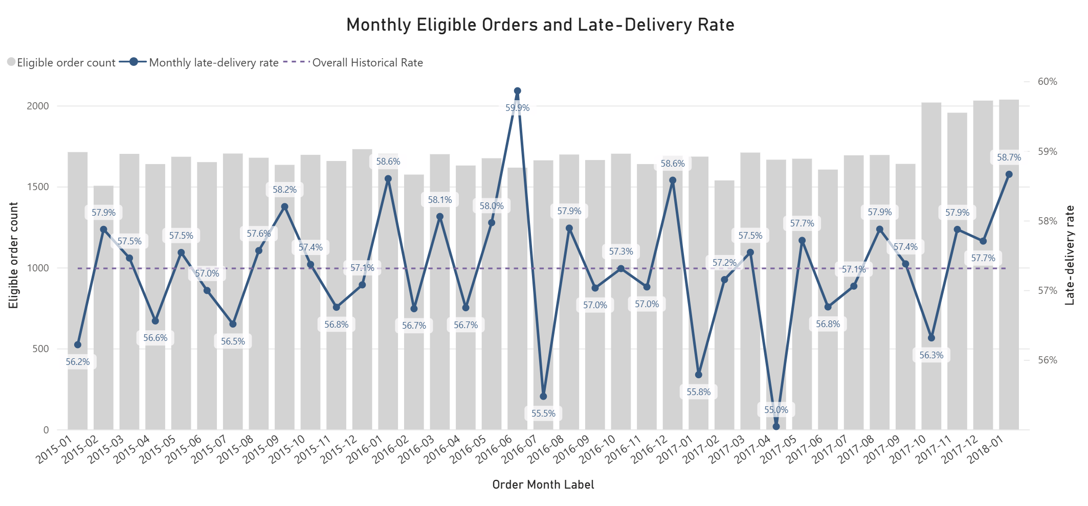
AQ1 - EVIDENCE
Late delivery stayed high, with no sustained trend
57.31% overall | 55.04% - 59.86% monthly | No sustained upward or downward trend
Delivery risk review | Portfolio case study
5
Notes:
This chart shows monthly eligible-order volume together with the monthly late-delivery rate. The dashed reference line is the overall historical rate of 57.31%. Monthly rates remained within a relatively narrow range, from 55.04% to 59.86%, and there was no sustained upward or downward movement. The important insight is therefore not a single peak month. Late delivery remained common throughout the period. From a decision perspective, that pattern supports an ongoing prioritisation process rather than a one-off response to a temporary spike.
[Sources]
- analyze/figures/aq1_monthly_delivery_trend.png
- analyze/tables/aq1_monthly_delivery_trend.csv
- analyze/tables/aq1_overall_delivery_kpis.csv
[/Sources]

Slide 6
AQ2 - MEASURE
AQ2 compares rates across operational groups
Segment rate
Exposure count
Order profile
Late orders divided by eligible orders within each category.
Eligible-order count retained beside every percentage.
Mean and median item count, quantity, and order value.
What share was late?
How much evidence sits behind the rate?
Do late and on-time orders look different?
Interpretation boundary
Observed differences are associations. They identify investigation and prediction signals, not confirmed causes.
Delivery risk review | Portfolio case study
6
Notes:
AQ2 uses the same late-delivery rate, but compares it across operational groups. The rate shows the share of late orders within each category, while eligible-order count provides exposure context so that a percentage is not interpreted without knowing the group size. I also compared the mean and median item count, order quantity, and order value between late and on-time orders. These comparisons are descriptive. They can identify attributes that deserve investigation or may help risk ranking, but they do not prove that an attribute caused a delivery to be late.
[Sources]
- analyze/tables/aq1_aq2_segment_delivery_summary.csv
- analyze/tables/aq2_order_profile_summary.csv
[/Sources]

Slide 7
AQ2 - EVIDENCE
Shipping Mode shows the clearest association
Historical late-delivery rate by Shipping Mode
60.15 pp
Gap between First Class and Standard Class
<= 1.19 pp
Spread across Customer Segment and Market
Business meaning
Investigate Shipping Mode and retain it as a ranking signal, without claiming causation.
Delivery risk review | Portfolio case study
7
Notes:
The focused comparison shows that Shipping Mode has a much larger spread than the other attributes reviewed. First Class recorded a 100.00% historical late-delivery rate and Second Class 79.99%, compared with 48.37% for Same Day and 39.85% for Standard Class. By contrast, Customer Segment and Market rates were tightly grouped, and the selected order-size measures were nearly identical between late and on-time orders. The conclusion is that Shipping Mode provides the clearest operational association and the strongest investigation signal. It remains an association, however, and should not be presented as a confirmed root cause.
[Sources]
- analyze/tables/aq1_aq2_segment_delivery_summary.csv
- analyze/tables/aq2_order_profile_summary.csv
- analyze/figures/aq1_aq2_segment_delivery_rates.png
[/Sources]

Slide 8
AQ3 - MEASURE
AQ3 tests ranking against a no-skill baseline
Held-out evaluation: 13,525 held-out orders | Earlier 80% of complete weeks used for training
AP
ROC-AUC
Baseline
Average Precision
Ranking ability
No-skill reference
How consistently does the risk ranking retain precision as more late orders are captured?
How often is a late order placed above an on-time order across the full ranking?
AP equals test prevalence; ROC-AUC equals 0.50 when the ranking has no useful signal.
Higher is better. These metrics evaluate relative ranking, not certainty for an individual order.
Delivery risk review | Portfolio case study
8
Notes:
AQ3 asks whether the model provides useful relative ranking on later orders. Average Precision summarises how well the ranking maintains precision while capturing more actual late orders. ROC-AUC measures the model's overall ability to place a late order above an on-time order. Both are compared with a no-skill baseline: a ranking that contains no useful order-level risk information. For that baseline, Average Precision equals the late-order prevalence in the test period and ROC-AUC equals 0.50. These are ranking measures. They support prioritisation, but they do not mean that the model can guarantee the outcome of an individual order.
[Sources]
- analyze/tables/aq3_model_evaluation.csv
- upload/03_analyze_delivery_risk_and_workload(7).ipynb
[/Sources]

Slide 9
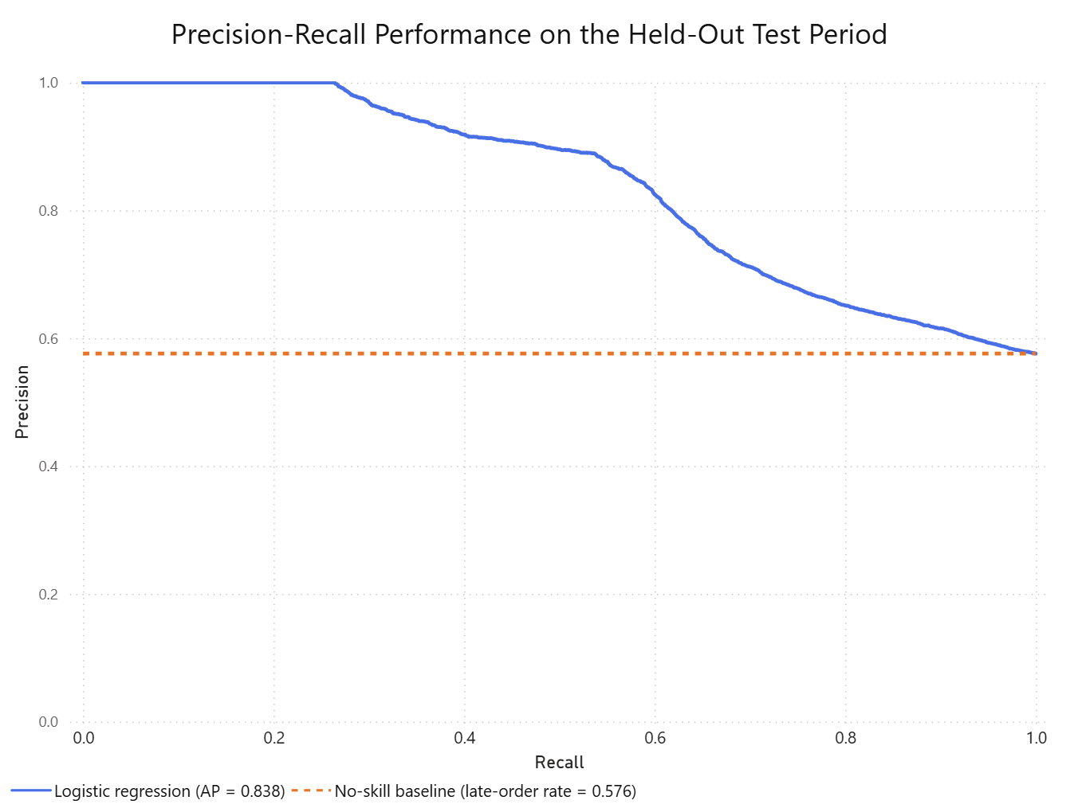
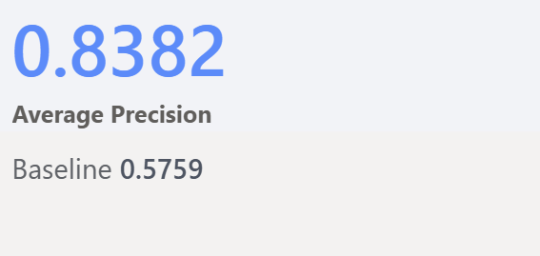
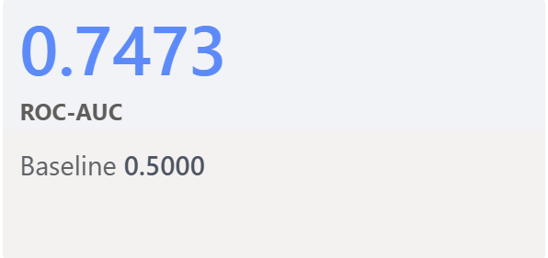
AQ3 - EVIDENCE
Logistic regression beat the ranking baseline
Use the score for relative prioritisation, not as certainty about an individual order.
Delivery risk review | Portfolio case study
9
Notes:
On the 13,525 held-out test orders, logistic regression achieved an Average Precision of 0.8382, compared with 0.5759 for the no-skill baseline. Its ROC-AUC was 0.7473, compared with 0.5000 for the baseline. The precision-recall curve also remains above the prevalence reference for almost the entire recall range. Together, these results show that the model placed late orders nearer the top of the ranking more effectively than the baseline. This supports using the scores for relative prioritisation; it does not establish that logistic regression is the best possible model or that every high-ranked order will be late.
[Sources]
- analyze/figures/aq3_precision_recall_curve.png
- analyze/tables/aq3_model_evaluation.csv
[/Sources]

Slide 10
AQ4 - MEASURE
AQ4 turns risk ranks into capacity choices
Capacity
Late-order recall
Maximum share of eligible orders that can be reviewed.
Selected late orders divided by all actual late orders.
How much workload can the team accept?
How much of the problem does the queue cover?
Review precision
Lift
Selected late orders divided by all selected orders.
Review precision divided by the overall test late-order rate.
How concentrated is the review queue?
How much better is ranking than review without signal?
Decision rule: review the highest-ranked orders until the selected capacity limit is reached.
Delivery risk review | Portfolio case study
10
Notes:
AQ4 converts the fixed risk ranking into an operational capacity decision. Capacity is the maximum share of eligible orders that can be reviewed. Late-order recall asks how many of all actual late orders are captured by the selected queue. Review precision asks how many selected orders were actually late. Lift compares that precision with the overall late-order rate, showing how much more concentrated the queue is than review without informative ranking. The decision rule is simple: rank eligible orders by risk and review the highest-ranked orders until the selected capacity limit is reached.
[Sources]
- analyze/tables/aq4_capacity_comparison.csv
- upload/03_analyze_delivery_risk_and_workload(7).ipynb
[/Sources]

Slide 11
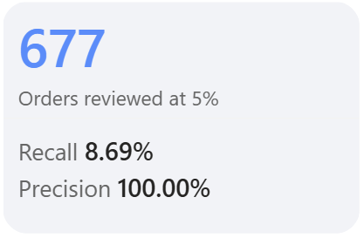
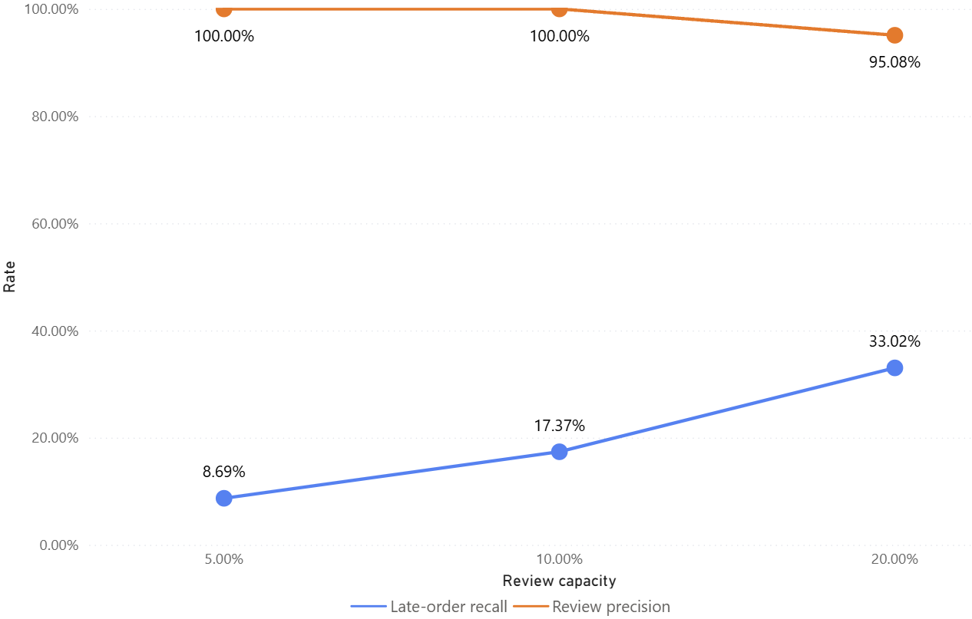
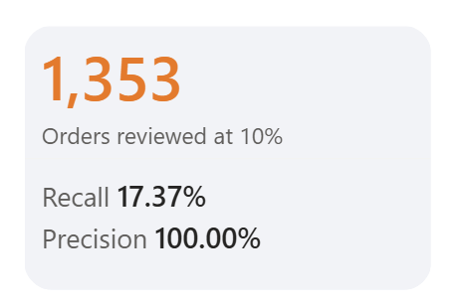
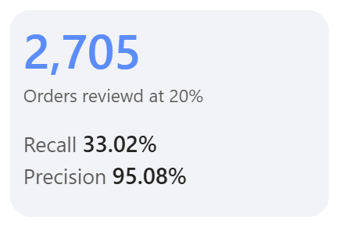
AQ4 - EVIDENCE
Capacity trades coverage for review efficiency
Delivery risk review | Portfolio case study
11
Notes:
The capacity comparison shows the central trade-off. At 5% capacity, 677 orders are reviewed and 8.69% of all late orders are captured. At 10%, the queue grows to 1,353 orders and recall rises to 17.37%. At 20%, 2,705 orders are reviewed and recall reaches 33.02%. Precision remains 100.00% at 5% and 10%, then decreases to 95.08% at 20%; lift similarly declines from 1.74 to 1.65. Increasing capacity therefore improves coverage, but it also increases workload and begins to reduce how concentrated the queue is.
[Sources]
- analyze/tables/aq4_capacity_comparison.csv
[/Sources]

Slide 12
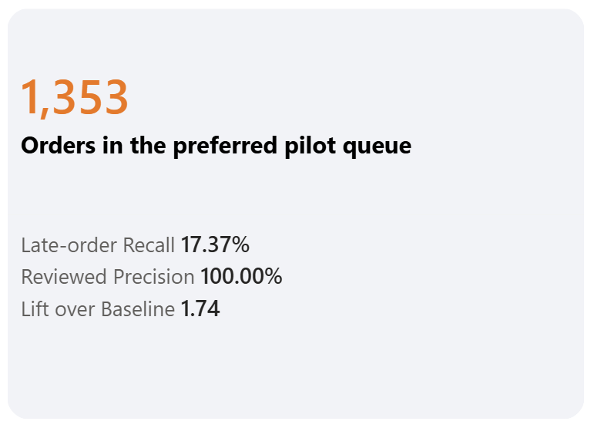
RECOMMENDATION
A top-10% queue is a practical pilot
Illustrative top-ranked orders
Risk rank | Order Id | Risk score
1 | 73312 | 0.9993170
2 | 73313 | 0.9993170
3 | 73457 | 0.9993170
4 | 73226 | 0.9993170
5 | 73245 | 0.9993170
Rank first; use Order Id only for traceability and deterministic tie-breaking.
Held-out test-period result; validate prospectively before operational adoption.
Delivery risk review | Portfolio case study
12
Notes:
I recommend the top-10% queue as a practical pilot starting point. It reviews 1,353 orders, captures 17.37% of the actual late orders in the held-out period, and produced 100.00% retrospective precision with 1.74 times lift. It captures more late orders than the 5% option without expanding into the lower-precision region observed at 20%. The operational output is a ranked order list using Order Id for traceability and deterministic tie-breaking. The 100% figure is a historical test-period result, not a promise of future performance, so the queue must be validated prospectively before routine adoption.
[Sources]
- analyze/tables/aq4_capacity_comparison.csv
- analyze/tables/aq4_preferred_10pct_review_queue.csv
[/Sources]

Slide 13
ACTION AND LIMITATIONS
Start with a controlled pilot and live validation
STEP 1
STEP 2
STEP 3
Limits to carry forward
1
Historical proxy data
Run the queue
Monitor outcomes
Validate and refine
2
Association is not causation
Generate the weekly top-10% ranking from order-creation fields.
Track workload, precision, recall, and reviewer actions.
Compare live evidence with the held-out results before scaling.
3
One held-out test period
4
Review benefit is not measured
Use the model to focus human attention - not to replace operational judgment.
Delivery risk review | Portfolio case study
13
Notes:
The next step is a controlled pilot rather than immediate full adoption. First, generate a weekly top-10% queue from information available at order creation. Second, record workload, actual outcomes, precision, recall, and any actions taken by reviewers. Third, compare live performance with the held-out results and refine the process only if the evidence supports it. In parallel, Shipping Mode should be investigated as an operational signal, without assuming causation. The main limitations are that this is historical proxy data, evaluation uses one held-out period, and the simulation does not show that reviewing an order prevents a late delivery. The model should focus human attention, not replace judgment.
[Sources]
- upload/03_analyze_delivery_risk_and_workload(7).ipynb
- analyze/tables/aq4_capacity_comparison.csv
[/Sources]

