Slide 1
Painting Case-Study By-DA_Interns_Wiz_Developers
Introduction
Problem
Approach
Tools
Solution
References
Conclusion

Slide 2
Basics required for case-study
01
02
03
Case studies allow us to connect theoretical knowledge with practical application.
Understand how business concepts apply to actual scenarios.
Apply lessons learned from case studies to similar business challenges.

Slide 3
Introduction
The case study is about museum and paintings
It is the case study where we have different type of data from where we are looking to solve specific problems.
Datasets: artist, canvas_size, museum, museum_hours, product_size, subject, work, image_link

Slide 4
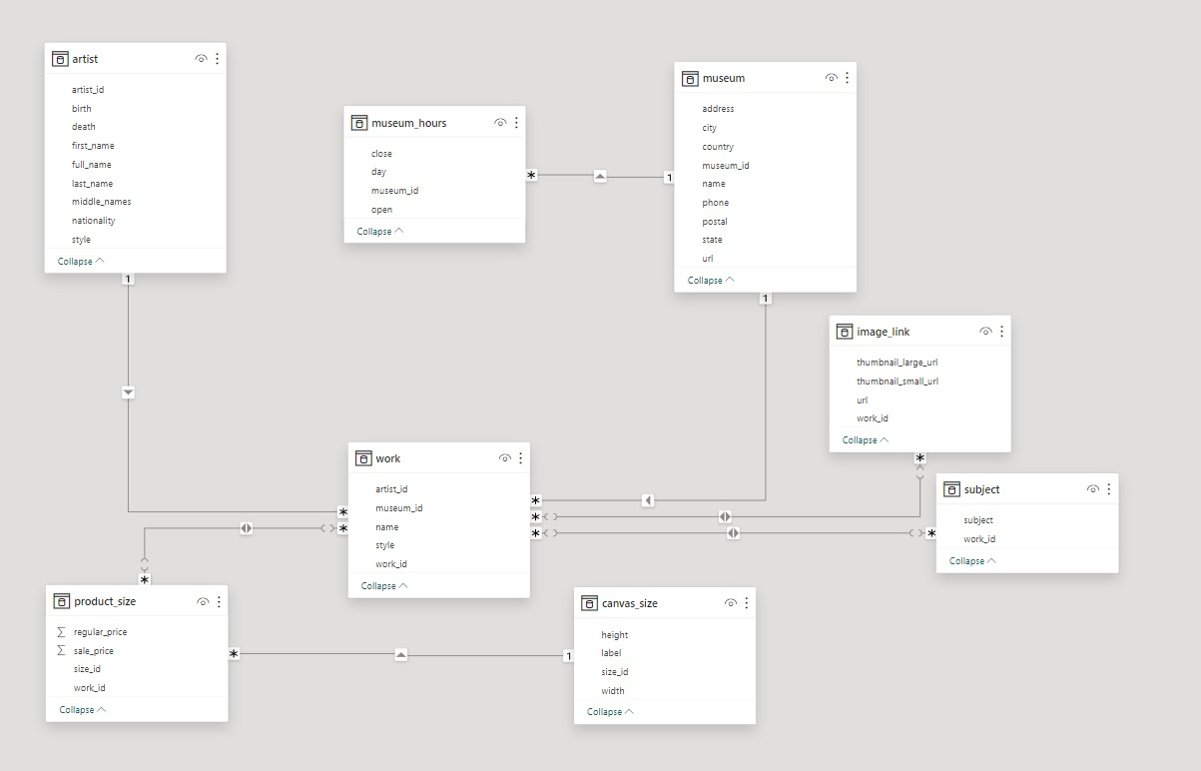

Slide 5
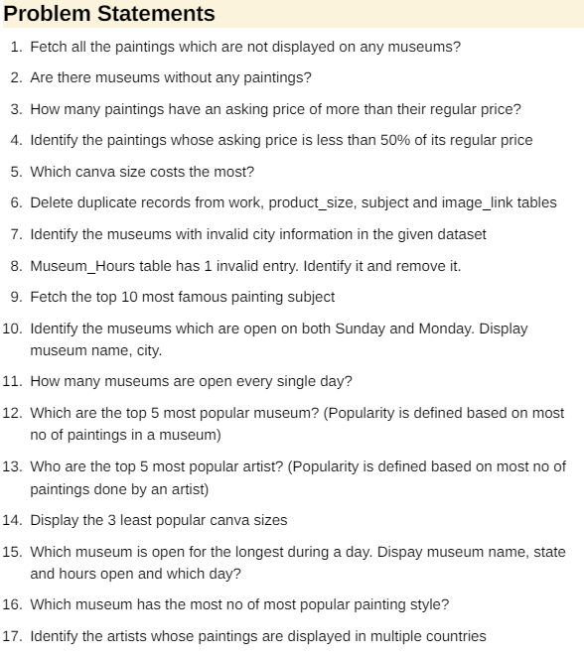
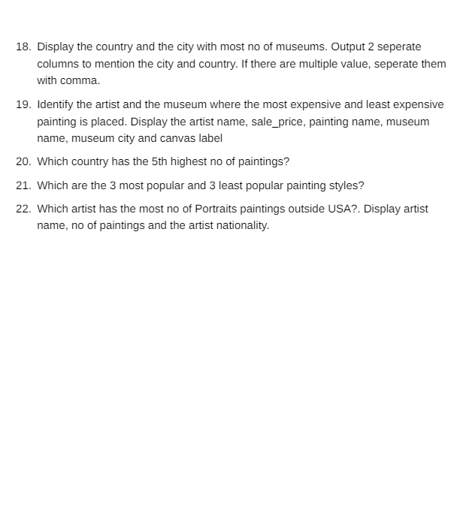
.
WE HAVE TO FIND SOLUTION FOR THESE PROBLEMS.
How????

Slide 6

Approach
Analyze the problem
Think a simple solution
Implement the solution

Slide 7


TOOLS
Python
SQL WE CAN USE BOTH HERE AS THE DATASET IS SUITABLE TO WORK WITH THESE.

Slide 8

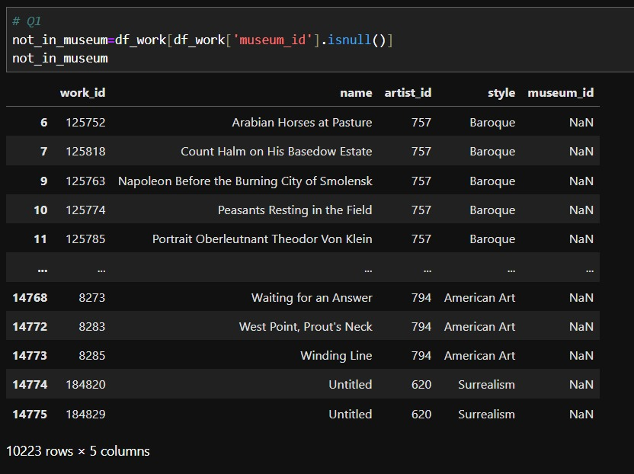
Problem & Solutions
Devarshi Dave

Slide 9
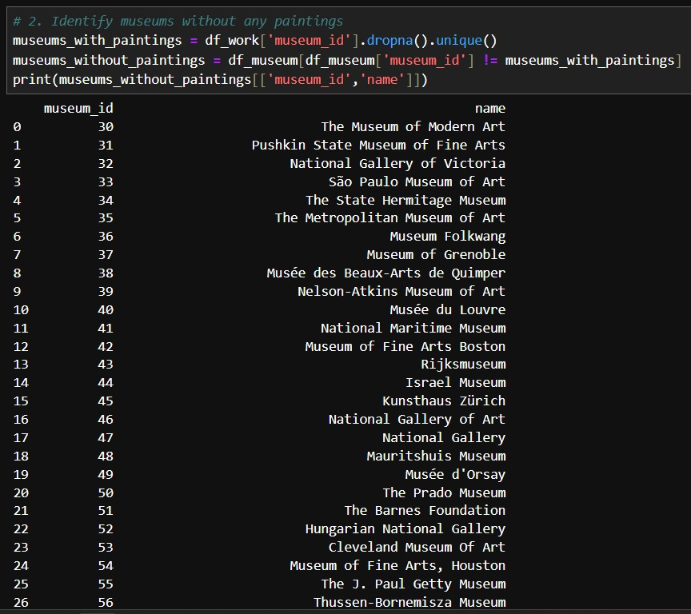
Devarshi Dave

Slide 10
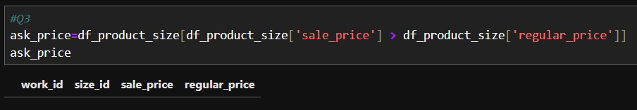

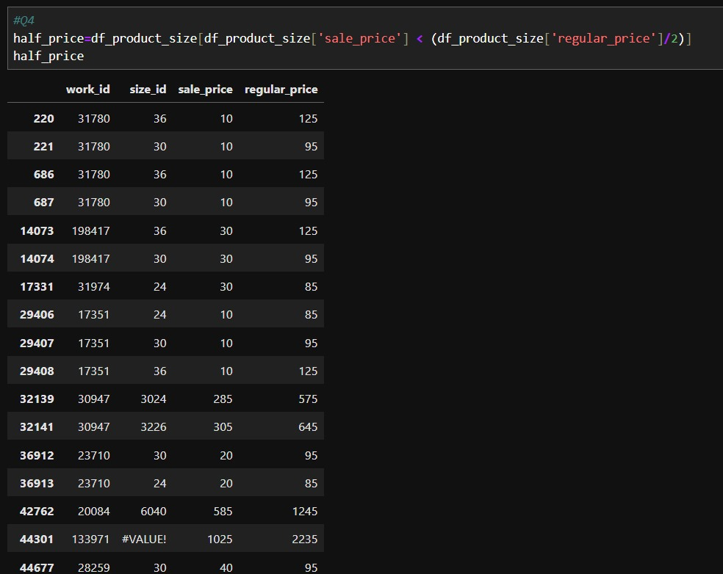
Devarshi Dave

Slide 11

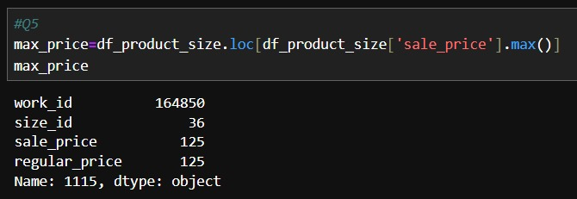
Devarshi Dave

Slide 12
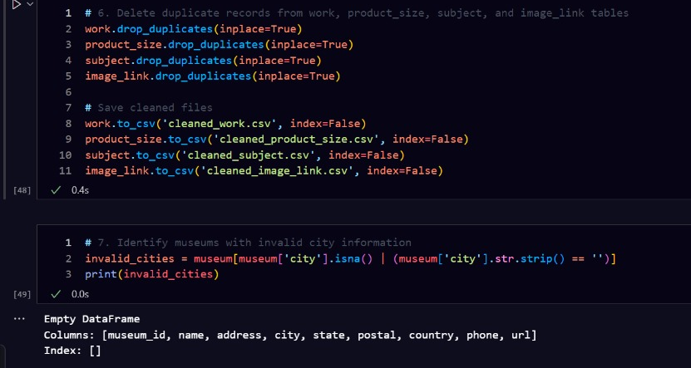
Aum Barai

Slide 13
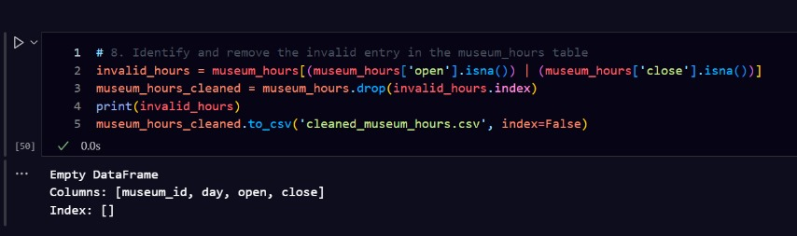
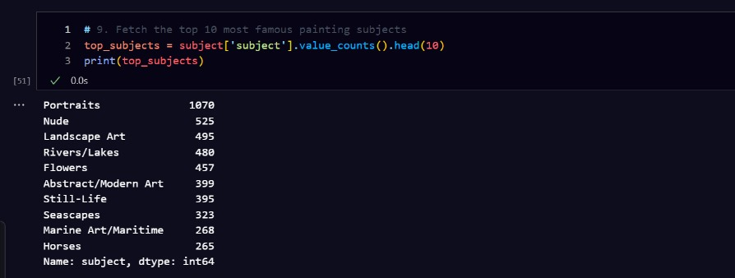
Aum Barai

Slide 14
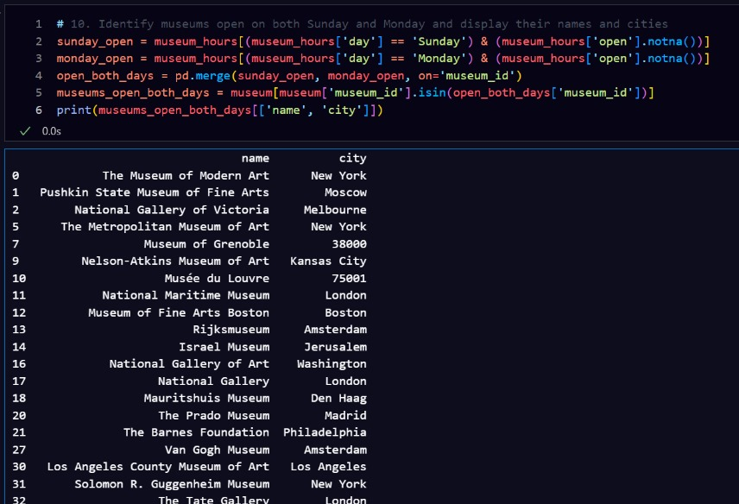
Aum Barai

Slide 15
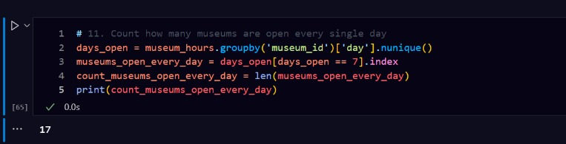
Aum Barai

Slide 16
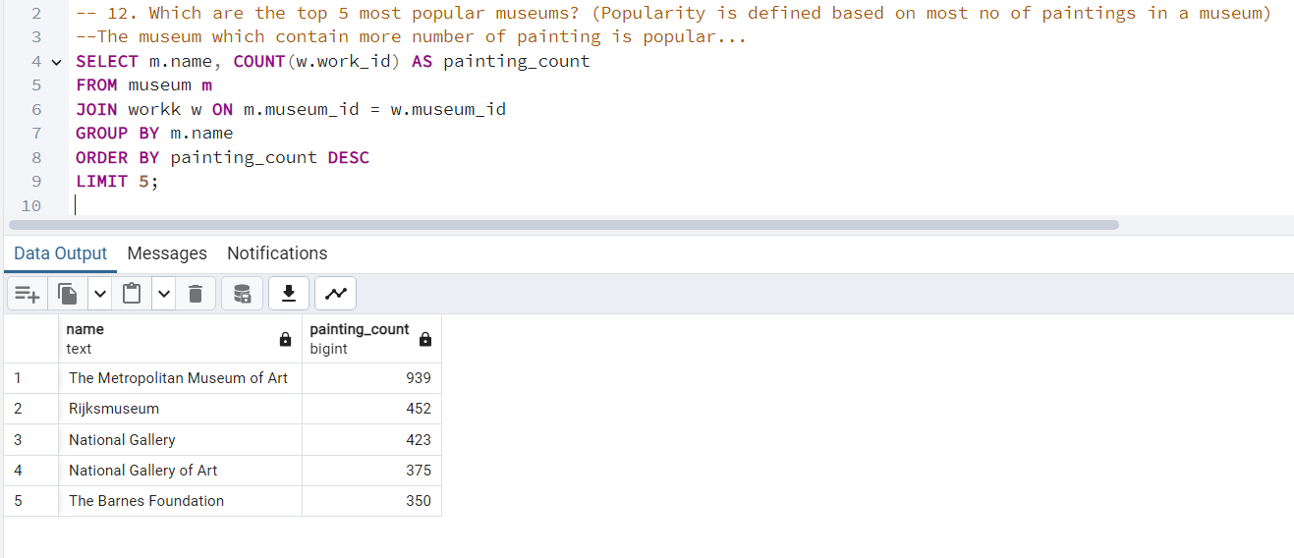
Malak Soni

Slide 17

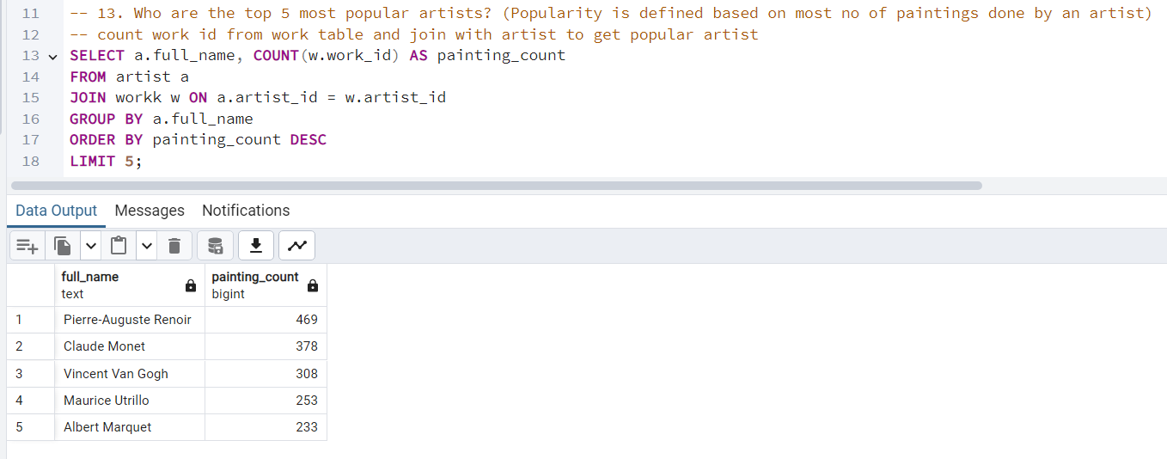
Malak Soni

Slide 18

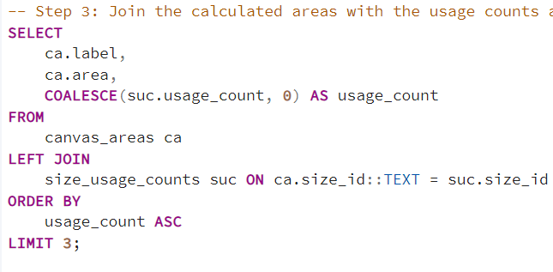
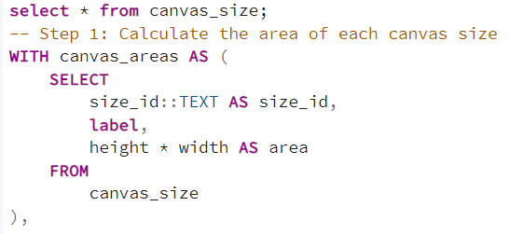
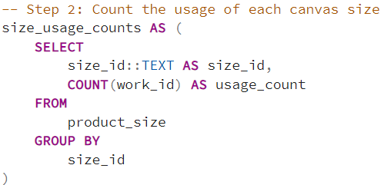
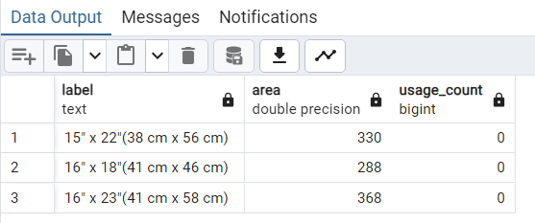

Malak Soni

Slide 19

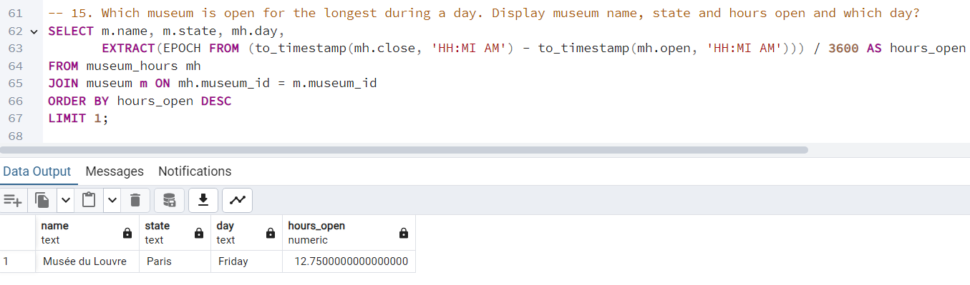
Malak Soni

Slide 20
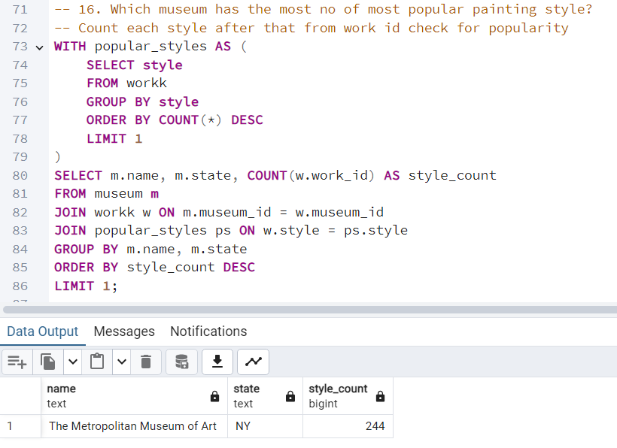
Malak Soni

Slide 21
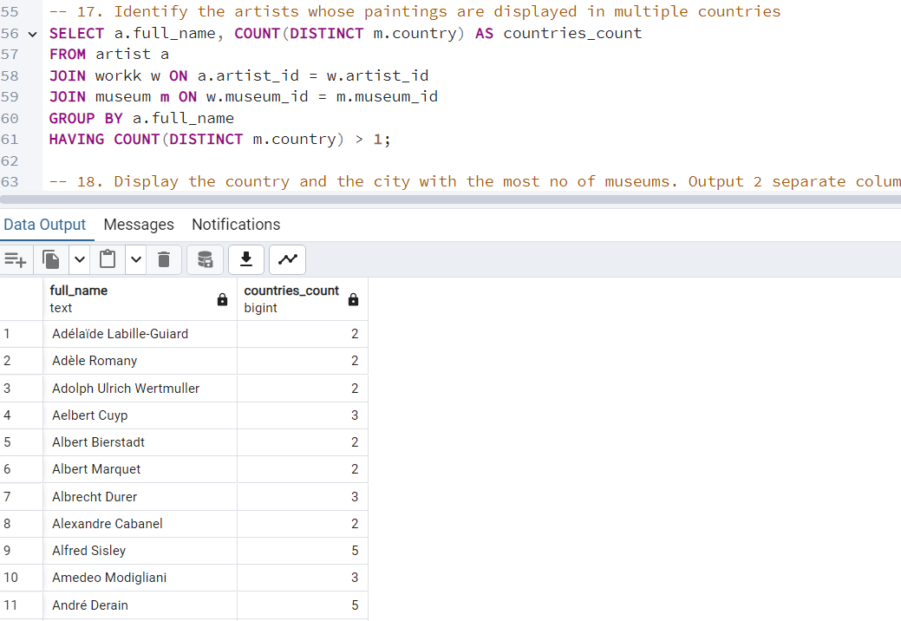
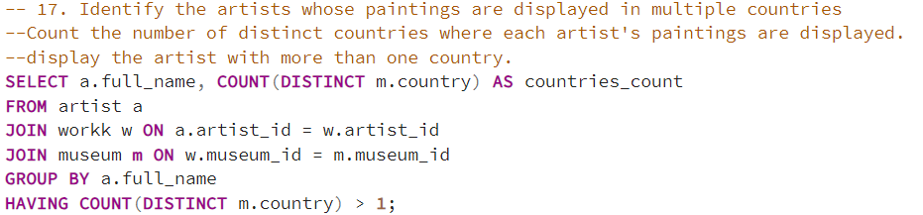
Malak Soni

Slide 22
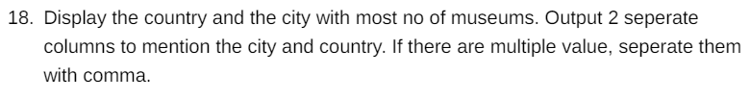
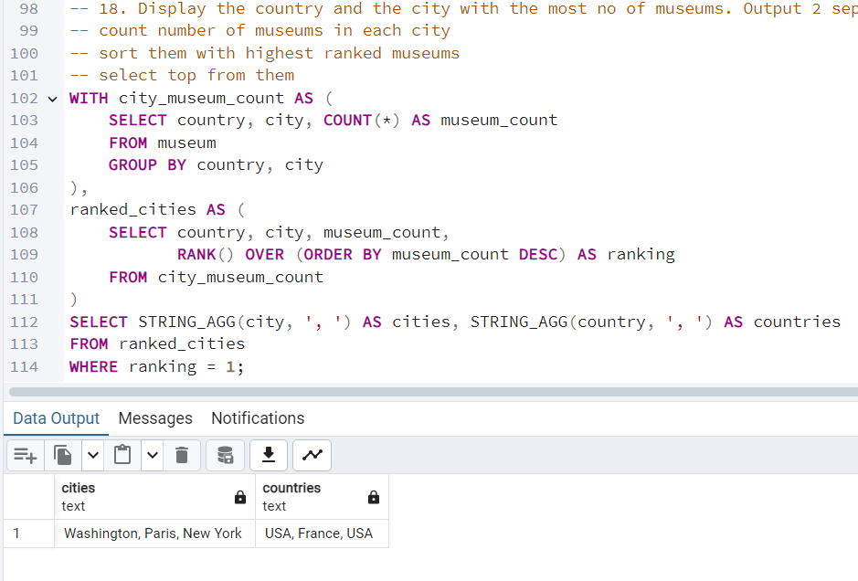
Malak Soni

Slide 23

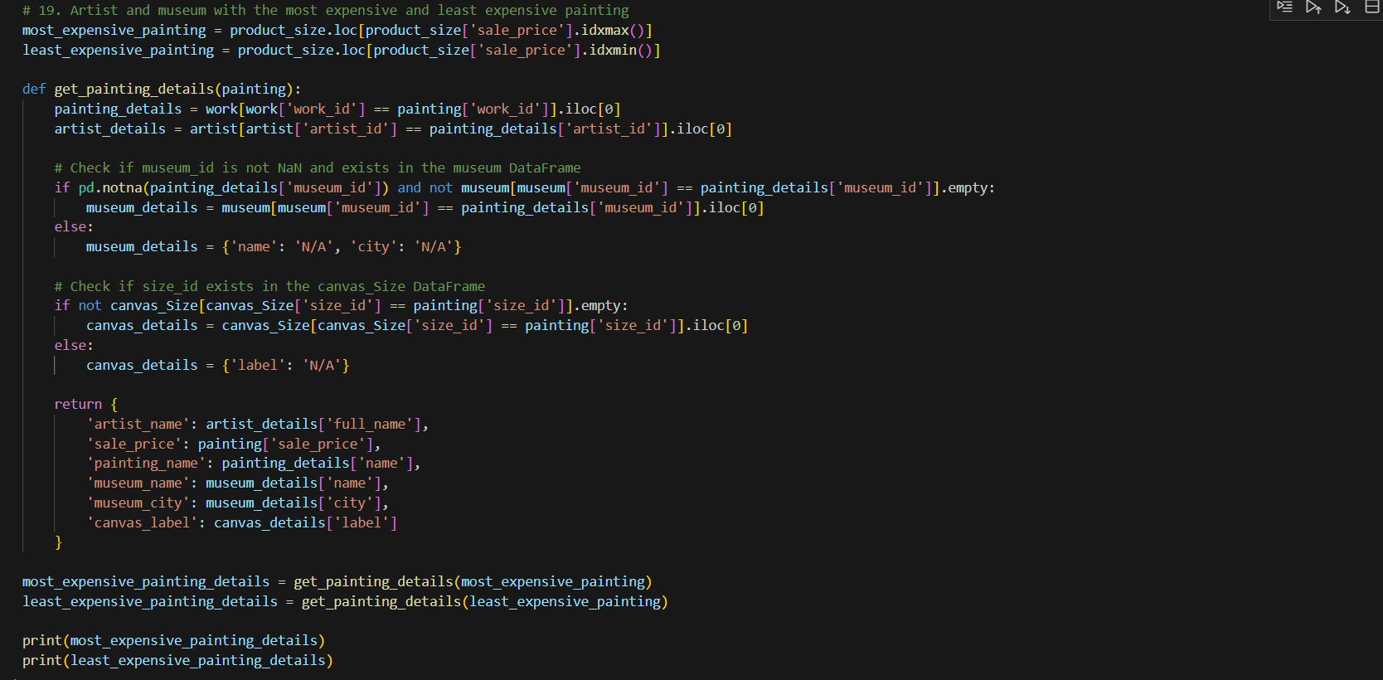
Saumya Gohil

Slide 24
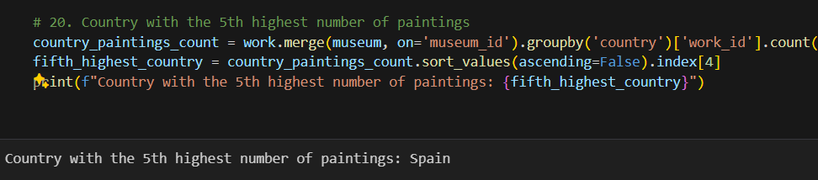
Saumya Gohil

Slide 25
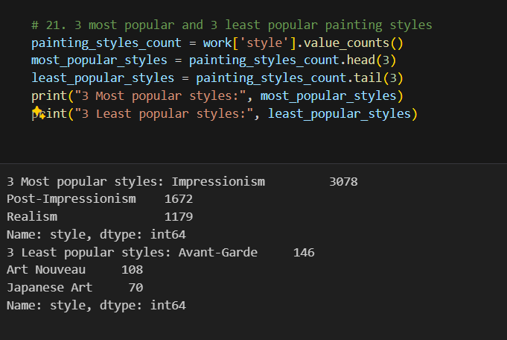
Saumya Gohil

Slide 26
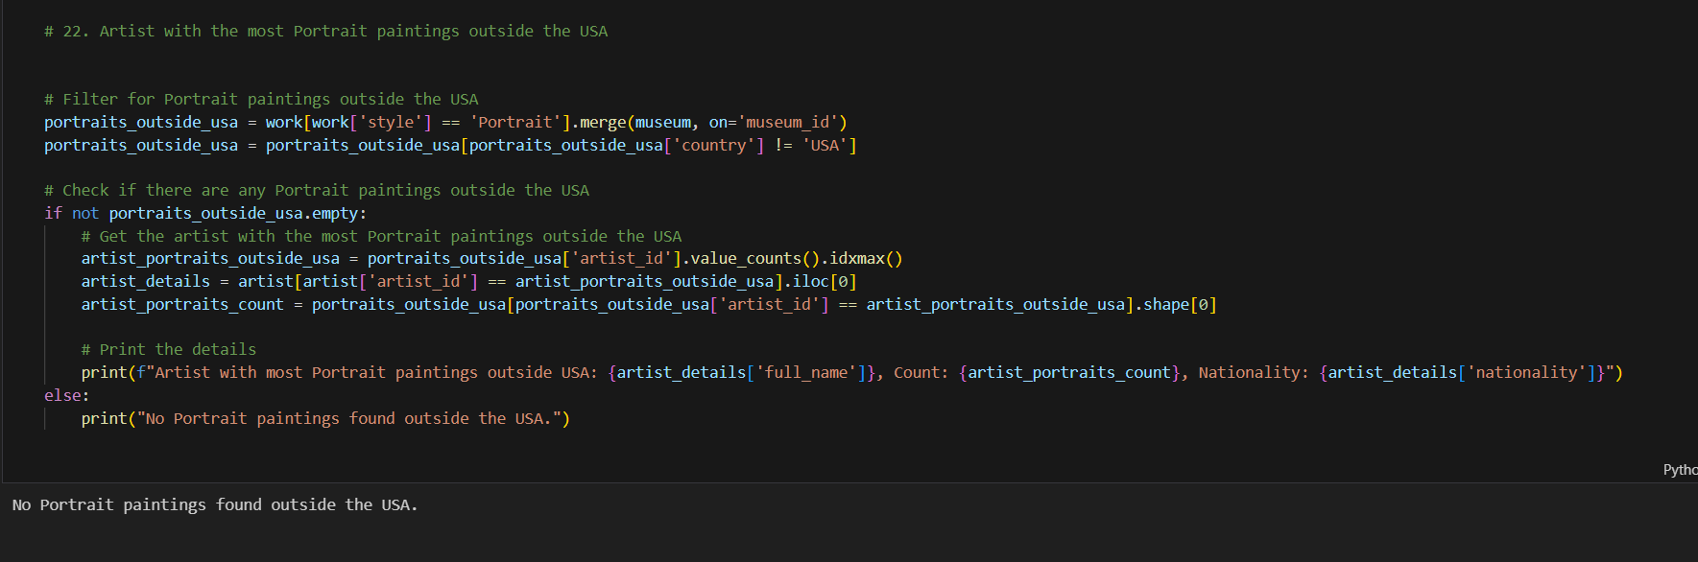
Saumya Gohil

Slide 27
CONCLUSION
Hence, we conclude that case study is something by which we can understand the real world problems.
After collecting data how we can analyze according to question of our interest.
There can be multiple ways to solve it.

Slide 28
References
https://youtu.be/npHOE0bsvJU?si=Srx7iJlL7l4UkTua
https://youtu.be/RxXdMs34lik?si=afi-mEpLXLG3lVm7
https://www.youtube.com/live/IicPavA37ew?si=OjaEFoiTXYrIXnBo
https://youtu.be/AZ29DXaJ1Ts?si=hu_Dmtf6bX5fsjt_
https://drive.google.com/drive/folders/1LfUr4UBIatS15sCfxUHoupBciy7GSy2R

Slide 29

Thank you
Aum Barai
Devarshi Dave
Saumya Gohil
Malak Soni
2nd Year(B.Tech AIML)
Data Analyst Intern
Wiz Developers

