Slide 1

HACKATHON MVP · SOFTWARE
THEME · DIGITAL TRANSFORMATION IN LENDING
THE DECISION SPINE
ARTHIX
Vivek
BHARAT INTELLIGENCE
Recommend · Assist First
Suppress · Verify
The right product.
The right moment.
Or no product at all.
RECOMMEND
Need + eligibility +
suitability + safety.
An AI-powered hyper-personalized banking intelligence layer for Bharat —
not a new bank, and not a chatbot that always sells.
PROBLEM STATEMENT TITLE
ASSIST FIRST
Arthix | AI-Powered Hyper-Personalized Banking for Bharat | Ctrl Freaks
Help before another
product is sold.
TEAM NAME (REGISTERED ON PORTAL)
CTRL FREAKS
Personalization as a
fiduciary act.
SUPPRESS
The responsible action
is to show nothing.
PROBLEM STATEMENT ID
THEME
PS CATEGORY
TEAM ID
To be confirmed
Digital Transformation in Lending
Software
To be confirmed
VERIFY
Unusual activity —
ask the customer.
ARTHIX · CTRL FREAKS · Hackathon prototype · Not RBI / DPDP certified
1 / 6

Slide 2
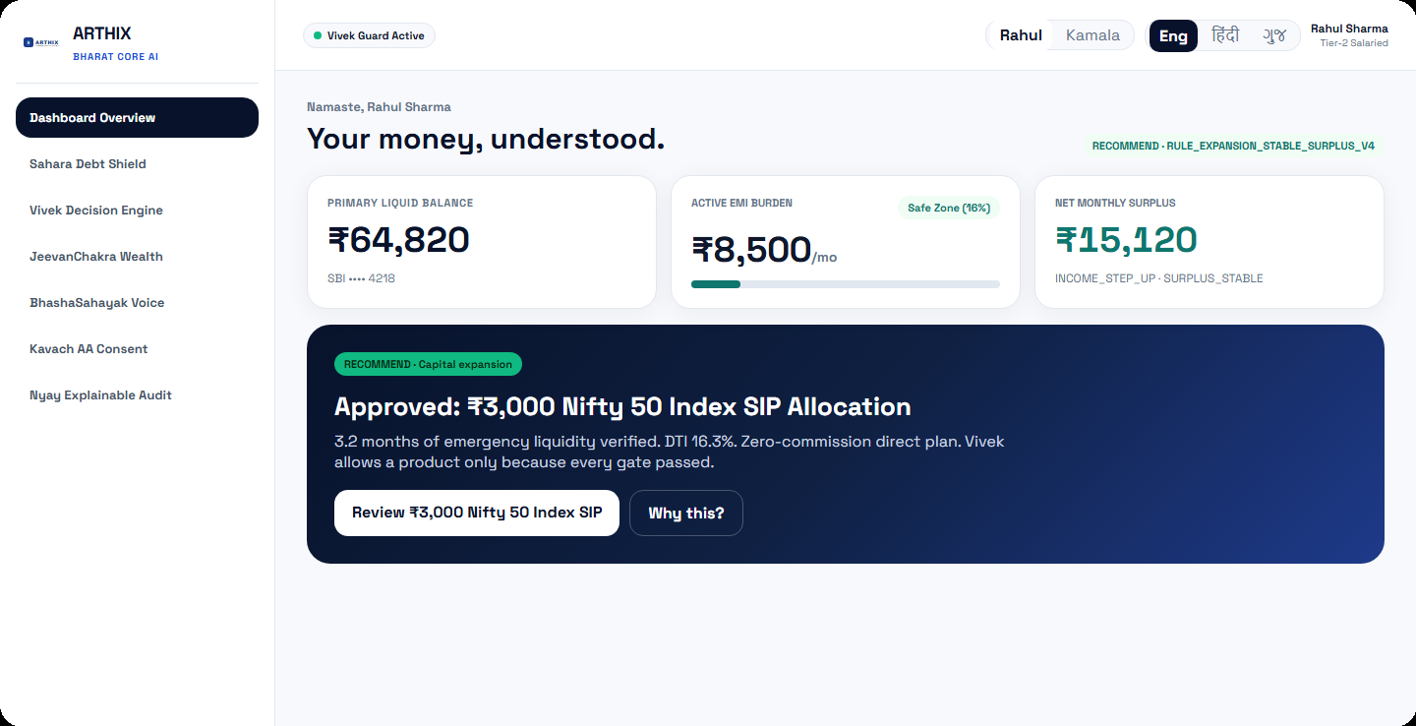
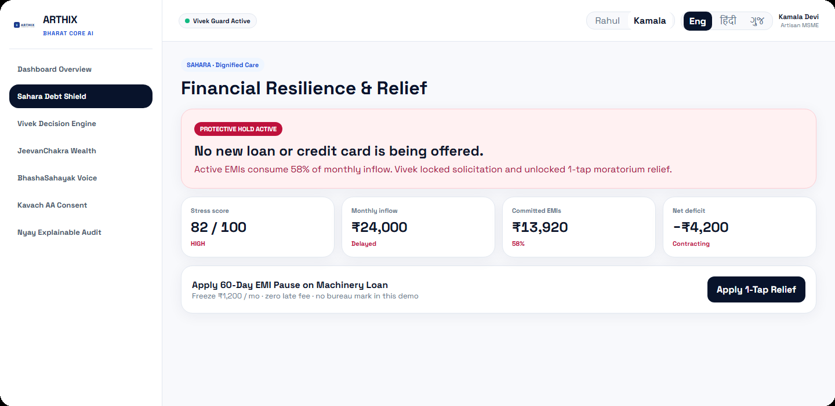
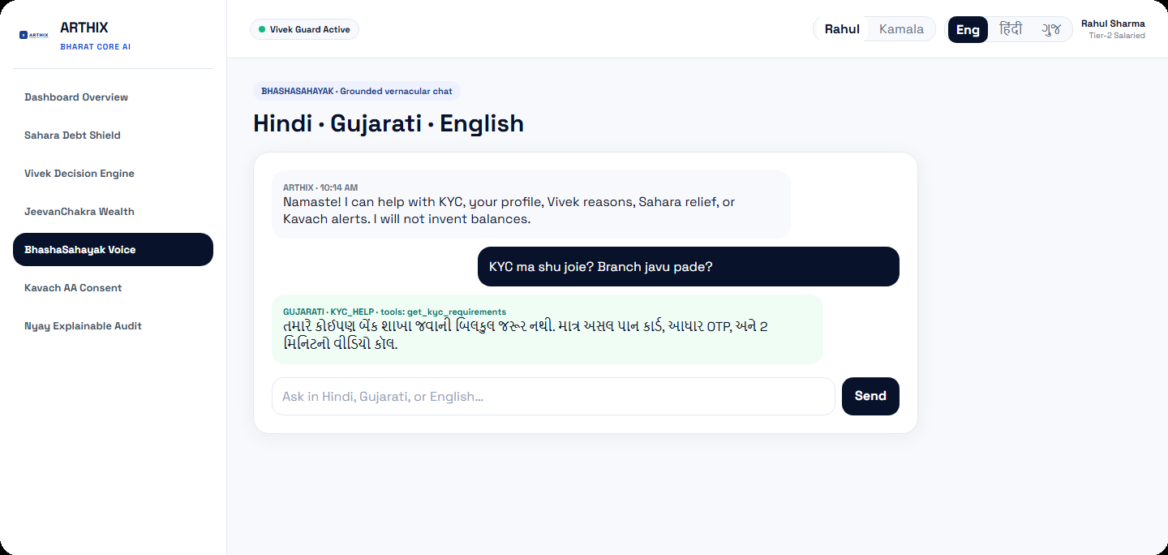
ARTHIX · CTRL FREAKS
Proposed Solution
A wellbeing-first intelligence layer that sits on existing banking journeys.
WHAT WE BUILT
HOW IT ADDRESSES THE PROBLEM
INNOVATION
ARTHIX reads a consented ledger, builds a financial profile, ranks product candidates, then lets Vivek decide whether to recommend, assist, suppress, or verify — with a Nyay reason the customer can inspect.
Same generic offer today reaches a first-time Gujarati user, a salaried Tier-2 professional, and a household missing EMI. ARTHIX personalizes the decision of whether to sell at all.
Ethics is a runtime gate, not a PDF. Vivek is deterministic — no neural net can override stress, leverage, or revoked consent.
Ledger
ArthBodh
JeevanChakra
Vivek
Nyay
Output
Consented
sample txs
Profile · DTI
runway · surplus
Ranks candidates
35/25/20/20 score
5 deterministic
gates
Consent · reasons
audit trail
Recommend /
Assist / Suppress
Rahul · Dashboard · RECOMMEND SIP
Kamala · Sahara · ASSIST FIRST
BhashaSahayak · Gujarati KYC
ARTHIX · CTRL FREAKS · Hackathon prototype · Not RBI / DPDP certified
2 / 6

Slide 3
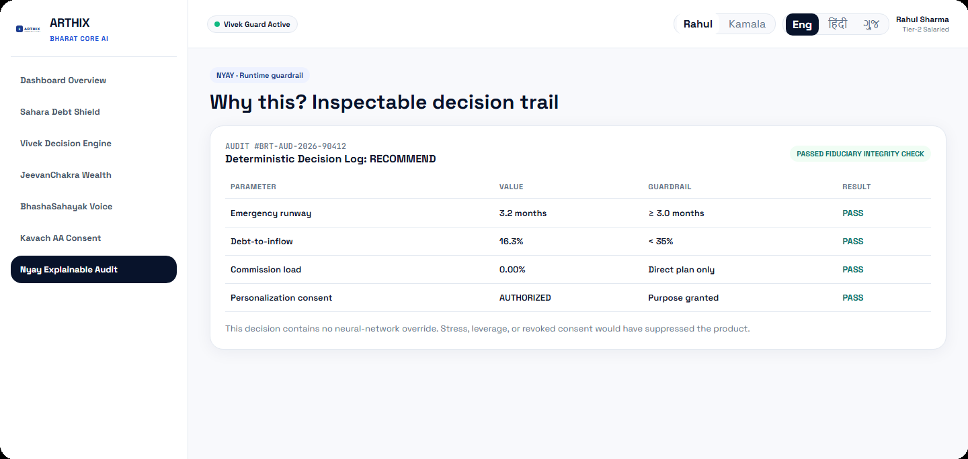
ARTHIX · CTRL FREAKS
Technology Stack & Implementation
What this repository actually runs — not a production wish-list.
FRONTEND
BACKEND
DATABASE
Next.js 14 · React 18
TypeScript · Tailwind · Lucide
Next.js Route Handlers
+ optional Express 5
SQLite via better-sqlite3
arthix.db auto-seeded
AI / ML (MVP)
AUTH / PRIVACY
TESTS / RUN
Deterministic rules + ranking
Intent templates · no LLM wired
Demo persona session token
Masked accounts · purpose consent
tsx suites · npm run dev :3000
npm run server :5000
MVP RUNTIME ARCHITECTURE
Customer
Next.js UI
API /api/v1
Services
SQLite
Vivek+Nyay
UI / locale
/ /login /consent /app
15 REST routes
7 Sanskrit modules
Seeded ledgers
Action + reasons
1 ArthBodh
2 JeevanChakra
3 Vivek
4 BhashaSahayak
Feature jobs on the sample ledger
Ranks; does not decide
4-state decision gates
HI · GU · EN grounded chat
5 Sahara
6 Kavach
7 Nyay
Nyay · inspectable ‘Why this?’ trail
Stress 0–100 · High → assist
Rule anomaly · never freeze
Consent · reasons · audit
Not in this MVP: live CBS / UPI / CKYC / bureau, Isolation Forest, K-Means, LLM API, Docker, voice.
ARTHIX · CTRL FREAKS · Hackathon prototype · Not RBI / DPDP certified
3 / 6

Slide 4
ARTHIX · CTRL FREAKS
Feasibility, Challenges & Risk Mitigation
Honest prototype assessment against the implemented MVP.
TECHNICAL
HIGH
OPERATIONAL
DEMO-READY
ECONOMIC
LOW COST
Seven modules, /api/v1, tests, and a runnable Next.js demo on sample ledgers.
Persona login, consent, dashboard, and 5-minute judge path are implemented.
Local SQLite. No paid model API in the MVP. Fits a hackathon budget.
SCALABILITY
CONTRACT-READY
DEPLOYMENT
LOCAL / SIMPLE
INTEGRATION
MOCKED RAILS
Decision contract (profile in → action + reasons out) can swap SQLite later.
npm run dev. No Docker in-repo. Production would need bank infra.
CBS, UPI, CKYC, OTP, DigiLocker, Google are honest demo adapters.
CHALLENGE → RISK → MITIGATION (each card reads left to right)
Sample-ledger intelligence
Quality depends on seeded txs, not live bureau.
Keep Vivek deterministic; label demo data; swap feature store later.
Mocked bank rails
Judges / users may read OTP/AA as live.
UI + README mark adapters as demo. Never claim live CBS/UPI.
AI accuracy / opacity
Black-box scoring would be unauditable.
No NN for decisions. Rule codes + EN/HI/GU reasons + Nyay log.
Consent / privacy
Financial data is sensitive; DPDP is statutory.
Purpose toggles, masked A/Cs, no PAN/Aadhaar stored, default-off model training.
Fraud false positives
Rule anomaly is a prototype, not a bank platform.
VERIFY with customer. Account is never auto-frozen.
Adoption / literacy
English-first apps cause KYC drop-off.
HI/GU/EN assistant, large type, one primary action, empty-state as a feature.
ARTHIX · CTRL FREAKS · Hackathon prototype · Not RBI / DPDP certified
4 / 6

Slide 5
ARTHIX · CTRL FREAKS
Impact & Benefits
Value shown on three seeded Bharat personas — not invented market statistics.
PRIMARY USERS
SECONDARY USERS
STAKEHOLDERS
Retail bank customers in Tier 2/3/4 and rural Bharat — first-time digital, salaried, and cashflow-stressed households.
Bank relationship staff / future RM workstation who need an inspectable reason instead of a propensity score.
Host bank (conduct + trust), regulators (explainability), and families protected from unsuitable credit.
SOLUTION
IMMEDIATE
USER
ORGANISATION
BHARAT
Vivek + Nyay
on consented context
Right action now:
recommend / assist / stop
Dignity, vernacular
help, inspectable why
Conduct risk ↓
trustworthy personalization
Fewer harmful loans;
better-timed suitable products
BEFORE vs AFTER (same engine, three ledgers)
₹15,120
Rahul monthly surplus
(seeded ledger)
Meena · first digital
English jargon KYC drop-off
Gujarati assist. No product dump.
16.3%
Rahul DTI · gate < 35%
Rahul · surplus
Offer fatigue / ULIP push
₹3,000 Direct Nifty 50 SIP + Why this?
82 / 100
Kamala Sahara stress
HIGH band
Kamala · stress
High-APR credit + collections
Credit suppressed. 60-day EMI relief path.
3 langs
Hindi · Gujarati · English
(text MVP, not voice)
ARTHIX · CTRL FREAKS · Hackathon prototype · Not RBI / DPDP certified
5 / 6

Slide 6

ARTHIX · CTRL FREAKS
References & Research Work
Sources actually used in the prototype. No project-report PDF was present in the workspace.
OFFICIAL & REGULATORY (cited in Vivek / Nyay)
RESEARCH PERFORMED IN THIS REPO
1. DPDP Act, 2023 — purpose-level consent
• Studied generic campaign / chatbot / separate-fraud stacks vs one fiduciary spine.
• Mapped three Bharat personas (Meena, Rahul, Kamala) to seeded ledgers.
• Chose rules over neural nets so a judge can replay every gate.
• K-Means, Isolation Forest, and LLM API remain documented production extensions — not shipped models.
Consent gate; model-improvement defaults to revoked.
2. RBI NBFC-Account Aggregator Master Directions
Consent-artifact pattern; AA UI is a mocked adapter in MVP.
3. RBI Guidelines on Digital Lending, 2022
Cited when suppressing aggressive unsecured credit under stress.
TECHNICAL REFERENCES
4. RBI Digital Lending Directions, 2025 (consolidation)
→ Next.js 14 App Router
→ Express 5
→ better-sqlite3
→ Tailwind CSS 3
→ ARTHIX GitHub
→ Project README / constitution
Production direction — not claimed as MVP certification.
5. SEBI — Investment Advisers / direct-plan discipline
Zero-commission Direct Nifty 50 SIP in the catalogue.
Scan repo
AumPethani05
/Arthix
6. RBI KYC Master Direction (guidance only in chat)
BhashaSahayak KYC help is a checklist, not live CKYC.
ARTHIX · CTRL FREAKS · Hackathon prototype · Not RBI / DPDP certified
6 / 6

