Slide 1

MeisterMatch
Swipe Right for the Perfect Fix – Connect with Vetted Skilled Workers in Under 2 Hours
Transforming Riga's gig economy, one swipe at a time

Slide 2

THE PROBLEM
Riga Has a Service Crisis
What Residents Face Daily
What Meisters Struggle With
Waiting days or weeks for urgent repairs – pipes burst, heaters fail, locks break
Inconsistent gig flow – feast or famine scheduling
Competing on price-only platforms like ss.lv
No-shows from ss.lv contractors who ghost after initial contact
No reputation system to showcase quality work
Payment disputes and delayed compensation
Scams and unreliable workers with no verification or ratings
Spending hours hunting for jobs instead of working
Winter emergencies: snow removal needs immediate response
Language barriers complicate finding trustworthy help

Slide 3

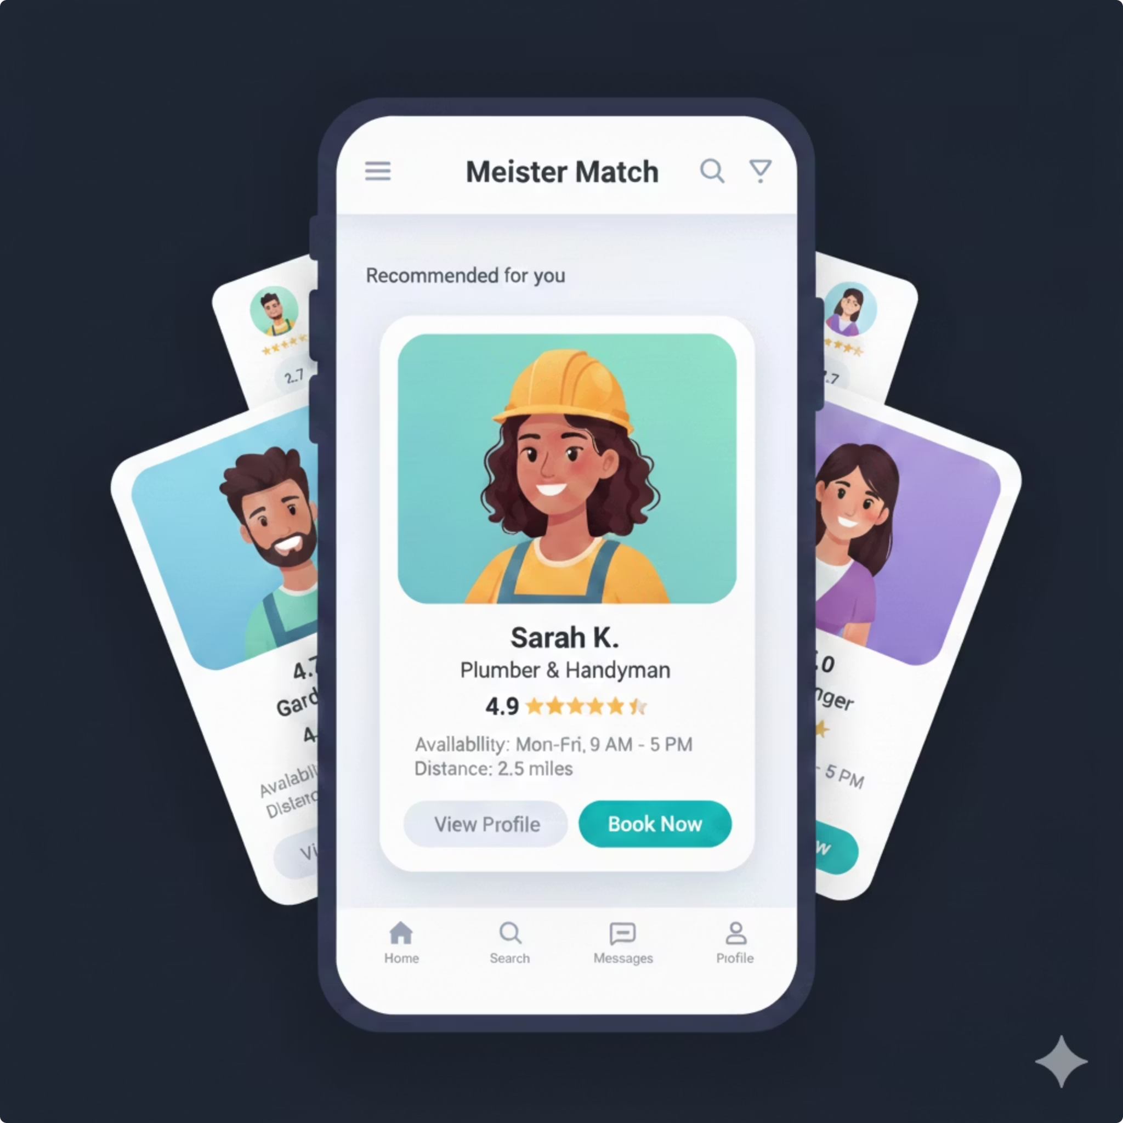
OUR SOLUTION
Swipe Away Your Stresses
Tinder-Style Matching
Post your urgent job and swipe through vetted meisters with ratings, photos, and real-time availability
Under 2 Hours
Matches happen in minutes – meisters arrive faster than ordering pizza
Fully Vetted
ID verification, background checks, and 4.8+ star ratings ensure quality and trust
Hyper-Local
Built for Riga neighborhoods with LV/RU/EN support and winter emergency badges

Slide 4
Why We Win
MeisterMatch outperforms legacy platforms on speed, trust, and user experience
Feature
MeisterMatch
ss.lv
GetaPro / Facebook
Response Time
✅ Under 2 hours
❌ 2-5 days (or ghosting)
⚠️ 1-2 days (unreliable)
Verification
✅ ID + background checks
❌ None
⚠️ Self-reported only
Ratings & Reviews
✅ 4.8+ stars required
❌ No system
⚠️ Inconsistent
Payments
✅ Secure in-app escrow
❌ Cash only (disputes)
⚠️ Direct (no protection)
Local Focus
✅ Riga neighborhoods + winter
❌ Generic Latvia-wide
❌ Not gig-specific
Mobile-First UX
✅ Swipe-to-match magic
❌ Desktop relic
⚠️ Clunky groups

Slide 5
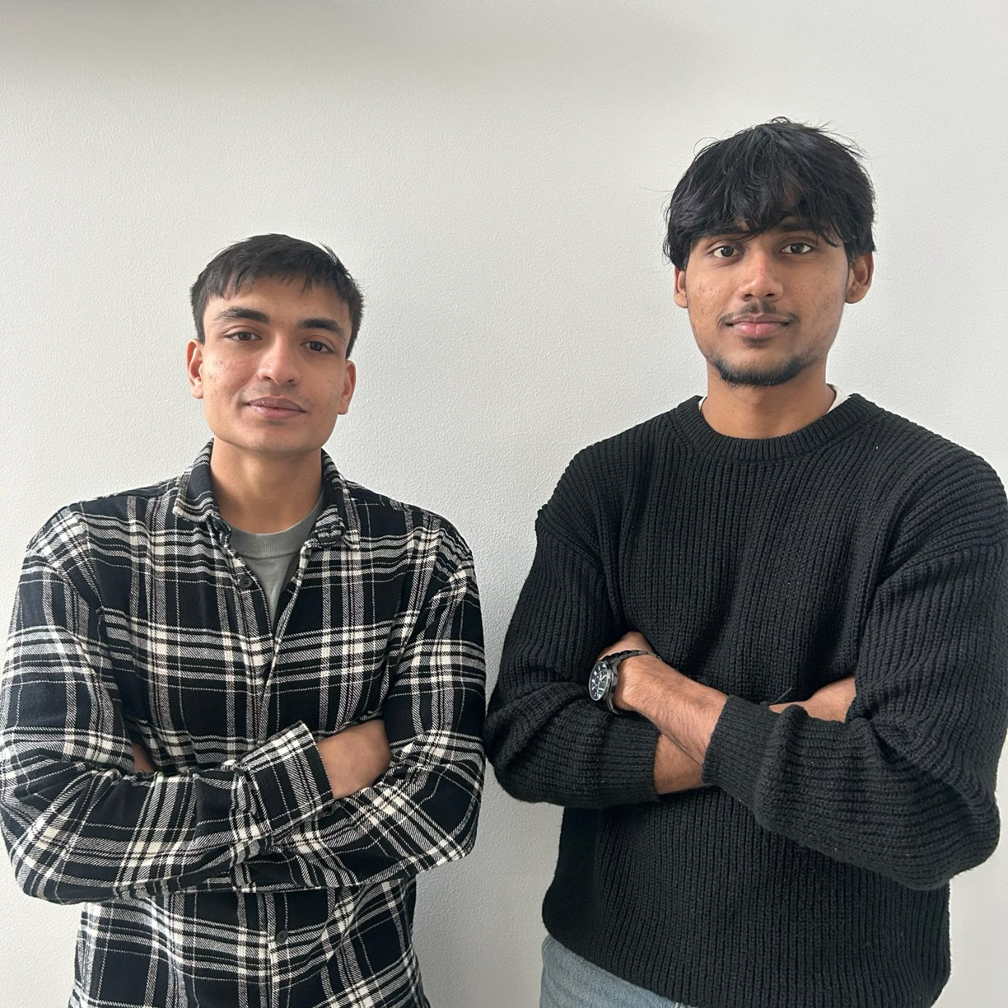
Our Team
Two passionate Computer Systems students at Riga Technical University, dedicated to leveraging our technical expertise to develop innovative, mission-driven solutions that address real-world challenges.

