Slide 1





AEROLINK
GROUP NO.10
AARYAN PRAVEEN
AISHWARYA PATIL
NILVI SHAH
AUM PATEL
CHAITYA VOHERA
PROFESSOR :
MANUEL MONTROND

Slide 2



ABOUT PROJECT
PROJECT OBJECTIVES
The surge in global air travel necessitates an updated Airlines Reservation System to cater to today's tech-savvy travelers. Our project focuses on developing a robust Airline Management System to oversee all operations efficiently. F﻿rom scheduling flights to managing reservations and handling customer support, the system aims to streamline airline operations effectively.
Streamline flight reservations
Enhance customer experience
Optimize airline operations
Manage flight information
Facilitate secure
transaction process

Slide 3

DESIGN SUMMARY
Defining System Needs :
Data Implementation :
To manage the Airline Database effectively, our initial task was determining the data to be stored, how to access the data, and analysis for overseeing the airline reservation system.
Upon completion of the ER diagram, we proceed to develop the DDL Commands and DML Insert Statements required for our database.
Structuring the Schema :
Enhancing Performance and Analytics :
Afterwards, we undertook the task of establishing the schema, outlining the different entity types like Flight, Airline, and Reservation, including their interrelationships and cardinalities, in line with the specified requirements.
For optimizing database performance,
we implemented indexes, views, procedures,
triggers, and UDFs to ensure the
database is finely tuned
for the anticipated workload.

Slide 4
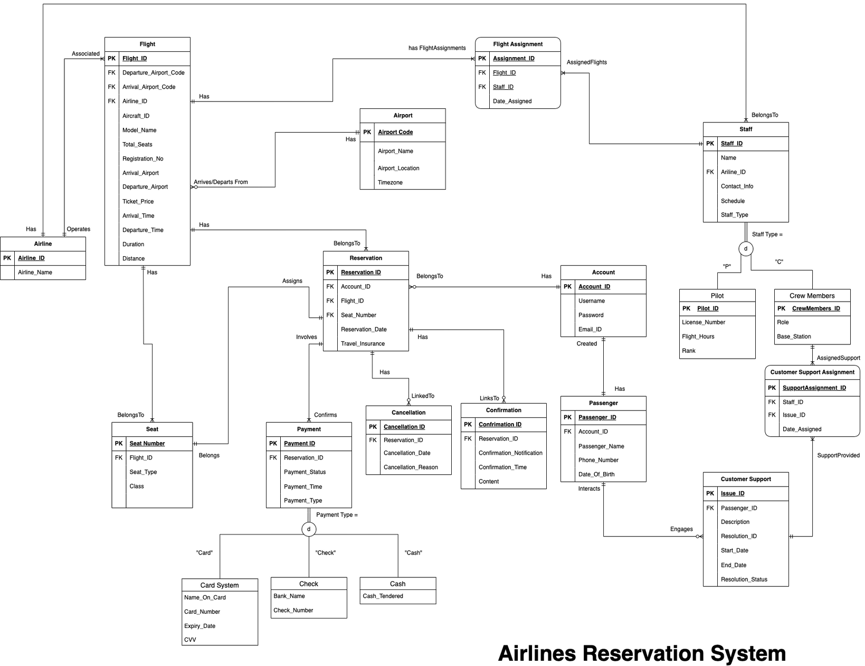
E-R
DIAGRAM

Slide 5
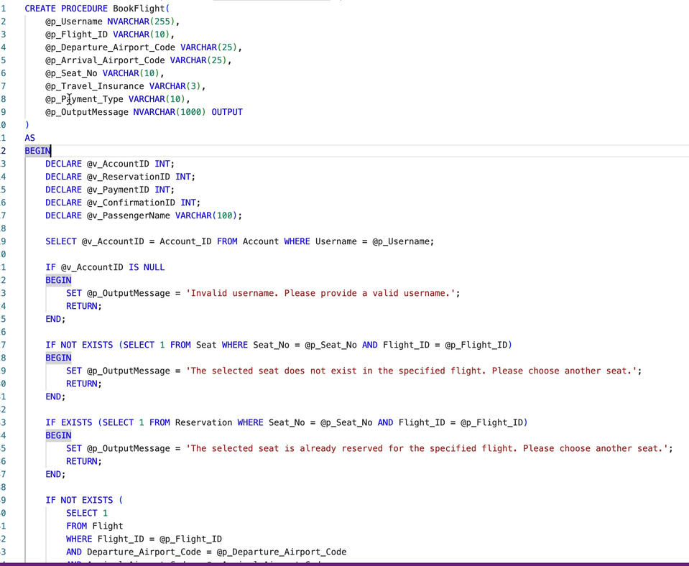
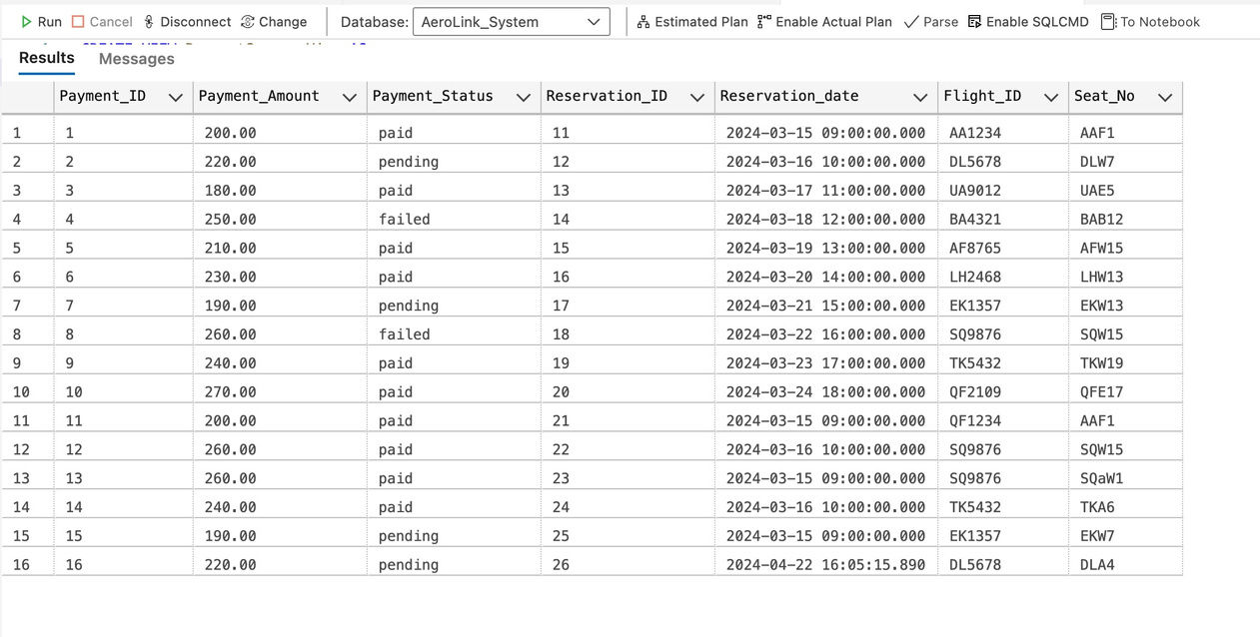
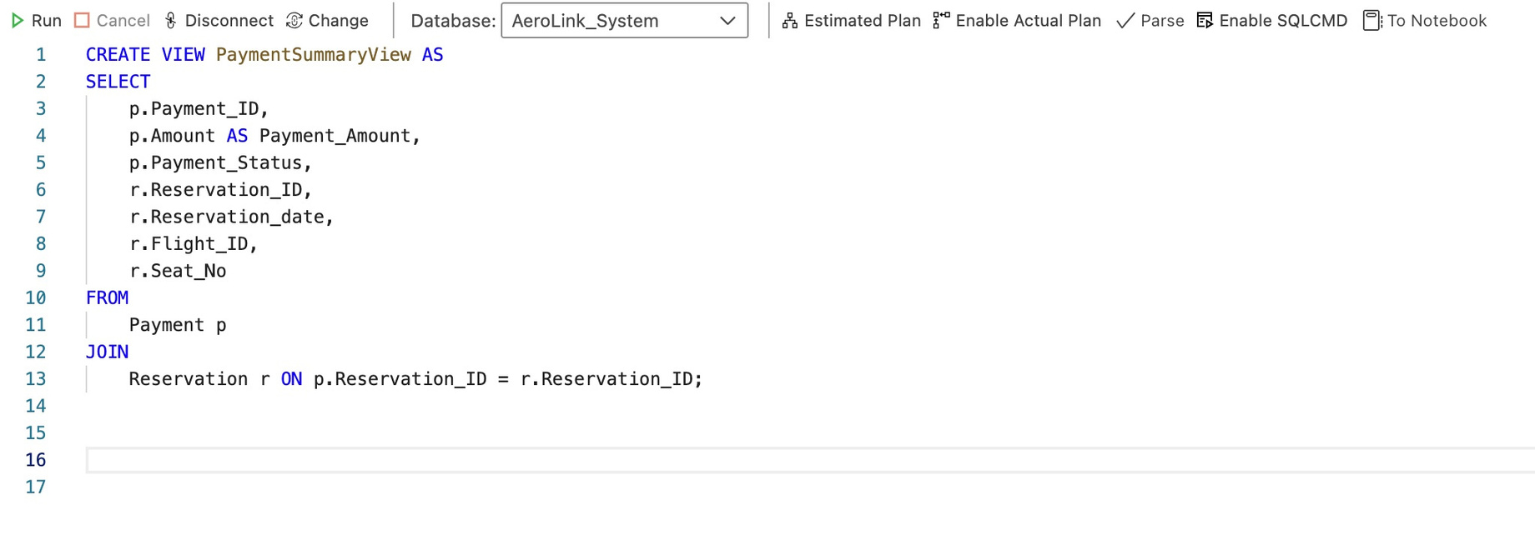
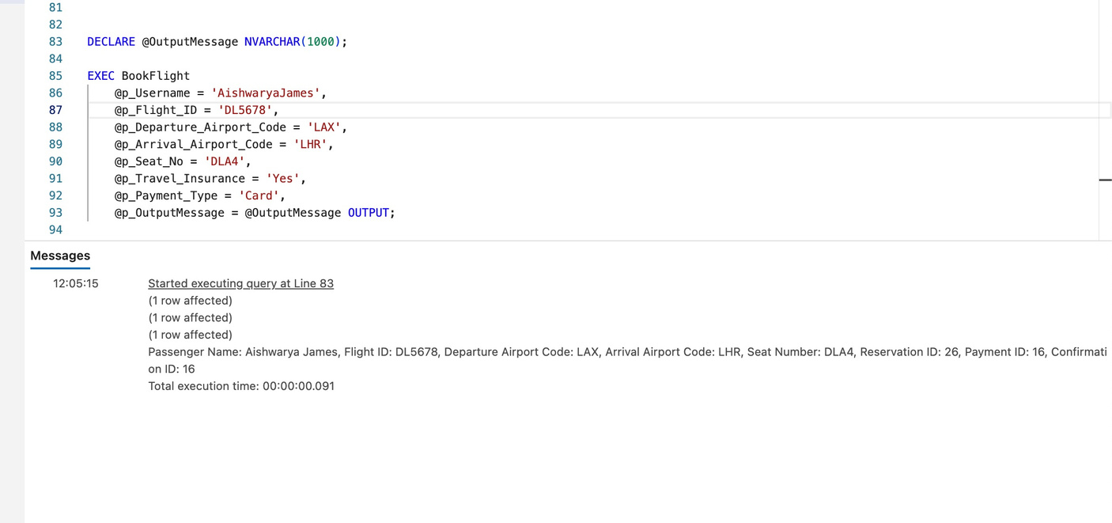
STORED PROCEDURE
VIEW
OUTPUT

Slide 6
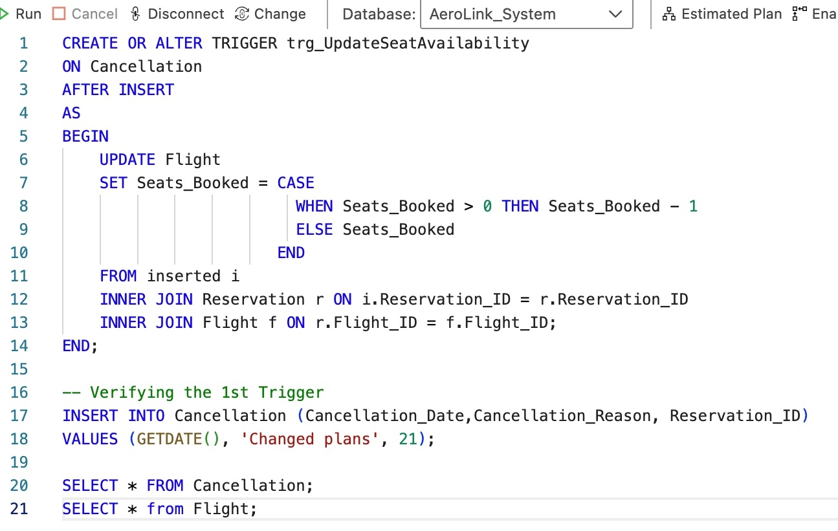
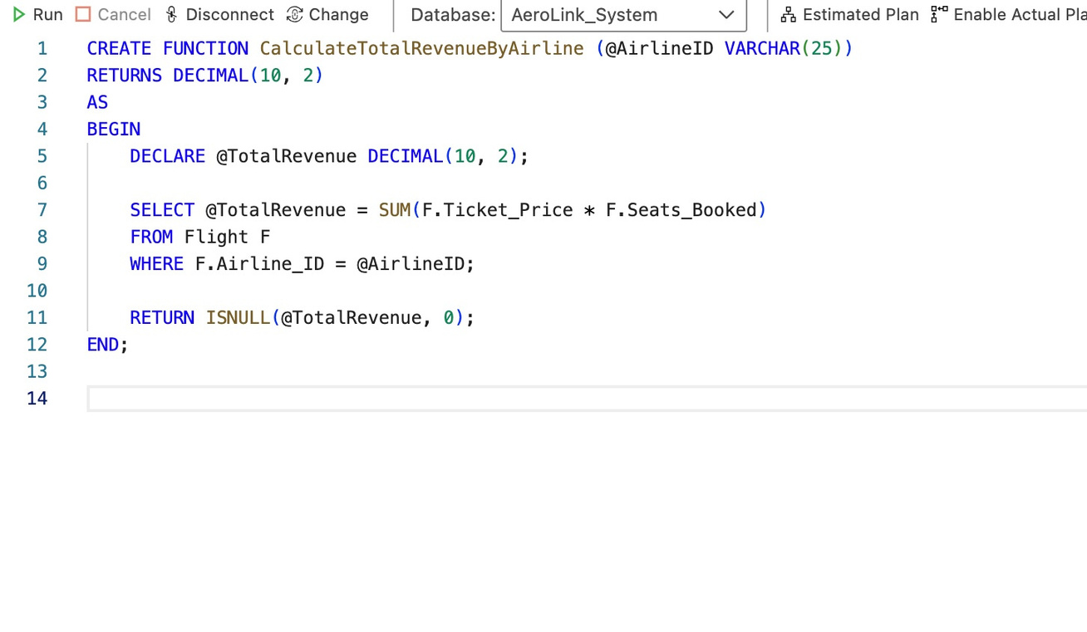
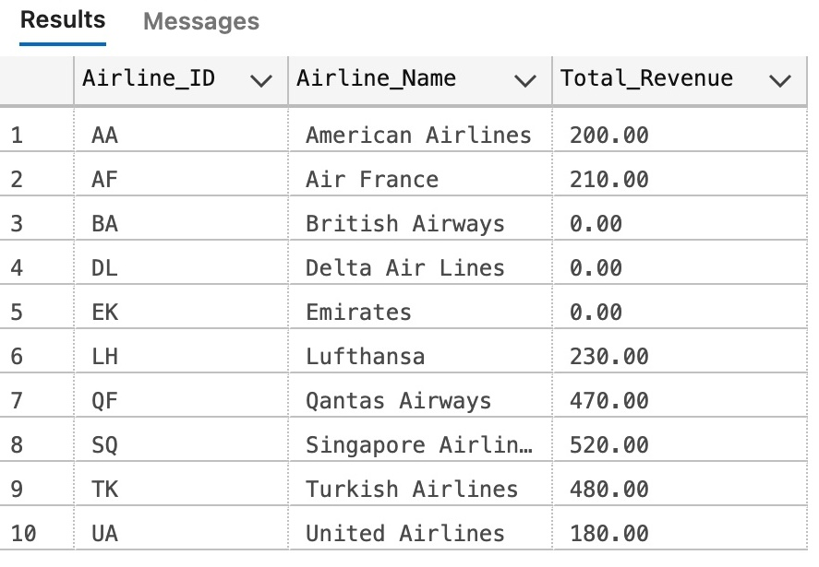
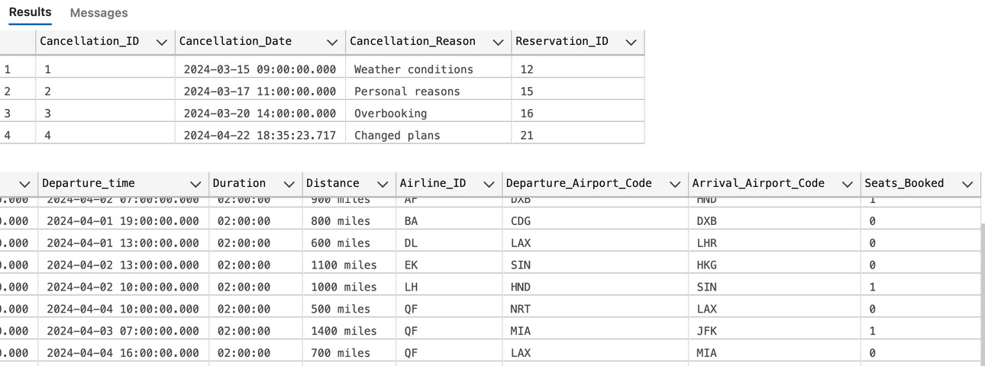
TRIGGERS
UDF
OUTPUT
OUTPUT

Slide 7
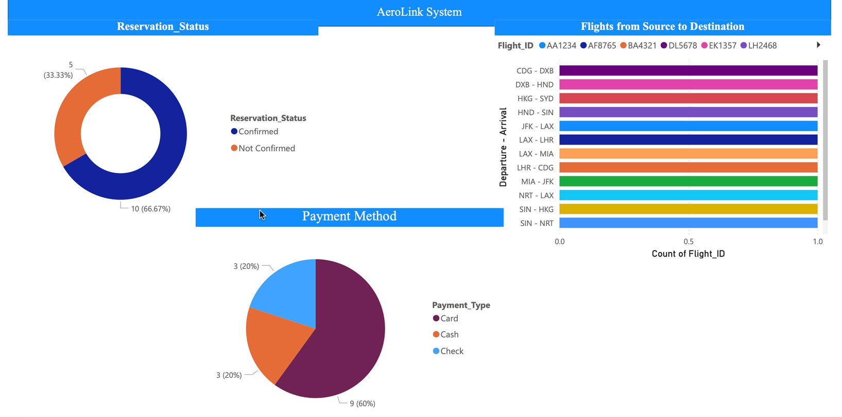
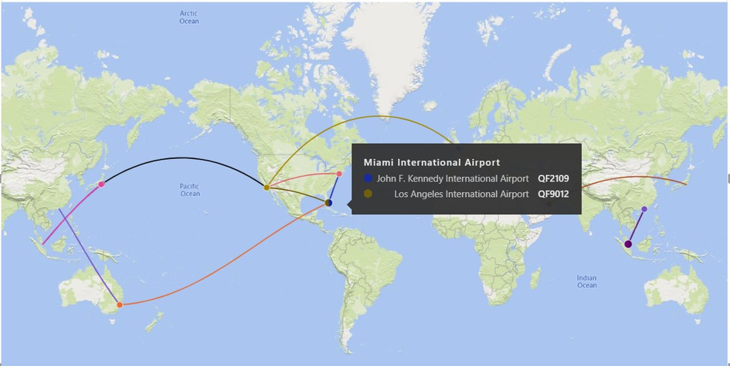
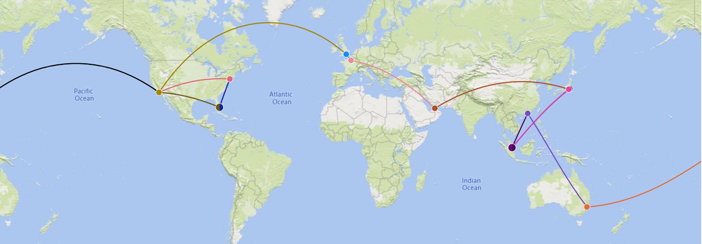
VISUALIZATIONS

Slide 8
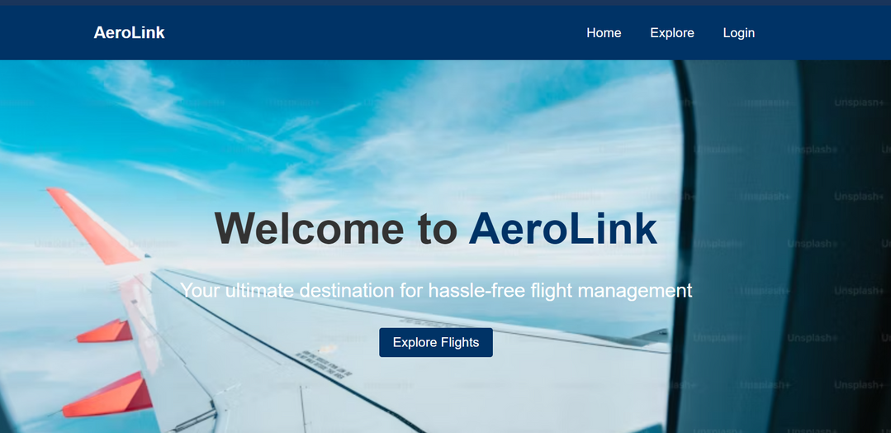
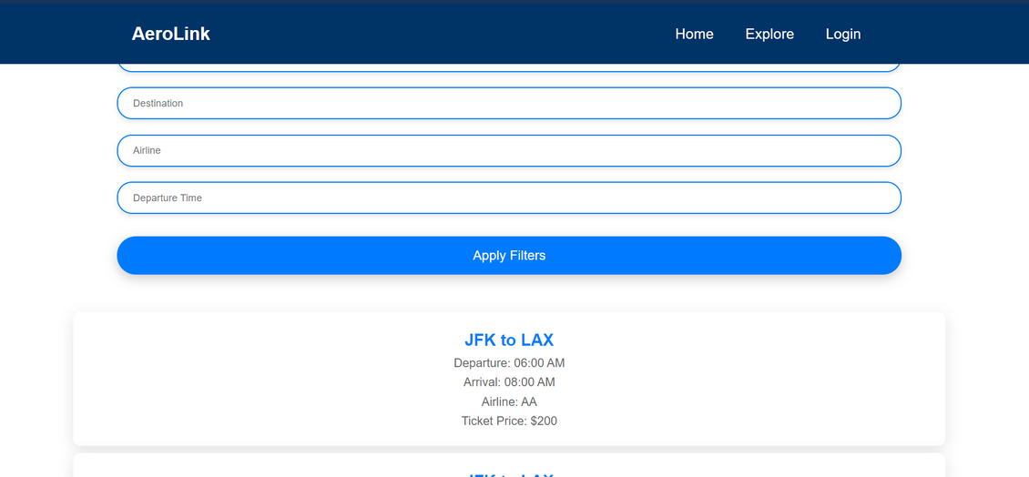
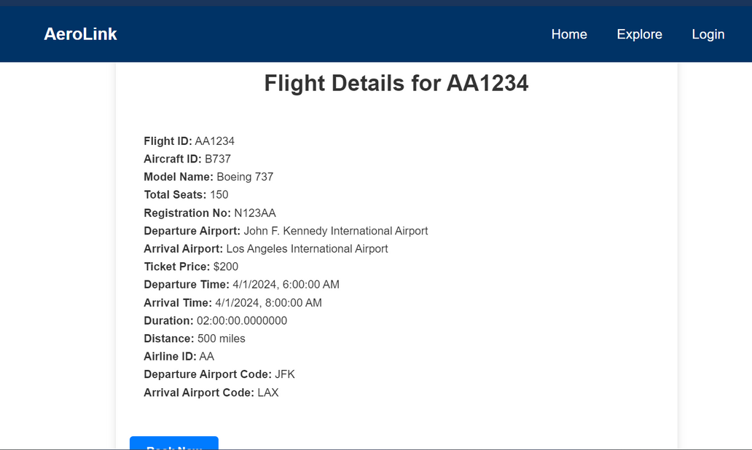
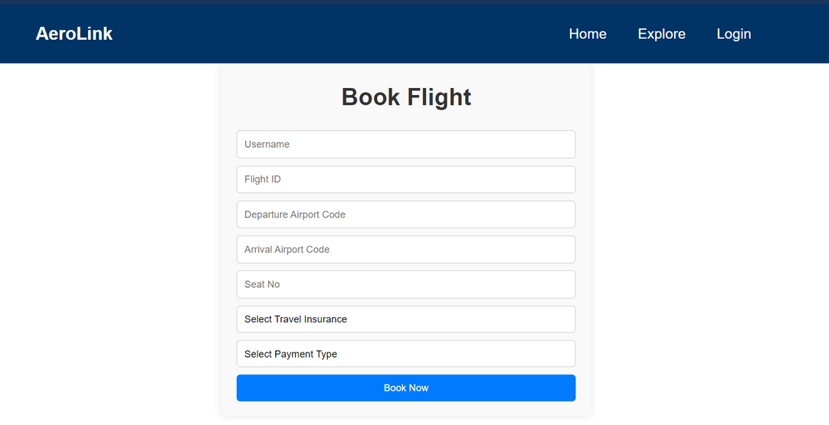
GUI

Slide 9
Thank you!
PROFESSOR MANUEL
GITHUB: https://github.com/Aumpatelarjun/DMDD_grp_10

