Slide 1
STOCK MANAGEMENT
Presented by
S Babu Sudarson 18BIT035
S Sankara Narayanan 18BIT051

Slide 2
STOCK MANAGEMENT FOR COMPANY
“Sudarson Traders” is a trading company located in Thoothukudi managed by “M.Sunairajan”.
It is a wholesale Rice shop.
To handle this company’s Sales, Purchases and Stock we created this Stock Management System.
So it is easier to calculate available stocks and sales.

Slide 3
STOCK MANAGEMENT SYSTEM
This project is targeted for the stock management
system in a rice shop.
Stock management is a very complex process which
also need a very efficient management.
It enhances correctness and reduces man power.
It also gives details about sales and the purchase.

Slide 4
SOFTWARE REQUIREMENTS
Front-End Design : JAVA
Back-End Database : MYSQL
Operating System : Windows 7 or higher.

Slide 5
CONCEPTS OF JAVA
JFrame
JButton
JPanel
JRadioButton
JMenu
JLabel

Slide 6
JFrame
JFrame is a class in Java and has its own methods and constructors. Methods are functions that impact the JFrame, such as setting the size or visibility.
Constructors are run when the instance is created, One constructor can create a blank JFrame, while another can create it with a default title.
The class JFrame is an extended version of java.awt.Frame that adds support for the JFC/Swing component architecture.
Eg : JFrame f=new JFrame();

Slide 7
JButton
JButton is a control component that has a label and generates an event when pressed.
When a button is pressed and released, AWT sends an instance of ActionEvent to the button, by calling processEvent on the button.
Eg : b=new JButton("Login");
b.addActionListener(this);

Slide 8
JTextField
The object of a JTextField class is a text component that allows the editing of a single line text. It inherits JTextComponent class.
JTextField t1=new JTextField(15);
JPasswordField
The object of a JPasswordField class is a text component specialized for password entry. It allows the editing of a single line of text. It inherits JTextField class.
JPasswordField t1=new JPassworldField(15);

Slide 9
JLabel
JLabel is a class of java Swing .
JLabel is used to display a short string or an image icon.
JLabel can display text, image or both .
JLabel is only a display of text or image and it cannot get focus .
JLabel is inactive to input events such a mouse focus or keyboard focus.
Eg: l1=new JLabel("Username");

Slide 10
Jmenu
The JMenuBar class is used to display menubar on the window or frame. It may have several menus.
The object of JMenu class is a pull down menu component which is displayed from the menu bar. It inherits the JMenuItem class.
The object of JMenuItem class adds a simple labeled menu item. The items used in a menu must belong to the JMenuItem or any of its subclass.

Slide 11
JPanel
The JPanel is a simplest container class. It provides space in which an application can attach any other component. It inherits the JComponents class. It doesn't have title bar.
Eg :
JPanel p=new JPanel();
p.setLayout(new java.awt.FlowLayout());
p.add(l1);

Slide 12
JRadioButton
The JRadioButton class is used to create a radio button. It is used to choose one option from multiple options. It is widely used in exam systems or quiz. It should be added in ButtonGroup to select one radio button only.
Eg :
j1=new JRadioButton("Search by ID");
j1.addActionListener(this);
panel.add(j1);

Slide 13
MouseListener
The Java MouseListener is notified whenever you change the state of mouse. It is notified against MouseEvent. The MouseListener interface is found in java.awt.event package. It has five methods.
Methods of MouseListener interface
The signature of 5 methods found in MouseListener interface are given below:
public abstract void mouseClicked(MouseEvent e);
public abstract void mouseEntered(MouseEvent e);
public abstract void mouseExited(MouseEvent e);
public abstract void mousePressed(MouseEvent e);
public abstract void mouseReleased(MouseEvent e);

Slide 14
Java KeyListener Interface
The Java KeyListener is notified whenever you change the state of key. It is notified against KeyEvent. The KeyListener interface is found in java.awt.event package. It has three methods.
Methods of KeyListener interface
The signature of 3 methods found in KeyListener interface are given below:
public abstract void keyPressed(KeyEvent e);
public abstract void keyReleased(KeyEvent e);
public abstract void keyTyped(KeyEvent e);

Slide 15
Action Listener
ActionListener is an interface (not a class) that contains a single method:
public void actionPerformed( ActionEvent evt) ;
A class that implements the interface must contain an actionPerformed() method. The ActionEvent parameter is an Event object that represents an event (a button click).
Eg:The actionPerformed() method is invoked automatically whenever you click on the registered component.
public abstract void actionPerformed(ActionEvent e);

Slide 16
CONCEPTS OF MYSQL
Insert
The INSERT INTO statement is used to insert new records in a table.
Eg :
INSERT INTO table_nameVALUES (value1, value2,value3, ...);
insert into users values(username,password);

Slide 17
Update
There may be a requirement where the existing data in a MySQL table needs to be modified. You can do so by using the SQL UPDATE command. This will modify any field value of any MySQL table.
Syntax :
The following code block has a generic SQL syntax of the UPDATE command to modify the data in the MySQL table −
UPDATE table_name SET field1 = new-value1, field2 = new-value2
[WHERE Clause]
update vendor set ADDRESS='"+ad+"' where VENDID="+no+";

Slide 18
Delete
If you want to delete a record from any MySQL table, then you can use the SQL command DELETE FROM.
Syntax :
DELETE FROM table_name [WHERE Clause]
Eg :
Delete from cust where cusid=11;

Slide 19
Select
The SQL SELECT command is used to fetch data from the MySQL database
SELECT field1, field2,...fieldn
FROM table_name1, table_name2...
[WHERE Clause]
[OFFSET M ][LIMIT N]
Select * from buyv;
select PRODNAME from product;

Slide 20
Java Database Connectivity with MySQL
To connect Java application with the MySQL database, we need to follow 5 following steps.
Register the Driver.
Create a connection.
Create SQL Statement.
Execute SQL Statement.
Closing the connection.

Slide 21
Register the Driver
The specified class loader is used to load the class or interface. If the parameter loader is null, the class is loaded through the bootstrap class loader.
The class is initialized only if the initialize parameter is true and if it has not been initialized earlier.
Class.forName("com.mysql.cj.jdbc.Driver");

Slide 22
Opening Connection
The JDBC Connection class, java.sql.Connection, represents a database connection to a relational database. Before you can read or write data from and to a database via JDBC, you need to open a connection to the database.
Eg :
Connectionconn=DriverManager.getConnection("jdbc:mysql://localhost:3306/Project","root",“password");
Statement interface resides in java. sql package and it is used to execute a static SQL statement and returning the result of the executed query. Statement interface has two sub-interfaces CallableStatement and PreparedStatement
Eg :
Statement smt=conn.createStatement();

Slide 23
Executing a SQL Statement
Interface ResultSet. A table of data representing a database result set, which is usually generated by executing a statement that queries the database. A ResultSet object maintains a cursor pointing to its current row of data. Initially the cursor is positioned before the first row.
Eg :
ResultSet rs1=smt.executeQuery("select * from cust where cusid='"+no+"';");
smt.executeUpdate("update vendor set VENDPHNO="+no+" where VENDID="+no1+";");

Slide 24
FEATURE DESCRIPTION
The followings are the features used in our software
Add new item
Purchase
Sales
Customer Details
Vendor Details
Report Viewing

Slide 25
REPORTS
We can view reports like:
Sales of a Day
Purchase of a Day
Sales to a Customer
Purchase from a Vendor

Slide 26
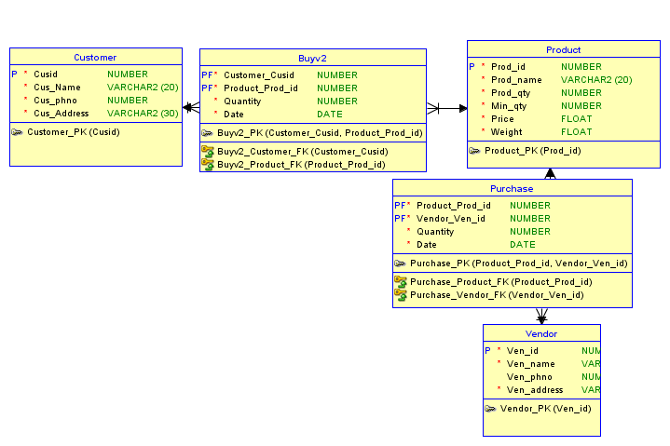
Entity Relationship Diagram

Slide 27
CODE

Slide 28
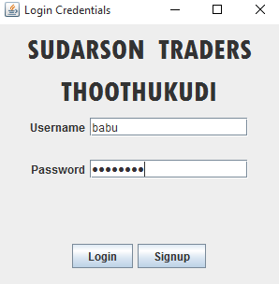
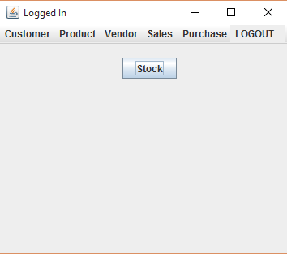
GUI SCREENSHOTS

Slide 29
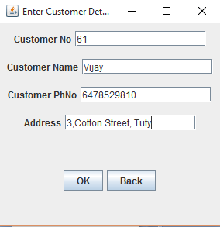
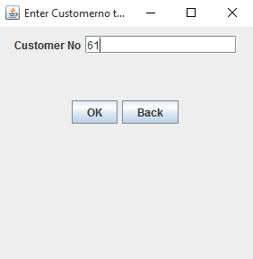
Insert and Delete Customer

Slide 30
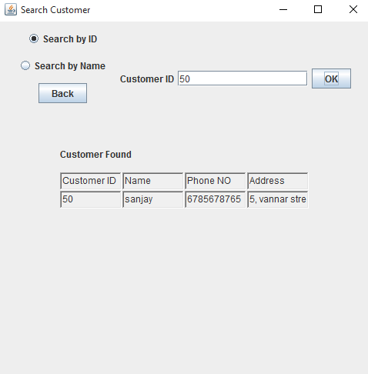
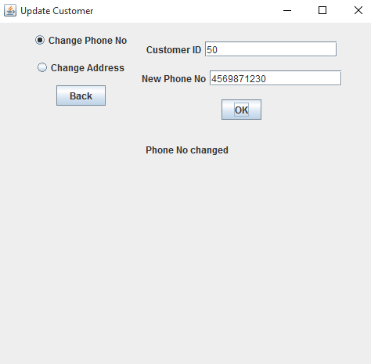
Search and Update Customer

Slide 31
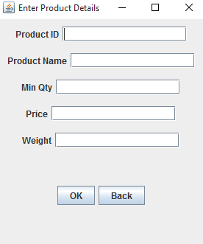
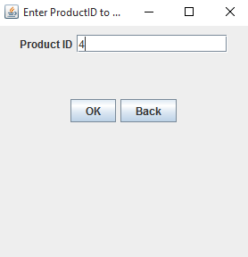
Insert and Delete Product

Slide 32
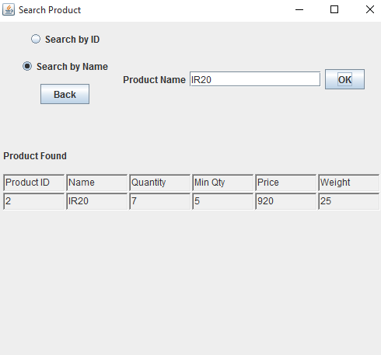
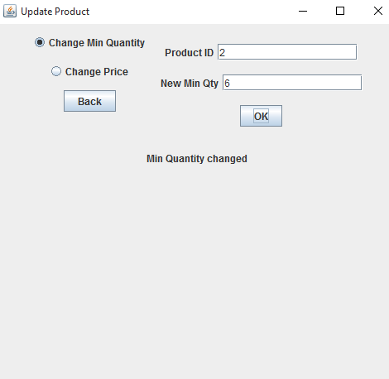
Search and Update Product

Slide 33
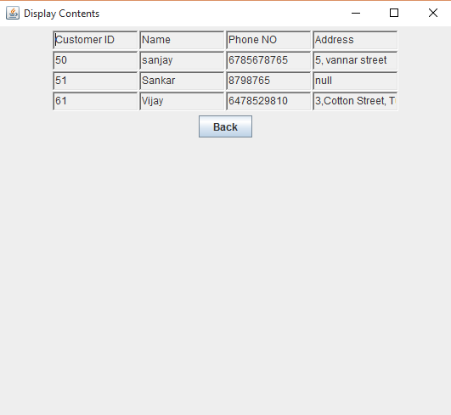
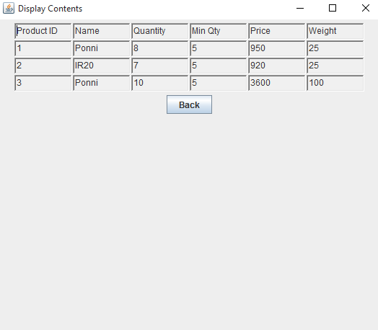
Display of Customer and Product

Slide 34
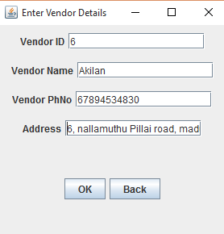
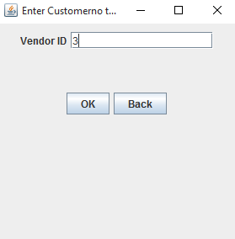
Insert and Delete Vendor

Slide 35
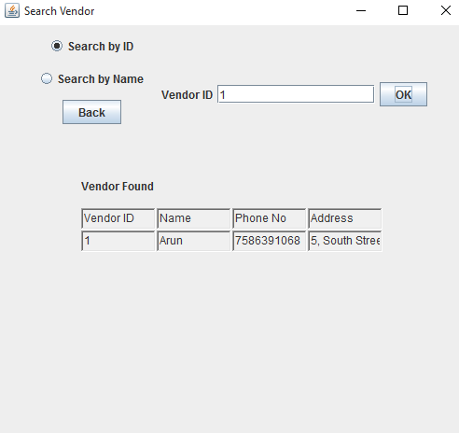
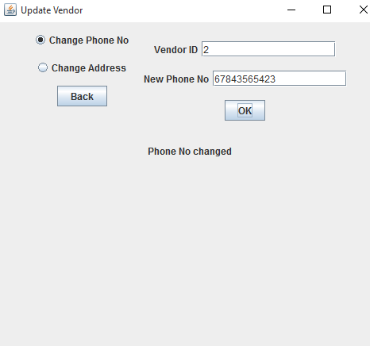
Search and Update Vendor

Slide 36
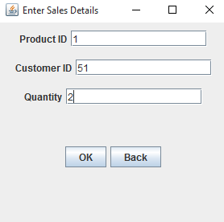
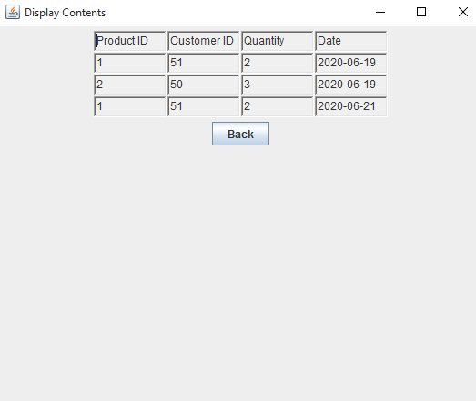
Sales Entry

Slide 37
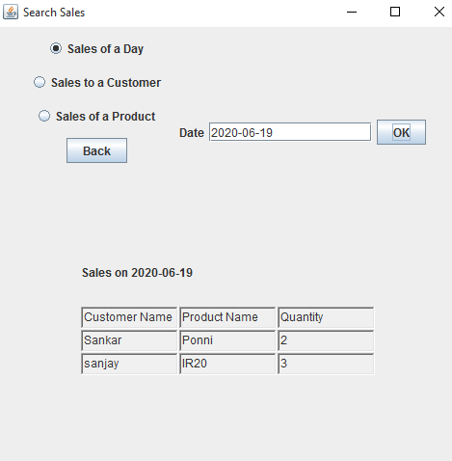
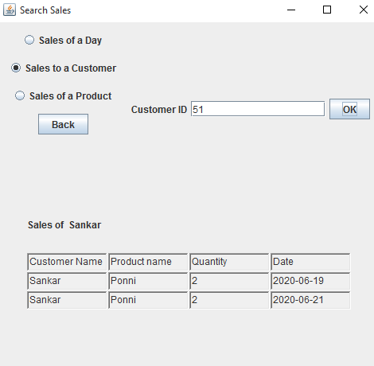
Sales Report

Slide 38
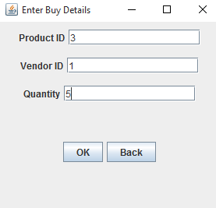
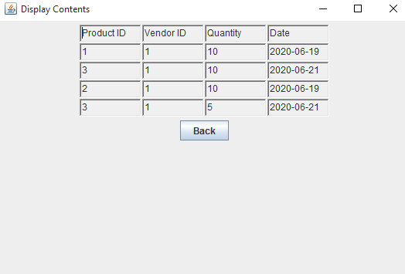
Purchase Entry

Slide 39
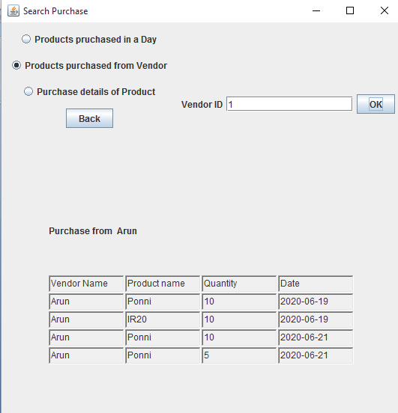
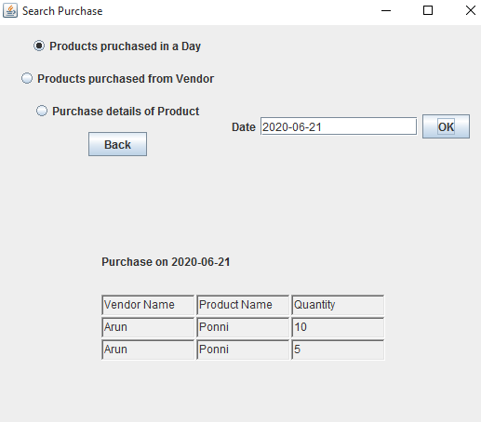
Purchase Report

Slide 40
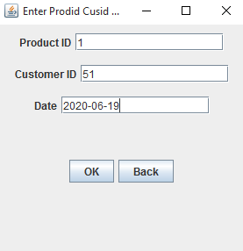
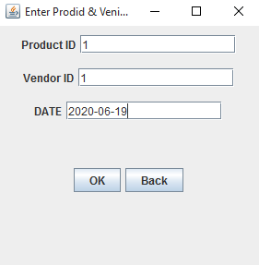
Remove Sale and Purchase

Slide 41
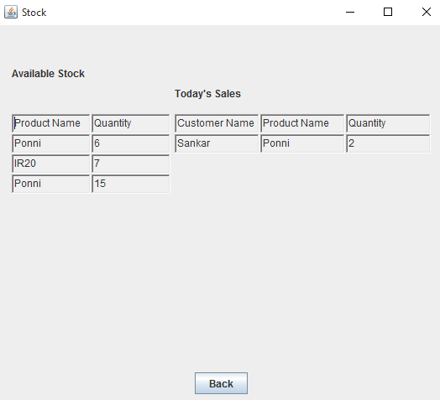
STOCK

Slide 42
CONCLUSION
The system is designed to reduce human labour and efficiently maintaining the stock.
It provides flexible and powerful reports regarding items, purchase and sales.

Slide 43
THANK YOU

