Slide 1
Lan Network with Redundancy
By-
Aum Shah(RA2011003010872)
Sheetal Jatav(RA2011003010885)
Pooja Jalan(RA2011003010867)

Slide 2
Problem Statement
To implement LAN Network design with redundancy with HSRP
The organization’s network has to be upgraded by having dual intermediate routers which would automatically failover, and provide high availability access to the internet.

Slide 3
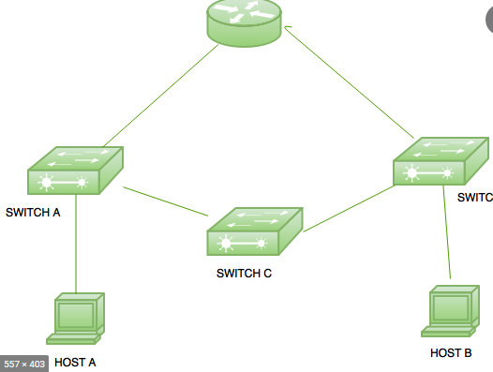
What is Network Redundancy
Network redundancy is a process through which additional or alternate instances of network devices, equipment and communication mediums are installed within network infrastructure.
It is a method for ensuring network availability in case of a network device or path failure and unavailability.

Slide 4
Why is network redundancy important?
Reducing chances of network failure: Your network is more likely to stay running and connected with a network redundancy plan.
Optimizing time and money: Damage to your network can cost organizations in time, money and human resources.
Raising network uptime: Network uptime refers to how long your business's network remains running.
Improving company security: Network redundancy helps protect your company against physical damage to your network

Slide 5
Without any backup systems in place, all it takes is one point of failure in a network to disrupt or bring down an entire system.
OUR OBJECTIVES

Slide 6
Functionality
A network which has redundancy in the design to to be setup for an organization. The organization is currently having an internet connection, which is setup using a Cisco router. The gateway addresses for users in the LAN is currently provided as an intermediate routers address, which would then forward all internet bound packets to the internet router. The network has to be upgraded by having dual intermediate routers which would automatically failover, and provide high availability access to the internet. HSRP is to be used for the deployment. The project identifies the configurations required on Cisco routers to achieve the same.
Networking Requirements
LAN IP Network Design
Network Topology Diagram
Configurations required on the routers to setup high availability with HSRP.
Configurations required on the routers to setup appropriate IP address and internet packet forwarding on the routers.
Configurations required on the LAN PC’s for appropriate gateway parameters.
Verification and Testing Procedure

Slide 7
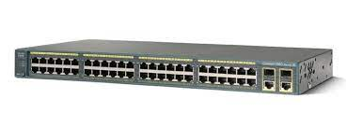
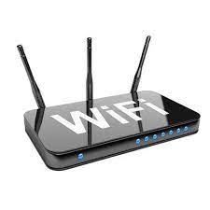
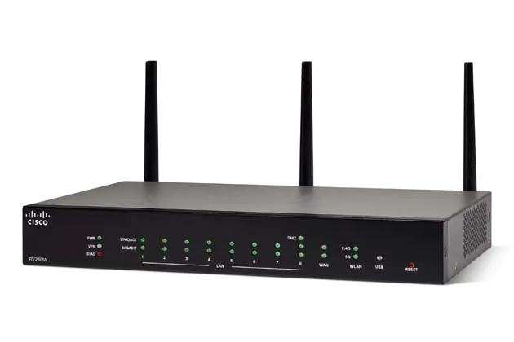

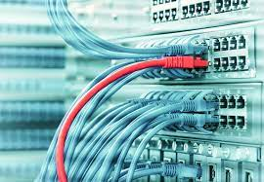
Hardware Requirements
1.Cisco routers ( 2 nos)
Cisco switches ( 2 nos)
3.Internet router (Internet not mandatory)
5.Network cables.
4.PC (As per requirement)

Slide 8
What Are The Different Types Of Network Redundancies?
Multiple Spanning Trees (MST)
Ring Networks
Diverse Trunking
Multi-Protocol Label Switching (MPLS)

Slide 9
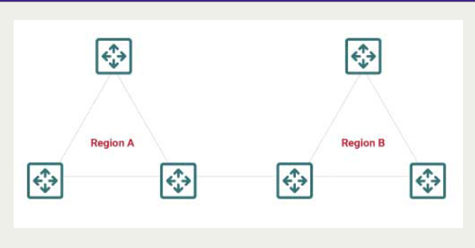
Multiple Spanning Trees (MST)
MST supports load-balancing capability while still allowing for scalability. It enables the designated administrator to plan out a random number of VLANs to one MST instance. As a result, there are the least number of instances essential to satisfy a design.

Slide 10
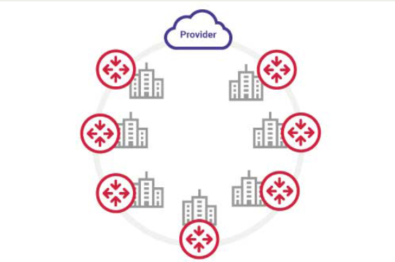
Ring Network
A ring network is a type of topology in which nodes are connected in a closed loop (ring) configuration.

Slide 11
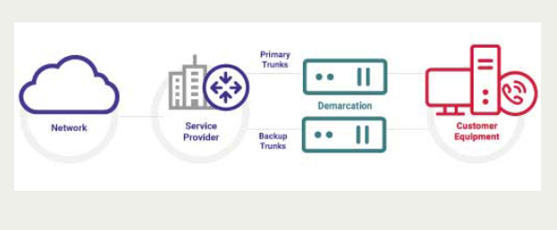
Diverse Trunking
Diverse trunking provides communications and network access between two switching centers. A trunk can consist of multiple wires, cables, or fiber optic strands bundled together in a single physical sheath.

Slide 12
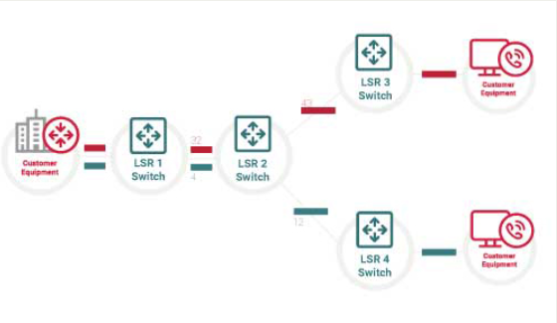
Multi-Protocol Label Switching (MPLS)
A MPLS cloud is a meshed and redundant network in which data packets are assigned labels that specify the paths or routes for transmission across the network.

Slide 13
Protocols for management of redundant routers:
HSRP
VRRP
GLBP

Slide 14
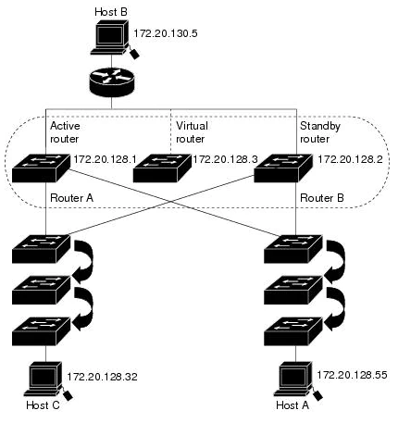
HSRP
Hot Standby Router Protocol or HSRP is Cisco’s standard method of providing high network availability by providing first-hop redundancy for IP hosts configured with a default gateway IP address.
HSRP routes IP traffic without relying on the availability of any single router.

Slide 15
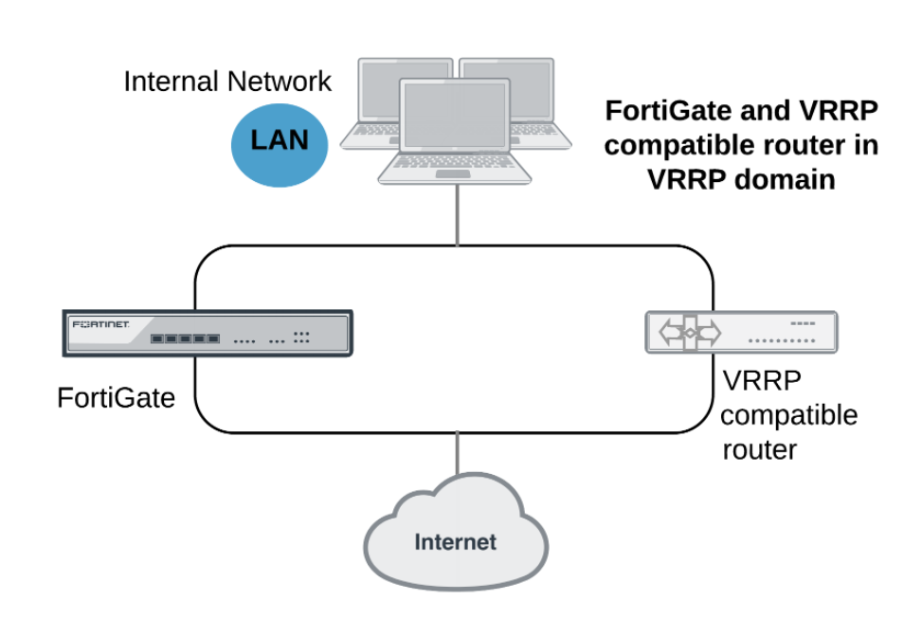
VRRP
The Virtual Router Redundancy Protocol (VRRP) eliminates the single point of failure inherent in the static default routed environment.
VRRP specifies an election protocol that dynamically assigns responsibility for a virtual router to one of the VPN Concentrators on LAN.

Slide 16
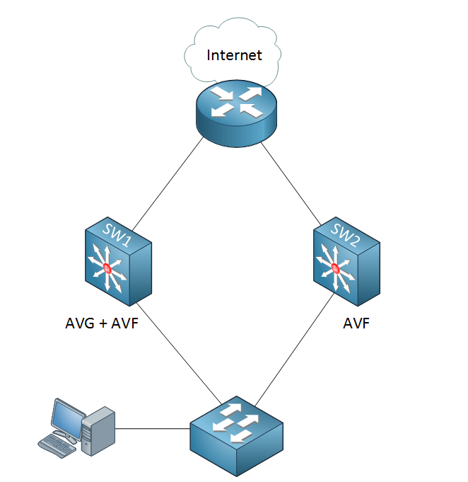
GLBP
GLBP stands for Gateway Load Balancing Protocol and just like HSRP / VRRP it is used to create a virtual gateway.
One of the key differences of GLBP is that it can do load balancing without the group configuration.

Slide 17
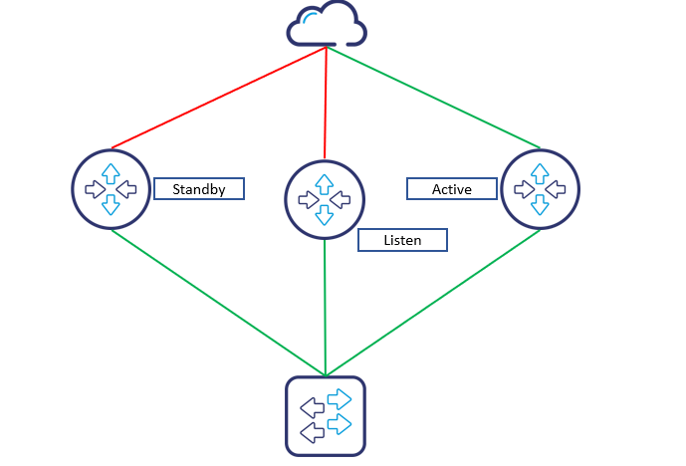
The one we will implement will be HSRP it is a proprietary protocol from Cisco.
It is a routing protocol that provides backup to a router in the event of link or hardware failure.
Using HSRP, several routers are connected to the same segment of an Ethernet and work together to present the appearance of a single virtual router on the LAN.
The most efficient method

Slide 18
Switches and routers
Subnet connections
Backup
Power
WAN and SD-WAN
OTHER FACTORS TO KEEP IN MIND WHILE DESIGNING NETWORK REDUNDANCY

Slide 19
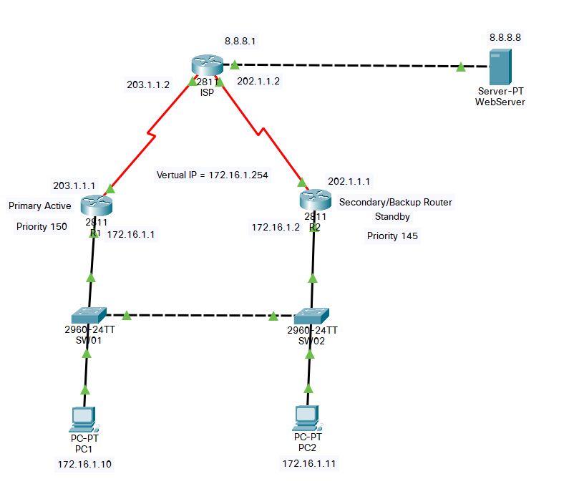
Network Topology Diagram

Slide 20
Design constraints
-Recovery time speed
-Weak security
-Cisco proprietary protocol

