Slide 1
CAPSTONE PROJECT-II
BIKE SHARING DEMAND PREDICTION
(Supervised Machine Learning Regression)
Presented By:
Mohd Aun Farooqui

Slide 2
AGENDA:
INTRODUCTION
PROBLEM STATEMENT
WORKFLOW
DATA COLLECTION AND UNDERSTANDING
DATA WRANGLING AND FEATURE ENGINEERING
EXPLORATORY DATA ANALYSIS
PREPARATION OF DATA FOR MODEL BUILDING
FEATURE MANIPULATION
FEATURE IMPORTANCE
MODEL SELECTION AND VALIDATION
CONCLUSION

Slide 3
INTRODUCTION
Bike-sharing services have become increasingly popular in recent years due to their cost-effectiveness, convenience, and environmental sustainability. With the growing demand for such services, it becomes essential for service providers to accurately predict the demand for bikes to meet the needs of their customers. This is where machine learning comes into play, as it provides an efficient way to predict bike rental demand by analyzing various factors like weather conditions, time of day, day of the week, etc.
In this project, we aim to develop a machine learning model that accurately predicts the number of bikes rented at a given time based on the available data. The dataset used in this project is obtained from a bike-sharing service provider, and it contains various parameters like date, time, temperature, humidity, windspeed, etc., which can be used to predict bike rental demand

Slide 4
PROBLEM STATEMENT:
Currently Rental bikes are introduced in many urban cities for the enhancement of mobility comfort. It is important to make the rental bike available and accessible to the public at the right time as it lessens the waiting time. Eventually, providing the city with a stable supply of rental bikes becomes a major concern. The crucial part is the prediction of bike count required at each hour for the stable supply of rental bikes.

Slide 5
WORKFLOW:
Data Collection And Understanding
Data Wrangling And Feature Engineering
Exploratory Data Analysis (EDA)
Preparation of Data For Model Building
Model Selection And Evaluation
Conclusion

Slide 6
DATA COLLECTION AND UNDERSTANDING:
We had Seoul Bike Data for our analysis and model building
The Dataset contain weather information (Temperature, Humidity, Wind Speed, Visibility, Solar Radiation and Rainfall), the number of bike rented per hour and date information.
In this we had total 8760 observations and 14 features including target variable.
DATA DESCRIPTION:
Date - year-month-day
Rented Bike count - Count of bikes rented at each hour
Hour - Hour of the day
Temperature-Temperature in Celsius
Humidity - %
Windspeed - m/s
Visibility - 10m
Dew point temperature - Celsius
Solar radiation - MJ/m2
Rainfall - mm
Snowfall - cm
Seasons - Winter, Spring, Summer, Autumn
Holiday - Holiday/No holiday
Functional Day - NoFunc(Non Functional Hours), Fun(Functional hours)

Slide 7
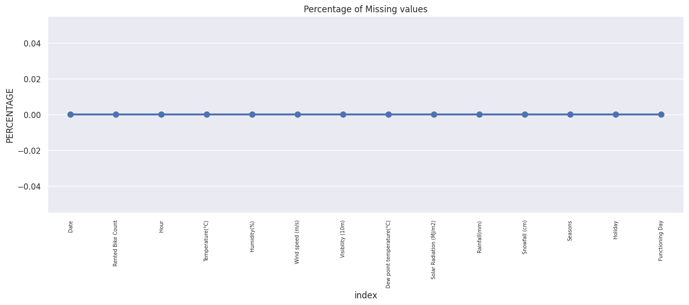
DATA WRANGLING AND FEATURE ENGINEERING:
As we know, we had 8760 observations and 14 features.
Categorical Features: Seasons, Holidays and Functioning days.
Numerical Columns:
Date, Hour, Temperature, Humidity, Wind Speed, Visibility, Dew Point Temperature, Solar Radiation, Rainfall, Snowfall and Rented Bike Count.
We had zero null values in our dataset.
Zero duplicate entries found.

Slide 8
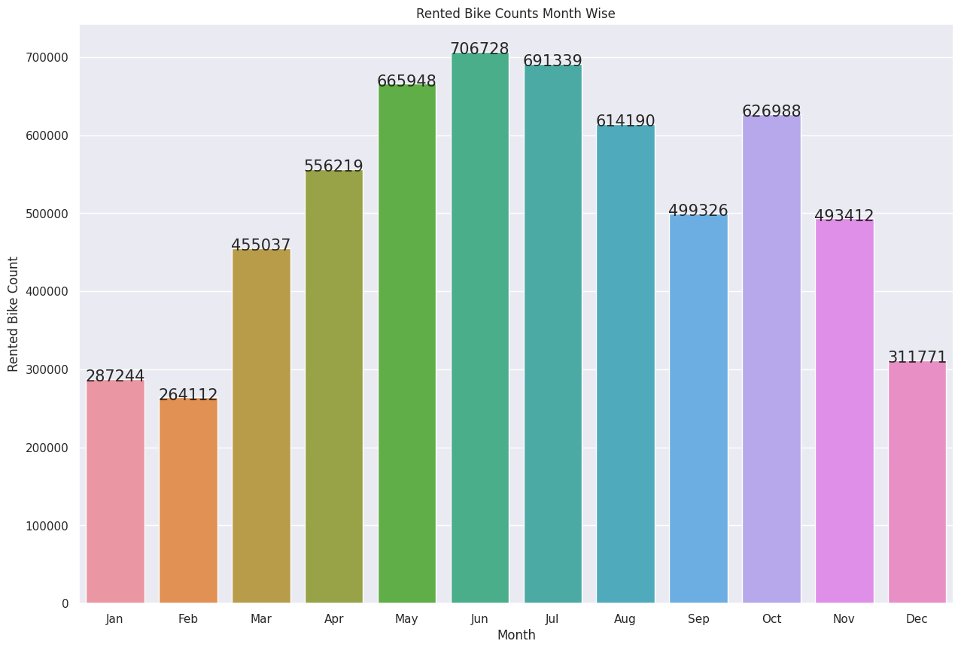
EXPLORATORY DATA ANALYSIS:
ANALYSIS BASED ON RENTED BIKE COUNT MONTH WISE:
The number of rented bikes is generally higher in the summer months (May, June, July, and August), which could be due to the warmer weather and people spending more time outdoors.
The number of rented bikes is generally lower in the winter months (December, January, and February), which could be due to colder temperatures and more inclement weather.
There is a steady increase in the number of rented bikes from January to June, followed by a gradual decrease from July to December.
The annotations added to each bar provide additional information about the exact number of bikes rented per month, making it easy to compare and analyze the data.

Slide 9
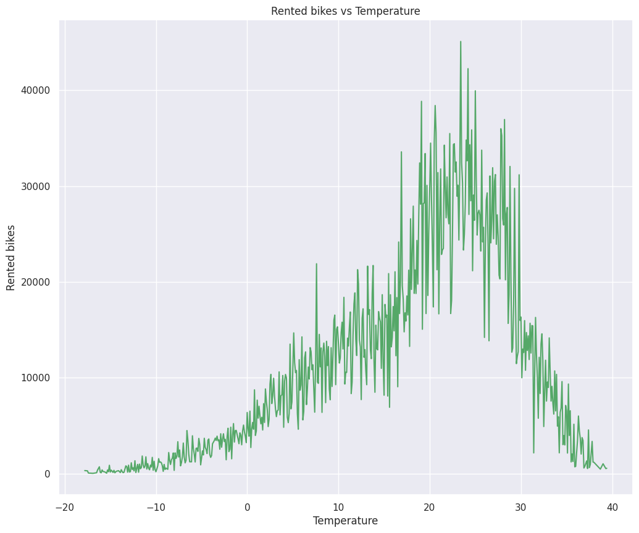
ANALYSIS BETWEEN THE TEPERATURE AND THE RENTED BIKE COUNTS:
From the graph, we can see that people prefer to take bike ride more often when the temperature is near about 25 degrees Celsius.
we can easily conclude that the people gave more preference to bike riding in summers as compare to other seasons.

Slide 10
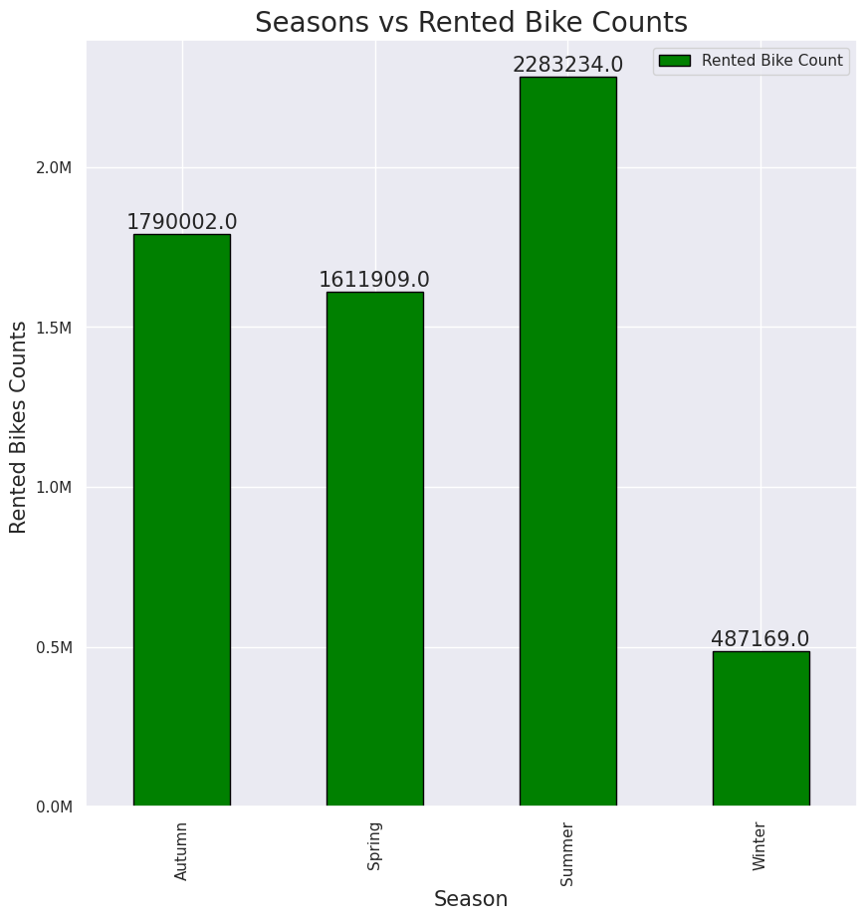
ANALYSIS BETWEEN SEASON AND RENTED BIKE COUNT:
The bar chart shows the total number of rented bikes for each season. The highest number of rented bikes occurred in the fall season, followed by the summer, spring, and winter seasons, respectively.
This insight can be used by the bike rental business to plan inventory and staffing levels during each season, as well as to develop targeted marketing campaigns to increase rentals during lower-demand seasons. The business can use this information to allocate resources efficiently and make informed decisions that can help drive growth and ensure long-term success.

Slide 11
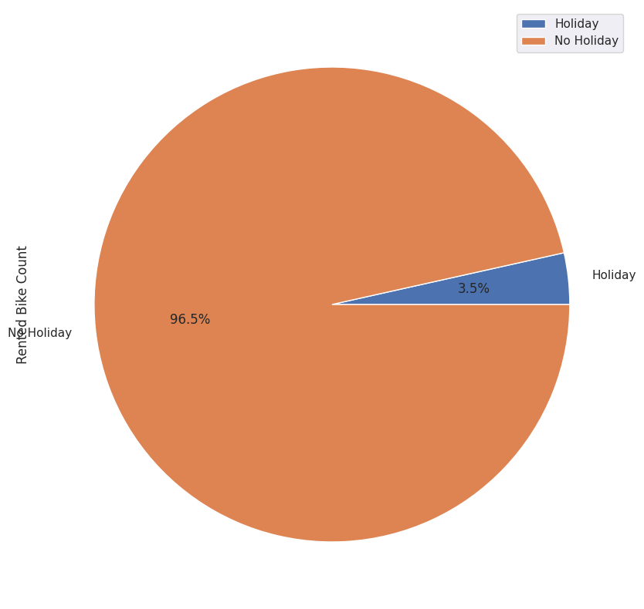
ANALYSIS BASED ON DEMAND OF BIKE IN THE WORKING DAY AND IN HOLIDAY:
The pie chart shows the percentage of rented bike counts during holidays and non-holidays. From the chart, we can see that a significant proportion of rented bikes are used during non-holidays, which is around 96.5% of the total rented bike counts. Only 3.5% of rented bikes are used during holidays. This could be due to people using rented bikes as their daily means of transportation or for recreational purposes, regardless of whether it's a holiday or not.

Slide 12
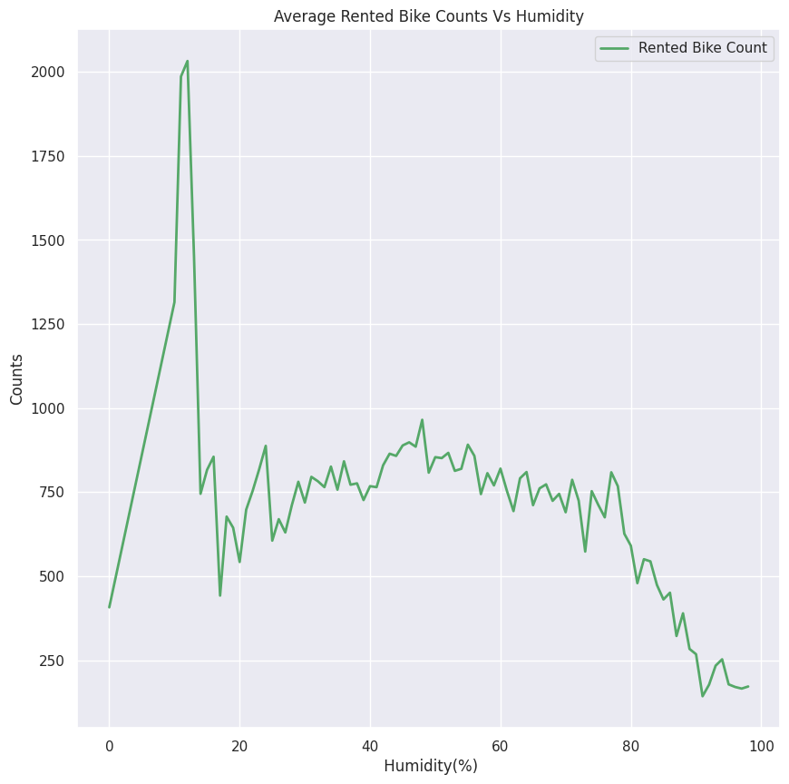
ANALYSIS OF BIKE COUNT BASED ON HUMIDITY:
There appears to be a negative correlation between humidity and bike rentals, which means that as the humidity increases, the average number of bikes rented decreases.
The highest number of bike rentals occurs at around 30-50% humidity, while the lowest number of bike rentals occurs at around 80% humidity.
The overall trend of the line suggests that humidity is an important factor to consider when predicting bike rental demand. This information can be useful for bike rental companies when planning their operations and marketing strategies.

Slide 13
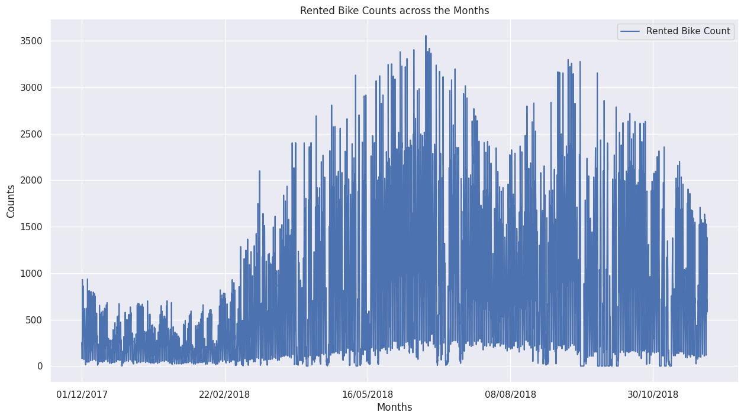
ANALYSIS OF BIKE COUNT BASED ON MONTH IN OUR ENTIRE DATASET:
The line chart between the months and Rented Bike Counts shows several key insights:
The overall trend in bike rentals appears to be increasing over the course of the year, with higher counts during the summer months and lower counts during the winter months.
The highest bike rental counts occurred in August and September, likely due to favorable weather conditions during these months.
The lowest bike rental counts occurred in January and February, likely due to the colder weather and less favorable outdoor conditions.
There appears to be some seasonal variation in bike rental demand, with higher counts during the warmer months and lower counts during the colder months.

Slide 14
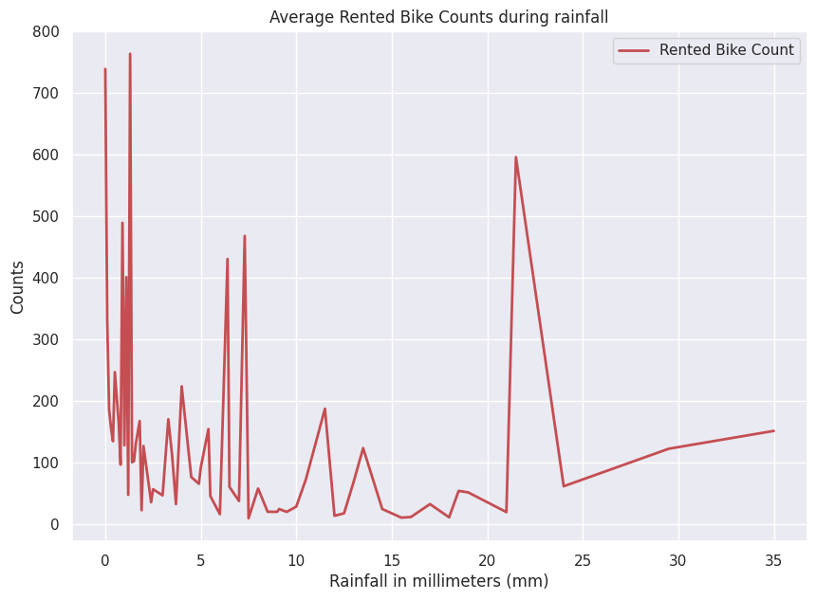
BIKE COUNT VS RAINFALL ANALYSIS:
The line plot between the rainfall and average rented bike counts suggests that there is a negative correlation between the two variables. As the amount of rainfall increases, the average rented bike count decreases. This could be due to the fact that people tend to avoid riding bikes during rainy weather, which may cause a decrease in demand for rented bikes during such periods.

Slide 15
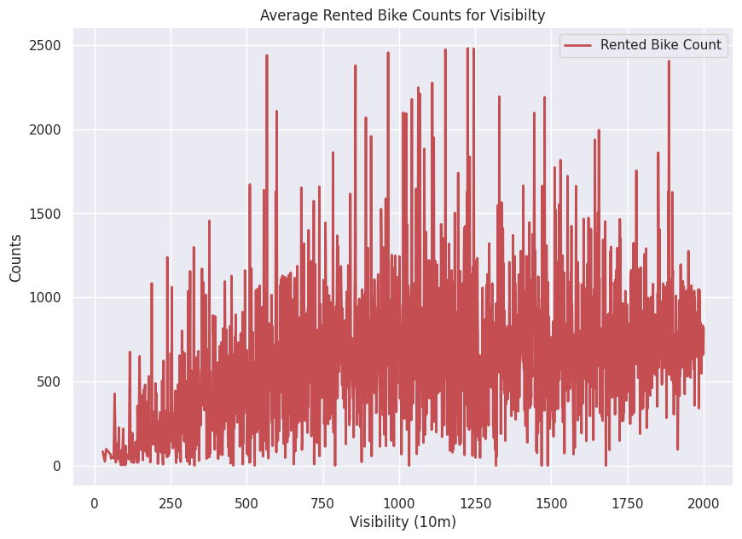
ANALYSIS BASED ON BIKE COUNT VS VISIBILITY:
From the chart, it seems that there is a positive correlation between visibility and rented bike counts. As visibility increases, the average rented bike count also increases. This suggests that people may be more willing to ride bikes when the weather is clear and visibility is good. This insight could be useful for bike rental companies in terms of predicting demand and optimizing their rental fleet based on weather conditions.

Slide 16
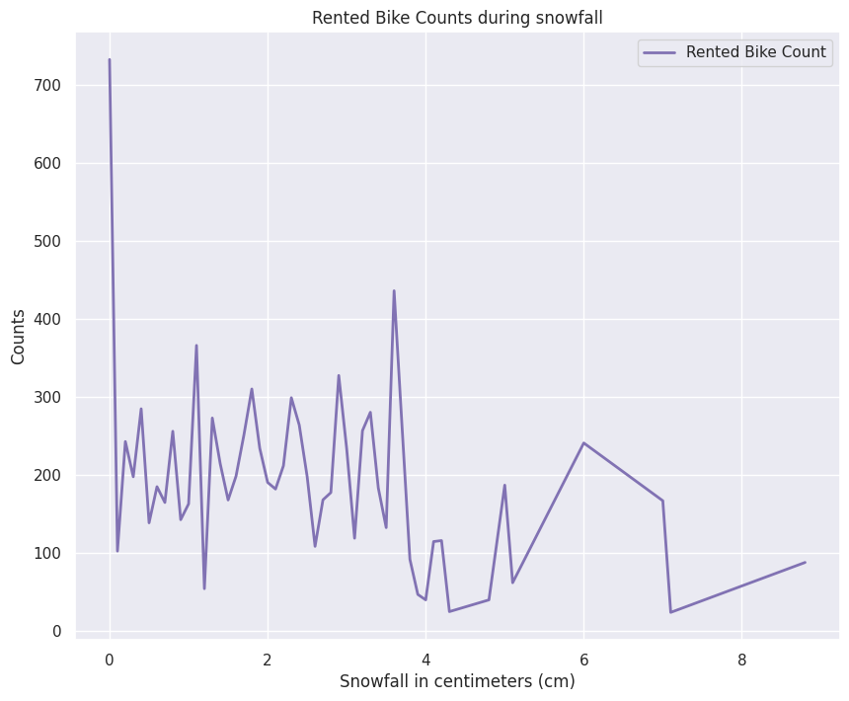
ANALYSIS BASED ON BIKE COUNT VS SNOWFALL:
From the chart, we can see that the average rented bike counts decrease with increasing snowfall. This suggests that the snowfall negatively impacts the bike rental business, as people may be less likely to rent bikes during snowy conditions.

Slide 17
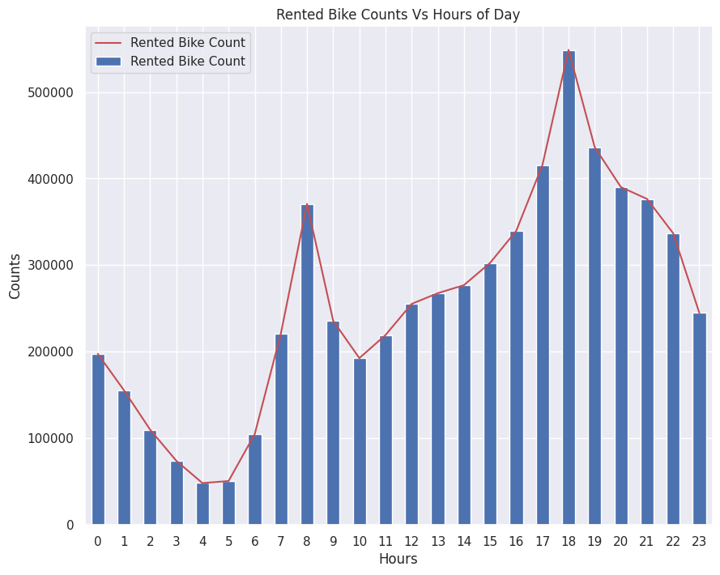
ANALYSIS BASED ON BIKE COUNT VS HOURS PER DAY:
The bar chart shows the total rented bike counts for each hour of the day, while the line chart shows the trend of rented bike counts across hours of the day. The insights gained from the chart are:
The most number of bikes are rented during the peak hours of 7-9am and 5-9pm.
The trend line shows an overall increase in rented bike counts from early morning to evening, peaking at around 6pm, and then a decline during the late night and early morning hours.

Slide 18
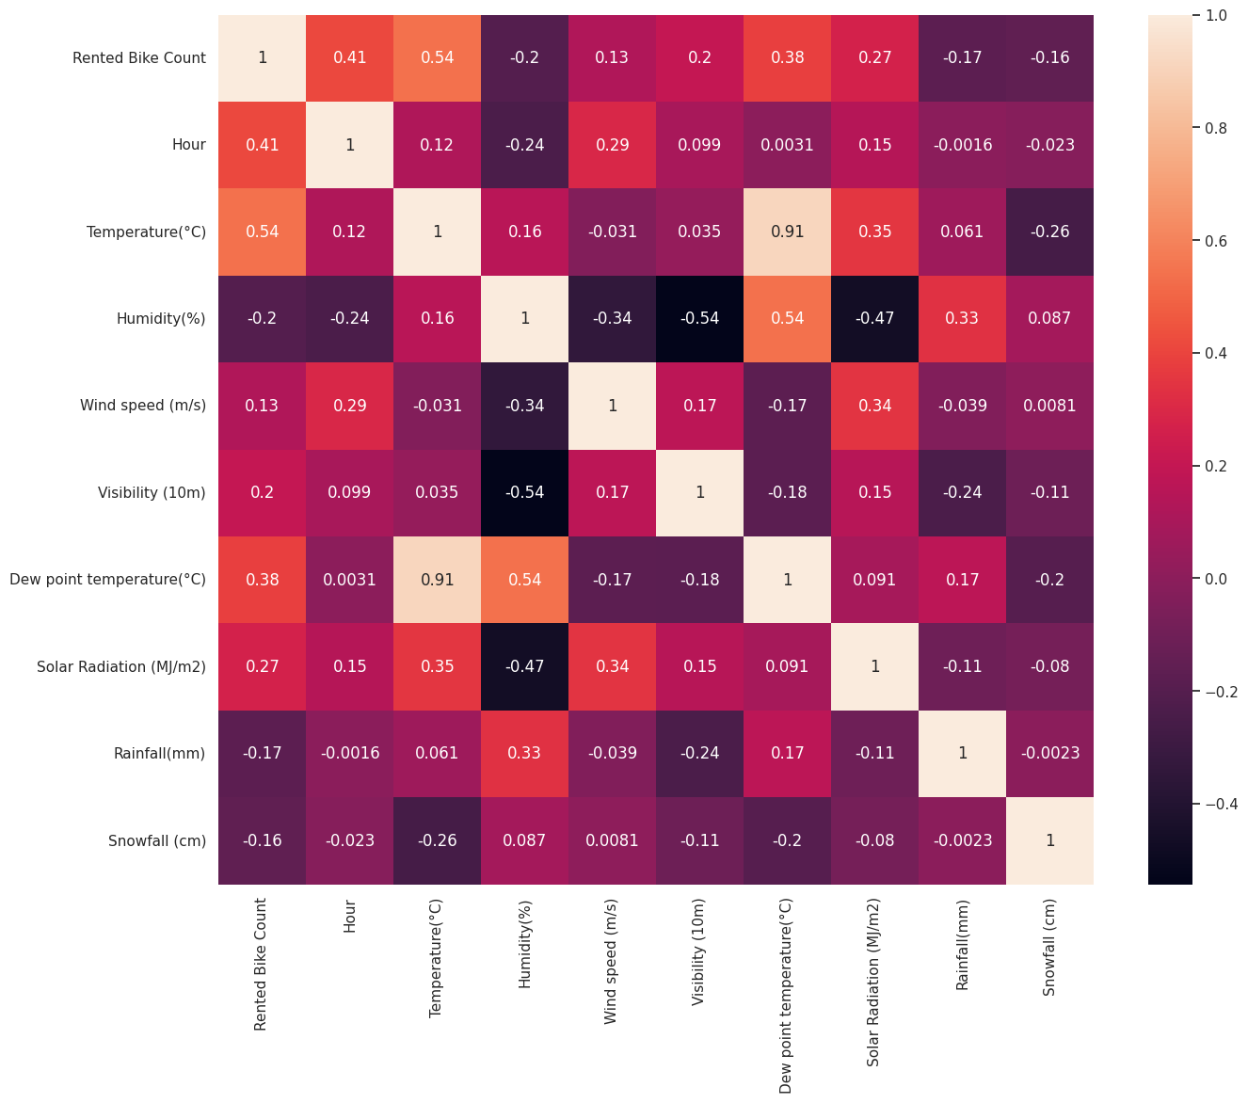
PREPARATION DATA FOR MODEL BUILDING:
From the heatmap, we can observe that there are some strong positive correlations between the following variables:
Dew Point Temperature and Temperature(C)
Rented Bike Count and Temperature(C)
There are also some strong negative correlations between:
Rented Bike Count and Wind speed (m/s)
Rented Bike Count and Visibility (10m)

Slide 19
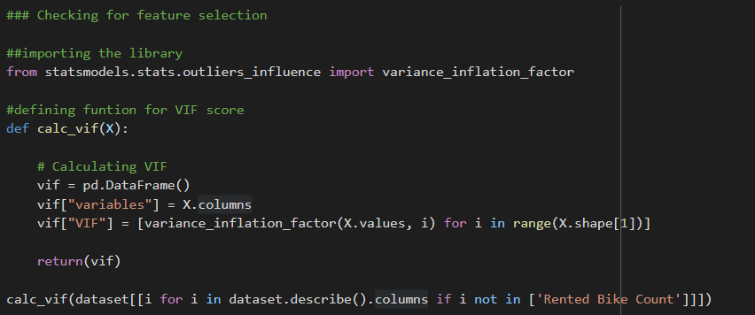
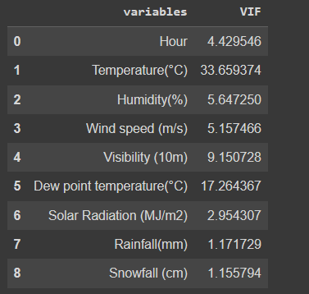
FEATURE MANIPULATION:
In this project, I have used the Variance Inflation Factor (VIF) method to check for feature selection. The VIF score indicates how much the variance of a regression coefficient is increased due to multicollinearity in the data. High VIF values indicate high multicollinearity among the independent variables, which may lead to inaccurate and unstable estimates of the regression coefficients. Therefore, it is essential to remove highly correlated variables or combine them to reduce their VIF score to an acceptable level. Hence, I have used the VIF method to identify highly correlated variables in the data set and then remove or combine them to reduce multicollinearity.
Based on the VIF score, it seems like all the features have VIF values lower than the threshold value of 10, indicating that there is no multicollinearity issue between the features
But we can see that temperature and dew point temperature has VIF value 33.65937 and 17.264367 respectively indicating multicollinearity. This means that these two variables are highly correlated with other independent variables in the dataset. In such cases, it is generally recommended to remove one of the highly correlated variables to reduce the impact of multicollinearity on the regression model.

Slide 20
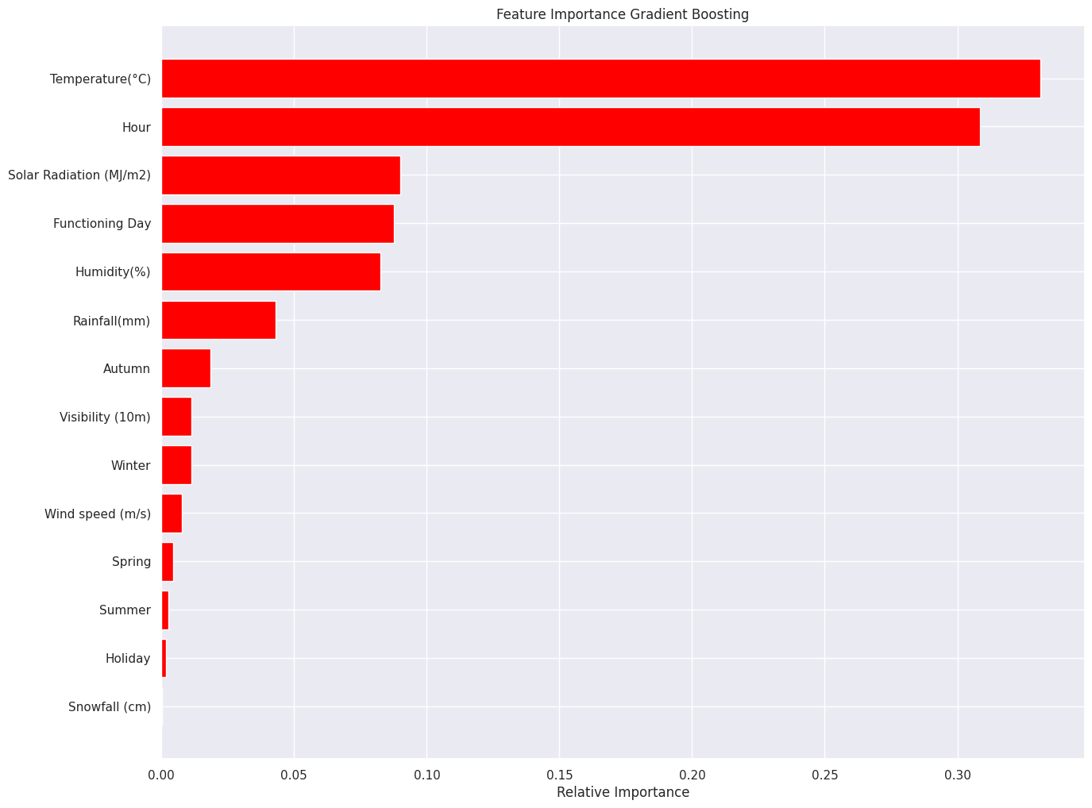
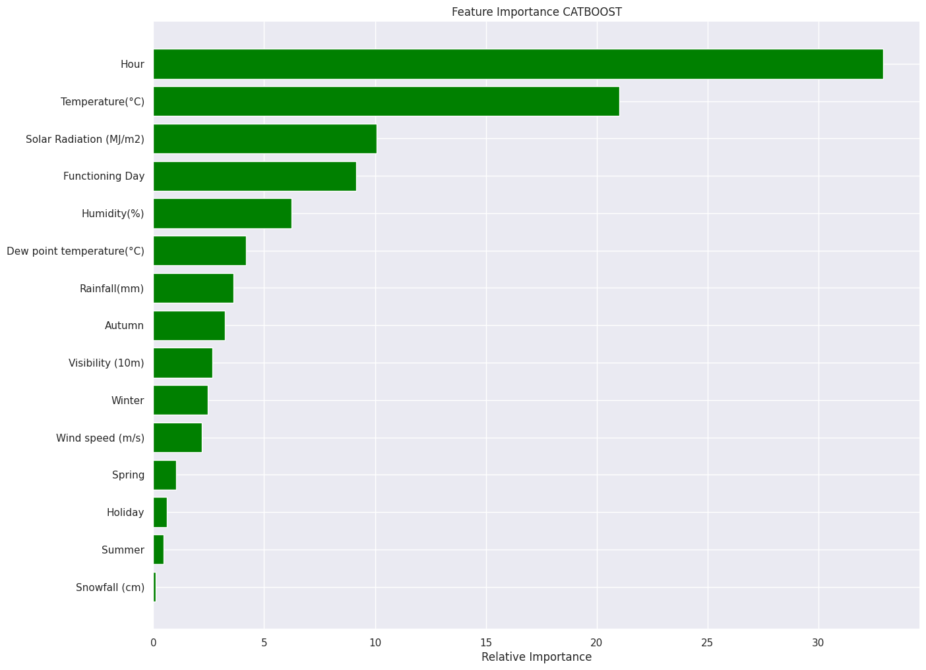
FEATURE IMPORTANCE:
According to the Gradient Boosting and CatBoost method Temperature and Hour are most important features.

Slide 21
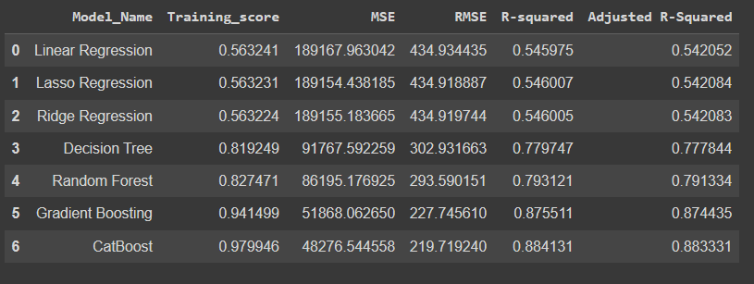
MODEL SELECTION AND VALIDATION:
It is clearly evident that the Adjusted R2 score for linear regression is very less.
Adjusted R2 score very good for Gradient Boosting and CatBoost.
To get better predictions we prefer CatBoost Algorithm over other regression algorithms.

Slide 22
CONCLUSION:
The temperature, hours, and solar radiation features were found to be more relevant for the bike count required at each hour for the stable supply of rental bikes.
As we have analyzed the various features, we have seen that people prefer to take bikes on rent when temperature is near about 25 degrees Celsius.
Other factors such as rainfall and snowfall also have an impact on the requirement of bikes for rent. Because in heavy rainfall and snowfall bike riding sometime becomes dangerous.
As we have analyzed that the rental bike demands are high in the evening and in the morning. So bikes should be available at that time to fulfill the bike demands.
The Bike demand increases with an increase in visibility and decreases with an increase with humidity.
We tried adding possible columns to make the model a bit more complex but for Linear Regression model it is still too general.
We have to make our model more complex for better discretion or move to tree and ensemble algorithm for better results.
Random forest gives predictions better than a decision tree model. Predictions made by Gradient Boosting are better than all the models that we have used. The value of the Adjusted R-squared for the Gradient Boosting method is 0.875, which is very good.
Adjusted R-squared for both Gradient Boosting and CatBoost are almost same. The adjusted R_squared score for CatBoost is 0.883. Because of the additional benefits, I will choose CatBoost over Gradient Boosting.

Slide 23

THANKYOU

