Slide 1
EDA CAPSTONe PROJECT hotel booking analysis
Presented by:​
Mohd Aun Farooqui
Akhsay Bajpai

Slide 2
AGENDA
Introduction​
Problem statement
Work flow
Dataset
Data description
Data wrangling
Conclusion

Slide 3
Introduction
A few decades ago, traveling was not a part of everyday life. But today travel is an enormous budding industry of 8.5 trillion economy. This directly affects the hotel industry which is highly competitive.
We have compact data to study about the hotel industry, mainly the booking. Here we are focusing on two types of hotels. This data set contains different hotel types, countries located, guest, stays. Also the study have some factors that affect booking like wait time, lead time ,year, months, average daily rate etc.

Slide 4
Problem statement
The hotel industry is one of the most important component of the wider service industry, catering for customers who required overnight accommodation. It is also closely associated with the travel industry and the hospitality industry.
For the project we are analyzing hotel booking data of city hotels and a resort hotel (data:2015 to 2017). The information includes the booking time, check-in and check-out time, room type, customer stay-time, the visitors break, available parking-space, cancellation cases.
The key objective of this project to analyze and explore the given data to conclude the meaningful important factors which can help hotel management to improve both revenue and quality. Also mainly root cause analysis for the cancellation cases can be scrutinize to take necessary preventive actions.

Slide 5
workflow
Data collection and understanding the problem.
We will be going though the each variable and do logical analysis about their meaning and importance for this problem.
Data cleaning and manipulation.
we’ll clean the dataset and handle the missing data, outliers and categorical variables.
Test assumptions. We will check if our data meets the assumptions required by most multivariate techniques.
EDA(Exploratory Data Analysis) and Visualization.
Univariate analysis:
Univariate analysis is the simplest form of analysing data i.e, study of one variable. Its major purpose is to describe
,distribution of single data, and find patterns in the data.
Bivariate analysis:
Bivariate analysis between two variables. One of the variable will be dependent and the other is independent. The study is
to analysed between the two variables to understand what extent the change has occurred.
Multivariate analysis:
Multivariate data analysis is the study of relationships among the attributes , classify the collected samples into
homogeneous groups, and make inferences about the underlaying population from the sample.

Slide 6
Dataset
We have hotel booking dataset containing information about city and resort hotels. This dataset has 32 variable and with around 119,390 entries were used to describe 40,060 observations for the resort and . The study has the data recorded between 2015 to 2017 which has booking that shows effectively arrived and bookings that were cancelled.

Slide 7
Data description
Hotel: Hotel type(city/resort).
Is_cancelled: Value indicating if the booking was cancelled(1) or not(0).
Arrival_date_year: year of arrival date.
Arrival_date_month: month of arrival date.
Arrival_date_week_number: week of arrival date.
Day_of the_month: Day of the arrival month
Stay_in_weekend_nights: Number of weekend nights(Saturday and Sunday) the guest is stayed in hotel.
Stay_in_week_nights: Number of week nights(Monday to Friday) the guest stayed in hotel.
Adults: Number of adults.
Children: Number of babies.
Babies: Number of babies.
Meals: Type of meal booked.
Country: Country of origin.
Market_segment: Market segment designation(TA/TO).
Distribution channel: Booking distribution channel.
Is_repeated_guest: Value indicating if the booking name was from repeated guest (0) or not (1).

Slide 8
Data description
Previous_cancellation: Number of previous booking that were cancelled by customers.
Previous_booking_not_cancelled: Number of previous booking not cancelled by customer.
Reserved_room_type: Code of room type reserved.
Assigned_room_type: Code for the type of room assigned to the booking.
Booking_changes: Number of changes made to the booking from the moment the booking was made.
Deposit_type: No deposit, Non refund, Refundable.
Agent: agent of the travel agency that make the booking.
Lead_time: Number of days that elapsed between the entering date of the booking and the arrival date.
Days_in_waiting_list: Number of days the booking was in the waiting list before it was confirmed to the customer.
Customer_type: Type of customers.
Adr: Average daily rate as defined by dividing the sum of all lodging transactions by the total number of staying nights.
Required_car_parking_space: Number of car parking space required for the customer.
Reservation_status: Reservation last status.

Slide 9
Data wrangling
Data cleaning:
Dropping columns with maximum null values like agent and company.
Column with nominal null values have been updated by Median (columns: numbers of children) and Mode (column: country).
Data manipulation:
Here we are combining columns for effective study
kids = babies + children
total_stays =m Stay_in_weekend_nights + stay_in_week_nights
Revenue = total_stay(no cancel guest)*ADR

Slide 10
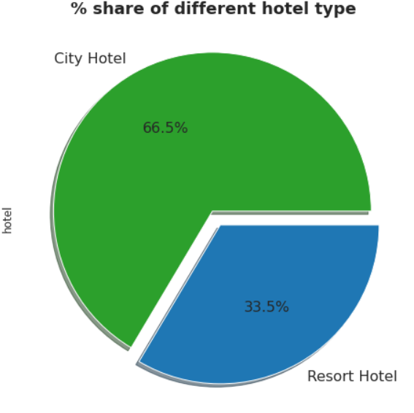
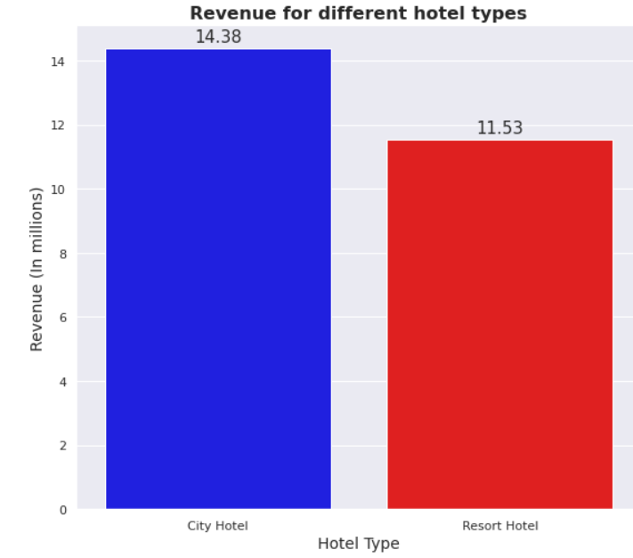
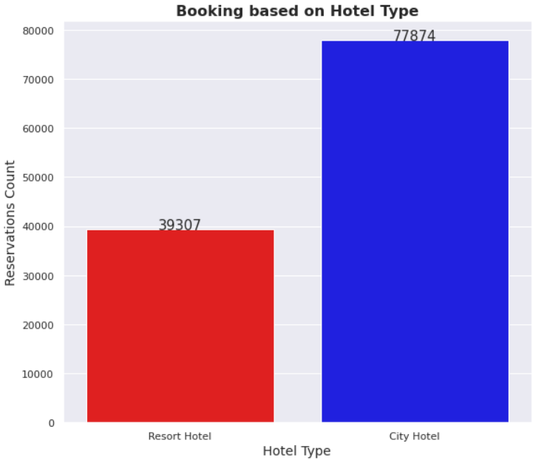
Percentage share of different hotel type, their booking and revenue:
City hotels are most preferred hotel by guests. Since the booking are double for city hotels but the revenue difference is not much in between them. So ,This shows the resort hotels are more expensive as compared to city hotel.

Slide 11
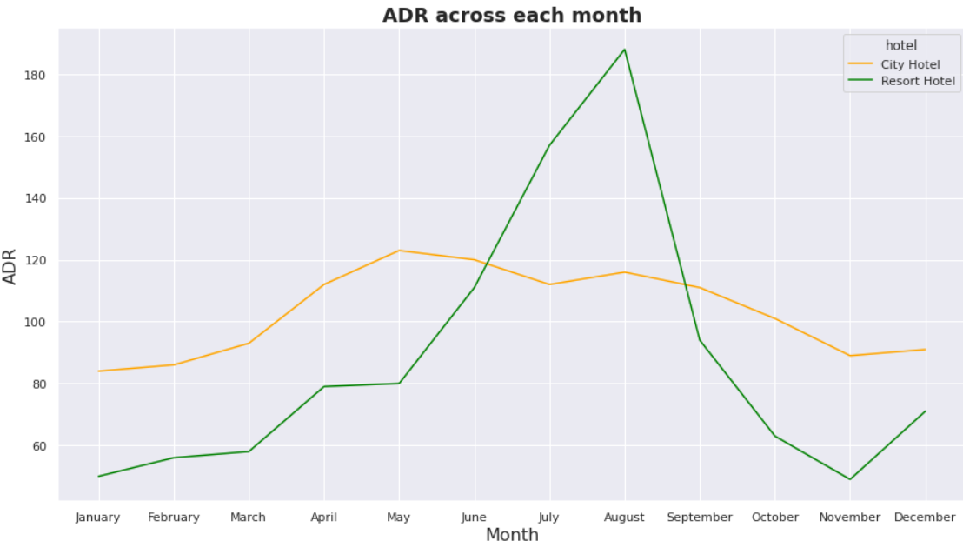
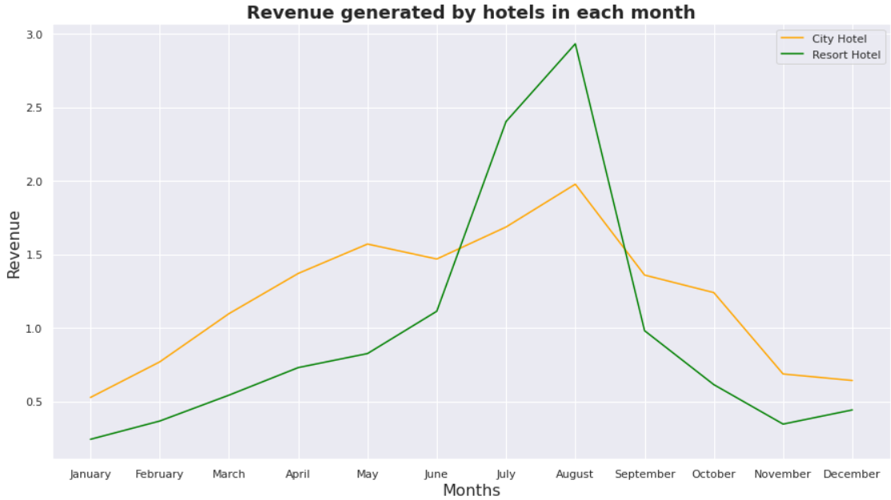
Analysis on adr and revenue:
City hotel have nearly constant ADR from April to September and after that ADR start decreasing, so the best time for booking a city hotel is from October.
Resort hotel ADR increasing between May to August and then started falling down, so best time booking resort hotel is from October to April as we are getting lower ADR.
Here we can see that for both city hotel and resort hotel getting higher revenue from June to September. Hence this time period is best to generate revenue.

Slide 12
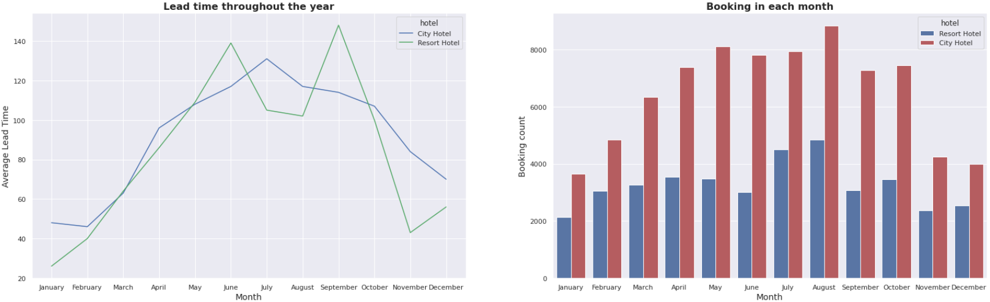
Study of reservation based on lead time and booking of hotels in each month:
From the above graph we can see in city hotels there is a peak in lead time from April to July and the booking is high in August. And in resort hotels we can see two peaks in lead time, first in June and second in September and booking is high in July, August and October, so people usually book hotel 30-60 days in advance.
The booking lead time is the number of days between the time a guest book their room and the time they are schedule to arrive at the hotel.

Slide 13
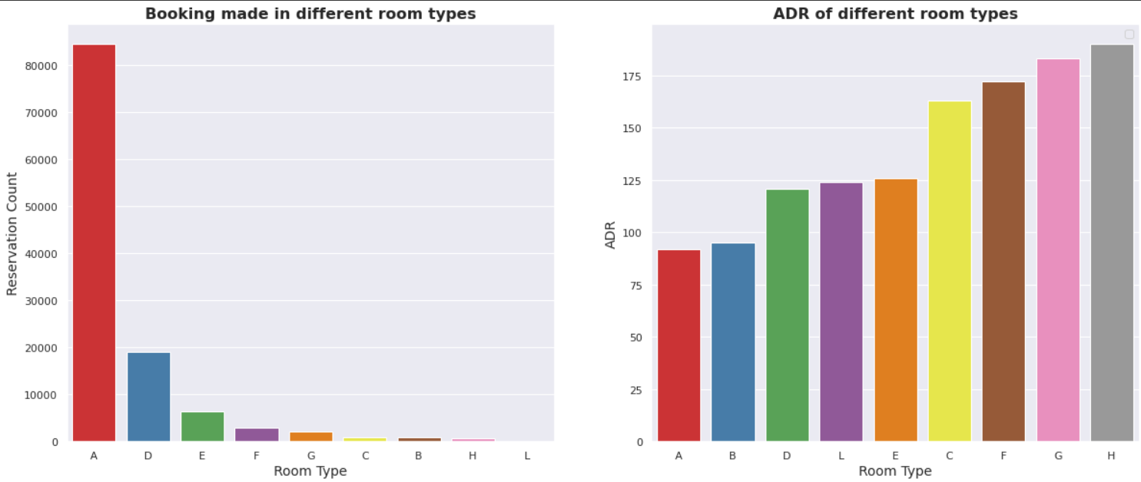
Preferred room type:
Majority of people prefers room type-A which seems to be more economical for booking as it has the least ADR. And ADR is higher for room type-H so lesser booking are made.

Slide 14
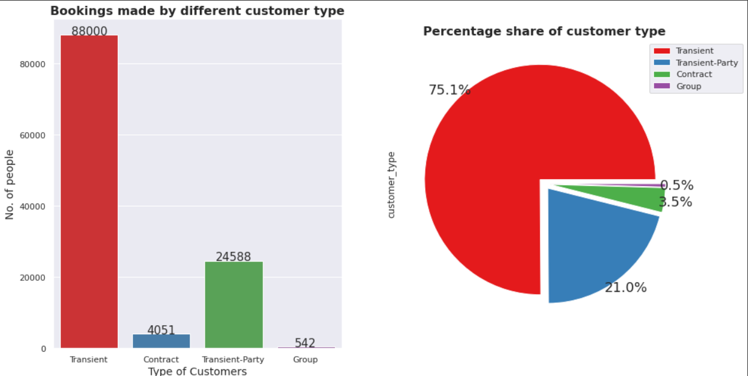
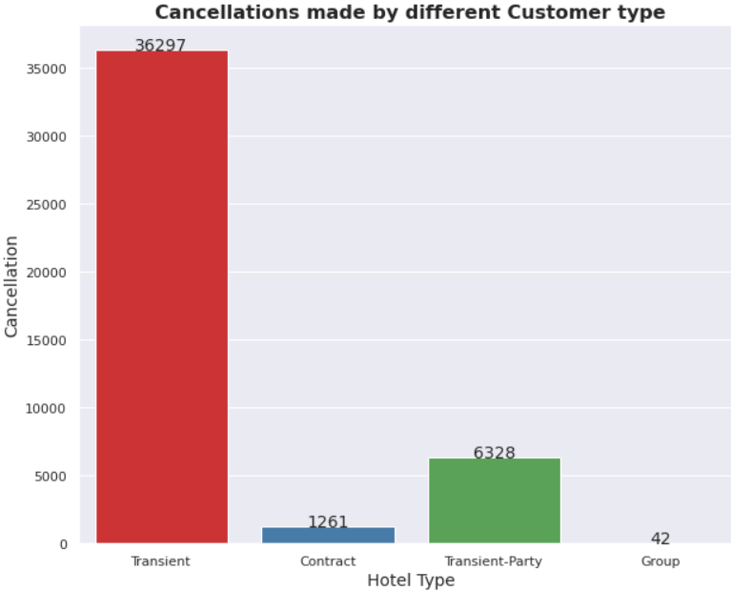
Booking and cancellation done by customer type:
More than 75% of bookings are done by Transient customer type only.
And we can see that transient customers type cancellation rate is high.

Slide 15
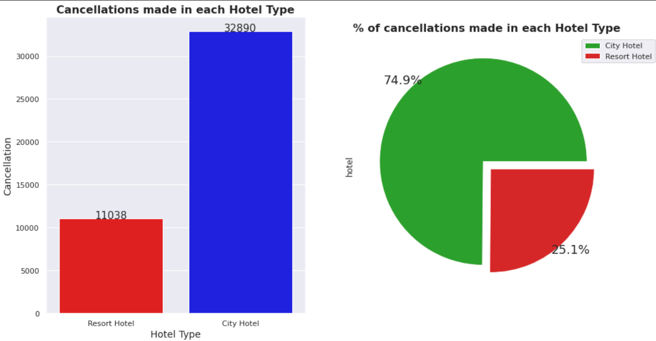
Cancellation made in each hotel type:
Cancellation is less in Resort hotels as compared to City hotels.
Cancellation rate is 75% in City hotels as compared to 25% in Resort hotels.

Slide 16
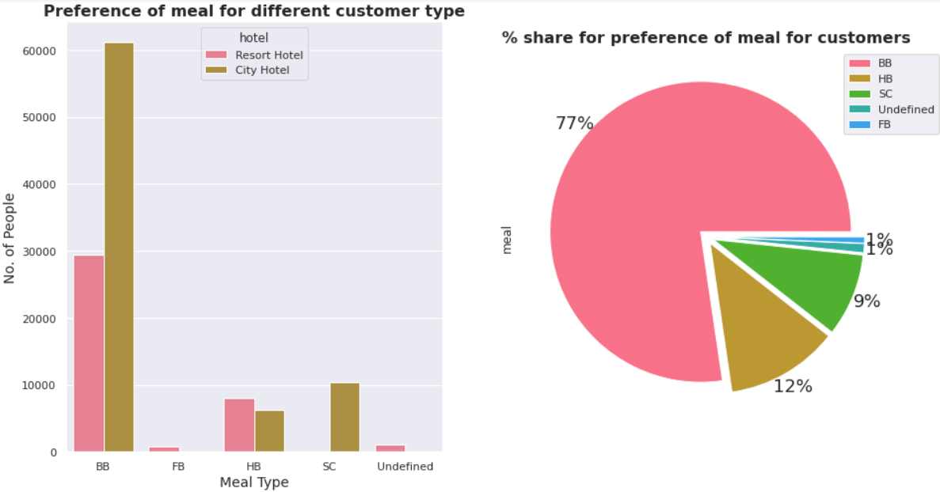
Analysis based on meal:
77% of people preferred BB(bed & breakfast) meal type in both the hotel.
Meal:
BB: Bed and breakfast
HB: Half board (Breakfast and dinner normally)
FB: Full board (Breakfast, lunch and dinner)
SC: Self catering
Undefined: Room only packages without meals

Slide 17
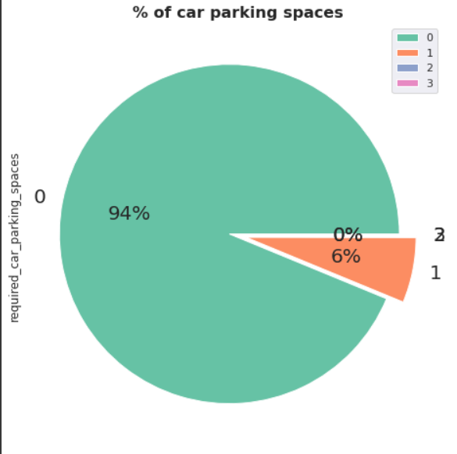
Car parking space in hotel:
About 94% of people don't require the car parking spaces while booking hotel. So, most of customers don’t required car parking spaces.

Slide 18
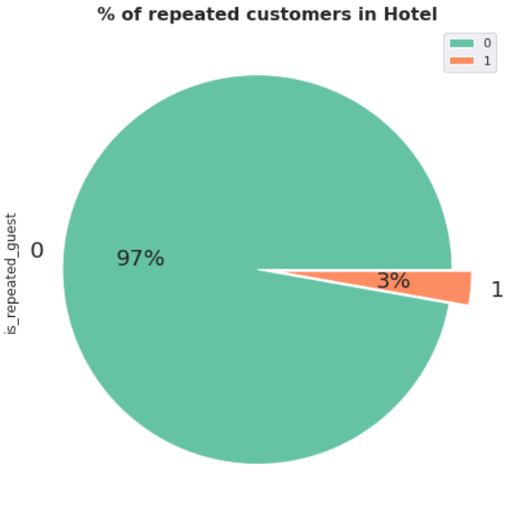
Analysis based on repeated guest:
Mostly the guest are new customers

Slide 19
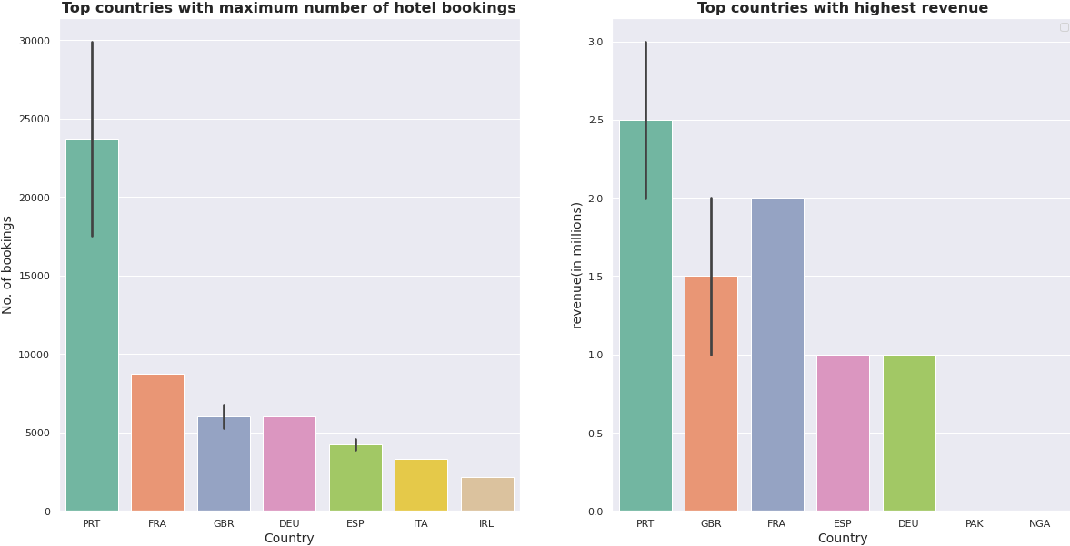
Analysis based on country:
We have a huge number of visitors from western Europe namely Portugal, France, UK and same countries generate highest revenue.

Slide 20
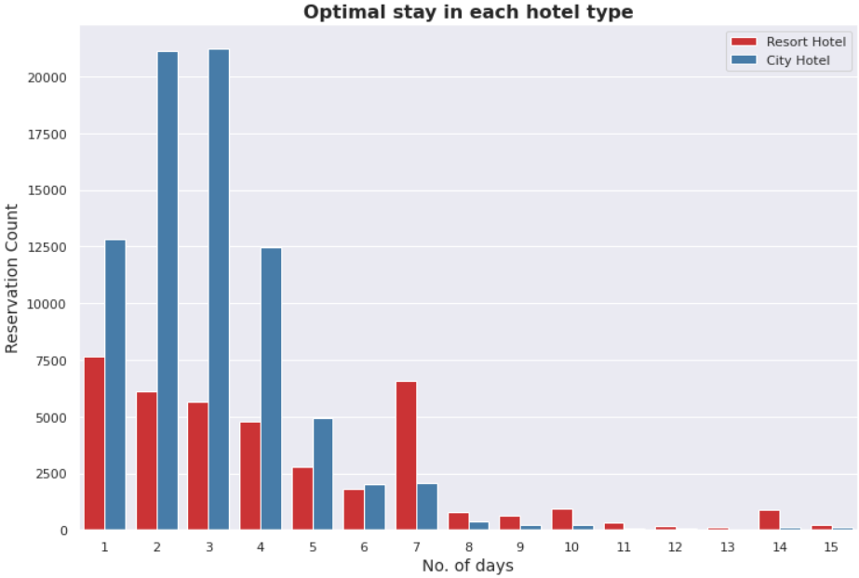
Preferred stay period
Here we can see that most people preferred to stay in city hotel for 1 to 4 days and for longer stay they preferred resort hotel 1 to 7 days.

Slide 21
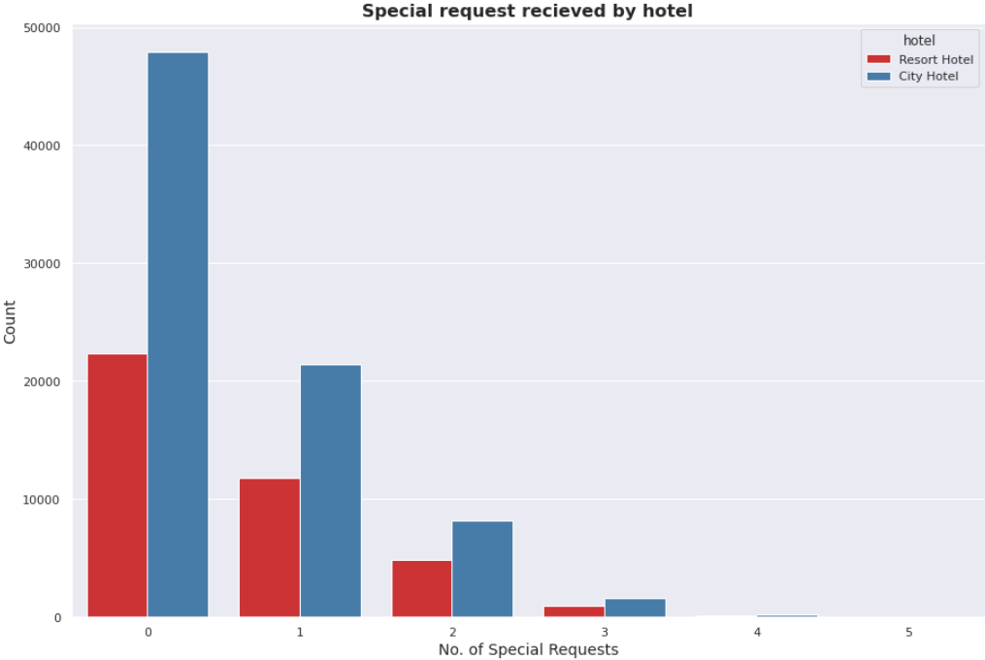
Analysis based on special request:
City hotel received more special request than resort hotels .most of the customer don’t have special request.

Slide 22
conclusion
Majority of people prefer A-room type so hotels should increase their numbers to get more revenue.
Transient customers cancels more often but when people book in groups it leads to lesser cancellations, hence hotels should provide some offers focusing transient customers to decrease cancellations.
Maximum number of bookings are in the month May to August, so hotels should provide exciting deal to customers to increase their booking in off season.
As hotels are getting less repeated customers so management should take customer’s feedback and improve the hotel facilities to increase the count of their repeated guests.
About 94% of people don't require the car parking spaces while booking hotel.
We have a huge number of visitors from western Europe namely Portugal, France, UK and same countries generate highest revenue. So marketing teams should target these countries to get more customers.
People prefer city hotels for shorter stay and resort hotels for longer stay.
City hotels receives more special requests than Resort hotels. Most of the customers don't have special requests.

Slide 23
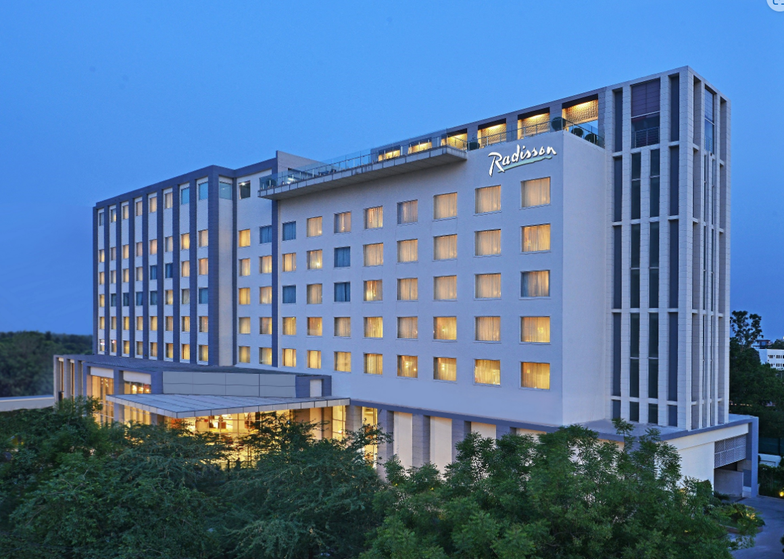
THANK YOU

