Slide 1
Capstone Project – 3 Mobile Price Range prediction (Supervised Machine Learning classification project)
Presented By:
MOHD AUN FAROOQUI

Slide 2
AGENDA
INTRODUCTION
PROBLEM STATEMENT
UNDERSTANDING THE DATASET
EXPLORATORY DATA ANALYSIS
FEATURE ENGINEERING AND DATA PRE-PROCESSING
MACHINE LEARNING ALGORITHM
FEATURE IMPORTANCE
MODEL SELECTION
CONCLUSION

Slide 3
Introduction
The mobile phone has become an integral part of our daily lives, and with the emergence of new technology, the market for mobile phones has become extremely competitive. With this competition, mobile phone manufacturers are continuously working on improving their products and adding new features, which in turn is leading to an increase in the number of mobile phones available in the market.
To aid buyers in selecting the best mobile phone to suit their needs, we can use Machine Learning algorithms to predict the price range of a mobile phone based on its features. In this project, we will use a mobile phone dataset to develop a machine learning model that can accurately predict the price range of a mobile phone.

Slide 4
Problem statement
The problem statement of mobile price range prediction is to develop a model to predict the price of a mobile when the specifications of a mobile are given and to find the ML algorithm that predicts the price most accurately. The project involves using various features such as battery power, RAM, pixel_size, touch_screen etc, To predict the price of a mobile. The goal is to develop a model that can accurately predict the price of a mobile phone based on its features.

Slide 5
Understanding the dataset
Data Description:
The data contains information regarding mobile phone features, specifications etc. and their price range. The various features and information can be used to predict the price range of a mobile phone.
Battery_power : Battery capacity in mAh
Blue : Has bluetooth or not
Clock_speed : speed at which microprocessor executes instructions
Dual_sim : Has dual sim support or not
Fc : Front Camera mega pixels
Four_g : Has 4G or not
Int_memory : Internal Memory capacity
M_dep : Mobile Depth in cm
Mobile_wt : Weight of mobile phone
N_cores - Number of cores of processor
Pc - Primary Camera mega pixels
Px_height - Pixel Resolution Height
Px_width - Pixel Resolution Width
Ram - Random Access Memory in Mega Bytes
Sc_h - Screen Height of mobile in cm
Sc_w - Screen Width of mobile in cm
Talk_time - longest time that a single battery charge will last when you are
Three_g - Has 3G or not
Touch_screen - Has touch screen or not
Wifi - Has wifi or not
Price_range - This is the target variable with value of 0(low cost), 1(medium cost), 2(high cost) and 3(very high cost).

Slide 6
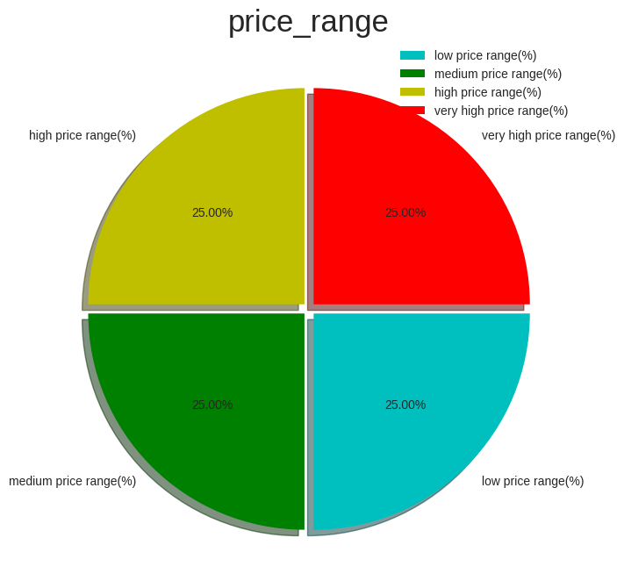
EXPLORATORY DATA ANALYSIS
Pie Chart on Target Variable i.e., price_range (Univariate)
The chart shows the distribution of the target variable "price_range" in the mobile phone dataset. It indicates that the dataset is fairly balanced, with each price range group accounting for roughly the same proportion of the data. About 25% of the phones fall into each of the four price range categories: low, medium, high, and very high.

Slide 7
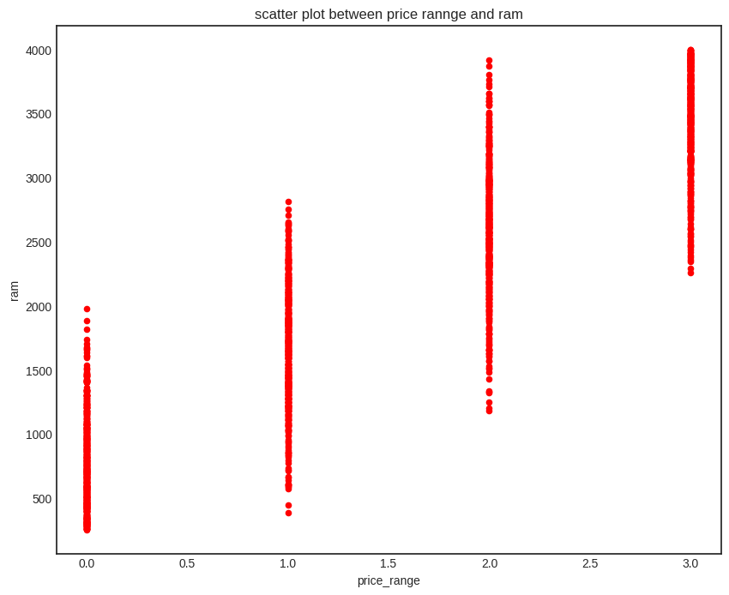
Ram with price range
From the scatter plot, we can see that there is a strong positive correlation between the RAM of a mobile phone and its price range. This means that as the RAM increases, the price range of the phone also increases
AS we can see from the graph,
There is RAM for low price range from upto 2000 MB,
RAM for midium price range from 300 to 2900 MB,
RAM for high price range from 1200 to 3900 MB,
RAM for very high price range from 2200 to 4100 MB.

Slide 8
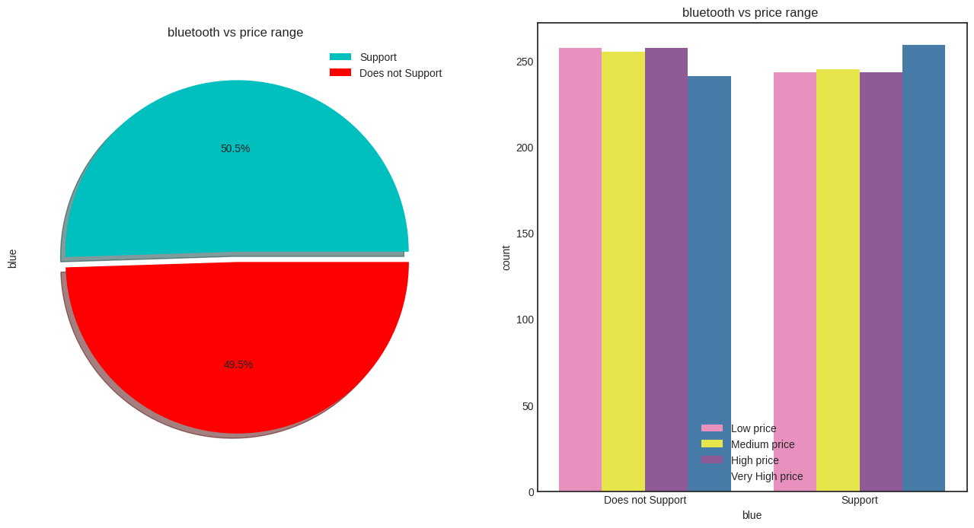
Bluetooth Vs price range
The pie chart shows the distribution of the number of mobile phones that support Bluetooth and those that do not. It can be seen that the mobile phones (50.5%) support Bluetooth, while (49.5%) do not.
I found in count plot graph, that low price, medium price, high price and very high price all does not support Bluetooth and bluetooth support data both are almost same.

Slide 9
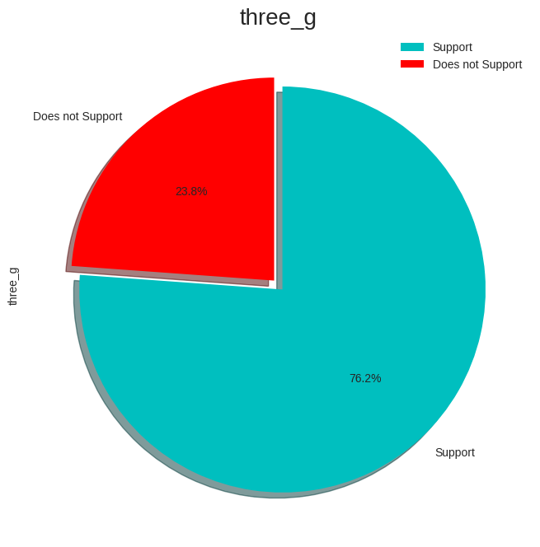
three_g
I got to know that, there are 1523 data which support 3G and 477 Data which do not support 3G.
From the pie chart, we can see that around 76.2% of the mobile devices in the dataset support 3G technology, while the remaining 23.8% do not

Slide 10
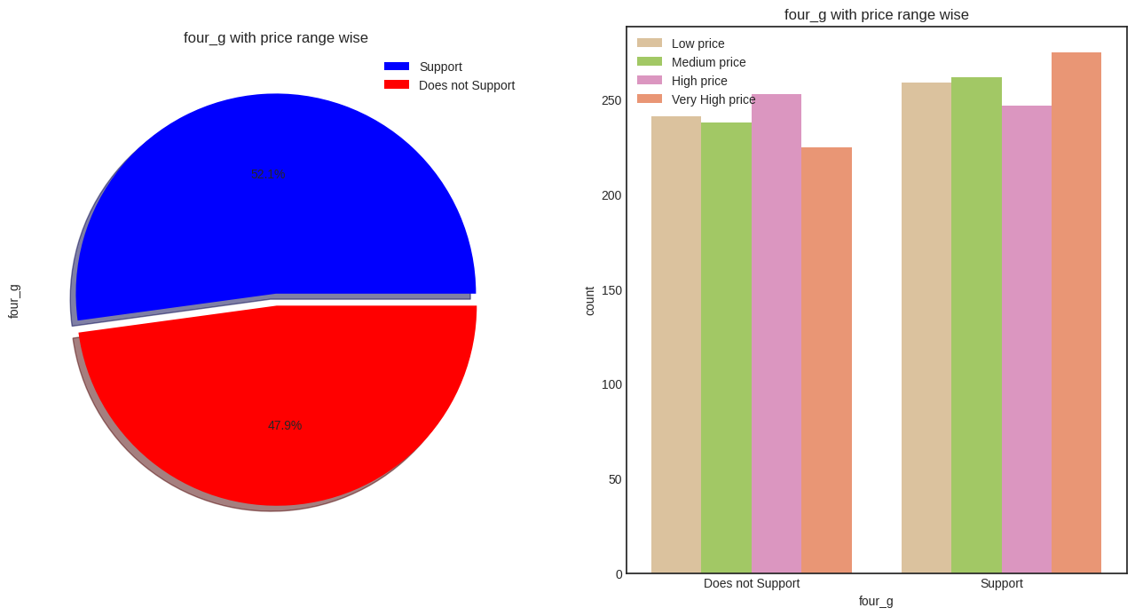
four_g with price range wise
The insights gained from the chart are as follows:
Around 52.1% of the mobile devices in the dataset support 4G, while the remaining 47.9% do not support 4G.
Among the devices that support 4G, a higher proportion of devices falls under the medium and high price range categories.
Among the devices that do not support 4G, a higher proportion of devices falls under the low and medium price range categories.

Slide 11
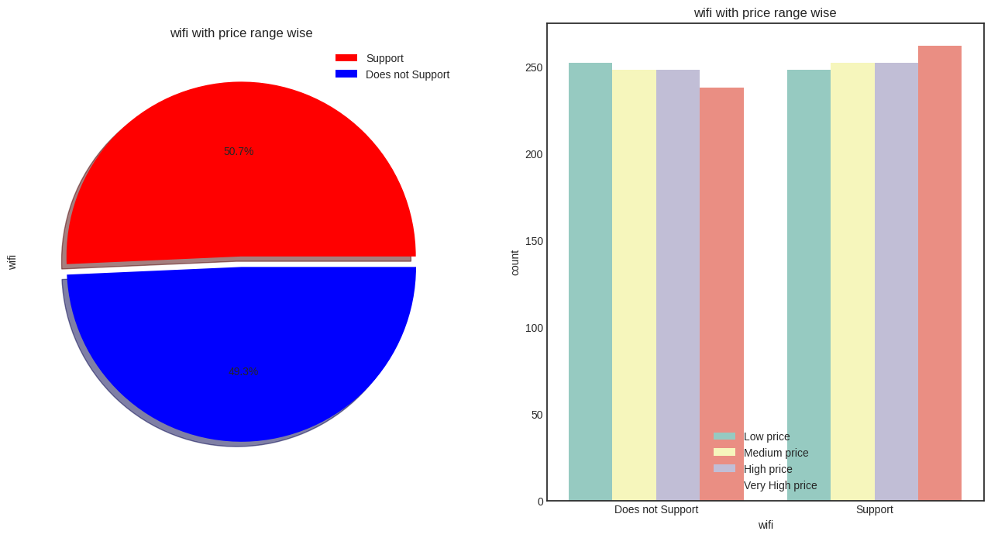
wifi with price range wise
There are 1014 mobile devices which support wifi and 986 which does not support.
About 50.7% of the mobile devices in the dataset support wifi, while about 49.3% do not support wifi.

Slide 12
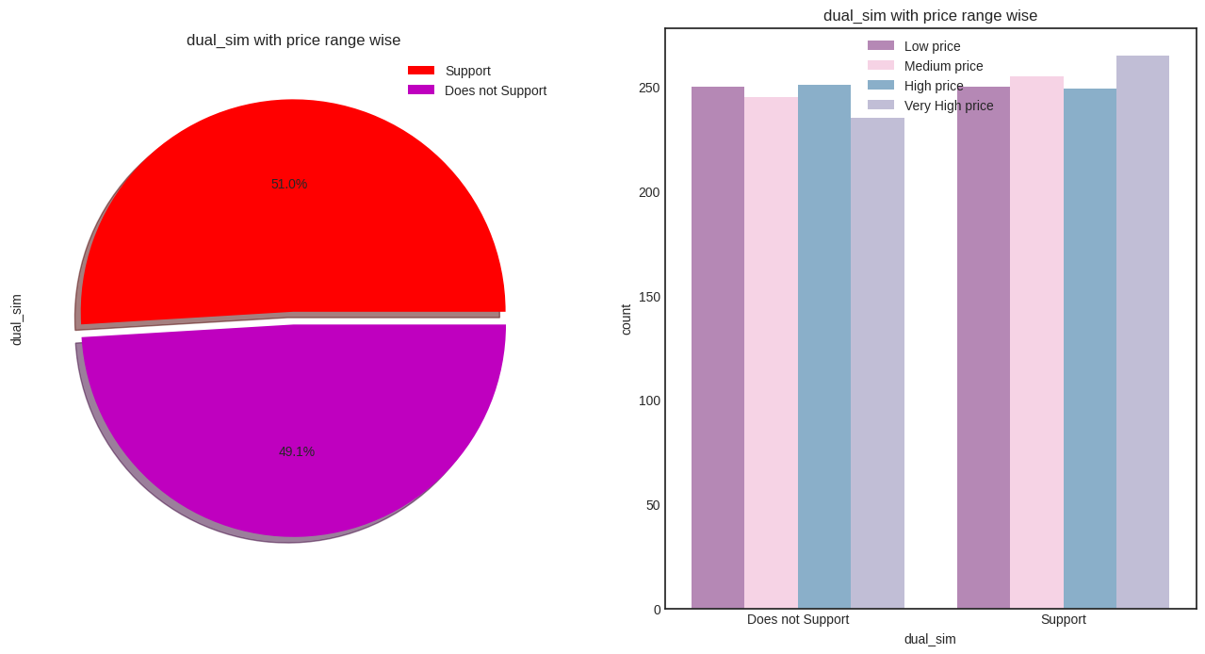
dual_sim with price range wise
From the pie chart, we can see that about 51.09% of the mobile phones in the dataset support dual SIM functionality, while the remaining 49.1% do not support it.
while the count plot shows the distribution of the dual SIM feature across the different price ranges.

Slide 13
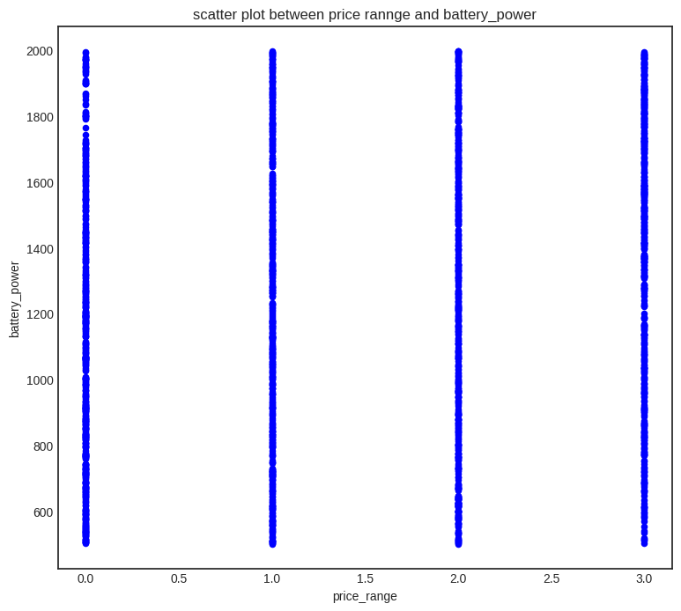
battery_power with price range wise
From the plot, it is observed that there is a positive correlation between price_range and battery_power. As the battery_power increases, the price_range also increases.

Slide 14
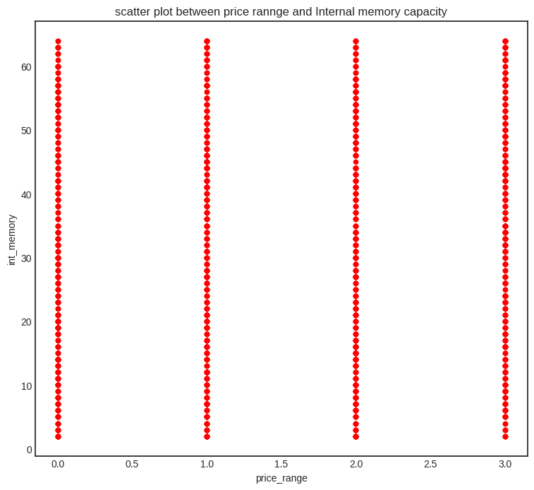
Internal memory capacity with price range wise
Above plot show how the internal memory MB is spread. Internal memory capacity has constant with price range while moving from Low cost to Very high cost

Slide 15
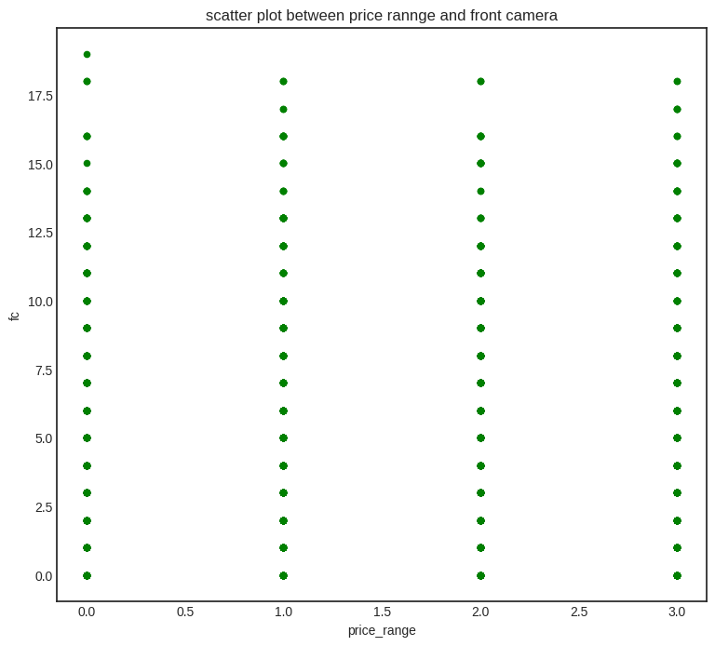
Front camera with price range
Above plot show how the front camera Mega pixel is spread. Front camera has constant with price range while moving from Low cost to Very high cost

Slide 16
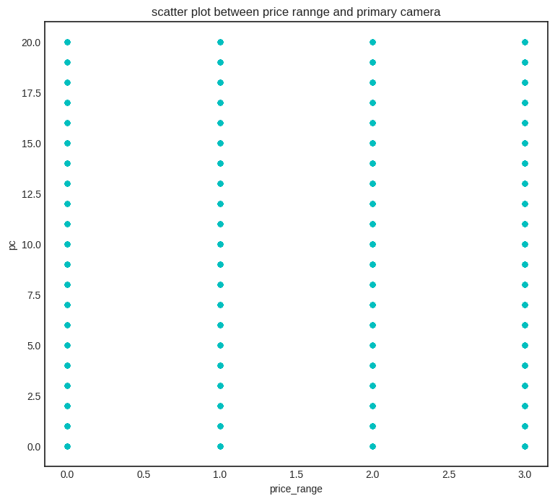
Primary camera with price range
Above plot show how the primary camera Mega pixel is spread. Front camera has constant with price range while moving from Low cost to Very high cost

Slide 17
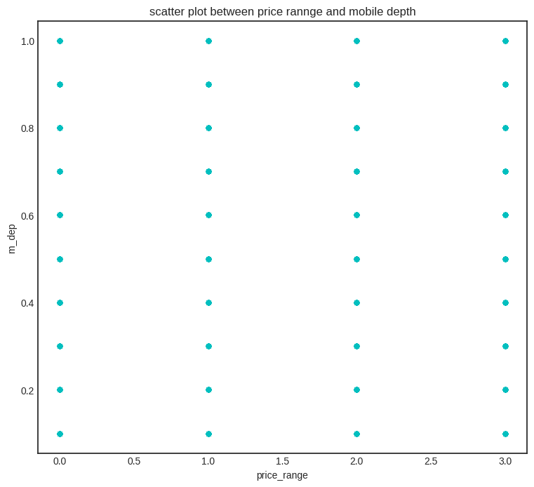
Mobile depth with price range
Above plot show how the mobile depth in cm is spread. Mobile depth has constant with price range while moving from Low cost to Very high cost.

Slide 18
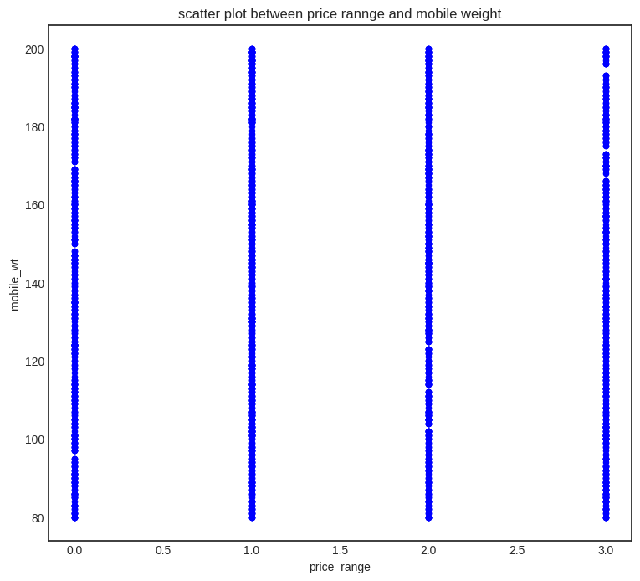
Mobile weight with price range
Mobile weight has constant with price range while moving from Low price to Very high price.

Slide 19
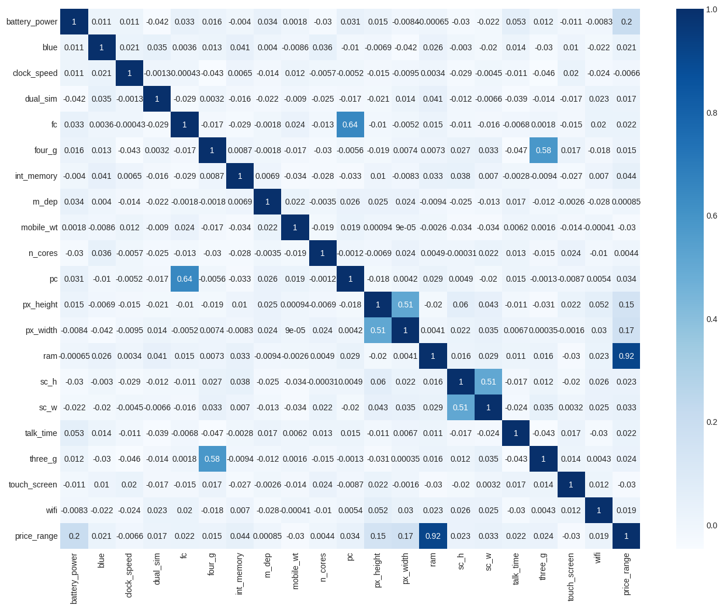
Correlation Heatmap
RAM and price_range shows high correlation which is a good sign, it signifies that RAM will play major deciding factor in estimating the price range.
There is some collinearity in feature pairs ('pc', 'fc'), ('px_width', 'px_height'), and ('sc_h', 'sc_h') .The ('pc', 'fc'), ('px_width', 'px_height'), and ('sc_h', 'sc_h') correlations are justified since there are good chances that if front camera of a phone is good, the back camera would also be good.
Also, if sc_h increases, sc_w increases, px_height increases, pixel width also increases, that means the overall pixels in the screen

Slide 20
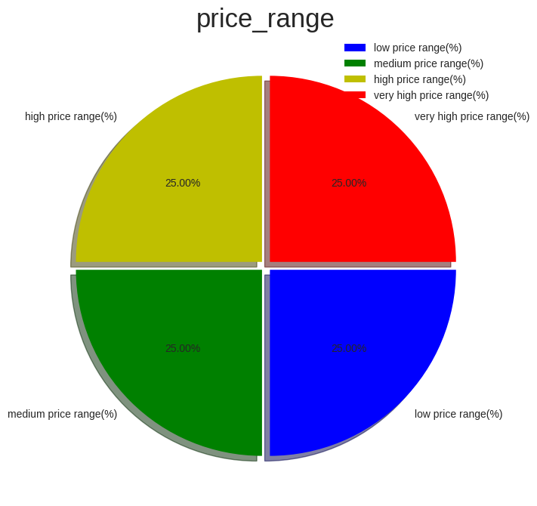
Feature Engineering & Data Pre-processing:
Handling Missing Values:
There are no missing values present in our dataset.
2. Handling Outliers:
It seems like there are not much outlier present in our dataset. So, I skipped this part.
3. Data Scaling:
I have used the 'StandardScaler' method to scale the data. This method standardizes the features by removing the mean and scaling to unit variance. It transforms the features such that they have a mean of zero and a standard deviation of one.I used this method because it is a widely used scaling technique and is recommended when the features have a normal or nearly normal distribution.
4. Data Splitting:
I have used a splitting ratio of 75:25 for training and testing the model. This means that 75% of the data is used for training the model and 25% of the data is used for testing the model.
I have chosen this ratio as it is a common practice in machine learning and provides a good balance between having enough data to train the model and having enough data to test the model's performance.
5. Handling Imbalanced Dataset:
Our dataset is properly balanced, As we can see from the pie-chart.
So, we don’t need to handle our data.

Slide 21
Machine Learning Algorithms:
Decision Tree Classifier
Logistic Regression
XgBoost Classifier
Support Vector Classifier

Slide 22
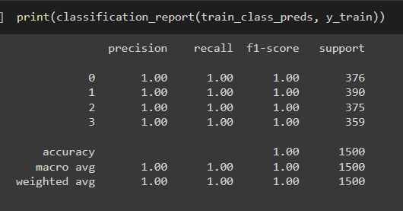
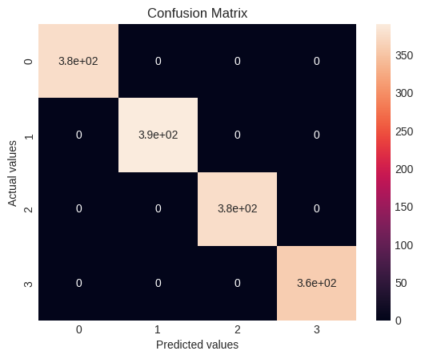
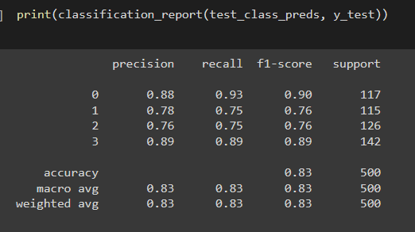
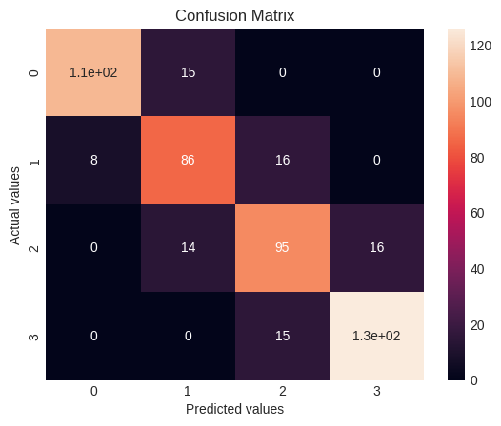
Implementing Decision Tree Classifier
Train_accuracy = 100%
Test_accuracy = 83%
Based on the classification report of the decision tree model, we can see that the model has overfit the training data with 100% accuracy on the training set but a much lower accuracy of 83% on the test set. This suggests that the model has memorized the training data and is not able to generalize well to new unseen data.

Slide 23
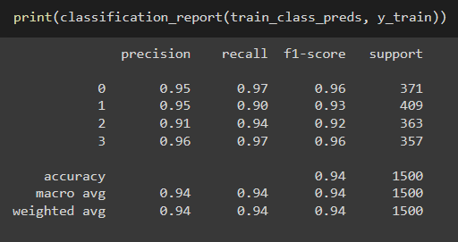
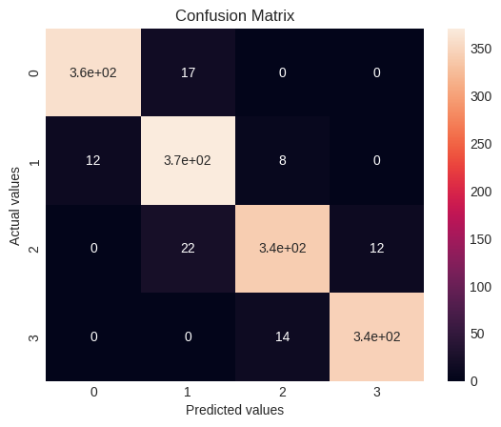
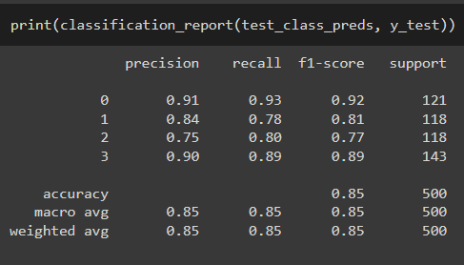
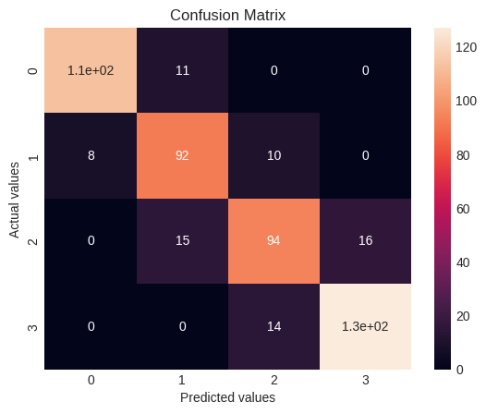
Cross- Validation & Hyperparameter Tuning
Train_accuracy = 94%
Test_accuracy = 85%
I used GridSearchCV technique for hyperparameter optimization in this case because it exhaustively searches over a specified parameter grid to find the optimal set of hyperparameters for the model. It provides a systematic approach to tune hyperparameters and find the best combination of hyperparameters which leads to better performance. Additionally, it uses cross-validation to evaluate the performance of each set of hyperparameters, which helps to avoid overfitting.

Slide 24

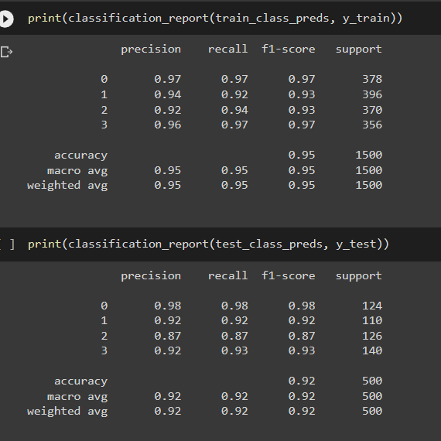
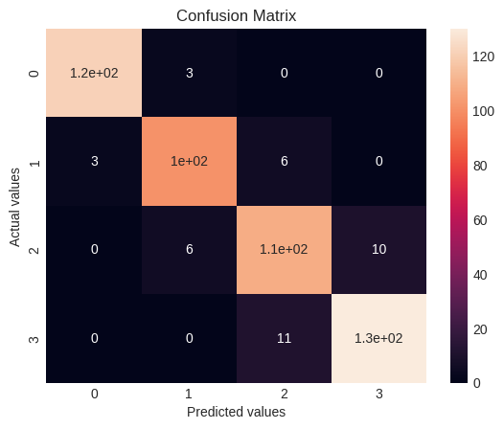
Implementing Logistic Regression
Train_accuracy = 95%
Test_accuracy = 92%

Slide 25
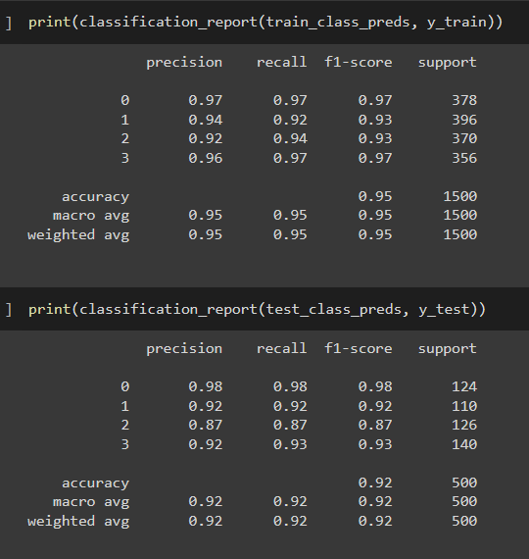
Cross- Validation & Hyperparameter Tuning
Train_accuracy = 95%
Test_accuracy = 92%
I used GridSearchCV to optimize the hyperparameters of the Logistic Regression model.
Unfortunately, there was no improvement in the model's performance after applying GridSearchCV in this case. The accuracy score remained the same as the initial Logistic Regression model, and the precision, recall, and F1-score were also similar.

Slide 26
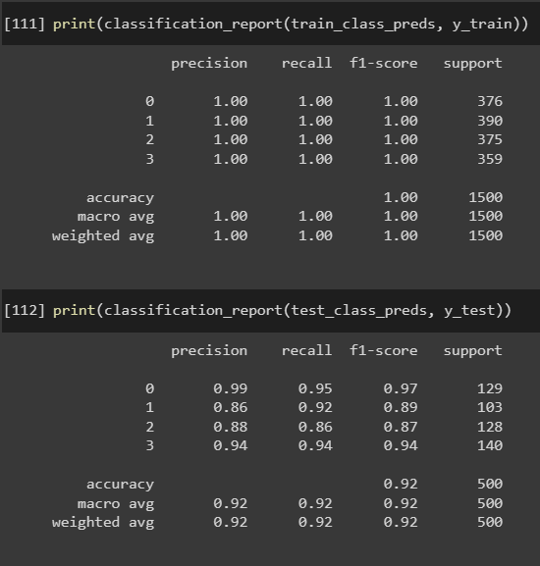
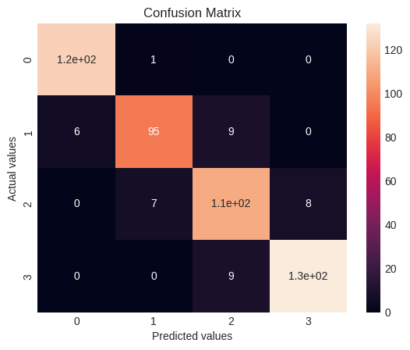
Implementing Xgboost Classifier
Train_accuracy = 100%
Test_accuracy = 92%

Slide 27
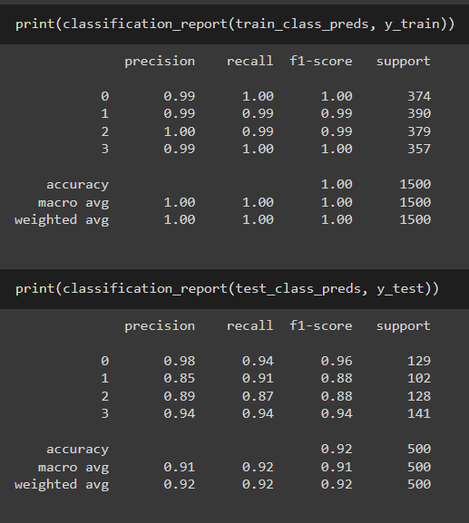

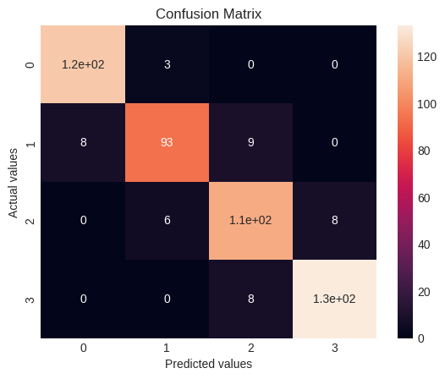
Cross- Validation & Hyperparameter Tuning
Train_accuracy = 100%
Test_accuracy = 92%
I used GridSearchCV to optimize the hyperparameters of the Xgboost Classifier model.
Unfortunately, there was no improvement in the model's performance after applying GridSearchCV in this case. The accuracy score remained the same as the initial Xgboost classifier model. However the precision, recall, and F1-score were change.

Slide 28

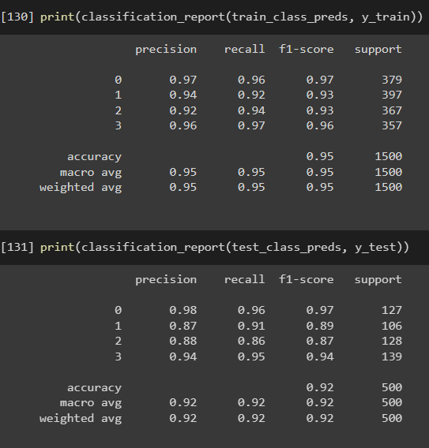

Implementing Support Vector Classifier
Train_accuracy = 95%
Test_accuracy = 92%

Slide 29

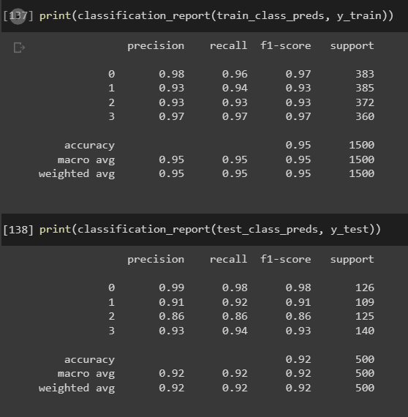

Cross- Validation & Hyperparameter Tuning
Train_accuracy = 95%
Test_accuracy = 92%
I have used GridSearch CV hyperparameter optimization technique of the Support Vector Classifier.
Unfortunately, there was no improvement in the model's performance after applying GridSearchCV in this case. The accuracy score remained the same as the initial Support Vector Classifier model, and the precision, recall, and F1-score were change.

Slide 30
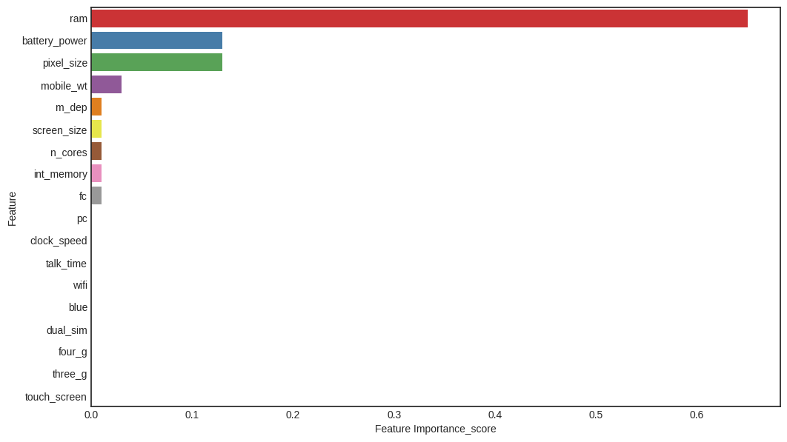
Feature Importance
I can clearly see that only Three variables are very important and influencing the class prediction, while rest of the variables have no importance.
Ram
Battery power
Pixel_size

Slide 31
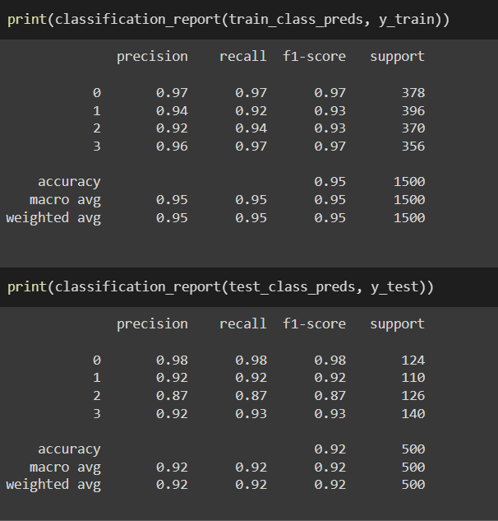
Model Selection
I chose the logistic regression model which is hyperparameter optimized because that model gave me the best accuracy score compared to the other model.

Slide 32
Conclusion
Based on the analysis and modeling performed in this project, we can conclude that the mobile price range can be predicted with a good accuracy using machine learning algorithms.
Ram has continuous increase with price range while moving from Low cost to Very high cost.
The mobile price range has almost constant battery, internal memory, and primary camera.
We started by exploring the data and cleaning it by handling missing values, feature scaling, and one-hot encoding.
After that, we performed feature selection and feature engineering to extract new features from existing ones.
We then trained and evaluated four machine learning models: Decision Tree Classifier, Logistic Regression, XGBoost Classifier, and Support Vector Classifier.
We used cross-validation and grid search to optimize the hyperparameters of each model.
Our best performing model was the Logistic Regression, which achieved an accuracy of 95% on the train set and 92% on the test set.
We used SHAP values to understand the feature importances and explain the model predictions.
The feature RAM, battery power, pixel size played more important role in deciding the price range of mobile phone.
Overall, our project demonstrates the effectiveness of machine learning algorithms in predicting mobile price range and can be used by mobile manufacturers to estimate the price range of their products based on the features. However, there is still room for improvement in terms of feature engineering and exploring other machine learning algorithms.

Slide 33

THANKYOU

