Slide 1

CAPSTONE PROJECT – 4 NETFLIX MOVIES AND TV SHOWS CLUSTERING (Unsupervised Machine Learning project)
Presented By:
MOHD AUN FAROOQUI

Slide 2
Agenda
Introduction
Problem Statement
Understanding The Data
Data Wrangling
Exploratory Data Analysis
Textual Data Pre-processing
Dimensionality Reduction
Machine Learning Algorithm Implementation
Conclusion

Slide 3
Introduction
Netflix is one of the largest streaming platforms in the world with over 230 million subscribers as of 2023 in more than 190 countries. It offers a wide range of movies, TV shows, and documentaries to its subscribers. Due to this extensive range of content, it becomes difficult for a user to choose what they want to watch. This problem is known as the "paradox of choice." In this project, we have developed a content-based recommendation system that suggests similar movies and TV shows based on the user's selection.
The recommendation system is built using the Netflix dataset, which consists of TV shows and movies available on Netflix as of 2021. The dataset contains information such as title, director, cast, description, rating, etc. The recommendation system uses natural language processing techniques to extract relevant features from the movie/TV show descriptions and then uses machine learning algorithms to recommend similar movies/TV shows.

Slide 4
Problem Statement
The problem statement of this project was to develop a content-based recommendation system for Netflix movies and TV shows. The goal was to provide personalized recommendations to users based on their preferences and viewing history. The primary objective was to help Netflix users discover new content that they might enjoy based on their interests, previous watching behavior, and movie or TV show preferences. The secondary objective was to cluster similar movies and TV shows together to better understand the content and to make it easier for users to find what they are interested in.

Slide 5
Understanding The Dataset
The dataset used for this project is the Netflix Movies and TV Shows dataset, obtained from AlmaBetter. The dataset contains information of the TV shows and movies available on Netflix as of 2021. The dataset includes information such as show title, director, cast, country of origin, release year, rating, duration, type (TV show or movie), and a description of the show or movie. The dataset contains a total of 7787 rows and 12 columns. This dataset is used to develop a content-based recommendation system for Netflix shows and movies.
Variable Description:
show_id: Unique id for every movies/Tv shows
type: Identifier - A movie or Tv show
title: Title of the movie/show
director: Director of the show
cast: Actors involved in the show
Country: Country of production
date_added: Date is what added on Netflix
release_year: Actual release year of the show
rating: TV rating of the show
duration: Total duration in minutes or number of seasons.
listed_in: Genre
Description: The summary description

Slide 6
Data Wrangling
This dataset contains 7787 observations and 12 features. It has some null values present in director, cast, country, date_added, and rating.
Replaced missing values in the 'director', 'cast', and 'country' columns with the label 'Unknown'.
Imputing missing values in the 'rating' column with the mode.
Transformed the 'duration' column in the Dataframe by splitting the string value on whitespace delimiter and converting it into an integer datatype.
Converted the timestamp in the 'date_added' column to datetime format to fetch other details.And added new columns to the Dataframe, such as'day_added', 'month_added' and 'year_added', to gain more insights from the data.
Changed the values in the rating column by Creating a dictionary to map the current ratings to new ratings.

Slide 7
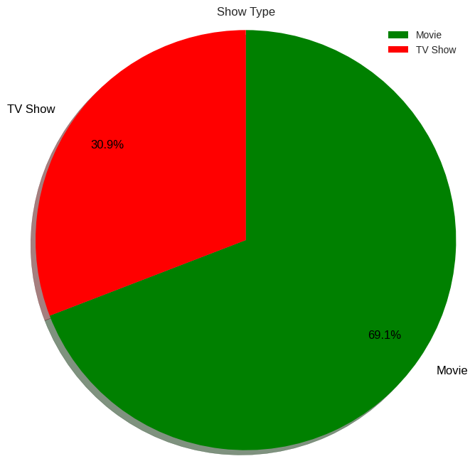
Exploratory Data Analysis Show Type:
The pie chart shows that out of all the content available on Netflix, the majority (69.1%) is comprised of movies, while the remaining 30.9% is TV shows. This indicates that Netflix has a greater number of movies available for streaming as compared to TV shows.

Slide 8
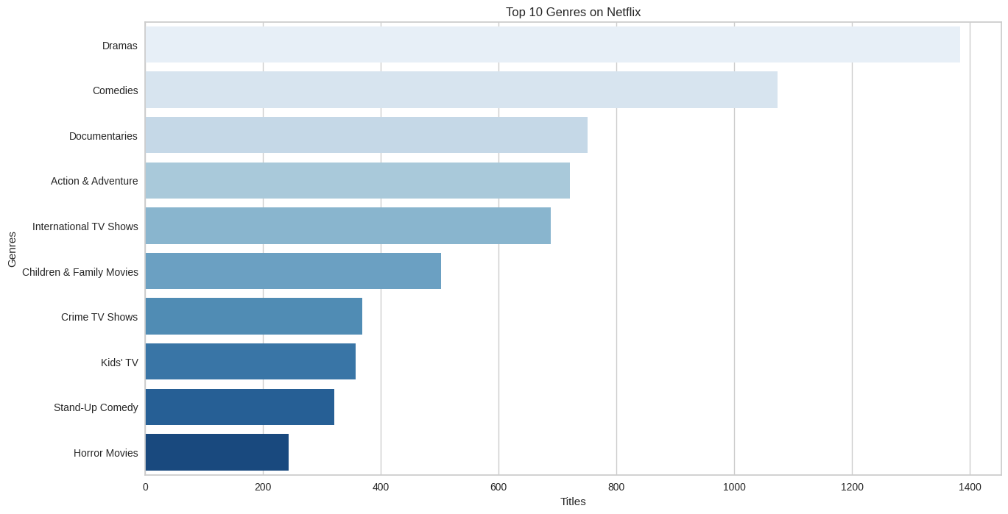
Top 10 Genres
From the chart, we can gain the following insights:
The top 3 genres on Netflix are Drama, Comedy, and Documentary.
The top 10 genres account for more than half of all titles on Netflix.
The frequency of genres decreases rapidly after the top 5, indicating that there is a long tail of less popular genres on the platform.

Slide 9
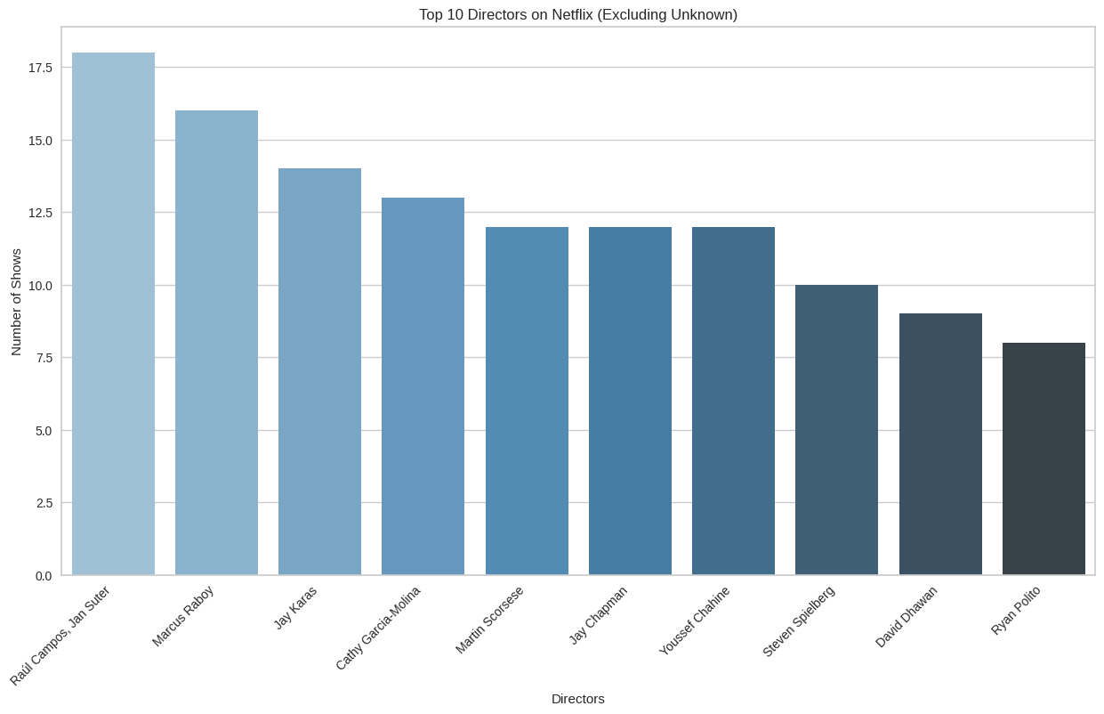
Top 10 Directors
From the bar chart of the top 10 directors,
we can see that Raul Campos and Jan Suter have the most number of shows among all directors in the dataset. This suggests that they are the most popular and in-demand directors for Netflix shows and movies.
The next three directors on the list are Martin Scorsese, Jay Chapman and Youssef chahine, who have directed almost an equal number of shows. This suggests that they are also popular among the audience.

Slide 10
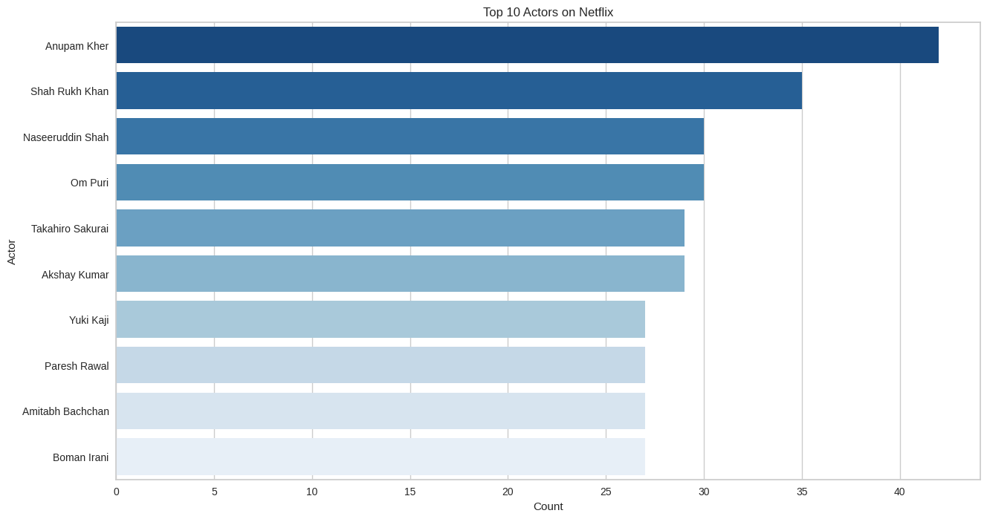
Top 10 Actors
The chart visualizes the top 10 actors who appear most frequently on Netflix.
The insight gained from this chart is that Indian actors dominate the list, with Anupam Kher being the most frequent actor on Netflix, followed by Shah Rukh Khan, Om Puri and Naseeruddin Shah.
There are also present internationally known actors such as Takahiro Sakurai and Yuki Kaji.

Slide 11
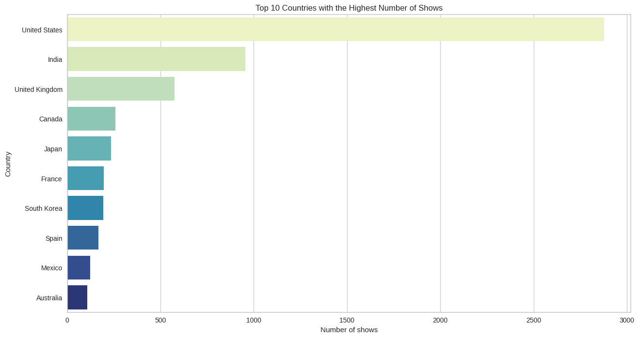
Top 10 Countries
From the chart, we can see that the United States has the highest number of shows available on Netflix followed by India and the United Kingdom.

Slide 12
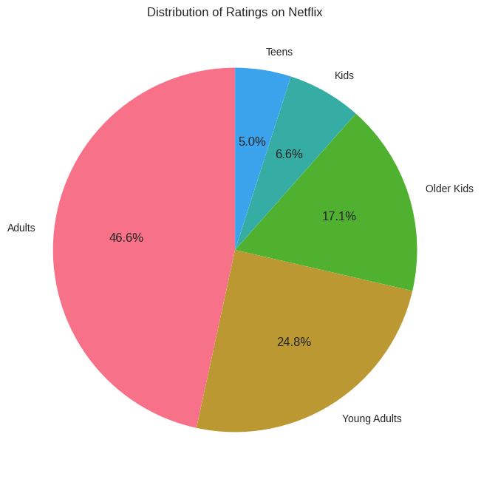
Distribution of Rating
From this chart, we can see that the most common rating in the Netflix dataset is Adults (TV-MA - Mature Audiences), which accounts for almost 46.6% of all titles. This is followed by Young Adults (TV-14 - Parents Strongly Cautioned) and Older Kids (TV-PG - Parental Guidance Suggested), which account for about 25% and 17% of titles, respectively.

Slide 13
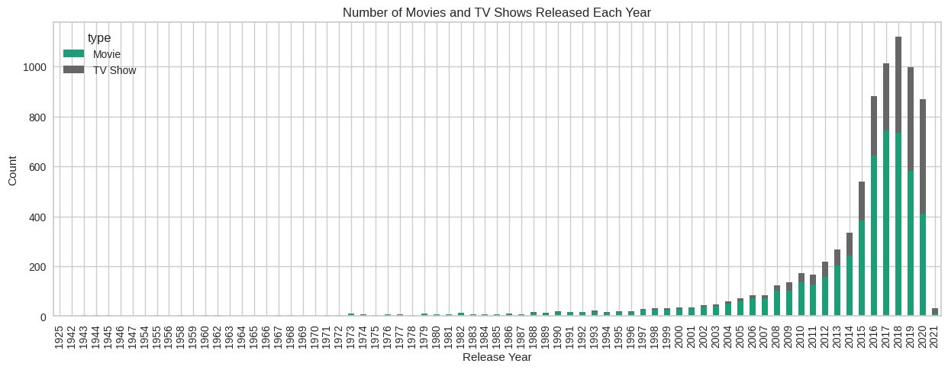
Year of Movie/Show Release
The chart shows the number of movies and TV shows released each year from 1925 to 2021.
It indicates that there was a significant increase in the number of releases in the past decade compared to previous years.
Additionally, it shows that there were more movie releases than TV show releases until the mid-2010s, after which the number of TV show releases surpassed the number of movie releases.
This suggests that the streaming industry is shifting towards producing more TV shows than movies.

Slide 14
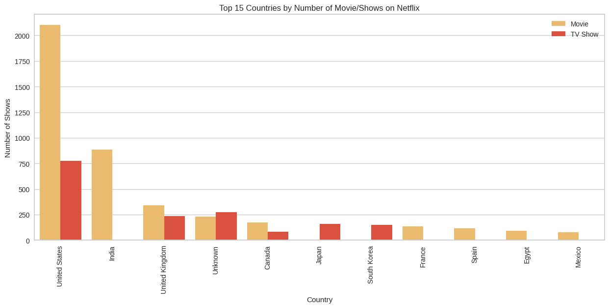
Country VS No of Movies/Shows
The United States has the highest number of Movies/shows, followed by India and the United Kingdom.
We can also see that the majority of the shows from these countries are Movies, rather than Tv Shows.

Slide 15
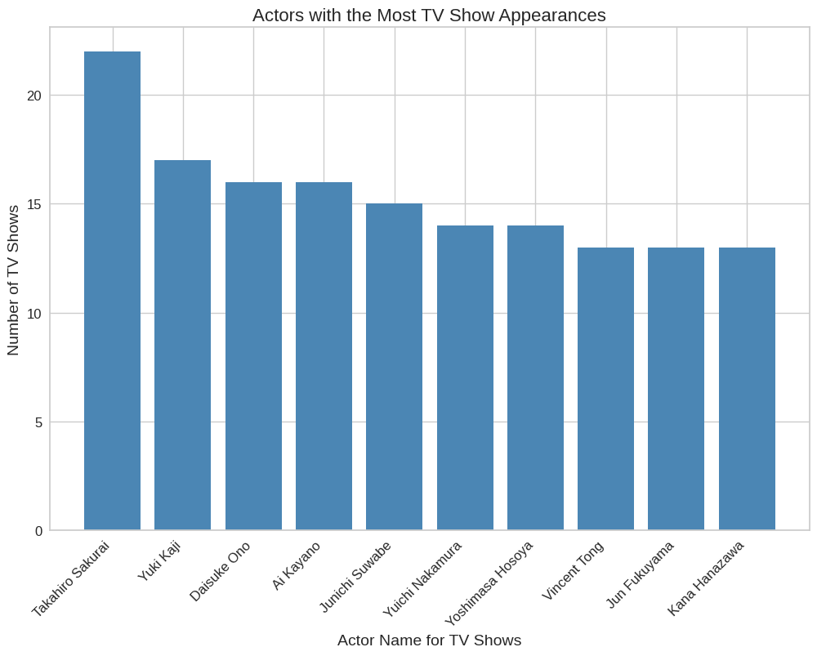
Actor vs TV Shows
From the chart, we can see the top 10 actors with the most TV show appearances on Netflix. The data shows that Takahiro Sakurai has the most appearances in TV shows on Netflix, followed by Yuki Kaji and daisuke Ono.

Slide 16
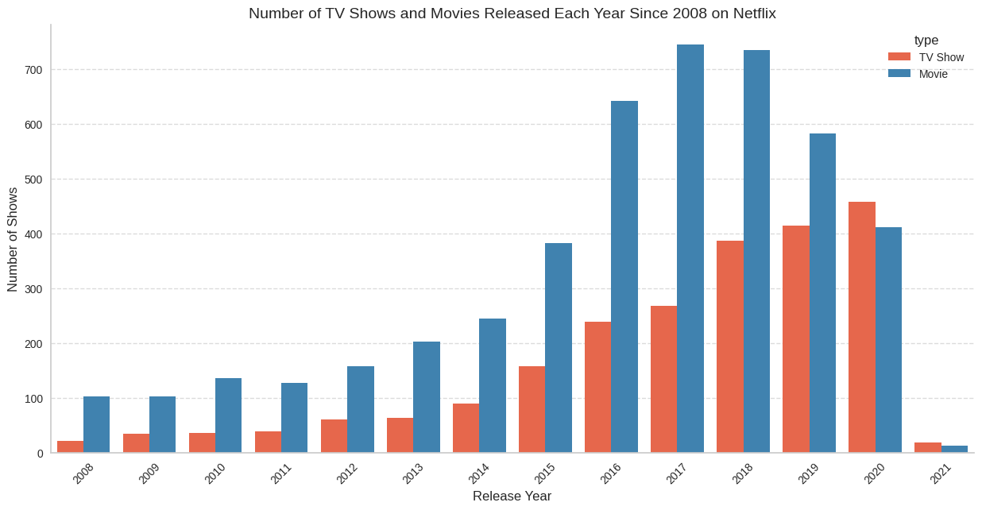
Type VS Release year
From the chart, we can see that the number of TV shows and movies released on Netflix has been steadily increasing since 2008.
The number of movies released has remained relatively stable, while the number of TV shows has increased significantly.
we can also see that there was a significant increase in the number of both TV shows and movies released in from 2016 to 2019.

Slide 17
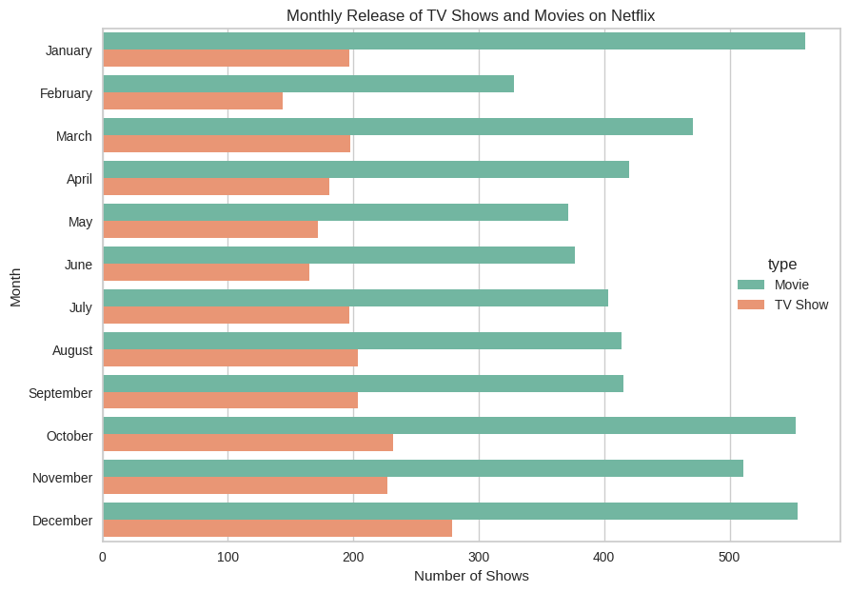
Release Month
We can be observed that there is a peak in the month of January, October and December, a dip in the month of February.
We can see that there are more Movies released than Tv Shows throughout the year, and the number of releases for both types of content is fairly consistent throughout the year with no significant spikes or dips.

Slide 18
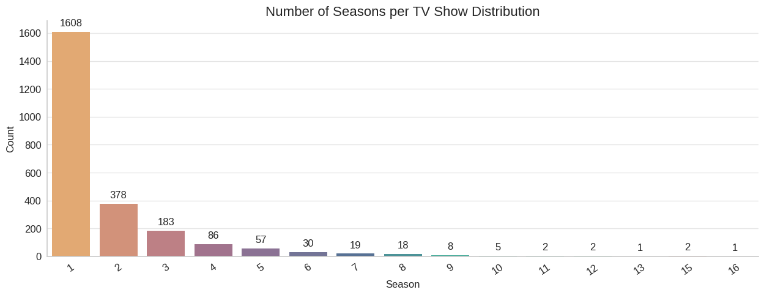
Seasons in each TV show
From the chart, we can see that the majority of TV shows on Netflix have only one, two or three seasons, which indicates that Netflix tends to produce more limited series rather than long-running shows.

Slide 19

Title
It appears that the word "family" is the most commonly used word in the movie descriptions, followed by "life", "find" and "friend". This suggests that the themes of family, life, and find are prominent in the movie collection.

Slide 20
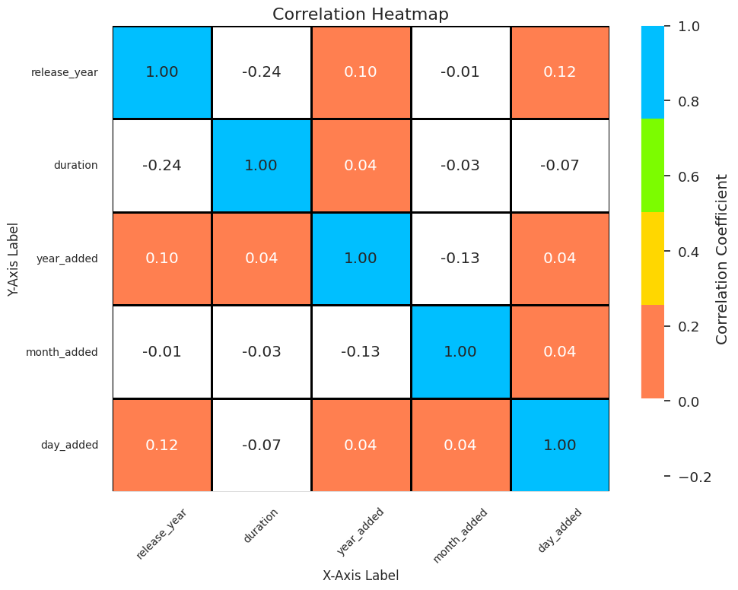
Correlation Heatmap
This heatmap can provide valuable insights into the relationships between different variables in the Netflix dataset.
We can see that duration and release year are negatively correlated by 24%.
year added and release year are positively correlated by 10%.

Slide 21
Textual Data Pre-processing
1. Expand Contraction: Expanding contractions means converting shortened or contracted words to their full forms. For example, "I'm" would be expanded to "I am" and "don't" would be expanded to "do not". It is a common preprocessing step in natural language processing tasks, such as sentiment analysis or text classification, as it can help improve the accuracy of models.
2. Lower Casing: Lowercasing is a basic text preprocessing step that involves converting all the text to lowercase. This step is important because in natural language processing, words are treated as equivalent, regardless of their capitalization. By lowercasing all the text, we can ensure that two words with different capitalization are considered as the same word.
For example, the words 'apple' and 'Apple' will be considered as two separate words, if we lowercase both the words, they will be considered as the same word.
3. Removing Punctuations: Removing punctuations involves removing all the special characters from the text data, such as . , ? ! etc. This step is necessary to ensure that the text data is clean and ready for further processing.
4. Removing Stop-words: Removing stop-words means removing commonly used words in a language that do not contribute much to the meaning of a sentence. In Natural Language Processing, removing stop-words is a common step for data cleaning. It helps reduce the dimensionality of the dataset and improves the accuracy of the analysis.
For example, in the English language, some commonly used stop-words include "a", "an", "the", "in", "on", "at", "to", etc.
5. Removing non-ASCII characters: Removing non-ASCII characters is a common preprocessing step in natural language processing tasks, as many text data sources contain non-ASCII characters that can interfere with text processing tasks such as tokenization, stemming, and lemmatization.
6. Tokenization: Tokenization is the process of breaking down a stream of text into words, phrases, symbols, or other meaningful elements, referred to as tokens, which are used for further natural language processing. The most common form of tokenization is word tokenization, which splits text into individual words based on whitespace or punctuation marks.
7. Text Vectorization: Text vectorization is the process of converting text into numerical representations, so that machine learning algorithms can process it. In this project, we used CountVectorizer from the scikit-learn library to convert the pre-processed text into a matrix of token counts. The resulting matrix was then used to compute cosine similarity scores between the different TV shows and movies in the dataset.

Slide 22
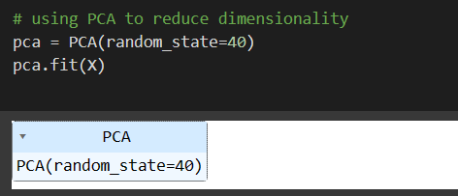
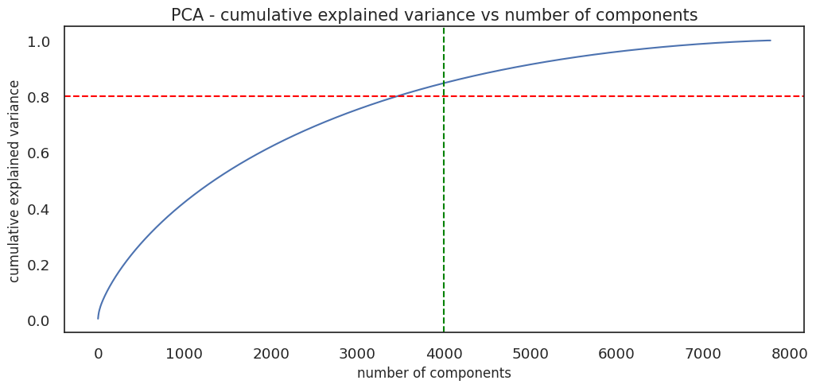
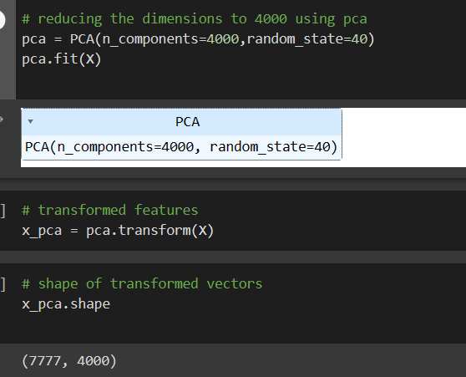
Dimensionality Reduction
Dimensionality Reduction: Dimensionality reduction is a process of reducing the number of features in a dataset while preserving its important properties. In natural language processing (NLP), it is often used to reduce the dimensionality of text data, which is typically represented as high-dimensional sparse vectors, to a lower-dimensional dense representation that is easier to work with.
There are several techniques for dimensionality reduction in NLP, But I have used Principal Component Analysis (PCA).
The plot showing the relationship between the number of components used in Principal Component Analysis (PCA) and the cumulative explained variance.

Slide 23
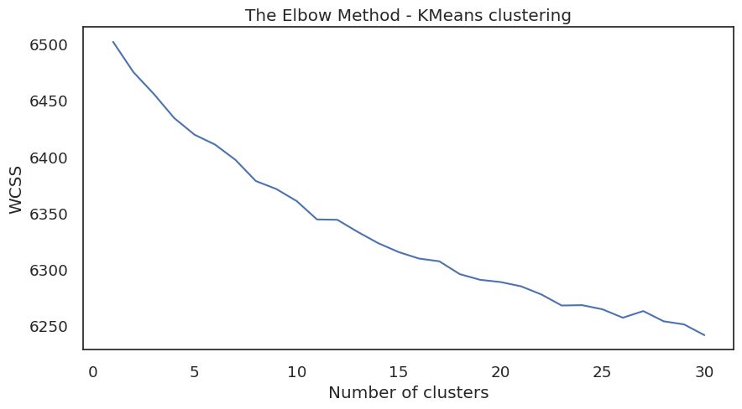
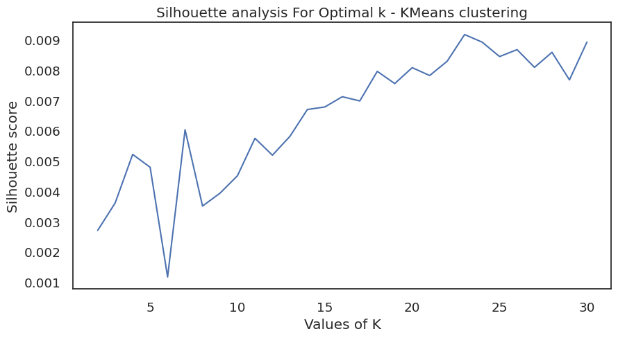
K-Means Clustering
K-Means Clustering is a popular unsupervised machine learning algorithm used for clustering data. The goal of K-Means Clustering is to group similar data points into a predefined number of clusters. The algorithm works by randomly assigning the data points to one of the K clusters and then iterating through a process of re-assigning the data points to their nearest cluster centroid and updating the centroid of each cluster until convergence is achieved.
The plot shows a bend or an elbow point, which is considered the optimal number of clusters. In this case, the plot indicates that the optimal number of clusters could be at somewhere 5 to 6.
From the silhouette score plot, we can see that the optimal number of clusters is 6, as it has the highest silhouette score compared to other cluster numbers.
This suggests that we can group the movies into 6 clusters using K-Means clustering.

Slide 24
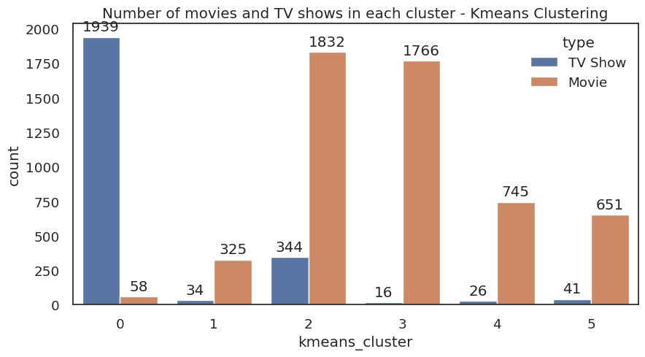
Number of Movies and TV shows to each cluster
From the Count-plot, we can see that the majority of TV shows are in Cluster 0, which has around 1939 TV shows and around 58 Movies. Cluster 2 and 3 has the highest number of movies around 1832 and 1766 respectively and also cluster 3 have least number of TV Shows around 16 shows.
We can say that Cluster 0 has more TV Shows than Movies, while Cluster 2 and 3 has more Movies than TV shows. This indicates that the clustering algorithm may have identified some underlying differences in the content of movies and TV shows, leading to different cluster assignments.

Slide 25
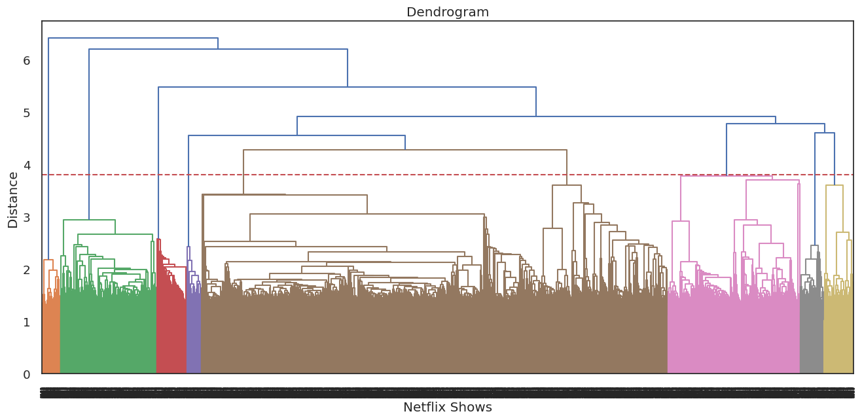
Hierarchical Clustering
The red horizontal line represents the threshold distance for which we can cut the dendrogram to obtain a certain number of clusters. In this case, the threshold is set at 3.8.
Hierarchical clustering is a method of clustering in which objects are grouped together based on their similarity using a hierarchical structure. In hierarchical clustering, a tree-like structure called dendrogram is used to represent the clusters.
The basic steps involved in hierarchical clustering are:
Begin with each data point as its own cluster.
Calculate the distance matrix between all pairs of clusters.
Merge the two closest clusters into a single cluster.
Recalculate the distance matrix.
Repeat steps 3-4 until all points are in a single cluster or until a stopping criterion is met.

Slide 26
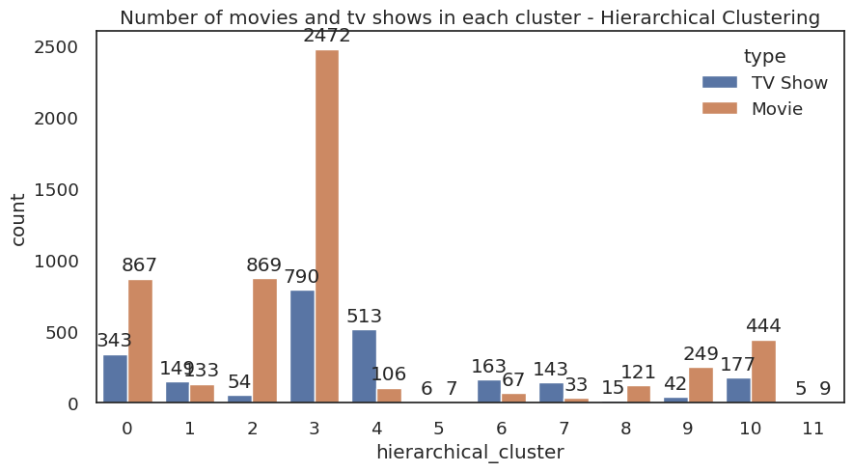
Number of movies and tv shows in each cluster
From the hierarchical clustering analysis, we can see that there are 5 main clusters. The largest cluster is Cluster 3, which contains the majority of the movies and TV shows which has around 2472 and 790 respectively. Cluster 0 and 2 are also quite large which contain almost similar number of movies and cluster 0 contain 343 TV shows. Cluster 1 and 5 are relatively smaller clusters.

Slide 27
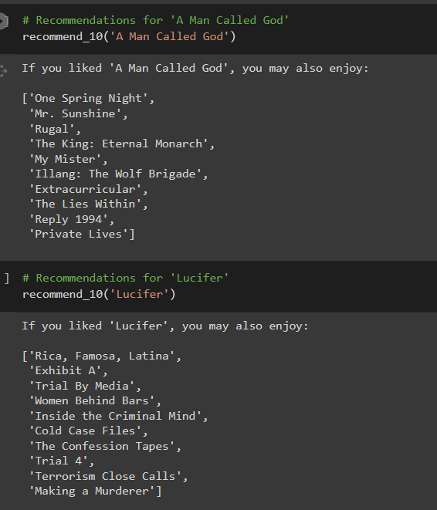
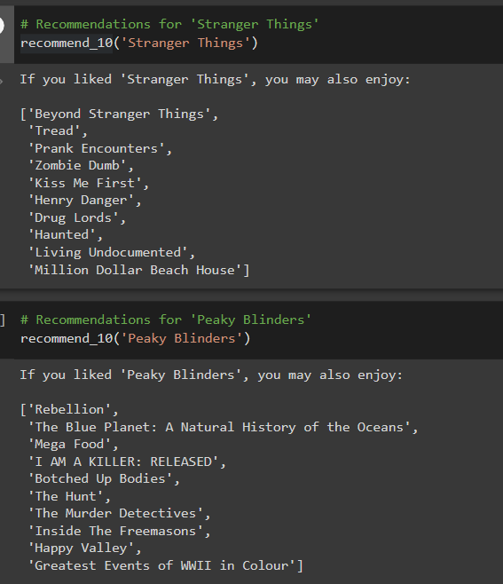
Content Based Recommended System
Content-based recommendation systems are a popular and widely used approach to provide personalized recommendations to users. These systems are based on the idea that a user’s preferences can be predicted based on their previous interactions with items, such as their watched movies and TV shows history. The goal of a content-based recommendation system is to recommend items to a user that are similar to items that they have previously interacted with.

Slide 28
Conclusion
After performing exploratory data analysis on the Netflix dataset, we can conclude that:
Netflix's content has increased over the years, with a significant increase in the number of TV shows since 2008.
The majority of the content on Netflix is movies, followed by TV shows and documentaries.
The United States is the country with the most content on Netflix, followed by India and the United Kingdom.
The most common genre on Netflix is drama, followed by comedy, Documentaries and Action & Adventure.
Netflix has a diverse range of content from different countries, with a significant portion of content being produced in the United States.
Most TV shows on Netflix have one season, with a few having two, three or more seasons.
FROM MODEL IMPLEMENTATION:
The data was clustered based on the attributes: director, cast, country, genre, rating, and description.
TFIDF vectorizer was used to tokenize, preprocess, and vectorize the values in these attributes, creating a total of 20000 attributes.
The k-means clustering algorithm was implemented to group similar movies and TV shows together based on the extracted features. It was found that a value of 6 was optimal for the number of clusters.
The content-based recommendation system was built using cosine similarity on the Netflix dataset. The dataset was preprocessed, cleaned and transformed into a structured format. A bag-of-words approach was used to create a term frequency-inverse document frequency (TF-IDF) matrix, which was then used to compute cosine similarities between pairs of movies and TV shows.
Finally, the content-based recommendation system based on cosine similarity was able to recommend 10 similar movies/TV shows based on a selected title. This system could be used to suggest movies or TV shows to Netflix users based on their preferences.
I hope that these recommendation systems can be used to help users find TV shows and movies that match their interests. By providing recommendations that are tailored to the user's preferences, we can enhance their overall experience of using Netflix.

Slide 29
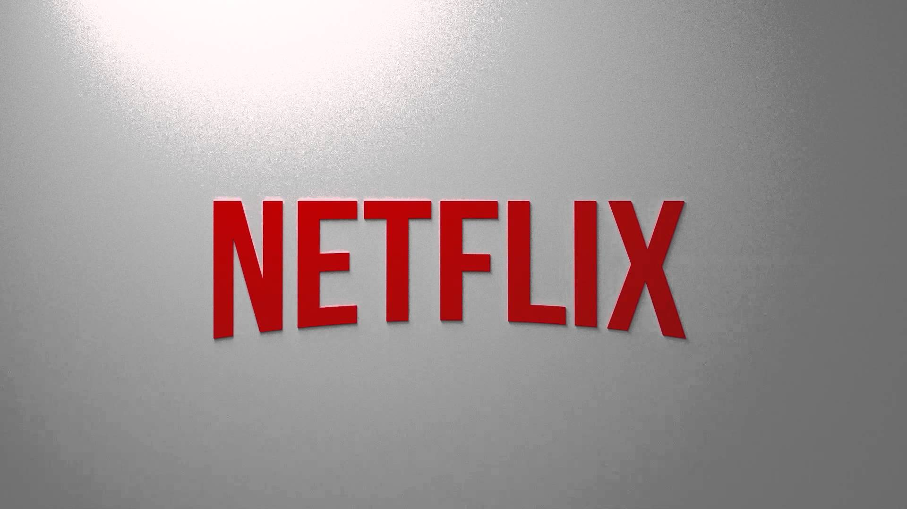
THANKYOU

