Slide 1

A Tour of Golang

Slide 2

Table of content
About Golang
Installation and setup
About Packages, Import statement
About variables, Data Types and function
About flow control statement, if-else, switch and defer
Conditions and Boolean Expression, Chained conditionals
Explanation for the types, structs, enum, and maps
Explanation Range, Slices/Array
Methods and Interfaces
Concurrency
Pointers and Derefrences
object-oriented design in Go (encapsulation, inheritance, and polymorphism)

Slide 3

Practical lessons
Weekly Q&A and practice code snippets
Usage of framework (eg, gin)
Building Simple CRUD with Go
Building microservice with Go (Lambda function)
Simple cron job service
Simple service integration
Building rpc service

Slide 5
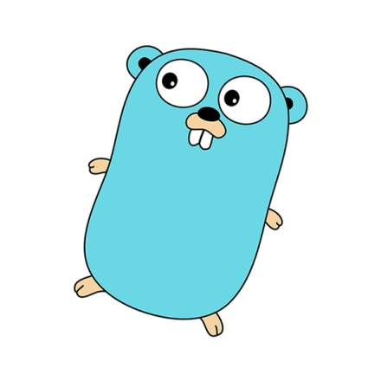
About Golang
open source programming language developed by Google
Statically typed, compiled language
Support concurrent programming
lightweight, scalable, and quick in responding to its users

Slide 6
Installation and setup
Installation
Download Golang - https://golang.org/dl/
Setup
$GOPATH
workspace directory
is used to resolve imports, as well as to install packages outside the go tree.
Window - %USERPROFILE%\go, Unix - $HOME/go
$GOROOT
Location where Go’s code, compiler, and tooling exists.
(Eg. /usr/local/go)

Slide 7
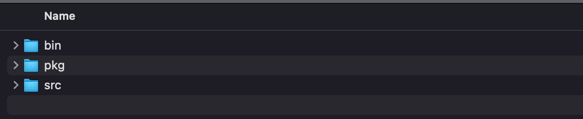
Golang Project Directory
GOPATH contains 3 directories,
bin: It holds compiled commands. Every command is named for its source directory.
pkg: It holds installed package objects.
src: It holds source code. The path below this directory determines the import path or the executable name.

Slide 8
Sample Golang program
package main
import "fmt"
func main() {
fmt.Println("Hello, world")
}

Slide 9
About Packages, Import statement
Package statement
Designed to maintain the large codebase by grouping them into related features together into single units.
To be able to share and reusable
Each package contains methods and functions
Package are declared in the top of the go file
Eg package controller, package test, etc

Slide 10
Import statement
Known as import path which is, to use the function that are included in the particular package by importing the package
Multiple import statements
import “fmt”
import "github.com/gorilla/mux”
factored import statement
import (
“fmt”
"github.com/gorilla/mux”
)

Slide 11
About variables, Data Types and function
Variable
Hold and store numbers, data, value in the memory location during runtime.
Can be reused in code by declaring variable and initializing value.
Rules for Naming variable
Variable names must begin with a letter or an underscore(_). And the names may contain the letters ‘a-z’ or ’A-Z’ or digits 0-9 as well as the character ‘_’.
Variable name must not start with number, digit
Variable name are case sensitive
Variable cannot be named only with keywords

Slide 12
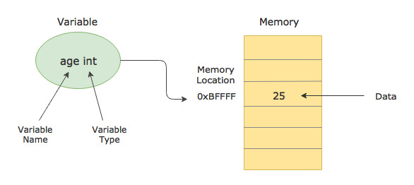
Example of declaring variable
//valid var str = "keyword" var integar = 12 var bool = true fmt.Printf("The value of string is : %s\n", str) fmt.Printf("The type of string is : %T\n", str) fmt.Printf("The value of integar is : %d\n", integar) fmt.Printf("The type of integar is : %T\n", integar) fmt.Printf("The value of boolean is : %t\n", bool) fmt.Printf("The type of boolean is : %T\n", bool) //invalid var 1nuerer = "invalid" var hello! = "invalid" var 121212 = 121212 //case sensitive var number = 12 var Number = 13 fmt.Println(number) fmt.Println(Number)

Slide 13
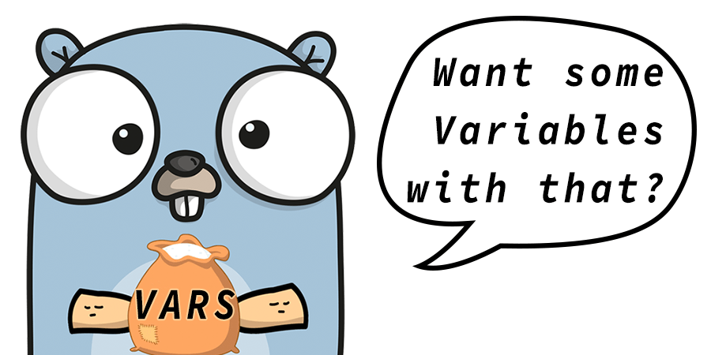
Variable Declaration
Declartion in variable can be done with var statement
Eg var something = 1
Variable can be declared either function level or package level
Example
package main
import "fmt"
var c, python, java bool // declaring on package level
func main() {
var i int // declaring on function level
fmt.Println(i, c, python, java)
}

Slide 14
Variables with initializers
A var declaration can include initializers, one per variable.
If an initializer is present, the type can be omitted; the variable will take the type of the initializer.
Example
var i, j int = 1, 2
func main() {
var c, python, java = true, false, "no!"
fmt.Println(i, j, c, python, java)
}

Slide 15
Short variable declarations
Can be used only inside in the function, (:=construct is not available in outside function)
Can be used in place of a var declaration with implicit type
Example
var i, j int = 1, 2
k := 3 // short assignment statement
c, python, java := true, false, "no!"
fmt.Println(i, j, k, c, python, java)

Slide 16
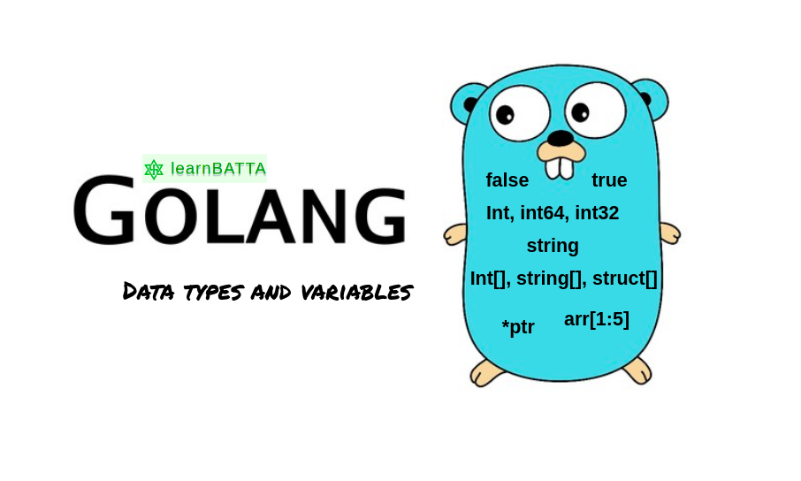
Data type
Specify the kinds of values that particular variables will store
Determines what operations can be performed on the data
Categories of data type
Basic type
Aggregate type (Derived types)
Reference type
Interface type

Slide 17
Basic type
Numbers
int int8 int16 int32 int64 uint uint8 uint16 uint32 uint64 uintptr,
Byte (same as uint8), Rune (same as int32)
float32 float64
complex64 complex128
Strings
“some sample string”
Boolean
True, false

Slide 18
Integer
DATA TYPE | DESCRIPTION
int8 | 8-bit signed integer
int16 | 16-bit signed integer
int32 | 32-bit signed integer
int64 | 64-bit signed integer
uint8 | 8-bit unsigned integer
uint16 | 16-bit unsigned integer
uint32 | 32-bit unsigned integer
uint64 | 64-bit unsigned integer
int | Both in and uint contain same size, either 32 or 64 bit.
uint | Both in and uint contain same size, either 32 or 64 bit.
rune | It is a synonym of int32 and also represent Unicode code points.
byte | It is a synonym of int8 .
uintptr | It is an unsigned integer type. Its width is not defined, but its can hold all the bits of a pointer value.

Slide 19
Signed integer and Unsigned integer
Signed integers in Go
Signed integer types supported by Go is shown below.
int8 (8-bit signed integer whose range is -128 to 127)
int16 (16-bit signed integer whose range is -32768 to 32767)
int32 (32-bit signed integer whose range is -2147483648 to 2147483647)
int64 (64-bit signed integer whose range is -9223372036854775808 to 9223372036854775807)
Unsigned integers in Go
uint8 (8-bit unsigned integer whose range is 0 to 255 )
uint16 (16-bit unsigned integer whose range is 0 to 65535 )
uint32 (32-bit unsigned integer whose range is 0 to 4294967295 )
uint64 (64-bit unsigned integer whose range is 0 to 18446744073709551615 )

Slide 20
Floating-type value
DATA TYPE | DESCRIPTION
float32 | 32-bit IEEE 754 floating-point number
float64 | 64-bit IEEE 754 floating-point number
Example
a := 20.45
b := 34.89

Slide 21
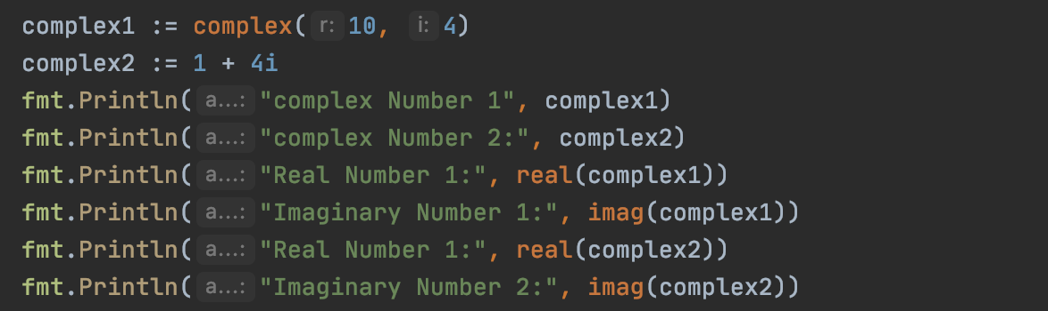
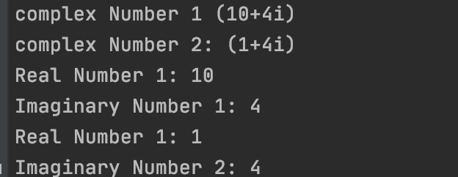
Complex Type number
Type of number
contains two parts - real numbers and imaginary numbers
Represent two type - complex64, complex128
Complex64 : Complex numbers with float32 real and imaginary parts
Complex128: Complex numbers with float64 real and imaginary parts
Example of complex type number
Complex type number can be created by using build-in function
func complex(real, imaginary FloatType) ComplexType

Slide 22
Strings
a sequence of variable-width characters
immutable and behave like read-only byte slices
Representation with one or more bytes using UTF-8 Encoding (https://en.wikipedia.org/wiki/UTF-8)
(UTF stands for Unicode Transformation Format. The '8' means it uses 8-bit blocks to represent a character)
Example
sample := "a£c” //4 bytes.
fmt.Printf("Length is %d\n", len(sample))

Slide 23
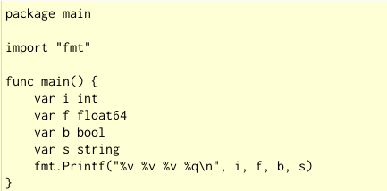
Zero value (initial value)
Variables declared without an explicit initial value are given their zero value.
The zero value is:
0 for numeric types,
false for the boolean type, and
"" (the empty string) for strings.

